Slide 1
FedEO Update
Yves Coene (Spacebel), Damiano Guerrucci (ESA), Mirko Albani (ESA)
CEOS WGISS #54
Data Discovery and Access, 04/10/2022

Slide 2
Outline
FedEO in CEOS domain
FedEO current metrics and DIF-10 export status
Ongoing activities
FedEO evolution activities
  EOCAT Evolution
  EOVOC Outcome

Slide 3
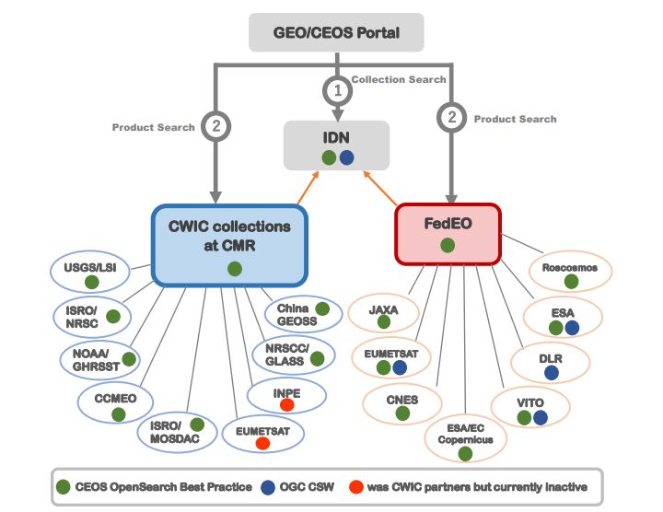
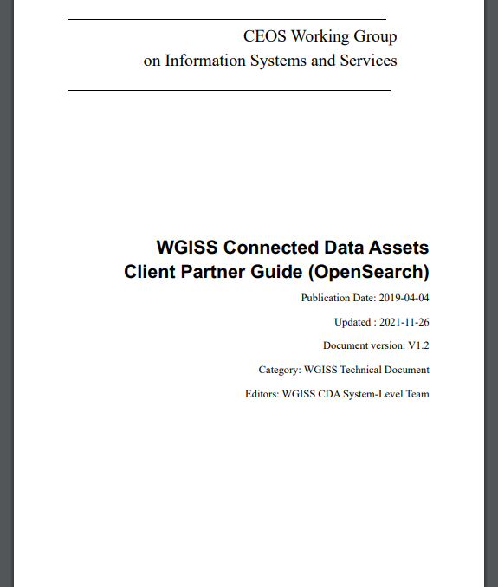
WGISS Connected Data Assets
FedEO: Federated Earth Observation missions access

Slide 4
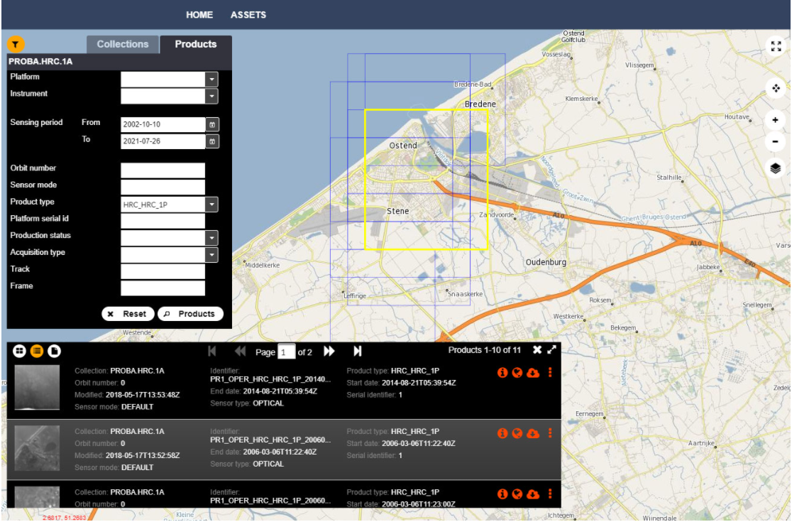
FedEO in CEOS Domain
Since 20 September 2021:
  FedEO Client available at
  https://fedeo-client.ceos.org
  FedEO Server available at https://fedeo.ceos.org/
  Validation server available at https://geo.spacebel.be
Notes:
https://earth.esa.int/eogateway/news/new-version-of-the-fedeo-client

Slide 5
FedEO Metadata Mediator
Automatic Procedure – Available on FedEO reference environment, on Operational environment at ESA since Oct 2019
Partner Metadata repository
Collection Metadata Import
(pull, e.g. daily)
Harvester
Metadata Preparation
Metadata Mediator
IDN
Complementary
Information
gcmd keyword
Metadata Preparation
IDN guideline for Information Content completeness and consistency
ESA Thesauri Service
FedEO Collection Catalogue
FedEO Gateway
ISO to DIF-10
pull
Collection Metadata Ingestion by IDN
DIF-10 Encoding
Mandatory GCMD terms
NASA DIF-10 Validator
(HERE)
IDN
repository
DIF-10 Validation

Slide 6
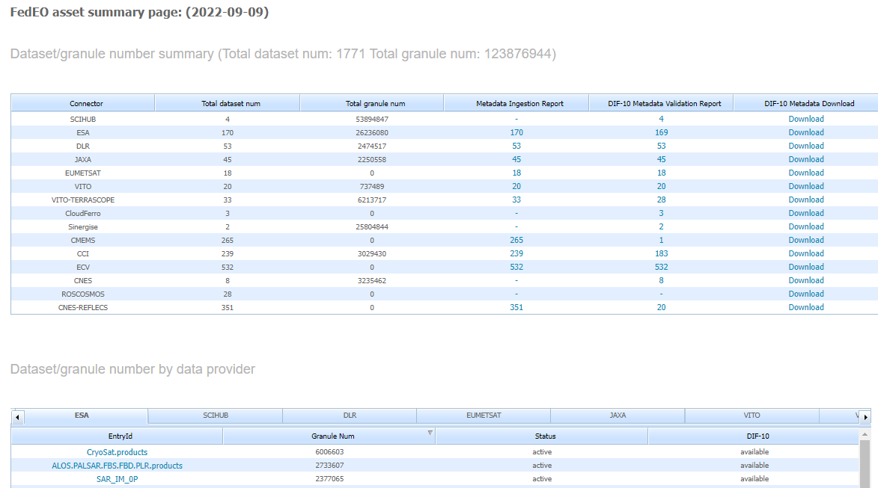
DIF-10 Metadata Export
https://fedeo.ceos.org/asset/index.html
Collections being harvested automatically by IDN, e.g. ESA, DLR, VITO.
ESA CCI 183 (ready to ingest in IDN).
See:
https://cmr.earthdata.nasa.gov/search/collections.umm_json?provider_id=FedEO&data_center=DE/DLR&pretty=true
https://cmr.earthdata.nasa.gov/search/collections.umm_json?provider_id=FedEO&data_center=VITO&pretty=true
https://cmr.earthdata.nasa.gov/search/collections.umm_json?provider_id=ESA&data_center=ESA/ESRIN&pretty=true
DIF-10 collections are available for being ingested into IDN, from
https://fedeo.ceos.org/asset/index.html
Notes:
https://cmr.earthdata.nasa.gov/search/collections.umm_json?provider_id=FedEO&data_center=DE/DLR&pretty=true
https://cmr.earthdata.nasa.gov/search/collections.umm_json?provider_id=FedEO&data_center=VITO&pretty=true
https://cmr.earthdata.nasa.gov/search/collections.umm_json?provider_id=ESA&data_center=ESA/ESRIN&pretty=true
https://access.earthdata.nasa.gov/holdings

Slide 7
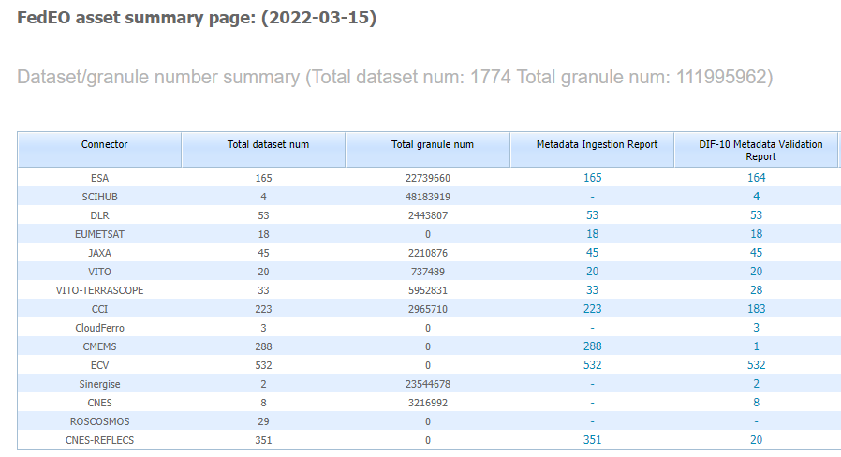
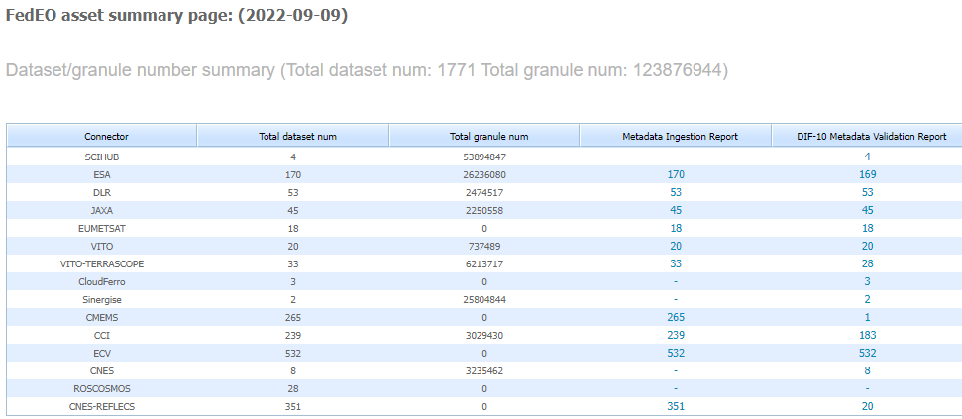
Metrics evolution
FedEO: 112 to 123.8 million granules since WGISS-53 (March 2022)
ESA (EOCAT): 170 collections with 26 million granules.

Slide 8
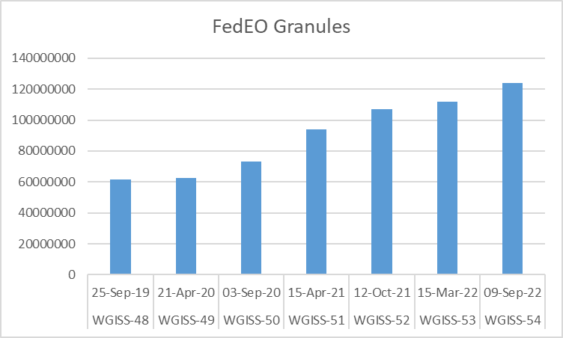
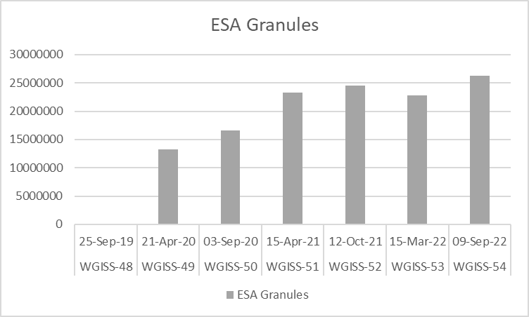
Metrics evolution
Evolution since September 2019
ESA (=EOCAT),
excluding SciHub and ESA CCI.

Slide 9
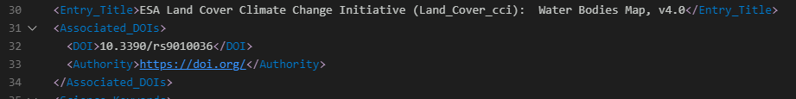
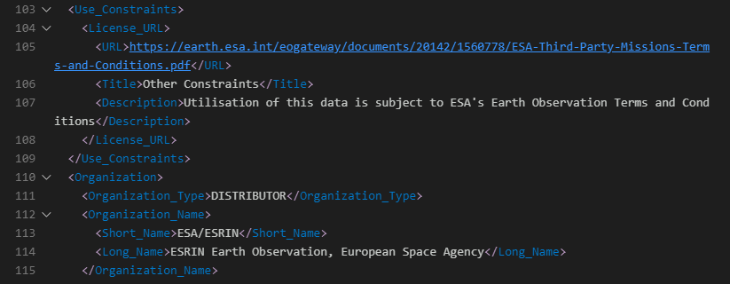
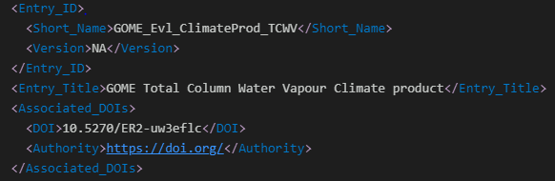
Software changes
DIF-10 export improved (March 2022):
  Use_Constraints included.
  Version information included (when available).
  DOI information included (when available in ISO collection metadata from Partners).
DOI (ESA CCI)
Use_Constraints
DOI (ESA EOCAT)

Slide 10
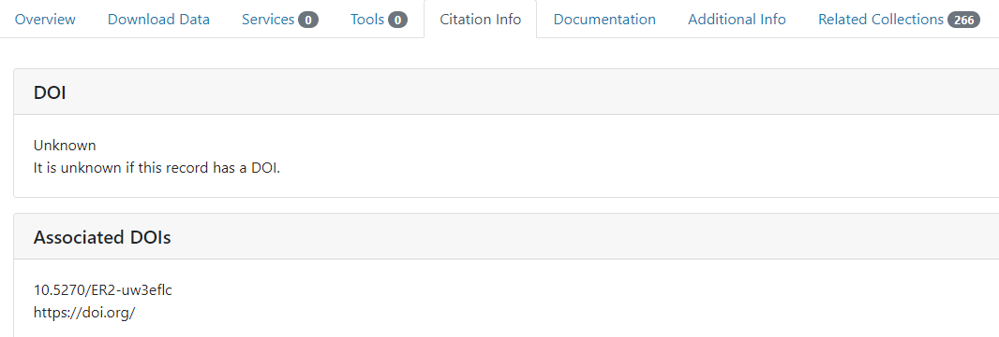
Software changes
Changes are now visible in IDN.
DOI encoding still to be improved: distinguish « DOI » from « associated DOI » in original ISO metadata.

Slide 11
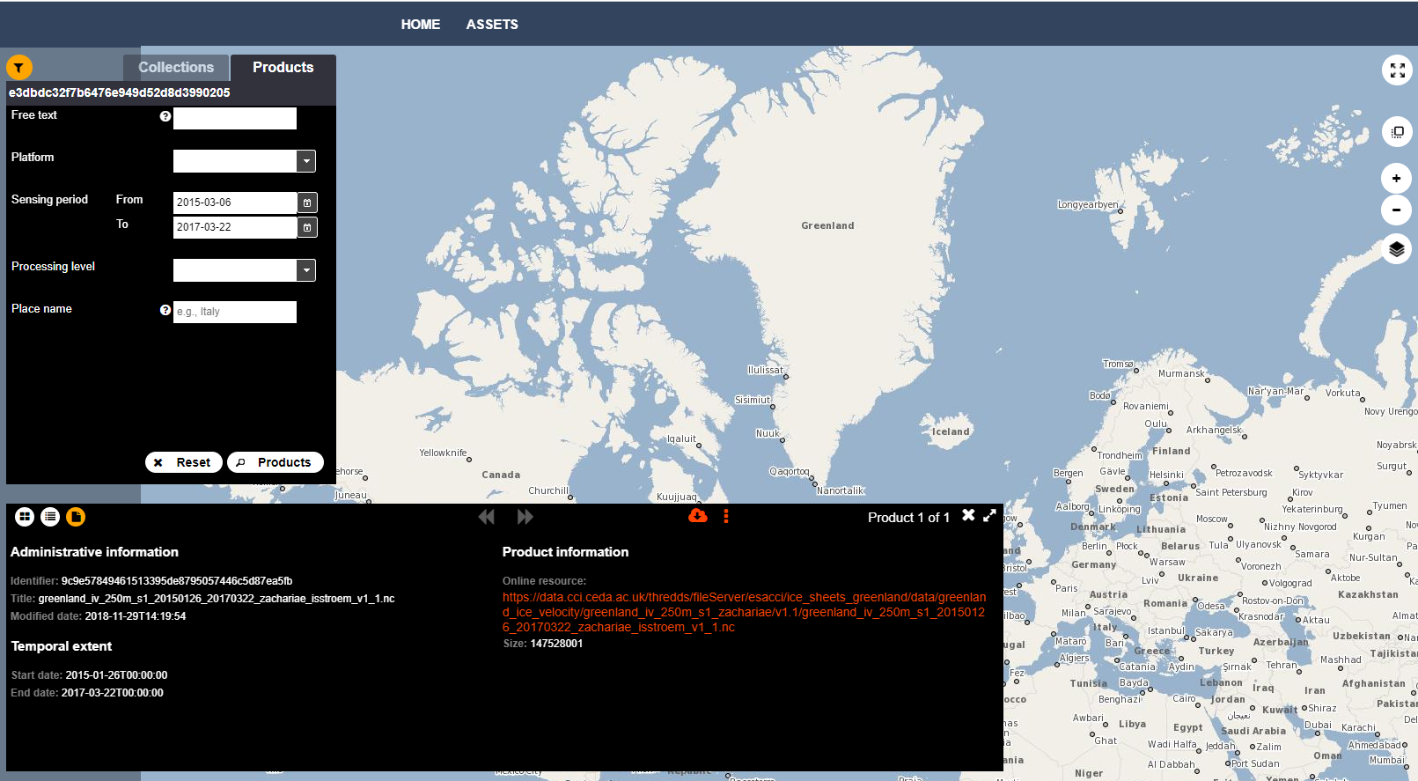
Completed integration activities
ESA CCI:
  Collections: 223
  Collections with valid DIF10: 180 (For others, too little info available in original ISO metadata records).
  Two step-search integration.
  Granules: 2.9 Million
  Insertion date in IDN: To be agreed.

Slide 12
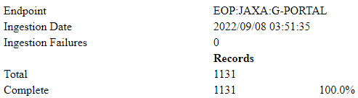
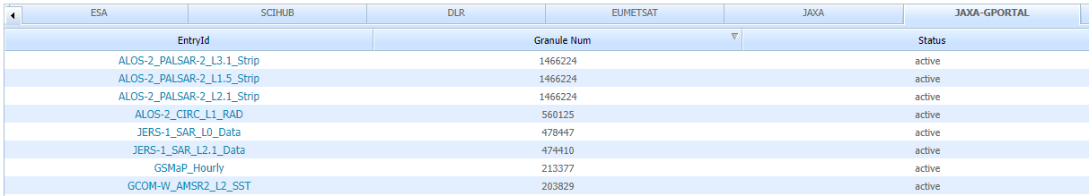
Ongoing integration activities
JAXA G-PORTAL ( In FedEO validation/integration environment )
  Collections: 1131
  All collections with valid DIF10: 1131.
  Granules: 16 million
  Work performed:
    Two step-search integration improved.
    Embedded metadata (in Atom) transformed to O&M metadata (OGC10-157r4).
Notes:
https://geo.spacebel.be/opensearch/asset/index.html

Slide 13
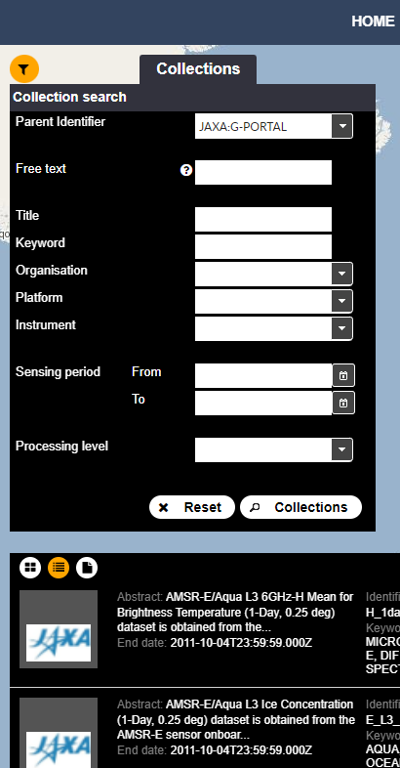
JAXA G-Portal OpenSearch I/F updates (Aug 2022)
Information returned by JAXA inside OpenSearch response transformed into O&M representation (OGC 10-157r4)
Updates deployed on https://geo.spacebel.be/opensearch/readme.html
“Old” interface can be tried with FedEO Client:
  https://fedeo-client.ceos.org/?url=https%3A%2F%2Feovoc.spacebel.be%2Fapi%3FhttpAccept%3Dapplication%252Fopensearchdescription%252Bxml
“Updated” interface can be tried with same FedEO Client:
  https://fedeo-client.ceos.org/?url=https://geo.spacebel.be/opensearch/description.xml
Updated interface allows standard-based Client to « understand » more properties as they are encoded using OGC 10-157r4 (https://docs.opengeospatial.org/is/10-157r4/10-157r4.html) and embedded in the Atom response (OGC 13-026r9).

Slide 14
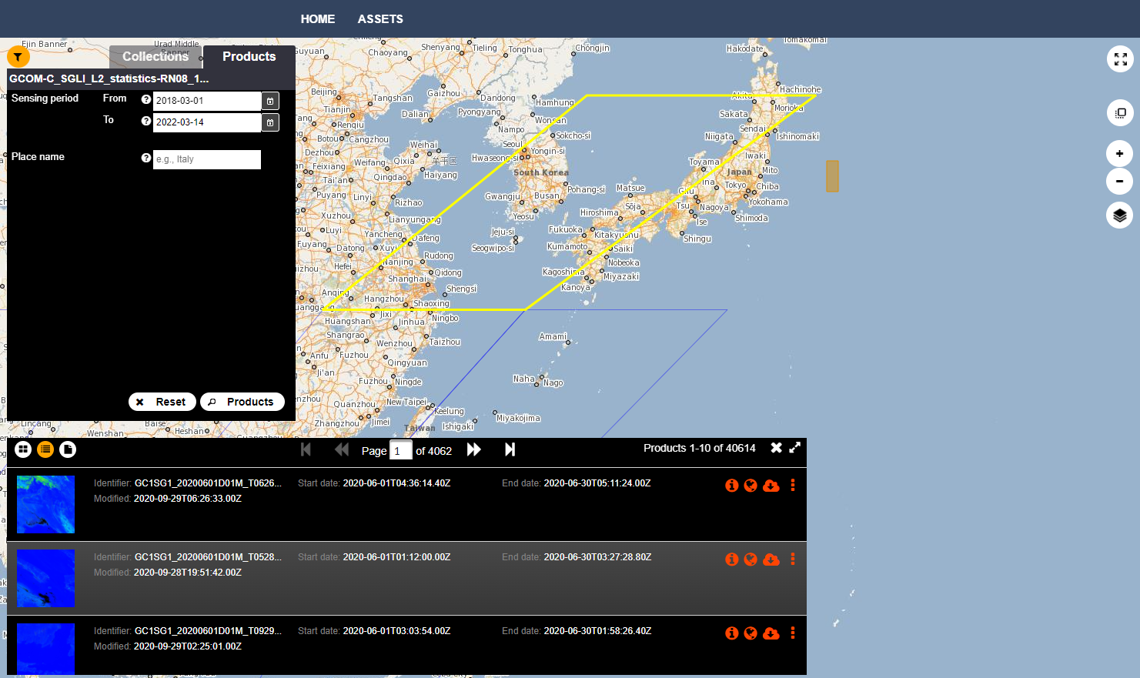

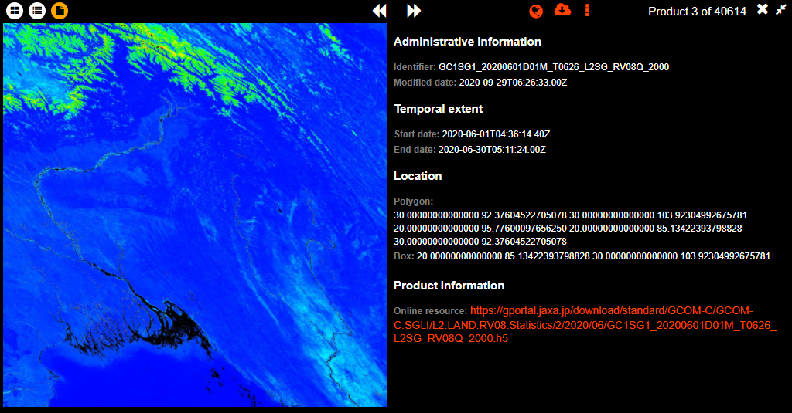
Notes:
GCOM-C/SGLI L2 Statistics-Land Surface Reflectance(RN08) (1-Month,1km)
March 2022

Slide 15
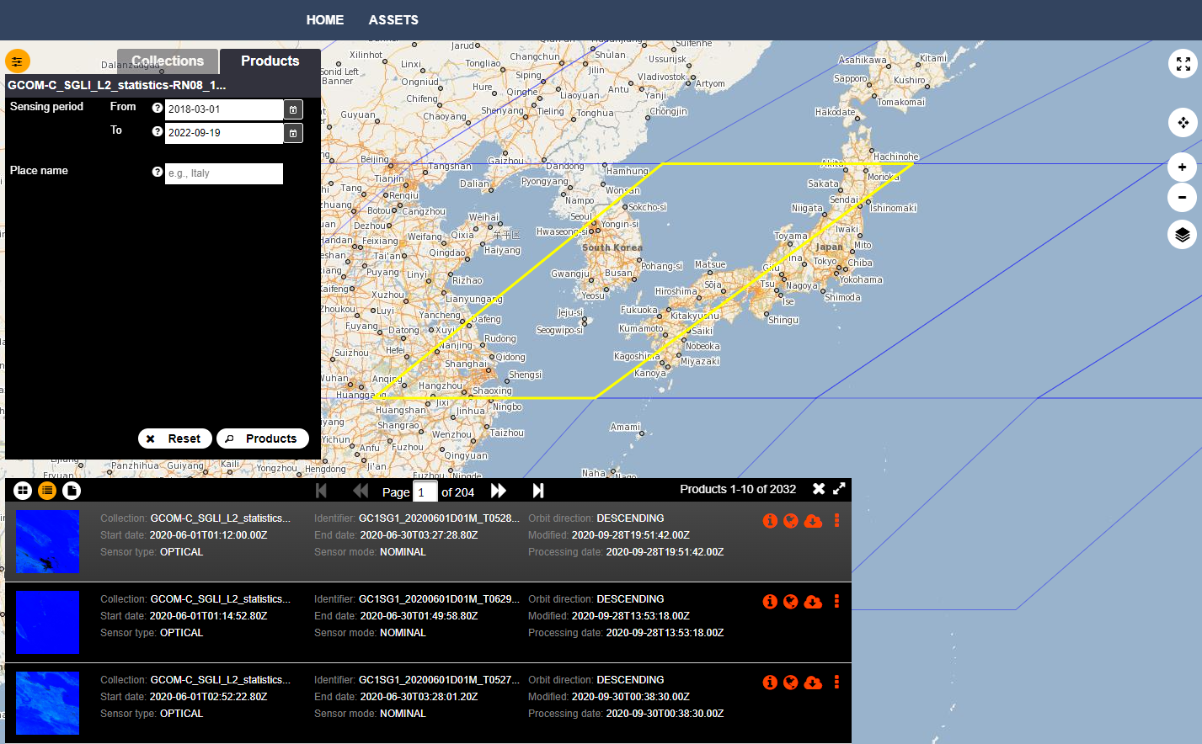

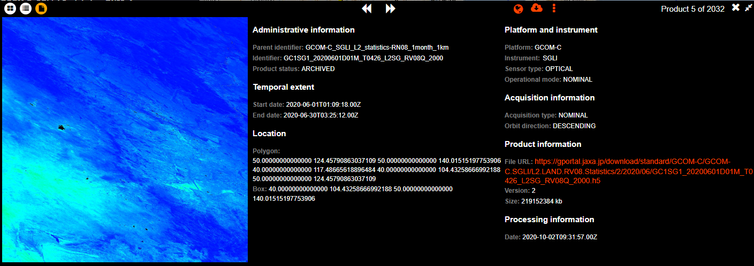
TBD: redo the next slide with additional output ?
Notes:
GCOM-C/SGLI L2 Statistics-Land Surface Reflectance(RN08) (1-Month,1km)
September 2022.

Slide 16
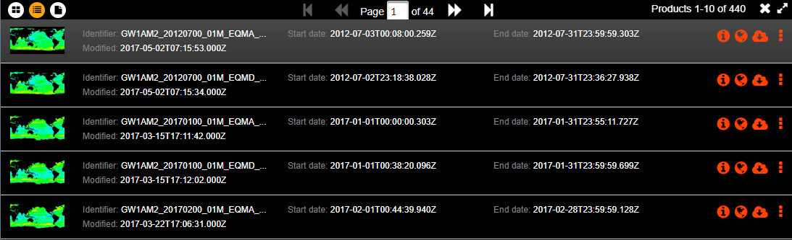
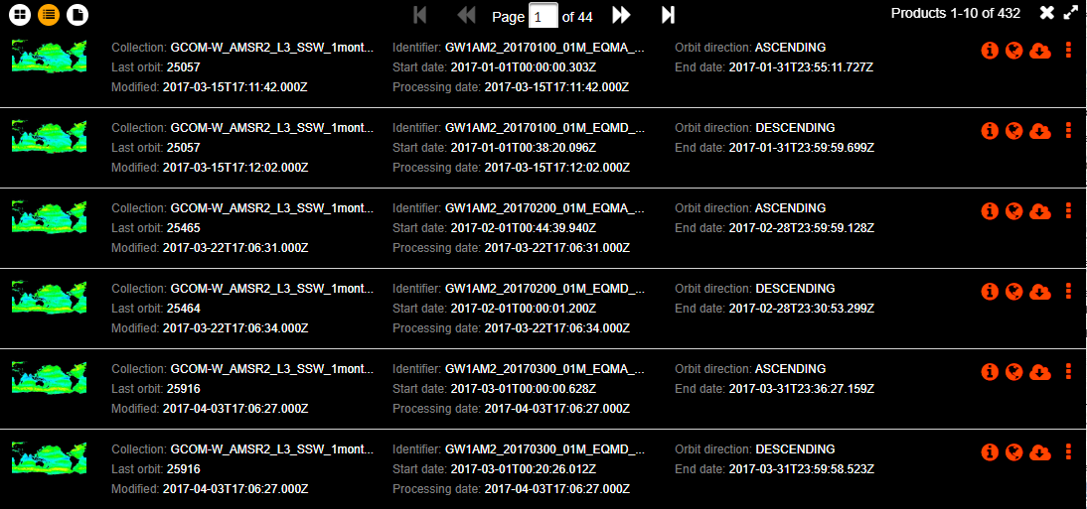
Before and after software changes (same client)
BEFORE
AFTER

Slide 17
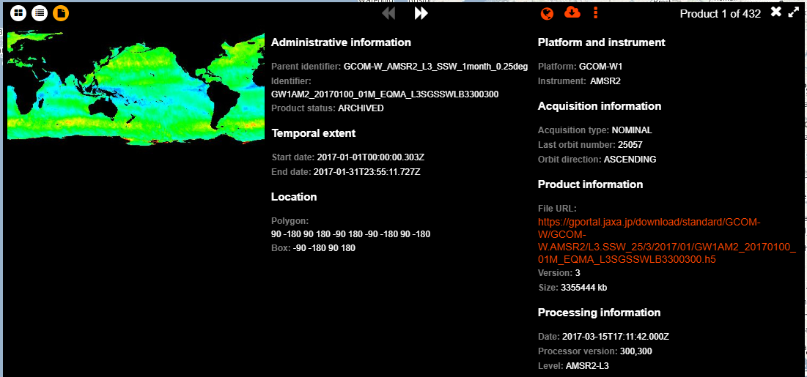
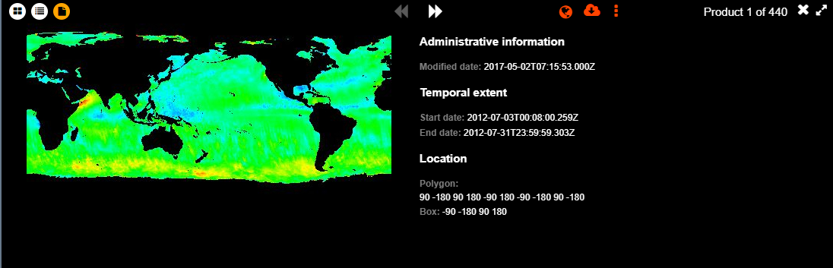
Before and after software changes (same client)
AFTER
BEFORE
Notes:
Example GCOM-W_AMSR2_L3_SSW_1month_0.25de
https://fedeo-client.ceos.org/?url=https%3A%2F%2Feovoc.spacebel.be%2Fapi%3FhttpAccept%3Dapplication%252Fopensearchdescription%252Bxml (before)
https://fedeo-client.ceos.org/?url=https://geo.spacebel.be/opensearch/description.xml (after)

Slide 18
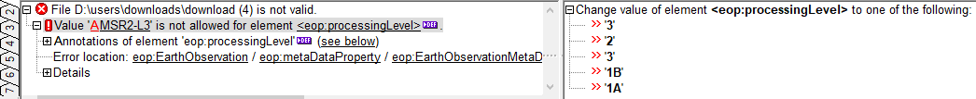
Ongoing integration activities
JAXA G-PORTAL ( In FedEO validation/integration environment )
  Additional improvements to be agreed with JAXA:
    Improve eop:EarthObservation information available in granule metadata, in particular property values (e.g. processingLevel) to allow validation.
    Additional (standard) queryables for granule search. E.g. gpc:polarization, eo:orbitDirection, searchTerms.
    Update online resource function codes in ISO collection metadata to have access in FedEO client and Atom response.
    Requests without parameters used for obtaining metrics (asset pages), often fail (time-out).

Slide 19
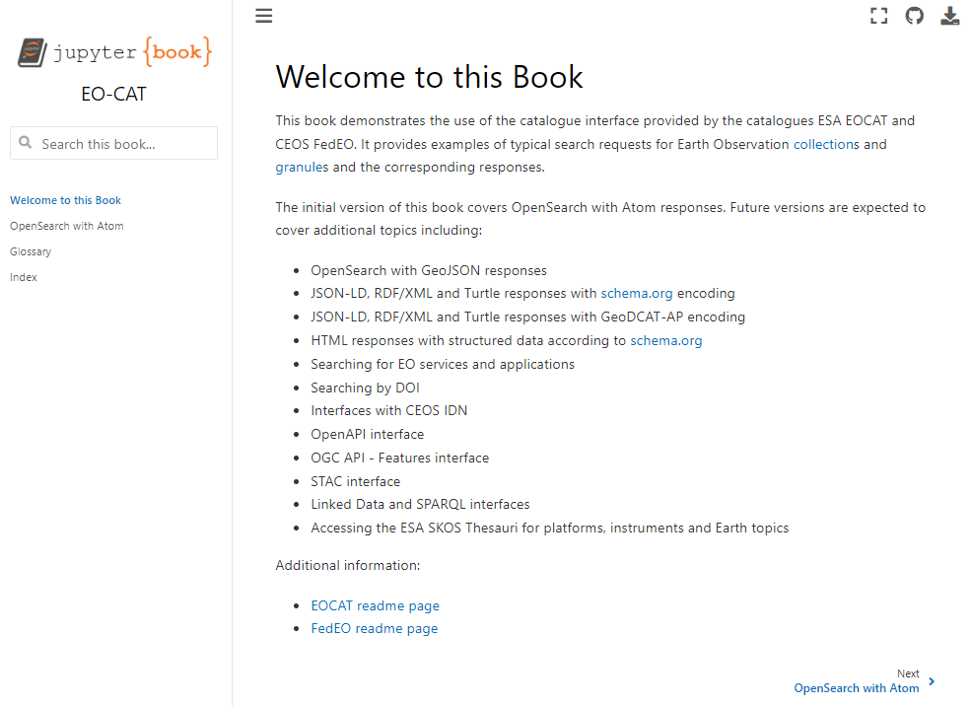
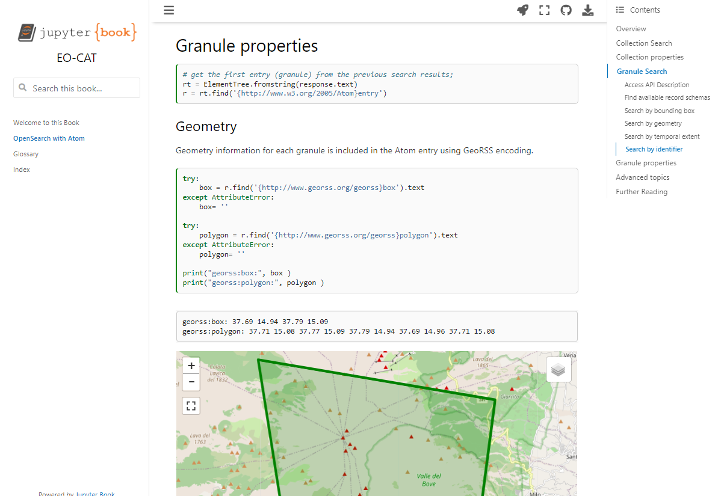
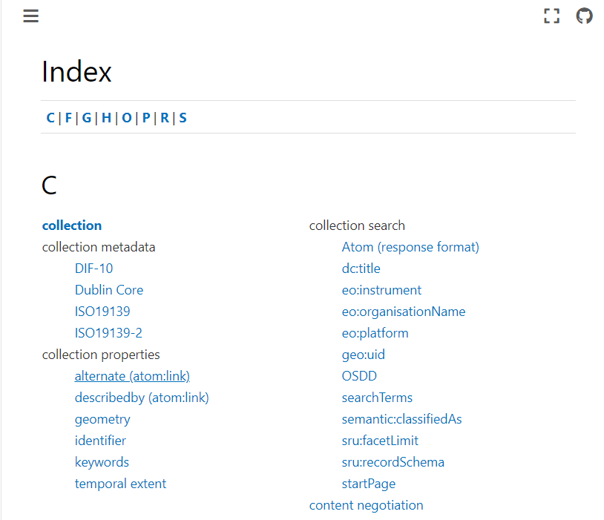
FedEO Evolution - EOCAT Evolution
Online documentation being prepared as part of EOCAT Evolution
  Implemented with Jupyter Notebooks and JupyterBook
  Includes Colab and Binder access
  Documentation will be available at https://github.com/eovoc/eo-books.

Slide 20
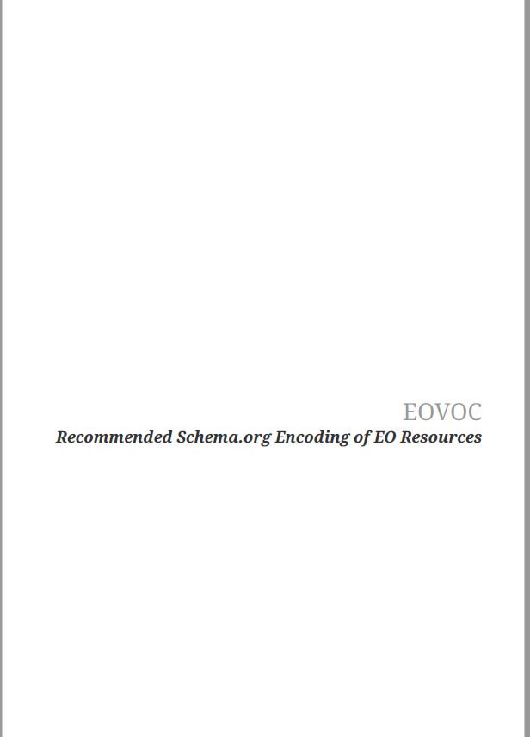




FedEO Evolution – EOVOC Outcome
“EOVOC” project presented at WGISS#52
Completed in August 2022
Engineering Report with recommendations for publication of EO resources using schema.org available:
  https://github.com/eovoc/eo-on-schema.org
Extension of FedEO Catalogue API with:
  JSON-LD, RDF/XML, Turtle, HTML
  Schema.org encoding
  GeoDCAT-AP encoding
  SPARQL façade in front of FedEO Catalogue
Prototype Catalogue accessible at:
  https://eovoc.spacebel.be/readme.html
  Linked Data Client at https://eovoc.spacebel.be/lodview
Transfer To Operations of project results is being planned.

Slide 21
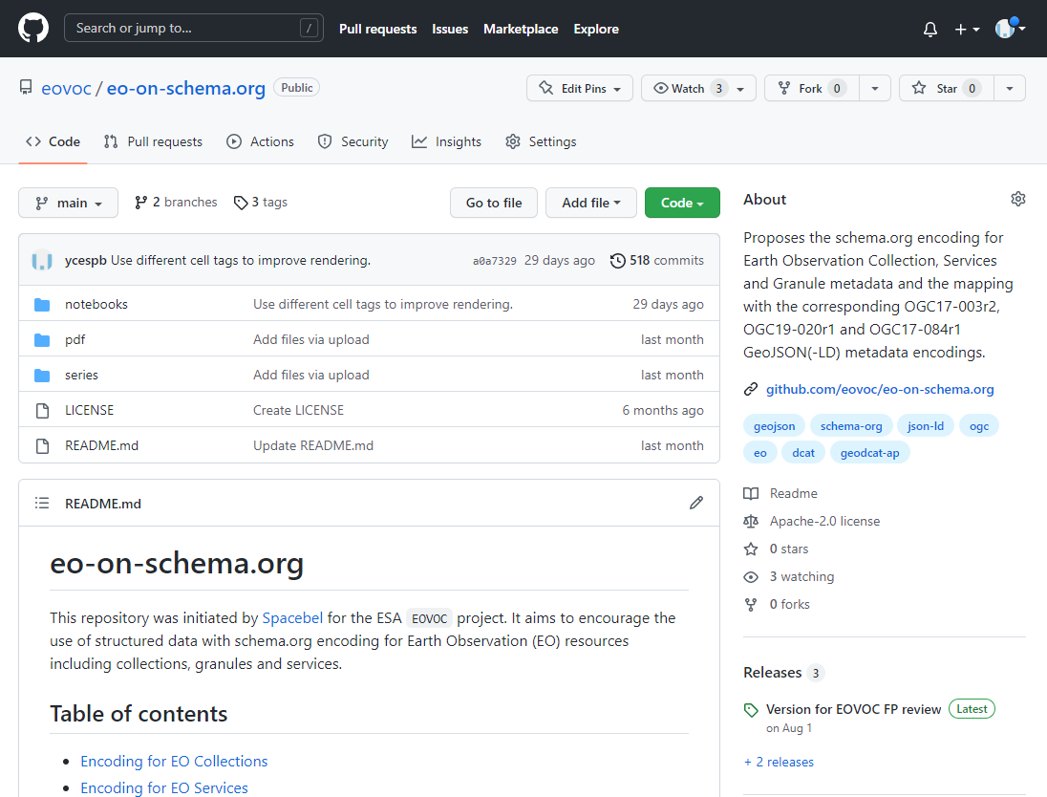
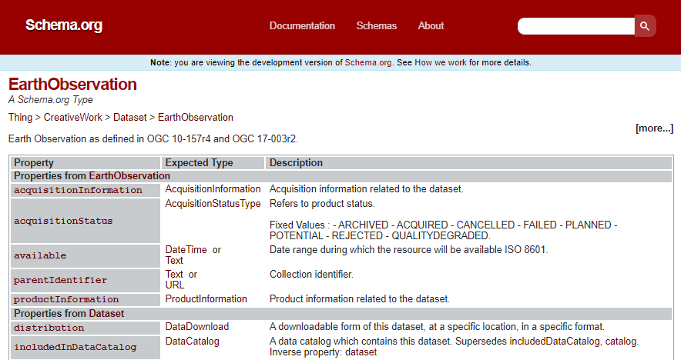
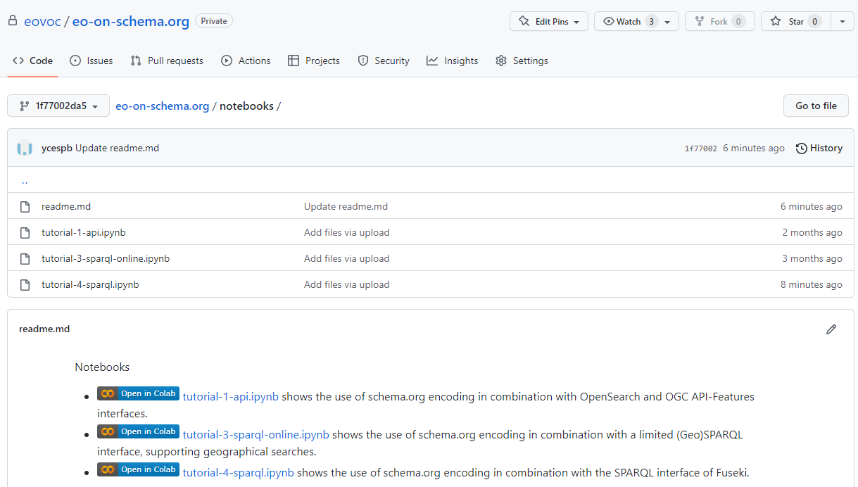
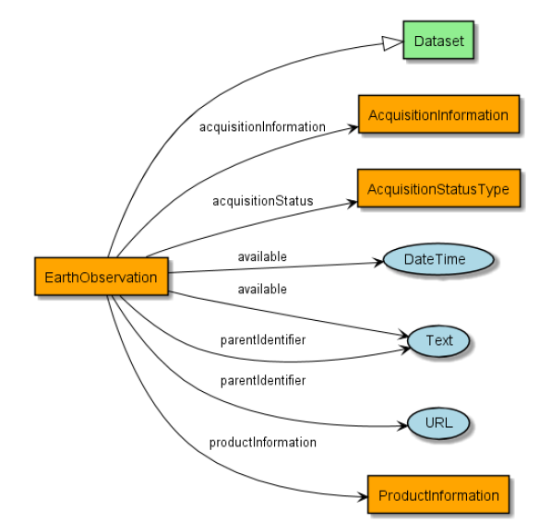
FedEO Evolution – EOVOC Outcome
Results available on public GitHub repository
  Schema.org recommendations for EO metadata resources
  Schema.org extension (EO granules) as per OGC 17-003r2 encoding.
  SHACL shapes
  Jupyter Notebook examples

Slide 22
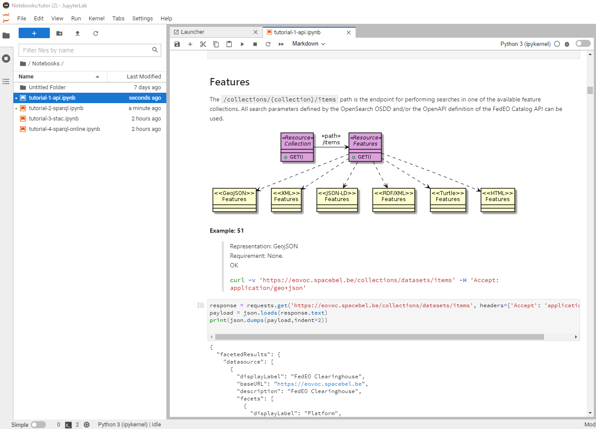
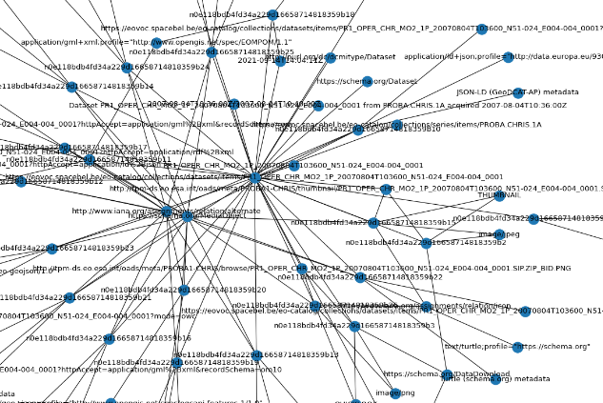
FedEO Evolution – EOVOC Outcome
Jupyter Notebooks with FedEO access examples:
  OpenSearch
  OGC API-Features
  (Geo)SPARQL
  Schema.org/GeoDCAT-AP

Slide 23


