Slide 1
DLR Current Archiving Technology and Future Trends
K. Molch, C. Wehn, S. Schropp, S. Kiemle, J. Senft
German Aerospace Center DLR
Earth Observation Center
Information Technology
CEOS-WGISS #54
4 October 2022
JAXA, Tokyo & virtual

Slide 2
Executive Summary DLR Archiving Technology and Future Trends
Hierarchical Storage Management (HSM) concept still holds; 1st data copy migratingto disk-based archive; 2nd copy on tape
Online data holdings on exploitation platforms change role of archive from being the initial contact point in EO data flows and primary data source for users to being the “vault”
Fast transfer of mass data from archive to online storage on platforms required → upload, reload, disaster recovery
Renewed consideration whether to archive intermediate and higher level products
Across-agency coordination & collaboration for large archive data holdings of common interest (e.g. Sentinel user level data) would seem useful

Slide 3
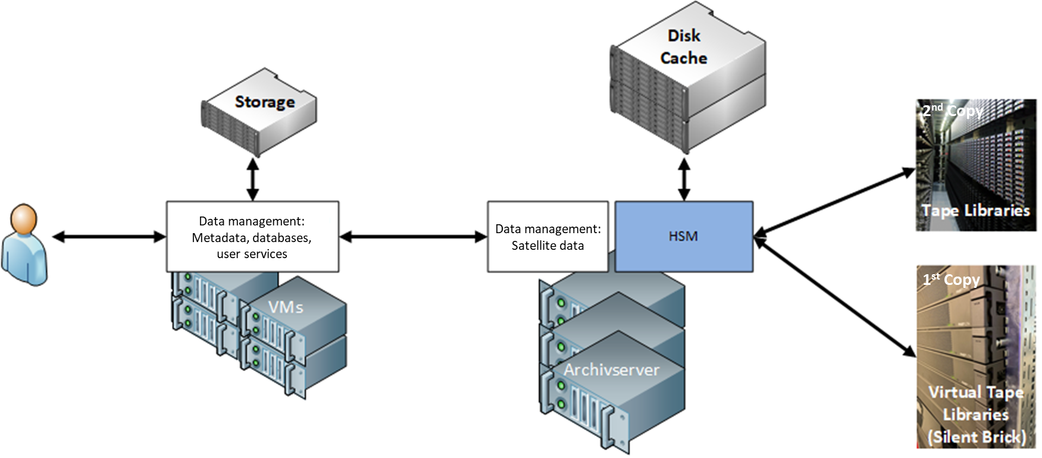
Archiving Technology, Media, and Infrastructure Status and Evolution
Hardware
Five tape libraries (SL 8500, SL 3000) in Oberpfaffenhofen and Neustrelitz (100 PB capacity total)
New disk-based “virtual tape library” (FastLTA Silent Brick System) introduced in Oberpfaffenhofen (20 PB) → increasing capacity and performance
Mass data I/O servers
Media
First copy: T10 000 C tape → migration ongoing to FastLTA Silent Brick System
Second copy: LTO-6/-7 tape → LTO-9 tape
Software
Hierarchical Storage Management (Oracle HSM), looking for a new solution
Data Management System
Legacy “Data and Information Management System” (DIMS) → updating some components as needed for current missions
New addition “Online Data Management System” (ODMS) → central catalogue, eviction, LTA reload to platforms → ties together analysis platforms and long-term archive

Slide 4
Operations Concept, Data Flows, and Processes Then and Now
Massive online EO data storage on analysis platforms is changing the role of the archive and hence the dominant data flows
Fewer deliveries from the archive directly to users
Efficient upload and reload of large data volumes (petabytes) onto platforms (HPC or in cloud)
Disk-based 1st copy
Copernicus compatible LTA interface supporting high-throughput mass data transfer, deployable on cloud or HPC infrastructures
Ingestion flow (mission PDGS, other EO data) via HPC platform terrabyte to internal cloud and LTA
LTA
D-SDA
Processing system
HPC platform collab.
terrabyte
HPC platform in-house
IDA/Geofarm
HPC/Cloud platform external
LTA
D-SDA
Data flow
Interaction

Slide 5
Archiving policy and archives content What is being archived in LTA?
National EO mission data
E.g. SRTM X-SAR, TerraSAR-X, TanDEM-X, EnMAP
Raw/Level 0 data always; higher level data/intermediate products tbd. for future missions
Aiming at full geo-redundancy, i.e. 1 copy each in Oberpfaffenhofen and Neustrelitz → e.g. EnMAP
International EO data of DLR scientific interest
E.g. daily AVHRR 1km data over Europe since 1980s
Currently two copies at one site (either OP or NZ) in different buildings
Copernicus Sentinel user level data
Sentinel-1, -2, -3 OLCI, -5P; most product types, complete time stack, curated (gap filling, traceability in future)
Sentinel-2 collection 1 reprocessed data; deletion of previous S2 baselines tbd. (approx. 11 PB)
Only 1 copy in LTA for some (“working copy” on HPC platform)
→ Across-agency coordination of Copernicus user level data archives would be useful
In-house regional and global spatial information products
E.g. Global Urban Footprint, Global Snow Pack, Global Water Pack, AVHRR curation L2, L3 products (“Timeline”), ...
Focus on access (visualization, download)
LTA: file based or with simple product model (similar to ESA EO-SIP)

Slide 6
Archived Data Format/Packaging
Data model for ingestion into data management database (“Product Library”) specifically designed for each new collection
Simple standardized data model (similar to ESA EO-SIP) also used
Taxonomy: collection → products → components (primary data, quicklook(s), metadata) → files (any format)
Metadata and quicklook components used for populating catalog
For use on platforms (internal, external): either file based or processed to ARD in cloud-optimized formats for direct use

Slide 7
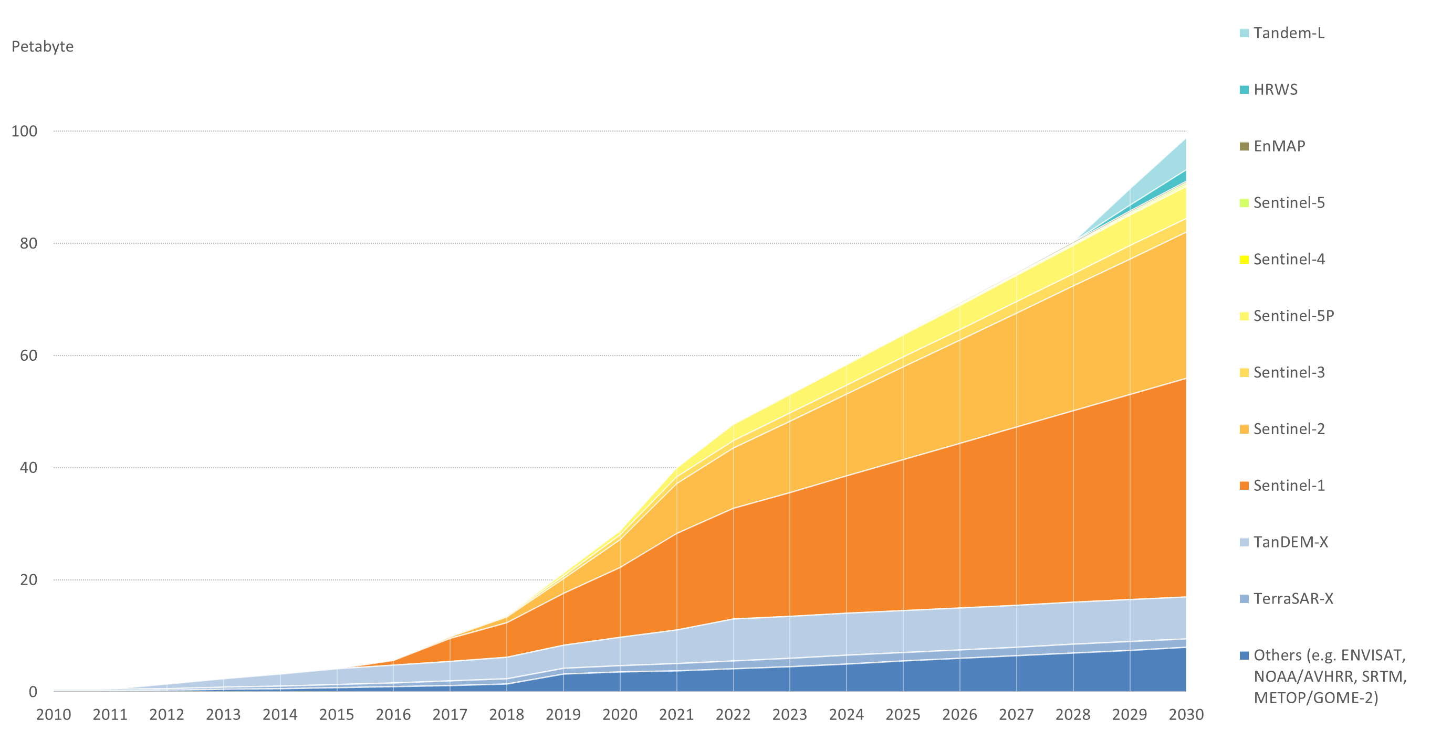
Archive Volume and Trends
> 50 petabytes
> 40 EO missions
> 360 “collections” i.e. product types
> 64 million products
Today

Slide 8
Challenges and Needs
Manageing multiple data copies, versions, and formats across LTA and various online storage systems (terrabyte, IDA, Geoservice) → internal inventory at collection (/layer) level
Tracking provenance; making the information available to users
Managing multiple collection and product catalogs (ISO, EOWEB-PL, STAC) exposed internally/externally via different interfaces → “Master catalog” envisaged for new Online Data Management System (ODMS)
Large and growing datasets of global interest, e.g. Sentinel user level data
Coordination of archive data holdings across agencies would seem useful
Can we achieve redundancy of curated “authentic copies” across agencies - including consistency checks, defined interfaces?

Slide 9
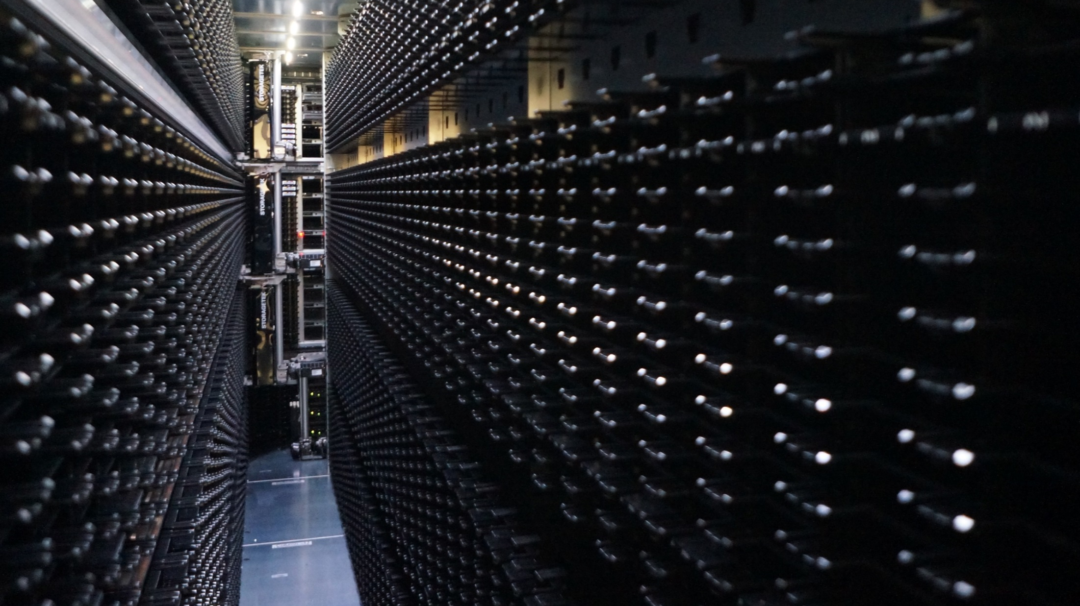
Thank you very much
Questions?
Katrin Molch
DLR Earth Observation Center
Katrin.Molch@dlr.de

