Slide 1
CNES Archive Technology and Future Trends
Johan Aussenac, CNES
Richard Moreno, CNES
Agenda ID: 2022.10.04_14.10
WGISS-54
Tokyo, Japan (JAXA)
3-7 October 2022

Slide 2
Datalake Objective
CNES is currently installing a new Datalake in its Toulouse premise
This datalake will embark the next CNES long term archive
We will present this Datalake and focus on the technologies and principles used for Long Terme Archive.
Slide 2

Slide 3
Summary
New Spatial and Scientific Data storage to improve Data analysis in CNES
CNES internal Datasets :
Centralised storage solution for all projects
adress volumetry ramp-up for new project like SWOT, GeoDataHub,...
External Datasets:
Centralised storage to cache (copy) usefull datasets like the Sentinel products (PEPS platform)
Auxiliary Data : Surface or Topography models, Weather, Orbit...
Data sharing between projects without duplication (Especially for Large Dataset)
Online datasets for realtime usage, Web access (not only diffusion), Parallel processing, DataLabs
More collaboration and data sharing between institution : Data Grid for DataTerra/GaiaData (Use data where it is : data locality)
More interoperability through a standardised Object API (S3) with Glacier features
Slide 3

Slide 4
Datalake Objective
Designed for high volume storage > 100 PiO
All users access centralised on the S3 Disk system (No direct access to Tiers3 like a classical HSM driving tape : Users need to stage data on tiers2) = Objective = Best performances for several concurrent user access (Tiers3 is not directly exposed to users)
S3 API on Datalake / POSIX only on the Application or processing: If user needs POSIX semantic / He has to retrieve Data on datalake and process on HPC or VM POSIX storage ((Parallel FS or Block Storage)
Long Term Archive solution : (Named STAF in CNES / Critical Mission to preserve data for future use). Specific API developed as a gateway between ground segment system and Datalake (Back end abstraction)
New HTTP Rest API replacing the old Client/Server app
ILM (Information Lifecycle Management) To manage Storage Class: (AWS S3 & GLACIER)
OnLine
NearLine Single Copy
NearLine Dual Copy (Only for LTA purpose at the beginning)
Slide 4

Slide 5
Functional View
S3 interface
Dedicated interface & service
Via a dedicated tools: REGARDS
Implementig OAIS
Tier 1 – Perf/HPC storage
Tier 2 – « Online » storage
Tier 3 – « Near line » storage
Performance: intermediate
Storage: full disk – distributed
S3 API
Initial storage : 35 PB
~ Glacier
Storage: tapes
Performance: reduced
Initial storage : 35 PB up to 100 PB
Performance oriented
POSIX Storage
GPFS: 8 PB
Double copy
Storage: tapes with other technology
In another location
Performance: reduced
Initial storage : 5 PB up to 100 PB
CNES ARCHIVE
Slide 5

Slide 6
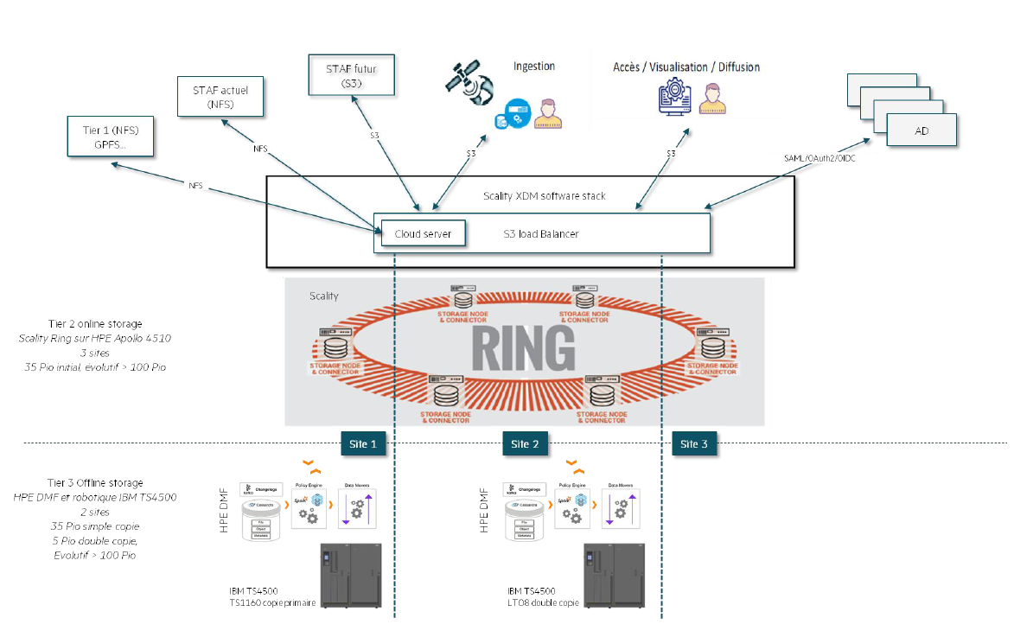
Functional View
Tier 2 online storage
Scality Ring on HPE Apolo 4510
3 sites
35 Pio – extention to 100+ Pio
Scality XDM + HPE DMF
S3 interface for the users
Great ease of Datalake data management: the Scality and DMF couple makes hierarchical data management transparent by offering both access through S3 and NFS protocols.
Tier 3 Offline storage
HPE DMF & IBM TS4500 tape library
35 PiB single copy
5 PiB double copy
Can be extended > 100 PiB
IBM TS4500
Second copy LTO08
IBM TS4500
Primary copy TS1160
Slide 6

