Slide 1

WGISS - Working Group on Information Systems and Services
Committee on Earth Observation Satellites
Cooperation with CGMS
Mirko Albani – European Space Agency (ESA)

Slide 2
Executive Summary
The Coordination Group for Meteorological Satellites (CGMS) globally coordinates meteorological satellite systems. CGMS Working Group IV addresses data access and end user support.
WGISS DSIG presentation well received at CGMS WG-IV mtg (April 22).
WG-IV adopted CEOS WGISS DSIG BP/guidelines as applicable to CGMS members datasets about three years ago.
                → Keep them informed about future evolutions
WG-IV members also interested in the applicability of the DSIG guidelines to ground-based data and data stored on the cloud.
→ Potential area of cooperation and BP/guidelines extension
WG-IV expressed interest in a joint meeting or session with WGISS to share experiences and present respective activities.
→ Potential cooperation in other areas (e.g. data access, cloud services, metadata)
Way forward for discussion: WGISS chair to contact CGMS WG-IV chair to discuss/identify opportunity for joint session/meeting

Slide 3
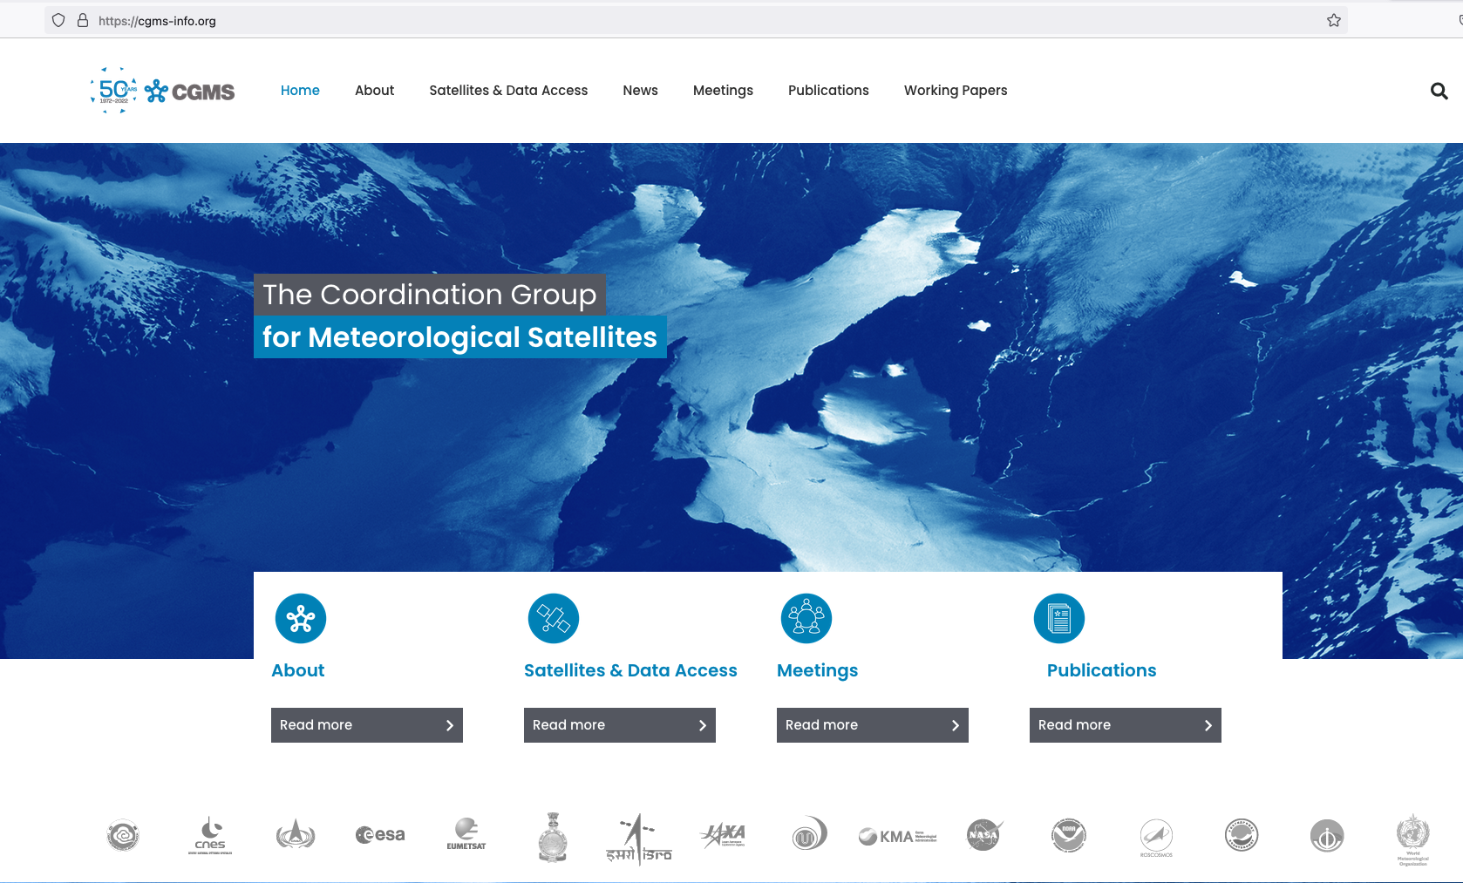
CGMS Background and Scope
https://cgms-info.org/
The Coordination Group for Meteorological Satellites (CGMS) is the group that globally coordinates meteorological satellite systems. This includes protection of in orbit assets, contingency planning, improvement of quality of data, support to users, facilitation of shared data access and development of the use of satellite products in key application areas.

Slide 4
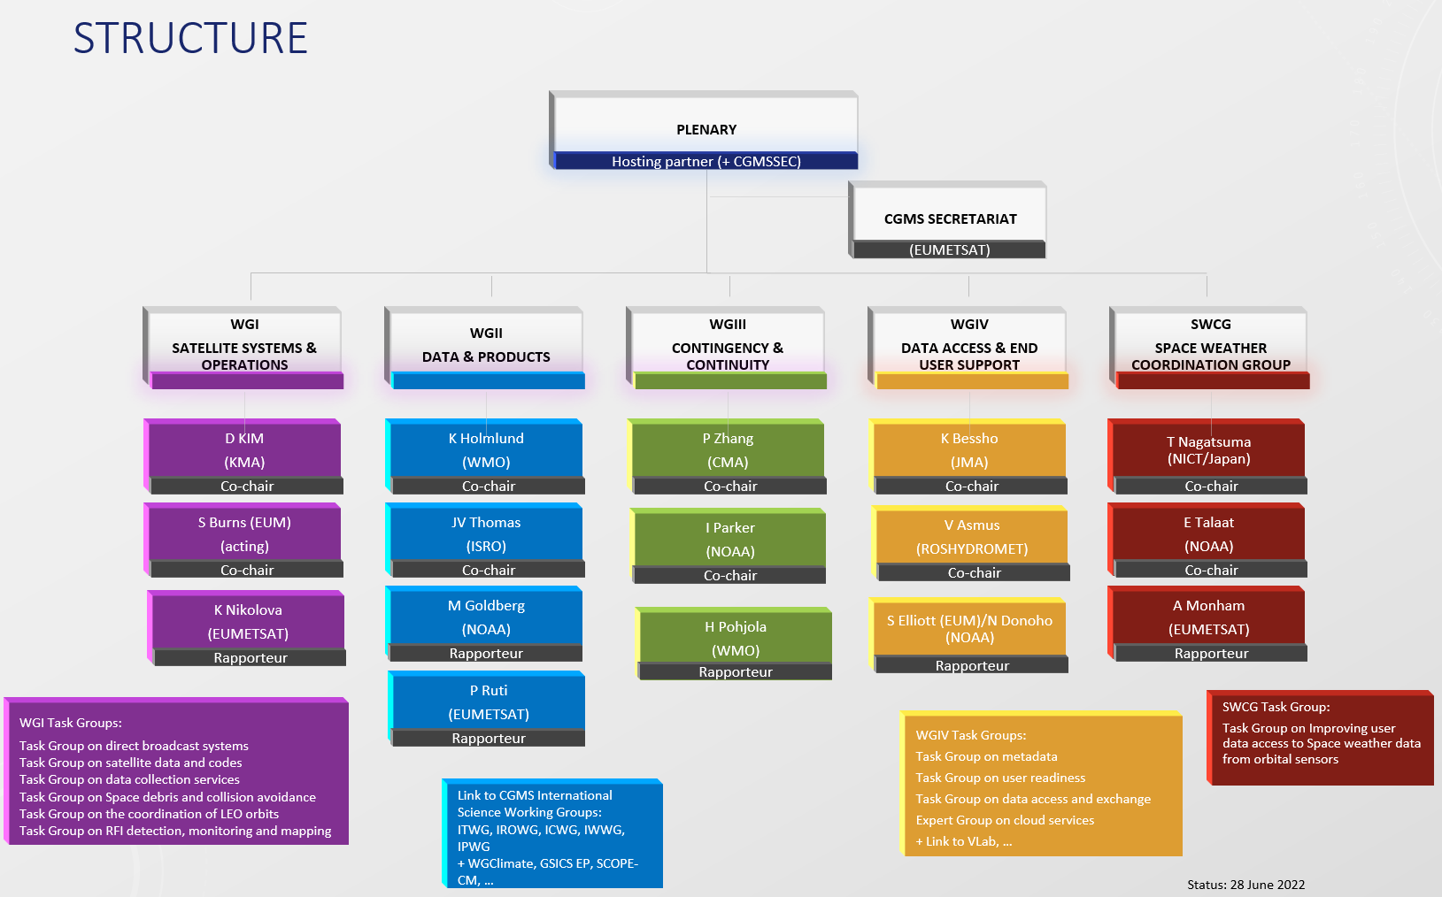
CGMS organization

Slide 5
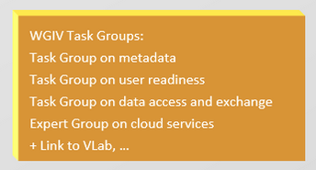
CGMS Working Group IV: Data access and end user support
Background
Initiated in 1989 it now addresses data access and end user support.
Members: China (CMA), Europe (EUMETSAT) India (IMD), Japan (JMA), Federal Republic of Korea (KMA), Russia (ROSHYDROMET), USA (NOAA), and WMO. Open to all CGMS members & invited experts.
Co-chairs: Kotaro Bessho, JMA / Vasily Asmus, ROSHYDROMET
Rapporteurs: Simon Elliott, EUMETSAT / Natalia Donoho, NOAA
Scope of CGMS Working Group IV
Provide a forum for CGMS agencies to address topics of interest in areas related to data access in general and the contribution to the WMO Information System. It addresses issues related to dissemination systems, data formats and metadata exchange, and also deals with the user interfaces and data access.
WG IV ToR: https://www.cgms-info.org/Agendas/WP/CGMS-46-CGMS-WP-18%20v2

Slide 6
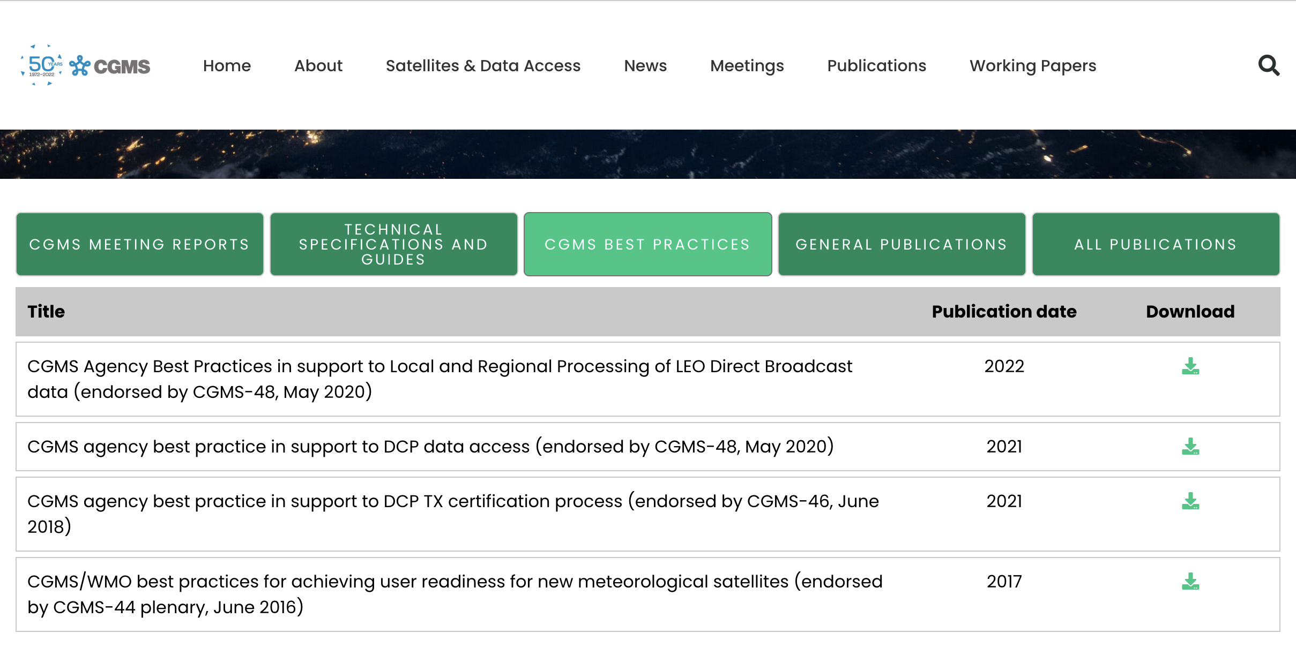
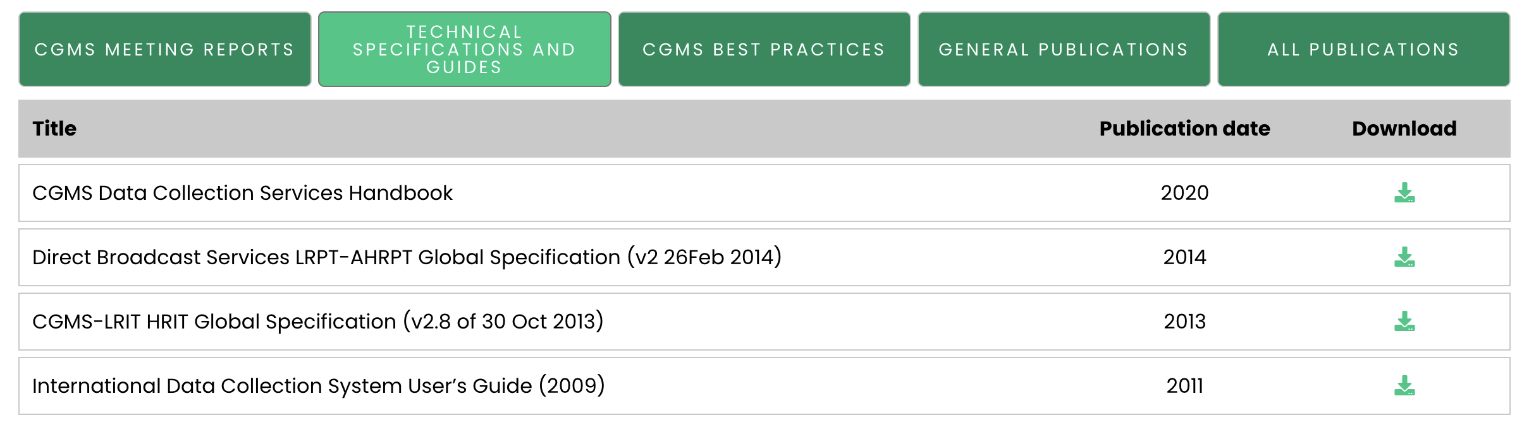
CGMS Publications and Best Practices

Slide 7
CGMS interest to have a presentation on WGISS Data Preservation Guidelines
WGISS DSIG Presentation at
CGMS working group IV meeting on 28th April 2022

Slide 8

Data Stewardship Interest Group
WGISS accomplishes its Data Preservation and Curation efforts through the Data Stewardship Interest Group (DSIG)
Share investigations, developments, experiences and lessons learned
Draft common best practices or guidelines for adoption by WGISS
Sponsor technical exchanges and the conduction of joint activities and/or pilot projects on specific data stewardship topics (e.g. archiving, preservation)
Establish and maintain a CEOS “Data Purge Alert” service and pursue recovery of historical EO datasets
Contribute to GEO and standardization activities
Focus on EO Data and Technical Content

Slide 9
Data Stewardship Best Practices
Document Tree
EO Data Stewardship
Cooperative Framework
Policy Documents
CEOS Agencies EO Space Data Sets
Applied to
Data Purge Alert Procedure & White Paper
Recommended / Reference
Individual organizations'
policies (stewardship, access, ...)
Recommended / Reference
Technical Documents
Reference Model for Data Stewardship
Glossary of Acronyms and Terms
General guidelines and best practices
Support
Preservation Workflow
EO Data Preservation Guidelines
Preserved Data
Set Content
Associated Technical Content Preservation
CEOS DMSMM Maturity Matrix
Persistent Identifiers (DOI)
Guidelines and best practices on specific topics
Technical implementation procedures
EO Data Set
Consolidation Process
Measuring EO
Data Usage
Image Source: http://eastenders.wikia.com/wiki/File:Under-construction.png

Slide 10
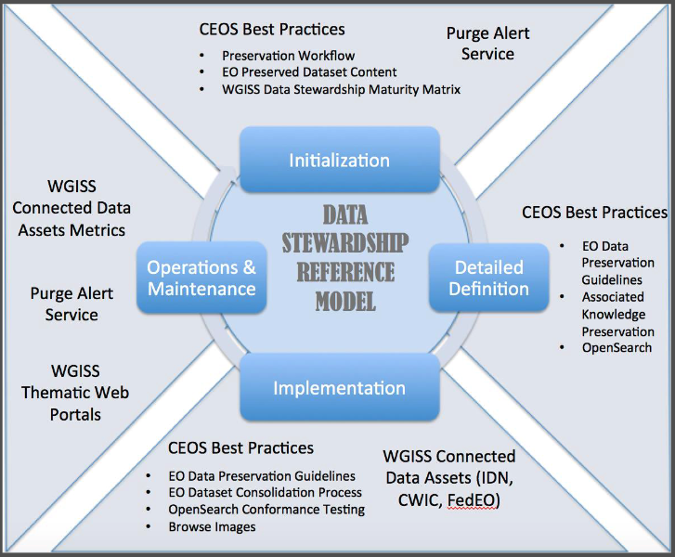
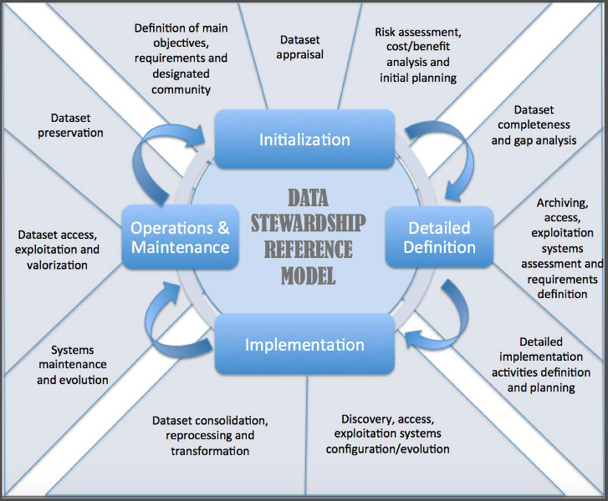
Reference Model for Data Stewardship

Slide 11
EO Data Preservation Guidelines BP
The Preservation Guidelines support the “Detailed Definition” and “Implementation” steps of the Stewardship Reference Model.
CONTENT: Eight main “themes” consisting of “guiding principles” and a set of “guidelines” that should be applied to guarantee the preservation, accessibility, and usability of EO space data in the long term.
Preserved data set content definition and appraisal
Archive operations and organization
Archive security
Data ingestion
Archive maintenance
Data access and interoperability
Data exploitation and re-processing
Data purge prevention

Slide 12
Preserved Data Set Content BP
This document identifies the EO data associated content that should be preserved to ensure long-term usability and exploitation of EO data. It should be tailored for each mission/instrument involving mission experts and the designated user communities.
The PDSC BP is structured along EO missions phases:
Mission Concept (MC)
Mission Definition (MD)
Mission Implementation (MI)
Mission Operations (MO)
Post Mission (PM)

Slide 13
CEOS Persistent Identifiers BP
The main purpose of a persistent identifier is to help data users cite and find specific data sets. This document provides recommendations on the use of Persistent Identifiers (PIDs) for Earth Observation data, allowing their globally unique, unambiguous, and permanent identification.

Slide 14
Purge Alert Service White Paper
CEOS has established a "Purge Alert Procedure" to help to ensure the long-term preservation of valuable Earth observation data.
This procedure enables data archive managers to:
Alert other CEOS organizations about EO data scheduled to be purged;
Support transfer of responsibility to other interested organizations or archive centers.

Slide 15
… not only Best Practices
DSIG organizes technical sessions on various topics like:
Archive Holdings and Technology: archived data volume at CEOS space agencies is growing exponentially. At the same time archiving technology is changing very rapidly. Objective of the session is to present the status of CEOS agencies archives in terms of content, technology and future evolutions/trends.
Data Provenance: ensure that the content of the archived data and associated information remains unchanged and, if changes are made, that these are documented, preserved and made available as well (provenance information).
Heritage Data Recovery: climate related applications are requiring more and more to extend critical long-term science observations back in time through recovery and use of heritage (historical) datasets. Objective of the session is to identify historical/heritage datasets currently not accessible to users (e.g. because on old media, not kept online, etc.) and trigger potential joint recovery actions.
… and more
Contacts : Mirko.Albani@esa.int & i.maggio@rheagroup.com
https://ceos.org/ourwork/workinggroups/wgiss/preservation/

Slide 16
Outcomes and potential areas of CGMS-WGISS cooperation
WGISS DSIG presentation well received.
WG-IV adopted CEOS WGISS DSIG BP/guidelines as applicable to CGMS members datasets about three years ago.
                → Keep them informed about future evolutions
WG-IV members also interested in the applicability of the DSIG guidelines to ground-based data and data stored on the cloud.
→ Potential area of cooperation and BP/guidelines extension
WG-IV expressed interest in a joint meeting or session with WGISS to share experiences and present respective activities.
    → Potential cooperation in other areas (e.g. data access, metadata, cloud services)
Way forward for discussion: WGISS chair to contact CGMS WG-IV chair to discuss/identify opportunity for joint session/meeting

Slide 17
Spare Slides
(not presented to CGMS but provided for information)

Slide 18
Preservation Workflow BP (1/2)
The Preservation Workflow BP is intended to assist EO data managers in the task of preparing Earth observation space data sets for long-term accessibility and usability. Data curation, as part of an overall data stewardship, includes data preservation, which is targeted at protecting data integrity and ensuring sustainable accessibility and usability.

Slide 19
Preservation Workflow BP (2/2)
CONTENT:
The workflow identifies and describes a set of actions and activities to be implemented to ensure a sustainable preservation of Earth observation (EO) data.
It describes in detail the Stewardship Reference Model and the input/output of each activity plus the supporting CEOS Best Practices which can be used in each step.

Slide 20
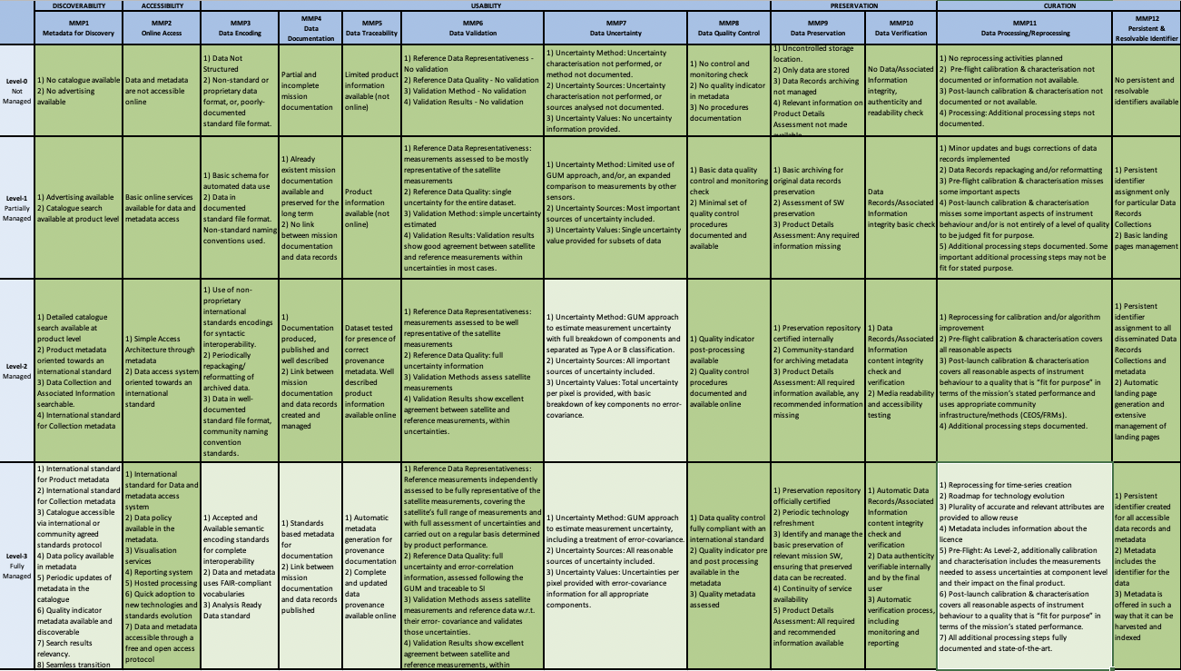
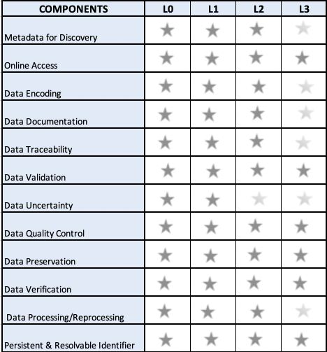
CEOS WGISS Data Management Stewardship Maturity Matrix
The Data Management Stewardship Maturity Matrix White Paper defines all activities needed to preserve and improve the information content, quality, accessibility, and usability of data and metadata. It is used to define initial objectives and measure progress and achievement.

Slide 21
Generic EO Data Set Consolidation Process
The Generic EO Consolidation Process provides a series of technical recommendations focused on the implementation of actions for the consolidation of Data Records and their Associated Information.

Slide 22
Glossary of Acronyms and Terms
This document provides a list of definitions for frequently used acronyms and terms in the field of Earth observation data stewardship. The main goal is to pursue alignment between various sources and Space Agencies.

Slide 23
Measuring EO Data Usage
Metrics and indicators have been historically collected by data owners/providers to gather relevant information on data usage, to generate statistics, stimulate user engagement, and to monitor processes and services. This document provides recommended parameters/metrics/indicators to be used, and information to be collected by data providers.

