Slide 1

AVHRR International Cooperation Activities and Partners
WGISS
Committee on Earth Observation Satellites
Mirko Albani (ESA)

Slide 2
Executive Summary
AVHRR cooperation objectives
Unfold and make accessible 1km AVHRR data from regional archives (possibly open and free)
Transcribe unique AVHRR data from heritage media
Identify a common format for AVHRR Level-1b data and pursue (re)processing from AVHRR data owners/holders
Facilitate data discovery through the WGISS Connected Data Assets Infrastructure
Progress since last WGISS
Inventory of existing national/regional HRPT and LAC data archives under consolidation
  Version 1 updated with feedback received from few people: more inputs needed – please help in compiling V2
  High Priority Datasets identified (for further action): Africa (SANSA), Africa (University of Rome / ASI), Australia (CSIRO), South America (GiDyC-Servicio Meteorológico Nacional Argentina): will seek for more information and contact relevant people in such organizations
Identification of high priority heritage media to be transcribed and approaches/opportunities
  Pilot activity started by ESA with Memnon (Sony Europe) to assess feasibility of transcribing three types of Optical Disks containing unique AVHRR data: successful transcription of the provided samples; full transcription of 300 disks from UK university of Reading plus additional available at ESA will be attempted in 2023.
Data discoverability and reprocessing to be addressed at a later stage
  Ad-hoc addressed requests for inputs will be sent soon to address item 1 above

Slide 3
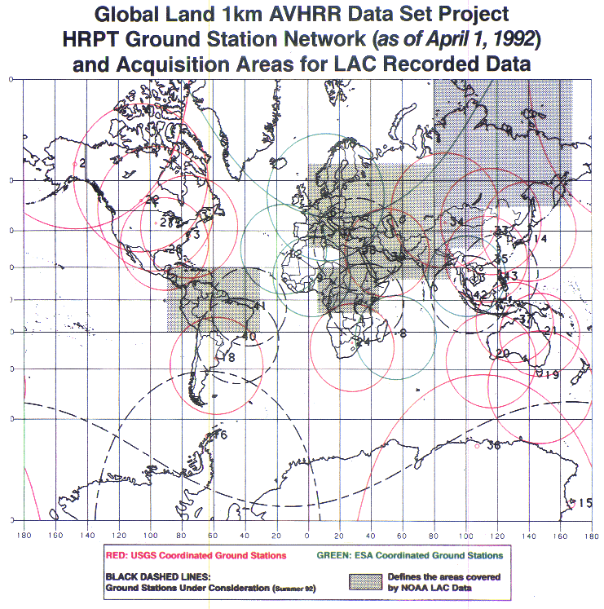
1km AVHRR dataset: a unique asset
The basis for global land applications is the Global Land 1-km AVHRR data set covering the period 1992-99
Spatial resolution makes a difference. Comparison of coarse resolution AVHRR GAC data and 1-km AVHRR LAC data gives new insights on structural changes on land.
In addition, there are many national / regional data archives of LAC data covering a longer period with high value for the retrieval of ECVs. The usage is today sometimes limited due to unknown:
Accessibility
Responsibility
Data format and structure
AVHRR receiving stations contributing to global land 1km AVHRR data set. (https://lta.cr.usgs.gov/1km/hrpt_image)

Slide 4
Cooperation Activities on AVHRR
Objectives
Unfold and make accessible 1km AVHRR data from regional archives (possibly open and free)
Transcribe unique data from heritage media
Identify a common format for AVHRR Level-1b data and pursue (re)processing from AVHRR data owners/holders into the commonly identified format
Facilitate data access through the WGISS Connected Data Assets Infrastructure
First Discussion held at WGISS#50 and initial steps/actions defined.

Slide 5
AVHRR 1 Km digital data archives (excerpt)
GLOBAL
NOAA POES AVHRR GAC global archive: 1978 onwards
EUMETSAT MetOp AVHRR 1km FRAC global archive: late 2006 onwards
LOCAL
Europe: ESA & University of Bern, STFC CEDA (including Dundee Satellite Receiving Station), MeteoFrance.
Americas: NOAA and USGS (USA), NRCan/CCMEO (Canada), GiDyC-Servicio Meteorológico Nacional (Argentina)
Asia: CMA (China), IRIM (Mongolia)
Africa: SANSA (South Africa), University of Rome (Kenya)
Australia: CSIRO
Others missing?

Slide 6
European 1-km AVHRR archive hosted at ESA
Europe: Long time series (1981–2021 ongoing) of AVHRR data from different platforms (POES, MetOp)
Unique source to retrieve Essential Climate Variables (ECV) to investigate climate change over last 40 yrs
Includes data from University of Bern, Dundee Satellite Receiving Station and ESA holdings.
Two-ten overpasses per day.
Dataset consists of more than 260.000 data products harmonized and consolidated through a dedicated ESA project (Heritage Space Programme).
All accessible free of charge via ESA dissemination services.
Archived for unlimited time by ESA.
Processing to Level-1c ongoing.
Additional activities being defined for 2023-24

Slide 7
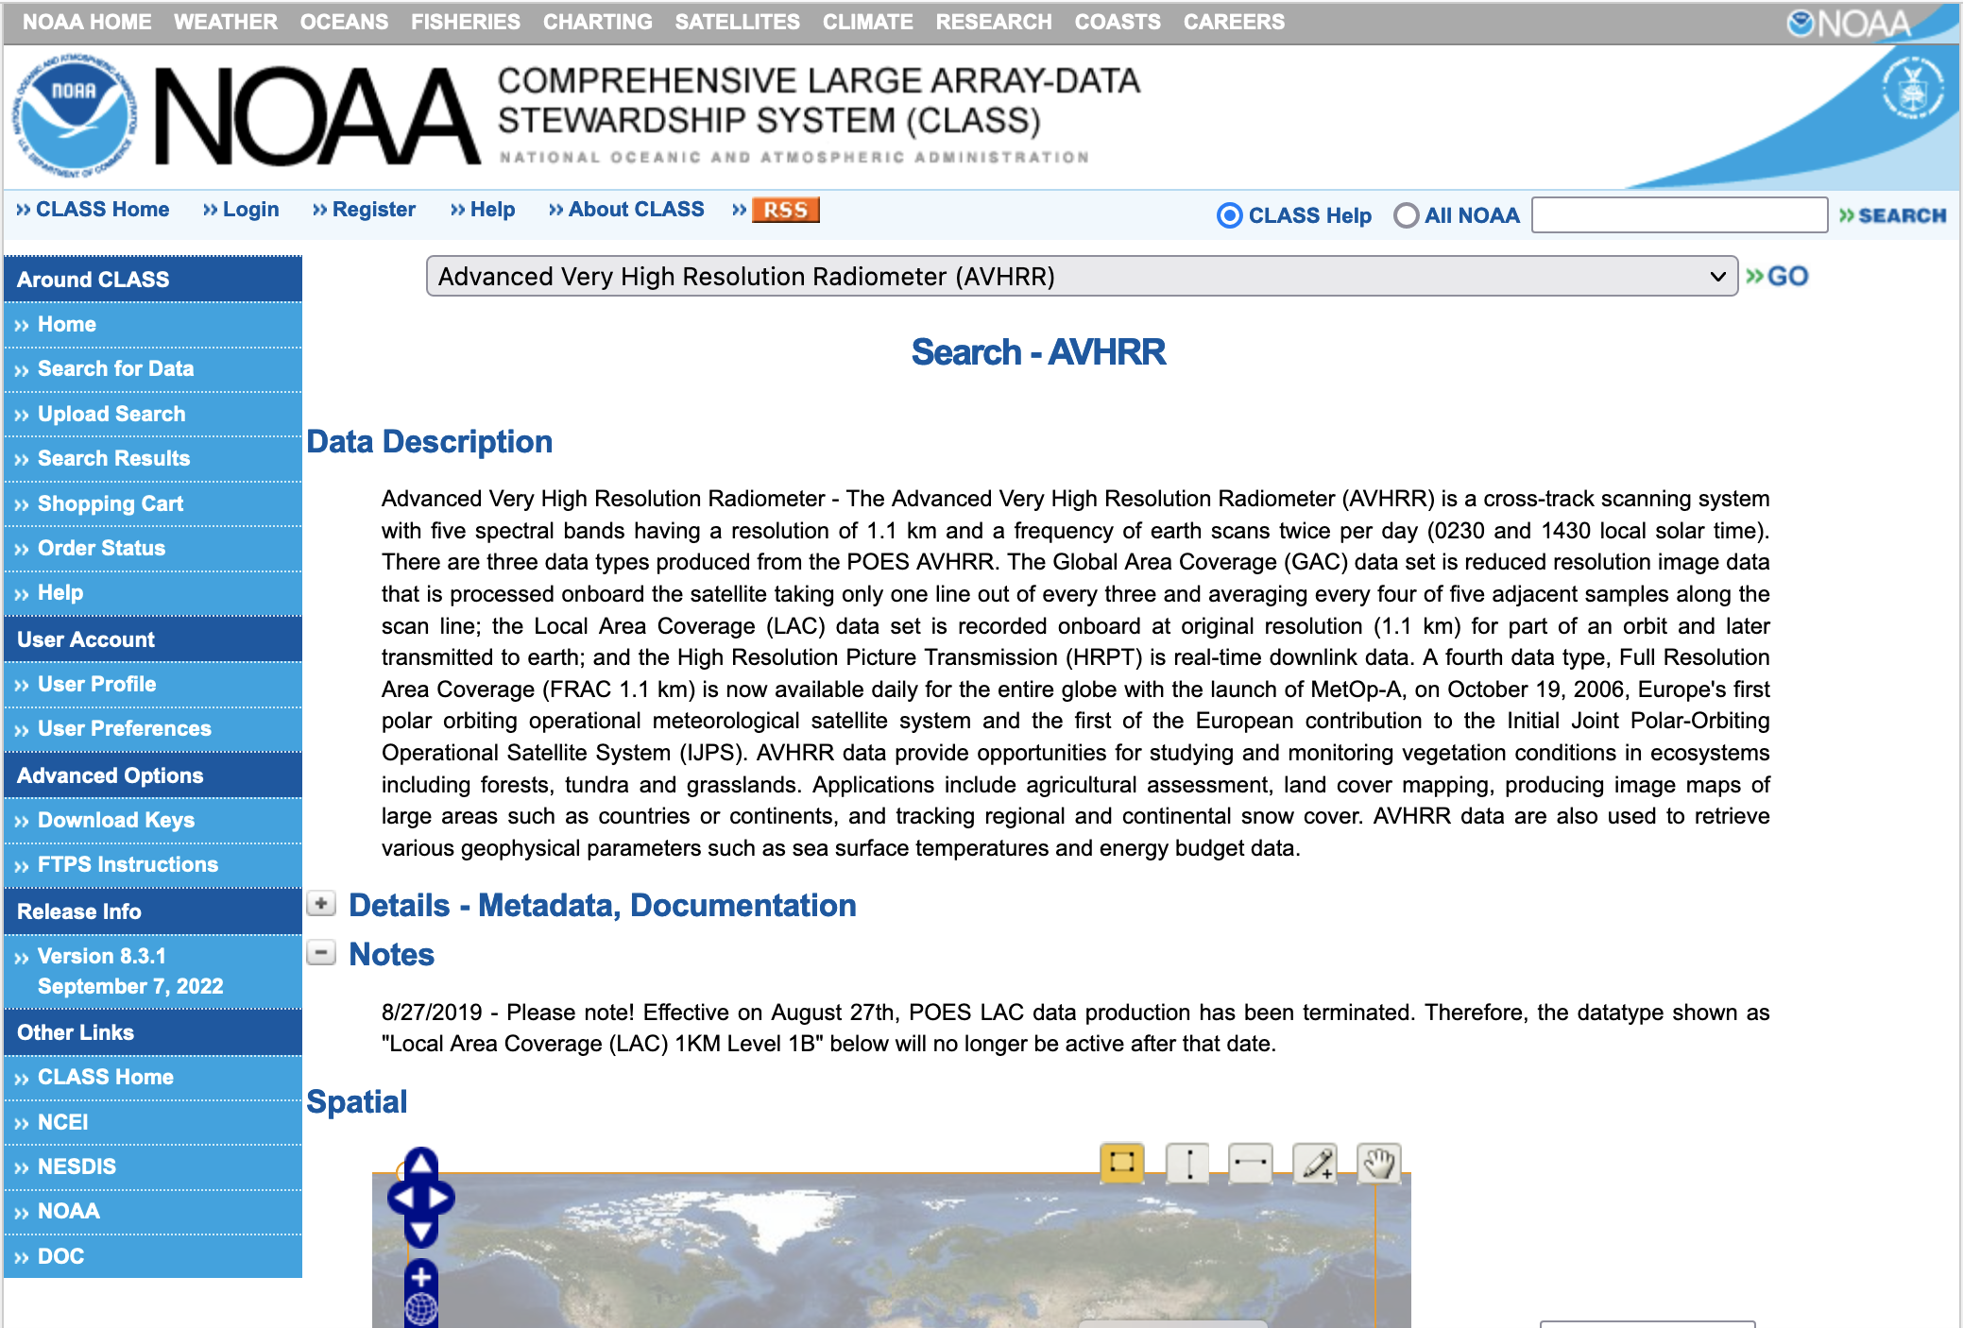
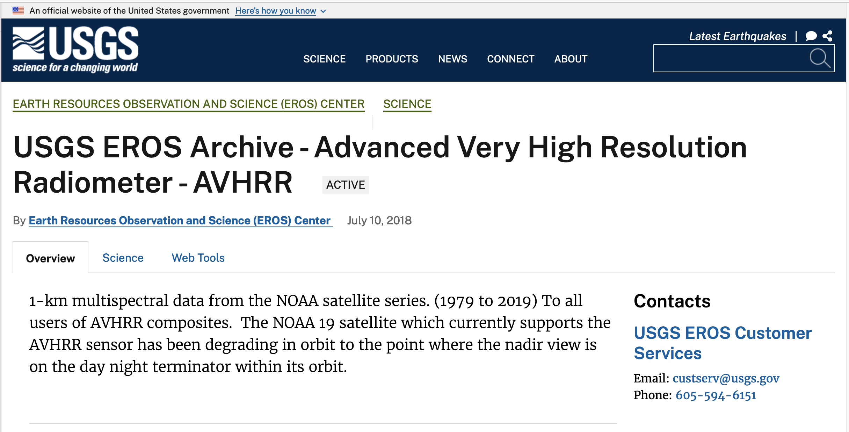
North America 1-km AVHRR archives

Slide 8
AVHRR 1 Km media archives (excerpt)
In addition, several hundred heritage media (optical disks, DLTs) with potential unique AVHRR data are available in different places like for example:
  ESA (Optical Disks)
  University of Reading (Optical Disks)
  University of Rome (DLTs)
  Others to be added

Slide 9
Cooperation Activities on AVHRR
Ongoing activities
Build an inventory of existing national/regional HRPT and LAC data archives:
  Version 1 updated with feedback received from few people: more inputs needed – please help in compiling V2 (expected by end December 2022)
  High Priority Datasets identified (for further action): Africa (SANSA) and (University of Rome / ASI), Australia (CSIRO), South America (GiDyC-Servicio Meteorológico Nacional Argentina): will seek for more info and contact relevant people in these organizations to discuss way forward
Provide AVHRR points of contact and stakeholders with the AVHRR Dataset Consolidation Procedure and Processing Format used in the European consolidation project run at ESA. Collect feedback and discuss possibility to have a common/harmonised format.
  To be started after inventory completion
Identify high priority heritage media to be transcribed and identify transcription approaches/opportunities
  Pilot activity started by ESA with Memnon (Sony Europe) to assess feasibility of transcribing three types of Optical Disks containing unique AVHRR data: successful transcription of the provided samples; full transcription of 300 disks from UK university of Reading plus additional available at ESA will be attempted in 2023.
Check status of Discoverability of AVHRR datasets worldwide and pursue common entry point through WGISS CDA infrastructure
  To be started after inventory completion

Slide 10
Back-up Slides – Initial List of Regional Archives
WGISS
Committee on Earth Observation Satellites

Slide 11
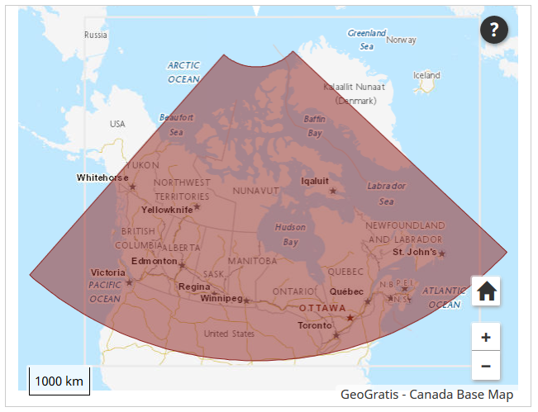
Canada – NRCan/CCMEO
1981 – 2013 (+ AVHRR L1B LAC/HRPT received after that date); level 1c at CCMEO
These are open source data covered by WMO CGMS data distribution policy, they can be shared freely and without charge.
The Canadian sector is of high value to analyze changes of the environment.
The former developed pre-processing and retrieval of ECVs by A. Trishchenko and K.Klopenkov was of high quality and the standard for many other AVHRR processing chains.
Further development and processing was stopped some years ago but raw AVHRR data are available by NRCan.
https://open.canada.ca/data/en/dataset/9045136a-d6e7-a825-491d-ee5dc77a2620

Slide 12
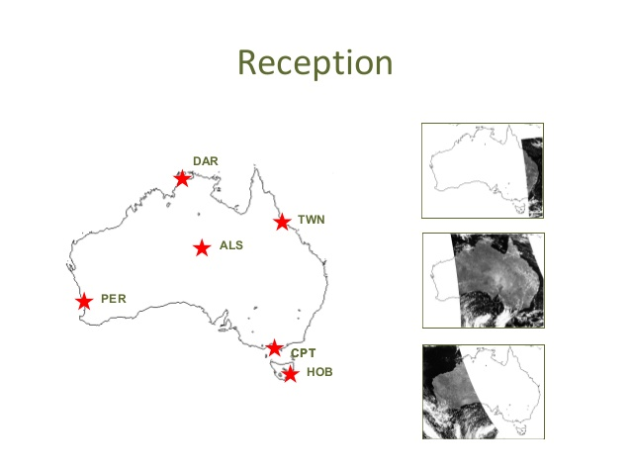
Australia - CSIRO
AVHRR reception based on 6 stations for continuous 1-km data set.
Multiple state and federal agencies have been acquiring the data in this manner with reception stations in Hobart, Melbourne, Perth, Alice Springs, Darwin and Townsville.
Since the early 1990s CSIRO has been merging these separate local data sets to produce a stitched archive which makes use of the redundancy arising from overlap between reception stations to produce a higher quality and consistently formatted data set with national coverage.
The assembly of this data set continues within CSIRO today, though it is likely to come to an end sometime this decade as the last of the AVHRR sensors has now been launched.
Data availability: 1981 (NOAA-7) onwards.
Ian Grant, Bureau of Meteorology, Australia
https://link.fsdf.org.au/dataset/advanced-very-high-resolution-radiometer-avhrr

Slide 13
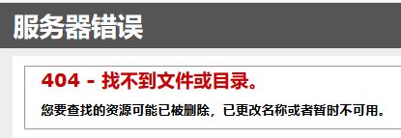
China - CMA
AVHRR-receiving stations for the global 1km land product (coordinated by USGS):
Beijing
Urumqi
Guanzhou
Agency for data access: National Satellite Meteorological Centre (NSMC)
Official contact: dataserver@cma.gov.cn
Searching for “AVHRR” on CMA web site results in
AVHRR 1-km data covering Himalaya-Hindukush of the period 1981 – 1992 would be of exceptional value for scientists to study the influence of climate change in this vulnerable region.

Slide 14
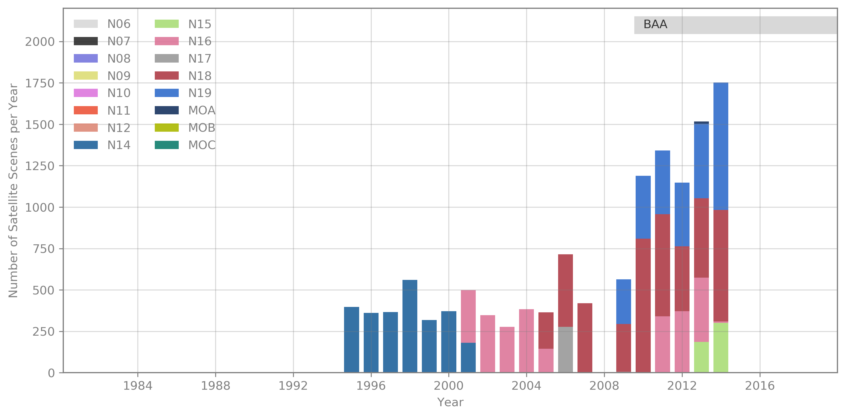
GiDyC-Servicio Meteorológico Nacional, Buenos Aires, Argentina
AVHRR BAA data
Source: Jefa Departamento Teledetección Y Aplicaciones Ambientales, GiDyC-Servicio Meteorológico Nacional, Buenos Aires, Argentina
Number of Scenes: 13.329
Satellites: N12, N14, N15, N16, N17, N18, MOA
Time Period: 1995 - 2014 (1995 - 2000 only evening overpasses)
Extent: roughly Lat=[-30,15] Lon=[-60,-15]
Format: QUO
Further info: BAA station data were included in the Global Land 1km AVHRR Data Project

Slide 15
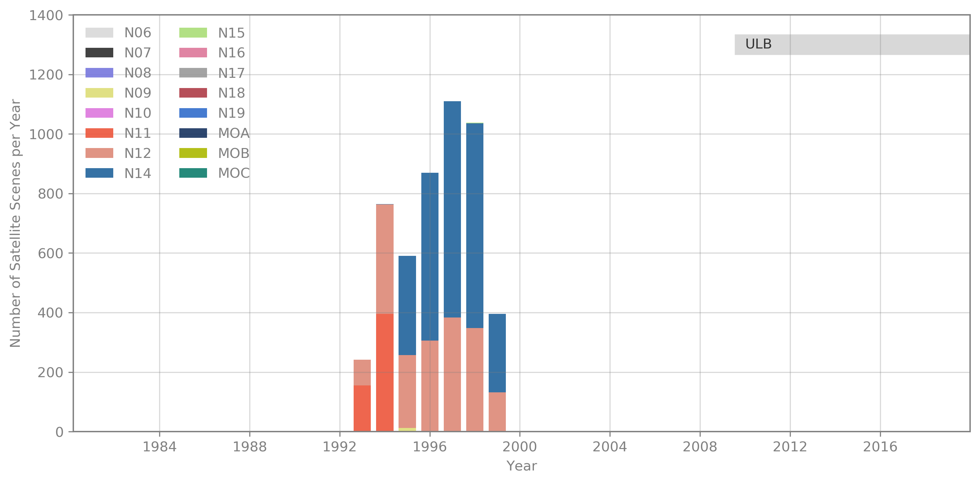
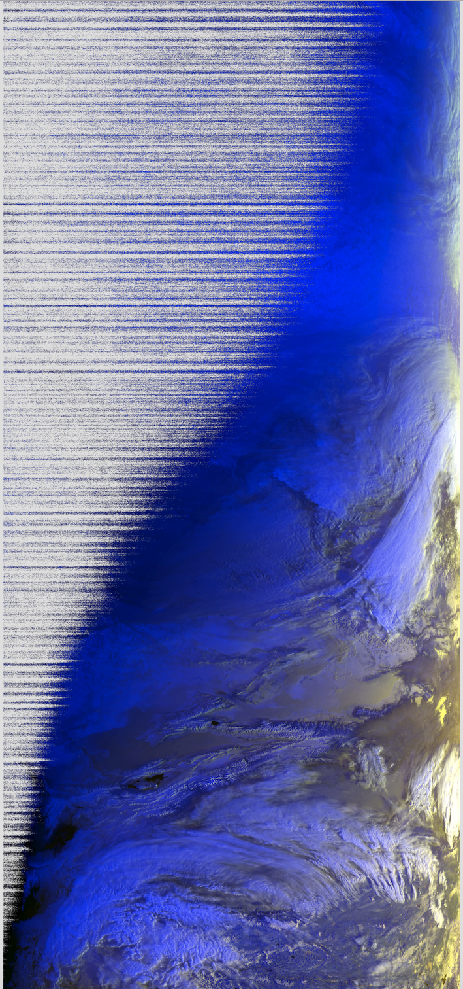
Ulaanbatar, Mongolia
AVHRR UBM data
Source: Remote Sensing Department, Information and Research Institute of Meteorology, Hydrology and Environment, Ulaanbatar, Mongolia
Number of Scenes: 5.016
Satellites: N09, N11, N12, N14, N15
Time Period: 1993 – 1999
Extent: roughly Lat=[20,70] Lon=[80,120]
Format: hmf (origin: dat, grid, lut)
Further info:- UBMx station data were included in the Global Land 1km AVHRR Data Project

Slide 16
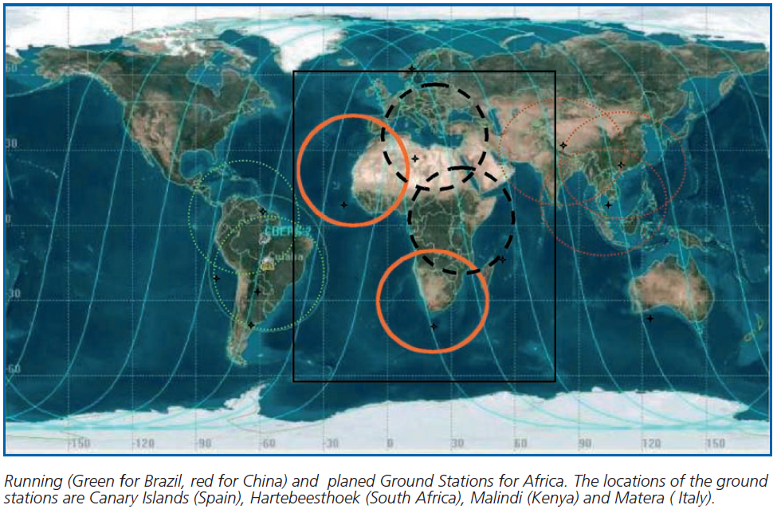
South Africa, Hartebeesthoek
Kenya, Malindi
1km NOAA AVHRR data received at Hartebeesthoek, South Africa (25°53' S 027°42' E)
1985 – 1998 (2003?) maintained by SAC – South African National Space Agency
In combination with Maspalomas, Matera and one station in Kenya can provide full coverage of Africa; yellow circle shows the reception area of La Réunion, which is included in the global AVHRR land data set archived at ESA
High value for climate studies to have access to AVHRR 1-km data from South Africa and one station in Kenya (1981 – 2020) for full coverage of Africa.
Contacts available at SANSA.
Contacts available at University of Rome for data acquired at Malindi Station (Kenya).

