Slide 1
NOAA Agency and Data Preservation Report
Kenneth Casey, PhD, Nancy Ritchey, and Rich Baldwin*
Deputy Chief, Data Stewardship Division
NOAA/NESDIS National Centers for Environmental Information (NCEI)
October 2022
WGISS-54
Tokyo
*With thanks to the NCCF Archive and Access Team, especially Ryan Berkheimer, Jeremy Hall, and John LaRocque

Slide 2
One-Slide Summary
Update on NESDIS Common Cloud Framework (NCCF)
NCCF continues progress since last WGISS update
NESDIS Cloud Archive and Access Team (A&A) delivered working MVP to NCCF Dev tier, now being operationalized (moved through Test tier and to Production tier) with March 2023 target
Virtual Archive Information Packages (vAIP) and Knowledge Graph lay the foundation for enhanced provence and discovery services and open the door to linked open data and open knowledge network capabilities
Updates from NOAA/NESDIS/NCEI
OneStop NOAA Data Catalog go operational again this month
Collection Metadata Editing Tool (CoMET) continues progress with improved documentation, training, and Data Stewardship Maturity Report integration

Slide 3
Update on the NOAA/NESDIS Cloud: Context
(2014-2015) NODC Cloud Pilots: teams from the NOAA National Data Centers worked in AWS to demonstrate serving archived data and generating value-added products
(2015-today) NOAA OneStop and the Mission Data Management System (MDMS): NESDIS then launched the OneStop project at NCEI to unify NOAA data discovery. Concurrently, NCEI worked on the MDMS to unify data management for the NCEI archives. Both built on premise but with cloud implementation in mind
(2017-2018) NESDIS Secure Ingest Gateway Pilot (SIGP): a cloud-based service for securely receiving and ingesting foreign satellite data sources into NESDIS
(2019-2021) NESDIS Cloud Integrated Project Team (IPT): two projects to demonstrate its single enterprise data management and production system in the cloud
(2020-today) NESDIS Common Cloud Framework (NCCF): ongoing efforts to operationalize capabilities, develop new features, migrate products and systems, etc
(2021-today) NESDIS Cloud Archive Program (NCAP) and NCCF Archive and Access (A&A) Team: the effort to first prototype (NCAP) and now operationalize (A&A) and improve the cloud archive implementation in the NCCF
Notes:
Several sets of activities, organic at first, but more organized and planned more recently, have led us to where we are today….

Slide 4
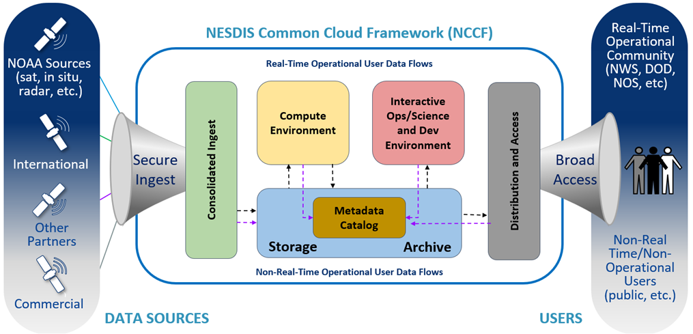
NESDIS Common Cloud Framework (NCCF)
Cloud enterprise architecture with a multi-account and multi-Virtual Private Clouds (VPC) deployment
Secure, fault tolerant, highly available, scalable architecture
Loosely coupled, independently scalable services
Implemented using Infrastructure as Code (IaC)
Reduced failover risk
Allows to minimize vendor lock in
Operationally deployed for high availability workflows in the Amazon Web Services (AWS) commercial cloud
Inclusion of automation to ensure secure deployment of new software and service updates
Notes:
- NESDIS is building the NESDIS Common Cloud Framework, which is a Cloud enterprise architecture that will bring the data, processing, and dissemination into the a common, secure, and scalable architecture.
- There will be loosely coupled, independently scalable service and implemented using infrastructure as code
- The high level concept is shown in this diagram with secure ingest of data and going through consolidated ingest, into storage, metadata management, and archive that is leverage for algorithms in a compute environment as well as science exploration. Finally there is distribution and access of data.
- The NCCF archive and access development is focused on this yellow highlighted box.
- This NCCF service will replace the current on-premise archives, including CLASS and three additional archival storage solutions that NCEI operates

Slide 5
Knowledge Graph (KG) Workflow
“Methods of building a KG take us from raw, messy, and disconnected data/information that is hard to query, analyze, and visualize to a more refined, organized, cleaned, and linked product that is easier to visualize, query, and analyze.” (Baclawski et al., 2020)
https://ontologforum.s3.amazonaws.com/OntologySummit2020/Communique/OntologySummit2020Communique.pdf
Critically, the KG is an integrated component of the archive workflow, not bolted on after the fact. Information and relationships are extracted throughout the workflow, and all these pieces are part of the data model.
Notes:
Underlying this new cloud archive is a new, essential component: a knowledge graph (KG). This diagram from Baclawski et al. (2020) shows a generalized view of how a KG is built. In our KG, we start with data acquisition, then extract features from that data/metadata and align them to concepts and relationships to be stored in the graph. There are many challenges in these processes, but when done well the resulting graph enables a whole new kind of interaction… no longer are we limited by basic free-text and key-value pair type searches (show me datasets where “platform” equals “R/V Knorr”). With a KG, we can move toward knowledge discovery… think of it like a map, that helps you explore new territory and follow your own line of inquiry. Connections that simply do not exist in current systems can be discovered and explored… “oh look, this dataset was funded by the NOAA Coral Reef Conservation Program but it was also used by that application that identifies appropriate placement of offshore wind farms, which means the CRCP indirectly helped support an entirely different segment of the economy.”
One of the key challenges is to accurately and consistently capture the concepts and their relationships…. I say “platform”, you say “ship” or “buoy” or “satellite”. So we must be able to align domain-specific terms to the more generalized concepts and relationships in the KG.
Importantly, the knowledge graph is an integrated component of the archive workflow, it’s not bolted on after the fact. The information and relationships are extracted throughout this workflow, and all these pieces are part of the data model.

Slide 6
Power of a Fully-Integrated KG
Every archive workflow step is tracked and considered “data”, enabling new kinds of searches and interactions
Deep provenance inquiries become possible, enabling scientific reproducibility and transparency
Linkages to other concepts in the KG (and even to other KGs) can be explored and traversed via the “connective” power of the KG
So how do we do this at scale? …
Notes:
- This full integration enables tracking provenance and relating data, standards, processes throughout these steps. Each step in this process is considered data. For example, if I want to search for a particular feature extraction method that might fit my use case I can search across all the ones being used.
- You can also search and see how a particular data set is composed that provides transparency into the data sets and how to recreate those data.
- As a data user you will be able to better discover the data you want, understand the origin of those data, how to use them, and understand how that asset is connected to other assets through the “connective” power of the knowledge graph

Slide 7
Repeatable Process Templates
Ingest
Event Bus (EventBridge)
store
Pre- processor
AIU Workflow
AIC Workflow
AA Workflow
file
graph
Apply Tags
Load Config
Read Message
Read Message
store
store
Transform Data
store
= step function archetype
Archive Data
Compute Membership
Legend
= read
store
= predefined step
Generate AIU
graph
graph
Store Data
= write
Generate AIC Membership
= read/write
= configurable step
graph
graph
Build AIC, AA Messages
graph
Generate Delivery Record
graph = vAIP knowledge graph interaction
Build AIC, AA Messages
store = S3 object storage or database interaction
Build AIC, AA Messages
graph
Notes:
Ensuring the workflows to ingest data and metadata and build the KG are manageable at scale requires the use of repeatable process templates. This slide illustrates the concept of the repeatable, reusable templates… configurable steps, combined with other predefined steps, are managed and executed by the Event Bus (using AWS Eventbridge), allowing us to have a full, repeatable provenance trace for every granule and every collection in the NOAA Cloud Archive. Next to each step (in grey), interactions take place with the KG (“graph”) or persistent storage (“store”, S3 or a database)

Slide 8
Cloud Archive Knowledge Graph
Archival Information Collection
Archival
Information
Unit
As Archival Information Units (AIUs) are processed in the workflow,
information about the AIU and its relationships are stored in the graph.
Policy
Granule Description
hasContext
describedBy
hasMembers
Storage Checksum
Archival Information Unit
Distribution License
File Link
hasFixity
hasAccessRights
File Format
hasData
Granule Packaging
File
packagedAs
hasContent
hasStructure
File Schema
hasSemantics
With thanks to Dave Neufeld: Cooperative Institute for Research in Environmental Sciences
UNIVERSITY OF COLORADO BOULDER and NOAA
Notes:
This slide attempts to visualize the kind of knowledge - concepts and their relationships - that are being stored in the graph. The ones shown link to others not shown, so the whole graph can be thought of as a map that can be explored by moving from one linked relationship to another.

Slide 9
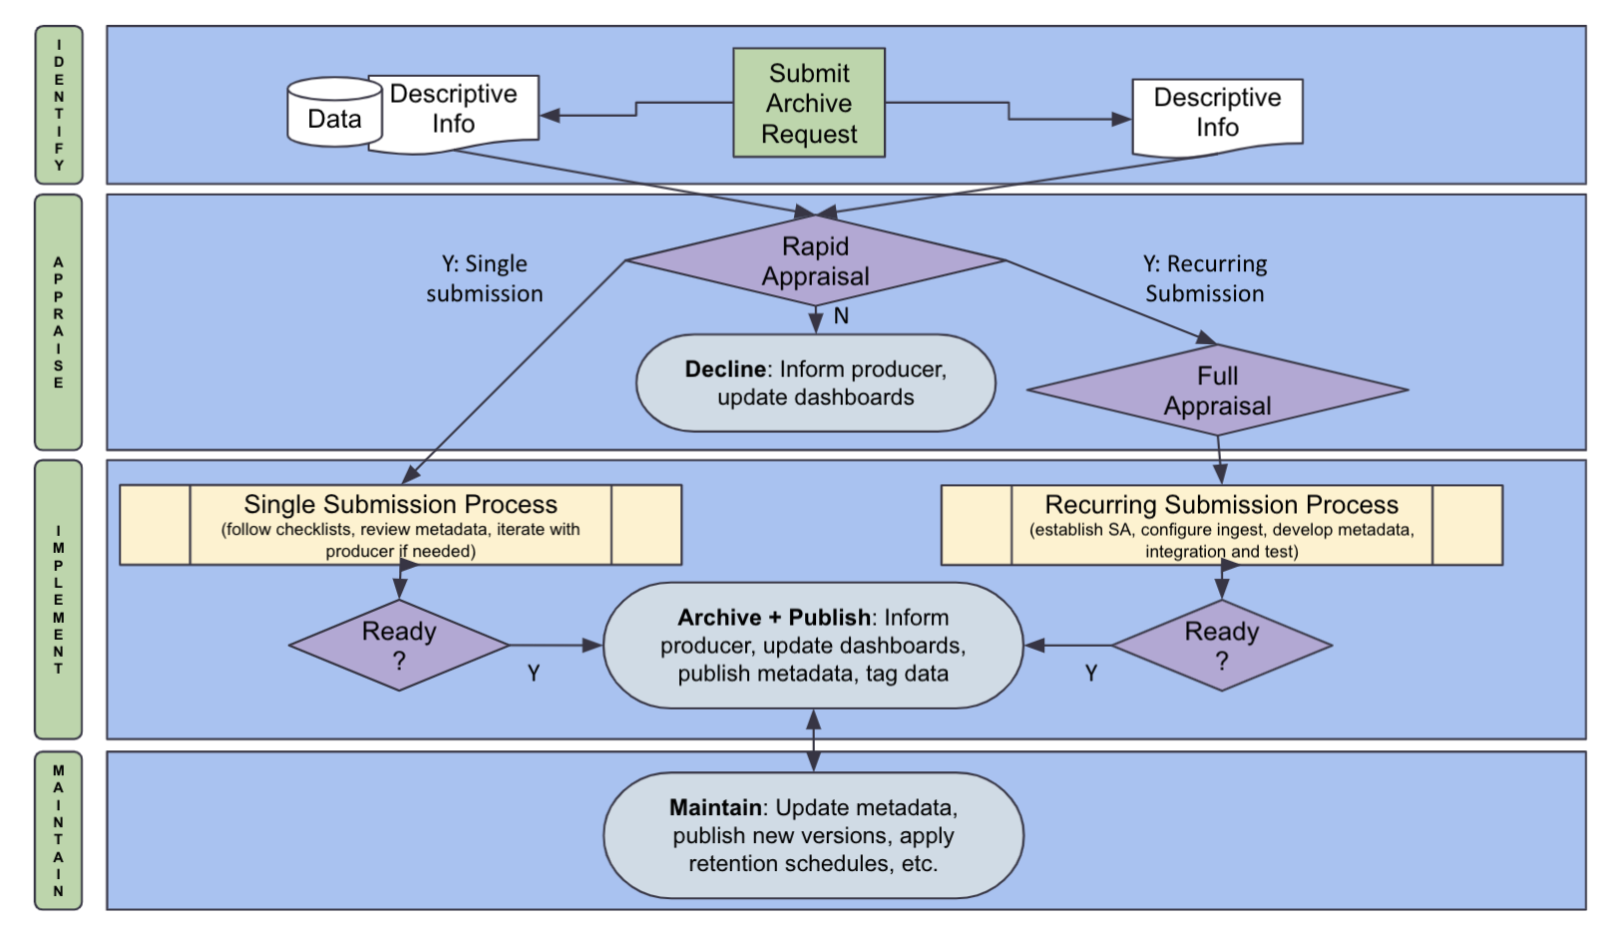
Enterprise Cloud Archive Functionality
Overall Unified Cloud Archive Workflow
Identify
Appraise
Implement
Maintain
Notes:
- So what does the overall cloud archive workflow look like? You can see that we are accommodating both “one-off” Send2NCEI-style single submissions on the left as well as recurring submission on the right, but critically all data will flow through the same steps… going from identifying requests to archive through appraising the requests, to implementing the archive of and access to the data, and then continuously maintaining and curating the data and data flows

Slide 10
Enterprise Cloud Archive Functionality
Initial focus is on the Minimally Viable Product (MVP) for recurring data submissions
Minimum Viable Product (MVP)
Notes:
- There is a lot here, so to start we focused on a minimum viable product (MVP) that handles recurring data, such as data that is arriving routinely from a satellite or radar or other operational observing system.

Slide 11
Enterprise Cloud Archive Functionality
Single Request Portal
Single Data Submissions
Appraisal and Ingest Configuration
Mature Metadata Management Tools
Implement Enterprise Public Discovery and Access Capabilities
Minimum Viable Product (MVP)
Notes:
- And as you can see here, after the MVP we have a number of other components to develop… very excited to get this MVP into operations but lots more to do!

Slide 12
Cloud Archive Timeline
PI2 | PI3 | PI4 | PI5 | PI6 | PI7 | PI8 | PI9 | PI10 | PI11 | PI12 | PI13 | PI14 | PI15 | PI16 | PI17 | PI18 | PI19 | PI20 | PI21 | PI22 | PI23 | PI24 | PI25 | PI26 | PI27 | PI28 | PI29
2021 | 2022 | 2023 | 2024 | 2025 | 2026 | 2027
IOC
Enterprise Archive Capability
Sustainment of Archive / Access Enterprise Functionality
NCCF Archive
IOC
NCCF Enterprise, Archive,
and Stewardship Development
NCCF Enterprise Archive, and Stewardship and Iterative Optimization Releases
Connection/Development of Functionality of Existing Archive Systems
Key Accomplishments / Insights
Transition from pilot to NCCF in progress
NCAP - Piloted archive capability in NCCF within 12 months
Initial Operational Capability for Archive end of Q2FY23
Migration of Legacy Data Streams from Existing Archive Systems
Notes:
- Right now we are focused on deploying that MVP as an initial operating capability by next March (March of 2023). From there we will continue development of the archive functionality while starting to migrate data into the workflow, leveraging the migration to inform the development of the enterprise archive and access functionality.
- While the full migration is expected to be complete about 2027, the ability to access data from the Cloud archive and leverage the technology will be available incrementally as we migrate data into the Cloud.

Slide 13
Activities at NCEI
Scaled Agile Framework (SAFe) implementation of an Agile Release Train (ART), focused on sustaining our on-premise enterprise archive systems and data ingest until we migrate to the cloud is going extremely well… exceeded 80% target every program increment
OneStop-Inventory Manager V3 going operational again this month (public updates have been on hold for last couple years)
Re-enables the official NOAA Data Catalog
CoMET updates continue…
CoMET = Collection Metadata Editing Tool

Slide 14
Activities at NCEI: CoMET
CoMET User Guide and Documentation Updated
Application Programming Interface (API) Trainings Held
Bulk automation and flexible workflow
Data Stewardship Maturity Report (DSMR) integrated
Allows for output of a compliant PDF document for submission to NOAA Central Library (with cross-referencing and DOI)
Timeframe for public availability still being determined
Login.gov is the highly-likely solution to be implemented
Login.gov recently incorporated into NCEI’s Send2NCEI (S2N) system and has been selected for cloud applications as well
CoMET = Collection Metadata Editing Tool

Slide 15
Questions?

