Slide 1
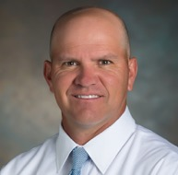
CEOS Systems Engineering Office (SEO) Report
Brian Killough, NASA, CEOS SEO
Agenda ID: 2022.10.04_10.20
WGISS-54
Tokyo, Japan (JAXA)
3-7 October 2022

Slide 2
Cloud Computing Prototypes
The SEO has been testing several cloud computing frameworks to understand CEOS data access and technology capabilities. These cloud frameworks use our data!
Google – we use the Google Cloud (paid compute environment), Colab (free notebook platform, but limited) and Earth Engine (free satellite datasets).
Amazon – we use the AWS Cloud (paid compute environment), SageMaker (free notebook platform, but limited), and the AWS Open Data Catalog (free satellite datasets).
Sentinel Hub – we are working with Sinergise to test ODC integration with the Sentinel Hub via CreoDIAS (European cloud provider).
Microsoft – we have just started testing with the Microsoft Azure Cloud (paid compute environment), Azure Labs (free notebook platform, but limited) and the Planetary Computer Data Catalog (free satellite datasets).
Slide 2

Slide 3
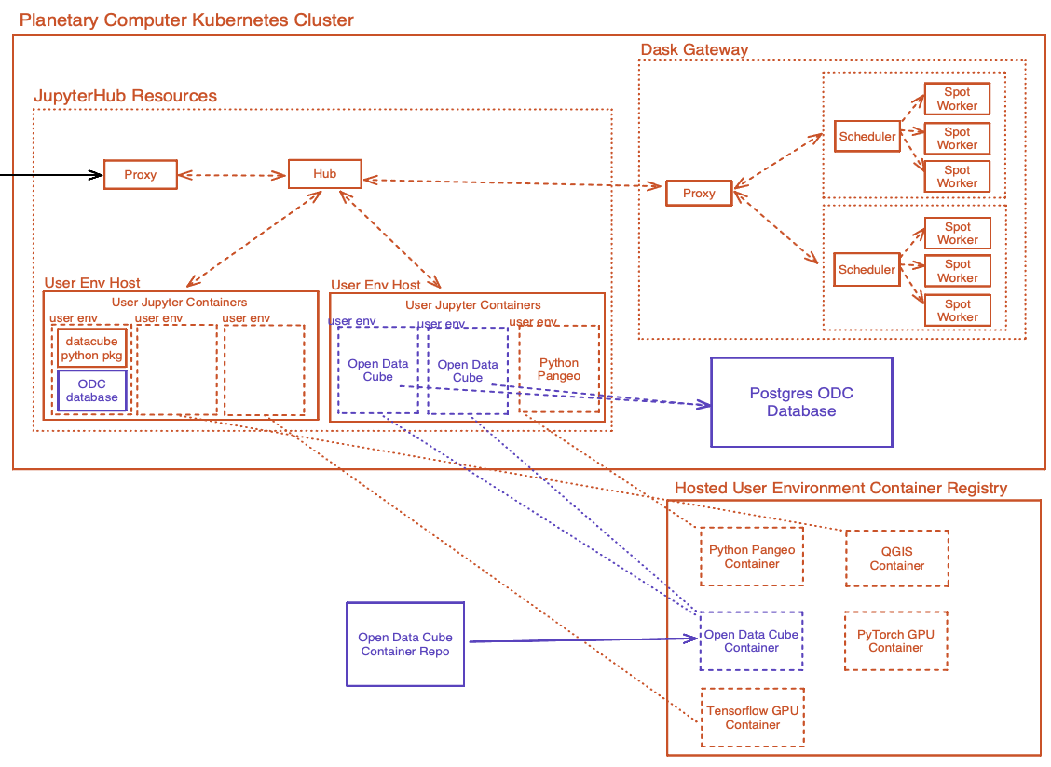
Open Earth Alliance (OEA)
The Open Earth Alliance (OEA) is a new GEO Community Activity created in 2021 by the ODC Founding Partners to expand the impact of ODC, support the concept of regional data cubes, and explore new open source data solutions and technologies.
The SEO and CSIRO have been the primary contributors to this initiative.
The OEA received $60,000 in Microsoft Azure credits via a GEO award in 2022. This has supported testing and integration of ODC using Jupyter Hub (notebook server) and Dask (parallel processing). We are also testing Kubernetes containers for efficient deployments.
The initial results are very promising as these solutions are 100% open source and provide scaleable data science solutions.
Data Science and GIS are merging !!!
Slide 3

Slide 4
Regional Data Cubes
Digital Earth Africa – The SEO led the deployment and testing of the African Regional Data Cube in 2018. The success of this prototype led to a fully funded DE-Africa. Leadership has now completely transitioned to Africa (SANSA). The SEO still represents CEOS on the Steering Group.
Digital Earth Pacific – The SEO has worked with the Pacific Community (SPC, formerly the South Pacific Commission) to guide the initial prototype and conduct user needs meetings. SPC is now working on securing funding. The SEO represents CEOS on the Steering Group.
Digital Earth Americas – The SEO is working with CSIRO (Chile) and INEGI (Mexico) to explore opportunities toward a future DE-Americas. To date, we have conducted several workshops in the region and explored user needs. These workshops have involved several regional stakeholders (e.g., AmeriGEO, ECLAC). A future Caribbean initiative funded by Mexico is likely the next opportunity to build awareness and explore needs.
Slide 4

Slide 5
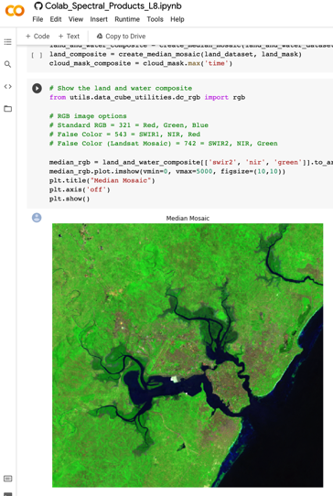
ODC Sandbox Testing
The Open Data Cube (ODC) Sandbox now has 19 applications in GitHub. This open source tool is a great example of “open science” and has gained significant popularity as an educational and research tool.
The SEO worked with Digital Earth Africa to develop many of their ODC applications and tools. They recently released 100+ application notebooks online focused on satellite datasets, real-world examples and SDGs. This is a fantastic resource for global users!
The SEO is planning to participate in several webinars to promote open science and use of CEOS satellite data. These include WGCapD “Jupyter Notebook Day” in late October and the GEO Knowledge Hub (future 3-part webinar series). Each event will use the ODC Sandbox.
https://www.openearthalliance.org/sandbox
Slide 5

Slide 6
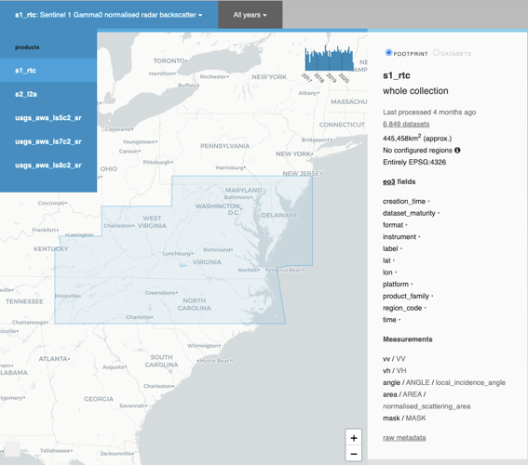
EAIL Progress
The Earth Analytics Interoperability Lab (EAIL) continues to operate and support CEOS projects. 17 data product pipelines are available (Landsat 5-9 Surface Reflectance and Temps, Sentinel-1-RTC, Sentinel-2, and DEM (NASA, Copernicus).
Jonathan Hodge (CSIRO-Chile) is the primary lead and architect of EAIL with some support from the SEO.
EAIL operates on the Amazon Cloud using Open Data Cube and supports Dask scaling for larger analyses.
The EAIL is currently supporting data and algorithm testing for several CEOS initiatives ... COAST (in progress) and WGCV (in early planning to support Cal-Val campaigns).
Slide 6

