Slide 1
WGISS Chair Report
Dr. Makoto NATSUISAKA, JAXA
Agenda ID: 2022.10.04_10.00
WGISS-54
Tokyo, Japan (JAXA)
3-7 October 2022

Slide 2
Major Events after WGISS-53
All CEOS
SIT37 (March 29th - 31st, 2022)
SIT-TW (Sep.13-15)
CEOS SEC meetings
CEOS deliverable update toward SIT-TW and Plenary
CEOS ARD Oversight Group
CEOS Ocean Coordination Group
LSI-VC Lead
CEOS Interoperability Framework
CEOS Engagement with Standard Organizations
LSI-VC-12 (Sep. 9th)

Slide 3
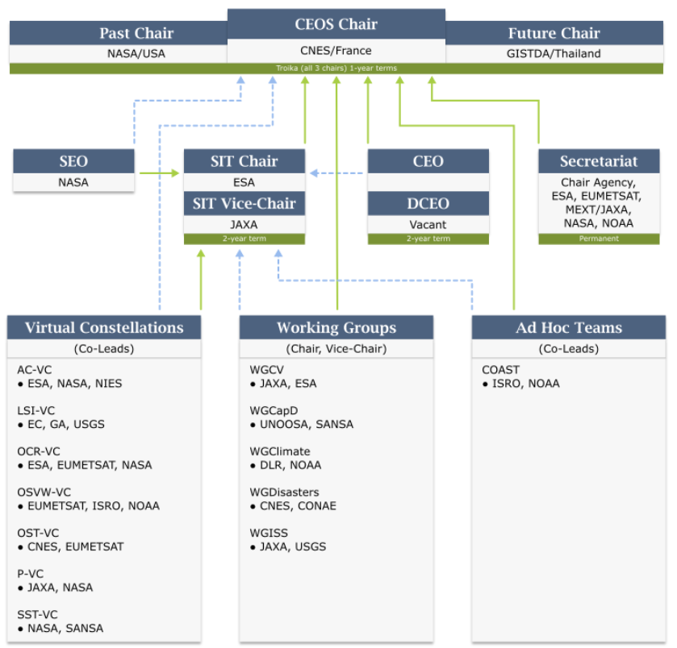
CEOS Activities
Chair CNES initiative “Paths to Sustainability: from strategy to practical measures Version 1.0 – 25 October 2021” in response to the Paris Climate Agreement, the Sendai Framework for Disaster Risk Reduction, and the 2030 Agenda for Sustainable Development.
The engagement with the International Methane Emissions Observatory (IMEO) launched at the G20 Summit is a data-driven, action-focused initiative by the UN Environment Programme (UNEP) with support from the European Commission is one of the new topics. https://www.unep.org/explore-topics/energy/what-we-do/imeo
Cooperation with “New Space” is also one of the new topics.

Slide 4
CEOS ARD Oversight Group
Identified as a core component of the future CEOS ARD Governance Framework.
Act as a forum for all matters related to CEOS ARD.
Representatives from the CEOS Virtual Constellations are integral to the effort going forward, as these are the CEOS entities with the technical expertise to recommend, develop and maintain Product Family Specifications.
Also provide:
Strong coordination across CEOS
Promote CEOS ARD in a unified way

Slide 5
CEOS Ocean Coordination Group
CEOS Ocean Coordination Group is a task force led by SIT Chair to coordinate CEOS ocean-related activities and clarify CEOS contribution to UN Ocean Decade.
COAST expects the EAIL continuity and has an interest AI/ML. -> Presentation from COAST

Slide 6
Cooperation with Other Entities
CEOS ARD Oversight Group … CEOS SIT
CEOS Ocean Coordination Group … CEOS SIT
CEOS Interoperability Framework … LSI-VC -> joint session
CEOS Engagement with Standard Organizations … LSI-VC -> joint session
EAIL initiative … SEO, WGDisaster (Flood Pilot Project), WGCV (DEMIX), COAST, Rice Monitoring Community -> Interoperability Data and Use
Jupyter Notebook initiative … SEO, WGCapD -> TechExpo
Common DSMM … WGCV, CGMS group IV -> DSG session
Common On-line Dictionary … WGCV -> joint session
ISO TC211/OGC -> liaison report

Slide 7
Highlights of WGISS-54
CEOS Interoperability Framework -> joint session
CEOS Engagement with Standard Organizations -> joint session
A task force which consists of LSI-VC, WGCV, SEO, etc.. is now preparing ToR and will submit it to the CEOS plenary to be held in November.
Slide 7

Slide 8
Highlights of WGISS-54
Review WGISS Organizational Structure -> Need Update
Review WGISS ToR -> Need Update
Rebuild Data Interoperability and Use Interest Group -> Need Update
WGISS Contributions to the CEOS Interoperability Framework and CEOS Engagement with Standards Organizations initiatives -> joint session
WGISS Vice-Chair Solicitation -> Plenary
Date for WGISS-55 -> Plenary
Location of WGISS-56 -> Plenary
Slide 8

Slide 9
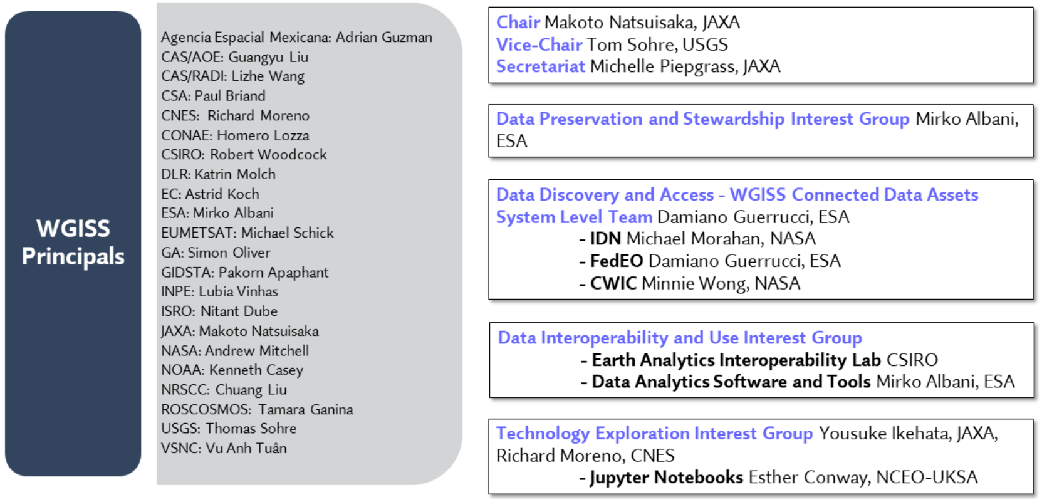
Organizational Structure & ToR
WGISS TOR … https://ceos.org/ourwork/workinggroups/wgiss/
What can WGISS do for CEOS agencies and Data Providers …
https://ceos.org/what-can-wgiss-do-for-ceos-agencies-and-data-providers-2/
Slide 9

