Slide 1
Welcome and JAXA EO Program
Dr. Riko OKI, JAXA
Agenda ID: 2022.10.04_09.45
WGISS-54
Tokyo, Japan (JAXA)
3-7 October 2022

Slide 2
Welcome
Welcome to Japan!
Welcome back to the in-person meeting!
We celebrate in person meetings as 54th WGISS, and 6th WGCV-WGISS joint meetings!
Slide 2

Slide 3
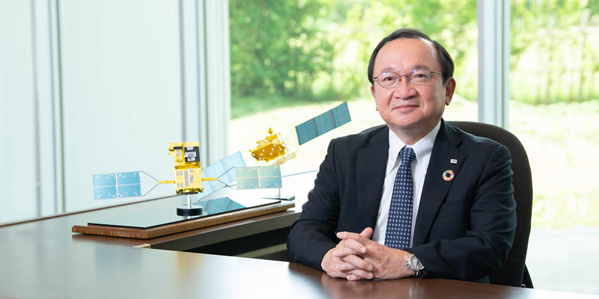
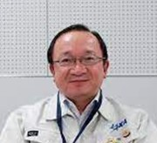
JAXA EO Program - Direction
HIRABAYASHI Takeshi, Senior Chief Officer of Earth Observation Missions,
Space Technology Directorate I
CEOS JAXA principal
GCOM Project
EarthCARE/CPR Project
GOSAT-2 Project
ALOS-3 Project
ALOS-4 Project
GOSAT-GW Project
EORC
Research
Calibration and Validation
OKI Riko, Director
Earth Observation Research Center
KUZE Akihiko
CEOS WGCV Chair (2021-2022)
SAOC
Satellite Operation
Dara Production and Distribution
HIRABAYASHI Takeshi, Director
Satellite Applications and Operations Center
NATSUISAKA Makoto
CEOS WGISS Chair (2022-2023)

Slide 4
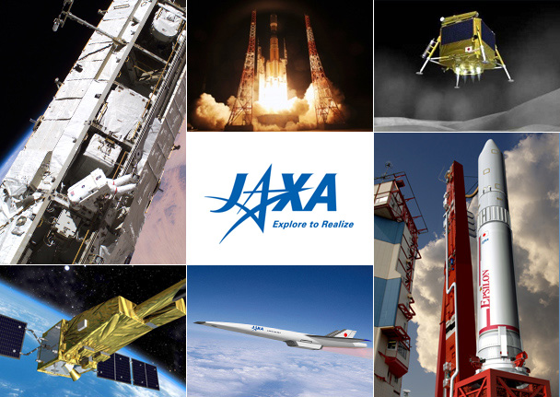
JAXA Organization
The Japan Aerospace Exploration Agency (JAXA) was born through the merger of three institutions, namely the Institute of Space and Astronautical Science (ISAS), the National Aerospace Laboratory of Japan (NAL) and the National Space Development Agency of Japan (NASDA). It was designated as a core performance agency to support the Japanese government's overall aerospace development and utilization. JAXA, therefore, can conduct integrated operations from basic research and development, to utilization.
In 2013, to commemorate the 10th anniversary of its founding, JAXA created the corporate slogan, "Explore to Realize," which reflects its management philosophy of utilizing space and the sky to achieve a safe and affluent society.
Slide 4

Slide 5
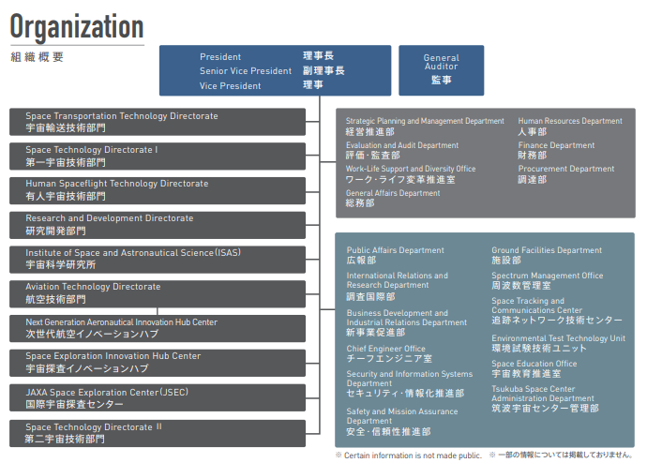
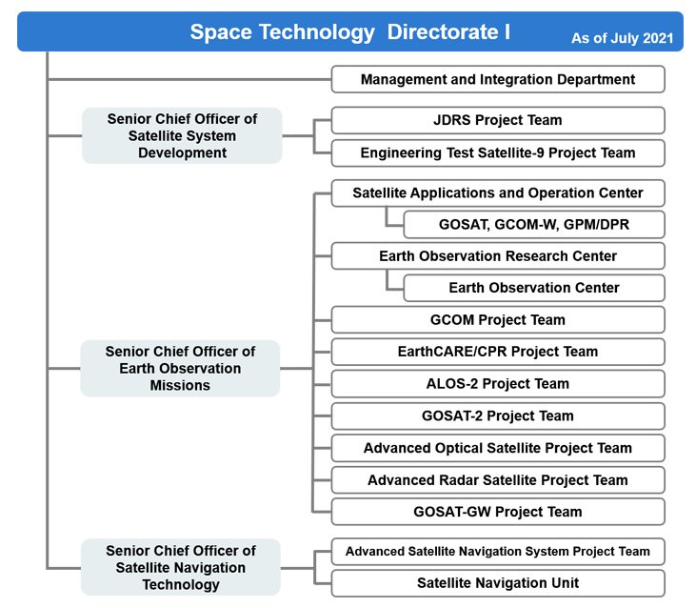
JAXA Organization
https://global.jaxa.jp/activity/pr/brochure/files/general_202207.pdf
Slide 5

Slide 6
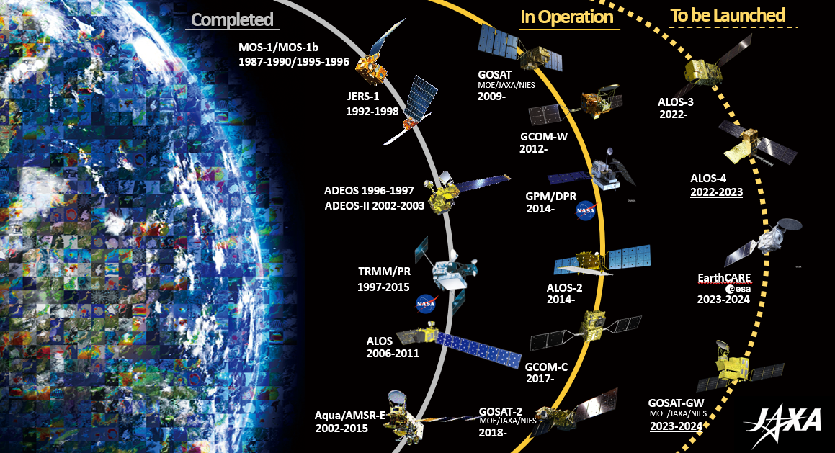
JAXA EO Satellites and Sensors

Slide 7
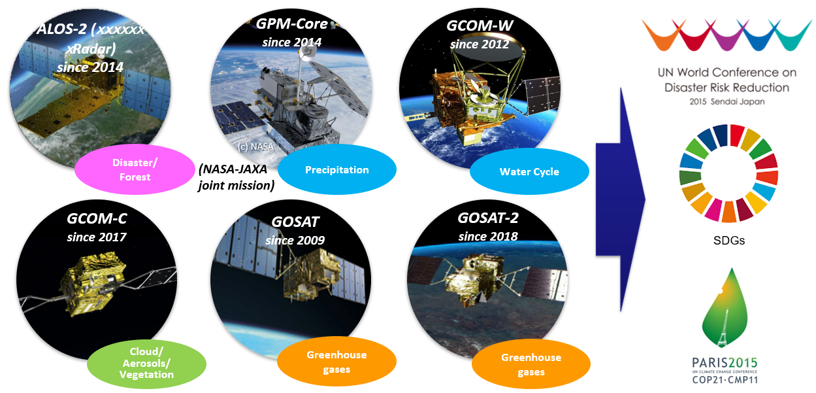
Challenges ＆Goals
Slide 7

Slide 8
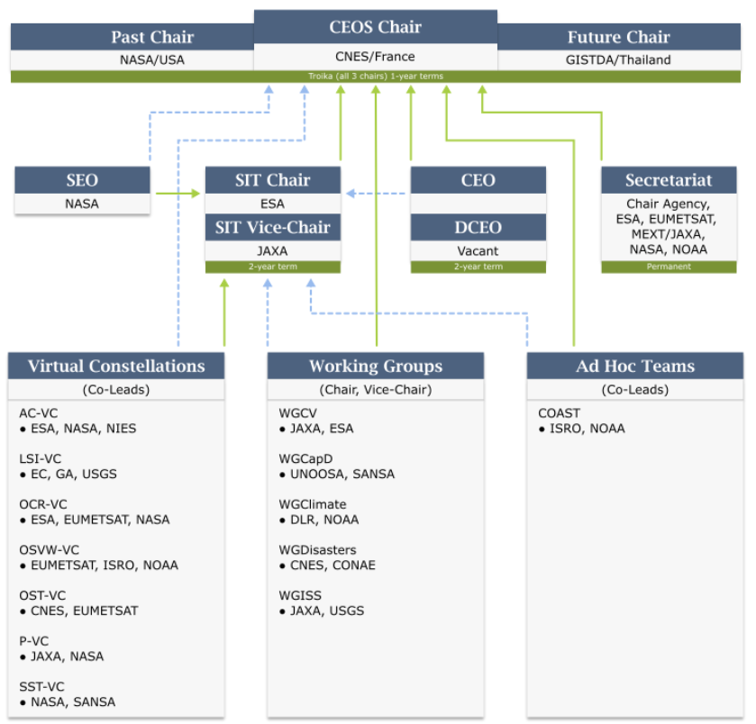
JAXA CEOS engagements
CEOS is one of the most important partner for the JAXA EO Program.
JAXA members are currently participating in 8 CEOS entities.
The activities in WGISS and WGCV are inevitable to realize “interoperability” of satellite data.
JAXA Participation
Slide 8

Slide 9
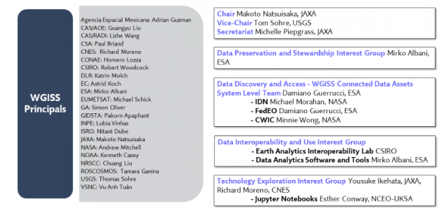
WGISS activities
Slide 9

Slide 10
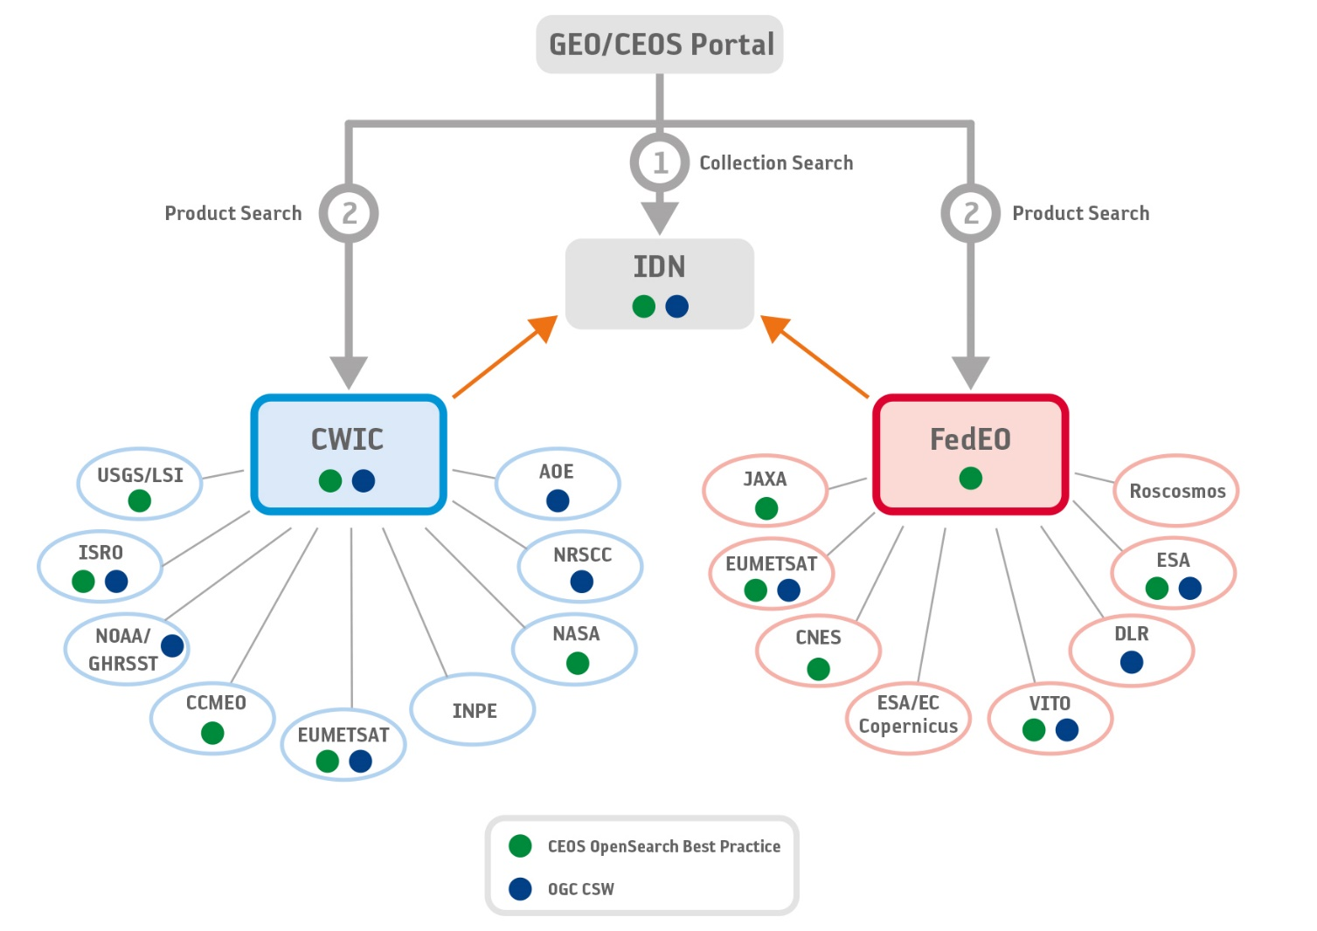
Benefits from WGISS activities
Owing to the WGISS activities, JAXA gets various benefits.
WGISS Data Connected Asset
CEOS Opensearch
DOI
Data in the cloud and STAC
AI/ML
Jupyter Notebook
Slide 10

Slide 11
Highlights of WGISS-54
6th WGISS/WGCV joint meeting
CEOS Interoperability Framework
CEOS Engagement with Standard Organizations
Slide 11

