Slide 1
NOAA Agency Report
Kenneth Casey, PhD
Deputy Director, Data Stewardship Division
NOAA/NESDIS National Centers for Environmental Information (NCEI)
March 2022
WGISS-53
Virtual

Slide 2
One-Slide Summary
As part of changes across the US Federal Government, NOAA is substantially revising its data governance
  New “Assistant Chief Data Officers” from all components of NOAA supporting Chief Data Officer
  “Environmental Data Management Committee” evolving to the “NOAA Data Governance Committee”
  Scope now includes all NOAA data (business, administrative, financial, etc) not just environmental
Update on NESDIS Common Cloud Framework (NCCF)
  NCCF continues progress
  NESDIS Cloud Archive Program integrated into NCCF and on track for late 2022 initial operating capability
  New knowledge graph supports the emerging Cloud Archive
Updates from NCEI
  OneStop NOAA Data Catalog update to V3 in May-June time frame
  Collection Metadata Editing Tool (CoMET) continues progress, integrating Data Stewardship Maturity tools
Notes:
US Federal Data Strategy: The Federal Data Strategy (FDS) encompasses a 10-year vision for how the Federal Government will accelerate the use of data to deliver on mission, serve the public, and steward resources while protecting security, privacy, and confidentiality.
The NOAA Data Strategy Consists of Five Goals:
Goal 1: Align data management leadership roles across the organization.
Goal 2: Govern and manage data strategically to most effectively steward the US taxpayers’ investment.
Goal 3: Share data as openly and widely as possible to promote maximum utilization of NOAA data.
Goal 4: Promote data innovation and quality improvements to facilitate science and support data-driven decision making.
Goal 5: Engage stakeholders and leverage partnerships to maximize the value of NOAA data to the Nation.

Slide 3
New Data Governance at NOAA
Updates to data governance across US Federal agencies as a result of the Evidence Act and the Federal Data Strategy
Current NOAA data governance approach is out of date and not in alignment with the importance of data to NOAA’s mission
Data governance is being expanded to include all of NOAA’s data, not just environmental data
Since 2009, the Environmental Data Management Committee (EDMC) has implemented Procedural Directives to manage the environmental data, but the EDMC is evolving into the NOAA Data Governance Committee (DGC) and will have within its scope all NOAA data
Notes:
The current NOAA data governance approach is out of date and not in alignment with the importance of data to NOAA’s mission. There is a pressing need to expand the scope of data governance in the organization to include all NOAA data, not just the environmental portfolio. A federated governance structure through Assistant Chief Data Officers (ACDO) is required in the line and staff/corporate offices to ensure the policies and best practices are supporting the NOAA mission, taking advantage of new technology and policy advances, and enhancing the access and democratization of NOAA’s critical data holdings
The current NOAA data governance body is the Environmental Data Management Committee (EDMC). The EDMC was formed in 2009 from a formal charge by the NOAA CIO and NOAA Observing Systems Councils (NOSC). NOAA Administrative Order (NAO) 212-15, last updated in 2010, establishes NOAA’s Environmental Data Management Policy and gives the EDMC authority to develop and approve Procedural Directives relevant to management of environmental data. It has been a dozen years since there has been a substantial update to NOAA’s data governance approach. Requirements for NOAA within the Evidence Act and the Federal Data Strategy, among others, necessitate meaningful change in agency data governance, however, a consistent framework for data governance across NOAA is much more than just a compliance exercise.

Slide 4




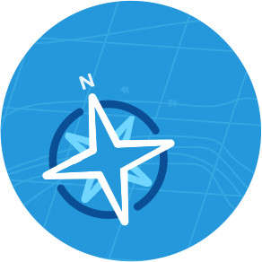


Assistant Chief Data Officers (ACDOs)
New Data Governance at NOAA
ACDO Recommendation:
Full-time ACDO in each NOAA line office
Lead for data governance and NOAA Data Strategy implementation
Report directly to a senior official
Principal Member on the NOAA Data Governance Committee
NOAA DGC:
Governance and Policy
Data Lifecycle Management Coordination & Integration
Stakeholder Engagement and Collaboration
Workforce Capabilities, Capacity, and Innovation
NMFS
ACDO
NOS
ACDO
NESDIS
ACDO
NWS
ACDO
NOAA
Data Governance Committee
NOAA
CDO
OAR
ACDO
SO/CO
ACDO
OMAO
ACDO
Notes:
CDO = Chief Data Officer, ACDO = Assistant Chief Data Officer
NESDIS = National Environmental Satellite, Data, and Information Service; NMFS = National Marine Fisheries Service; NOS = National Ocean Service; NWS = National Weather Service; OAR = Oceanic and Atmospheric Research; OMAO = Office of Marine and Aviation Operations; SO/CO = Staff Office/Corporate Offices

Slide 5
Update on the NOAA/NESDIS Cloud: Context
(2014-2015) NODC Cloud Pilots: teams from the NOAA National Data Centers worked in AWS to demonstrate serving archived data and generating value-added products
(2015-today) NOAA OneStop and the Mission Data Management System (MDMS): NESDIS then launched the OneStop project at NCEI to unify NOAA data discovery. Concurrently, NCEI worked on the MDMS to unify data management for the NCEI archives. Both built on premise but with cloud implementation in mind
(2017-2018) NESDIS Secure Ingest Gateway Pilot (SIGP): a cloud-based service for securely receiving and ingesting foreign satellite data sources into NESDIS
(2019-2021) NESDIS Cloud Integrated Project Team (IPT): two projects to demonstrate its single enterprise data management and production system in the cloud
(2020-today) NESDIS Common Cloud Framework (NCCF): ongoing efforts to operationalize capabilities, develop new features, migrate products and systems, etc
(2021-today) NESDIS Cloud Archive Program (NCAP): the effort to first prototype and now operationalize and iteratively improve the cloud archive implementation in the NCCF
Notes:
Several sets of activities, organic at first, but more organized and planned more recently, have led us to where we are today….

Slide 6





NESDIS Cloud Portfolio Vision
NESDIS Common Cloud Framework (NCCF)
Real-Time Operational Community (NWS, DOD, NOS, etc)
NOAA Sources (sat, in situ,
radar, etc.)
Real-Time Operational User Data Flows
Compute Environment
Interactive Ops/Science and Dev Environment
Consolidated Ingest
Distribution and Access
International
Secure Ingest
Broad Access
Metadata Catalog
Other Partners
Storage
Archive
Non-Real Time/Non- Operational Users
(public, etc.)
Non-Real-Time Operational User Data Flows
NCAP focused on Storage, Archive, & Distribution and Access Services of the NCCF and will utilize the other components like Consolidated Ingest
Commercial
DATA SOURCES
USERS
Notes:
This is the vision for the NCCF, capable of ingesting data from all sources, managing those data in the cloud via a set of framework services, and then making the data accessible to our whole spectrum of users.

Slide 7
Where do we stand today?
NCCF
Operational cloud ingest, compute, and product generation in a high-security, high-availability environment in AWS
Numerous activities to migrate legacy operational data ingest and product generation
NCAP
Finalized prototype for all cloud archive MVP Features
Added prioritized features to support completeness
Hardened the prioritized features to prepare the MVP for transition to operations in the NCCF
Experimented with NASA CMR
CMR = Common Metadata Repository
MVP = Minimally Viable Product
Notes:
Here is where we stand today in realizing that NCCF vision. NCAP is coordinating with NCCF, and is currently

Slide 8
Where will we stand next week (literally)?
NCCF
Operational cloud ingest, compute, and product generation in a high-security, high-availability environment in AWS
Numerous activities to migrate legacy operational data ingest and product generation
Integrated NCAP as new “NCCF Archive and Access Team”
  Establishes cloud archive as a clear, foundational element of the NESDIS Common Cloud Framework
Initializing 3-month program increment to begin operationalization of initial cloud archive capability (with goal to reach IOC this fall)
IOC = Initial Operating Capability
Notes:
Here is where we stand today in realizing that NCCF vision.

Slide 9
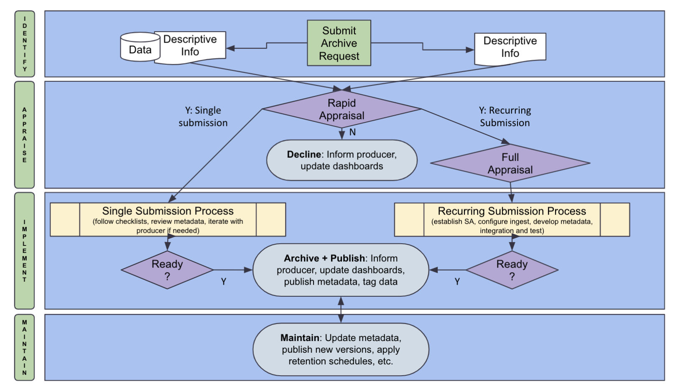
Consolidated Cloud Archive Workflow
I
DENT
I
FY
Data
Descriptive Info
Submit Archive Request
I
DENT
I
FY
Descriptive Info
APPRA
I
SE
Y: Single submission
Rapid Appraisal
Y: Recurring Submission
Submit Archive Request
N
Decline: Inform producer, update dashboards
Full
Appraisal
Data
Descriptive Info
Descriptive Info
I
MPLEMENT
Single Submission Process
(follow checklists, review metadata, iterate with producer if needed)
Recurring Submission Process
(establish SA, configure ingest, develop metadata, integration and test)
Ready?
Archive + Publish: Inform producer, update dashboards, publish metadata, tag data
Ready?
Y
Y
Cloud Archive MVP
MA
I
NTA
I
N
Maintain: Update metadata, publish new versions, apply retention schedules, etc.
APPRA
I
SE
Rapid Appraisal
Y: Single submission
Y: Recurring Submission
N
Decline: Inform producer, update dashboards
Full
Appraisal
I
MPLEMENT
Single Submission Process
(follow checklists, review metadata, iterate with producer if needed)
Recurring Submission Process
(establish SA, configure ingest, develop metadata, integration and test)
Archive + Publish: Inform producer, update dashboards, publish metadata, tag data
Ready?
Ready?
Y
Y
MA
I
NTA
I
N
Maintain: Update metadata, publish new versions, apply retention schedules, etc.
Notes:
So, what does the NCAP Cloud Archive, being built within and as a part of the NCCF, look like? Let’s start with a high level overview of our consolidated archive workflow. The area highlighted in red is the focus of our cloud archive MVP - it is focused on routine, recurring archive submissions. We call this “consolidated” because right now, on premise, we handle these different kinds of archive submissions with different systems, and indeed even have multiple systems for handling our Recurring Submissions.

Slide 10


NOAA Cloud Archive Foundation
Data Model
OAIS-RM
Ingest as SIP
Storage via AIU
Context via AIC
Access via AA as DIP
Framework
API Driven Policy
Archetypes
Templates
Instances
Technology
Semantic Web
Ontologies
Knowledge Graphs
Object Storage
The NOAA Cloud Archive:
a set of virtual AIPs, stored in the cloud, described and linked together (and ultimately with the outside world) by a comprehensive knowledge graph
From the Open Archival Information System Reference Model (OAIS-RM):
SIP - Submission Information Package
AIU - Archival Information Unit
AIC - Archival Information Collection
AA - Access Aid
DIP - Dissemination Information Package
AIP - Archival Information Package
vAIP - Virtual AIP
Notes:
The foundation of the NOAA Cloud Archive consists of the data model provided by the OAIS-Reference Model, an API driven framework consisting of reusable templates to manage archive workflow tasks, and the technology of the semantic web. Take together, the NOAA Cloud Archive is a set of virtual AIPs, managed in cloud object storage, described and linked together and ultimately with the outside world, but a comprehensive knowledge graph.

Slide 11
Repeatable Process Templates
Ingest
Event Bus (EventBridge)
s3
Pre-
processor
AIU
Workflow
AIC
Workflow
AA
Workflow
file
graph
Apply Tags
Load Config
Read Message
Read Message
s3
s3
s3
Transform Data
= step function archetype
Archive Data
Compute Membership
Legend
= read
s3
= predefined step
Generate AIU
graph
graph
Store Data
= write
Generate AIC Membership
= read/write
= configurable step
graph
graph
Build AIC, AA Messages
graph
Generate Delivery Record
graph = knowledge graph interaction
Build AIC, AA Messages
s3 = object storage interaction
Build AIC, AA Messages
graph
Notes:
This slide illustrates the concept of the repeatable, reusable templates… configurable steps, combined with other predefined steps, are managed and executed by the Event Bus (using AWS Eventbridge), allowing us to have a full, repeatable provenance trace for every granule and every collection in the NOAA Cloud Archive.

Slide 12
Cloud Archive Knowledge Graph
Archival Information Collection
Archival
Information
Unit
As Archival Information Units (AIUs) are processed in the workflow,
information about the AIU and its relationships are stored in the graph.
Policy
Granule Description
hasContext
describedBy
hasMembers
Storage Checksum
Archival Information Unit
Distribution License
File Link
hasFixity
hasAccessRights
File Format
hasData
Granule Packaging
File
packagedAs
hasContent
hasStructure
File Schema
hasSemantics
With thanks to Dave Neufeld: Cooperative Institute for Research in Environmental Sciences
UNIVERSITY OF COLORADO BOULDER and NOAA
Notes:
This slide illustrates the concept of the repeatable, reusable templates… configurable steps, combined with other predefined steps, are managed and executed by the Event Bus (using AWS Eventbridge), allowing us to have a full, repeatable provenance trace for every granule and every collection in the NOAA Cloud Archive.

Slide 13
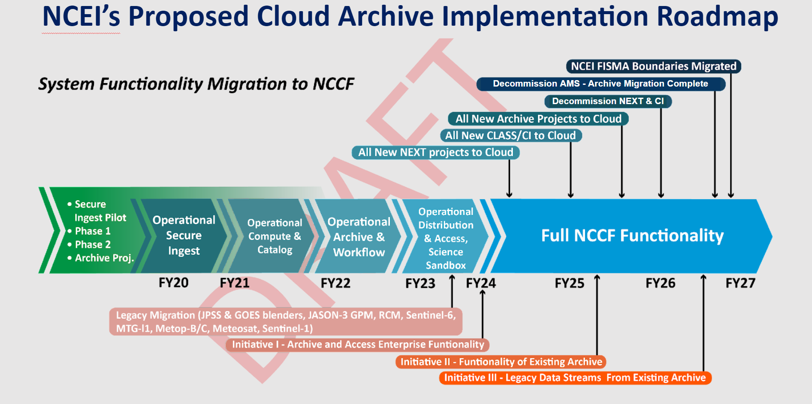
Looking Ahead
IOC
FOC
Notes:
Looking ahead, here is the proposed (draft) view of our cloud archive implementation roadmap. We hope to achieve operationalization of our cloud MVP to each an IOC state by the end of 2022, and achieve FOC by FY25. The slide also depicts how we plan to break the cloud archive work into three Initiatives (Initial Archive and Access Functionality, Migration/Establishment of the fuller existing archive functionality, and the migration of legacy data streams). and notional dates for when we might be able to retire existing on-prem systems.

Slide 14
Activities at NCEI
Launched a new Scaled Agile Framework (SAFe) implementation of an Agile Release Train (ART), focused on sustaining our on-premise enterprise archive systems and data ingest until we migrate to the cloud
OneStop-Inventory Manager V3 update planned for May-June release (public updates had been on hold for last couple years)
  Re-enables the official NOAA Data Catalog
CoMET updates continue…
CoMET = Collection Metadata Editing Tool

Slide 15
Activities at NCEI: CoMET
Repository-like (e.g. Git) functionalities
  Version Control, Revert, and User Tracking
Application Programming Interface (API)
  Bulk automation and flexible workflow
Data Stewardship Maturity Questionnaire (DSMQ) integrated
  Data Stewardship Maturity Report (DSMR) capability later this year
  Allows for output of a compliant PDF document for submission to NOAA Central Library (with cross-referencing and DOI)
Timeframe for public availability still being determined
CoMET = Collection Metadata Editing Tool

Slide 16
Questions?

