Slide 1
WGISS/CEOS Update from GEO
March 2022
Paola De Salvo

Slide 2
Updates from GEO
Update from Data Working Group and its 4 subgroups
Updates from the GEO Knowledge Hub
Update from GEOSS and EAG process

Slide 3
Data Working Group/Data Sharing – Data Management Principles
Review of Data Sharing and Data Management Principles Documents
Finalize the DMPs Crosswalk (GEO -FAIR-TRUST-CARE)
DMPs Success stories – Living document
Towards a GEO DMPs self assessment tool
Establishment of GEO Educational Series – launch at the GEO Symposium
Data Analysis Survey & Engagement calls

Slide 4
Data Working Group: In Situ Data
Bringing together selected experts to focus on topics of direct relevance to the in-situ data community within the GEO context
Key objectives:
Promoting Findable, Accessible, Interoperable, Re-usable (FAIR) and open data
Defining and promoting interoperable data management strategies and other relevant standards for in-situ data
Identifying the main challenges to the sharing and re-use of in-situ data, and seeking potential solutions
Justifying the need for continued and sustainable funding of in-situ data capture
Highlighting the increasing role of citizen science for augmenting in-situ data collection
Current priority areas:
Identifying common barriers to sharing in-situ data, e.g. data formats, licensing etc., and proposing potential solutions
Prioritizing observations necessary to advance GWP activities and engaging with relevant initiatives best placed to provide access to key data sets
Engaging existing networks that coordinate in situ data within specific domains
Practical actions to increase access to data most relevant for advancing the GEO engagement priorities

Slide 5
Data Working Group/Law and Policy
Working to Ensure the Legal Interoperability of Shared Data:
Review previous GEO guidance that encourages the use of standard open data licenses
Public domain dedications and licenses from Creative Commons, Open Data Commons
Determine whether legal, policy, or technical developments require any update to or augmentation of previous GEO guidance
Open Science, FAIR principles, AI/ML and cloud storage and compute
Understand barriers to implementation, educate data users and providers about the issue, and recommend actions that could promote adoption by GEO and its members and participating organizations

Slide 6
Data Working Group/Data Ethics
Subject:
In the framework of GEO, Data Ethics deals with the moral problems related to data (both structured and unstructured), algorithms, and corresponding practices, to formulate and support morally acceptable solutions (e.g. proper conduct or right values) and to avoid adversely impact people and society.
Data Ethics describes a code of behavior, specifically what is right and wrong.
Ongoing activities:
Definition of the sub-group ToR and next deliverables
Study on possible Data Ethics issues with the use of cloud computing platforms/infrastructures.
Focus:
Moral questions of Data Ethics are analogous of those characterizing information ethics, while they are data-centric and not information-centric. Data Ethics includes addressing and recommending concepts of right and wrong conduct, with transparency in and defensibility of actions and decisions driven by automated/artificial intelligence (AI) in relation to data in general and personal data in particular
Focus on data itself and application, and then continue study with use case analysis method.

Slide 7
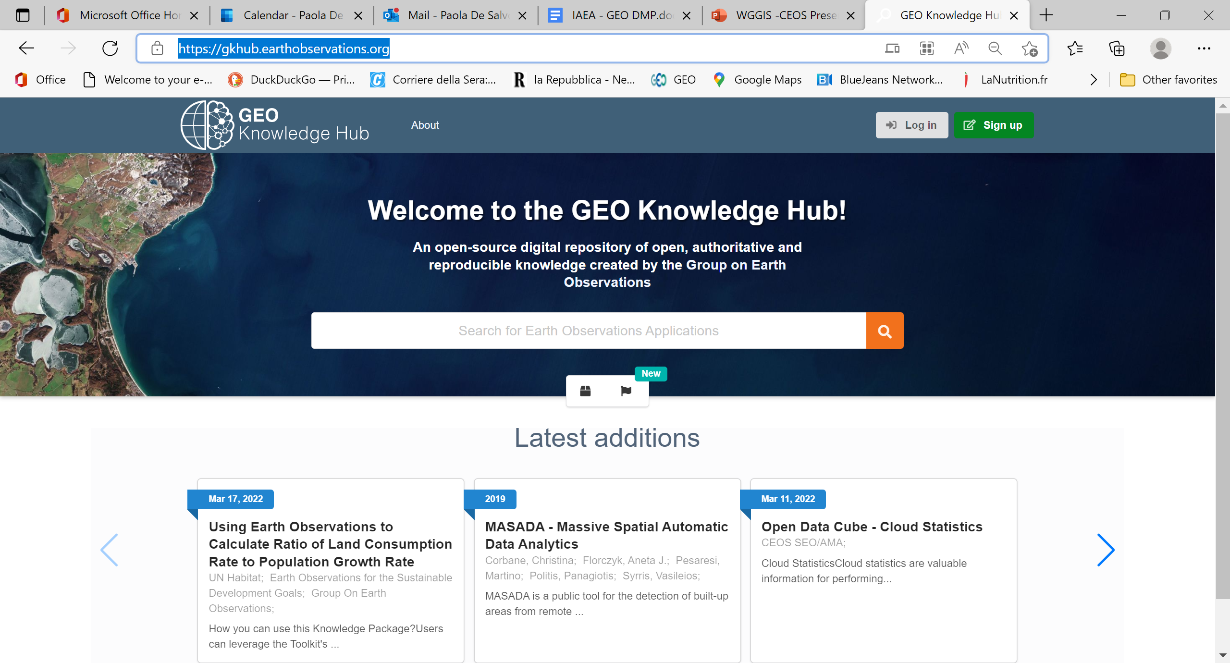
GEO Knowledge Hub
GEO Knowledge Hub (earthobservations.org)

Slide 8
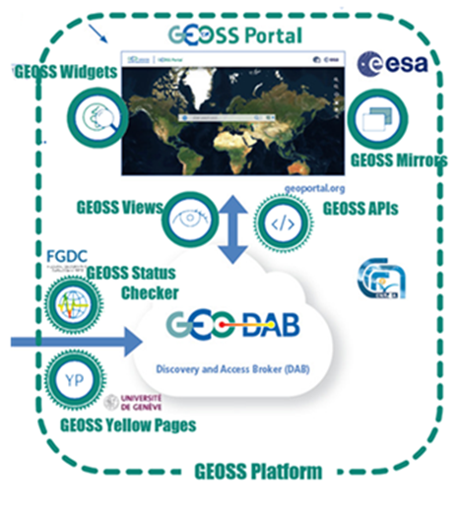
GEOSS Platform
GEOSS Platform Plus (GPP, an H2020 co-funded project , started on January 1st 2022):​ GPP contributes to the implementation of the Global Earth Observation System of Systems (GEOSS), aiming at evolving the European GEOSS Platform components to enable access to tailor-made information and actionable knowledge and will do so in close collaboration with the GEO partners (via the GEOSS Infrastructure Development Task Team) with a user-centric approach.​
Ongoing activities ​
Participation to DWG Engagement calls ​to collect user communities' requirements to be exploited to drive the GEOSS Platform enhancements and to implement a more user centric approach in the framework of GPP
GEOSS Platform ongoing developments
Rethinking of several components and functionalities to address GDPR compliancy
YP: rethinking of YP form and implementation of a widget to be hosted on YP owner premises ​
Mirror Sites: rethinking of mirror sites (MS as a widget) and a new wizard to support semi-automatic request and creation of MS on Communities premises ​
GEOSS Portal and GEO DAB: Implementation of flags to identify and manage empty collections
GPP first cycle of requirements collection: functionalities, architecture, services ​

Slide 9
Rethinking GEOSS - EAG: timeline

Slide 10
EAG: Implementation Approach (ToR)
Outline (03/22)
Review
Assessment
Recommendation (03 - 09/22)
Report (09/22)
Presentation (10/22)
Review of GEO Key documents …
REVIEW
Current status of GEOSS (based on MTE, but also own observations/ findings), Working Groups (example)
Technologies
Utilization, Users
Linkage to other systems
….
Link and synergies: Institutions, Initiatives, Programmes …
ASSESSMENT
Technology, infrastructure
provider of user-orientated information
→ Way forward for GEO
RECOMMENDATION

Slide 11
Thank You

