Slide 1
Explore Analysis Ready Data (ARD) with the data cube for atmospheric composition
Julia Wagemann¹, Federico Fierli², Christine Traeger², Marco Cucchi³
¹ MEEO s.r.l., ² EUMETSAT, ³ B-Open

Slide 2
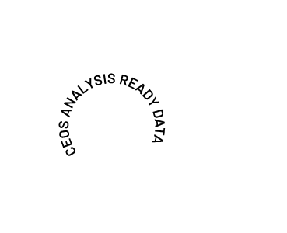
What is ‘Analysis Ready Data’ ?
Analysis Ready Data (CEOS ARD) are satellite data that have been processed to a minimum set of requirements and organized into a form that allows immediate analysis with a minimum of additional user effort and interoperability both through time and with other datasets
(Committee on Earth Observation Satellites)

Slide 3
Why do we need ‘Analysis Ready Data’ ?
Common pre-processing steps to harmonize satellite data for large area and long term analyses:
Geolocation and spatial alignment
To allow comparison of observations of the same location on the Earth’s surface over time
Most of the time working with satellite data goes toward making data ’ready’ for analysis instead of actual analysis
Radiometric calibration
To provide consistent data that reflect surface changes and not changes due to sensor changes
80%
Data
preparation
Atmospheric correction
20%
Analysis
To reduce the variable radiometric influence of the atmosphere
Generation of per pixel quality flags
To allow users to filter unsuitable observations, e.g. clouds
after Dwyer et al. (2018). Analysis Ready Data: Enabling Analysis of the
Landsat Archive

Slide 4
Why do we need ‘Analysis Ready Data’ ?
Most of the time working with satellite data goes towards making data ’ready’ for analysis instead of actual analysis
Common pre-processing steps to harmonize satellite data for large area and long term analyses:
Data
preparation
Geolocation and spatial alignment
80%
To allow comparison of observations of the same location on the Earth’s surface over time
20%
Analysis
Radiometric calibration
Users of the same data are
repeating the same preparatory steps
To provide consistent data that reflect surface changes and not changes due to sensor changes
Atmospheric correction
80%
20%
To reduce the variable radiometric influence of the atmosphere
80%
80%
20%
20%
Generation of per pixel quality flags
80%
80%
20%
To allow users to filter unsuitable observations, e.g. clouds
20%
after Dwyer et al. (2018). Analysis Ready Data: Enabling Analysis of the
Landsat Archive

Slide 5
Principle idea of ARD
Shifting the responsibility of data pre-processing from EO data users to data providers, such as EUMETSAT
EO data users
Geolocation and spatial alignment
Radiometric calibration
Atmospheric correction
Generation of per pixel quality flags
EO data providers

Slide 6
How does it look like in practise?
Analysis Ready Data are often disseminated in form of a data cube with either a regional or thematic focus
after Kopp et al. (2019): Achieving the Full Vision of Earth Observation Data Cubes

Slide 7
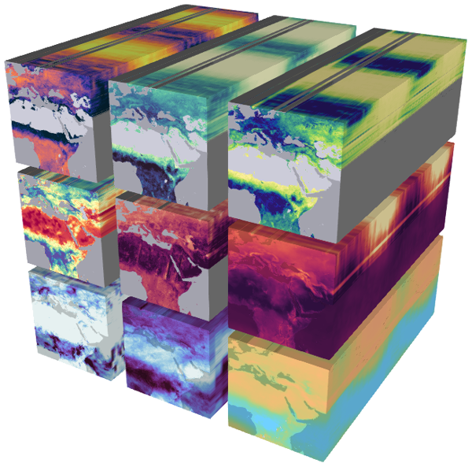
Examples of ARD and data cube initiatives
Earth System Data Cube
Biosphere-atmosphere interactions
Rapid action on Covid-19 and EO
Open Data Cube
Euro Data Cube
Technology and Atmospheric Mission Platform

Slide 8
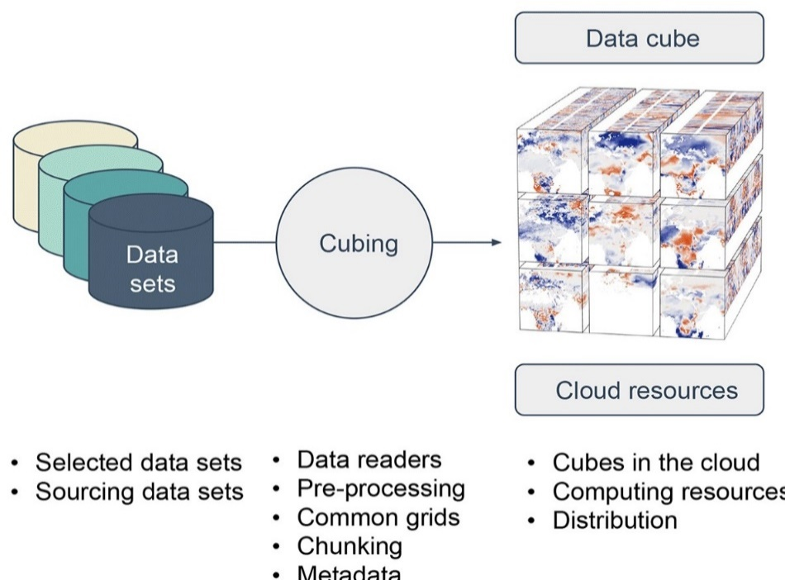
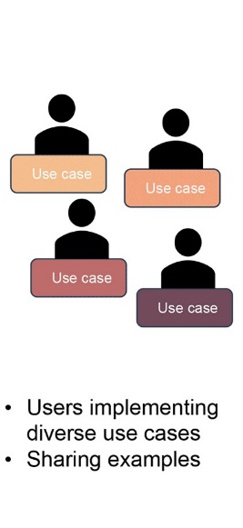
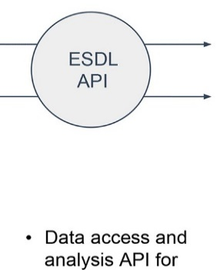
Principle of data cubes
Examples of ARD and data cube initiatives
Earth system data cubes unravel global multivariate dynamics Miguel D. Mahecha et al.; https://doi.org/10.5194/esd-11-201-2020
Facilitating data access and data handling saves time, which can be used to answer scientific questions.
Notes:
To make SAF data easier accessible and easier to handle, especially for users who would like to work across SAF boundaries, the idea of a data cube was born. Data Cubes could be one possibility to facilitate data access and data handling and thus foster the use of EUM (incl. SAF) / EO data.
There is not widely accepted definition of a what a data cube actually is. However, a recent paper describes the idea of data cubes in Earth Observation.
In general cubes are about storing and providing multi-dimensional data. This means
Having a common data model (common grid, common metadata, common metadata definition, …)
Putting data into such a common data format requires a some form of service, typically a software, which actually that does this.
Such a service requires information on the data sets of interest, the region of interest and the period of interest that should be cubed.
If the data sets of interest are accessible via APIs, it makes the whole process much easier.
The result of a cubing service is then a data cube.
Users should be able to “slice”/”drill” the data cube in different ways: ROI’s, Periods of interest (not only successive periods, but also e.g. certain months, seasons of a time period, etc.)
In addition it would be a distinct advantage if users can be provided with tools to work with the data cube (examples scripts, or ready to use tools), and if they have possibilities to share code and application examples.
---------------------------------------------------------------
Pre-processing steps are “delivered” as a service. I.e. data (from different sources and in different format) are provided in a common data model (homogeneous grid, one data format, homogeneous meta data).
User can easily access the pre-processed data, have access to all documentation and can share experience (and code).

Slide 9
Prototype D&V Cube at glance
Variable | Datasource | Temporal Coverage | Spatial Resolution | Temporal Resolution
Global Radiation | Satellite | Jan 1983 – Dec 2020 | 0.05° | Daily & monthly
Direct normal Solar Radiation | Satellite | Jan 1983 – Dec 2020 | 0.05° | Daily & monthly
Sunshine Duration | Satellite | Jan 1983 – Dec 2020 | 0.05° | Daily & monthly
Land Surface Temperature | Satellite | Jan 2004 – Dec 2020 | 0.05° | Hourly
Reference Evapotranspiration | Satellite | Jan 2004 – Dec 2020 | 0.05° | Daily
NDVI | Satellite | Mar 2007 – Dec 2020 | 0.01° | 10-daily
Fractional Vegetation Cover | Satellite | Jan 2004 – Dec 2020 | 0.05° | Daily
Leaf Area Index | Satellite | Jan 2004 – Dec 2020 | 0.05° | Daily
Fraction of absorbed photosynthetically active radiation | Satellite | Jan 2004 – Dec 2020 | 0.05° | Daily
Soil Wetness Index (root zone) | Satellite | Jan 1992 – Dec 2020 | 0.1° | Daily
Precipitation | In situ | Jan 1982 – Dec 2020 | 1° | Monthly
T2m | Re-analysis | Jan 1979 – Oct 2020 | 0.1° | Monthly
Spatial Coverage: | Europe
Grid: | Regular Lat / Lon
Data Format: | CF compliant netCDF4
Users are able to
access via THREDDS
download the entire cube (3TB) or subsets / subsamples
analyse the data on the VM using the CM SAF R Toolbox (and other Tools, e.g. Jupyter Notebooks) → work in progress
11 May 2022
Information Day
May 2021 – August 2021
Exploration Phase
SALGEE meeting November 2021
D&V session during
Notes:
Now back to the prototype D&V Cube: Here you can see the variables it contains. Most of them are provided by CM SAF, the LSA SAF and the H SAF, where the LSA SAF contributes most variables. Because it fits the purpose, we also decided to include data records on precipitation provided from the GPCC (Global Precipitation Climatology Centre) and T2m from ERA-5 land re-analysis.
The start of the temporal coverage is different, because we wanted to provide data as far back as possible. The end date, however, is December 2020 for all, but the T2m, as by the time the cube was created (Jan/Feb 2020), ERA-5 land was only available until October 2020.
The cube covers the area of Europe, all data are provided on a regular lat/lon grid in CF compliant netCDF format.
In May this year we organized an information day for interested users with presentations about the variables in the cube and information on how to access the cube. Since then we run the so called “Exploration Phase”, in which registered users can test the cube and ask for support and can share their experiences with others. The Exploration phase is currently paused, as we need to fix some technical issues with the data cube itself, but we will continue as soon as possible.
The data cube and application examples will be discussed during the next SALGEE meeting.

Slide 10
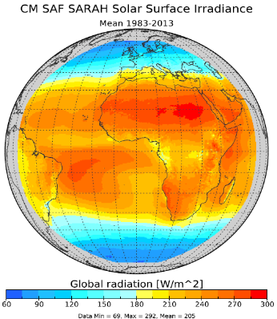
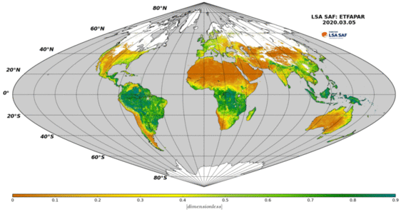
Creating the cube
Collecting the data from different providers
Harmonize grid → re-gridding
Different methods available
Changing the data!
Impact on accuracy
Error measures and flags!!
Harmonize metadata
Not trivial
CF-conventions helpful, but additional standard names needed
Issues to consider:
Data are changed while re-gridding
Documentation not strictly applicable
Who is the provider of the data?
…
Harmonize file format
Notes:
Creating the cube itself, had some challenges:
First of all: collecting data from the providing entity. But with some very nice and knowledgeable colleagues there, this worked well. Thanks again!
Second: Re-gridding the data to a common grid:
We needed to decide for a method to do that. There several options and probably different preferences – however we decided for bilinear interpolation. This means also changing the original data. I.e. strictly speaking the documentation of the original data, such as PUM and Validation reports, etc. are not applicable to the data in the cube. Yet, they are the best documentation available at this point. However, we have of course, documented all methods that have been applied to create the cube.
Third is Harmonizing the metadata, which is also not trivial:
CF conventions are helpful, but there are still some open issues that needed consideration in this case, e.g.: who is the provider of the data in the cube? Note: the data have been changed while re-gridding. So is it the providing entity (SAF) or is it EUMETSAT? We have decided to differentiate between data provider (the entity providing the original data, e.g. SAF) and publisher (EUMETSAT).
Harmonizing the file format was one of the easier tasks.

Slide 11
EUMETSAT’s Atmospheric Composition Data Cube (ACDC)
3 Data services
3 instruments on 4 different satellites
6 atmospheric variables
18 different data products in 3 different data formats (NetCDF, HDF5, ASCII)
Instrument
Variable
Temporal resolution
Spatial resolution
GOME-2
GOME-2
TROPOMI
Absorbing Aerosol Index (AAI)
Formaldehyde (HCHO)
Nitrogen Dioxide (NO2)
Daily | 23 Jan 2007 – present
Monthly | Jan 2007 – Jul 2016
Monthly | Feb 2018 – present
1 deg x 1 deg
1 deg x 1 deg
0.125 deg x 0.125 deg
GOME-2
Nitrogen Dioxide (NO2)
Monthly | Feb 2007 – Aug 2017
0.25 deg x 0.25 deg
IASI
Carbon Monoxide (CO)
Formic acid (HCOOH)
Ammonia (NH3)
Monthly | Oct 2007 – Jan 2022
Monthly | Oct 2007 – Jan 2022
Monthly | Oct 2007 – Jun 2020
1 deg x 1 deg

Slide 12
EUMETSAT’s Atmospheric Composition Data Cube (ACDC)
EUMETSAT Data Tailor API
https://anaconda.org/Eumetsat/epct
EUMETSAT Atmospheric Composition Data Cube plugin
Multi-variable
Multi-product
Multi-platform
Multi-sensor
Define time coverage
Select Region of Interest
Select variables of interest
…

Slide 13
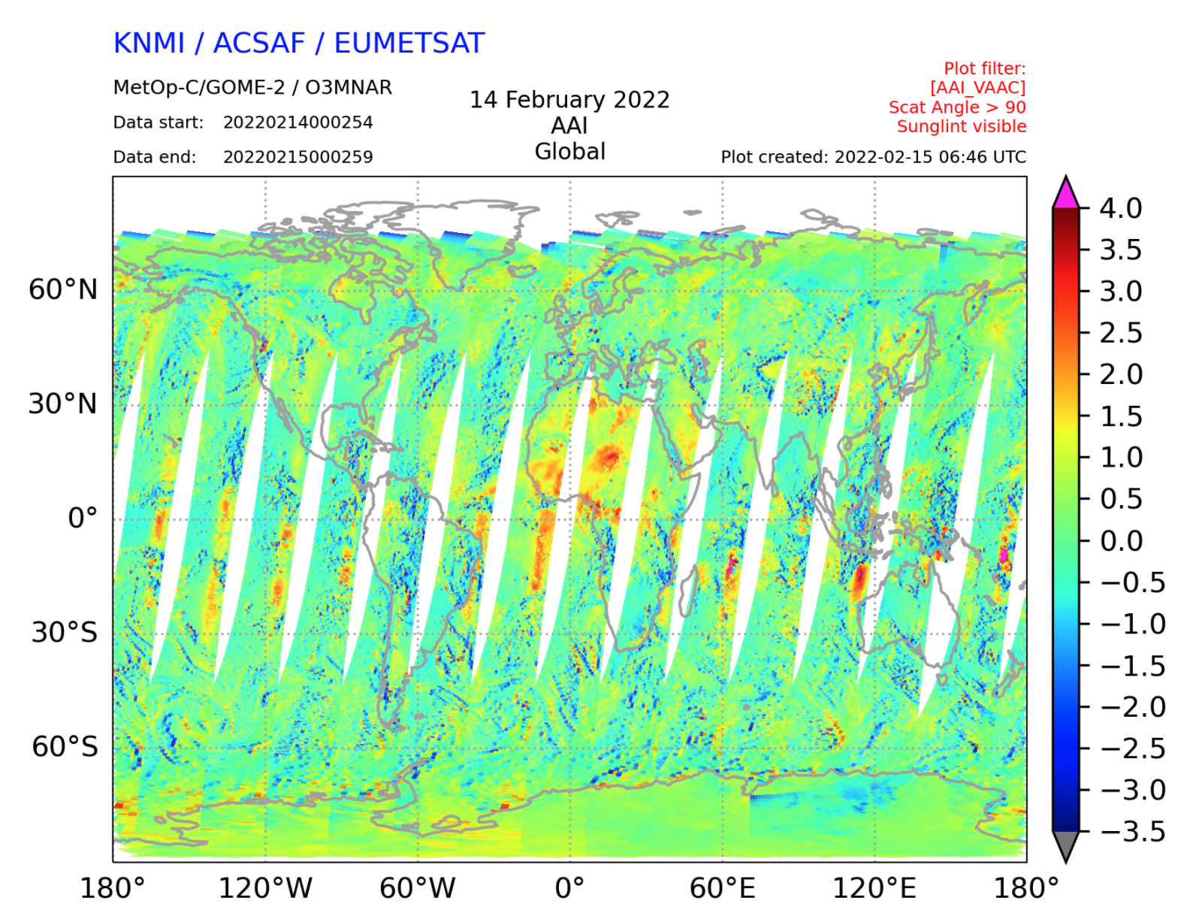
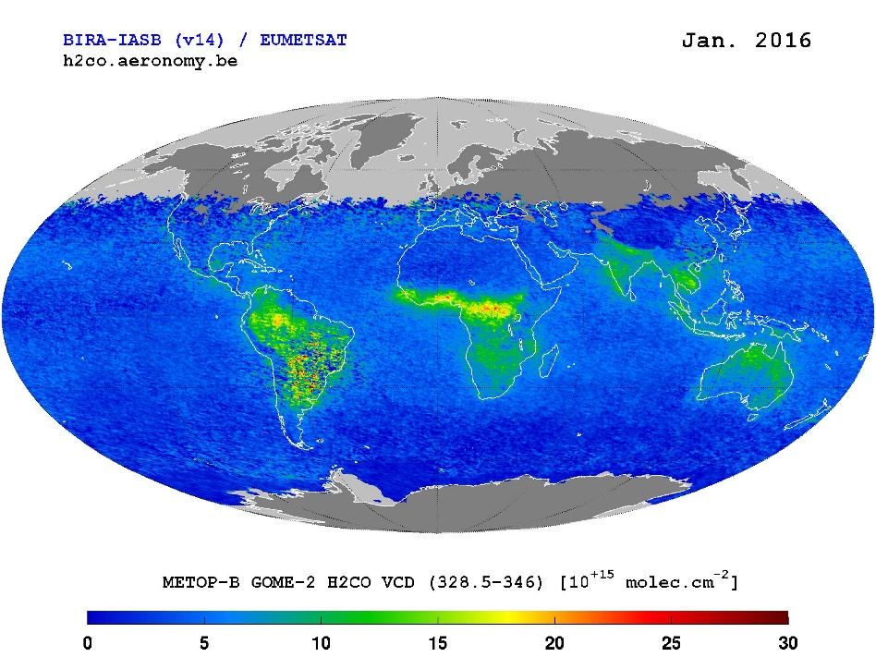
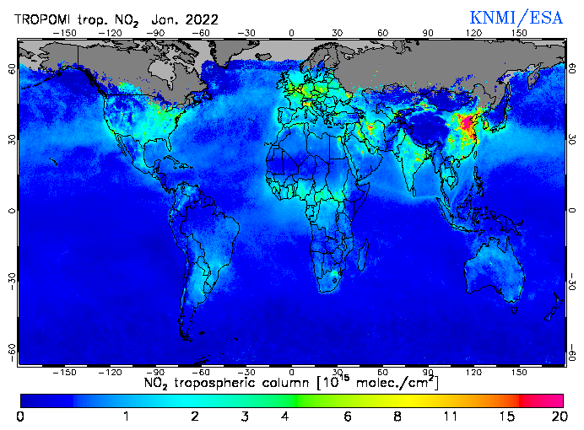
EUMETSAT’s Atmospheric Composition Data Cube (ACDC)
GOME-2 AAI
GOME-2 HCHO
TROPOMI NO₂

Slide 14
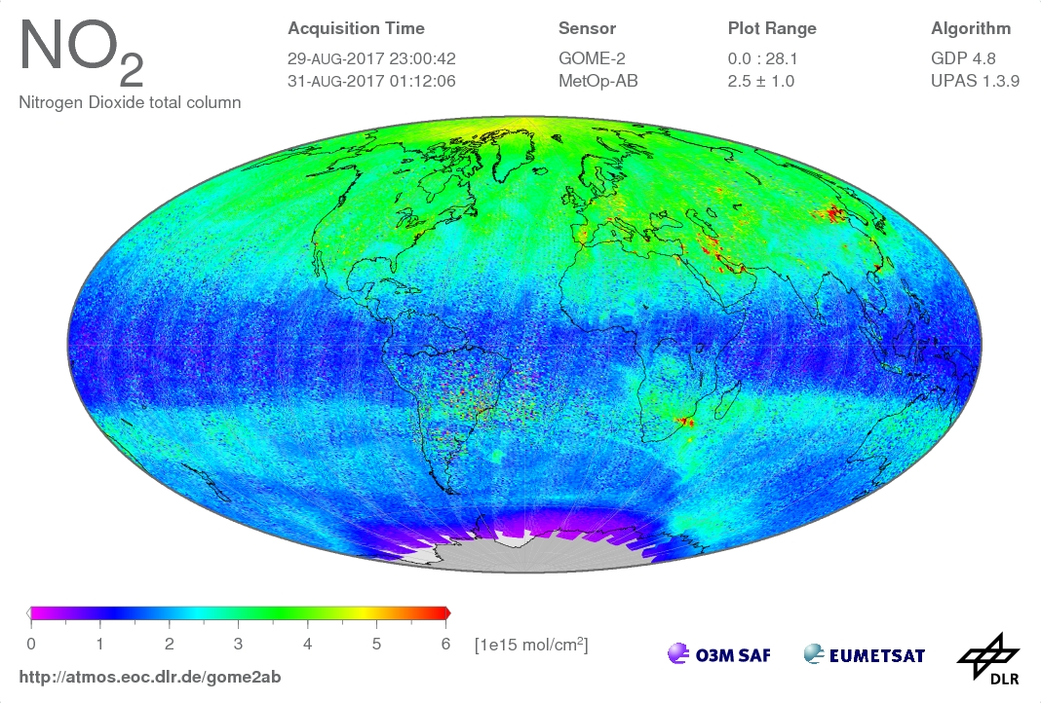
EUMETSAT’s Atmospheric Composition Data Cube (ACDC)
GOME-2 NO₂

Slide 15
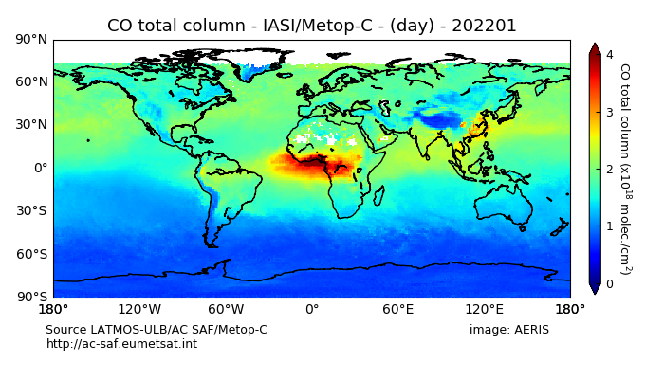
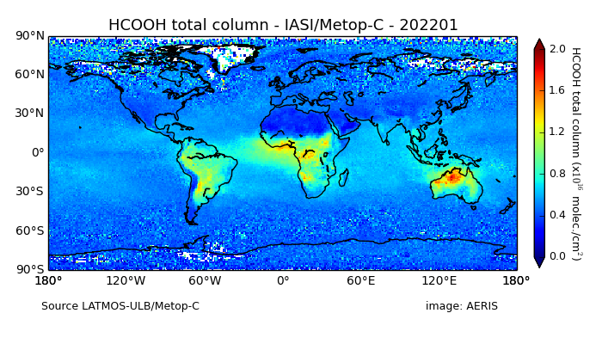
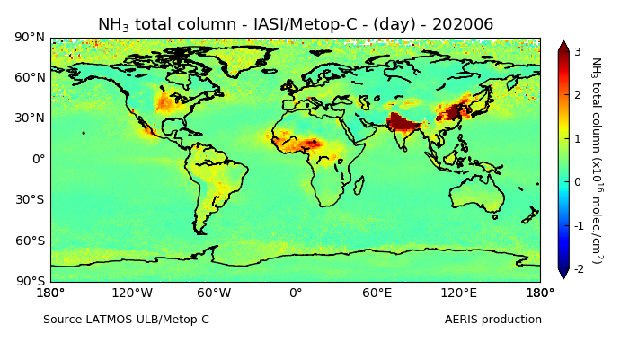
EUMETSAT’s Atmospheric Composition Data Cube (ACDC)
IASI CO
IASI HCOOH
IASI NH₃

Slide 16
EUMETSAT’s Atmospheric Composition Data Cube (ACDC)
Explore the Atmospheric Composition Data Cube (ACDC) with Jupyter
Training platform: https://epct.ltpy.adamplatform.eu
Register: https://login.ltpy.adamplatform.eu/

