Slide 1
NRSCC’s Methodology for Data Publishing and Repository
Prof. LIU Chuang
NRSCC Data Publishing Center
Global Change Research Data Publishing & Repository, World Data System
Institute of Geographical Sciences and Natural Resources Research, Chinese Academy of Sciences
23 March 2022, WGISS-53

Slide 2
1. Research Data Publishing & Repository
1.1 China has 4963 academic journals, more than
1,897,000 research papers published in 2020
In which, more than 500 journals for earth science (environment, ecosystem, geography, remote sensing, agriculture ….), more than 125,000 research papers published in 2020.
At least 60,000 new datasets in earth science created, which supported the research papers in 2020.

Slide 3
1. Research Data Publishing & Repository
1.2 China has supported 20 national data centers since 2019, 12 of them are related to the earth science
only less than 5% new datasets could be archived and openly available through the national data centers
even so, the data quality is a challenging issue

Slide 4
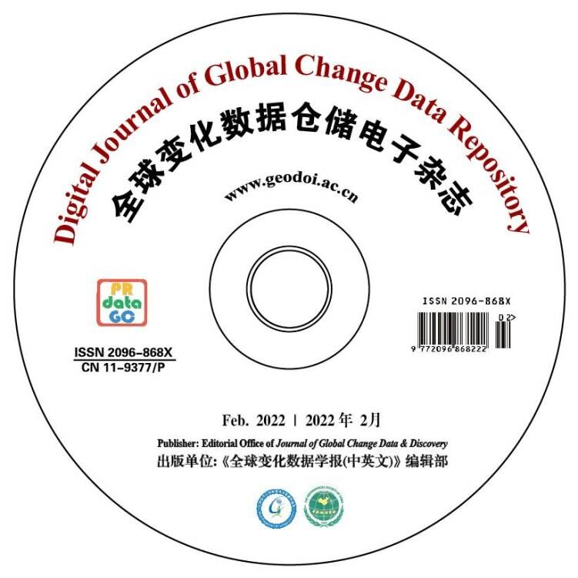
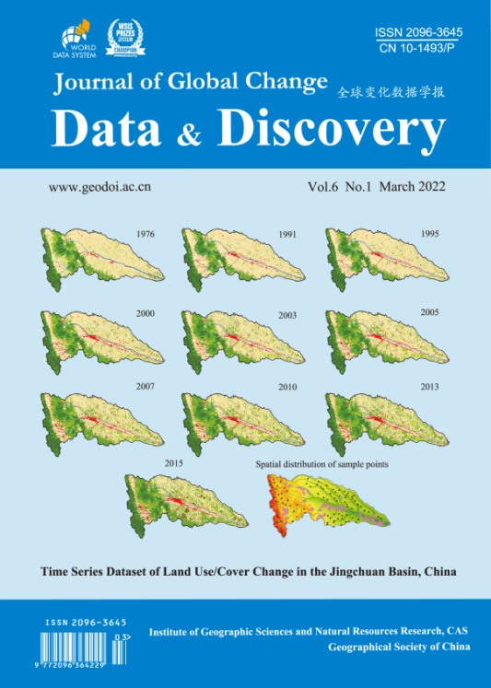
1. Research Data Publishing & Repository
1.3 Peer reviewed data publishing and repository – data publishing infrastructure
ISSN 2096-868X
ISSN 2096-3645

Slide 5
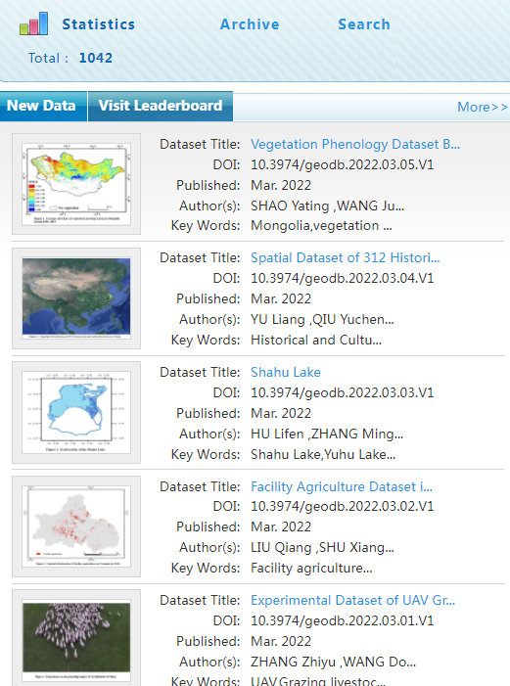
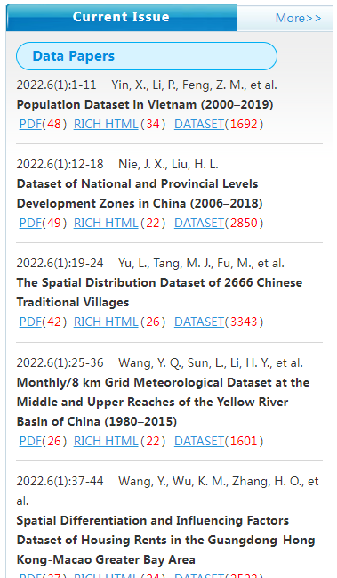
1. Research Data Publishing & Repository
1.3 Peer reviewed data publishing and repository – data publishing infrastructure

Slide 6
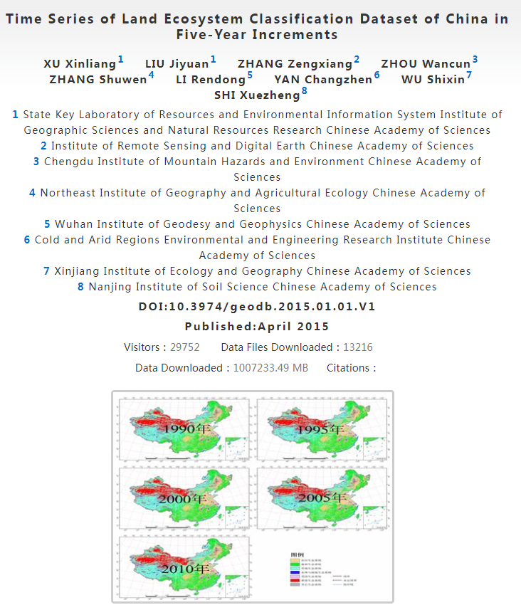
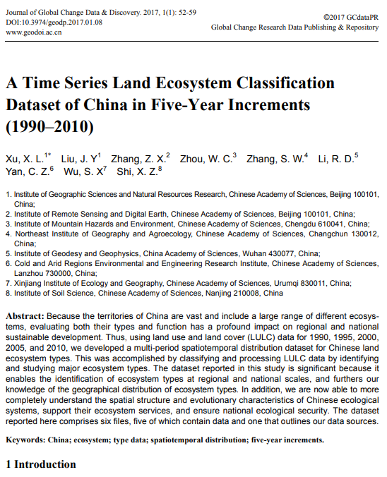
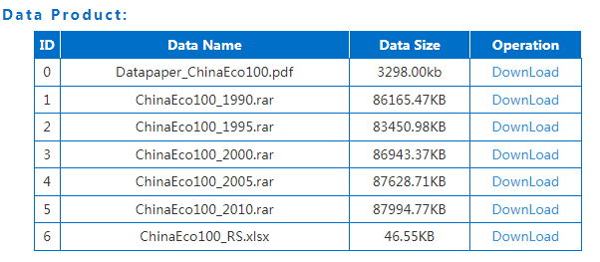

Slide 7
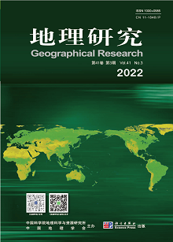
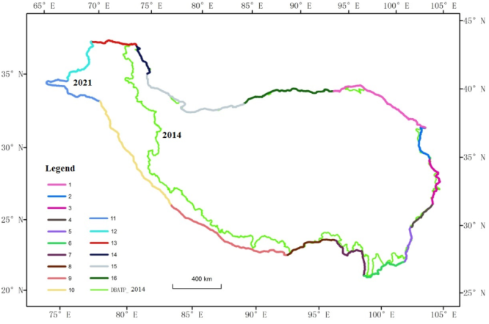
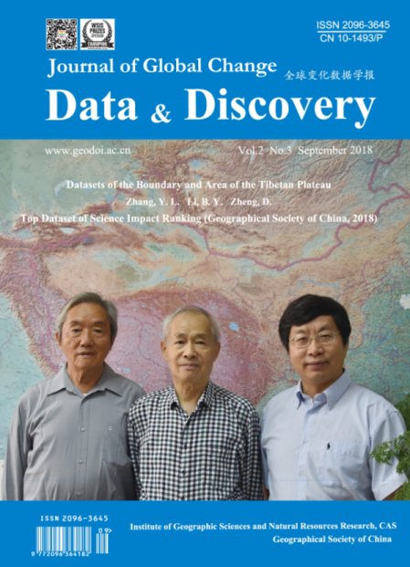
1.4 Three journals coordinating program
Tibet boundary
Research Result
Dataset
Data paper

Slide 8
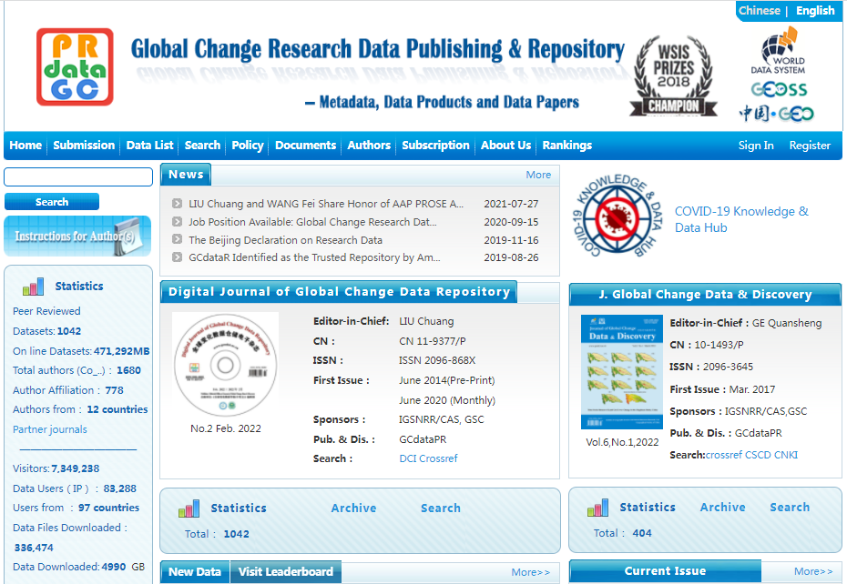
2. Progress

Slide 9
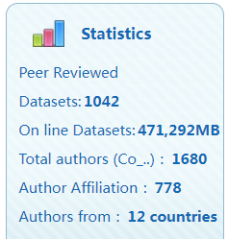
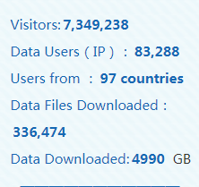
2. Progress

Slide 10
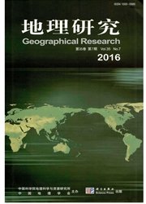
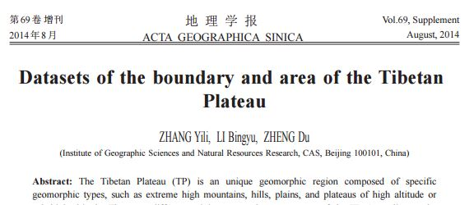
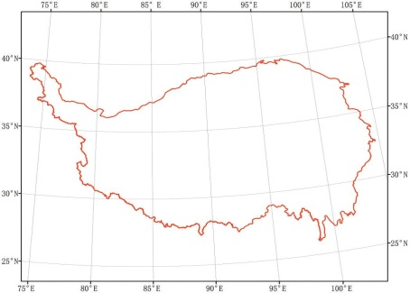
3. Global Networking：
Discovery
Data paper
Zhang Yili, Li Bingyuan, Zheng Du. A discussion on the boundary and area of the Tibetan Plateau in China. Geographical Research, 2002, 21(1): 1-9.
Dataset
ZHANG Yili,LI Bingyu,ZHENG Du.2014.Datasets of the Boundary and Area of the Tibetan Plateau
Acta Geographica Sinica, 2014,
DOI: 10.11821/dlxb2014S012
DCI
ZHANG Yili,LI Bingyu,ZHENG Du.2014.Datasets of the Boundary and Area of the Tibetan Plateau ( DBATP ) ,Global Change Research Data Publishing & Repository,DOI:10.3974/geodb.2014.01.12.V1
SCI

Slide 11
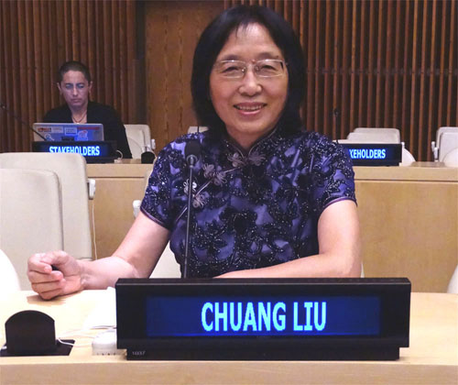
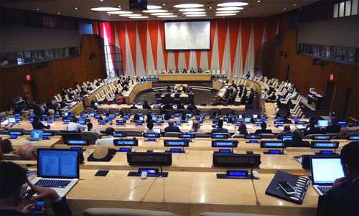
4. Impact: Sharing Research Data, Reducing Digital Divide at UN GA 2015
As we enter the big data era, data sharing in developing countries has become even more critical. …I would like to suggest U.N. continue to pay more attention to reduce the digital divide.
-- LIU Chuang (2015), New York
The President of the United Nations General Assembly's Informal Interactive Consultations on WSIS+10, ECOSOC Chamber, United Nations Headquarters, New York, 2 July 2015

Slide 12
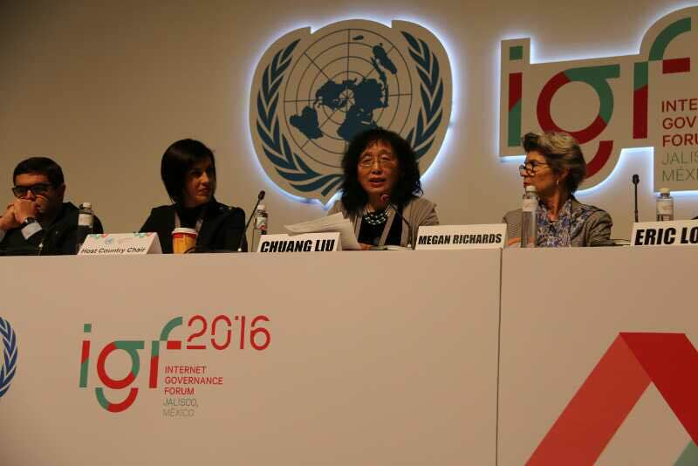
Acting Locally, Networking Globally
Panel at the Internet Governance Forum, UN 2016

Slide 13
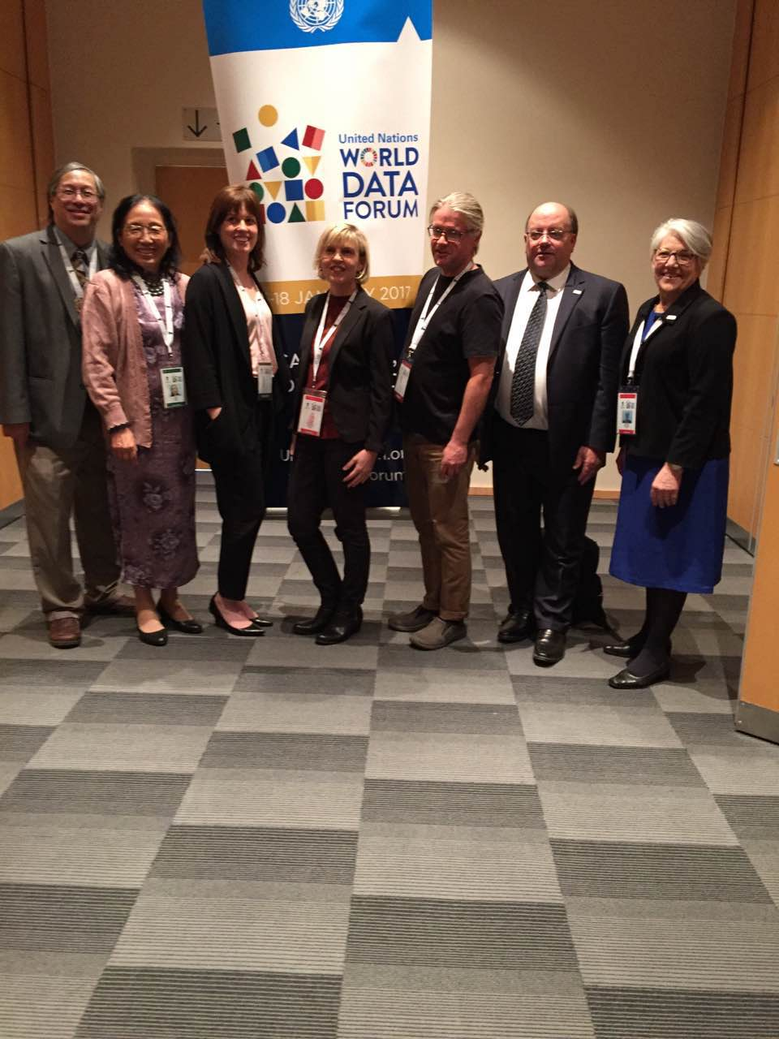
The First World Data Forum of UN at Cape Town in 2017
(one of the best cases)

Slide 14
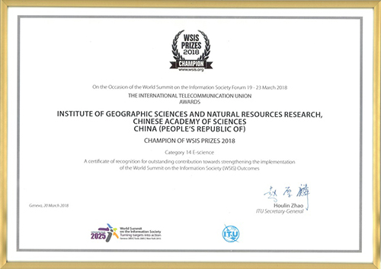
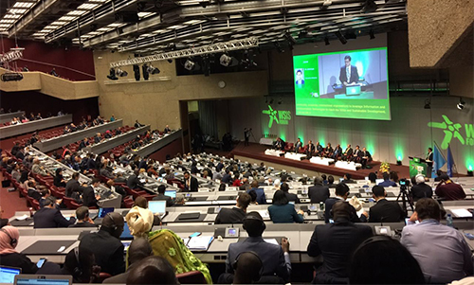
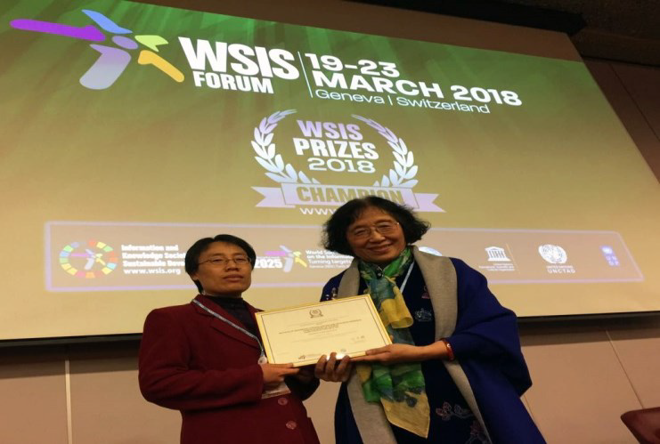
WSIS Prize 2018 (e-Science Champion)

Slide 15
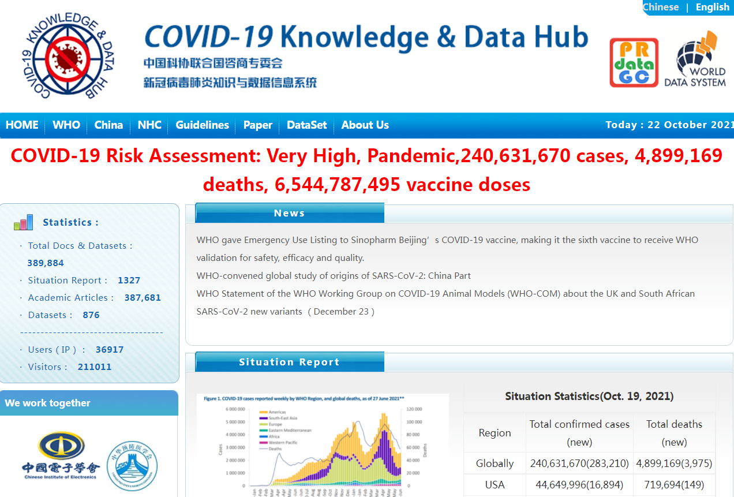
WSIS Prize 2021

Slide 16
Thank You !

