Slide 1
Working Group on Information Systems and Services (WGISS)
Committee on Earth Observation Satellites
Mirko Albani/ESA
WGISS#53 Virtual Meeting
Data Integrity and Authenticity on Cloud SESSION
23th March 2022

Slide 2
Background & Approach
Action WGISS-49-13: WGISS DSIG to investigate how to handle replicas of data for example in the cloud: PID assignment? Using watermarks? Mechanism for handling that to be further discussed and recommendation issued.
Four approaches to manage Data replicas on cloud (to grant the Data
Integrity and Authenticity) analysed:
Inclusion of a Persistent Identifier in the metadata file of each single product;
Inclusion of HASH Code embedded in any replicated and disseminated product;
Use of digital signature (e.g. Watermark);
Implementation of a Blockchain mechanism (e.g. KSI Blockchain).

Slide 3
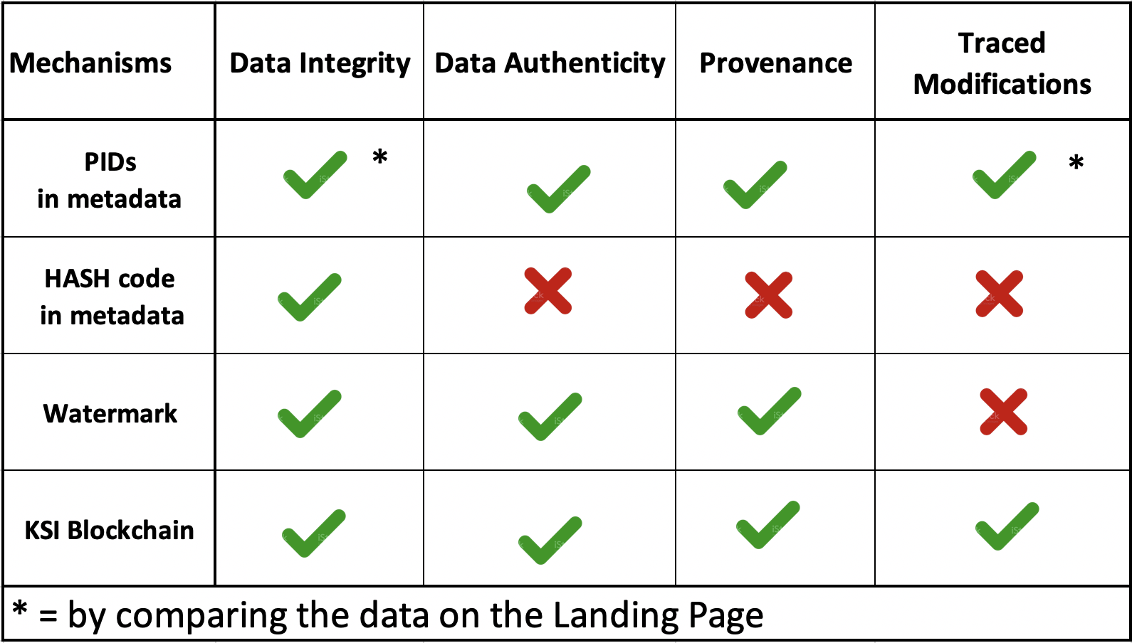
Executive Summary
Mechanisms to handle a data replica on the cloud granting
data integrity and authenticity

