Slide 1
WGISS Data Management & Stewardship Maturity Matrix Use Case
Iolanda Maggio
RHEA c/o ESA ESRIN
CEOS WGISS-53
23 March 2022

Slide 2
Executive Summary
Main concept of the WGISS Data Management & Stewardship MM
Step by Step in using the DMSMM
How to read the final result of DMSMM

Slide 3
Main Concepts

Slide 4
Data Management and Stewardship Maturity Matrix (DMSMM): Main concepts
DMSMM defines all activities needed to preserve and improve the information content, quality, accessibility, and usability of data and metadata.
Data stewardship “encompasses all activities that preserve and improve the information content, accessibility, and usability of data and metadata” (National Research Council 2007).
Data management includes all activities for “planning, execution and oversight of policies, practices and projects that acquire, control, protect, deliver and enhance the value of data and information assets.” (Mosely et al. 2009).

Slide 5
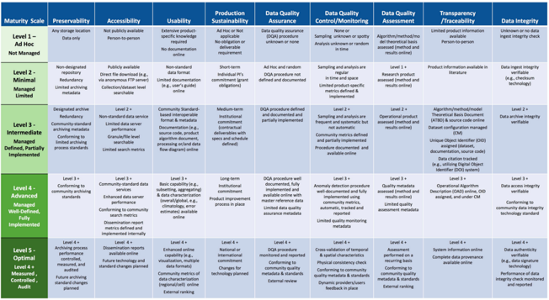
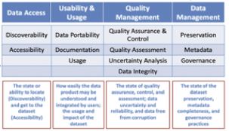
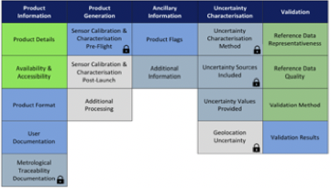
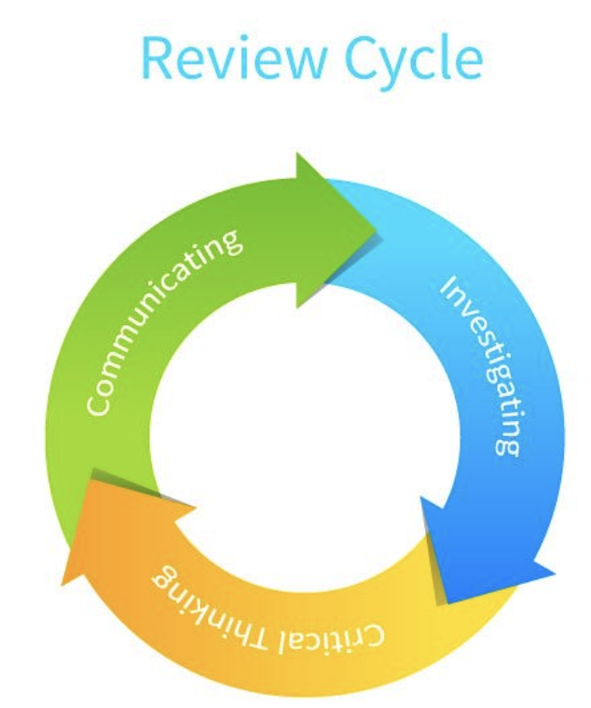
Starting Points
MM for Long-Term Scientific Data Stewardship
RDA FAIR Data Maturity Model
WMO Stewardship MM for Climate Data
ESA Earthnet Quality Data Assessment Pilot
GEOSS Data Management Principles
CEOS WGISS DMSMM: Generation process

Slide 6
CEOS WGISS Data Management & Stewardship Maturity Matrix
http://ceos.org/document_management/Working_Groups/WGISS/Interest_Groups/Data_Stewardship/White_Papers/WGISS%20Data%20Management%20and%20Stewardship%20Maturity%20Matrix.pdf

Slide 7
DMSMM pillars
5 Areas
Discoverability
Accessibility
Usability
Preservation
Curation
4 Level of Maturity
L0 Not Managed
L1 Partially Managed
L2 Managed
L3 Fully Managed
12 Components
Metadata for Discovery
Online Access
Data encoding
Data Documentation
Data Traceability
Data Validation
Data Uncertainty
Data Quality Control
Data Preservation
Data Verification
Data Processing/Reprocessing
Persistent & Resolvable Identifier

Slide 8
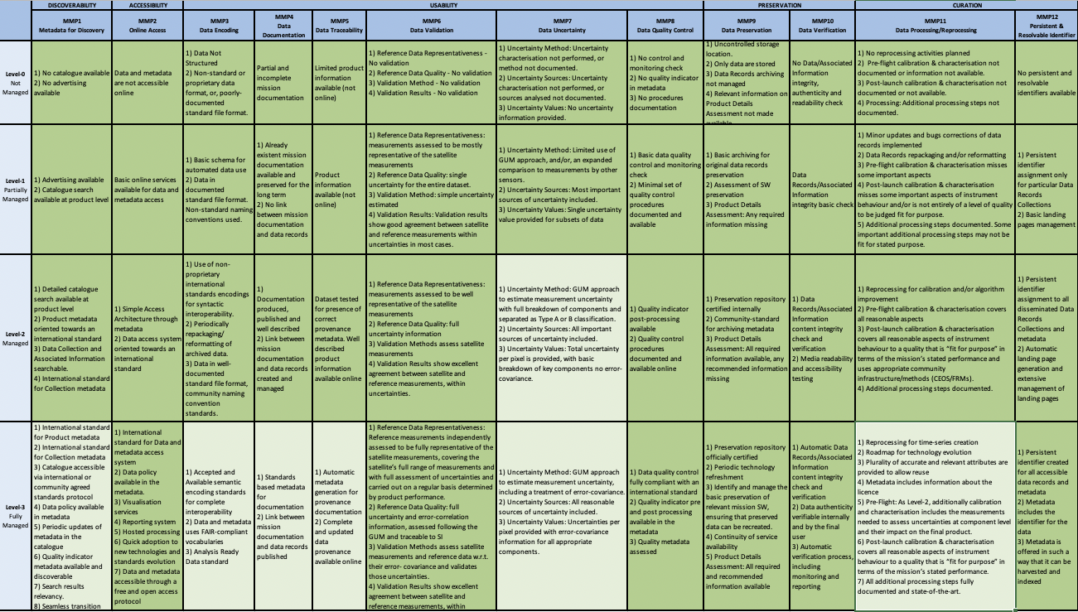
Data Management & Stewardship Maturity Matrix - Scope
A way to measure the status of the Agency Data Stewardship processes in place
A way to plan goals of Data Stewardship processes and projects
A specific Use Case to explain how to use the matrix is inserted in a relevant session of this presentation

Slide 9
Step by step in DMSMM

Slide 10
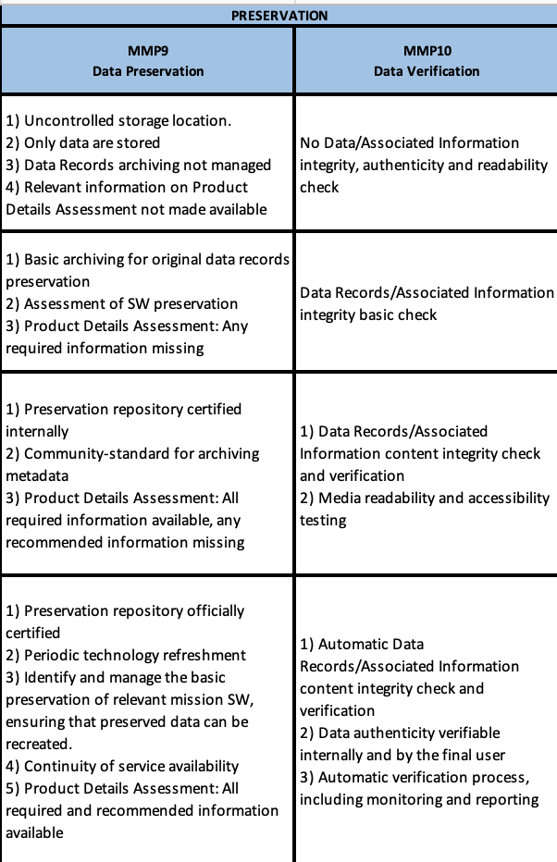
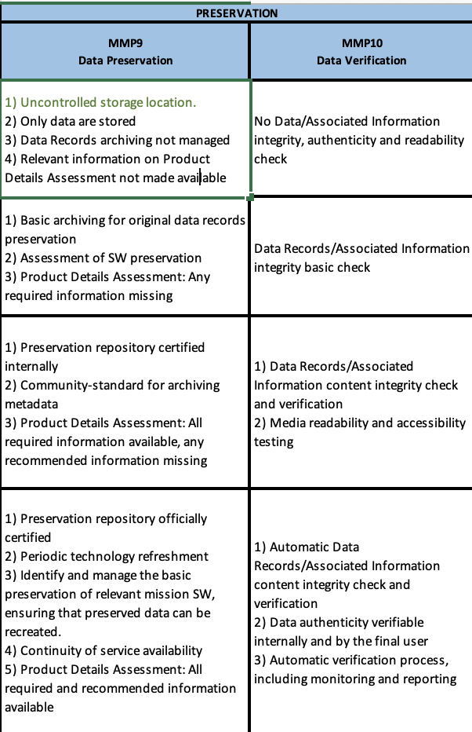
For each component go through the checklist
Do a verification for each
task putting in green the
task already implemented.

Slide 11
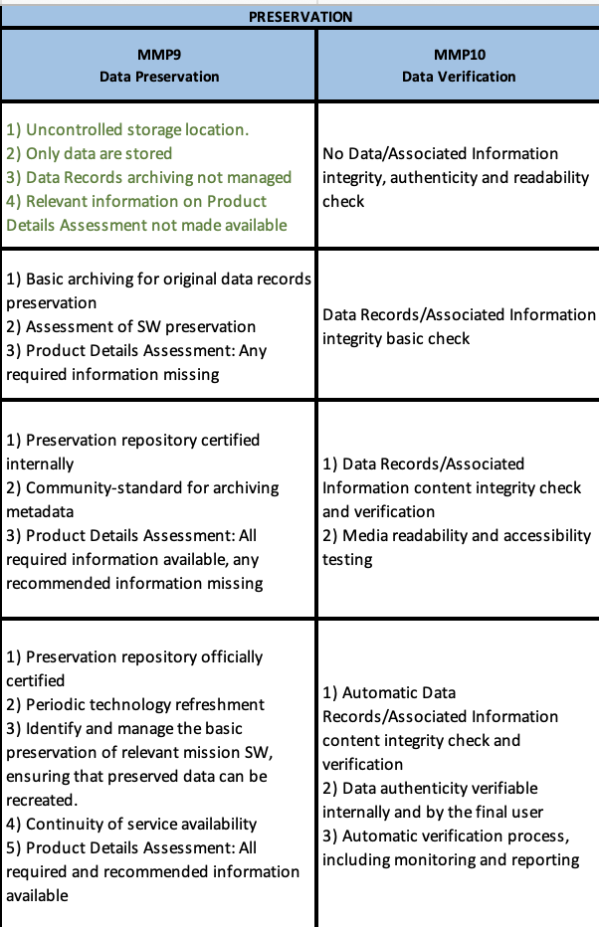
For each component go through the checklist
Do this verification for each
task in the maturity level under
analysis.

Slide 12
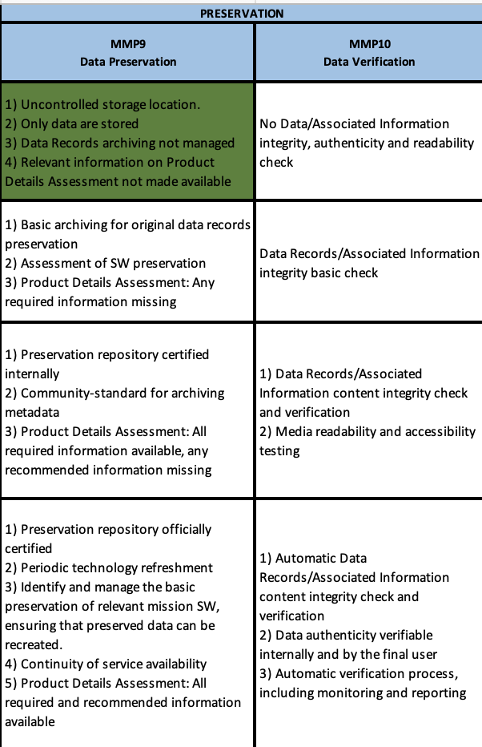
For each component go through the checklist
When all tasks in the analysed
maturity level are fully covered
put the whole cell in green.

Slide 13
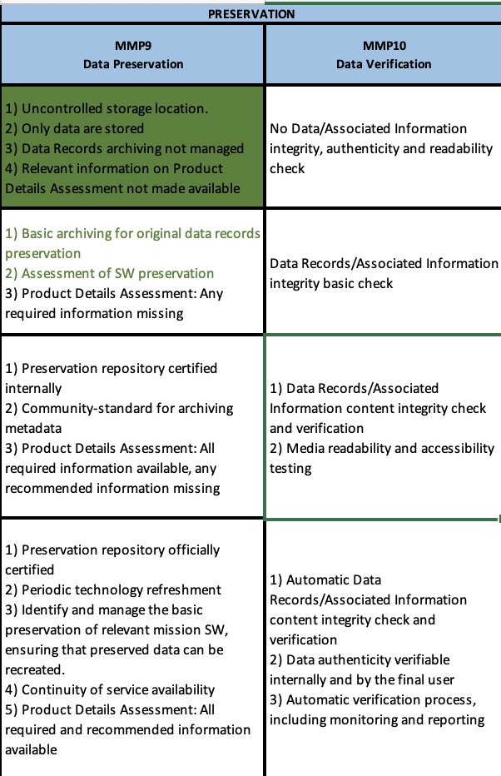
For each component go through the checklist
The analysis continues in the
next level of maturity.

Slide 14
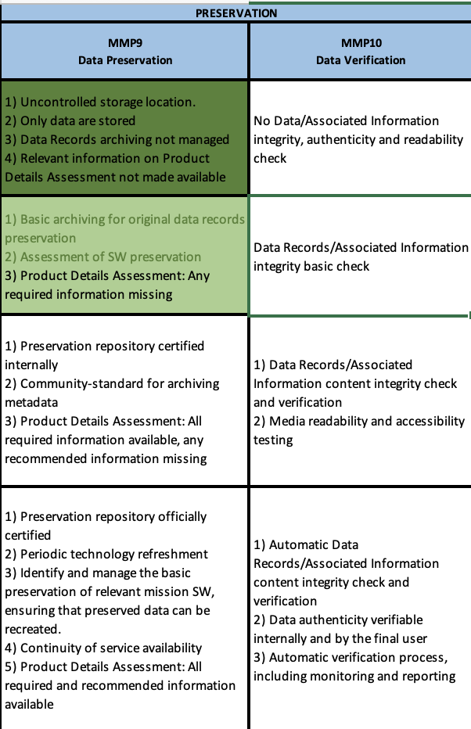
For each component go through the checklist
When a task is not already
implemented it remains in black
and at the end cell, partially
covered becomes light green.

Slide 15
Score compilation
L0
L1
L2
L3

Slide 16
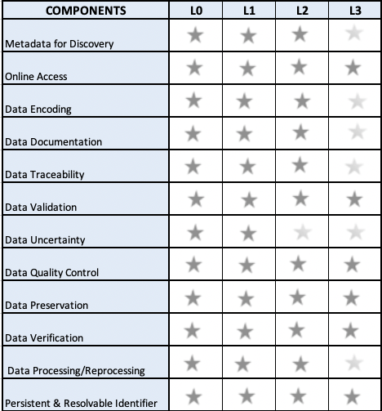
Example of final view of the DMSMM and Score

Slide 17
EXCERT OF USE CASE

Slide 18
ENVISAT MIPAS L2 Data Use Case
Envisat MIPAS L2 - Temperature, Pressure and Atmospheric Constituents profiles [MIPAS_2PS/2PE] Data.
This MIPAS Level 2 data product describes localised vertical profiles of pressure, temperature and 21 target species (H2O, O3, HNO3, CH4, N2O, NO2, CFC-11, ClONO2, N2O5, CFC-12, COF2, CCL4, HCN, CFC-14, HCFC-22, C2H2, C2H6, COCl2, CH3Cl, OCS and HDO).
It has a global coverage of Earth's stratosphere and mesosphere at all latitudes and longitudes.

Slide 19
Use case: ENVISAT MIPAS L2 Data
First Step: Analyse the relevant Goals & Objectives to be reached and visualise the final measurement on the table.
Green means complete objectives to be reached and light green means partial or optional objectives to be reached

Slide 20
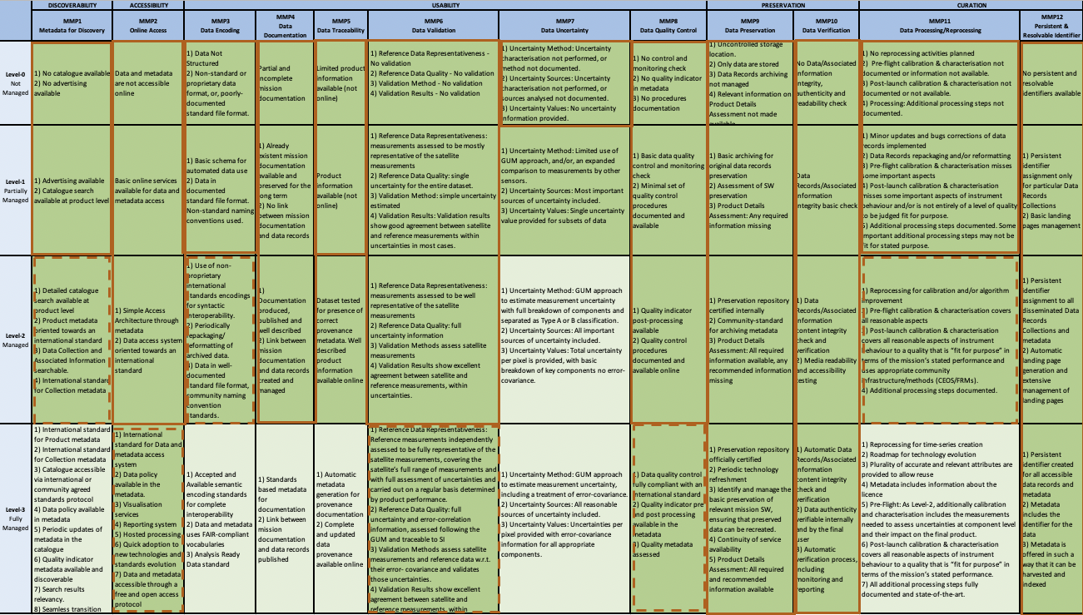
Use case: ENVISAT MIPAS L2 Data
Intermediate Steps: Periodically the operator can verify the status of the Data Management and Stewardship processes highlighting the missing steps to reach the specific goals.
Completed Steps
Not completed Steps

Slide 21
Use case: ENVISAT MIPAS L2 Data
Last Step: Closure of the process and creation of the final score ore
If the dataset owner needs to go in details on the data quality the following slides describe an example of the further process.

