Slide 1
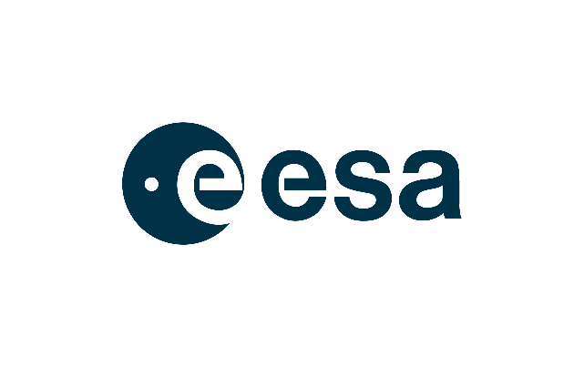
GEOSS Platform – Data Brokering
R. roncella¹, m. santoro¹, P. Mazzetti¹, G. Colangeli², A.scremin², e. li santi², j. van bemmelen²
CEOS WGISS-53 – 22/03/2022
1. National Research Council of italy – institute of atmospheric pollution research (cnr-iia) ^{2. european space agency (esa)}

Slide 2
OUTLINE
GEOSS Platform Focus
GEOSS Platform components
GEOSS Views and Filters
GEO-DAB Supported Standards
Possible enhancements
Notes:
Note1(empty collection): most of Fedeo Collections seem to be empty, but also the last results in CWIC and IDN sources contain empty collections
Note2(mistaken link format): https://cmr.earthdata.nasa.gov/search/concepts/C1459296627-LARC_ASDC.xml
Note3(filters): such as for sentinel or landsat

Slide 3
GEOSS Platform Focus
Improving the experience of the users of in particular as regards the accessibility and usage of services and knowledge
Exploiting the potential of the ……... infrastructure to the maximum extent
Reinforce European Participation in
Increasing access to and use
of heterogeneous data, including in situ measurements and data from regional and national
Delivering … services and knowledge, including for climate change adaptation and mitigation with a view to science-based decision making

Slide 4
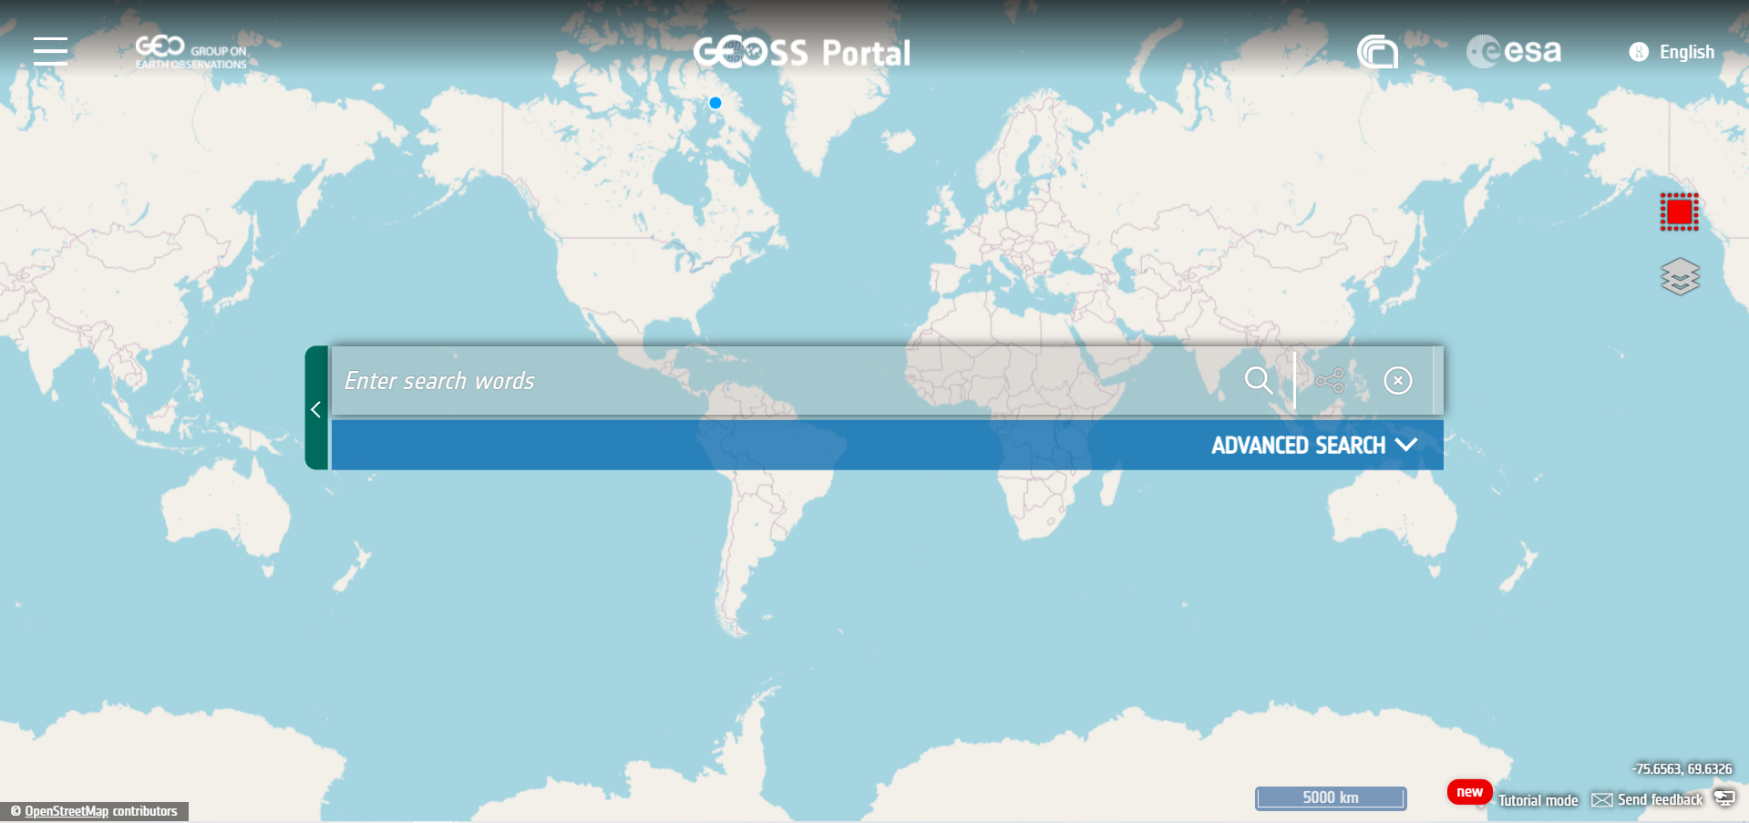
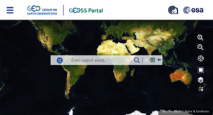
GEOSS Platform Enhancements Drivers
Enhancements DRIVERS
Lessons-learned from the evaluation of the implementation of the EU Strategy on Adaptation to climate change (COM(2018)738)
Priorities identified under the European Green Deal
Requirements expressed by the Mission on Adaptation to Climate Change including Societal Transformation
Enhancements High level Objectives
Enhanced GEOSS Portal concept: more dynamic – customisable according to user needs.
In-situ
Knowledge Generation
Actionable Information

Slide 5
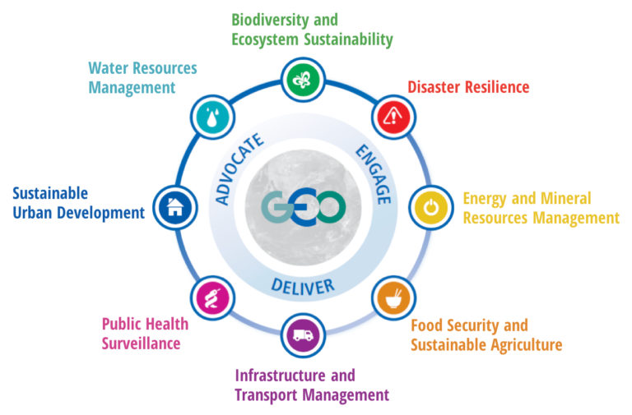
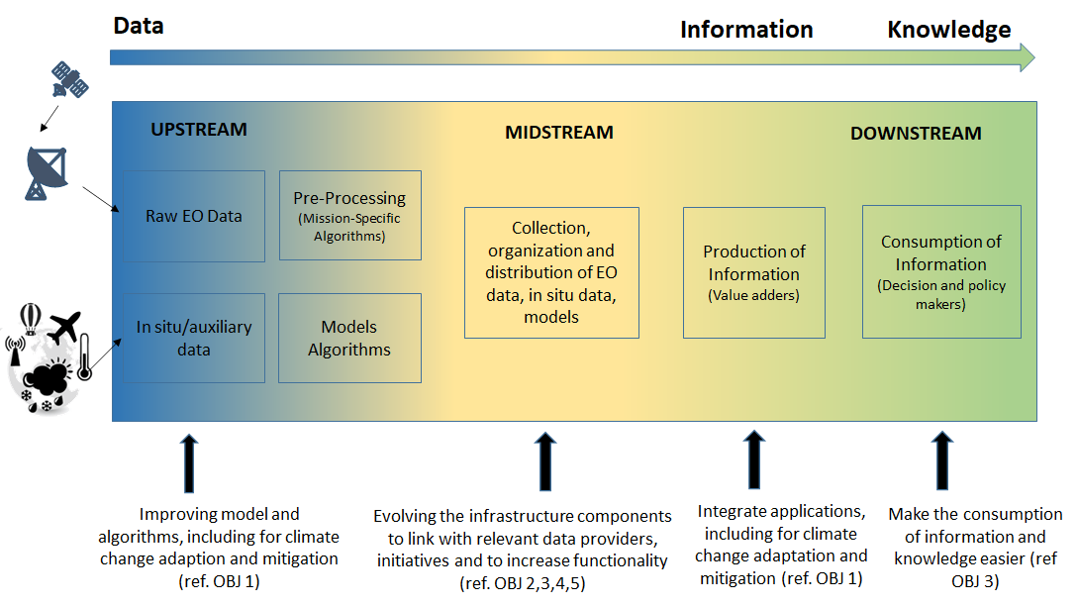
GEOSS Platform is user and technology oriented
Users
User-centric: This regards functional evolutions required by users to access tailor-made information and actionable knowledge. Next activities will focus on services to non-specialists in the domain of adaptation to extreme climatic events and to changes in climatic conditions.
Architecture/infrastructure/technology driven: This should lead to full exploitation of the GEOSS infrastructure and its components, in particular evolutions agreed by the GEOSS Infrastructure Development Task Team (GIDTT), and be driven by trends in IT, leading to a more user-friendly, up-to-date, and therefore, familiar environment.

Slide 6
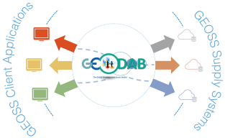
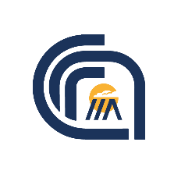
GEOSS Platform main components
Enhanced GEOSS Portal concept: more dynamic – customisable according to user needs.
Enhanced GEOSS Discovery and Access Broker: connects users with GEOSS providers.
GEOSS
Status
Checker
To monitor health and store consolidated scores of resources
GEOSS Status Checker
GEOSS
Yellow
Pages
Entry Point for new resource providers and information regarding them
GEOSS Yellow Pages

Slide 7
GEOSS Views and Filters
Views
Subset of the whole GEOSS resources defined by applying, via the GEO-DAB component, a set of clauses:
Discovery clauses (e.g. spatial envelope, keywords, data sources, etc.)
Access clauses (e.g. access protocol, data format, CRS, etc.)
Examples:
Global Observation System for Mercury (GOS4M)
All-Atlantic Ocean Data Community
Digital Belt and Road (DBAR)
…
Filters
Show statistical information on the result set: number of datasets provided by the brokered sources, frequency of terms from keyword, data format, protocol, organisation
Allow to filter out unwanted results by selecting only those of interest
Examples (specific filters):
Sentinel filters: Cloud Coverage, Product Type, Sensor Mode, Sensor Swatch, Sensor Polarisation, etc.
Earthquake filters: Magnitude Type, Magnitude Limit, Depth, etc.

Slide 8
GEO-DAB Supported Standards
GEO Discovery and Access Broker (GEO DAB) is a brokering framework interconnects hundreds of heterogeneous and autonomous supply systems
GEO-DAB supports more than 60 protocols to connect external services
GEO-DAB exposes several standards interfaces:
OGC Services (CSW, WMS, WCS…)
OpenSearch (used with GEOSS Portal)
Open Archive Initiative (OAI) PMH
…
GEO DAB presently brokers more than 190 open data catalogs and information systems in the GEOSS Platform

Slide 9
GEOSS Platform - CEOS Catalogues
Three brokered catalogues:
CEOS International Directory Network (IDN)
CEOS WGISS Integrated Catalog (CWIC)
Federated EO Gateway (FedEO) – CEOS
Protocol used: OpenSearch
First-level Query: Collections Harvested
Second-level Query: Granules Distributed
Possible enhancements:
Avoid Empty Collections
Custom filters on granules search
Custom views focused on specific use-cases

Slide 10
Thank you for your attention!

