Slide 1
STAC API for federated search
WGISS-53
March, 2022
Doug Newman
NASA ESDIS
douglas.j.newman@nasa.gov
This document does not contain technology or Technical Data controlled under either the U.S. International Traffic in Arms Regulations or the U.S. Export Administration Regulations.

Slide 2
Summary
STAC is a great candidate for a federated search solution
It has a lot of traction in our community beyond the use case of federated search
OpenSearch development is somewhat static
STAC can be used for federated search using the same CWIC architecture
Proposal: develop a parallel STAC implementation in CWIC

Slide 3
Acronyms
CCMEO | Canada Centre for Mapping and Earth Observation | MAAP | Multi-Mission Algorithm and Analysis Platform
CWIC | CEOS WGISS Integrated Catalog | NOAA NCEI | National Centers for Environmental Information
EUMETSAT | European Organisation for the Exploitation of Meteorological Satellites | NRSCC | National Remote Sensing Center of China
HATEOAS | Hypermedia as the engine of application state | OAFeat | OGC API - Features
IDN | CEOS International Directory Network | OSDD | Open Search Descriptor Document
INPE | Instituto Nacional de Pesquisas Espaciais | STAC | SpatioTemporal Asset Catalog
ISRO | Indian Space Research Organisation | USGS LSI | US Geological Survey Langelier Saturation Index

Slide 4
Introduction
Open Search and STAC overview

Slide 5
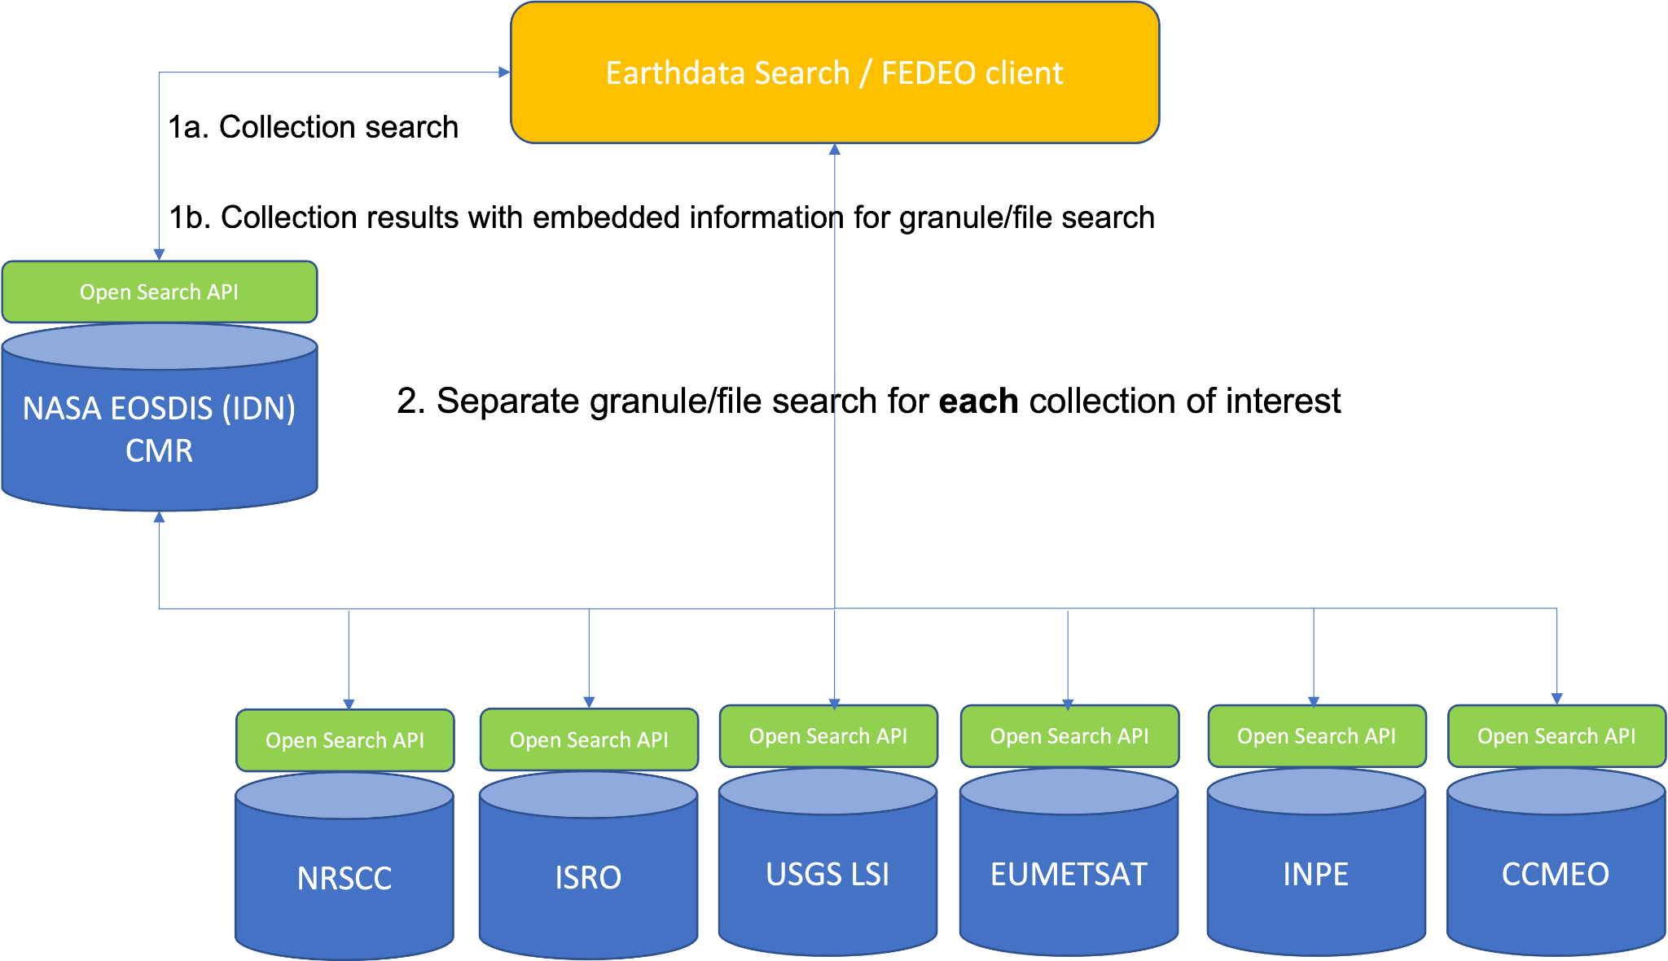
CWIC architecture today

Slide 6
Requirements of implementation
An accepted, standard protocol
The ability to provide two-step search
Hypermedia as the engine of application state (HATEOAS)
An accepted standard result format
Machine-readable API description or standard API

Slide 7
Opportunity
STAC versus Open Search

Slide 8
The state of Open Search
The implementation of CWIC federated search using Open Search was extremely successful
Open Search solved one problem extremely well
Is not used widely outside of the federated use case
Anecdotal evidence of some CWIC provider’s desire to retire their Open Search APIs

Slide 9
The case for STAC API
Already solves use cases outside of the federated use case (cloud-friendly discovery, for example)
Has all the features that made Open Search attractive for the implementation of a federated search architecture
Some CWIC providers have developed their own STAC APIs (NASA, INPE)
Existing, vibrant community and tooling (all open source)
STAC Browser
STAC API
pystac and intake-stac
CMR and CMR STAC are open sourced and being used successfully by MAAP and NOAA NCEI
STAC is specific to the earth science data domain

Slide 10
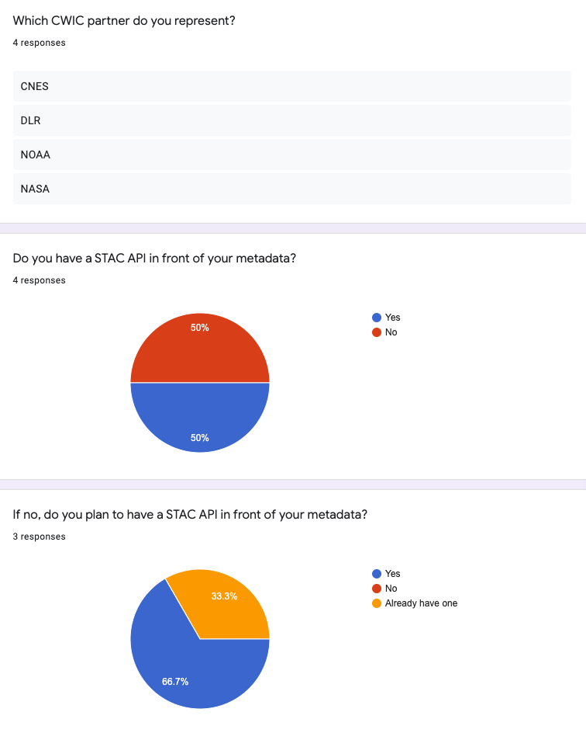
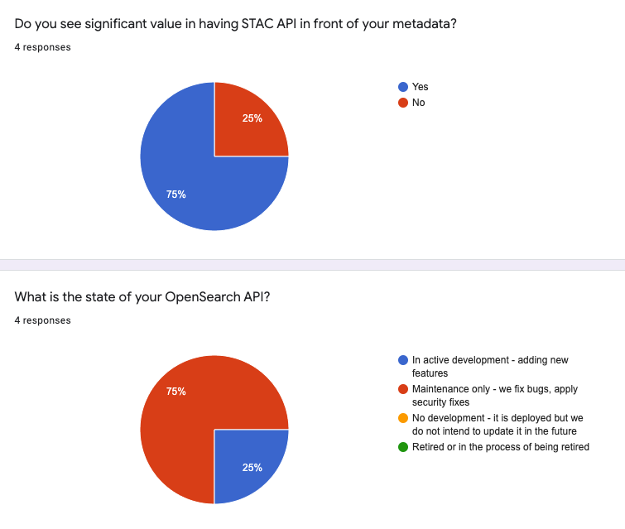
STAC API disposition in CWIC

Slide 11
Proposal
CWIC architecture, STAC implementation

Slide 12
STAC API specification
Catalogs (CWIC - provider)
There’s always a root catalog
Contains other catalogs and collections
Collections (CWIC - collections or datasets)
Can contain other catalogs (called sub-catalogs) to group Items further
e.g., For Landsat-8 there might be sub-catalog by Landsat Path and Row
Ultimately contains Items which are similar in some way(s)
e.g., same instrument, same region containing data from different instruments, etc.
Items (CWIC - granules or files)
A single scene or set of datafiles for a specific location at a specific date and time (when/where)

Slide 13
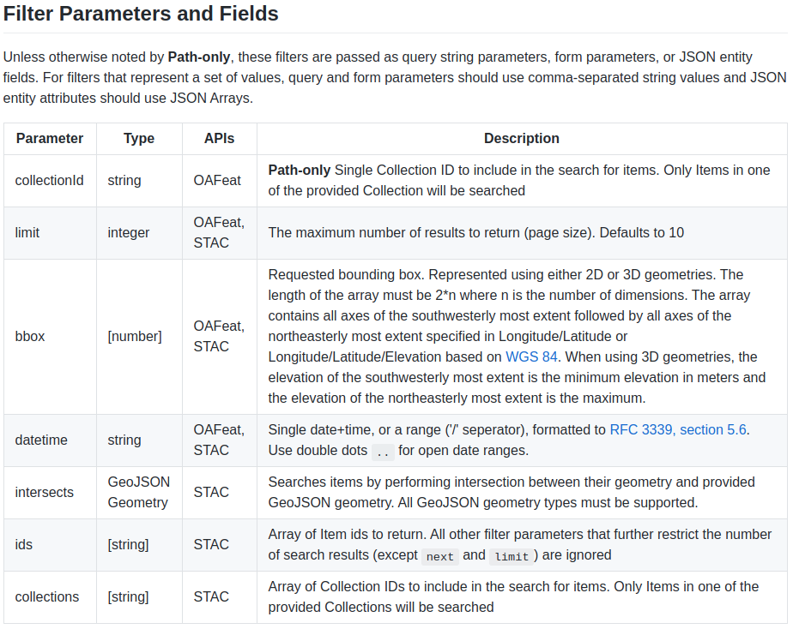
STAC API parameters
Notes:
Relevant STAC extensions:
https://github.com/stac-extensions/eo electro-optical bands and cloud cover
https://github.com/stac-extensions/projection projection
https://github.com/stac-extensions/scientific citations, DOI,

Slide 14
CWIC architecture
Notes:
The same as it is now but with STAC APIs.
Note: the addition of STAC does not preclude continued usage of OpenSearch.

Slide 15
STAC API implementation
Widely accepted standard
Hypermedia as the engine of application state (HATEOAS)
‘collection’ and ‘items’ implements two-step
JSON result format
Machine-readable API
{
"stac_version": "0.9.0",
"stac_extensions": [
"https://stac-extensions.github.io/eo/v1.0.0/schema.json",
“https://stac-extensions.github.io/projection/v1.0.0/schema.json”
],
…
}

Slide 16
Example
https://cmr.earthdata.nasa.gov/stac/ISRO/collections
collections:
[
{
id: "IMS1_HYSI_GEO.v1.0",
stac_version: "1.0.0-beta.2",
license: "not-provided",
title: "IMS-1 HYSI TOA Radiance and Reflectance Product",
description: "The data received from IMS1, HySI which operates in 64 spectral bands in VNIR bands(400-900nm) with 500 meter spatial resolution and swath of 128 kms.",
links:
[
...
{
rel: "items",
href: "https://uops.nrsc.gov.in/stac/collections/IMS1_HYSI_GEO.v1.0/items",
title: "Granules in this collection",
type: "application/json"
}
...
},
]
Search step 1: collection-level search at NASA CMR
Standards based, JSON result format
HATEOAS - links including ‘searching within this collection’
Search step 2: file-level search at partner STAC API
Machine-readable API from STAC standard
Notes:
https://cmr.earthdata.nasa.gov/stac/GES_DISC/collections?datetime=2009-04-22T00:00:00.000Z/2009-04-23T00:00:00.000Z
https://cmr.earthdata.nasa.gov/stac/GES_DISC/collections/ACOS_L2_Lite_FP.v7.3/items?datetime=2009-04-22T00:00:00.000Z/2009-04-23T00:00:00.000Z

Slide 17
STAC API implementation risks
No OSDD concept
Less flexible to develop
More assumptions when working with API
Best practices and guidelines need to be established
STAC-adherence of federated APIs (similar risk to Open Search)
Notes:
The lack of OSDDs:
Development flexibility - with OpenSearch you could name your parameters anything you like as long as you mapped them to a standard parameter in the OSDD. Here a bbox is a bbox.
API interaction: Here we have to rely on the STAC specification rather than an explicit document (OSDD) to programmatically construct a query to either the collection level or item level resource. In OpenSearch, understanding the protocol and reading the OSDD allow you to programmatically construct a query. With STAC, you need to understand the protocol, the API and the extensions that API might support.
STAC adherence: with the lack of OSDDs a client needs to trust that a federated STAC API adheres to the standard and certain extensions. This is similar to the risk we had/have with OpenSearch where guidelines and Best Practices are assumed by clients but not always followed by APIs. With the lack of OSDDs it is, imho, a slightly higher risk.

Slide 18
Questions

