Slide 1
Executive Summary
Hyperspectral Data Store and Access is an ESA GSTP project aiming to provide a cloud-native access to multidimensional data.
Formats trade-off resulted in the selection of Zarr format.
Implementation of Zarr-based Data Store prototype (OVH + AWS).
Converted PRISMA, Sentinel-2, ENVISAT, Copernicus products.
Proposed GeoZarr format supporting geospatial data and visuals.
Demonstrators including Jupyter Notebooks, OpenLayers, FedEO + STAC catalogue, advanced applications.
Results:
Outstanding performances based on independent portions (chunks) that are parallel-friendly, big-data friendly, and can be optimised (e.g. time).
Affordable and scalable object storage (store is cloud-agnostic).
Multidimensionality is an asset, facilitates time series/spectrum analysis.
Serverless : efficient and facilitate applications development with many libraries.

Slide 2
Data Storage and Format on Cloud
CEOS WGISS-53
Christophe Noël (Spacebel)
23 March 2022
Notes:
This presentation describes the GSTP project for the European Space Agency achieved by ScanWorld and Spacebel.

Slide 3
Outline
Project Context and Objectives
Introduction to Zarr Data Format
GeoZarr Demonstrator and Achievements
Demonstration Notebooks
OpenLayers GeoZarr Extension
Catalogue Integration
Advanced Applications
Project Outcomes

Slide 4
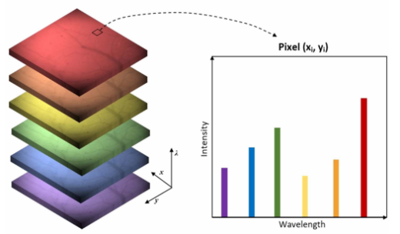
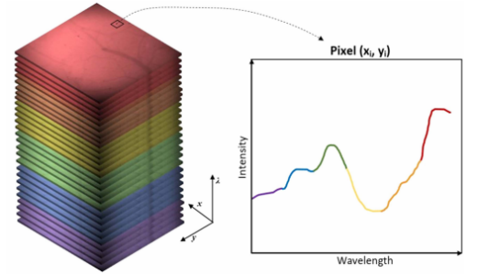
Project Context & Objective
Hyperspectral Data Store & Access
General Support Technology Programme
Cloud-Native Store for Hyperspectral Imagery
High Scalability
Reduced Costs
Native Data Access
Parallel friendly
Multidimensional

Slide 5
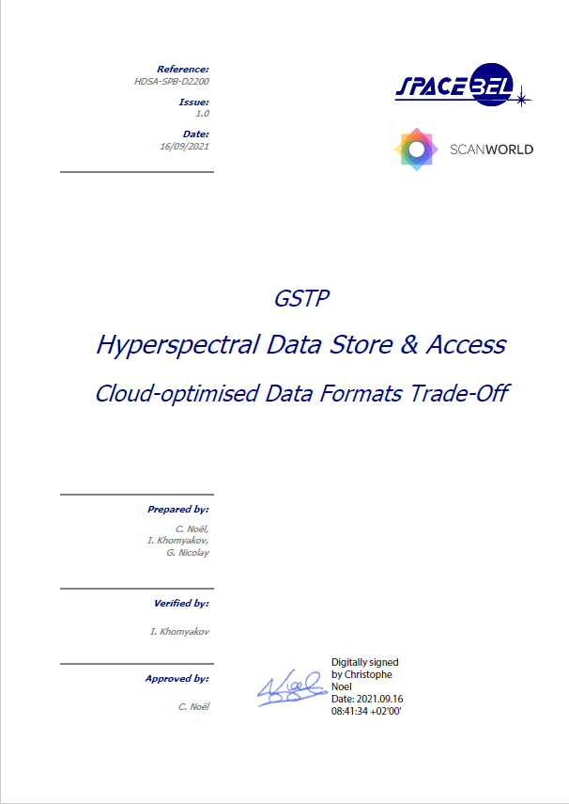
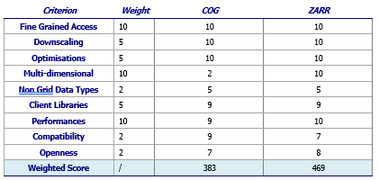
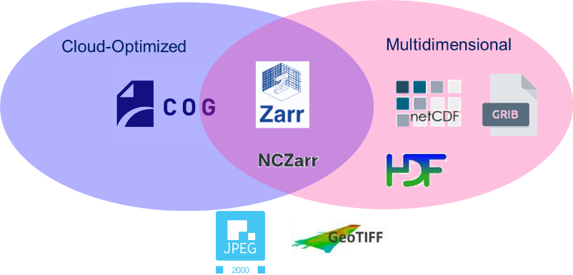
Cloud-Native Format Trade-Off
Selected Zarr: cloud-optimised and n-D array

Slide 6
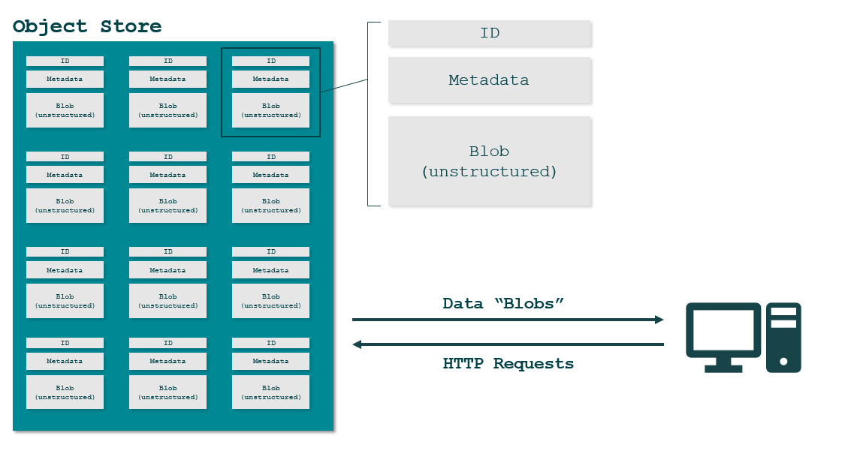
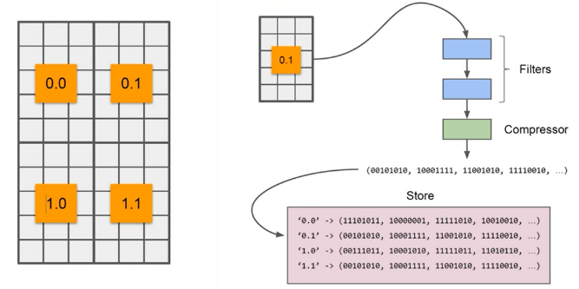
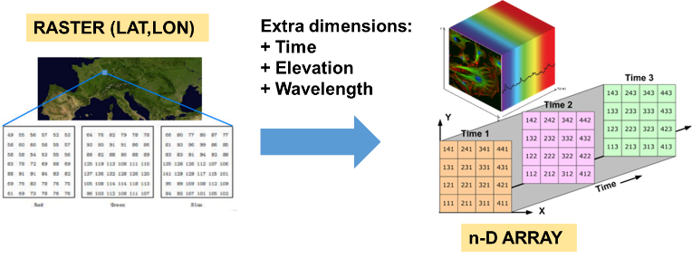
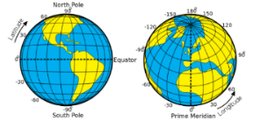
Assets of Zarr
Chunks: independent portions (parallel processing)
S3: affordable, scalable, cloud-agnostic
Multidimensional Array
Native Access (Serverless)
Extensible…

Slide 7
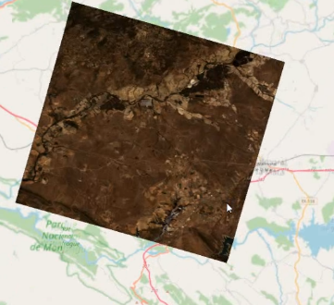
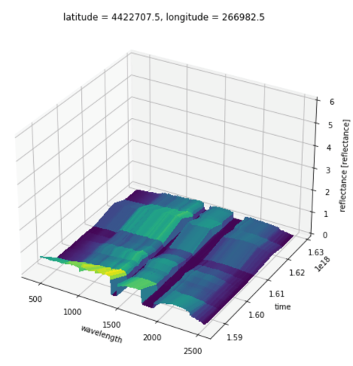
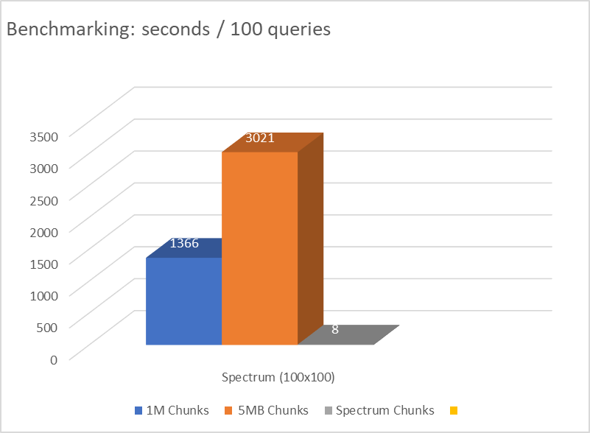
Benefits of Zarr Chunking
Fast on
Spatial Dimension
Fast on
Spectrum & Time

Slide 8
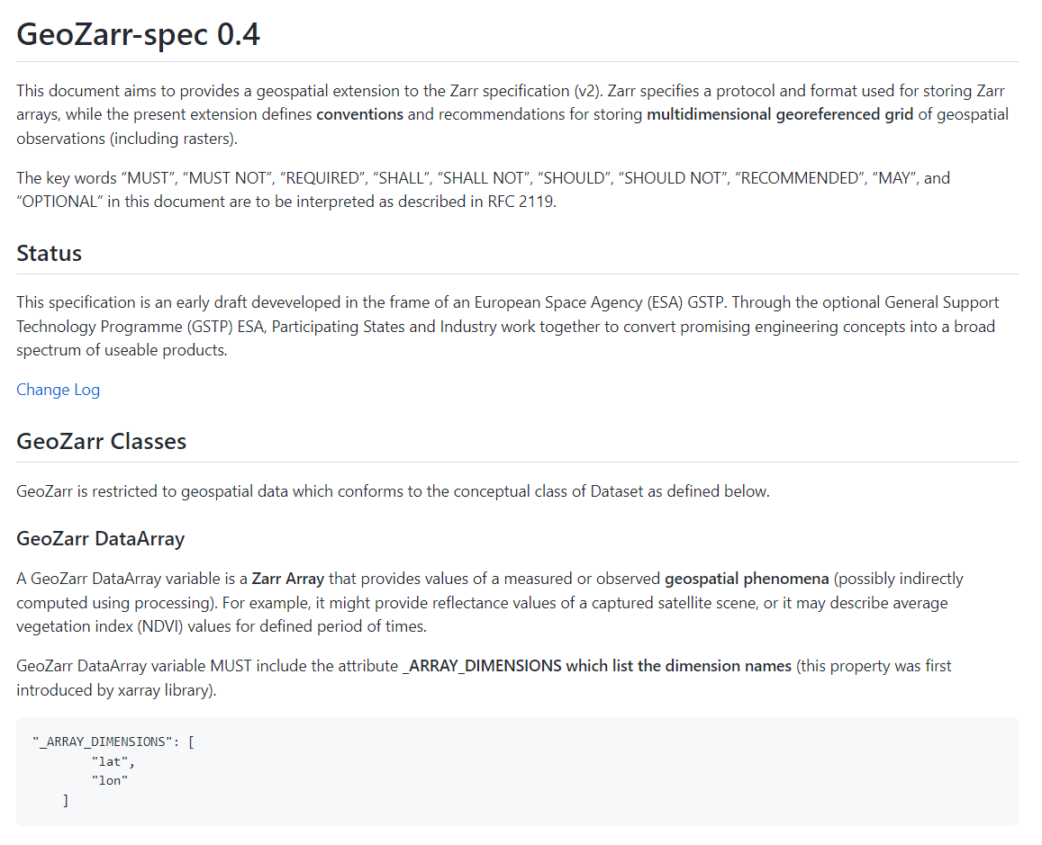
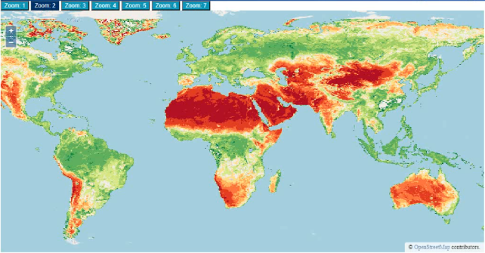
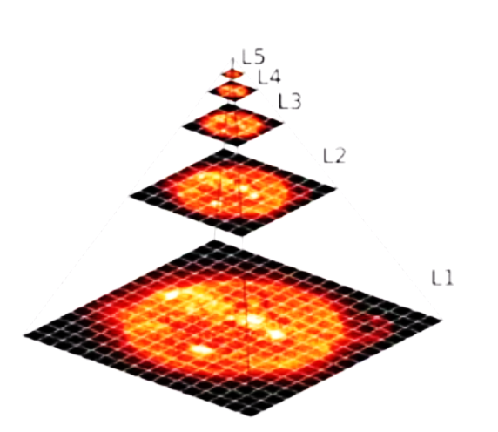
Zarr Extension - GeoZarr
Dataset Definition (xArray)
Geospatial Semantics
→ Climate and Forecast Conventions
Multiscales and Symbology
Notes:
Zarr specification includes no support for geospatial data.
We provided a set of recommendations. Its includes the adoption of CF conventions (from NetCDF) providing spatio temporal semantics, we also proposed constraints to facilitate the support by third parties, and we also adapted a multiscale draft to geospatial data.

Slide 9
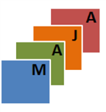
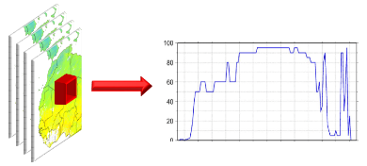
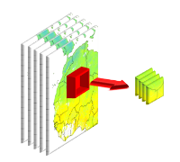
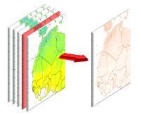
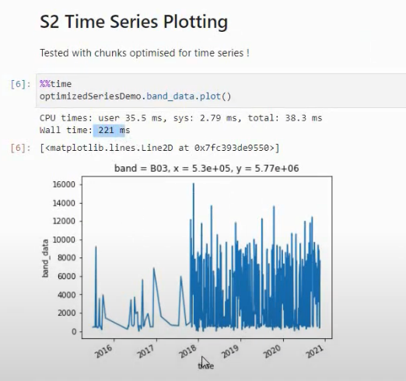
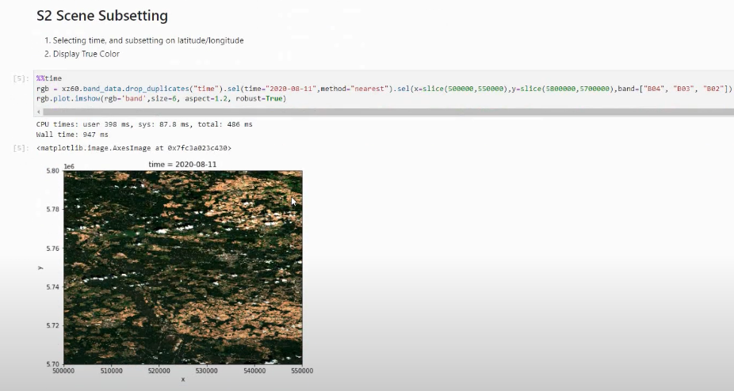
GeoZarr – Demonstration Store & Notebooks
10 scenes
15 Scenes (L2D)
1500 scenes (L2A)
55 Scenes
200ms !

Slide 10
GeoZarr - OpenLayers Extension Prototype
DIMENSION DISCOVERY & TRIMMING
RGB ARRAY SELECTION

Slide 11
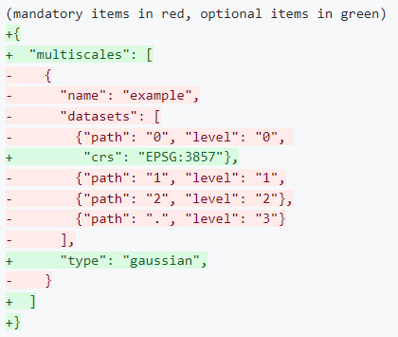
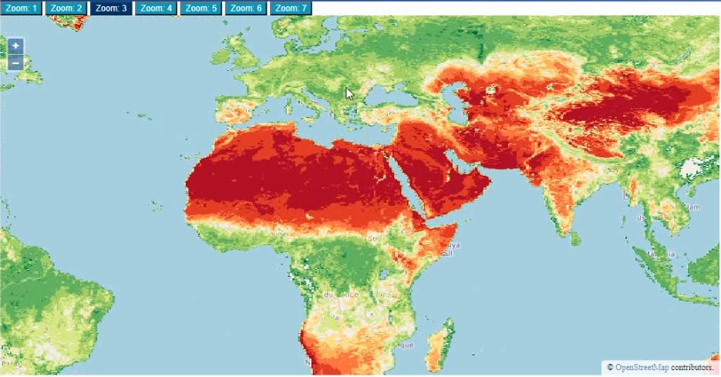
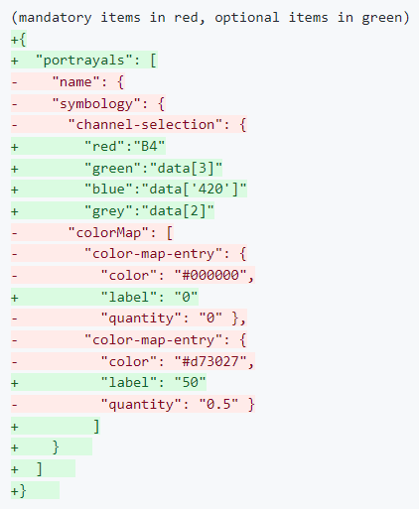
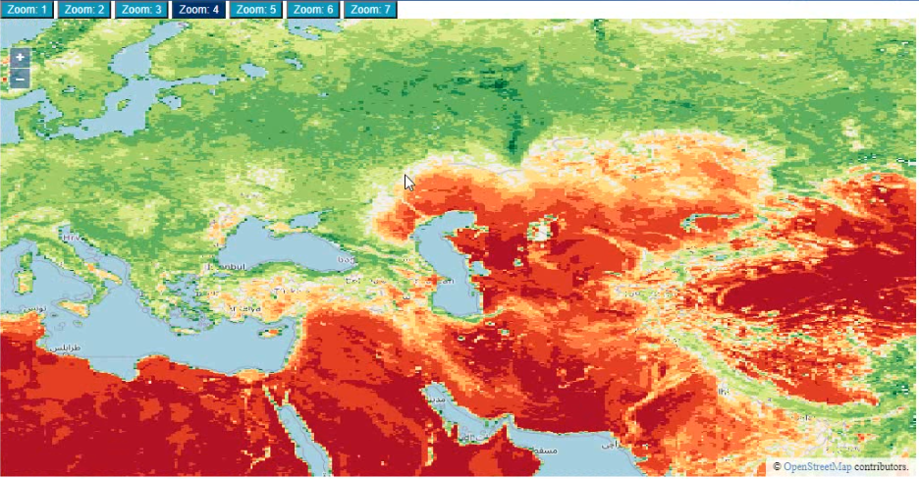
GeoZarr - Multiscales & Symbology
GeoZarr - Multiscales
GeoZarr - Portrayals

Slide 12
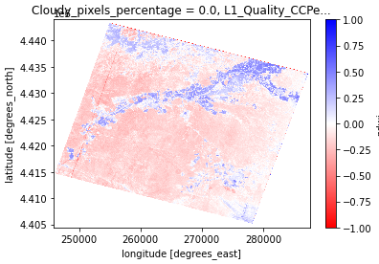
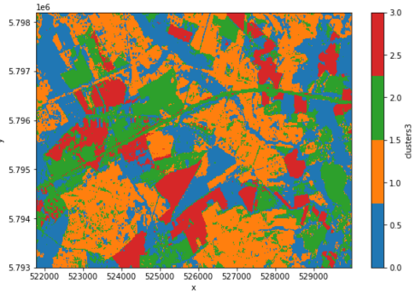
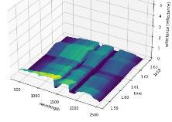
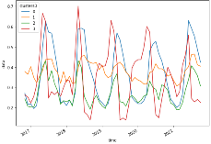
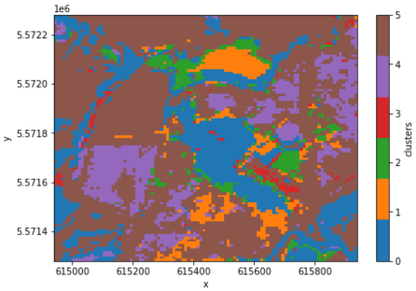
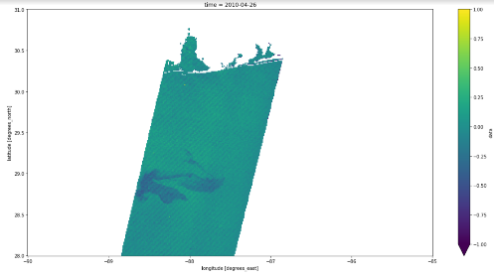
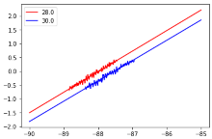
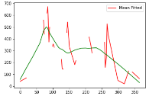
GeoZarr – Advanced Application (ScanWorld)
APP 1 (agriculture) Identification of Crop Status PRISMA
APP 2 (agriculture) Soil organic carbon monitoring SENTINEL-2
APP 3 (forestry) Identification of tree species using A.I.
Sentinel-2
APP 4 (water) Oil spills monitoring
ENVISAT

Slide 13
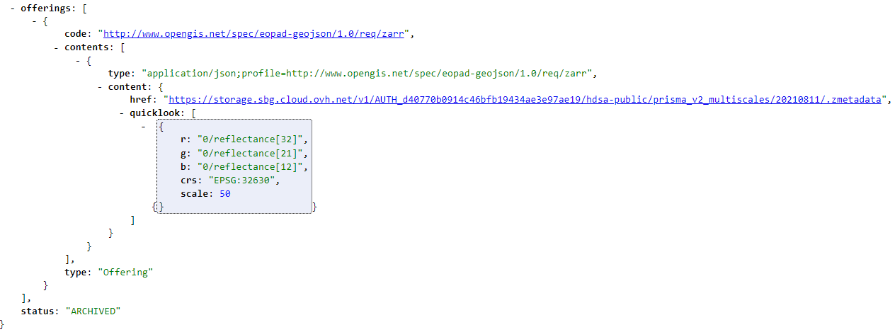
Catalogue & STAC Integration
Visual portrayal based on quicklook RGB attribute
→ not required if GeoZarr portrayals available

Slide 14
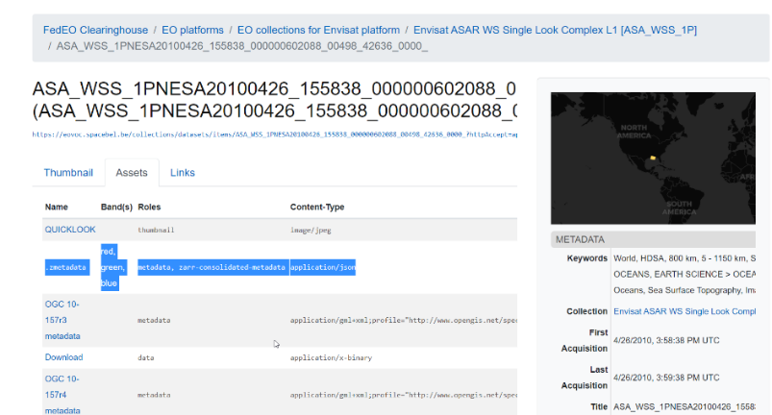
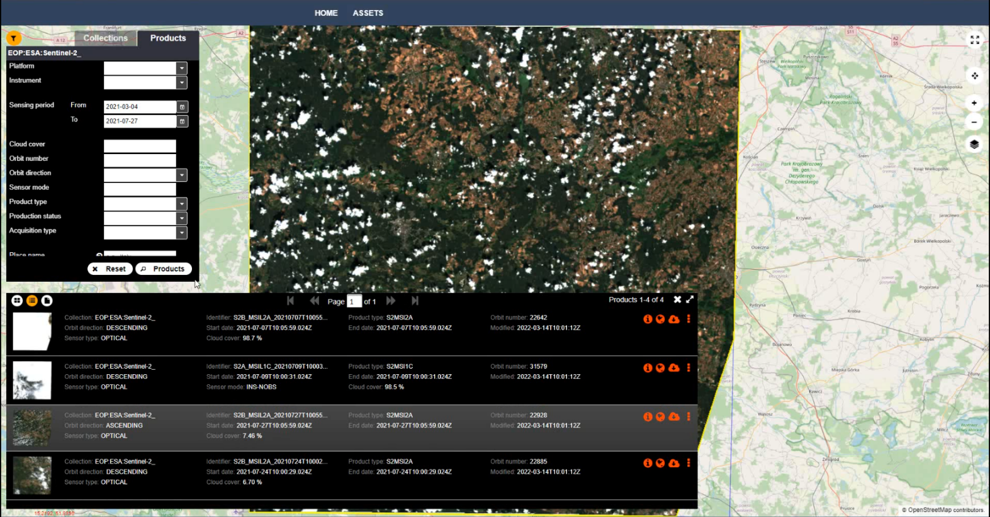
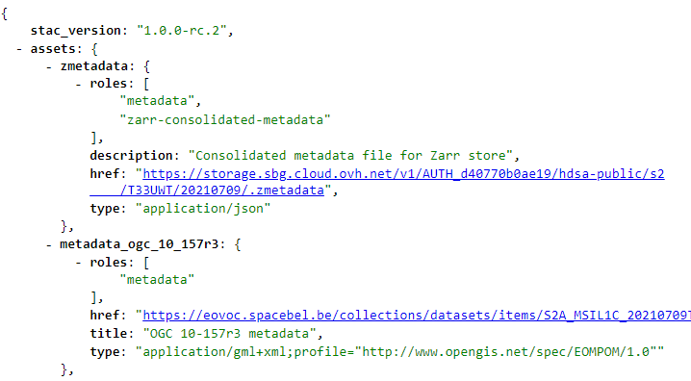
Catalogue & STAC Integration (2)
Zarr Display
Zarr Quicklook

Slide 15
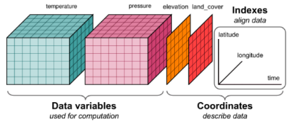
GeoZarr – Project Outcomes
MultiSpectral
Latitude / Longitude
L3/ARD Products
Time
Hyperspectral
Wavelengths
(Bands)
Altitude
...
Pixel-based Access (serverless)
Visualisation (serverless)
Combine Multiple Variables
Spectral Analysis
Time Series
Any Dimension Condensing or Resampling
Requires spatio/temporal resampling (e.g. GDAL/superimpose)
Serverless & Library-Friendly
Superfast +
Optimised Chunking
Highly Scalable
Cloud-Agnostic

Slide 16
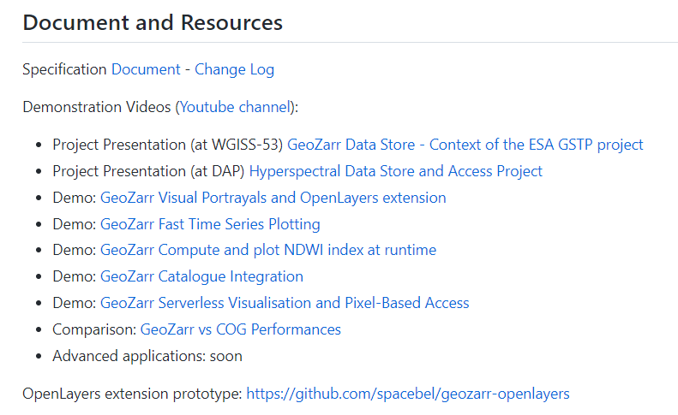
Questions ?
https://github.com/christophenoel/geozarr-spec

