Slide 1
Federated Earth Observation (FedEO)
Yves Coene (Spacebel), Damiano Guerrucci (ESA), Mirko Albani (ESA)
CEOS WGISS #53
22/03/2022

Slide 2
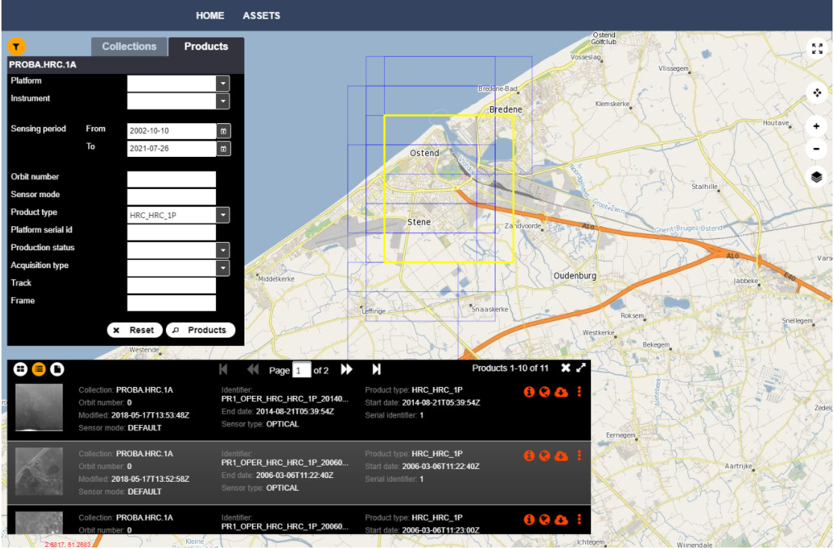
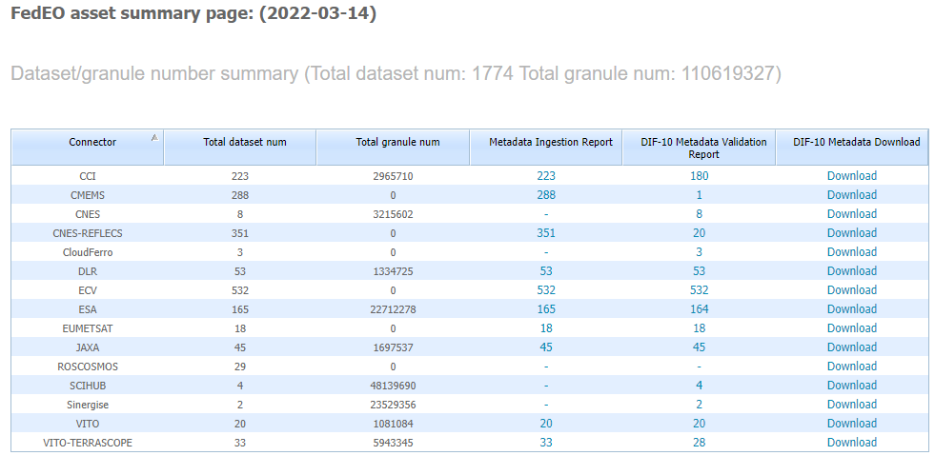
Executive Summary
FedEO in CEOS domain
Client and Server available under CEOS domain
WCDA Client Partner Guide update - 26/11/2021.
FedEO current metrics and DIF-10 export status
Evolution: 107 to 112 million granules
Collections: 1774
DIF10 export improvements (DOI, Use_Constraints, ..)
Completed: ESA CCI collections (180) ready for IDN.
Ongoing: JAXA G-PORTAL collections (1131) and granules (19 million).

Slide 3
Outline
FedEO in CEOS domain
FedEO current metrics and DIF-10 export status

Slide 4
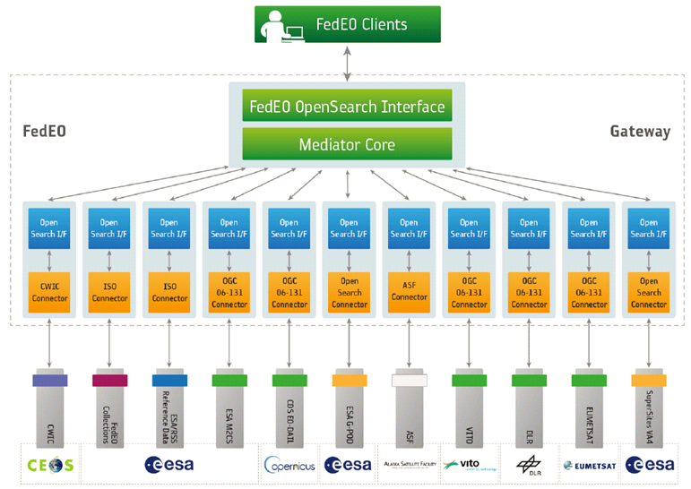
FedEO: Federated Earth Observation Gateway System
FedEO = Federated Earth Observation missions access
The FedEO system provides a unique entry point to a growing number of scientific catalogues and services.

Slide 5
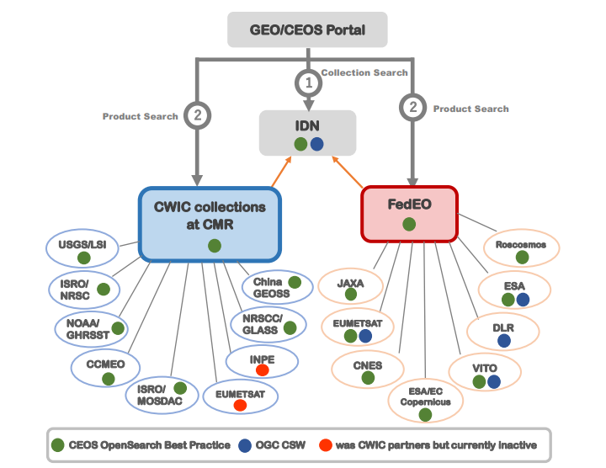
WGISS Connected Data Assets

Slide 6
FedEO Migration to CEOS Domain
Since 20 September 2021:
FedEO Client available at https://fedeo-client.ceos.org
FedEO Server available at https://fedeo.ceos.org/
Validation server available at https://geo.spacebel.be
Notes:
https://earth.esa.int/eogateway/news/new-version-of-the-fedeo-client

Slide 7
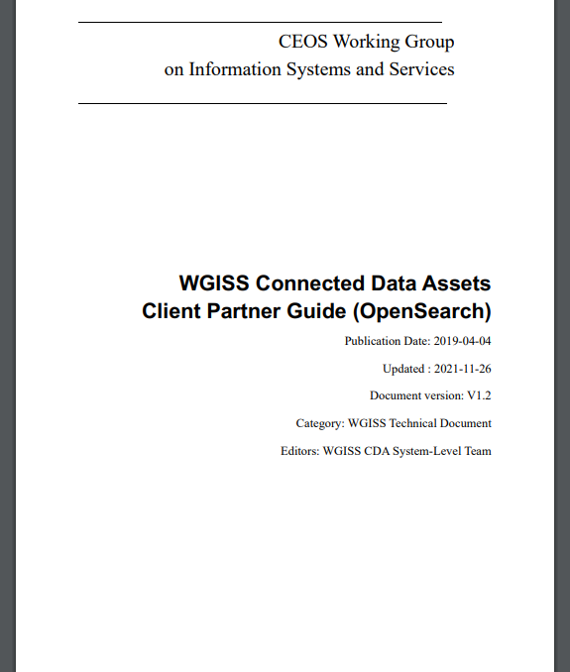
FedEO Migration to CEOS Domain
Documentation update:
WCDA Client Partner Guide (OpenSearch), v1.2, 26-11-2021, https://ceos.org/document_management/Working_Groups/WGISS/Documents/Discovery-Access/WGISS%20CDA%20OpenSearch%20Client%20Guide.pdf

Slide 8
FedEO Metadata Mediator
Automatic Procedure – Available on FedEO reference environment, on Operational environment at ESA since Oct 2019
Partner Metadata repository
Collection Metadata Import (pull, e.g. daily)
Harvester
Metadata Preparation
Metadata Mediator
IDN
Complementary
Information gcmd keyword
Metadata Preparation
IDN guideline for Information Content completeness and consistency
ESA Thesauri Service
FedEO Collection Catalogue
FedEO Gateway
ISO to DIF-10
pull
Collection Metadata Ingestion by IDN
DIF-10 Encoding
Mandatory GCMD terms
NASA DIF-10 Validator
(HERE)
IDN
repository
DIF-10 Validation

Slide 9
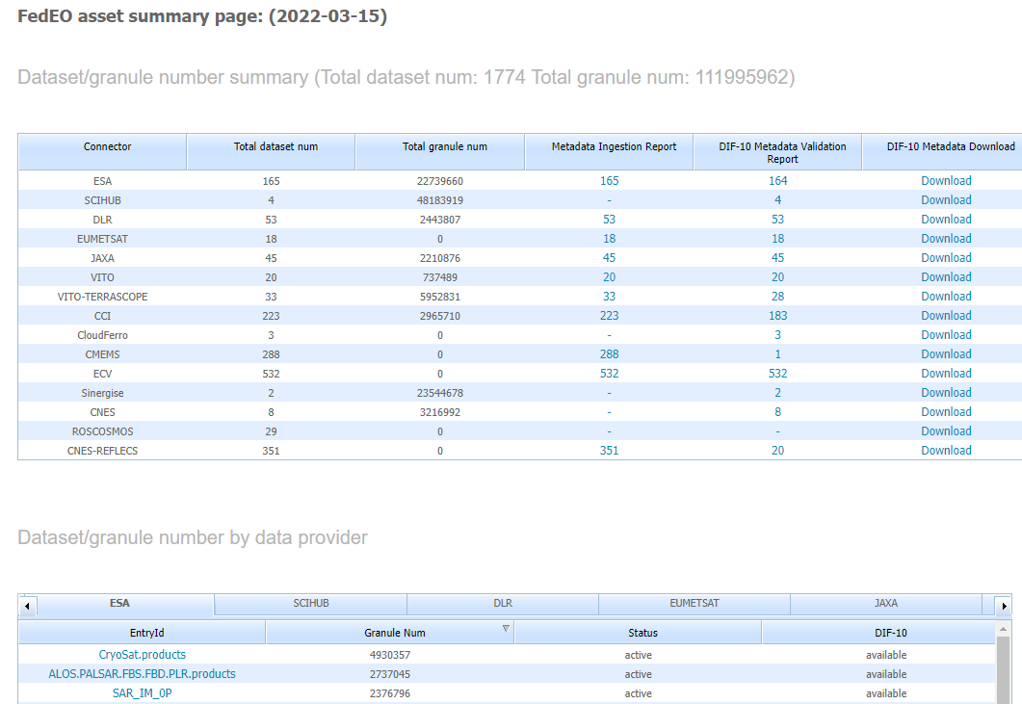
DIF-10 Metadata Export
https://fedeo.ceos.org/asset/index.html
Collections being harvested automatically by IDN, e.g. ESA, DLR, VITO.
ESA CCI 180 (ready to ingest in IDN).
See:
https://cmr.earthdata.nasa.gov/search/collections.umm_json?provider_id=FedEO&data_center=DE/DLR&pretty=true
https://cmr.earthdata.nasa.gov/search/collections.umm_json?provider_id=FedEO&data_center=VITO&pretty=true
https://cmr.earthdata.nasa.gov/search/collections.umm_json?provider_id=ESA&data_center=ESA/ESRIN&pretty=true
DIF-10 collections are available for being ingested into IDN, from
https://fedeo.ceos.org/asset/index.html
Notes:
https://cmr.earthdata.nasa.gov/search/collections.umm_json?provider_id=FedEO&data_center=DE/DLR&pretty=true
https://cmr.earthdata.nasa.gov/search/collections.umm_json?provider_id=FedEO&data_center=VITO&pretty=true
https://cmr.earthdata.nasa.gov/search/collections.umm_json?provider_id=ESA&data_center=ESA/ESRIN&pretty=true
https://access.earthdata.nasa.gov/holdings

Slide 10
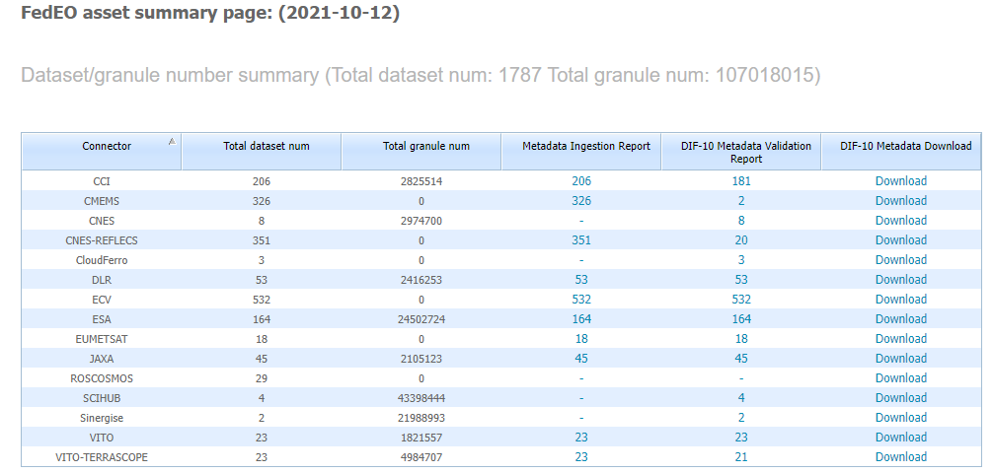
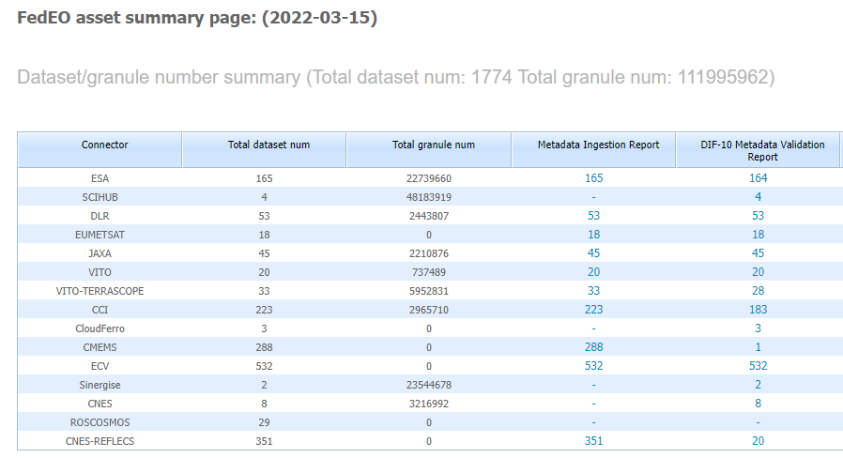
Metrics evolution
FedEO: 107 to 112 million granules since WGISS-52 (Oct. 2021)
ESA (EOCAT): 165 collections with 22.7 million granules.

Slide 11
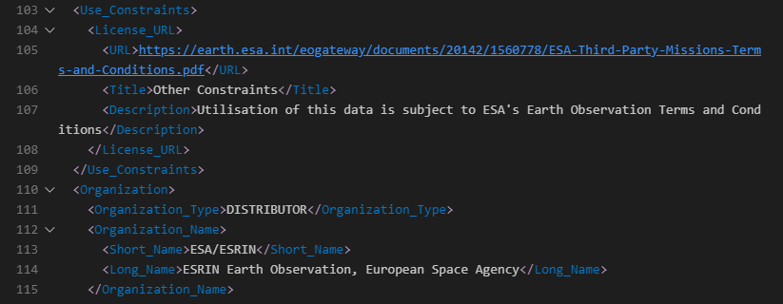
Software changes
DIF-10 export improved:
Use_Constraints included.
Version information included (when available).
DOI information included when available in ISO collection metadata from Partners.
DOI (ESA CCI)
Use_Constraints
DOI (ESA EOCAT)

Slide 12
Completed integration activities
ESA CCI
Collections: 223
Collections with valid DIF10: 180 (For others, too little info available in original ISO metadata records).
Two step-search integration (use of explicit media type to identify ISO collection metadata link still open). Different partners use different “rel” relations: “via”, “alternate”, “describedby”.
Granules: 2.9 Million
Insertion date in IDN: To be agreed.

Slide 13
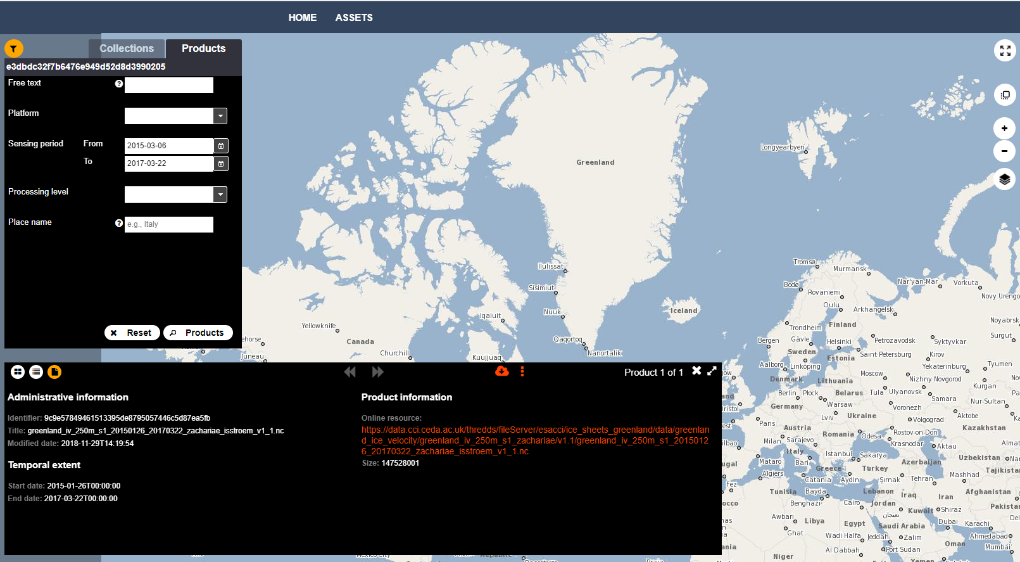
ESA CCI
Two-step search available:
“enclosure” and “related” links to data.

Slide 14
Ongoing integration activities
JAXA G-PORTAL (In FedEO validation/integration environment)
Collections: 1131
All collections with valid DIF10: 1131 (Remaining issues with CALET, CIRC, SLATS solved in ESA & GCMD Thesauri 17/3/2022).
Two step-search integration now underway.
Granules: 19 million

Slide 15
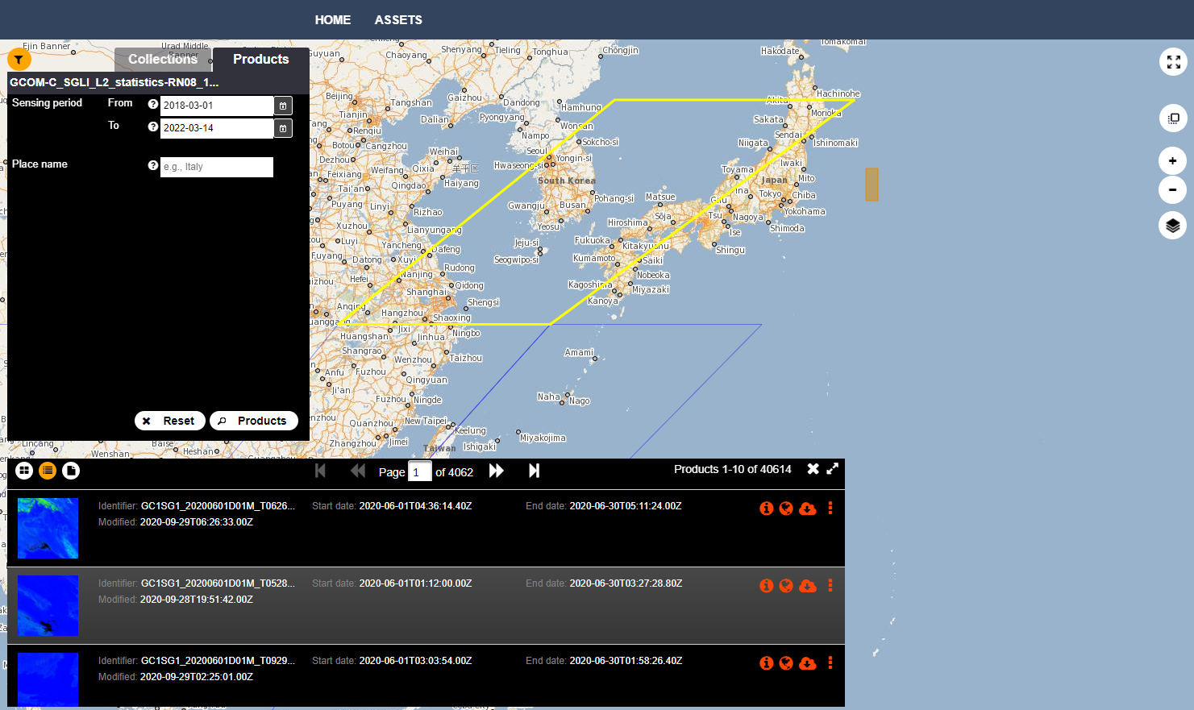
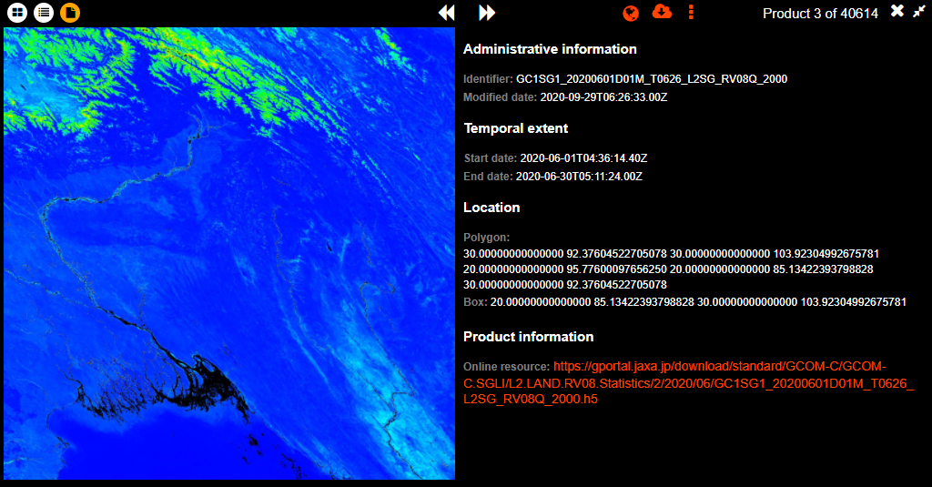

Slide 16
Ongoing integration activities
JAXA G-PORTAL ( In FedEO validation/integration environment )
Future work:
Exploit eop:EarthObservation information available in granule metadata.
Additional (standard) queryables for granule search. E.g. gpc:polarization, eo:orbitDirection, searchTerms.
Update online resource function codes in ISO collection metadata to have access in FedEO client and Atom response.
Test environment: https://fedeo-client.ceos.org/?url=https://geo.spacebel.be/opensearch/description.xml?parentIdentifier=EOP:JAXA:G-PORTAL

