Slide 1
WGISS 52 Summary and Discussion

Slide 2
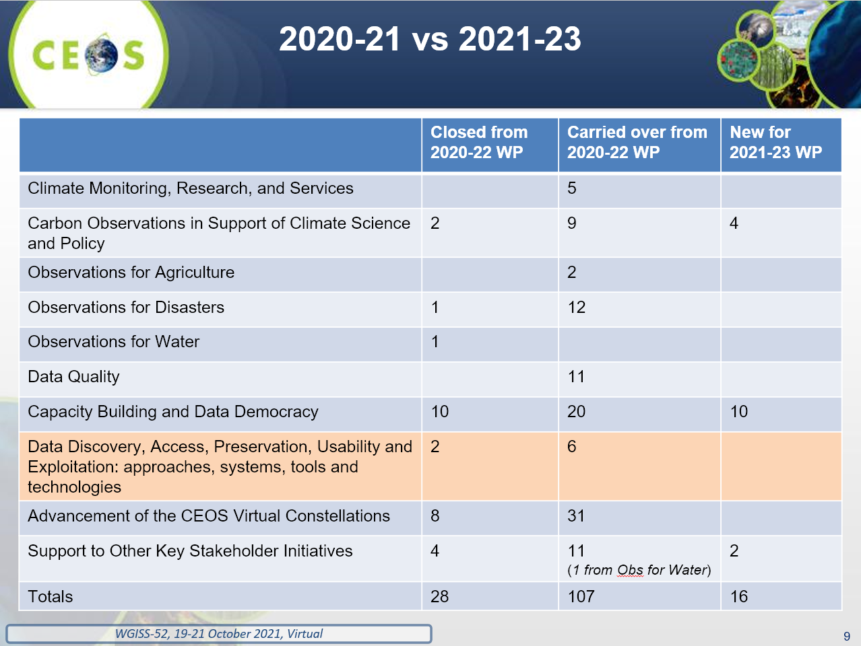
CEOS Executive Office report
CEOS Chair Theme links to WGISS:
Data deployments in the Cloud
EAIL and CEOS Data Cube
Data Cube and interoperability (data and APIs)
→ WGISS Future actions?
CEOS EAIL sustainability and expansion (More diverse nodes)
Jupyter initiatives with WGCapD
support ARD strategy – specifics?
GEO Mid-term evaluation: reassess the concept of GEOSS – WGISS action?

Slide 3
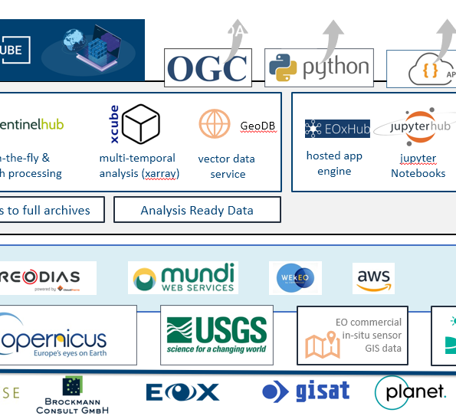
Enabling Open Science
Examples of accessing CEOS (Cloud) data in the more common APIs? → Jupyter Training target?
WGISS BP in science reproducibility (at least the part it contributes)? → how to assure and cite CEOS data sources
interoperable Data Cube APIs? → pick and promote a few common ones?
Cal/Val Standard → Link explicitly to ARD strategy?

Slide 4
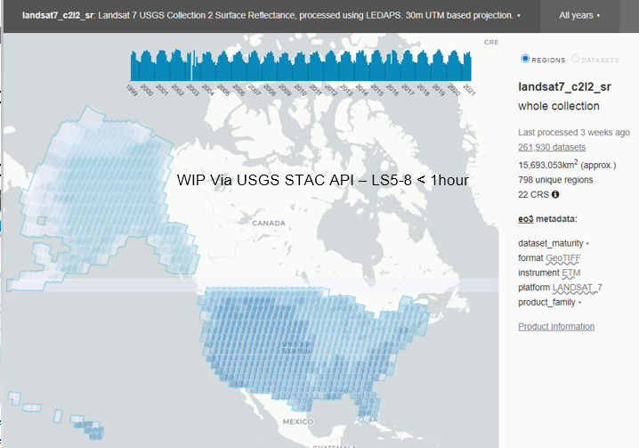
CEOS Data and Services in the Cloud
Discovery expanding:
Services BP – ESA lead
Cloud data (and replicas)
STAC browsing support
→ Continue yes, but generate some more specific actions for CEOS WP?
Massive increase in CEOS data in Cloud
used in EAIL
Continue yes, though more work to be done in interoperability, discovery, access, and use examples – actual interop experience feedback?
Cross-region – CEOS joint regional Caches?
Data Assurance in Cloud
→ Work to be done…

Slide 5
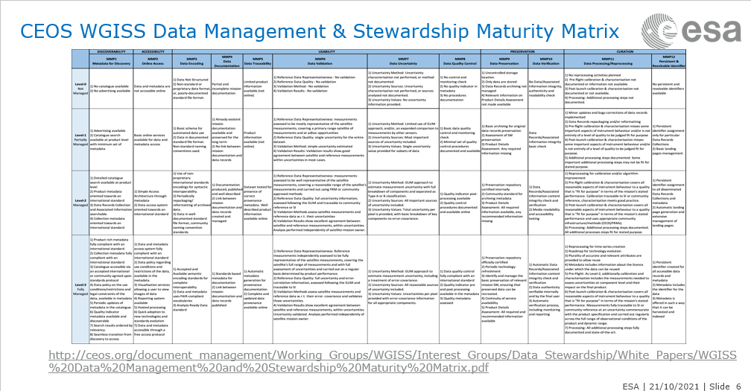
Data Preservation and Stewardship
Sharing Data Set Quality
WGISS Data Management & Stewardship MM
→ Well aligned to Open Science Theme particularly reproducibility and quality.
Data Integrity and Authenticity on Cloud
→Next action worked out

Slide 6
CEOS Plenary Presentation
Key outcomes?
Overall maturity and use of FDA, ARD markedly increased across agencies – now BAU?
Data in the Cloud
Availability!
Discovery is now much broader: Cloud, Download, replicas, Services and Tools, Quality, Maturity
EO Jupyter BP and capability building with WGCapD
CEOS EAIL
More nodes
Interoperability experiments
WGISS next steps
Embracing Open Science Theme
EAIL ongoing and expansion (Support EO Jupyter, Evaluate interop and use with CEOS projects)
Continue to address upcoming challenges in Discovery (including services), Quality and Authenticity in Cloud
Further EO Jupyter BP
Continue growth of Data in the Cloud
Notes:
showcase for the CEOS community, and especially for CEOS Principals and stakeholders, your WG's significant milestones, key accomplishments, and any matters for endorsement or specific consideration by the CEOS Plenary.

