Slide 1

Future Meetings
WGISS-52
October 21, 2021

Slide 2
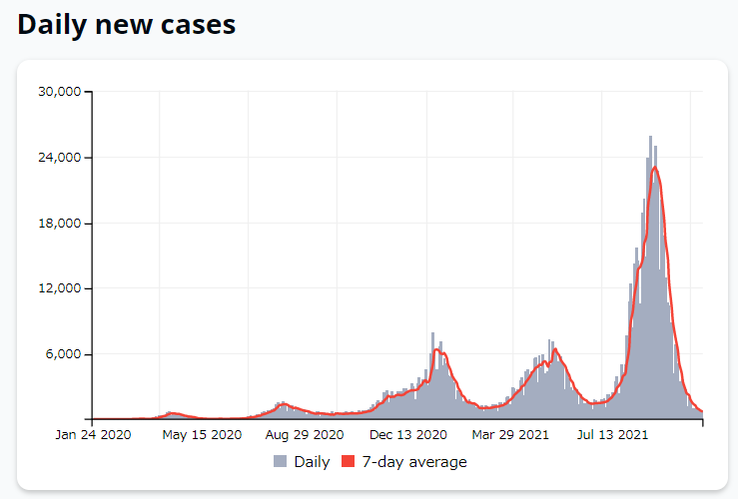
WGISS-53
WGISS-53 will be held on March 21-24, 2022, in Tokyo, as a hybrid style meeting.
The 4th Joint WS with WGCV is planned.
The number of cases for COVID-19 is decreasing but travels are still restricted. So, the final judgement is to be made in Jan. 2022.
https://covid19japan.com/

Slide 3
WGISS-54
CONAE kindly accepts the host of WGISS-54 in October in Buenos Aires.

