Slide 1
NASA Agency Report
Andrew Mitchell
WGISS 52
October 21, 2021

Slide 2
NASA Agency Report Executive Summary
Delivered 1.9 billion products to over 4 million users in FY20 ((Oct. 1, 2019 to Sept. 30, 2020) to every country in the world. NASA Earth Observing System Data and Information System (EOSDIS) data have been distributed to 195 independent countries
Provided data stewardship to almost 12,800 unique data sets for which we have minted over 9700 digital object identifiers that enable users to track data sets through publications and documentation.
By the end of FY20, had archived over 41.5 Petabytes of Earth Science data from more than 150 instruments, available to users worldwide.
Provided the ability to search over 34,500 data collections in the Common Metadata Repository, with 98% of queries completing in less than 1 second. The Common Metadata Repository itself has grown to manage over 710 Million data records describing NASA Earth science data collection, a 40% increase over last year.
  Scored 79 on the American Customer Satisfaction Index (ACSI) survey of users (over 9000) with an increase of 3000 respondents over last year. This continues the trend of high scores for EOSDIS performance, despite the pandemic, a shift to working from home, and changes in our NASA missions and the research community schedules and plans.
  The LANCE system supports over 760 unique near real-time datasets. In FY20, LANCE produced 1.8 Petabytes of data within 3 hours of satellite acquisition that were distributed to over 650,000 users. 90.9 million files were distributed in FY20.
  In FY20, Earthdata.nasa.gov website was visited by 436,402 people who visited/viewed over 1.7 million Earthdata information pages during the period. For the EOSDIS as a whole (including DAACs), we have 1.7 million people coming to our websites, viewing over 14.5 million pages of web-based information about Earth Science data and how to use it.

Slide 3
NASA’s Earth Science Data Systems Program
Actively manages NASA’s earth science data as a national asset (Satellite, Airborne and Field).
Develops capabilities optimized to support rigorous science investigations.
Processes (and reprocesses) instrument data to create high quality long-term earth science data records.
http://go.nasa.gov/2mMd5g1

Slide 4
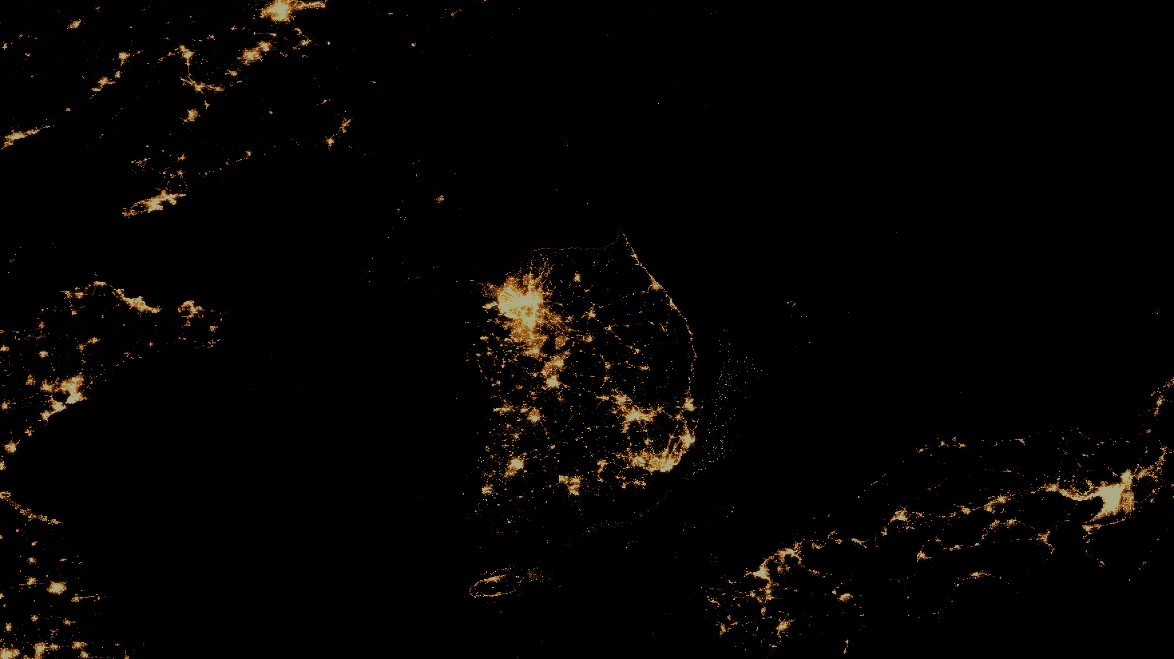
Earth Science Open Data Policy
Since1994
NASA Earth Science data are free and open to all users for any purpose as quickly as practical after instrument checkout and calibration
Notes:
"NASA's charter encourages the sharing of information." The National Aeronautics and Space Act of 1958 (as amended) states:
"The administration shall provide for the widest practicable and appropriate dissemination of information concerning its activities and the results thereof."

Slide 5
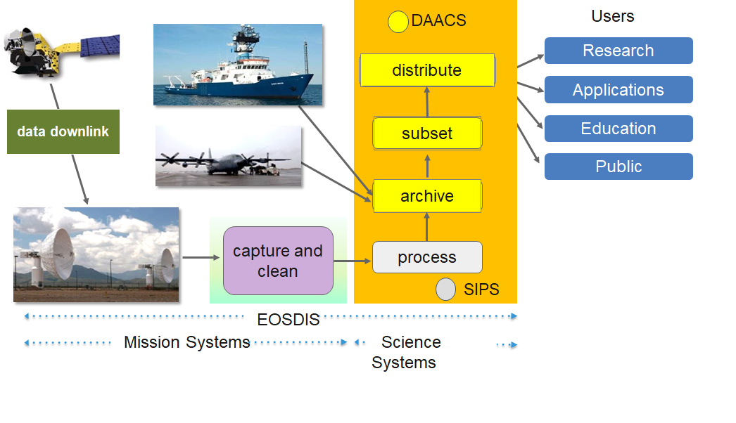
Earth Science Data and Information System (ESDIS)
The ESDIS Project manages the science systems of the Earth Observing System Data and Information System (EOSDIS). EOSDIS is a comprehensive distributed Earth science data and information system designed to support NASA's Earth science missions.
EOSDIS is designed to ingest, archive, distribute, visualize, all types of Earth Science data which include field campaign measurements, airborne data, in situ data, model data, ancillary products used for processing and other related datasets.
The ESDIS Project provides and controls all aspects of the effort including but not limited to requirements, design, acquisition, development, operations, maintenance and decommission.
Operating since 1994, it has been evolving to keep pace with technology and users' requirements.

Slide 6
Earth Science Data System (ESDS)
Open Source Policy
NASA’s ESDS requires that all software developed through research and technology awards (i.e., ROSES or unsolicited proposals) or in-house government funded development is to be made available to the public as Open Source Software (OSS). This includes all software developed with ESDS funding used in the production of data products, as well as software developed to discover, access, analyze, visualize, and transform NASA data. This policy does not apply to commercial off-the-shelf (COTS) software.
https://earthdata.nasa.gov/earth-science-data-systems-program/policies/esds-open-source-policy
Notes:
Image Source: https://unsplash.com/photos/QckxruozjRg

Slide 7
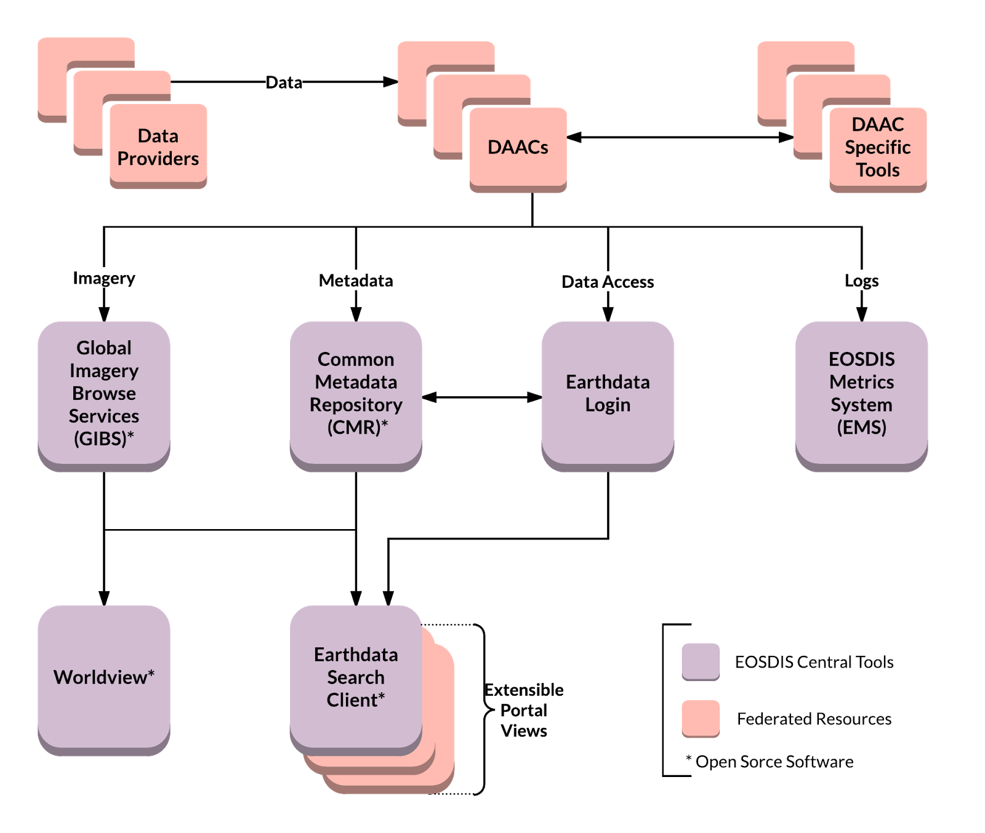
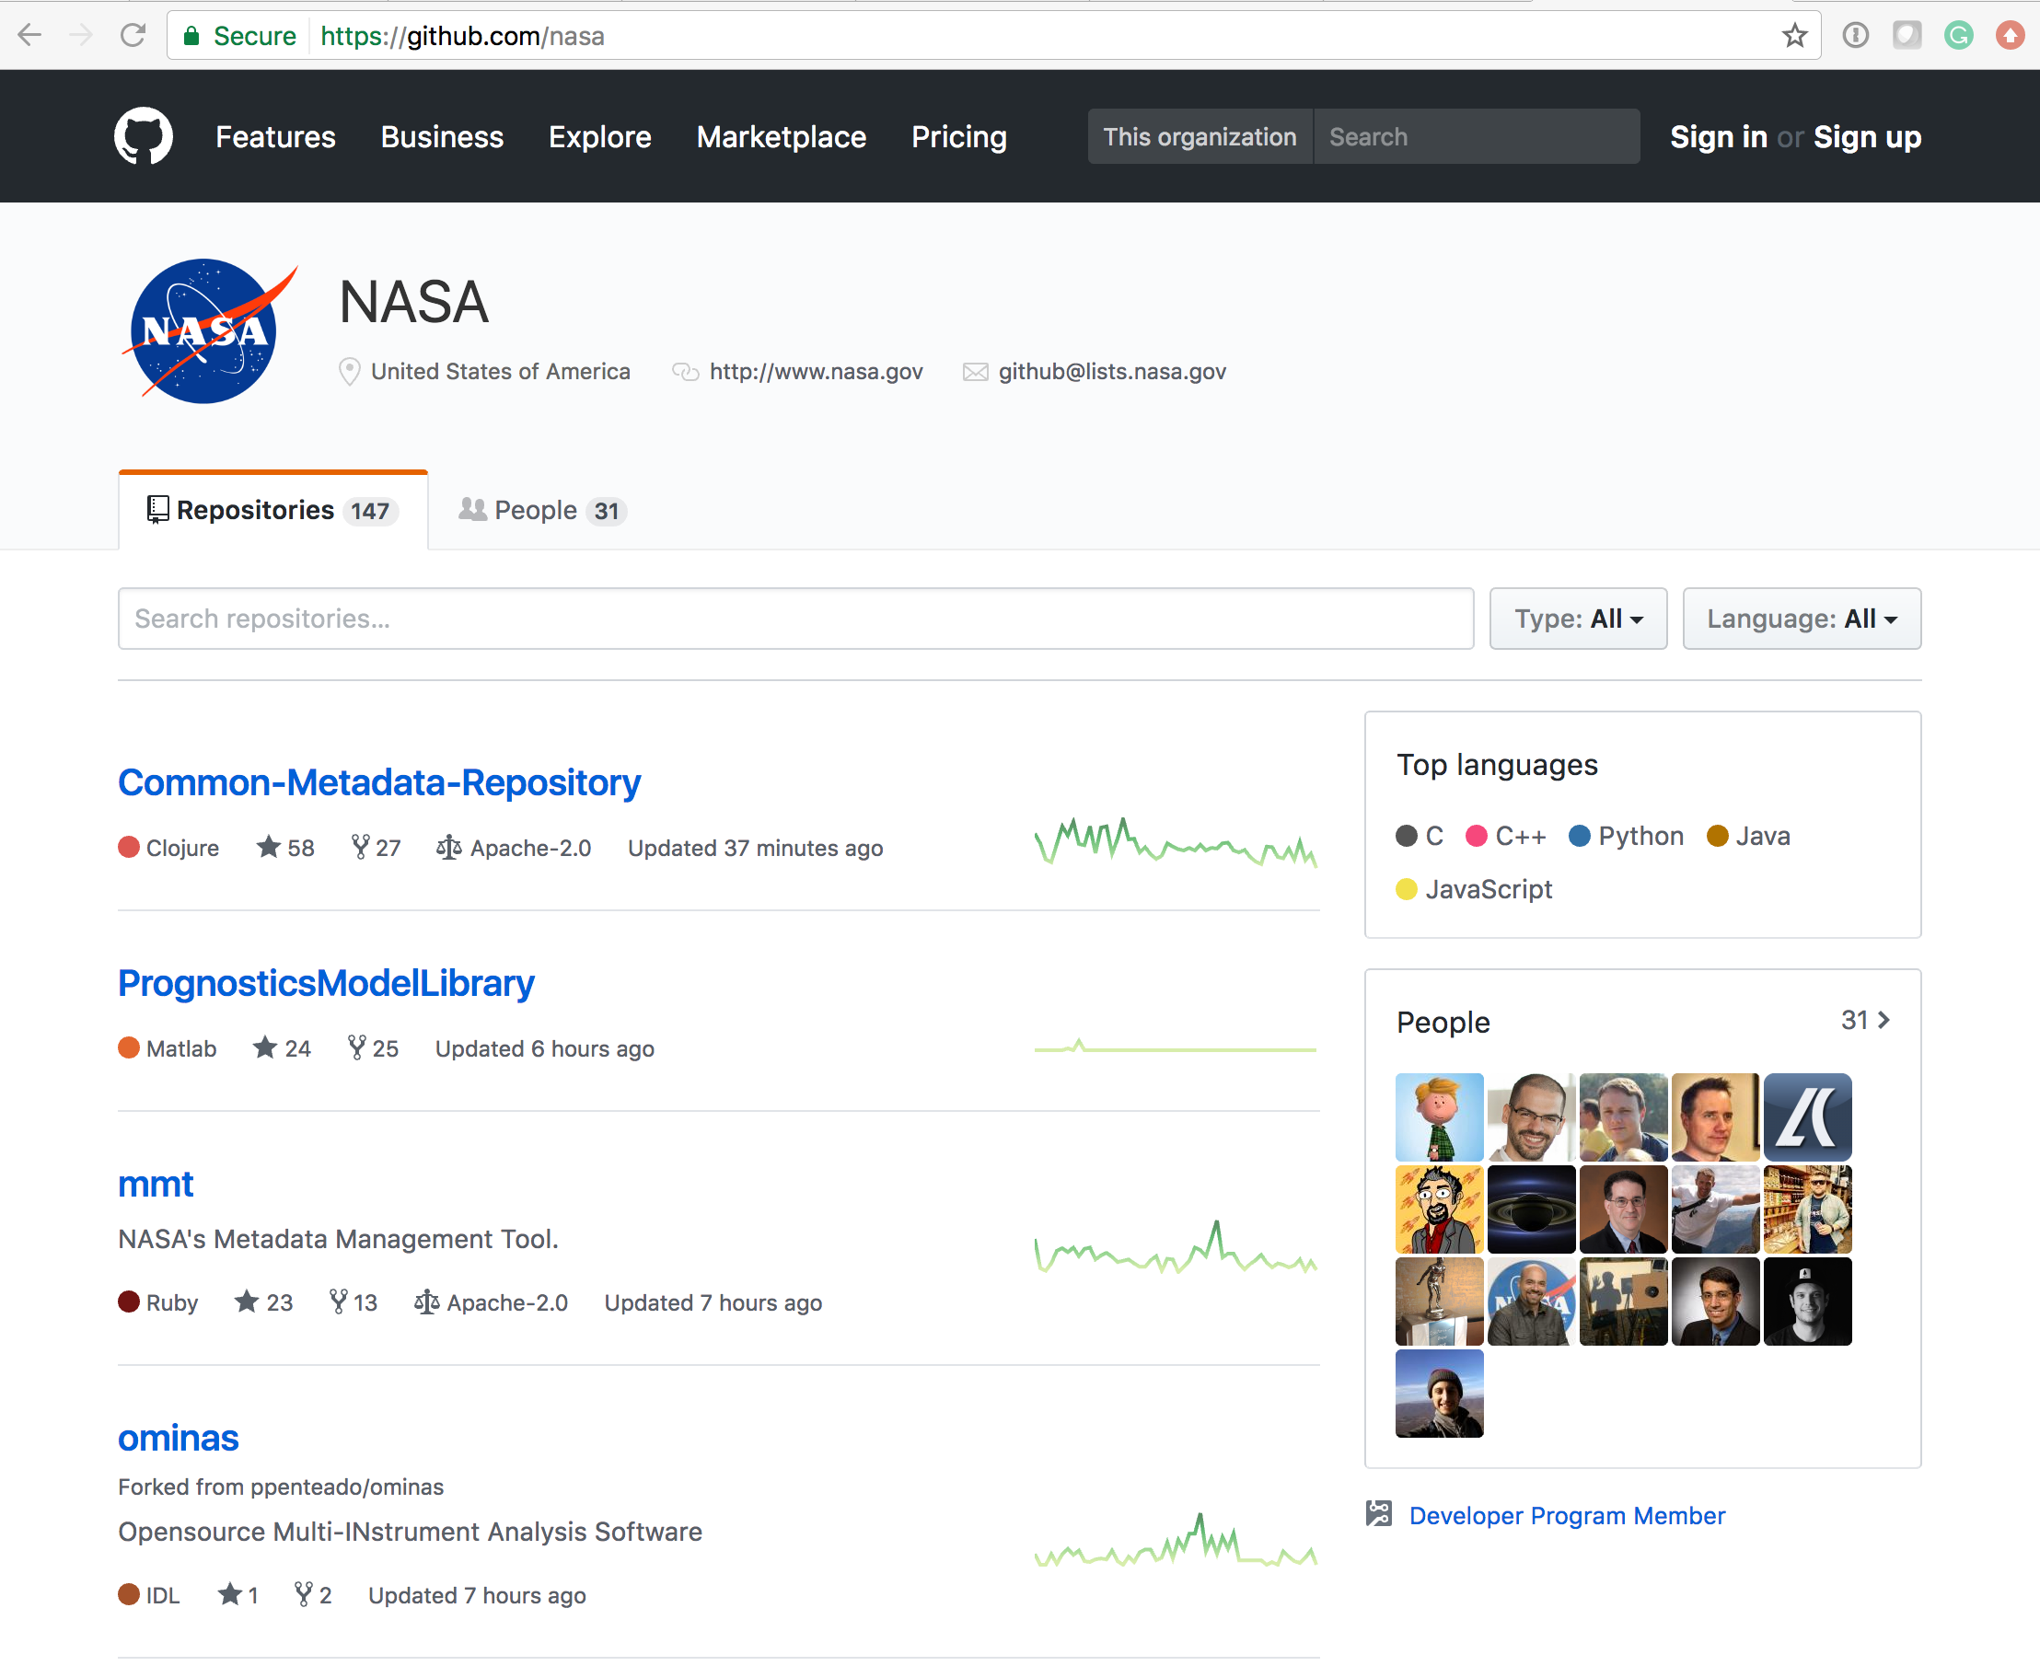
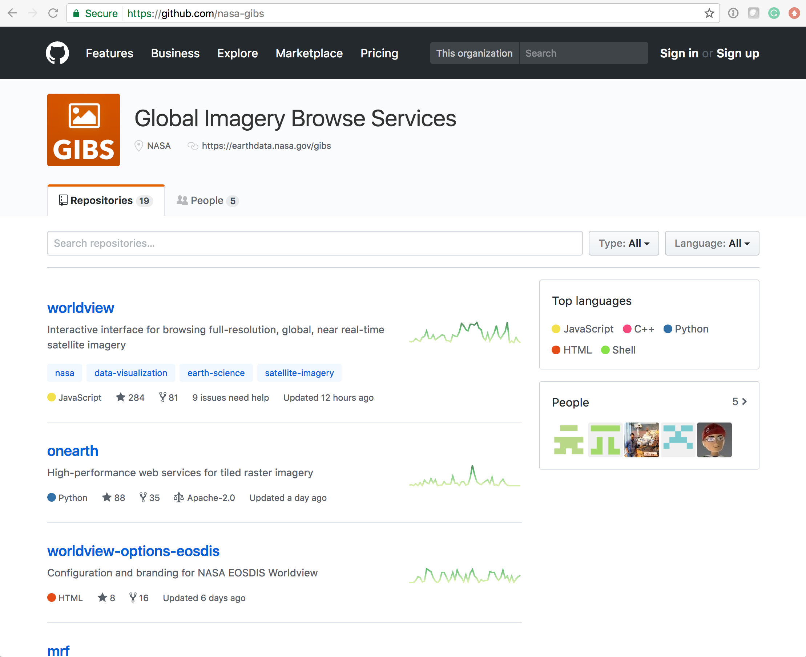
Open Data, Open Source, Open Services Cloud Architecture
Free data
download
Open APIs
Open Source Clients
Notes:
Common discovery and visualization tools and services spanning all DAACs and SIPS to improve the discoverability, access and usability.
Open API architecture allows application developers maximum flexibility to “mix-and-match” services. Supports multiple clients
Interfaces with international organizations and U.S. government agencies to “federate” NASA metadata into their systems.
Checkout Github for NASA Open Source Software

Slide 8

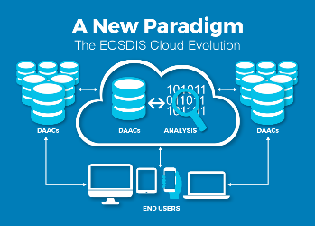


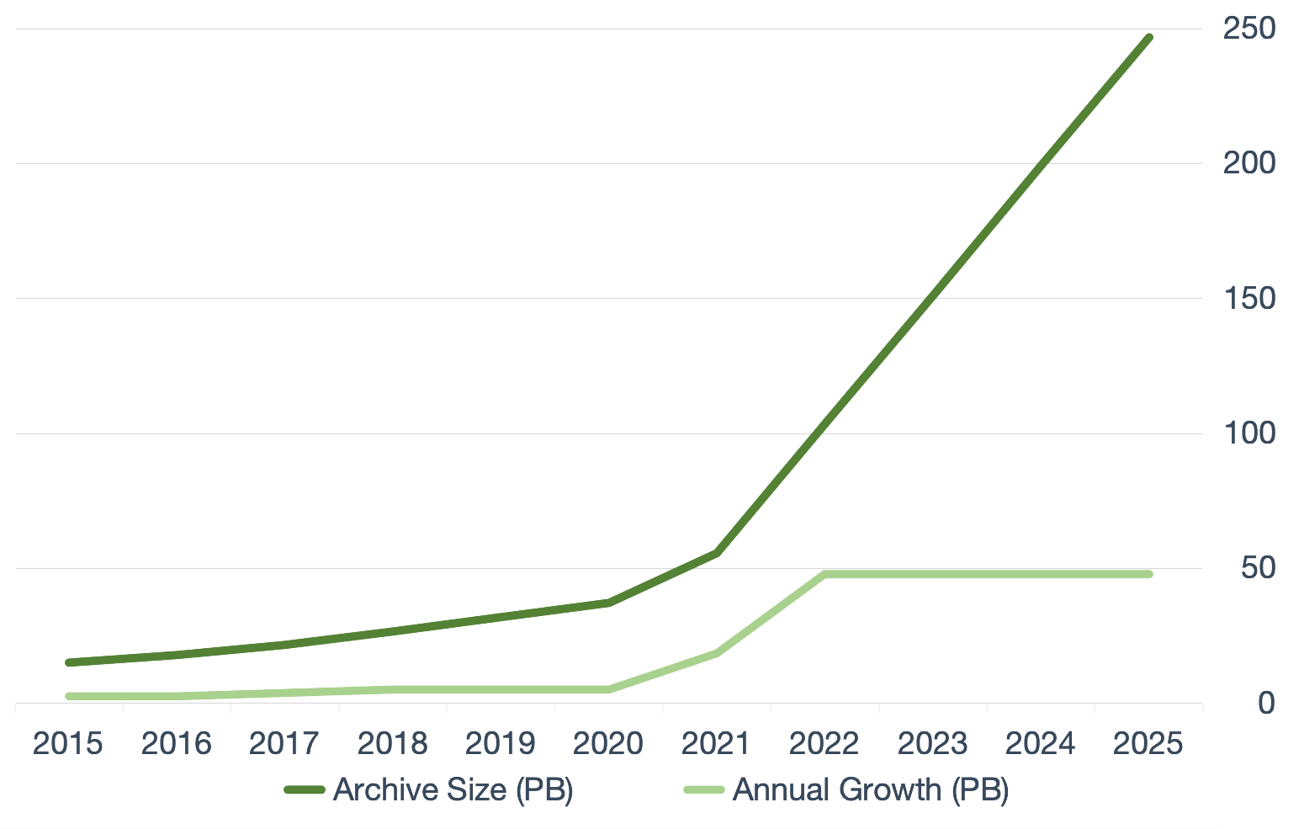
Earthdata Cloud
Data volumes for future missions will surpass in-house capacity/capability
Make data available to as many people as possible
Our users’ expectations and abilities are changing
Cloud Evolution: Our future
Scalable growth
Operational and analytical efficiency
Open science enables collaboration
Commercial cloud solutions
Agility and speed
Constant market-driven innovation by vendors (e.g., Amazon, Google)
Represent quickest path to enabling change
NISAR
SWOT
Today
Notes:
To efficiently handle storage and compute needs for the large SWOT and NISAR data volumes, new data management technologies and architectures are needed.
NASA’s Earth Observing System Data and Information System (EOSDIS) acquires, processes, preserves, and distributes observational data from various sources (satellites, aircraft, field measurements, and various other programs) to support Earth Science research focus areas. From its current size of approximately 30 petabytes (PB), the volume of data in the EOSDIS archive is expected to increase to approximately 250 PB by 2025.
Growth of Mission Data & Processing: Projected rapid archive growth and the need to effectively process significantly larger volumes of new mission data requires rethinking existing architectures. Estimating 132 TB daily ingest by 2022
Data Systems: More cost effective, flexible, and scalable data system ingest, archive, and distribution solutions are needed to keep pace with new mission advancement and capabilities
Science Users: Significantly larger data volumes requires additional ways to access and utilize these data, with “Data Close to Compute”
NASA’s Earth Science Data and Information System (ESDIS) Project has established the Earthdata Cloud Project aimed at operationalizing how EOSDIS (Earth Observing System Data and Information System) data collections can be archived collectively and disseminated in the cloud. As part of these efforts, EOSDIS successfully demonstrated that cloud environments offer performance and cost benefits.
Goals for EOSDIS cloud evolution:
Improve the efficiency of NASA’s data systems operations – continuing free and open data access to data
Prepare for new high-data-rate on-orbit missions
Increase opportunity for researchers and other users to access/process petabytes of data quickly without the need for complex data management capabilities
Allow for a transparent/extendable open source processing framework
Strategic Public and Private Partnerships
Demonstrate potential of cloud computing by bringing algorithms to the data to enable processing and analytics at scale.
Improve discovery of NASA data, services, and tools through commercial search engines.
Incorporate NASA Earth observation data into agency workflows.
Improve the ability to find and access Earth observation data and information.

Slide 9

EOSDIS Key Metrics for FY2020
EOSDIS FY2020 Metrics
(Oct. 1, 2019 to Sept. 30, 2020)
Unique Datasets Distributed | 12,798
Total Archive Volume | 41.86 PB
Average Archive Growth | 32.8 TB/day
End User Distribution Products | 1,884.2 M
End User Distribution Volume | 44.04 PB
End User Average Distribution Volume | 123.6 TB/day
Distinct Users of EOSDIS Data and Services (Google Analytics) | 3.9 M
Web Site Visits (Google Analytics) | 2.96 M

Slide 10
EOSDIS Yearly Total Data Volume (PB) and Number of Products (Billions) Distributed to End Users
FY2020 Number of Products Distributed by Discipline
Products whose discipline was not available or not applicable including some of the ancillary data
Total Volume Distributed: 44.0 PB
Total # of Files Distributed: 1,884.2 Million

Slide 11
Volume Changes
Total EOSDIS Accumulated Data Archive Volume (Petabytes)
Trend: FY2000-FY2020
As data is acquired and reprocessed the collection both grows and shrinks
Multi-year datasets need to be summarized/evaluated over long time series
Products range in size from kb to 1 GB
Important Events
FY2003 | Addition of ICESAT product
FY2008-FY2009 | Deletion of MODIS Collection 4 products
FY2013 | Addition of AQUARIUS and ICEBRIDGE products
FY2014 | Deletion of over 10 million files (2 PB) of data by ASF as part of their consolidation and transition of data to new media
FY2015-FY2019 | Reprocessing Collection 6 & 6.1 MODIS Terra and Aqua data products
FY2016 | Addition of GPM and ALOS PALSAR products
FY2017 | Addition of OB.DAAC
FY2018-2019 | Addition of SENTINEL 1A/1B and VIIRS products
Notes:
The trend data for earlier years are from EOSDIS Annual Metrics Reports.
Current fiscal year data will be updated by DAACS at the end of the fiscal year to report additional products or/and the deletion of the products that may not have been reported to EMS.

Slide 12
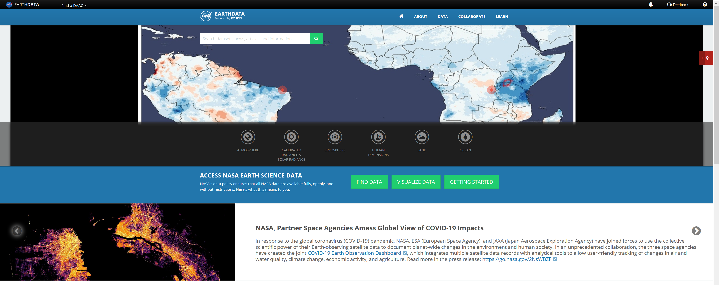
Additional information is available at:
  http://earthdata.nasa.gov/

