Slide 1
Working Group on Information Systems and Services (WGISS)
Committee on Earth Observation Satellites
Iolanda Maggio, Daniele Iozzino
Rhea GROUP for ESA
WGISS#52 Virtual Meeting
Data Integrity and Authenticity on Cloud
21st October 2021

Slide 2
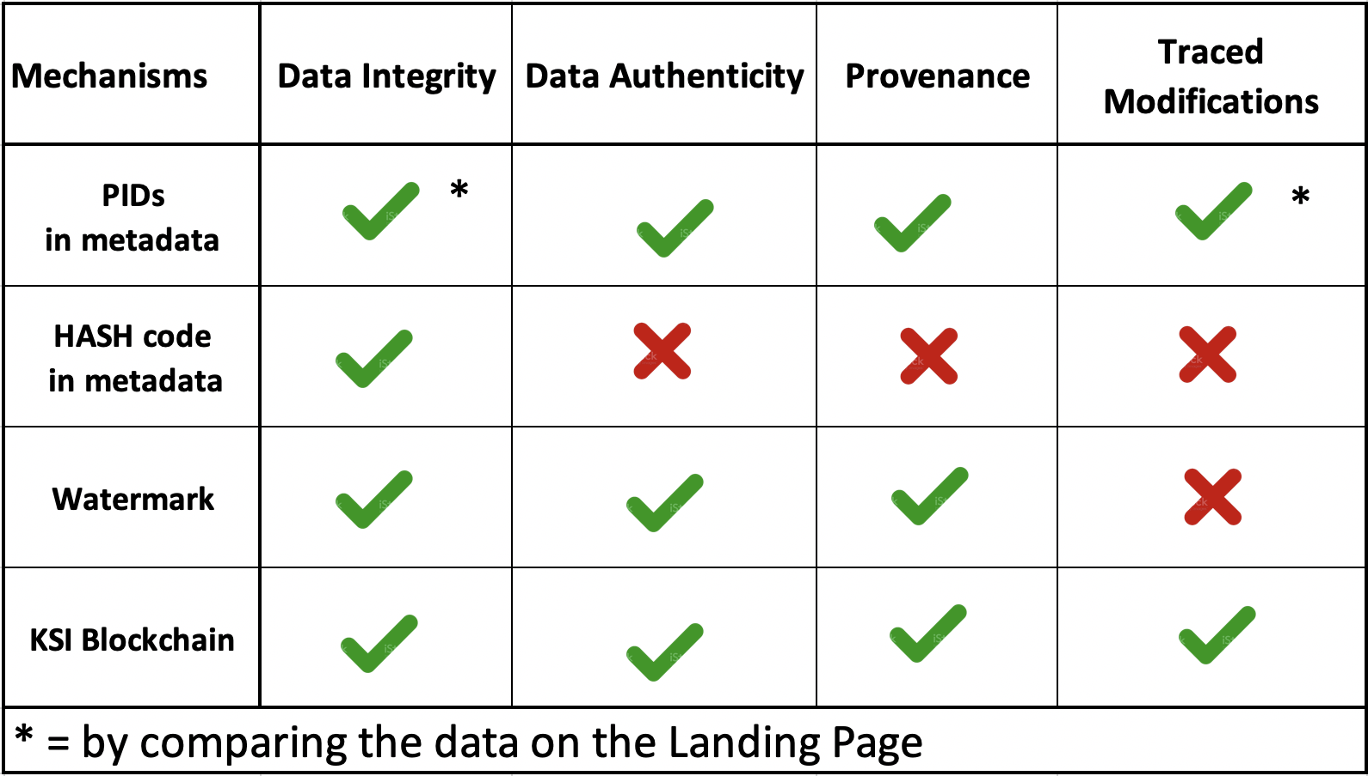
Executive Summary
Mechanisms to handle a data replica on the cloud granting
data integrity and authenticity
Is this enough for our scope?
Do we need further details?

Slide 3
Background & Definitions
Action WGISS-49-13: WGISS DSIG to investigate how to handle replicas of data for example in the cloud: PID assignment? Using watermarks? Mechanism for handling that to be further discussed and recommendation issued.
Controlled Data Replication: is the process by which data residing on a physical / virtual server or cloud instance (primary instance) is replicated or copied by the owner/holder to a secondary server(s) or cloud instance(s) (standby instance) to improve data access/archiving performance.
In such cases replicated data is an exact copy of the original one as the copy is managed by the data owner/holder.
Other Data Replicas: is the process by which data are copied from a controlled source to another location (e.g. on the Cloud) not managed by the original data owner/holder and made accessible to users (with or without manipulation / modification). Nature/integrity of the original dataset might have changed.
How can we grant data integrity and authenticity (or highlight modifications)?

Slide 4
Data Integrity and Authenticity
Four approaches to manage Data replicas on cloud (to grant the Data
Integrity and Authenticity) analysed:
Inclusion of a Persistent Identifier in the metadata file of each single product;
Inclusion of HASH Code embedded in any replicated and disseminated product;
Use of digital signature (e.g. Watermark);
Implementation of a Blockchain mechanism (e.g. KSI Blockchain).

Slide 5
Data Integrity and Authenticity mechanisms (1/3)
Persistent Identifier in the metadata file of each single product
&
HASH Code embedded in any replicated and disseminated product
Extract from the CEOS Persistent Identifier Best Practices
[REC_20]
As a general rule, assign PIDs to data collections (e.g. a consistent time-series) rather than an individual scene. The PID, assigned to data collection, could be inserted in the metadata file in each single product. This can be flexible, depending on how users will want to cite the data. The Resolved DOIs should lead to the original Landing Page of the Data Collection in which the final user can retrieve any relevant provenance information and consequently the proof of the data integrity and authenticity (e.g. Replicas in cloud environment). Other considered mechanisms could be watermark technology, HASH Code embedded in any replicated and disseminated product.
Note:
By using the PID in the metadata file the final user is sure that the data in the landing page pointed by the PID is the original one.
By using the Hash code in the metadata file the final user can check that the original data has not been modified but there is no info on provenance.
Using both mechanisms data integrity, authenticity and provenance can be granted.
Effort: Simple and low-cost campaigns to include PID (assigned at collection level) or HASH code in the metadata file of each product. No additional add-in needed for the user to explore the metadata file.

Slide 6
Data Integrity and Authenticity mechanisms (2/3)
Digital Signature and Watermark
In order to trust the data on the cloud, there is a need to track the origin of the data object. To address this problem, a watermarking technique, with visible watermark or hidden watermark, can be used to store the information about the origin of the data product.
By adopting this methodology, shared data object in the cloud maintain information on the original ownership of that data object. Efficiency and reliability of this approach can be evaluated by calculating the time required to embed both visible and hidden watermarks in data objects.
Note:
By using the watermark technique data modifications are not prevented. However if the data is modified the watermark with all its features (e.g. origin of the data) are lost.
Effort: Implement the watermark functionalities using dedicated proprietary SW. The user has to use the proprietary SW to inspect the watermark.

Slide 7
Data Integrity and Authenticity mechanisms (3/3)
KSI Blockchain Technology
KSI is a blockchain technology used to make sure networks, systems and data are free of compromise, all while retaining 100% data privacy.
KSI makes it impossible to change the data already on the blockchain and allows to mathematically prove the authenticity of the electronic data.
KSI provides information on the integrity and time of generation of any digital data and allows to verify the provenance of any EO product at any time.
Users can exploit KSI (via use of SNAP, Q-Gis, other raster processing units).
Modifications and duplications over the cloud are possible and traced.
Note:
By using a blockchain solution the end user can verify the provenance, integrity and authenticity of the data. Every future modifications of the data will be registered by the KSI blockchain.
Effort: Implement the Blockchain functionalities using dedicated proprietary SW.
The user has to use the proprietary SW to inspect the relevant information.

Slide 8
Conclusion of comparison
Mechanisms to handle a data replica on the cloud granting
data integrity and authenticity are compared in the table below

Slide 9
Way Forward
Is this analysis enough for our scope?
Do we need further details?

