Slide 1
OAIS Interoperability Framework (OAIS-IF)
52nd WGISS Meeting
Virtual Meeting, 21st October 2021

Slide 2
Executive Summary
Starting from the initial concept contained in the OAIS Reference Model from the Consultative Committee for Space Data Systems (CCSDS) and the latest supplements in development by its MOIMS Data Archive Interoperability (DAI) Workgroup, interoperability between user, systems and archives has become necessary to guarantee and to improve exchange, understanding and use of the collections of information/holdings, preserved in the existing ESA archives from all disciplines, from Directorates, from external Parties.
This presentation focuses on the following key points:
Standardization current status
Concept and architecture status for the interoperability framework between user, systems and Archives
Approach and scenarios adopted by ESA for the development of contextualized use cases in which interoperability and related standards lead to real benefits for ESA on its Heritage Data Repositories and Archives
Planned next steps and potential cooperation in the frame of WGISS

Slide 3
Standardization current status
Main achievements by CCSDS MOIMS DAI Workgroup and current versions:
  Awaiting ISO review, completed Agency Review (AR) for CCSDS 650.0-P-2.1: Reference Model for an Open Archival Information System (OAIS) become ISO14721
  Awaiting CESG approval for AR for:
    CCSDS 652.0-P-1.1: Audit and Certification of Trustworthy Digital Repositories (ISO 16363)
    CCSDS 652.1-P-2: Requirements for Bodies Providing Audit and Certification of Candidate Trustworthy Digital Repositories (ISO 16919)
  Started AR for CCSDS 653.0-R-1: Information Preparation to Enable Long Term Use (IPELTU) update
  Ongoing with significant progress for CCSDS 671.0: OAIS-Interoperability Framework Draft Architecture (OAIS-IF):
    Concept with descriptive material being drafted for future Green Book
    Architecture design drafted
    In progress discussion with ESA on additional interoperability use cases and testing with NASA

Slide 4
What is OAIS Interoperability Framework (OAIS-IF)
Supplement to the OAIS, that adds capabilities for system interoperability between Consumers, Producers and Archives (fully OAIS Reference Model conformant or not).
Designed for use by Archives, information Creators and users aimed to:
  improve interoperability between users and Archives by transferring “information” instead of data
  enable increased usability of information across all domains, making the information from different domains more easily usable for a broader range of consumers
  define how information should be exchanged if that information is to be usable.
OAIS-IF does not seek to specify:
  how an Archive preserves information
  how information should be created and encoded
  what software users must employ when using information.

Slide 5
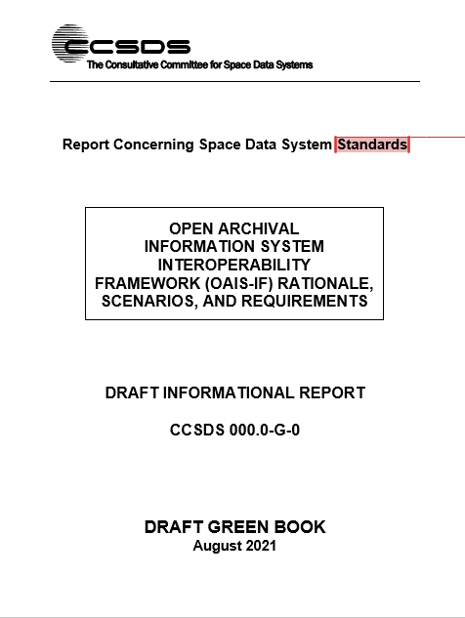
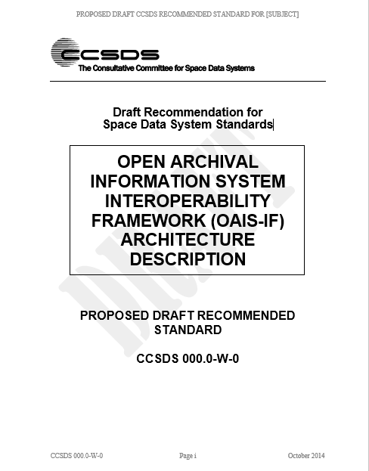
OAIS-IF documentation status
CONCEPT (DRAFT Green Book)
Areas of applicability for OAIS-IF
Interoperability scenarios
Requirements
UML Diagrams
ARCHITECTURE (DRAFT White Book)
OAIS-IF Overview
Architectural components, Information Model
Adapter Layer
Interface, Method, Data Structure
Application, Services

Slide 6
Interoperability between users, systems, Archives
Key questions
How to improve interoperability between users and Archives?
  by transferring Information rather than just Data
  by enabling the increased usability of information of all types across all domains.
How to transfer information between users and Archives ?
  by ensuring that the information is understandable, as far as possible
  by accompanying the information with evidence about its authenticity, and with everything needed for preservation
OAIS Interoperability Framework positioning
add capabilities for system interoperability between more general Consumers and Producers and Archives.
ensure applicability to any Archive (fully OAIS Reference Model conformant or non conformant) and any user.
does not define what should happen within an Archive or user systems except as needed for an interoperable interface.

Slide 7
OAIS-IF benefits for ESA
  Improvement of exchange, understanding and use of information from all domains, from Directorates, from external Parties;
  Increase of the use of the collections of information/holdings preserved in the existing Archives;
  Facilitated interoperability across Directorates and cross fertilization in the Agency ecosystem;
  Creation of contextualized interoperability scenarios and use cases that are significant for ESA on its Heritage Data Repositories and Archives.

Slide 8
ESA potential use cases for OAIS interoperability
Starting from May 2021, ESA has confirmed its participation in OAIS-IF framework prototyping, identifying applicable scenarios and information for use cases in the context of:
ESA Information and Records Archive
ESA Space Data Preservation Archive (ESRIN)
ESA Science Directorate Space Data Archive
Therefore, ESA has launched a series of activities aimed at defining potential use cases, applicable in some specific contexts of the Agency.

Slide 9
ESA Space Data Preservation Archive (ESRIN) potential use cases
The use cases applicable in the context of the ESA Space Data Preservation Archive located at ESRIN to support the OAIS Interoperability Framework (OAIS-IF) have been drafted, starting from the model proposed in the current Green Book and are under review.
The draft document includes the results of the analysis performed by ESA in terms of scenarios and use cases relevant for interoperability with other Archives, institutions or Agencies.
It applies to the Space Data Preservation Archive located at ESRIN to build a model for interoperability in accordance with the standards being developed by CCSDS MOIMS DAI Workgroup.
The use cases consider also interoperability with other elements of the ESA EO Space Data Preservation System.

Slide 10
ESA Space Data Preservation Archive (ESRIN) potential scenarios
The ESA internal scenarios refers to interoperability between:
  Components of the EO Space Data Preservation System (e.g. Space Data Preservation Archive and Space Data Technical Information Preservation Archive)
  Space Data Technical Information Preservation Archive and the ESA Data Dissemination System (DISSHarm)
An ESA external scenario refers to interoperability between the ESA Space Data Preservation Archive and other space Agencies Archives (e.g. for exchange of data or back-up purposes).
An additional interoperability scenario with focus on Provenance was analyzed.

Slide 11
Way forward
The use cases identified by ESA so far will contribute to OAIS-IF requirements finalization and testing.
Possible use case in collaboration with WGISS agencies (e.g. archives interoperability)?
Other scenarios relevant for WGISS could be considered to extend the OAIS-IF domain of applicability. Key questions:
  Is your organization already implementing some interoperability between Archives?
  Do you plan to use the OAIS-IF interoperability framework?
  Have you got any Archive that could benefit from interoperability and any suggestion for additional uses cases?

