Slide 1
Outline
Landsat Collection 2 Per-Pixel Quality Bands
Landsat Collection 2 CARD4L Assessment
Landsat Per-Pixel Traceability, Measurement, and Measurement Uncertainty
Landsat Quarterly Quality Reports
Level 2 Validation – Surface Reflectance
System Characterization Reports

Slide 2
Data Quality at USGS WGISS - 52
Oct. 21st, 2021
Cody Anderson
ECCOE PM, USGS/EROS
chanderson@usgs.gov

Slide 3
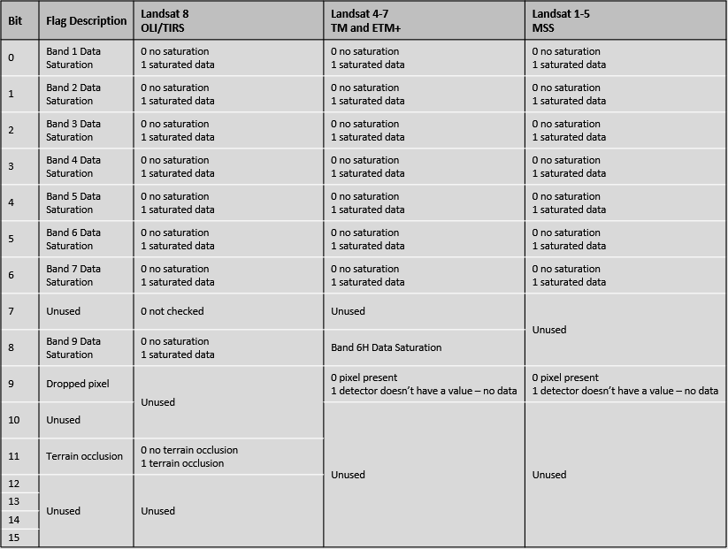
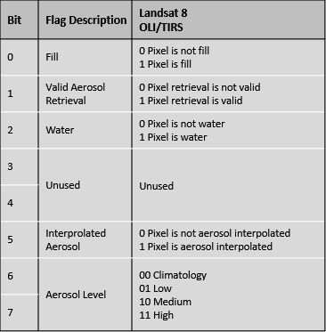
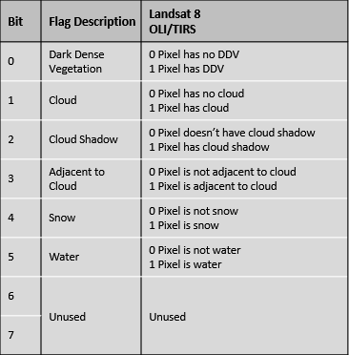
Landsat Collection 2 Per-Pixel Quality Bands
Landsat Collection 2 Radiometric Saturation Quality Assessment
Landsat Collection 2 Surface Reflectance Cloud Quality Assessment
Landsat Collection 2 Surface Reflectance Quality Assessment
Surface Temperature Quality Assessment: Uncertainty based on distance to cloud
https://www.usgs.gov/core-science-systems/nli/landsat/landsat-collection-2-quality-assessment-bands

Slide 4
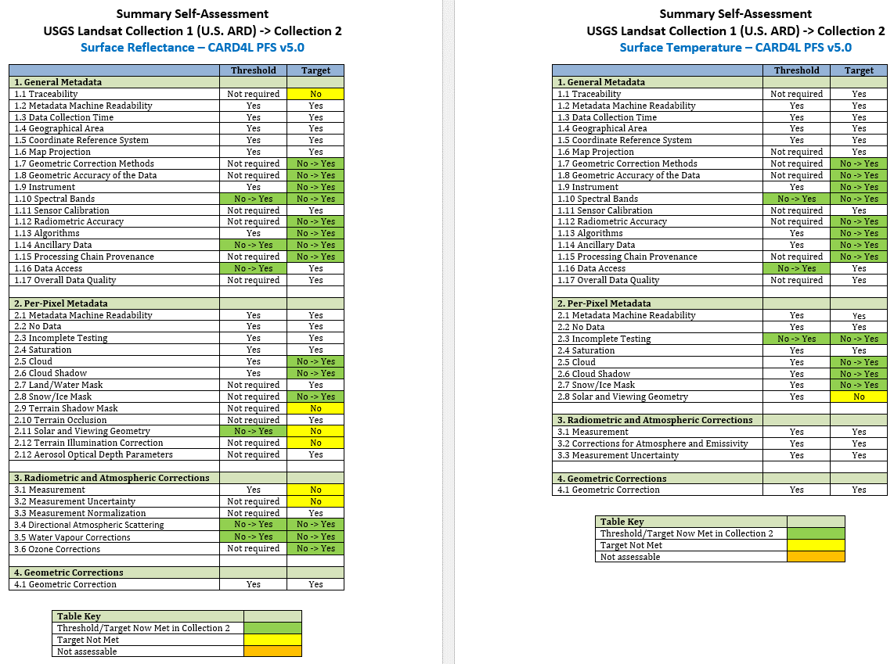
Landsat Collection 2 CARD4L Assessment

Slide 5
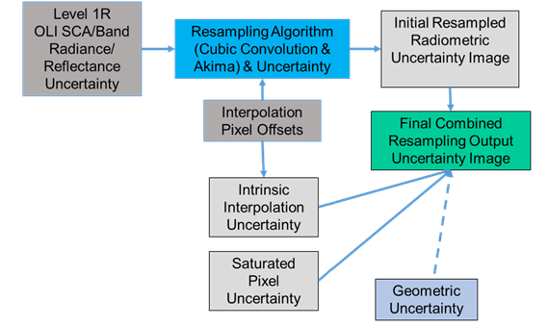
Landsat Per-Pixel Traceability, Measurement, and Measurement Uncertainty

Slide 6
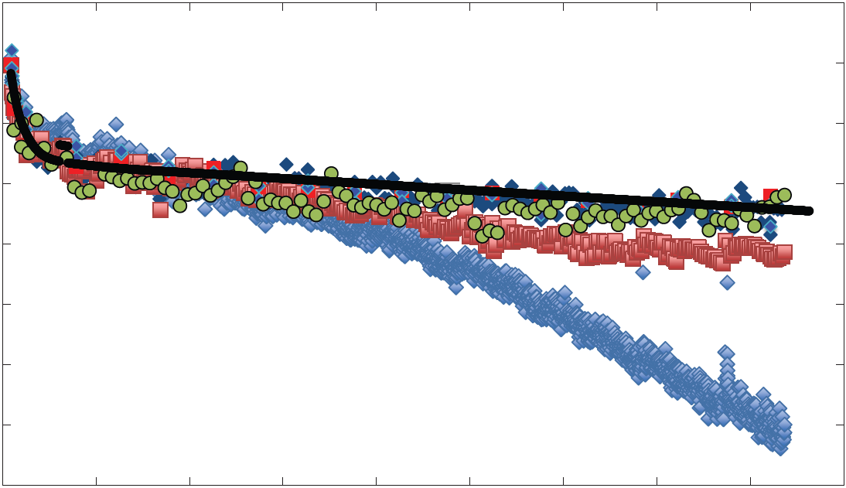
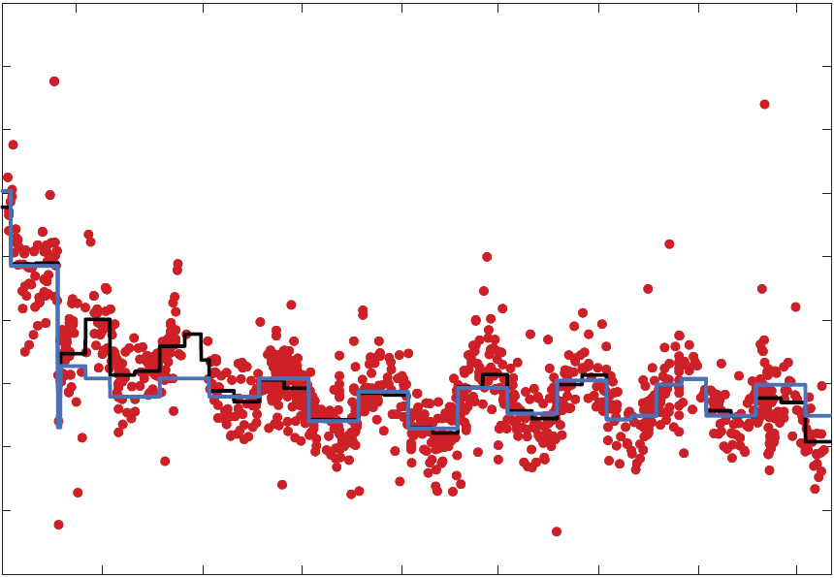
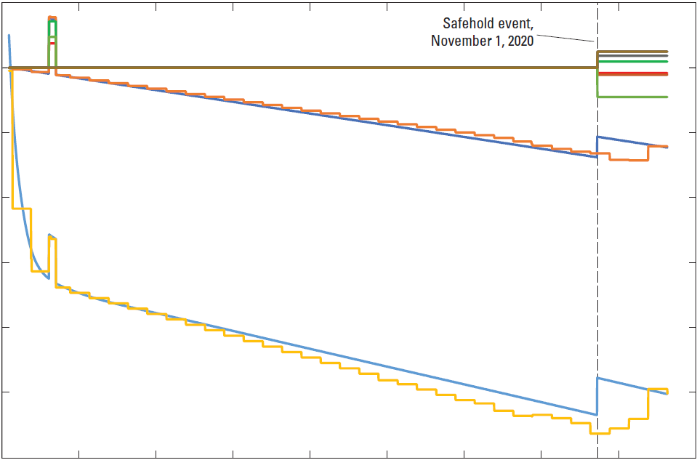
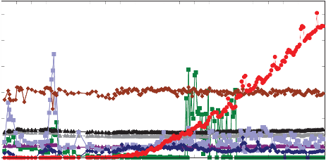
Landsat Quarterly Quality Reports
ECCOE Landsat Quarterly Calibration and Validation Report—Quarter 2, 2021
By Esad Micijevic,¹ Rajagopalan Rengarajan,¹ Md Obaidul Haque,¹ Mark Lubke,¹ Fatima Tuz Zafrin Tuli,¹ Jerad Shaw,¹ Nahid Hasan,¹ Alex Denevan,¹ Shannon Franks,¹ Michael Choate,² Cody Anderson,² Brian Markham,³ Kurt Thome,³ Ed Kaita,⁴ Julia Barsi,⁴ Raviv Levy,⁴ and Lawrence Ong⁴
Signal-to-Noise
Noise Equivalent Delta Temperature
Responsivity (Detector, Band)
Geodetic accuracy
Geometric accuracy
Sensor Alignment
Sensor Alignment
On-Board Calibration Sources
Coherent Noise
Calibration Changes

Slide 7
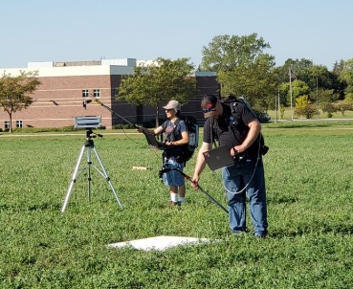
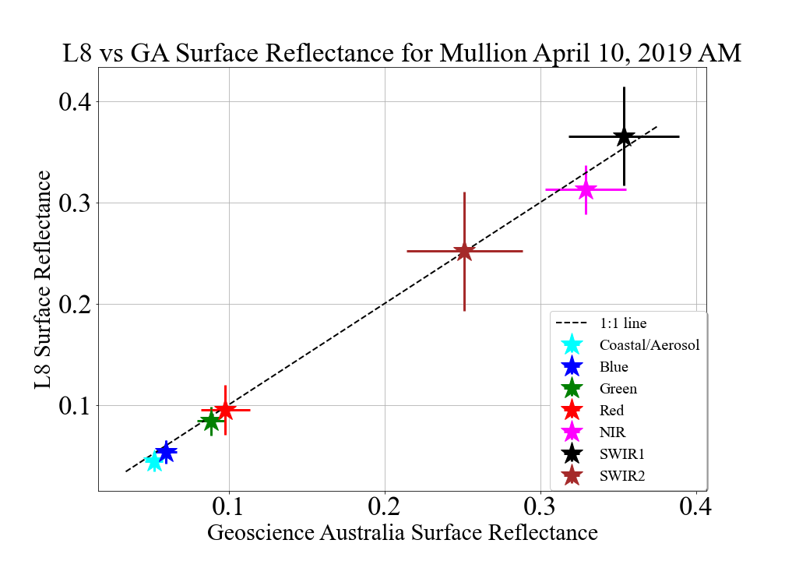
Level 2 Validation – Surface Reflectance
Manual Measurements
Automated Networks
Product Comparison
https://ceos.org/home-2/wgcv-radcalnet/

Slide 8
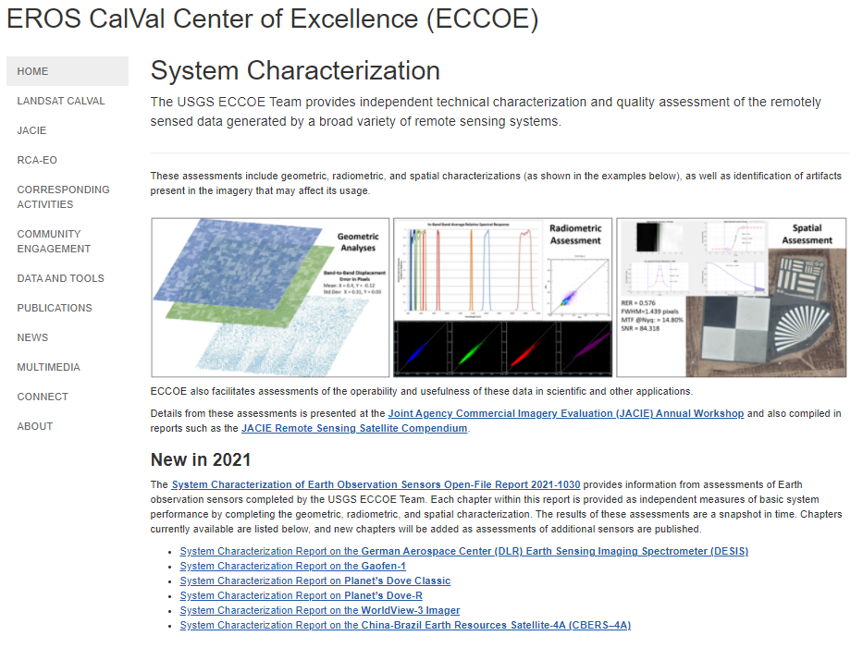
System Characterization Reports
https://www.usgs.gov/core-science-systems/eros/calval/system-characterization?qt-science_support_page_related_con=0#qt-science_support_page_related_con

