Slide 1
WGISS Data Management & Stewardship Maturity Matrix &
Quality Indicators
Iolanda Maggio, Paolo Castracane
RHEA c/o ESA ESRIN
CEOS WGISS-52 October 19-21,2021
21 Oct. 2021

Slide 2
CEOS WGISS-52 Oct. 19-21,2021 “WGISS Data Management & Stewardship Maturity Matrix & Quality Indicators” Iolanda Maggio and Paolo Castracane - RHEA c/o ESA ESRIN
Executive Summary
Overview on WGISS Data Management & Stewardship MM: Main Concept, Generation and Scope;
Principles of the Quality Assessment Framework -> ESA/NASA Evaluation Framework;
EDAP Best Practice Guidelines Activities -> Cal/Val Maturity Matrix;
EDAP vs WMO vs WGISS -> Notes on possible evolution for WGISS SMM and formal link in the WGISS DMSMM White Paper;
Way Forward
Use Case: ENVISAT MIPAS L2 Data;

Slide 3
CEOS WGISS-52 Oct. 19-21,2021 “WGISS Data Management & Stewardship Maturity Matrix & Quality Indicators” Iolanda Maggio and Paolo Castracane - RHEA c/o ESA ESRIN
Executive Summary
Way Forward
Implement the new proposed changes for WGISS DMSMM improvement;
Insert in the WGISS DMSMM White Pape the Annex with EDAP Maturity Matrix in order to give the opportunity to increase the Quality check on the Dataset to be measured;
Produce an automatic way to calculate the components measurement score
Use Case: ENVISAT MIPAS L2 Data

Slide 4
Data Management and Stewardship Maturity Matrix (DMSMM): Main concepts
DMSMM defines all activities needed to preserve and improve the information content, quality, accessibility, and usability of data and metadata.
Data stewardship “encompasses all activities that preserve and improve the information content, accessibility, and usability of data and metadata” (National Research Council 2007).
Data management includes all activities for “planning, execution and oversight of policies, practices and projects that acquire, control, protect, deliver and enhance the value of data and information assets.” (Mosely et al. 2009).

Slide 5
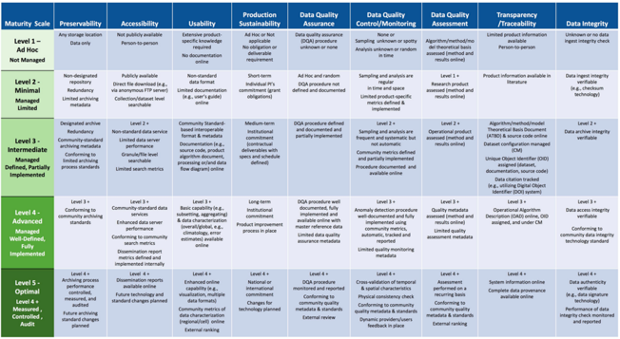
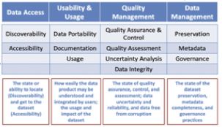
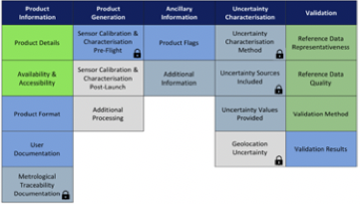
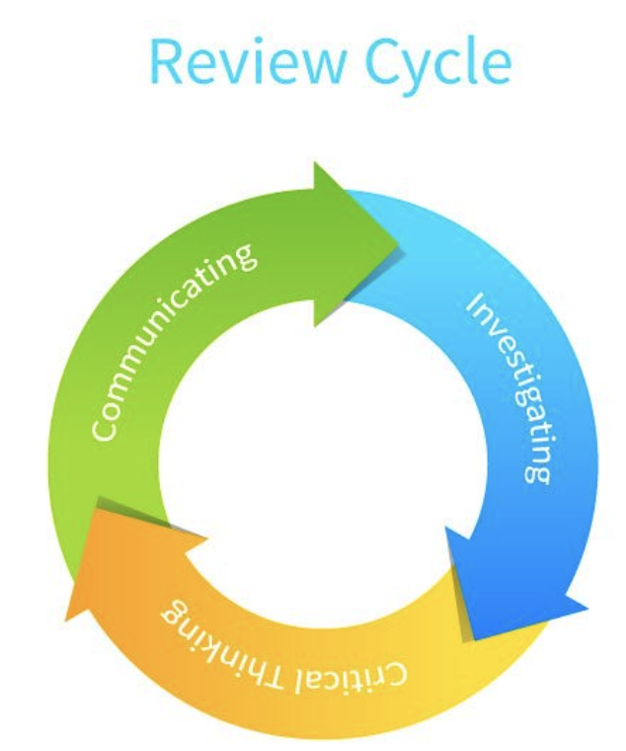
Starting Points
MM for Long-Term Scientific Data Stewardship
RDA FAIR Data Maturity Model
WMO Stewardship MM for Climate Data
ESA Earthnet Quality Data Assessment Pilot
GEOSS Data Management Principles
CEOS WGISS DMSMM: Generation process

Slide 6
CEOS WGISS Data Management & Stewardship Maturity Matrix
http://ceos.org/document_management/Working_Groups/WGISS/Interest_Groups/Data_Stewardship/White_Papers/WGISS%20Data%20Management%20and%20Stewardship%20Maturity%20Matrix.pdf

Slide 7
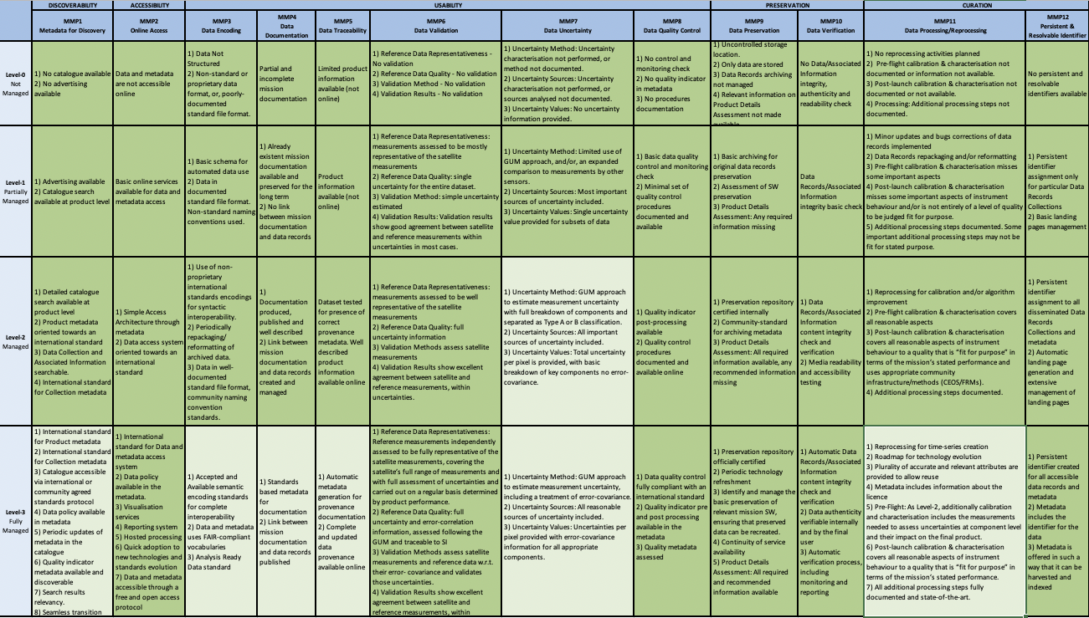
Data Management & Stewardship Maturity Matrix - Scope
A way to measure the status of the Agency Data Stewardship processes in place
A way to plan goals of Data Stewardship processes and projects
A specific Use Case to explain how to use the matrix is inserted in a relevant session of this presentation

Slide 8
Principles of the Quality Assessment Framework
The Quality Assurance framework for Earth Observation (QA4EO), established and endorsed by Committee on Earth Observation Satellites (CEOS), defines the following principle¹ regarding Earth Observation data quality:
“It is critical data and derived products are easily accessible in an open manner and have associated with them an indicator of their quality traceable to reference standards (preferably SI) to enable users to assess its suitability for their application i.e. its “fitness for purpose”.”
QA4EO Task Team, “Quality Assurance for Earth Observation Principles,” 2010. [Online]. Available: http://qa4eo.org/docs/QA4EO_Principles_v4.0.pdf.

Slide 9
ESA-NASA Evaluation Framework
NASA and ESA are working toward a comprehensive ESA-NASA Evaluation Framework that will include the utility of these data for Earth science research and applications
ESA Earthnet
NASA Commercial Smallsat Data Acquisition (CSDA) Program
The joint-ESA/NASA guidelines, based on the EDAP ones, are under definition. The guidelines will be tailored for Optical and SAR missions.

Slide 10
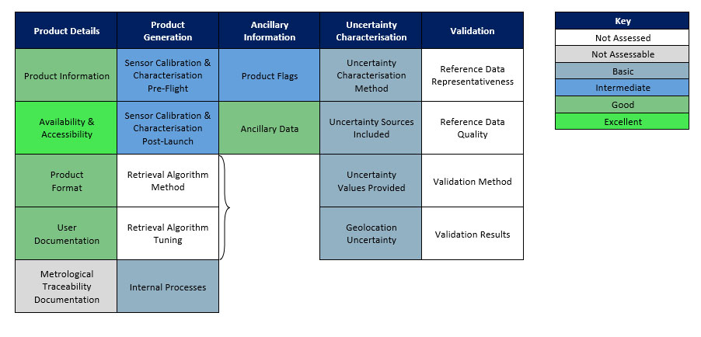
Correspondence between NASA and ESA evaluation criteria
NASA evaluation criteria:
NASA #6: Quality of vendor supplied imagery and/or data: Data attributes such as geolocation accuracy, quality of radiometric calibration, platform intercalibration, etc.
NASA #2: Accuracy and completeness of metadata: The accuracy and completeness of metadata that accompanies the imagery provided by the vendor.
NASA #1: Accessibility of vendor supplied imagery and data: The ease and efficiency with which data can be searched, discovered, and downloaded from the vendor systems.
NASA #3: Quality of User Support Services: The availability, responsiveness, and technical expertise required to answer Investigator inquiries.
NASA #4: Appropriateness of End User License Agreement (EULA): The suitability of EULA to allow Investigators to practice and perform open science.
NASA #5: Utility of data and imagery for advancing Earth system science research and applications: The ability of vendor provided imagery and data to support Earth system science research and application activities.
Earthnet Data Assessment Pilot (EDAP)
Data quality
Best Practice Guidelines
Metadata quality
Quality of data access & user services
Feedbacks from TPM and CCM teams under Earthnet Programme leadership
Licenses
Feedback from Earthnet Programme
Feedback from users requiring TPM data during their evaluation phase
(users are not paid by ESA, with exception of dedicated ESA contracts)

Slide 11
EDAP Best Practice Guidelines Activity
EDAP: The ESA Earthnet Data Assessment Pilot (EDAP) project is intended to perform quality assessment for various EO missions.
EDAP aims to assess satellite mission data quality in the QA4EO, Earthnet and New Space (Third Party Missions – TPM) context.
EDAP approach aims to define a mission quality Cal/Val Maturity Matrix
(EDAP Best Practice Guidelines Activity).
Note that e.g.:
EDAP does not consider some Data Management aspects in particular
Data Integrity, Preservation and Governance.
EDAP wrt WMO SMO does not consider Usage i.e. an index of citations or
references.

Slide 12
Cal/Val Maturity Matrix
Assessment results are provided in a Quality Assessment Report (QA Report) which is summarised in a Cal/Val Maturity Matrix
Approach to Grading
The assessment framework is aimed at verifying claimed mission performance and, where applicable, the mission follows community best practice to an extent that is “fit for purpose”. The particular grading criteria for each category are determined based on a logical interpretation of this principle.

Slide 13
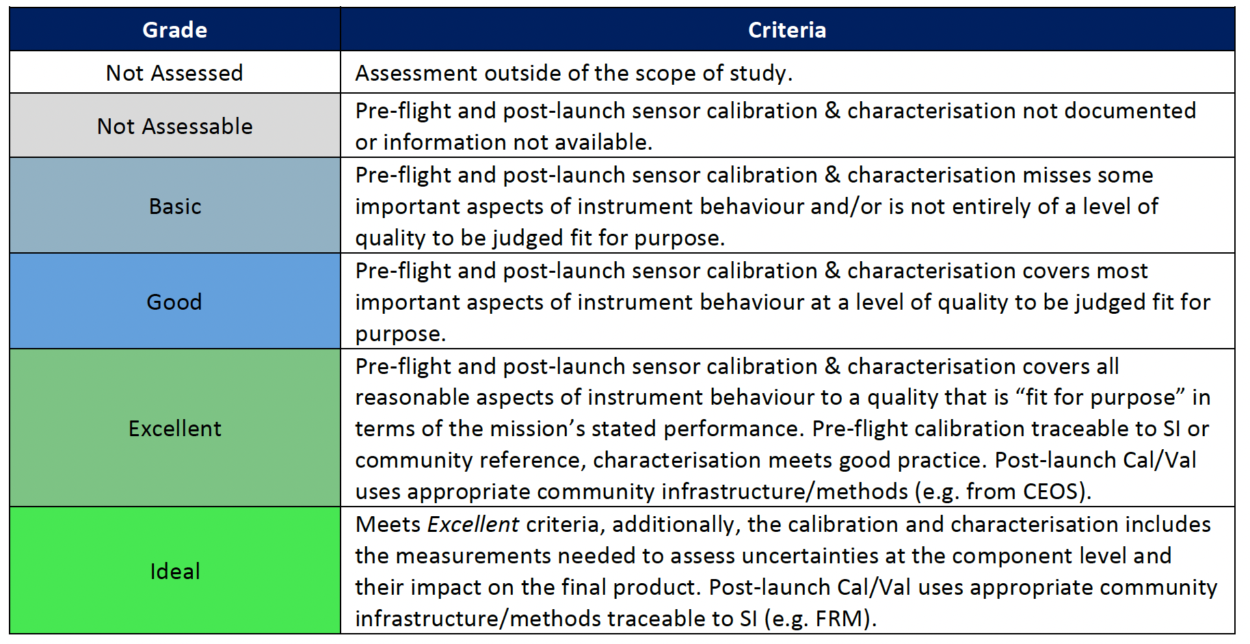
Cal/Val Maturity Matrix
Grading Criteria example: Sensor Calibration & Characterisation
(EDAP Best Practice Guidelines Activity).

Slide 14
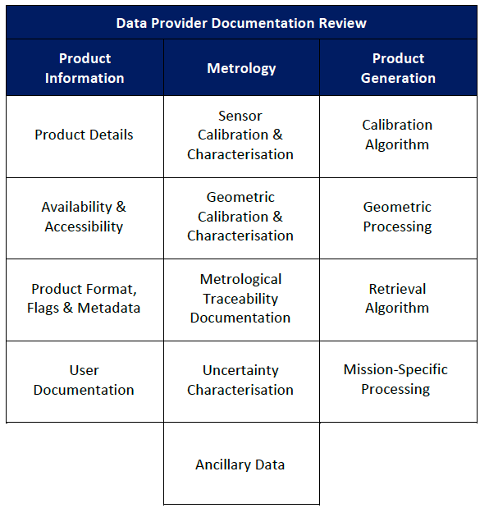
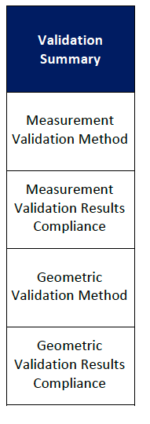
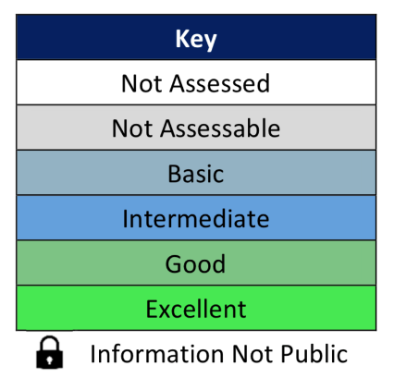
Cal/Val Maturity Matrix - Summary

Slide 15
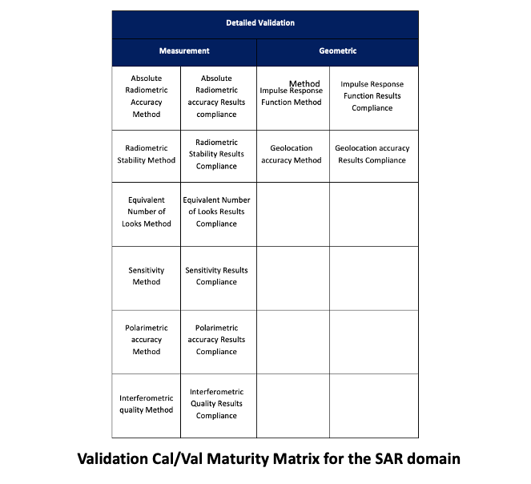
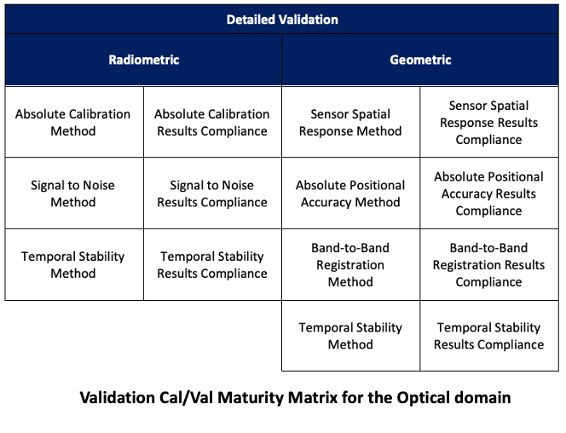
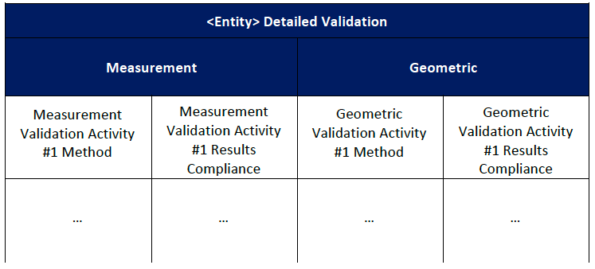
Detailed Validation Cal/Val Maturity Matrix

Slide 16
EDAP vs WMO vs WGISS
The same aspects in the different matrices are identified by the same color

Slide 17
Notes on possible improvements for WGISS SMM
Hereafter the proposed aspects (and corresponding items) to be included in the WGISS SMM according to the EDAP guideline EDAP.REP.001_0.2 assessment criteria.
DMP-3 NEW: In the Usability Category, in order to complement Data Encoding, the Product format, Flags an Metadata aspect has been included
DMP-6 NEW: In the Usability Category, in order to complement Quality, two important aspects i.e. Validation (Validation Method and Validation Results Compliance) and Metrology (Sensor Calibration & Characterisation, Geometric Calibration & Characterisation, Metrological Traceability Documentation, Uncertainty Characterisation, Ancillary Data ) have been included.
DMP-7 NEW: In the Preservation Category, in order to complement Preservation the aspect Product Details have been included.
DMP-9 NEW: In the Curation Category, in order to complement Reprocessing; It accounts for a wider meaning including general processing and calibration activities. The following aspect Processing/Retrieval has been included with the following item: Calibration Algorithm, Geometric Processing, Retrieval Algorithm, Mission Specific Processing.
Introduction of the FAIR (Findable, Accessible, Interoperable, Reusable) Data Principles in the WGISS SMM items in particular for Discoverability – DMP-1 Metadata for Discovery, Accessibility-DMP-2 Online access, Usability: DMP-3 Data Encoding and DMP-5 Traceability
Red Categories
Blue Aspects
Green (Items of the Aspect)

Slide 18
DMSMM 2021

Slide 19
Way Forward
Implement the new proposed changes for WGISS DMSMM improvement;
Insert in the WGISS DMSMM White Pape the Annex with EDAP Maturity Matrix in order to give the opportunity to increase the Quality check on the Dataset to be measured;
Produce an automatic way to calculate the components measurement score

Slide 20
USE CASE

Slide 21
ENVISAT MIPAS L2 Data Use Case
Envisat MIPAS L2 - Temperature, Pressure and Atmospheric Constituents profiles [MIPAS_2PS/2PE] Data.
This MIPAS Level 2 data product describes localised vertical profiles of pressure, temperature and 21 target species (H2O, O3, HNO3, CH4, N2O, NO2, CFC-11, ClONO2, N2O5, CFC-12, COF2, CCL4, HCN, CFC-14, HCFC-22, C2H2, C2H6, COCl2, CH3Cl, OCS and HDO).
It has a global coverage of Earth's stratosphere and mesosphere at all latitudes and longitudes.

Slide 22
ENVISAT MIPAS L2 Data Use Case
The vertical resolution of p, T and VMR profiles varies from 3 to 4 km, whereas the horizontal resolution is approximately 300 km to 500 km along track.
The resolution range of the dataset is: 3 km (vertical) x 30 km (horizontal) at the tangent point.
The latest reprocessed MIPAS Level 2 data (v8.22) is available as Standard (MIPAS_2PS) and Extended (MIPAS_2PE) products, both in NetCDF format.
Please refer to the MIPAS L2 v8.22 Product Quality Readme file for further details.
Reprocessed Data V8.22 - Available from 1 July 2002 to 8 April 2012 via FTP upon completing an Access Request. See MIPAS products availability table

Slide 23
Use case: ENVISAT MIPAS L2 Data
First Step: Analyse the relevant Goals & Objectives to be reached and visualise the final measurement on the table.
Green means complete objectives to be reached and light green means partial or optional objectives to be reached

Slide 24
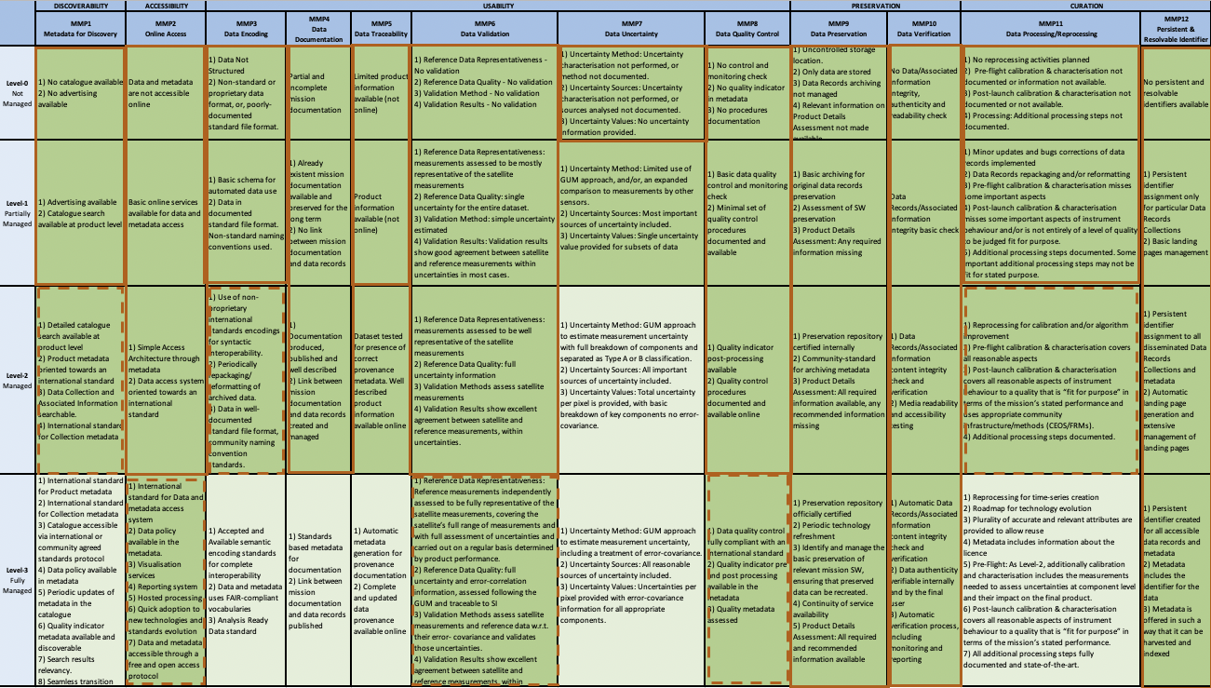
Use case: ENVISAT MIPAS L2 Data
Intermediate Steps: Periodically the operator can verify the status of the Data Management and Stewardship processes highlighting the missing steps to reach the specific goals.
Completed Steps
Not completed Steps

Slide 25
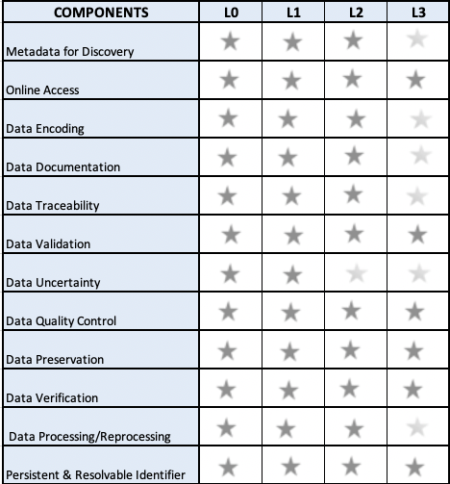
Use case: ENVISAT MIPAS L2 Data
Last Step: Closure of the process and creation of the final score ore
If the dataset owner needs to go in details on the data quality the following slides describe an example of the further process.

Slide 26
ENVISAT/MIPAS L2 Data (v8.22) - Use Case
References:
EDAP Best Practice Guidelines website https://earth.esa.int/eogateway/activities/edap/edap-best-practice-guidelines
EDAP Mission Quality Assessment EDAP.REP.001_2.0 - Mission Quality Assessment Guidelines
MIPAS Overview https://earth.esa.int/eogateway/instruments/mipas/description
ENVISAT MIPAS L2 [MIPAS_2PS/2PE] website
MIPAS L2 v8.22 Product Quality Readme file
IFAC-GA-2020-01-PR Final Report of the ESA-ESRIN Contract no. 4000112093/14/I-LG Support to MIPAS Level 2 processor Verification and Validation – Phase F December 2019
MIPAS Cal/Val https://earth.esa.int/eogateway/instruments/mipas/cal-val
Envisat MIPAS L1 - Geo-located and calibrated atmospheric spectra [MIP_NL__1P]
MIPAS Product Quality Readme file
MIPAS IN-FLIGHT CALIBRATION AND PROCESSOR VERIFICATION - H. Nett et al.
MIPAS Product Handbook - https://earth.esa.int/eogateway/documents/20142/37627/MIPAS-product-handbook.pdf
MIPAS L2 V8 Output Data Definition Issue:2.0 https://earth.esa.int/eogateway/documents/20142/37627/IODD+mipasNetCDF4.pdf
MIPAS Level 1B algorithms overview: operational processing and characterization. A. Kleinert et al. Atmos. Chem. Phys., 7, 1395–1406, 2007
QA4ECV Traceability Chains Guidance
Applying principles of metrology to historical Earth observations from satellites. Jonathan Mittaz , Christopher J Merchant and Emma R Woolliams. Metrologia · May 2019. https://doi.org/10.1088/1681-7575/ab1705
The horizontal resolution of MIPAS. T. von Clarmann, C. De Clercq, M. Ridolfi, M. H¨opfner, and J.-C. Lambert. Atmos. Meas. Tech., 2, 47–54, 2009
GAIA-CLIM Report / Deliverable D3.2. Generic metrology aspects of an atmospheric composition measurement and of data comparisons GAIA-CLIM 1 March 2016.

Slide 27
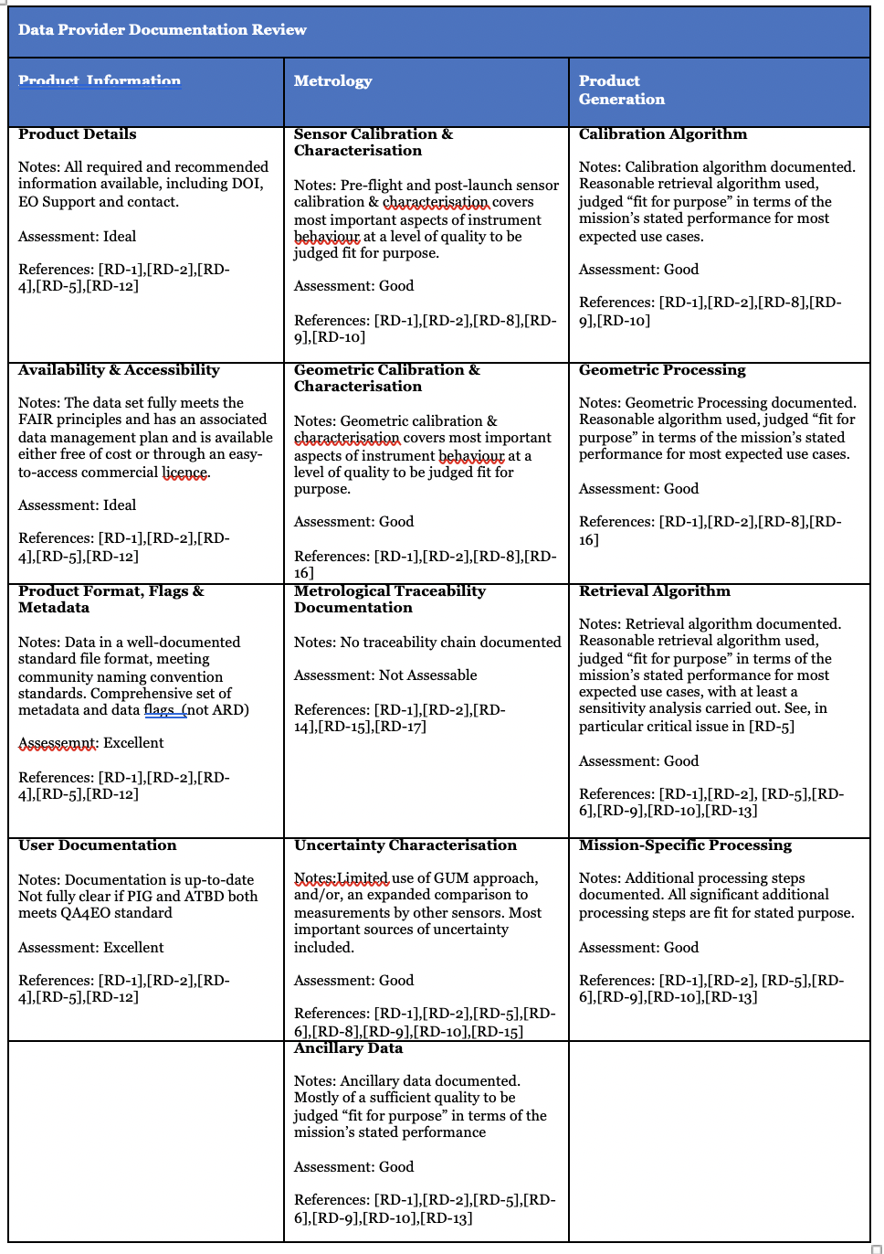
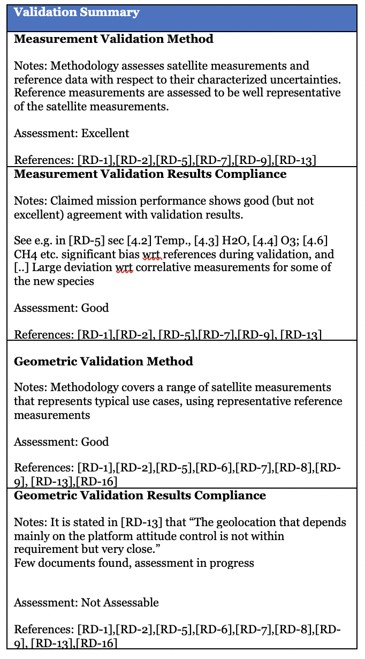
ENVISAT/MIPAS L2 Data - Cal/Val Maturity Matrix Details Partial Summary – in progress
Preliminary Analysis to be confirmed by a further assessment by MIPAS’ experts
Executive Summary
This is a preliminary analysis to be confirmed by a further assessment by the MIPAS’ experts. Regarding the ENVISAT/MIPAS L2 Data (v8.22) the Product Information Category is considered “Excellent/Ideal” in terms of information, documentation and data ease of access via the web. The Metrology category is considered “Good” considering the sensor calibration and characterization of the uncertainty characterization while documentation on Metrological traceability has not been found. Overall information for the Product Generation through the processing levels is considered “Good”. Regarding the Validation Summary, the methods are at the state-of-the-art; Compliance is generally “Good” for measurement and considered “Not Assessable” for Geometric results because the few documents found. Overall, the MIPAS performance is very good and the data produced are of high quality.

Slide 28
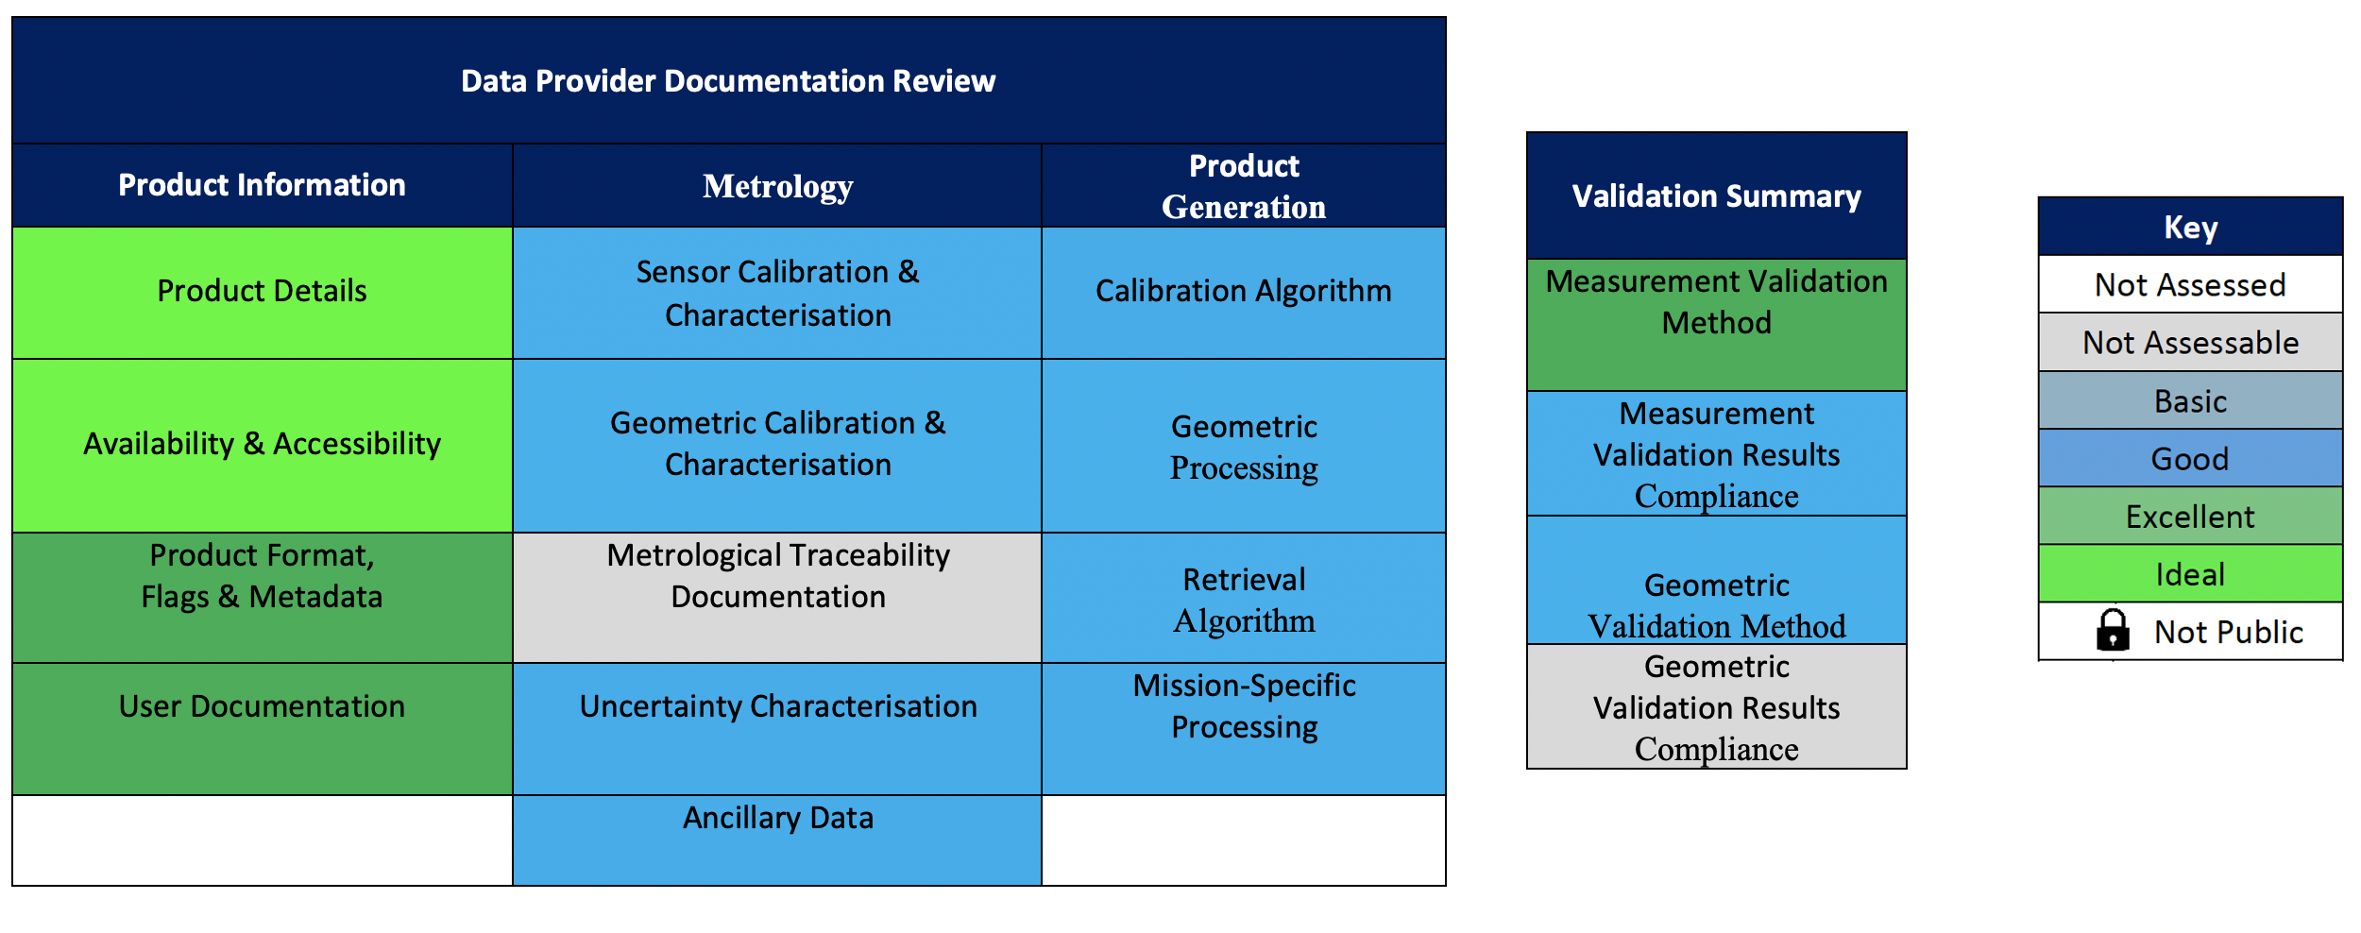
ENVISAT/MIPAS L2 Data (v8.22) - Cal/Val Maturity Matrix Partial Summary – in progress to be evaluated by experts
Cal/Val Maturity Matrix Summary for the MIPAS Level 2 (v8.22) data

