Slide 1
Jupyter Notebooks Webinar Feedback and Developing a Best Practice
WGISS - 52 Virtual Meeting
Wednesday 20th October 2021
Esther Conway (NCEO/CEDA), Ag Stephens (NCEO/UKSA), Richard Smith (NCEO/UKSA), Kenton Ross (NASA), Lauren Childs-Gleason (NASA), Yousuke Ikehata (JAXA), Makoto Natsuisaka (JAXA), Matt Paget (CSIRO), Brian Killough (SEO), Rizvi Syed (SEO), Damiano Guerruci (ESA) and Giuseppe Troina (ESA)

Slide 2
Actions !
CaoD , GEO ?, CODATA ?, WGISS
Data Discovery and Access
Collaboration and developing a Community of Interest
Training Capabilities (online access to Jupyter Notebooks and Data)
Data Interoperability and Use
Best Practice Document
Tech Expo
Introduction to Jupyter Notebooks
Data Preservation and Stewardship
CaoD/WGISS
Preservation and CEOS repository
Domain Specific /CapD Webinars
Tech Expo Webinars
Tech Expo

Slide 3
Who and why would we create a best practice document
Who will benefit form a Best Practice
Data Producers
Authors of Jupyter Notebooks
Providers of EO data training
Users of EO data
EO data archives
Providers of Data Analysis Infrastructure
JUPYTER NOTEBOOK BEST PRACTICE CONTENT
4.1 General Recommendations
4.2 Notebook description and function
4.3 Structure, workflow and documentation
4.4 Technical dependencies and Virtual Environments
4.6 Citation of input data and data access
4.7 Association with archived data
4.8 Incorporation with data cubes
4.9 Version control, preservation and archival
4.10 Open source software licensing
4.12 Publishing software and getting a DOI
4.12 Interoperability and reuse on alternate platforms
4.13 Creating a binder deployment

Slide 4
Notebook description and function
Clear understanding the purpose of a notebooks and deciding if it a reusable asset. Successfully conveying how and why a notebook should be used by its intended community
Core
Topic
Core
Topic
Develop guidelines with training examples and
Jupyter Day discussions ?

Slide 5
Structure, workflow and documentation
Encourage the development of good workflow and structure within notebooks along with quality documentation. Supporting their reuse and adaptation by new users
Good software engineering principles
Use of Functions
Use of Modules
Size of Notebook
Capturing Output
Core
Topic
Develop guidelines with training examples and
Juptyer Day discussions ?

Slide 6
Technical dependencies and Virtual Environments
Language and versions
Libraries
Other Code
Virtual Machines on Data Analysis Platforms
Installing libraries from within notebook, recommending conda etc.
Setting up virtual environments
Testing
Core
Topic
Develop guidelines and implement in training examples

Slide 7
Citation of input data and data access
Currently there is no guidance on how a Jupyter notebook should
Cite input data
Explain access requirements i.e. is it open or do need to apply for access
Location and structure of data
Citable as: Disney, M.; Chernetskiy, M.; Gomez-Dans, J.; Lewis, P.; Urban, M.; Schmullius, C. (2020): BACI: System State Vector (SSV) land surface time series dataset for the European regional site, 2000-2015, v1.0. Centre for Environmental Data Analysis, 30 January 2020. doi:10.5285/af13038e9caf499482a9bbb0b8fca2b8. http://dx.doi.org/10.5285/af13038e9caf499482a9bbb0b8fca2b8
Core
Topic
X
Develop guidelines with training examples and
Jupyter Day discussions ?
X
X
X

Slide 8
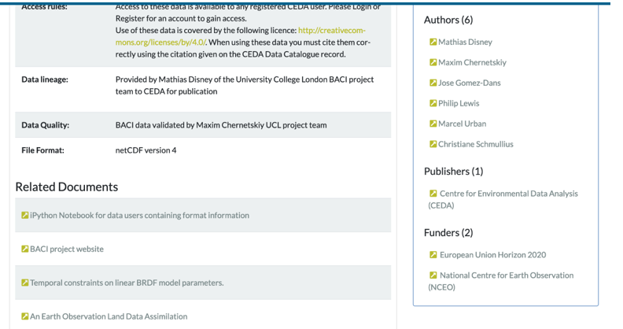
Association with archived data
There are many issue around how software should be linked to archived data and how permanent. This should be ? Areas for discussion include:
Research Objects
AIP’s
Part of the catalogue record
Deprecation and update
Advanced Topic
Discussion session in next WGISS – 53. Part of broader area of medium term preservation ?

Slide 9

Incorporation with data cubes
Establishing Connections with Data Cubes
Defining what data gets loaded
Working with xarray
Porting Notebook from hierarchical file system to a data cube
Advanced Topic
Advanced level: Tech Expo session on using Jupyter with datacubes

Slide 10
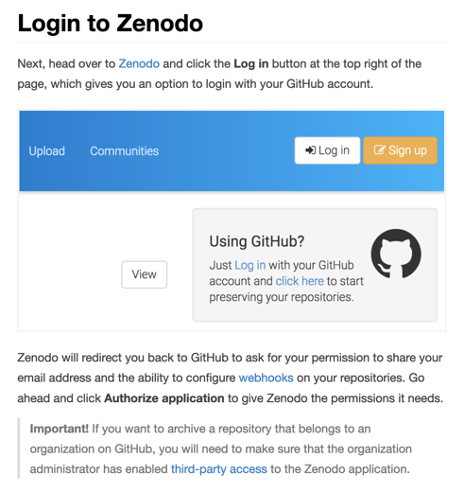
Version control, preservation and archival, publishing software, getting a DOI and licence
GitHub
Institutional/National Repositories
Structure of Repositories
Zenodo
Issuing a DOI
Versions
Creative Commons Licensing
Advanced Topic
Training users on using Github and setting up their own repository. Backed up by topic discussion at WGISS meeting

Slide 11





Interoperability and reuse on alternate platforms
Advanced Topic
How do we develop resource that can be used across platforms and direct users to valuable services. Use training notebooks as experiments

Slide 12

Creating a binder deployment
What is a Binder?
A Binder (also called a Binder-ready repository) is a code repository that contains at least two things:
Code or content that you’d like people to run. This might be a Jupyter Notebook that explains an idea, or an R script that makes a visualization.
Configuration files for your environment. These files are used by Binder to build the environment needed to run your code. Configuration files may be placed in the root of your repository or in a binder/ folder in the repository’s root (i.e. myproject/binder/).
A Binder repository can be built by a BinderHub, which will generate a link that you can share with others, allowing them to interact with the content in your repository.
Advanced Topic
How do we train users on setting up binder and adapting notebooks

Slide 13
Going Forward !
What should we do ?
  Detailed survey of training and Best Practice contributors
  Organize dedicated Jupyter Day for CapD training contributors April 2022 for full discussions
  Produce draft best practice of core topics for Jupyter Day
  Publish best practice on core topics after final review at WGISS - 54
  Organize Jupyter Week (hands on training) April 2023
  Develop advanced topics

Slide 14
Any other comments?
Contact Us !
esther.conway@stfc.ac.uk

