Slide 1

Working Group on Information Systems and Services (WGISS)
Committee on Earth Observation Satellites
Iolanda Maggio, Rhea GROUP for ESA
WGISS#52 Virtual Meeting
Inventory of FDA and Software and Tools
20nd October 2021

Slide 2
Executive Summary
FDA and OSS Inventories accessible through CEOS web site need to be kept alive and up to date
WORK IN PROGRESS (in cooperation with SEO team):
  Administrator account to ingest new FDAs and/or OSS
  Ingestion tool improvement including cross check function (to identify broken links)
NEXT STEPS:
  Both inventories will be circulated (to update existing entries and/or add new ones if/when available) by end of October;
  Input to be received by end of November;
  FDA and OSS inventories updated online by end of December.
Inventories will be updated once per year

Slide 3
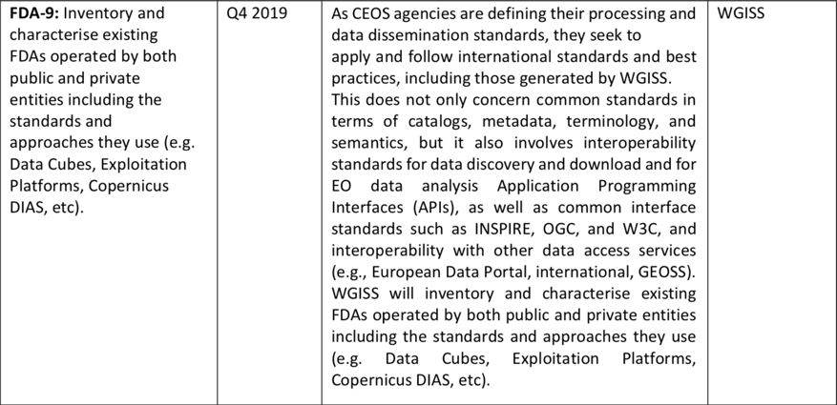
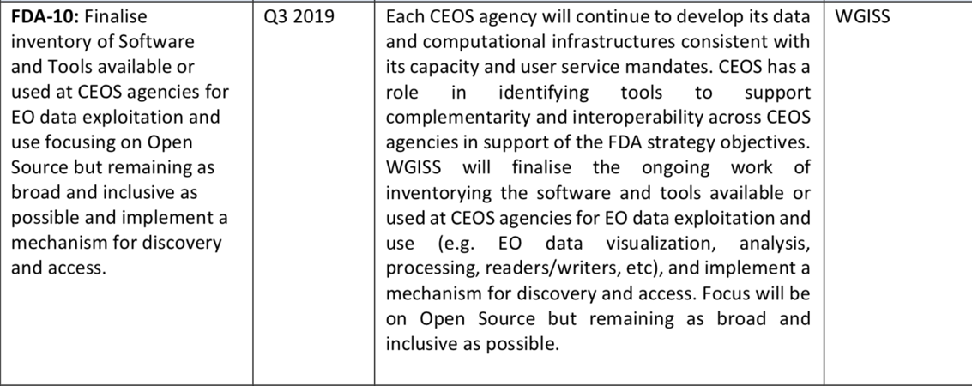
Background
OSS & FDA Inventory triggered by CEOS and WGISS Work Plan

Slide 4
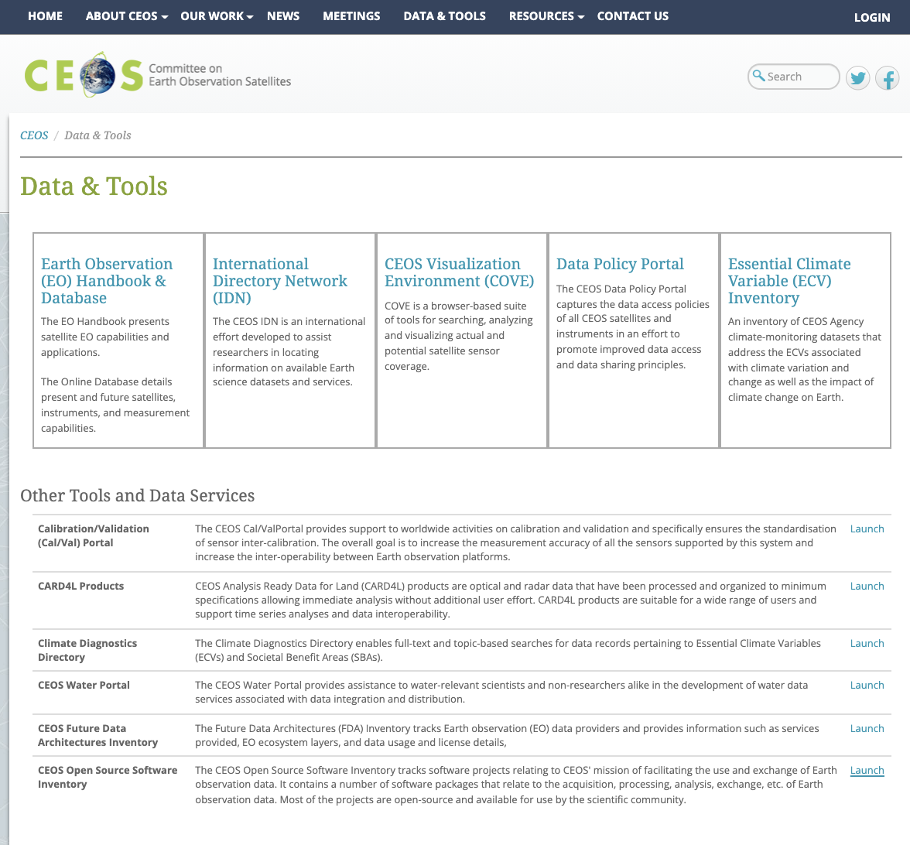
BACKGROUND

Slide 5
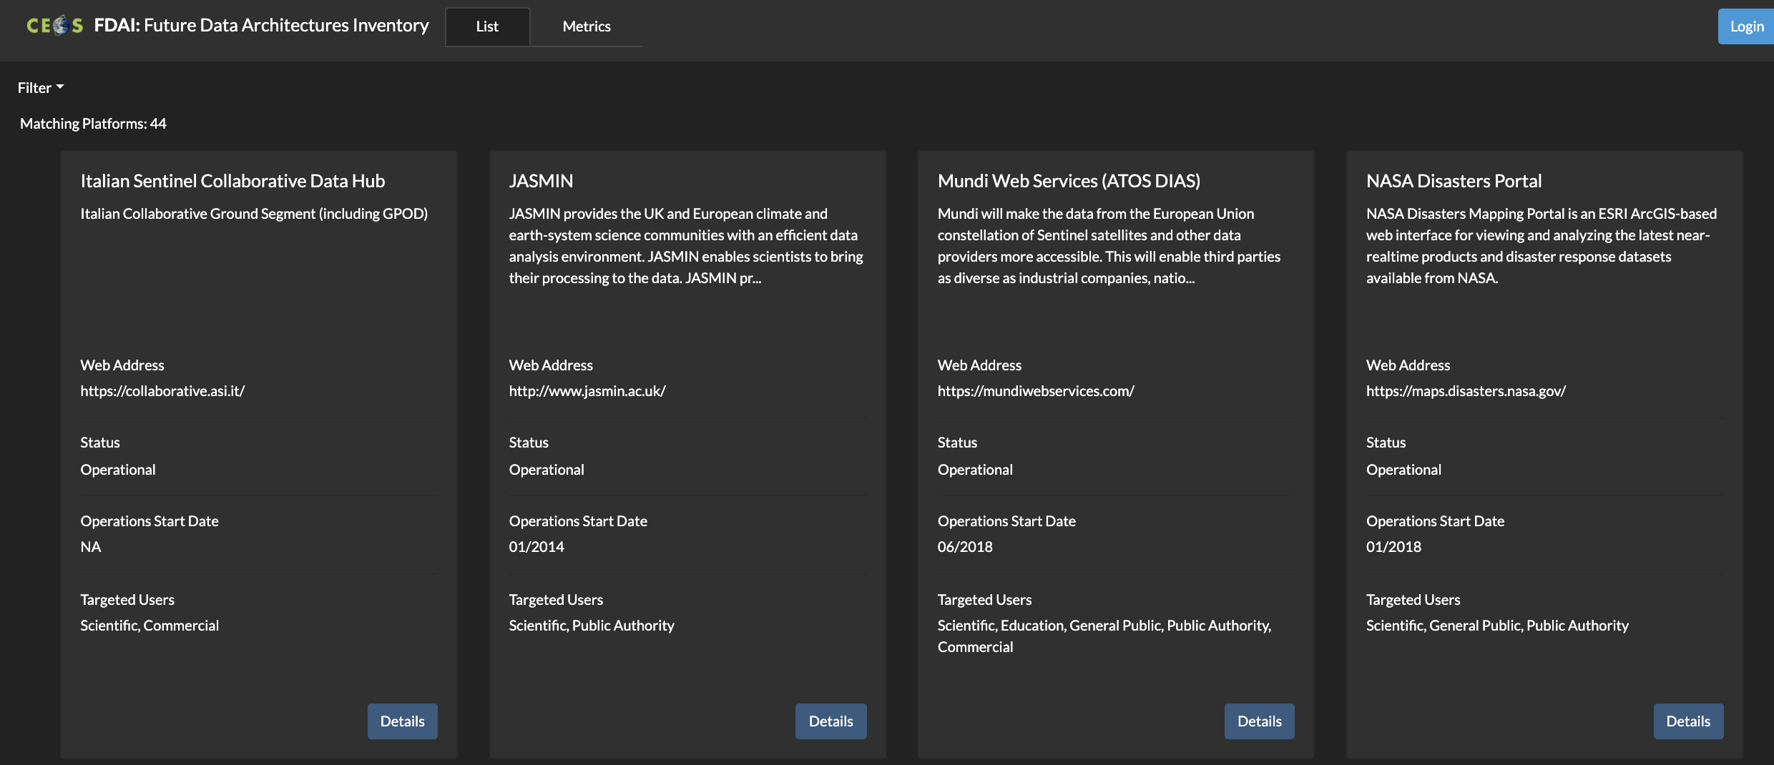
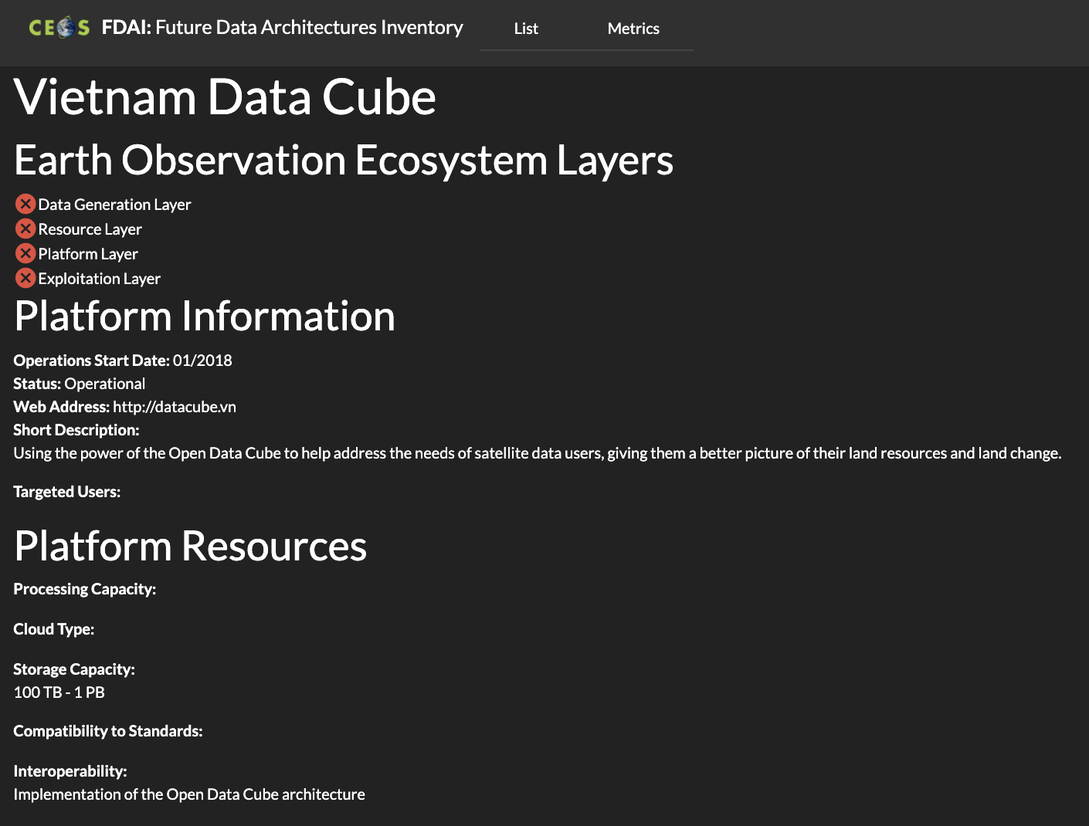
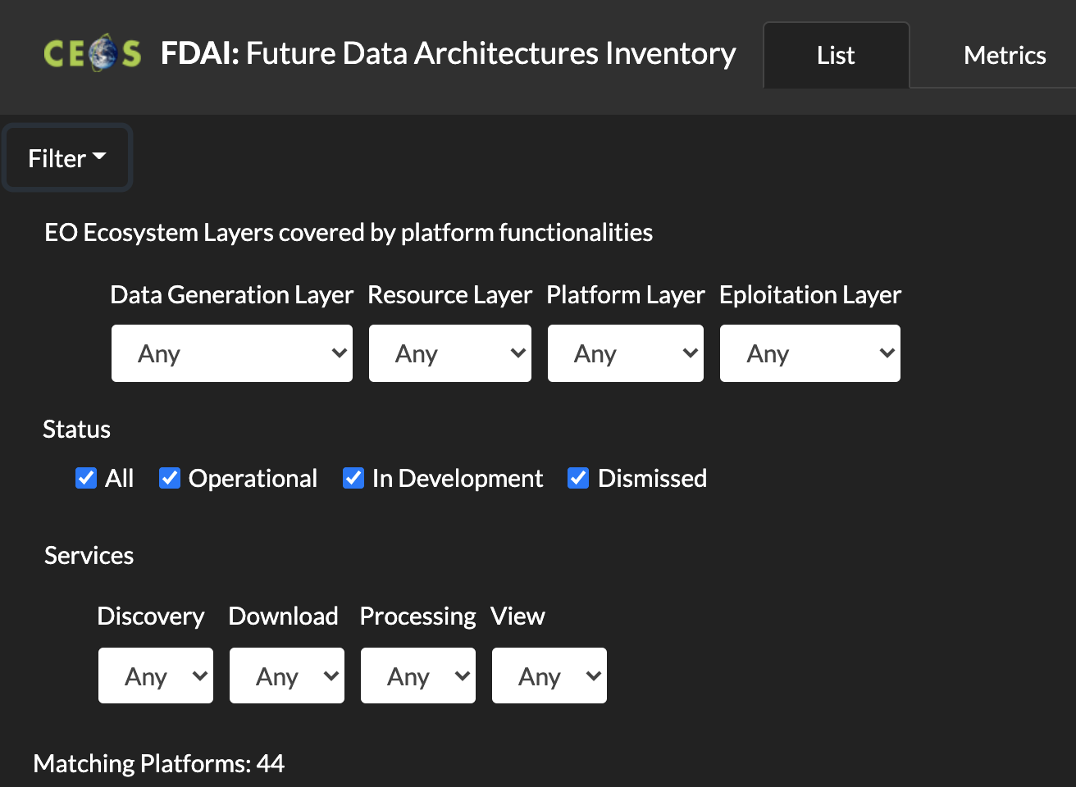
Future Data Architecture Elements Inventory web page
Notes:
Inserire filtro su ESA e prendere screenshot

Slide 6
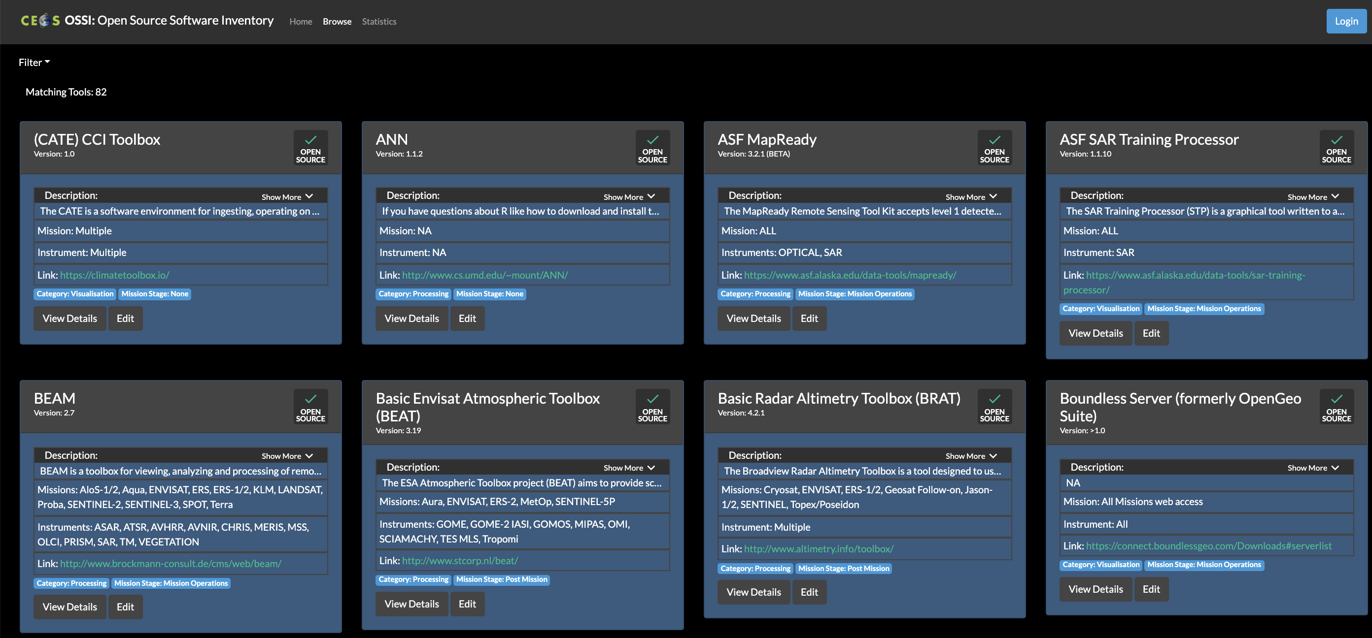
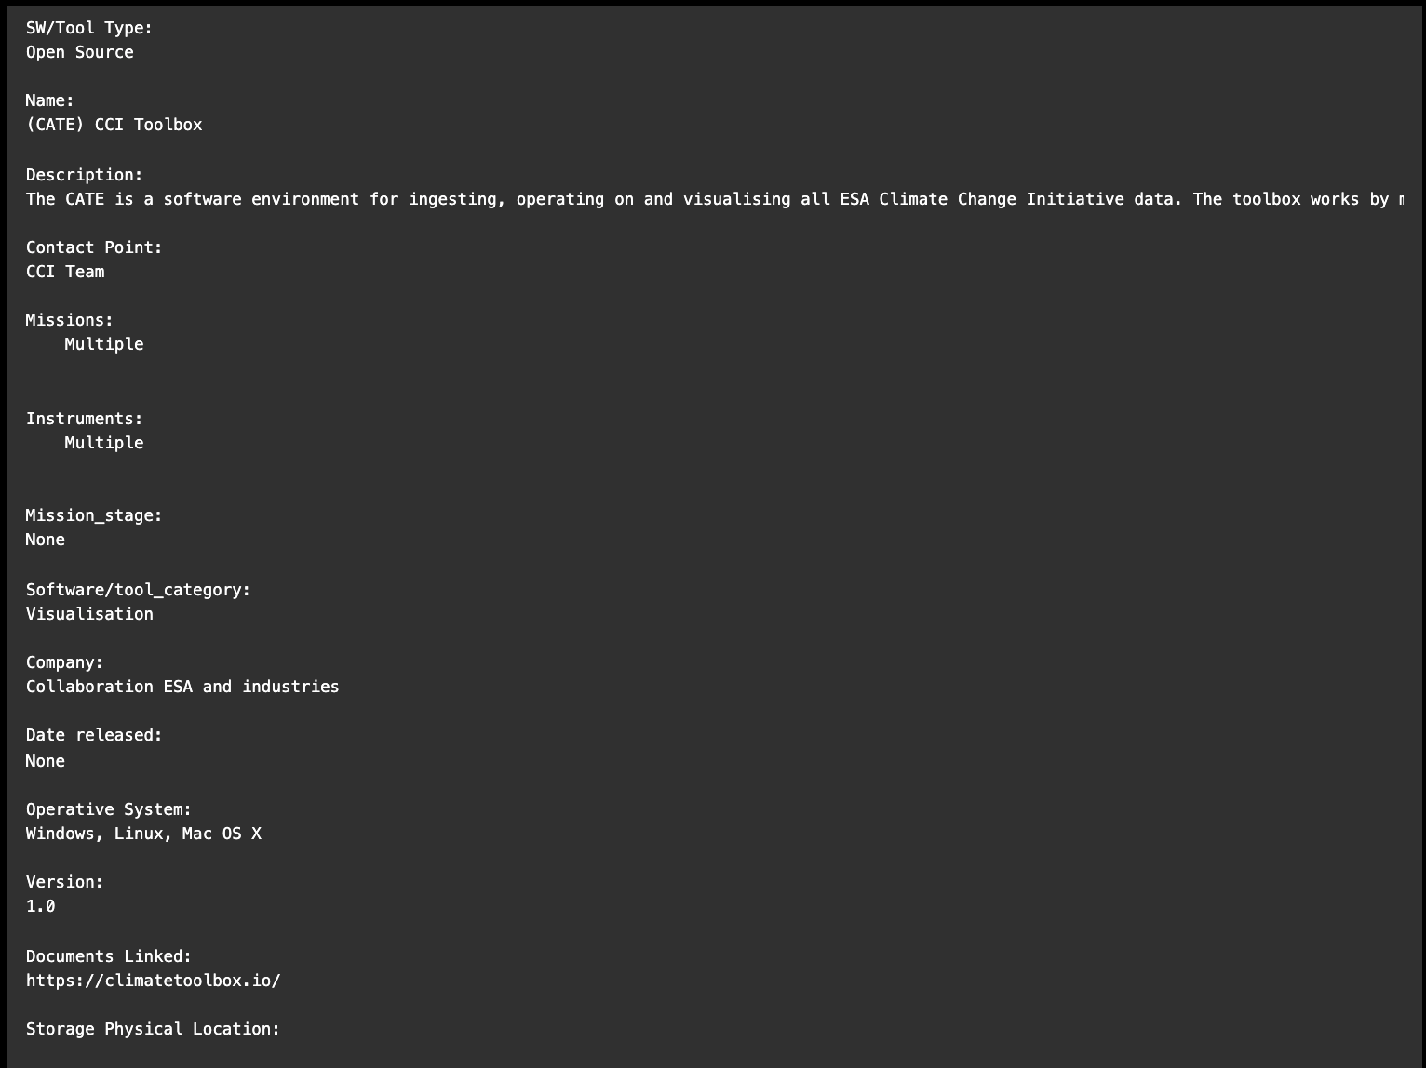
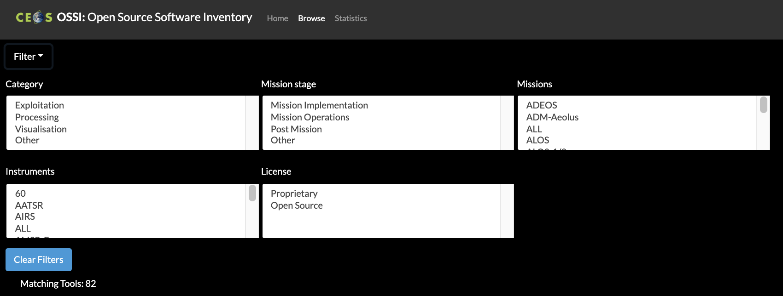
Open Source Software Inventory web page

Slide 7
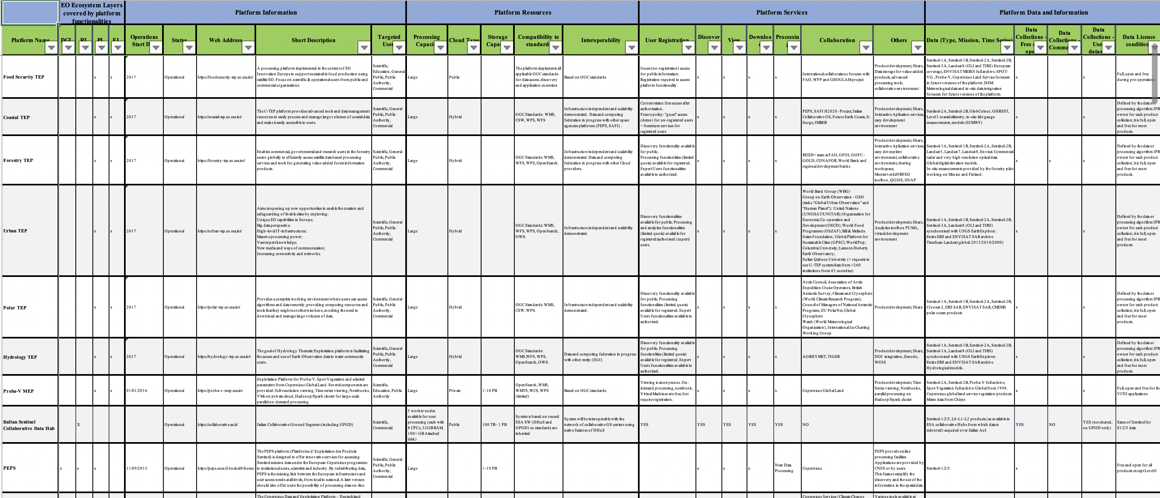
Future Data Architectures Survey
Relevant FDA Metadata and file circulated to WGISS members for contribution
FDA Inventory generated starting from the file updated by all interested Agencies

Slide 8
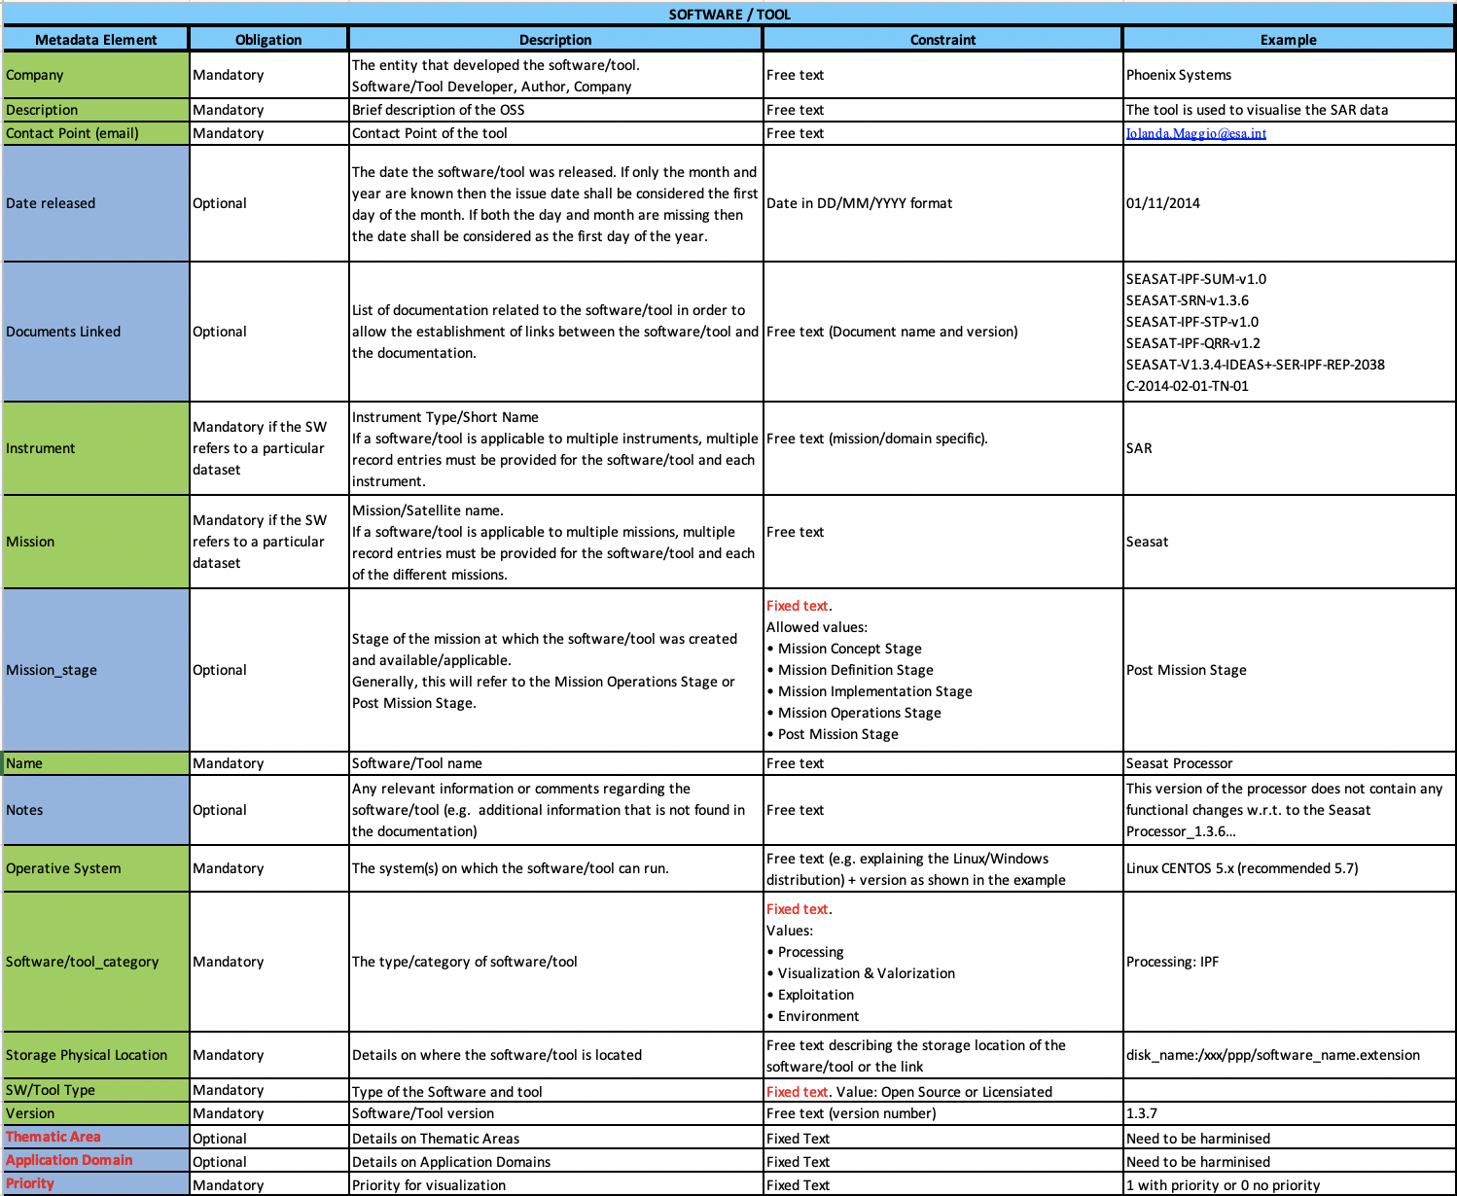
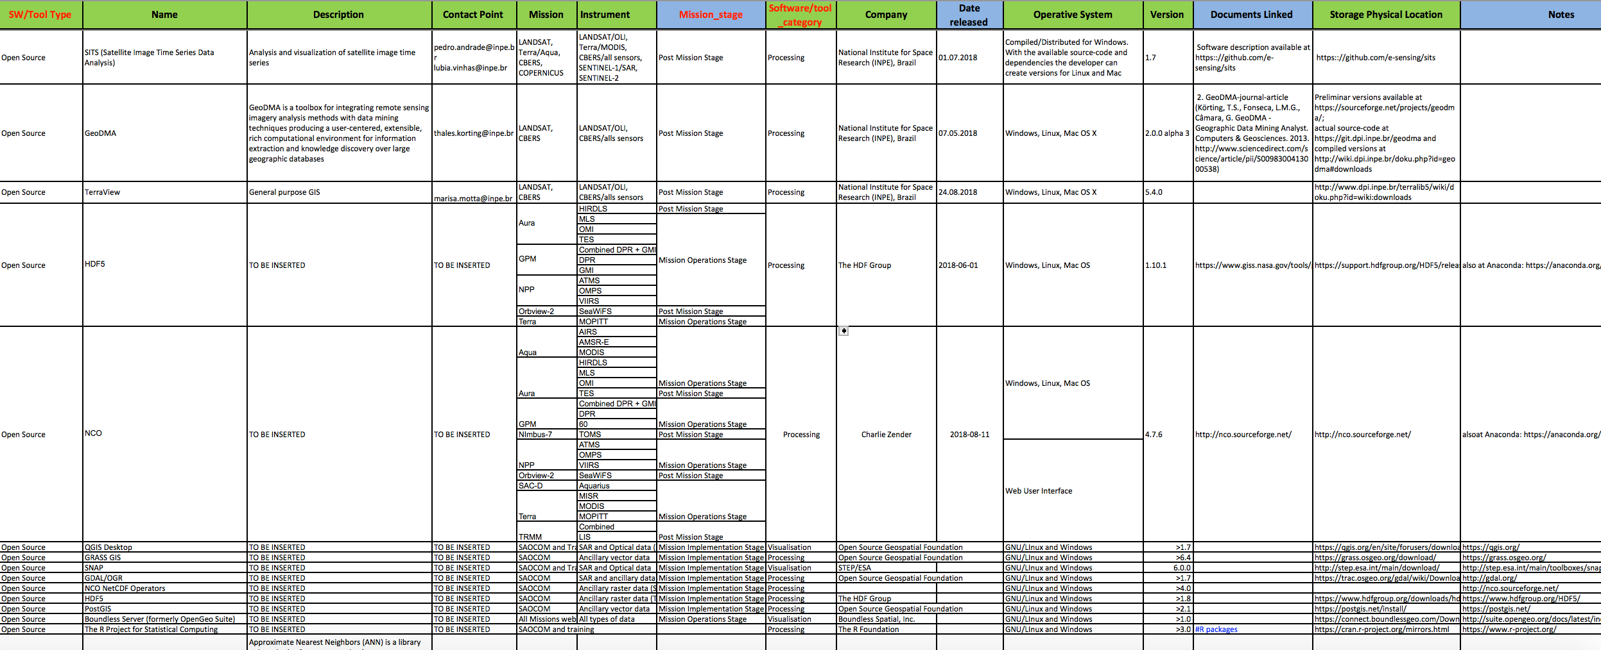
Open Source Software Survey
Relevant OSS Metadata and file circulated to WGISS members for contribution
OSS Inventory generated starting from the file updated by all interested Agencies

Slide 9
Working Progress & Next Steps
WORK IN PROGRESS (in cooperation with SEO team):
  Administrator account to ingest new FDAs and/or OSS
  Ingestion tool improvement including cross check function (to identify broken links)
NEXT STEPS:
  Both inventories will be circulated (to update existing entries and/or add new ones if/when available) by end of October;
  Input to be received by end of November;
  FDA and OSS inventories updated online by end of December.
Inventories will be updated once per year

Slide 10


