Slide 1
Executive Summary
Earth Analytics Interoperability Lab
Engagement Status:
46 registered users across CEOS projects
Training being provided to groups
Strategy and next steps
Sustaining the EAIL?
Interoperability analysis?
Specifically the STAC API experience
Discovery via CEOS Services
Other CEOS Cloud data?
EAIL and Jupyter Notebook BP
Interoperability Status:
ROI and Products determined by CEOS projects:
USGS Collection 2 COGS
Direct on AWS, STAC API
Element 84 Sentinel 2 COGS
Direct on AWS, STAC API
Sinergise S1 ARD Service
ordered-and-stored, fee for service
EAIL S1 ARD Service
Native processing, EAIL stores ARD COGS
NASA and COP DEM
EAIL stores copy
EASI Training notebooks EAIL tailored
Dask Gateway for scalable computing
Larger nodes, GPU – customisable

Slide 2
CEOS Earth Analytics Interoperability Lab Update
Committee on Earth Observation Satellites
Dr. Robert Woodcock, CSIRO, WGISS Chair
Dr. Brian Killough, NASA, CEOS Systems Engineering Office
Mr. Jonathan Hodge, CSIRO Chile, Program Director
WGISS 52 Virtual Meeting
19-21 October 2021
Notes:
The CEOS Earth Analytics Interoperability Lab (EAIL or “The Lab” for short) is a new initiative, an experiment mainly responding to demand from CEOS Projects related to the CEOS Future Data Architectures and Analysis Ready Data strategy

Slide 3
Why do we need an Interoperability Lab?
Validating interoperability between multiple CEOS organizations and working groups is complex
ARD and FDA are here and there are WGISS technologies and Best Practices that need to change
The CEOS EAIL is intended to help CEOS WG & VCs explore these challenges together
EAIL is jointed operated by WGISS, CEOS SEO, CSIRO (Aus) and CSIRO Chile
Notes:
Interoperability work is relevant to all of CEOS and connected to LSI-VC, WGISS, WGCapD and the SEO. Plus specific projects (CEOS-COAST), and collaborators (GEO GLAM, GEO Aquawatch).
A significant number of these projects have contacted WGISS and SEO for assistance and advice in two main areas:
Integrated EO data analytics platform technology
Analysis Ready Data – formats, discovery, use
All involve multiple CEOS agencies, hence there is a strong need to interoperability. Most are also seeking a place to conduct experiments with newer technologies that aren’t always available from a CEOS agency (at least not yet).

Slide 4
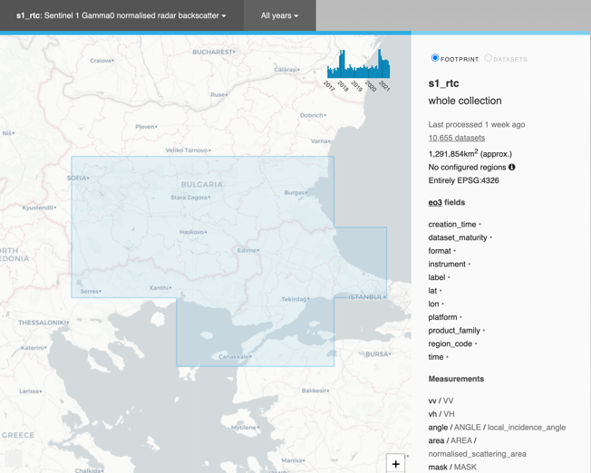
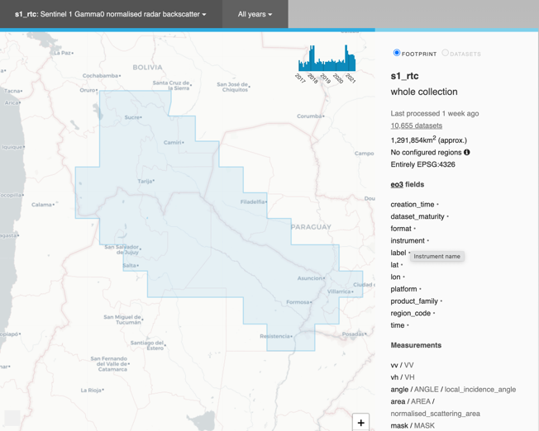
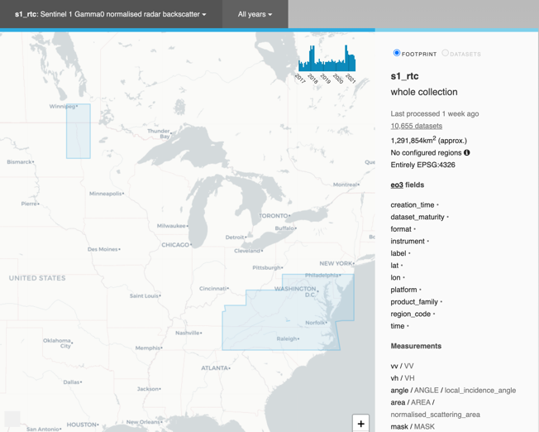
Sentinel 1
Red River, Balkans and Argentina/ Paraguay for dates identified
East coast USA 2017-2021
SAR ARD Processing pipeline automation
a.
b.
c.
https://explorer.eail.easi-eo.solutions/s1_rtc
Notes:
Additional areas currently require funding given the additional storage and ARD processing costs.

Slide 5
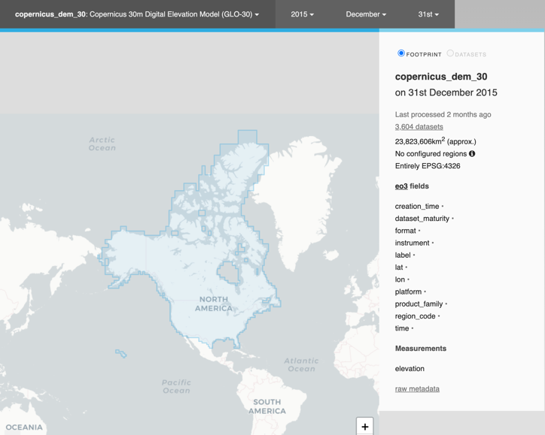
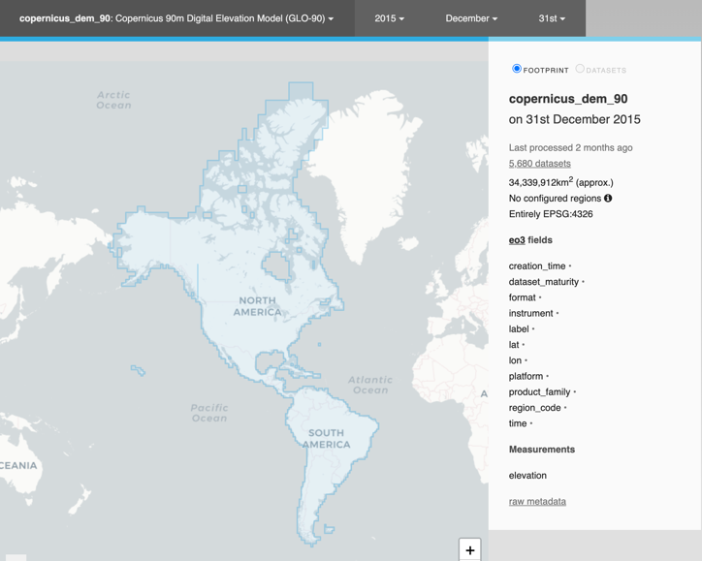
Copernicus DEM
30m: all of USA & Canada, 90m: all of Americas
Easy to add more if needed
https://explorer.eail.easi-eo.solutions/copernicus_dem_30
https://explorer.eail.easi-eo.solutions/copernicus_dem_90

Slide 6
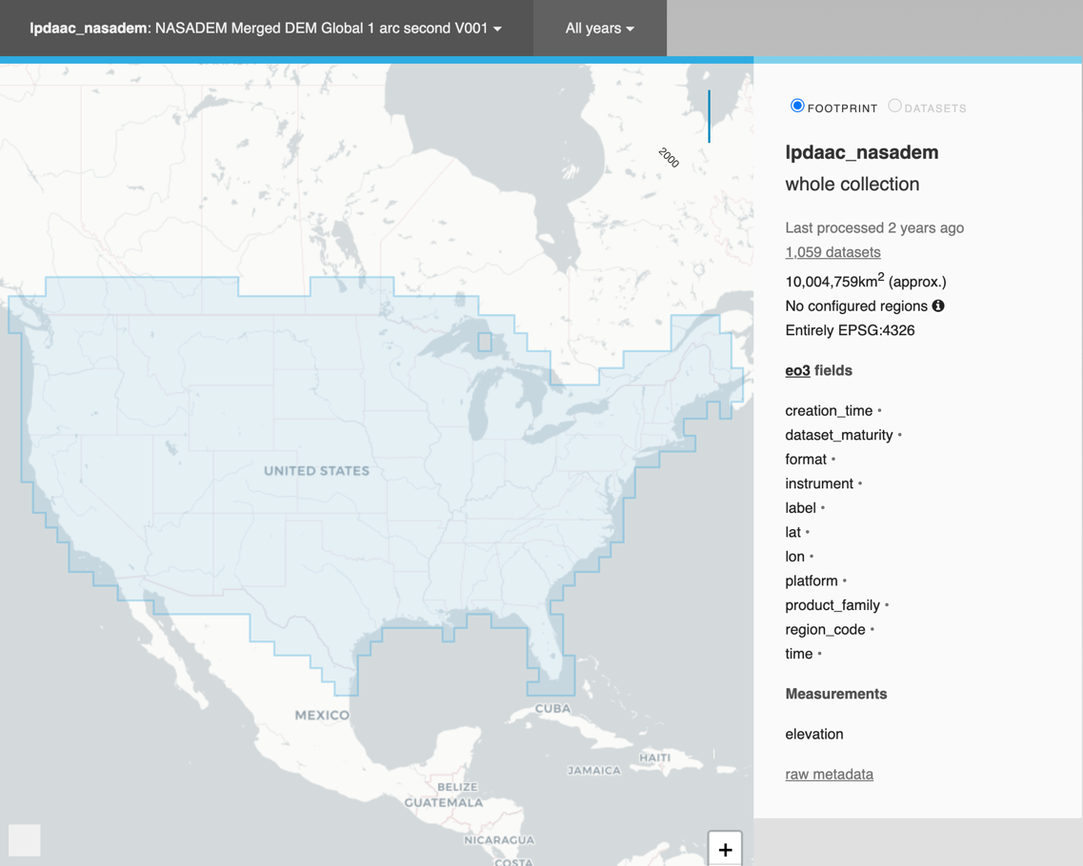
NASADEM
All of continental USA
30m resolution
Easy to add more areas
Currently just elevation, no “supplementary” calculations
https://explorer.eail.easi-eo.solutions/lpdaac_nasadem

Slide 7
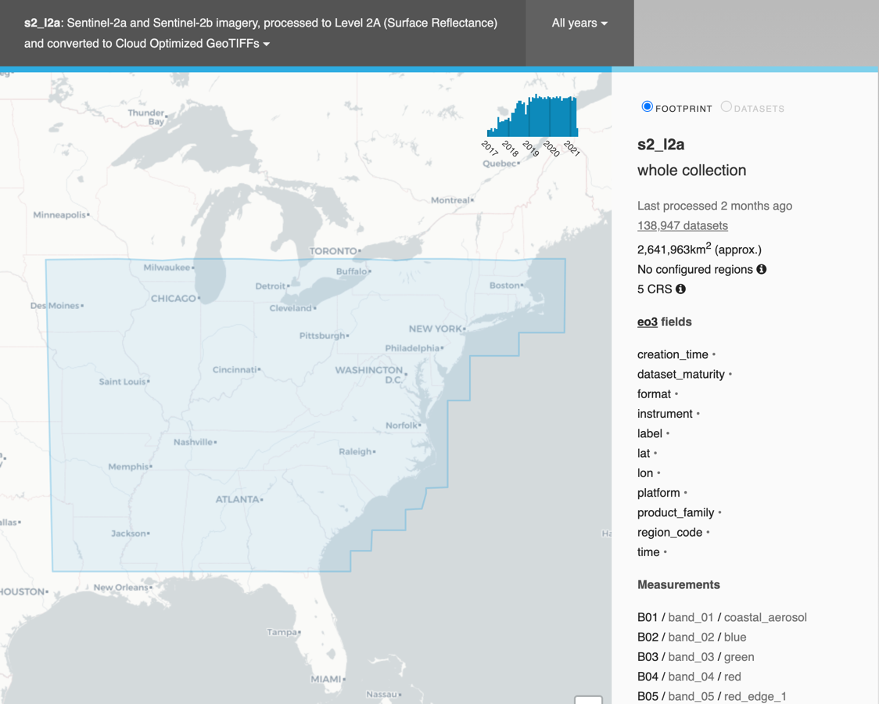
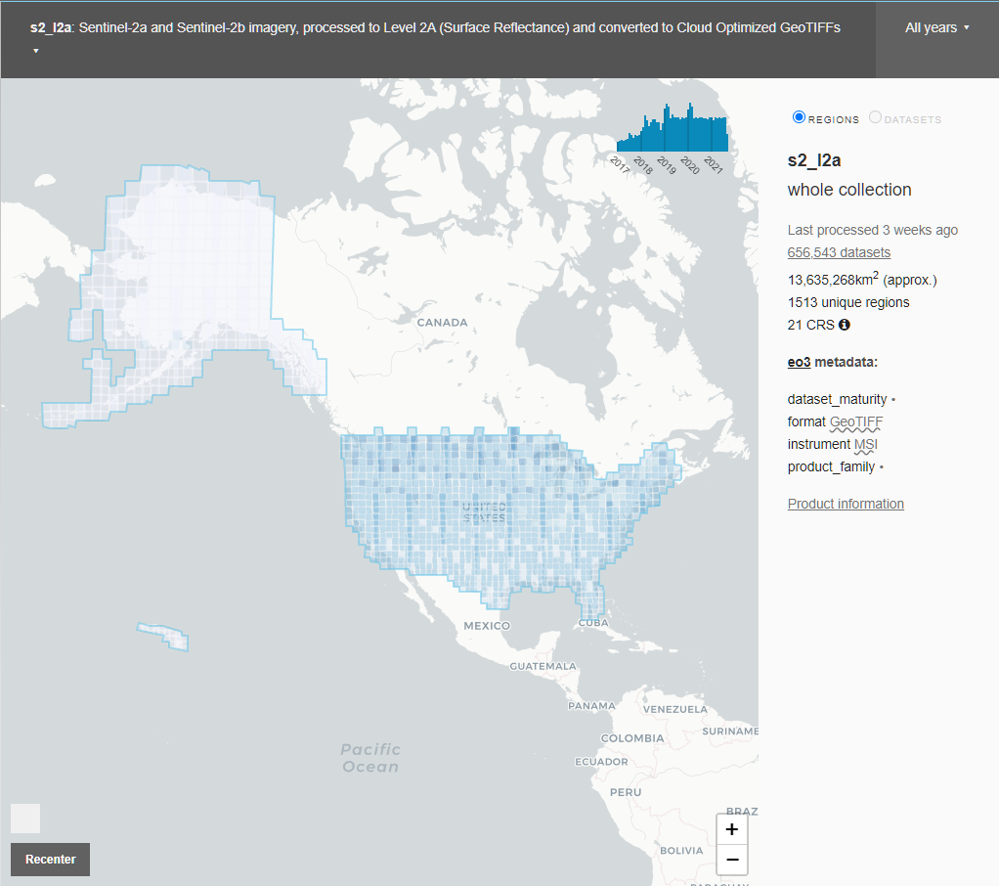
Sentinel 2
East coast USA
Full archive 2017-present
All bands, full resoltuion
Additional areas can be added very easily
Now via common STAC API
https://explorer.eail.easi-eo.solutions/s2_l2a

Slide 8
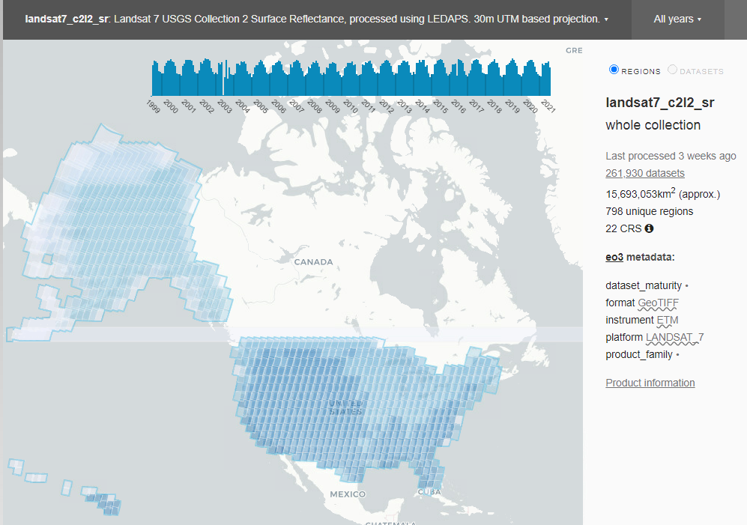
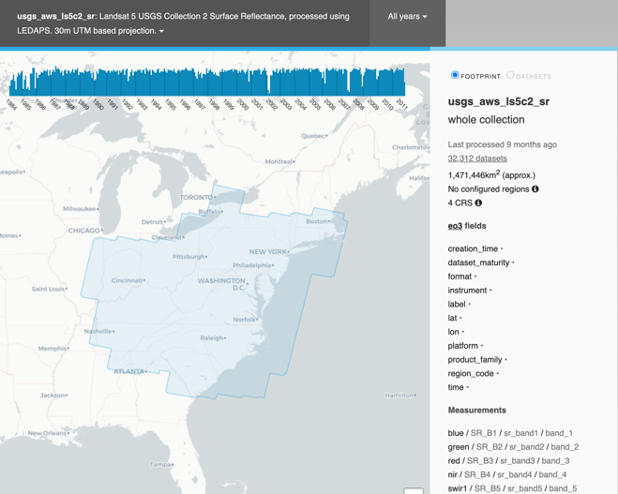
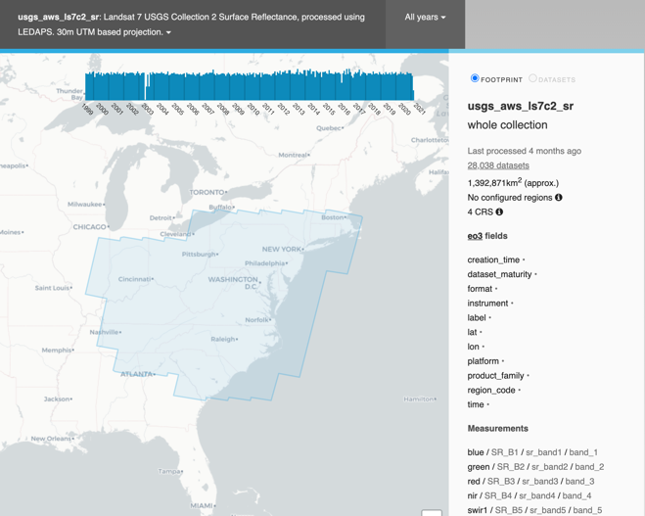
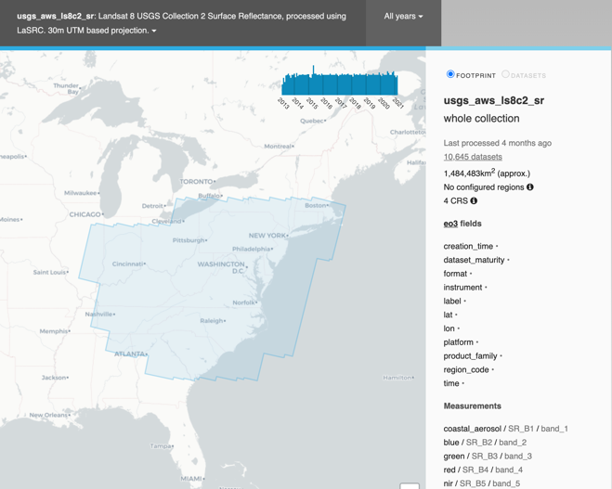
Landsat
Selected area of east coast, full archive, 1984-2021
Landsat 5,7 & 8 – all bands plus surface temperature
Possible to add more areas but requires some time (2-3 days)
WIP Via USGS STAC API – LS5-8 < 1hour
https://explorer.eail.easi-eo.solutions/usgs_aws_ls5c2_sr
https://explorer.eail.easi-eo.solutions/usgs_aws_ls7c2_sr
https://explorer.eail.easi-eo.solutions/usgs_aws_ls8c2_sr

Slide 9
Jupyter Notebooks and Dask on EAIL
Dask distributed computing
Visualization
Notes:
More EAIL demonstration in the Tech Expo Session with Matt PAget.

Slide 10
WGISS 52 – Strategy brainstorm
Asia-RiCE
CEOS COAST
WG Dis Flood Pilot
Projects plus SEO on EAIL
Engagement
Earth Analytics Interoperability Labs (participants)
CEOS EAIL, OEA ODC Colab operational
(?AI4GEO, Brazil DataCube, ISRO,…?)
CEOS
Sentinel 1 Data Pipelines?
Cloud Native Discovery?
Jupyter Notebooks
(BP in progress)
Interoperability
Best Practices
Demonstration Notebooks
Working Group:
SAR2CUBE
CSIRO Data Pipelines…
Working Group:
Data Discovery and Access
Working Group:
Tech Expo
AI4GEO
SEO
ESA…
Notes:
Jupyter notebooks best practice is underway.

