Slide 1

Supporting Open Geospatial Science
Pete Doucette, Director (acting)
Earth Resources Observation Science (EROS)
USGS, Sioux Fall, SD, U.S.A
Summary
Our definition of Open Geospatial Science (OGS) is consistent with the generally community, with emphasis on maintaining science integrity and reproducibility.
Impact to OGS has been best demonstrated via free & open data policy in 2008; includes Landsat ARD, metadata, provenance and Level 2 (surface reflectance) processing algorithms.
Potential investment areas:
  Cloud access to Landsat data (Level 2 and Level 3); global ARD and Level 3 (e.g., LCMAP, NLCD, LANDFIRE, etc.) data and science algorithms.
  Open science algorithms for harmonization among multiple data sets (e.g., HLS).
  Promotion/collaboration with of Open Data Science and OpenAI platforms (e.g., Open Data Cube, Pangeo, other).
Source: The Economist, May 6, 2017
https://www.economist.com/leaders/2017/05/06/the-worlds-most-valuable-resource-is-no-longer-oil-but-data
U.S. Department of the Interior
U.S. Geological Survey

Slide 2

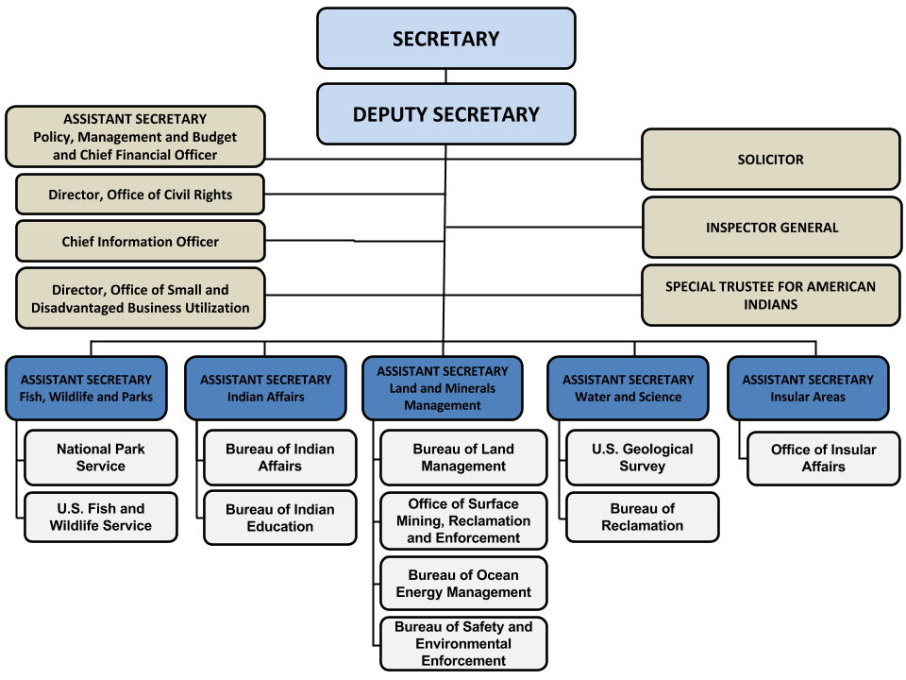
Mission: protect and manages the Nation's natural resources and cultural heritage.

Slide 3

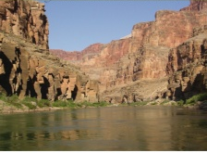
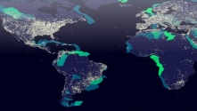
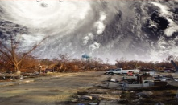
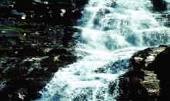
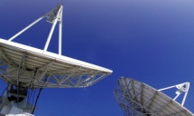
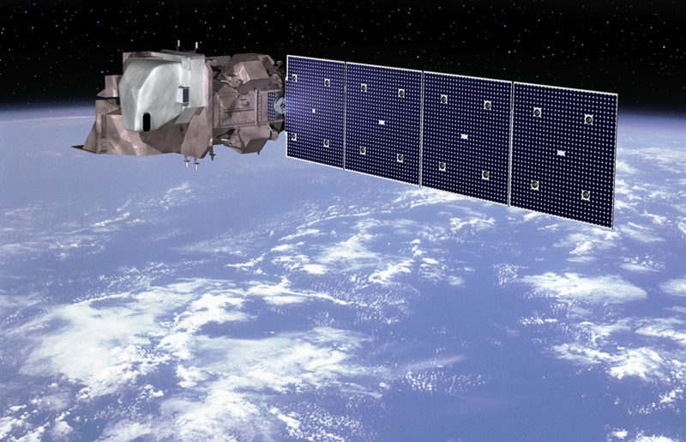
United States Geological Survey
Mission: Provide reliable scientific information to describe and understand the Earth; minimize loss of life and property from natural disasters; manage water, biological, energy, and mineral resources; and enhance and protect our quality of life.
Ecosystems
Energy and Mineral Resources and Environmental Health
Natural Hazards
Water Resources
Core Science Systems
Landsat

Slide 4

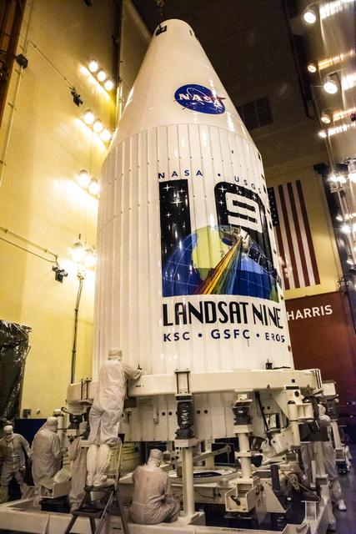
Notes:
Landsat 9 continued the relationship NASA and USGS developed in the build and launch of Landsat 8. Under Sustainable Land Imaging (SLI), NASA is responsible for developing the satellite and the launch vehicle, and USGS develops the ground system and operates the satellite once it’s been launched and checked out by NASA.
The left image is the launch vehicle nose fairing with the L9 logo painted on. The NASA images reflect the launch processing and launch of L8, which we’re hoping to repeat soon with L9’s launch set for September 16th. On the right side, USGS is responsible for the ground segment and the images are of the tracking sites we manage around the world to operate the mission, the mission operations center where we fly the satellite, and the Earth Resources Observation and Science Center in Sioux Falls, SD where the data is collected, archived, processed and distributed. The Earth Resources Observation and Science (EROS) Center near Sioux Falls, South Dakota performs the satellite operations and image data collection, archiving, processing, and distribution. EROS supports a large contractor force which provides subject matter expertise to meet Landsat 9 milestones, Landsats 7-8 flight operations, Landsats 7-8 ground operations, and Landsats 1-8 archive, processing and dissemination operations. These activities support the Administration’s priorities including the goals of EO 13990 (Protecting Public Health and the Environment and Restoring Science to Tackle the Climate Crisis) and EO 14008 (Tackling the Climate Crisis at Home and Abroad).

Slide 5








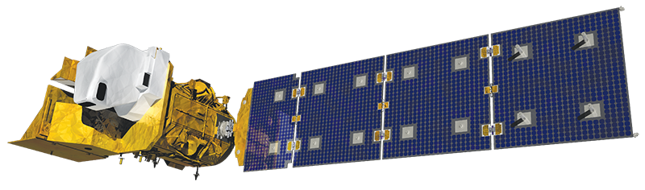
Sustainable Land Imaging
First Phase of SLI
Second Phase of SLI
Landsat 9
Landsat Next
?
Cross Calibration Radiometer Demo
Hyperspectral Technology Development & Infusion
Partnerships to access
new data & capabilities
SLI Technology Investments (NASA)
User Needs Development (USGS)
User Satisfaction
2010 2020 2030
Notes:
This diagram shows the history of the SLI relationship between NASA and USGS. The “First Phase of SLI” began in 2012 with the announcement by NASA of a joint program designed to ensure there would be no breaks in Landsat capability in the coming decades. This phase followed an architecture study which determined Landsat 9 should be a clone of Landsat 8, taking advantage of the engineering work that led to that successful mission. This phase also established continuing technology investment and user needs development activities designed to ensure future missions met the needs of the users while incorporating new technology.
The “Second Phase of SLI” was determined following a second joint agency architecture study that concluded in late 2019. This second phase continues the technology and user needs activities while introducing four new capabilities, designed to collectively meet the user needs compiled for the architecture study and incorporating the latest technology. This phase includes Landsat Next as the successor to Landsat 9, with the precise mission design being worked out this year in concept studies. The new mission will be much more capable than L9, with twice as many spectral bands and spatial resolution twice as good. The expectation is Landsat Next will be launched in the late 2020s. Another mission, called Landsat Beyond, will follow Landsat Next’s development in the 2030s, again, continuing the technology and user needs work to ensure a system that meets user needs while providing improved technology and capability.
Although Landsat Next will take the bulk of the development resources, the other three components also contribute capability in a way designed to improve the collective performance of the entire architecture. The Space-based cross calibration radiometer demo will show how a small satellite sensor could transfer the quality imagery of Landsat to commercial small satellites, making that data more valuable and easier to use. Hyperpectral technology, which brings the ability to detect much smaller wavelengths of energy than Landsat’s multispectral imagery, is seen as the logical next step in Landsat’s evolution. So the hyperspectral technology line here will continue to assess how and where hyperspectral data can actually satisfy today’s applications and help us scope the types of systems needed to collect, process and distribute this type of data in Landsat Beyond. Finally, the partnerships for new capabilities element will pursue strategic engagements with commercial, international and interagency partners to bring select mission data and services to augment Landsat data and meet needs that Landsat cannot meet. Together, the capabilities of the Second Phase of SLI will satisfy the vast bulk of the community’s user needs and do so in the most cost-effective manner possible.

Slide 6

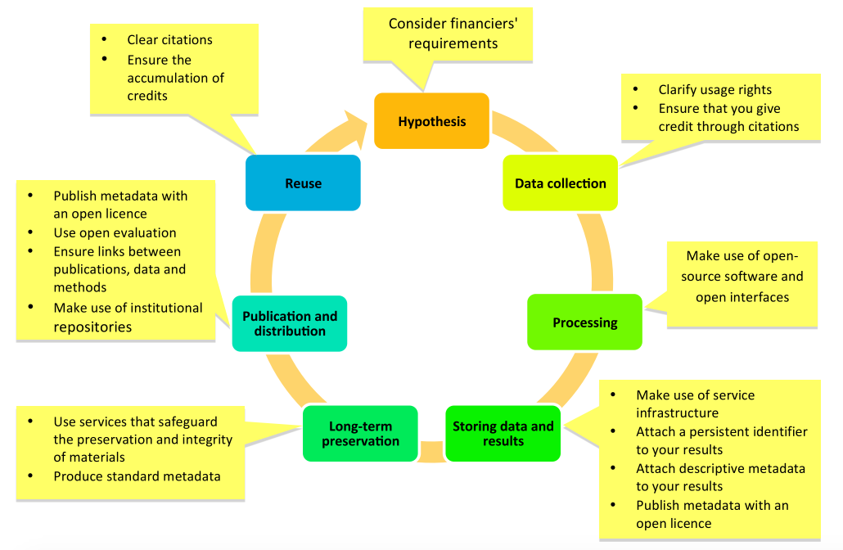
Open Science
Research
Cycle
Promoting reproducible science is the integrity goal
Promoting openness at different stages of the research process (Open Science and Research Initiative, 2014)

Slide 7
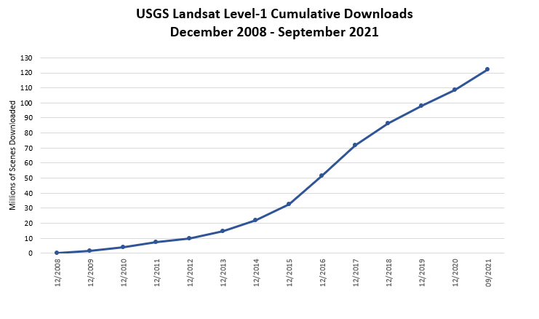
Impact of free and open data policy for Landsat
$2.2B in annual global economic benefit
(OPR2013-269, USGS/DIO)
Contingent Valuation Method
Free and open data policy
$3.45B in annual global economic benefit
(Open-File Report 2019-1112)
Contingent Valuation Method
There are no restrictions on Landsat data downloads; it can be used or redistributed as desired. We do request that you include a statement of the data source when citing, copying, or reprinting USGS Landsat data or images.
Notes:
Free mod res created a market for land monitoring, cloud-based platforms for EO, and influenced a new mindset across the community

Slide 8
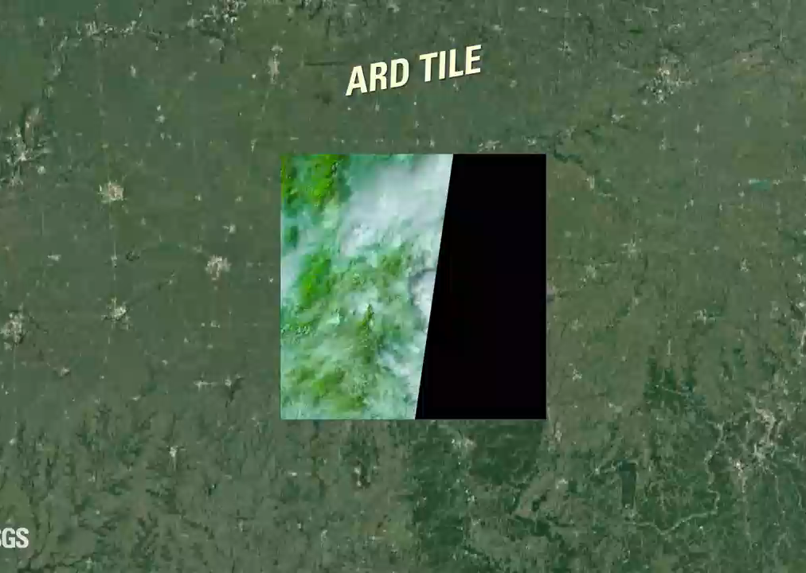
Open Analysis Ready Data (2017) over U.S.
2021
Landsat 9
2020
2013
Landsat 8
1999
Landsat 7
1993
1984
Landsat 5
Dwyer, J., Roy, D., Sauer, B., et al.. Analysis Ready Data: Enabling Analysis of the Landsat Archive. Remote Sens. 10(9), 1363, 2018.
1982
Landsat 4

Slide 9
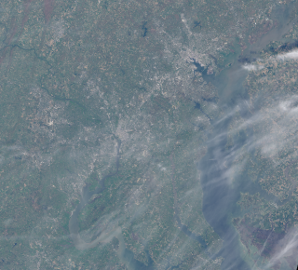
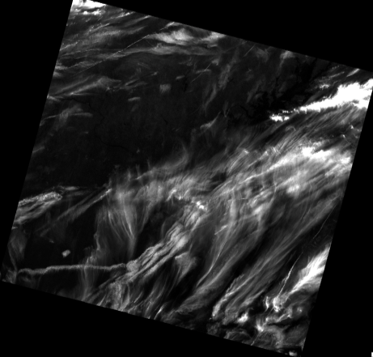
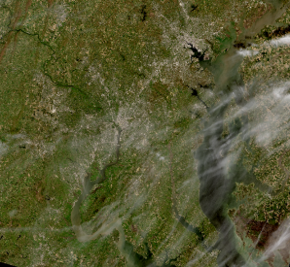
Open data calibration and science algorithms over spatial, spectral, and temporal dimensions
Level 1 data
Level 2 data
Identify
artifacts
Baltimore
Baltimore
D.C.
D.C.
Top of atmosphere
Surface Reflectance

Slide 10
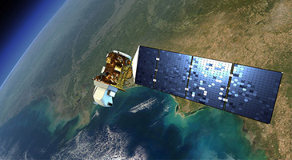
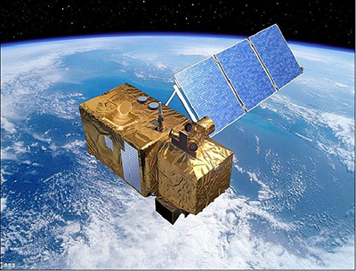
Open cross-sensor interoperability science algorithms
Harmonized Landsat/Sentinel
(HLS)
Landsat 8
(USGS)
Sentinel 2
(ESA)
Red Band
Green Band
NDVI
Landsat 8
Sentinel 2
Claverie, M., Ju, J., Masek, J., Dungan, J., Vermote, E., et al. The Harmonized Landsat and Sentinel-2 surface reflectance data set. Remote Sens. Environ. 2018.

Slide 11
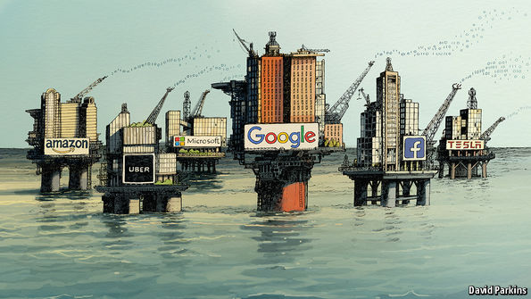
Data is the new oil
→ Data Science
Source: The Economist, May 6, 2017
Used with permission by
https://www.economist.com/leaders/2017/05/06/the-worlds-most-valuable-resource-is-no-longer-oil-but-data
Notes:
Read forbes 2019 article that data is not necessarily the new oil.
Main analogy is source of POWER, which is most fully realized via the engine of data science.
Of course ENVI analystics is about Earth Observation DATA, so the question to be answered is how is/should this community putting data science to work?

Slide 12

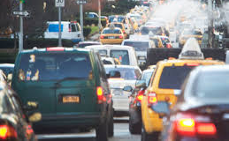
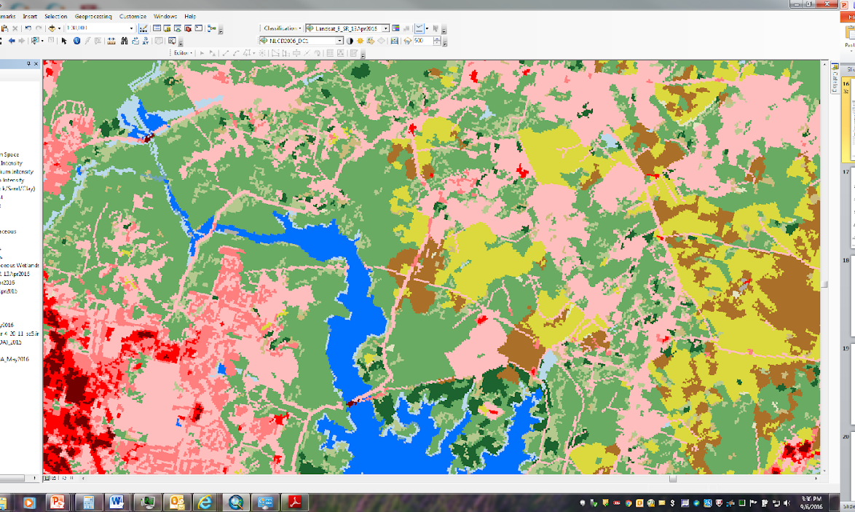
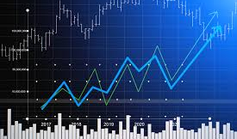
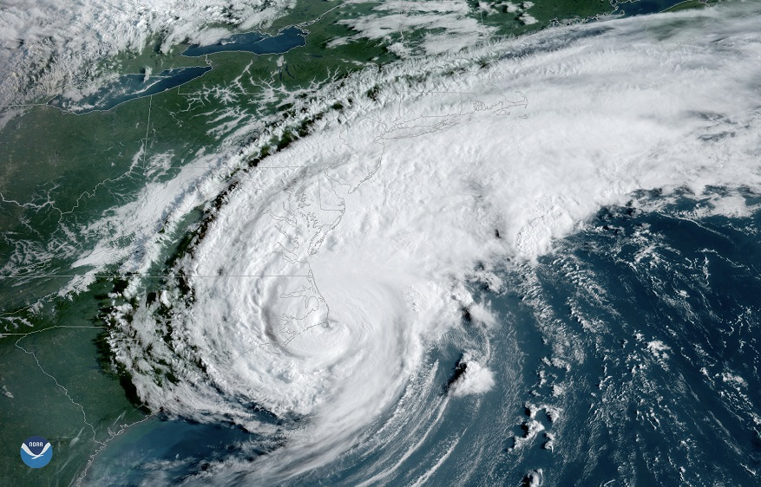

Transforming patterns (structure) that exist in the data, into useable knowledge to drive decision making.
Coordination with Open Data Science
and OpenAI
Notes:
We need to understand more than just patterns at one point in time, but over time. Often times, the temporal component of patterns provides the richest source of understanding, but can also be the most complex, especially as relationships become highly nonlinear. That’s were the power of Deep learning can provide some of the most insight, is with non-linear dynamical systems.
Useable versus actionable– sometimes the action to take is to not act because of unintended consequences.
Sounds almost trivially obvious. But the complexities that exist

Slide 13
Potential investment areas to support open (geospatial) science into the future
  Cloud access to Landsat data (Level 2 and Level 3); global ARD and Level 3 (e.g., LCMAP, NLCD, LANDFIRE, etc.) data and science algorithms.
  Open science algorithms for harmonization among multiple data sets (e.g., HLS)
  Promotion/collaboration with of Open Data Science and OpenAI platforms (e.g., Open Data Cube, Pangeo, other….)

