Slide 1
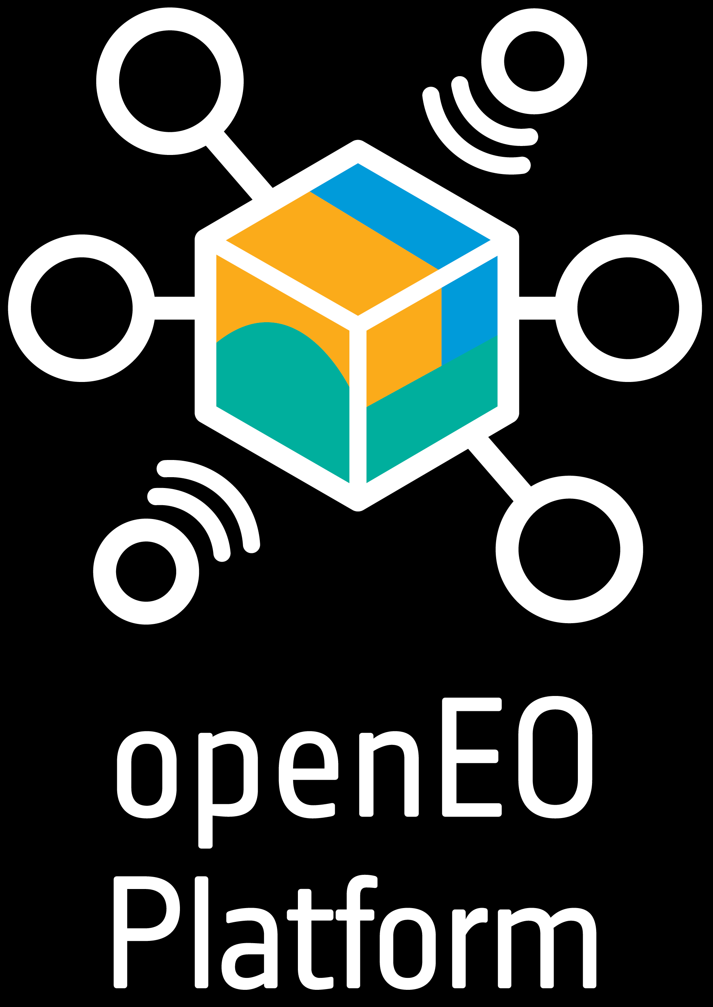
OpenEO Platform - Current Status and Evolution
openEO platform is a new ESA funded activity developing an operational service based on openEO API and a federation of cloud providers.
openEO platform aims at addressing a prevailing capability gap and developing a service that corresponds directly to EO community requirements.
openEO platform offers users a Jupyter lab interface, the graphical web editor and links to QGIS. It supports client libraries in Python, R and JavaScript.
openEO platform is being launched at the 2021 ESA Φ-Week and offers initially an Early Adopters and Training license package, with sponsoring from the ESA NOR.

Slide 2
OpenEO Platform -
Current Status and Evolution
CEOS/WGISS-52 meeting
Virtual Meeting
- - - - - - - - - - - - - - -
19/10/2021
Patrick Griffiths

Slide 3
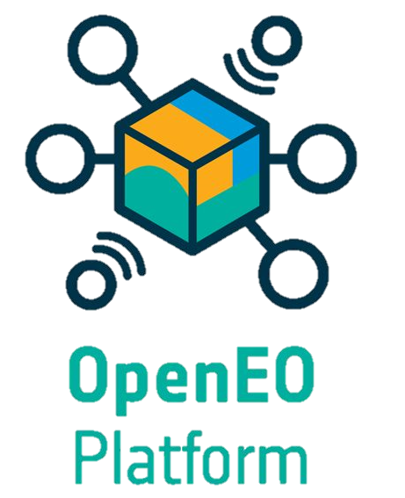
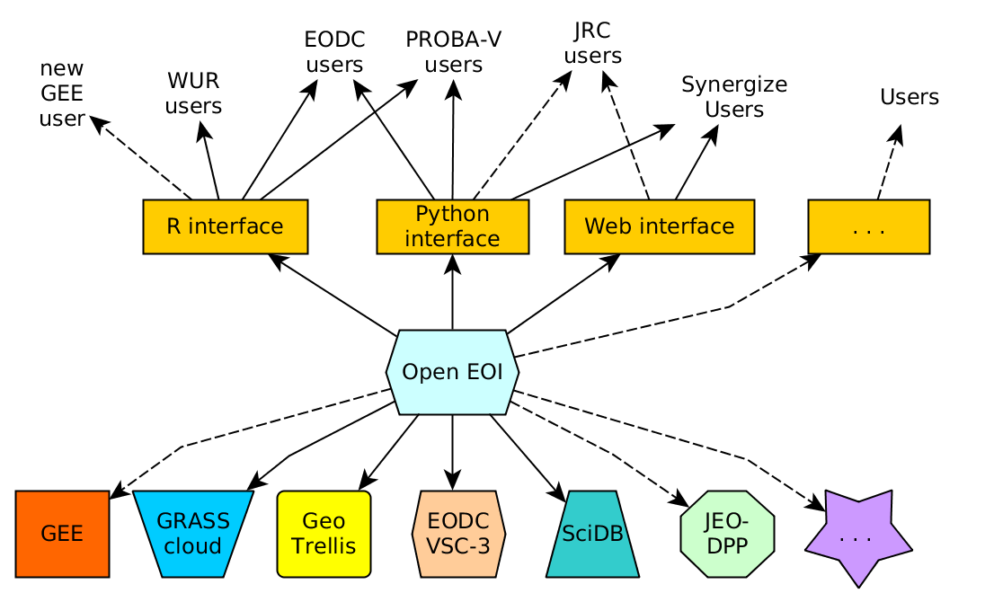
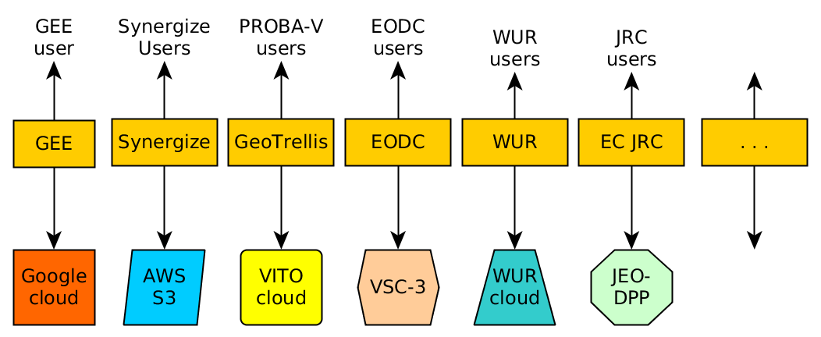
Background
openEO Platform responds to the ESA tender “Open Earth Engine”, targeting a federated open infrastructure for scalable, cloud-based EO processing and analytics.
Consortium including three key European EO cloud operators
Building on active user community
openEO Platform builds on achievements of H2020 project openEO and the API

Slide 4
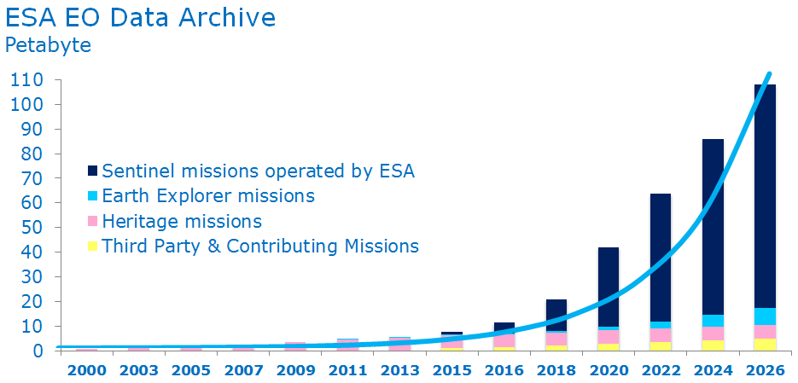
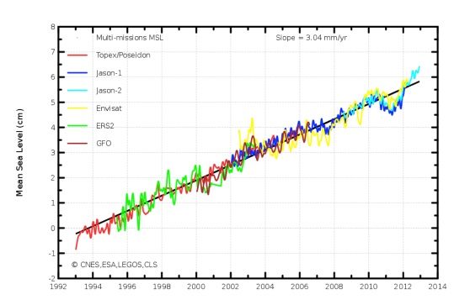
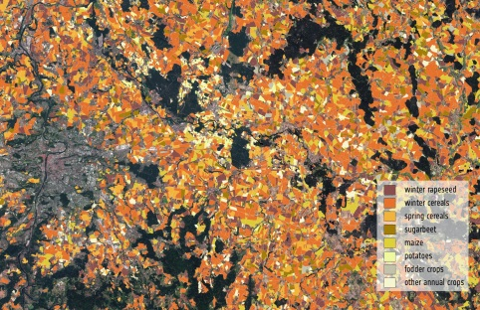
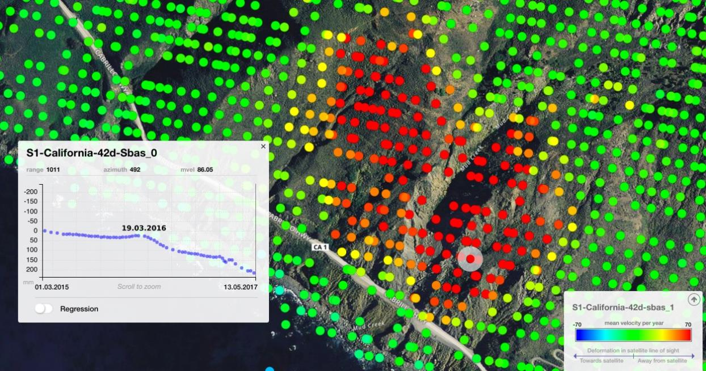
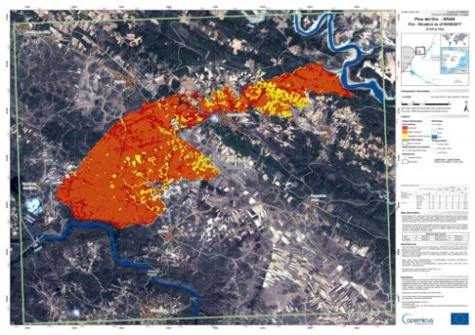
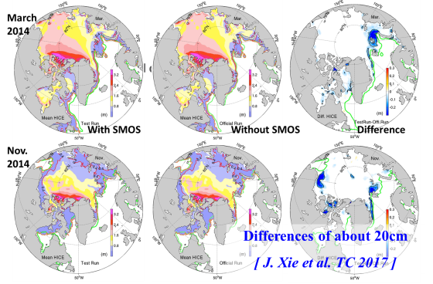
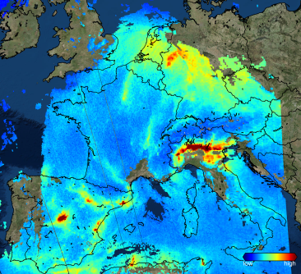
Big Data Challenges in EO
Data volume
Data continuity
Data sharing
Data quality
Innovation
Timeliness
Mission synergies
Diversity
Notes:
General message: operating the Sentinel satellites is very complex because of the many parameters that have to be taken into account and reconciled. This is extra challenging by the fact that Copernicus is an operational constellation and, the fact the Sentinel satellites are state-of-the-art technology (big data challenge & innovation challenge).
Examples per challenge:
Data volume: Copernicus is generating vast volumes of data (now 14 TB / day), which will lead to an exponential increase of ESA’s Data Archive. Acquiring this data and managing it requires technical and scientific expertise regarding data storage and processing.
Data Continuity: Copernicus is an operational system, meaning that data continuity should be ensured between different generations of a Sentinel mission, but also when Copernicus takes over an operational service, as S-6 will do for ocean altimetry, for instance.
Data sharing: the full and open free data policy means that data should be shared with various stakeholders, to this effect ESA is implementing the CollGS with MS
Data quality: Copernicus is a system on which policy-makers rely to get accurate information, such as for instance info on agricultural data in support of the EU Common Agricultural Policy. This means data quality must be guaranteed.
Innovation: Sentinel satellites are enabling innovation thanks to their scope and operational character, allowing us e.g. to monitor the effects of earthquakes, landslides and other natural phenomena in a way that was not feasible before (in terms of revisiting time & accuracy).
Timeliness: is always critical but since the Sentinels provide data for things like the Emergency Management Service (e.g. forest fires, floods etc), timeliness is a matter of saving lives.
Synergy between EO missions: e.g. Copernicus Marine Environment Monitoring Service (CMEMS) uses SMOS data for increased accuracy. In general Copernicus has a great value and potential also for scientific purposes.
Uniqueness: some Sentinels, such as S-5P, offer capabilities that are very unique, giving Europe a strategic advantage. Also in the expansion of the CSC, there will be unique capabilities, such as anthropogenic CO2 monitoring.

Slide 5
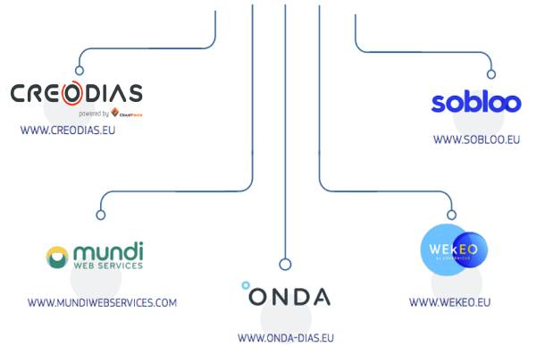
“Move the algorithm/user to the data”
…maybe it’s not that simple:
http://storyofchange.net

Slide 6
EO Platforms - Capability gaps in Europe
The EO cloud processing/analytical landscape in Europe is not matching European leadership in EO observational capabilities:
Fragmentation, redundancy and lacking coordination among EO platform providers
Prevalence of old Virtual Machine model (rather than dynamic resource allocation and scaling);
File-based storage and data access, rather than pixel-level flexibility and cloud native data structures;
Unappealing business models, lacking long term perspectives

Slide 7
EO Platforms - Capability gaps in Europe
Driving concepts guiding the development of openEO platform and for addressing the capability gap in Europe:
Abstracting complexity: intuitive analytics & programming libraries, dynamic resource allocation, federated cloud environments (EODC, TerraScope, CreoDIAS, EuroDataCube);
Providing transparency: Transparency of source code, scientific integrity & reproducibility, clarity & prior estimation of costing, confidentiality of IPR;
Pixel to continental scalability: pixel-level data access, scalable “building block” processes, clear roadmap for continental-global scale processing;

Slide 8
openEO platform - High level architecture
Programming API’s
and UI’s
Web API’s
Components
Support Python, JavaScript and R programming languages
Use EOSC for authentication and identity management
Multi-cloud deployment on EODC, TerraScope, CreoDIAS and data federation with EuroDataCube/SentinelHub
Notes:
Stakeholder involvement to be highlighted
Cop col GS, national cloud infrastructures

Slide 9
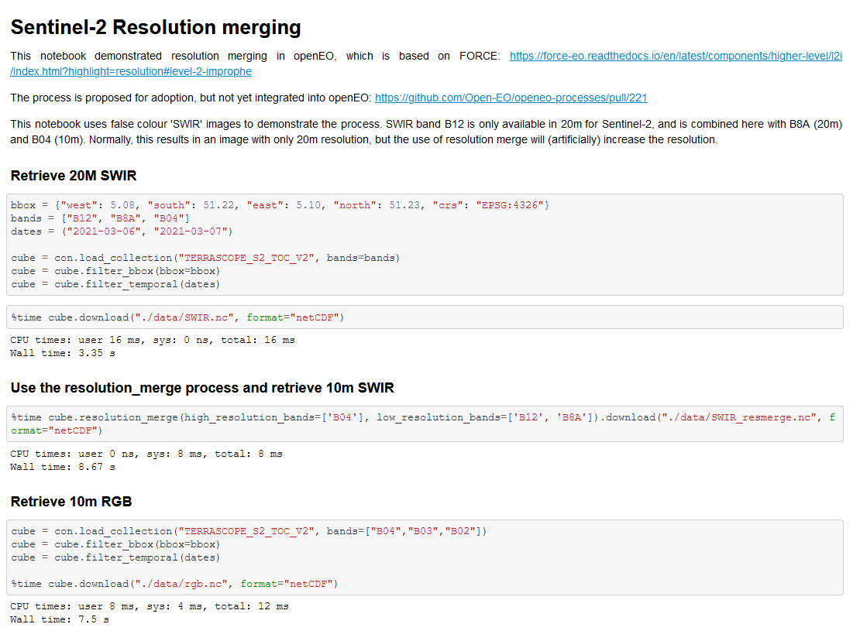
openEO platform – Jupyter notebook interface
Jupyter notebooks are the main development environment:
Collaboration
Sharing code
Interactive development
Executable tutorials
Notes:
SOTA sci interface for users today

Slide 10
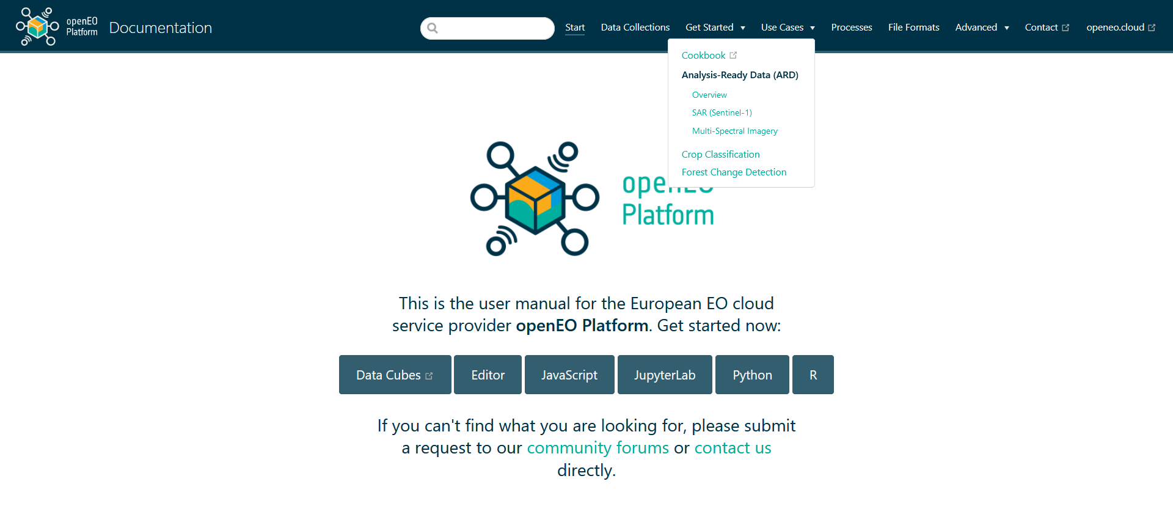
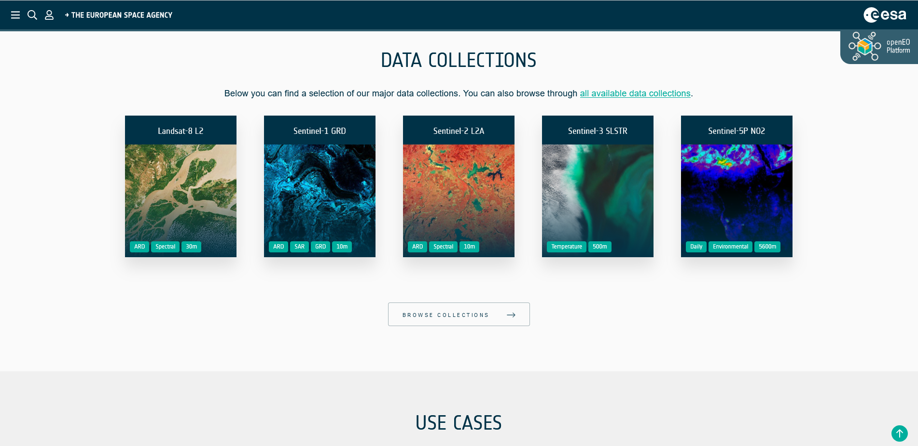
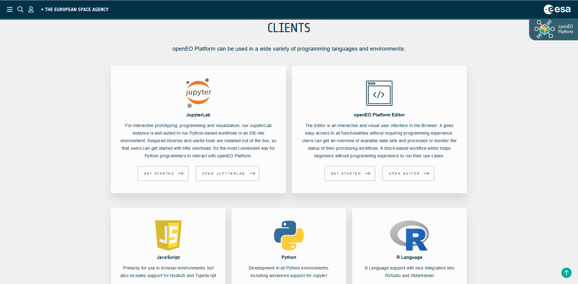
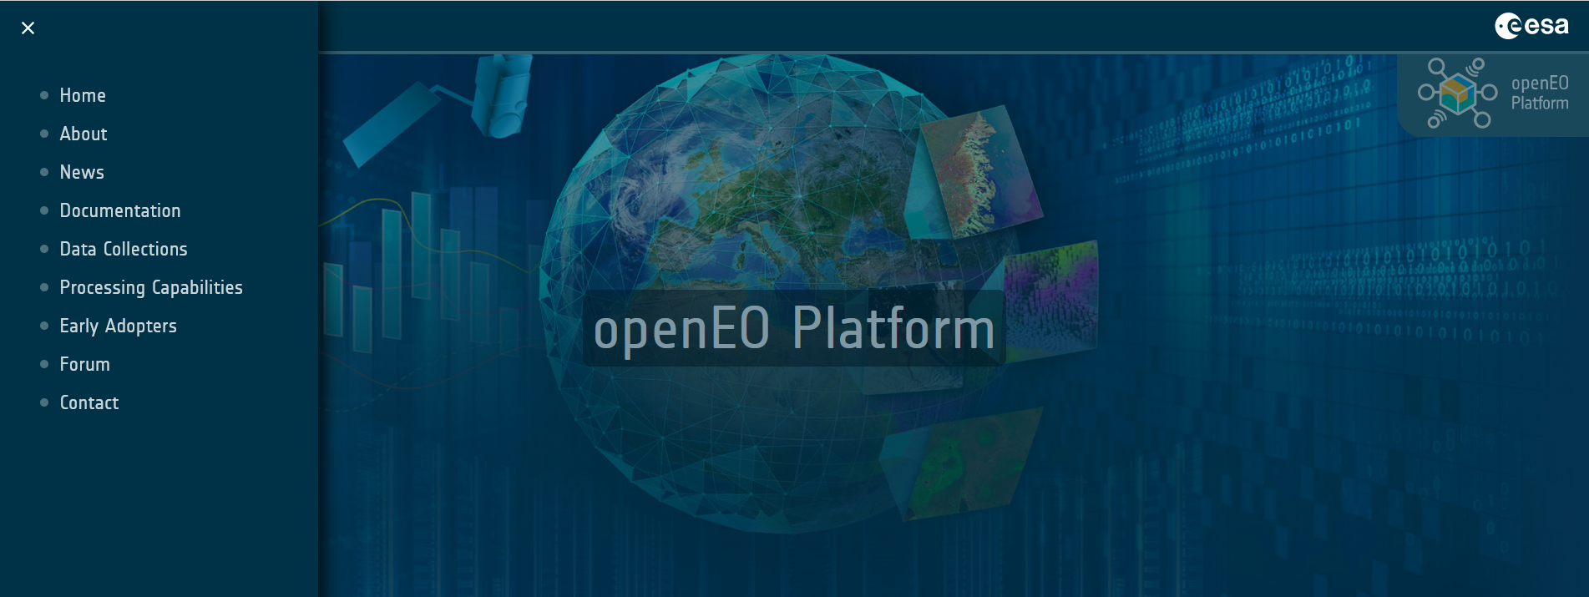
openeo.cloud
openeo.cloud

Slide 11
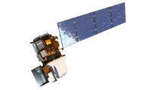
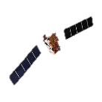
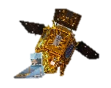
Initial roadmap along use cases
High Volume SAR Analytics
Link to AIS tracking
Systematic Feature Engineering
Pixel Level
Phenology
Dynamic ML parametrisation
Sampling
UC2:
Vessel
Detection
Use existing Service
Generate Indices
UC3:
Crop
Features
UC9:
Dynamic
LC EU
UC 15:
Crop
Conditions
UC1:
ARD
KO Sep ‘20
Iteration I, March ‚21
Iteration II, Sep ‚21
Iteration III, Mar ‚22
Iteration IV, Sep ‘22
Full Archive Frequency
Reductions
2. BYOC
Time series modelling
NRT Change detection
Downscaling
Regression Modelling
UC 11:
Flood
Risk
Temporal Resampling
Global Processing
e.g. moving window
UC6:
NRT
Forest
UC8:
Canopy
Cover
NO₂
UC4:
NO₂

Slide 12
openEO platform – ARD processing
openEO processes provide optimised, high-level operators as building blocks
(1) Connect to platform
(2) Define virtual datacube
(3) Convert to ARD following
user defined parametrisation
Notes:
Connect between S and G (ARD)
Comparison to PhD effort 10 years ago, simplification and paradigm shift

Slide 13
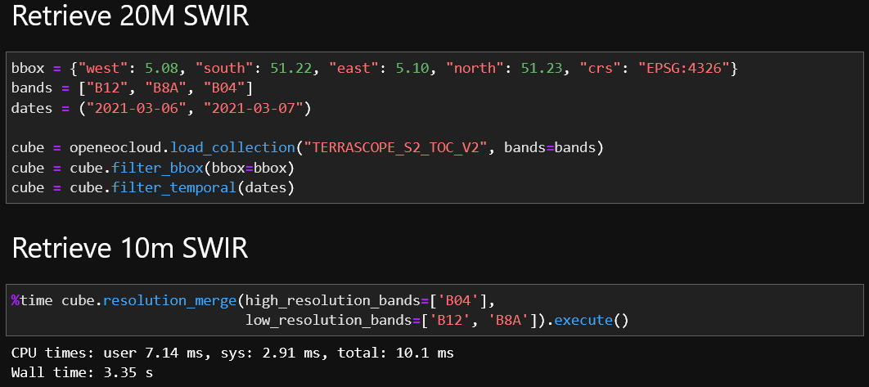
openEO platform – band sharpening
openEO processes provide optimised, high-level operators as building blocks
Notes:
Connect between S and G (ARD)
Comparison to PhD effort 10 years ago, simplification and paradigm shift

Slide 14
openEO platform evolution
Critical for the success and widespread adoption of openEO platform is that the platform responds in the best possible way to real world community requirements
Therefore we invite the community to get involved:
Register as an Early Adopter: https://openeo.cloud/early-adopters/
Get in touch and tell us what you intend to use openEO platform for!
Apply for sponsoring of the Early Adopters license through ESA Network of Resources (NOR): https://nor-discover.cloudeo.group/
Public Launch event
User consultation event

Slide 15
Thanks for listening!
Patrick.Griffiths@esa.int

