Slide 1
Enabling Open Science via Science Data Systems
-SESSION-
Diane Davies – NASA
Andrew Mitchell - NASA
WGISS 52
19th October 2021

Slide 2
CEOS 2021 Chair Theme
“Space-based Earth Observation Data for Open Science and Decision Support”.
The intent is to not add to the significant number of commitments that CEOS already has. Instead, the concept was to broadly disseminate the relevance of CEOS remote sensing activities and contributions in support of Open Science and decision making.

Slide 3
What are Open Science and Decision Support?
Across communities, common themes characterize the concept of “Open Science” (e.g., availability, accessibility, transparency, collaboration).
All of them align with increasing impact and accelerating science and decision support by lowering the barriers for all to contribute and benefit.
Open Science aims to ensure the free availability and usability of scholarly publications, the data that result from scholarly research, and the methodologies, including code or algorithms, that were used to generate those data. (Reference: Open Science by Design, Realizing a Vision for 21st Century Research (2018))
The Open Decision framework describes a process for making transparent, inclusive decisions in organizations that embrace open source principles. It brings together ideas and best practices from across the organization into a flexible tool that helps you make better business decisions. (Reference: https://openpracticelibrary.com/blog/open-decision-framework/)
Open Science is the movement to make scientific research and its dissemination accessible to all levels of an inquiring society, amateur or professional. Open science is transparent and accessible knowledge that is shared and developed through collaborative networks. (Reference: Wikipedia)

Slide 4
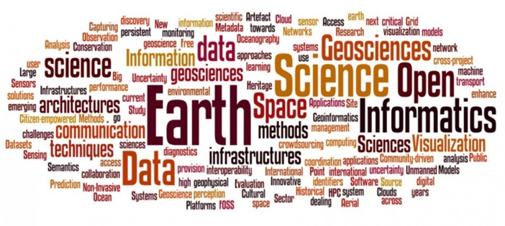
Why Open Science?
Growing volumes of free/open data
Growing numbers of global data users
Growing demand … climate, disasters, COVID-19
Aligning with global endeavors …
U.N. Sustainable Development Goals (SDG)
First UNFCCC Global Stocktake in 2023
Alignment with the GEO Knowledge Hub
AND
CEOS data must be accessible, its use must be transparent, and the products must be reproducible.
Image Credit: European Geoscience Union (EGU)

Slide 5
Demonstrating Open Science with Purpose
Accessibility … call attention to CEOS datasets (free and open) and create more efficient access points (e.g., MIM, CWIC/FedEO, COVE) with connected training and capacity building.
Transparency … promote sharing of data and algorithms among users and call attention to CEOS projects (e.g., EAIL, ODC Sandbox, COVERAGE) where this is demonstrated.
Reproducibility … promote workflows (e.g., CARD4L, GEO Knowledge Hub) that support reproducible products where users can demonstrate open science
Support Global Initiatives … demonstrate decision support for global endeavors (e.g., UN-SDG, GFOI, GEOGLAM) using an “open science” approach.

Slide 6
Session Goals
The goal of the session is to understand what open-science means to WGISS agency/program data systems.
We have invited presenters to cover the following:
Define open-science from your agency perspective.
Describe the potential impact to your agency.
Describe relevant investments in open-science (or planned investments) and the expected outcome

