Slide 1
CEOS Executive Officer Report
Marie-Claire Greening, CEO
CEOS Priorities
GEO Strategic Plan 2016-2025: Implementing GEOSS - Mid-term Evaluation
CEOS Chair Theme - Space-based Earth Observation Data for Open Science and Decision Support – and Priorities, including:
Data Deployments in the Cloud – Increase the number of free/open datasets in public computing clouds for improved access and use.
Earth Analytics Interoperability Lab (EAIL) – CSIRO released the Earth Analytics Interoperability Lab (EAIL) which is now supporting several flood pilot projects.
Open Data Cube Sandbox – The SEO released the Open Data Cube (ODC) Sandbox through the Open Earth Alliance GEO Community Activity and the GEO Knowledge Hub to demonstrate global CEOS data access via computing clouds using a free/open programming framework. 12 application notebooks are available for users.
CEOS Leadership Evolution
CEOS Work Plan 2021-23 and Deliverables

Slide 2
CEOS Executive Officer Report
Committee on Earth Observation Satellites
Marie-Claire Greening, CEOS Executive Officer
CEOS WGISS-52
Virtual Meeting
17 October 2021

Slide 3
CEOS Priorities
Ensure that climate observation requirements identified by the Global Climate Observing System (GCOS) – and implications of the Paris Climate Agreement – are addressed.
Ensure, in the context of the Sendai Framework for Disaster Risk Reduction 2015-2030, that CEOS Agency data are made available in support of disaster risk reduction and that CEOS continues engagement with UN agencies and authorities.
Ensure that space-based Earth observations support the success of the next decade of the Group on Earth Observations (GEO), and that CEOS engagement in GEO governance and leadership is enhanced.
Proactively engage in global discussions on the critical challenges that face society, including attaining the 2030 Agenda for Sustainable Development.
CEOS operates on a best-efforts basis. Responsible CEOS Entities are expected to accomplish the Objectives/Deliverables identified in the CEOS Work Plan to the best of their abilities.

Slide 4
GEO and the GEO Strategic Plan Mid-term Evaluation
GEO has recently undertaken a Mid-Term Evaluation (MTE) of its GEO Strategic Plan 2016-2025 : Implementing GEOSS and is now considering the findings and recommendations.
One of the key findings from the MTE was the need to reassess the concept of GEOSS (Global Earth Observation System of Systems) and its continued relevance in its original form.
The MTD recommends that GEO evaluate and decide:
what it wants or needs to pursue in terms of data infrastructure, producing data products, and user services,
how GEOSS can integrate and execute the Knowledge Hub, and
whether GEO has the capacity to carry this out.
The MTE report and all of its recommendations are currently under discussion within the GEO Programme Board (PB) and GEO Executive Committee (ExComm); CEOS is as a member of the PB and an observer to the ExComm.

Slide 5
CEOS Chair theme
NASA CEOS Chair theme 2020-21:
Space-based Earth Observation Data for Open Science and Decision Support
The 2021 CEOS Chair Implementation Plan has 17 measures of success including:
Data Deployments in the Cloud – Increase the number of free/open datasets in public computing clouds for improved access and use.
Earth Analytics Interoperability Lab (EAIL) – CSIRO released the Earth Analytics Interoperability Lab (EAIL) which is now supporting several flood pilot projects.
Open Data Cube Sandbox – The SEO released the Open Data Cube (ODC) Sandbox through the Open Earth Alliance GEO Community Activity and the GEO Knowledge Hub to demonstrate global CEOS data access via computing clouds using a free/open programming framework. 12 application notebooks are available for users.

Slide 6
CEOS Leadership Evolution
NASA
ISRO
CNES
GISTDA
Past Chair
CEOS Chair
Future Chair
Troika (all 3 chairs) 1-year terms
SEO
SIT Chair
CEO
Secretariat
SIT Vice-Chair
DCEO
Permanent
CSIRO / GA
2-year term
2-year term
ESA
Virtual Constellations
Working Groups
Ad Hoc Teams
WGISS
Chair
Vice-chair
???
CSIRO
JAXA
USGS
Primary Reporting Path
Secondary Reporting Path

Slide 7
SIT Technical Workshop 2021 Decisions

Slide 8
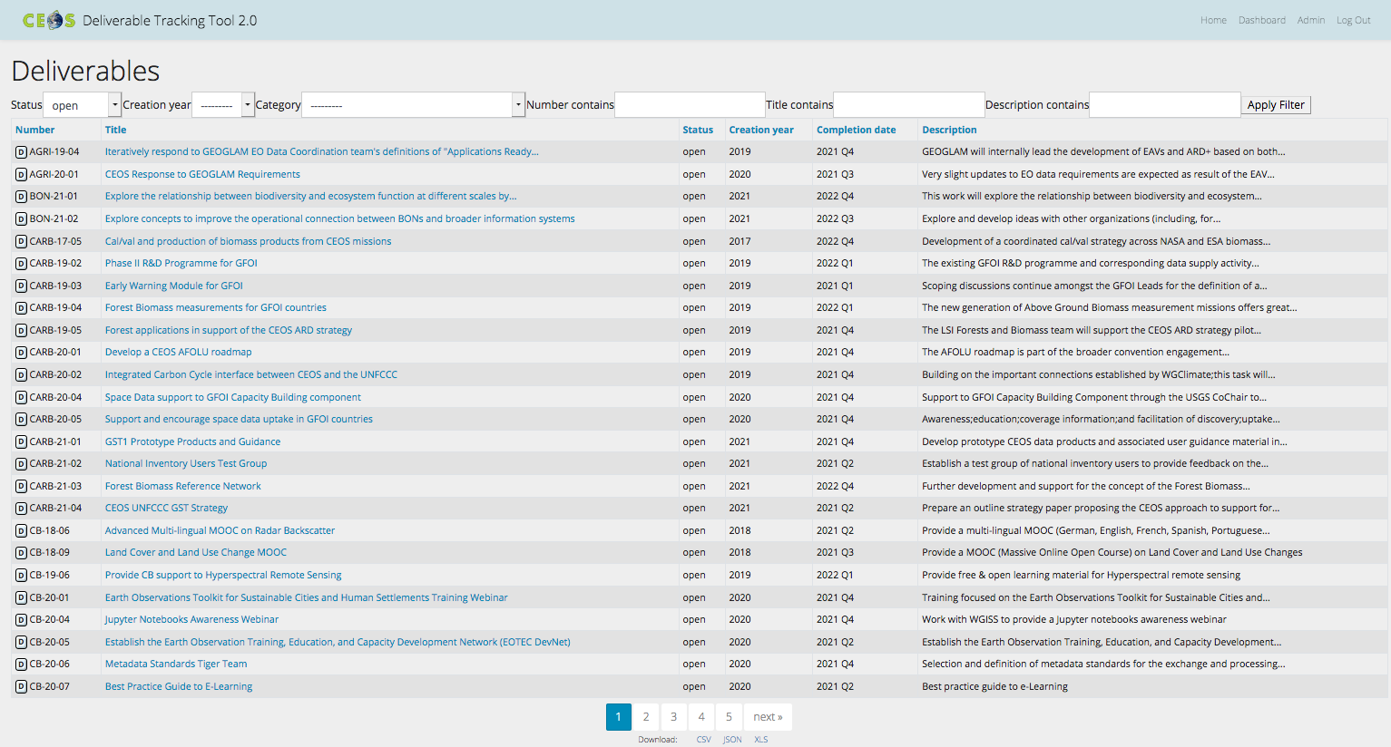
CEOS Work Plan 2021-23
3-year plan updated by all CEOS entities every year and put forward for formal endorsement at SIT in March
Detailed work defined as deliverables: outlined in the WP, reconciled & tracked in CEOS deliverable tracking tool
SIT
Plenary
Jan
Feb
Mar
May
Apr
Jun
Jul
Aug
Dec
Sep
Oct
Nov

Slide 9
2020-21 vs 2021-23
 | Closed from 2020-22 WP | Carried over from 2020-22 WP | New for 2021-23 WP
Climate Monitoring, Research, and Services |  | 5
Carbon Observations in Support of Climate Science and Policy | 2 | 9 | 4
Observations for Agriculture |  | 2
Observations for Disasters | 1 | 12
Observations for Water | 1
Data Quality |  | 11
Capacity Building and Data Democracy | 10 | 20 | 10
Data Discovery, Access, Preservation, Usability and Exploitation: approaches, systems, tools and technologies | 2 | 6
Advancement of the CEOS Virtual Constellations | 8 | 31
Support to Other Key Stakeholder Initiatives | 4 | 11 (1 from Obs for Water) | 2
Totals | 28 | 107 | 16

Slide 10
As of today…
 | Closed | 2021 | 2022 | 2023 & beyond
Climate Monitoring, Research, and Services |  | 3 (1 overdue) | 1 | 1
Carbon Observations in Support of Climate Science and Policy | 1 | 6 (1 overdue) | 6
Observations for Agriculture |  | 2
Observations for Disasters | 1 | 3 | 4 | 4
Data Quality | 2 | 7 | 2
Capacity Building and Data Democracy | 7 | 10 | 12 | 1
Data Discovery, Access, Preservation, Usability and Exploitation: approaches, systems, tools and technologies | 2 | 4
Advancement of the CEOS Virtual Constellations | 3 | 8 | 15 | 5
Support to Other Key Stakeholder Initiatives |  | 5 | 7 | 1
Totals | 15 | 50 | 46 | 12

Slide 11
CEOS 2021-23 Work Plan deliverables
The following are the deliverables listed within the Data Discovery, Access, Preservation, Usability and Exploitation: approaches, systems, tools and technologies section of the CEOS 2021-23 Work Plan:
green = deliverable completed; orange = deliverable in progress

Slide 12
Thank you!
Committee on Earth Observation Satellites
Marie-Claire Greening
CEOS Executive Officer
marie-claire@greeningconsulting.co.uk

