Slide 1

Data Preservation and Stewardship
USGS EROS Center
USGS EROS Center
U.S. Department of the Interior
U.S. Geological Survey

Slide 2
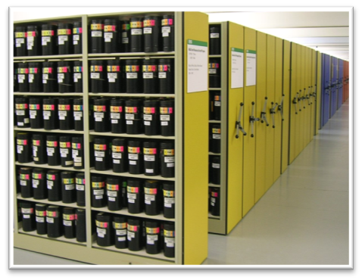
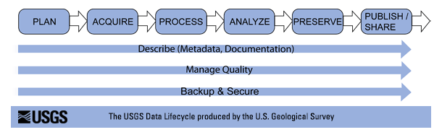
Goals and objectives:
Provide data management, access, archive, and distribution for all data sets within the USGS Historical Archives that have long term relevance to science and support the USGS mission
Improve access to the land archive
Utilize consistent data management
approaches across all data sets.
Develop and maintain data access,
preservation, and distribution infrastructure
to support the mission and other projects.

Slide 3
Land Data Management & Distribution
Utilize repeatable functions and processes
Develop efficient automated data ingest routines
  Data receipt, transfer from internet or media, QA/QC
Utilize consistent data management approach
  FGDC metadata, browse and image data linked and data base driven
    Key to web-enabling diverse collections
Maintain effective long-term records management
  Inventory controls, data base catalog management

Slide 4
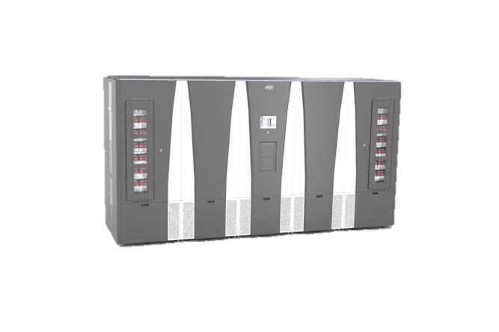
Robotic Tape Library System
Utilizes a Spectralogic Tfinity
tape library systems
Currently holds approximately
16 PB with 150 PB capacity
Offsite copies are stored NARA’s
Kansas City facility
Media are periodically updated as
new technology becomes available
Implementation of hierarchical store management enables distribution directly from the archived
  Utilizes varying “tiers” of disk (SATA/SAS/Solid State) that are used as a front-end cache to the tape

Slide 5
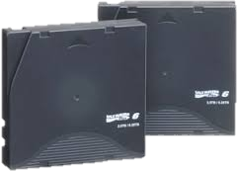
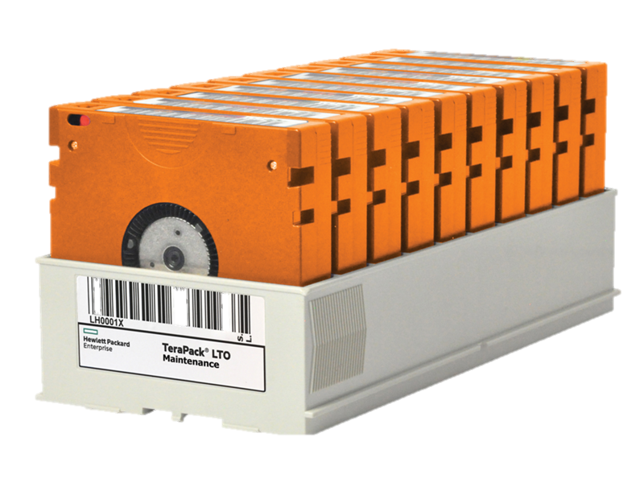
Data Archiving
Data is managed and preserved
using 3 copies: nearline, offline, and offsite
  Offsite copies are stored
  NARA’s Kansas City facility
Multiple media types are utilized to
ensure long term readability
  Currently using LTO-8 and
  IBM TS1160 tapes
Media are periodically updated
as tapes technology advances.
Records management schedules are
worked with NARA

Slide 6
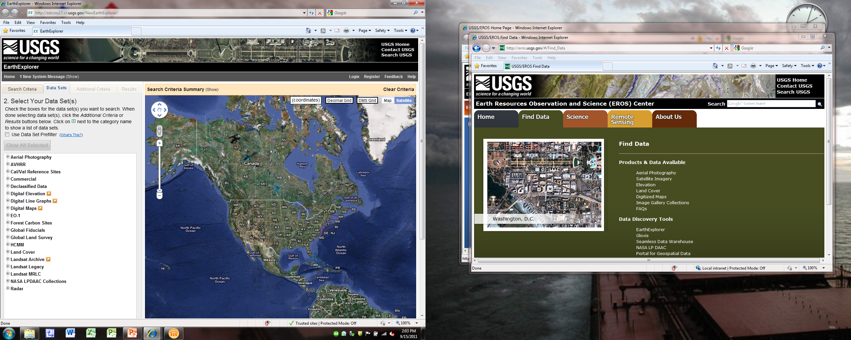
Data Discovery- EarthExplorer
  EarthExplorer - http://earthexplorer.usgs.gov
    400 plus data sets
    Restrict access available based upon agreements and licensing

Slide 7
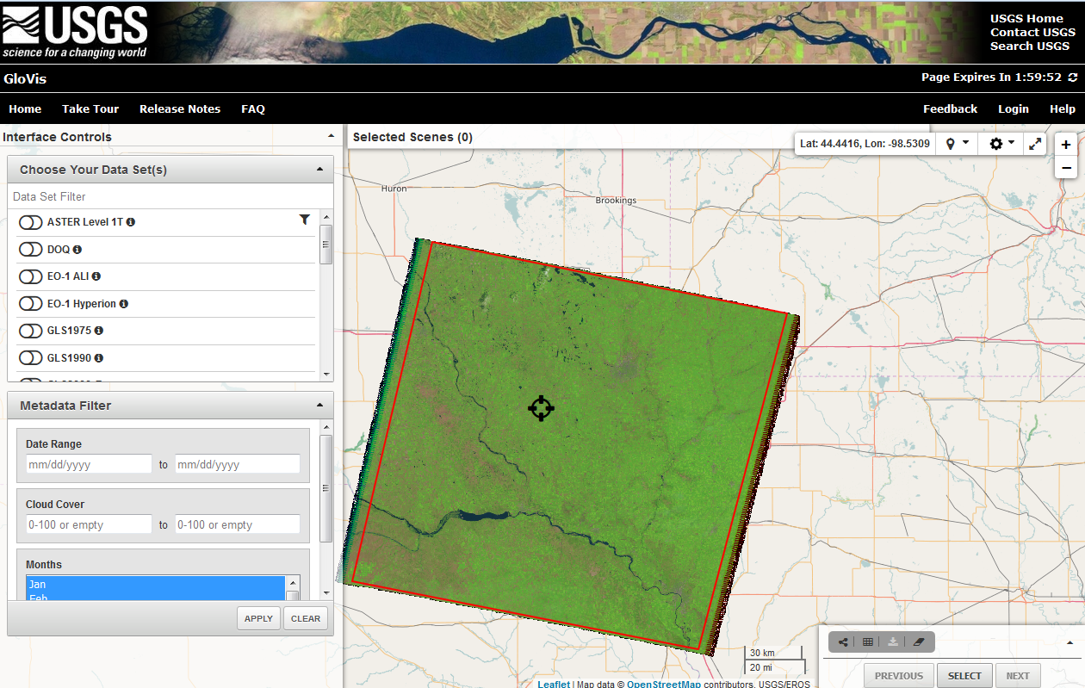
Data Discovery - GloVis
  Global Visualization Viewer - http://glovis.usgs.gov
    Full resolution scene-based imagery
    Recently redesigned to implement new features

Slide 8
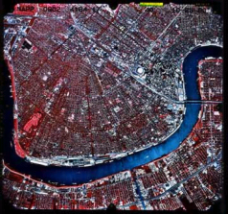

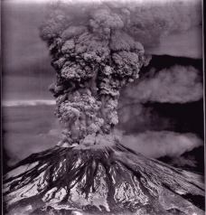
Aerial Photography Collection - Programs
U.S. Geological Survey Photography 1939 - 1995
National High Altitude Photography 1980 - 1989
National Aerial Photography Program 1987 - 2004
Space Acquired Photography 1969 - 1984
Other U.S. Federal Aerial Photography 1937 - 1999
Side-Looking Airborne Radar 1980 - 1994
High Resolution 2003 - Present
Unmanned Aircraft Systems (UAS) 2008 - Present

Slide 9
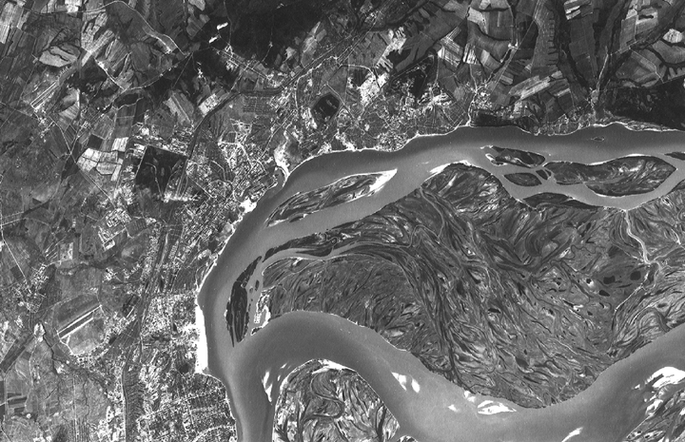
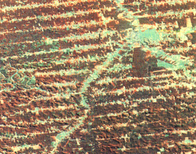
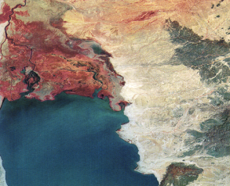
Satellite Collections
Declass 1 (Corona)
Declass 2 (KH-7, KH-9)
SPOT Pan/Multispectral
SPOT Data Buy
Landsat MSS
Landsat Thematic Mapper
Landsat 7 ETM+
Landsat 8 OLI
EOS/MODIS
EOS/ASTER
AVHRR LAC/HRPT
EO-1
SIR-C
Commercial Data Purchases
TerraLook
Orbview
ResourceSat-2
Sentinel-2
Notes:
The Antarctic Flight Line Maps feature hand-drawn flight lines along with the frame numbers of aerial photographs taken during the flight. The flight lines are labeled with TMA numbers, which is a reference to the trimetrogon aerial (TMA) photography acquired by the U.S. Navy for use in topographic mapping. TMA photography is a system of cameras positioned to take left oblique, vertical, and right oblique images simultaneously. The images are taken along a single flight line with the oblique cameras pointed at a depression angle of 30°. Each of the three cameras has an angular field of view of 60°, which provides 180° horizon to horizon coverage when the images are placed side-by-side. Not all flights were equipped with oblique cameras, and equipment malfunctions limited the availability of complete sets of photography. Flight lines continue to be cataloged by TMA number even though missions flown after January 1975 acquired images with a single vertical camera.

Slide 10
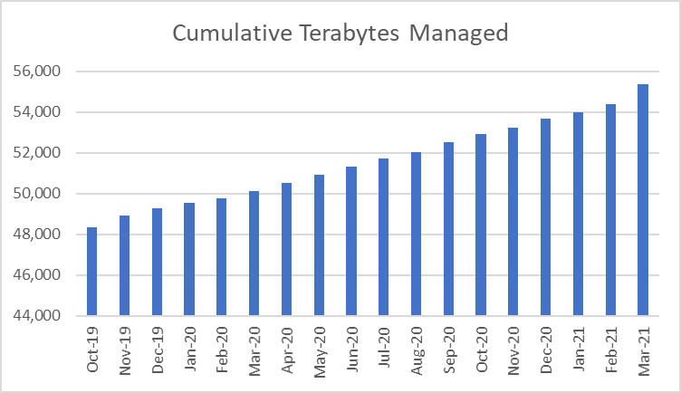
Data Holdings
*Represents all copies of holdings in uncompressed form
**Does not include Landsat Collection-2 data stored within the cloud

