Slide 1
CEOS WGISS USGS Report National Land Imaging Program Overview April 22, 2021

Slide 2
Deb Haaland
U.S. Department of the Interior
(DOI)
Organization

Slide 3
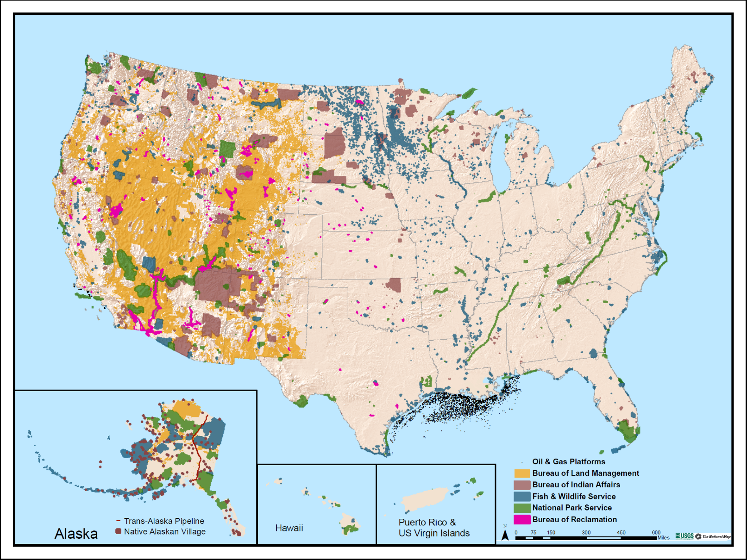
U.S. Department of the Interior – Manager of Federal Lands
DOI Bureaus
Bureau of Indian Affairs
Bureau of Land Management
Bureau of Ocean Energy Management
Bureau of Reclamation
Bureau of Safety and Environmental Enforcement
National Park Service
Office of Surface Mining, Reclamation & Enforcement
U.S. Fish & Wildlife Service
U.S. Geological Survey
DOI manages 20% of the U.S. land mass

Slide 5
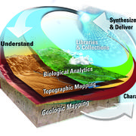
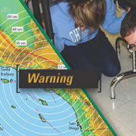
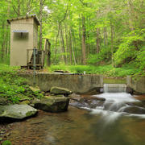
USGS Mission Areas
Core Science Systems
CSS leads USGS’s mission as the civilian mapping agency for the Nation. We conduct detailed surveys and develop high quality, highly accurate topographic, geologic, hydrographic, and biogeographic maps and data. Our maps allow precise planning for critical mineral assessments; energy development; infrastructure projects; urban planning; flood prediction; emergency response; and hazard mitigation.
Ecosystems
The USGS Ecosystems Mission Area, the biological research arm of the Department of the Interior (DOI), provides science to help America achieve sustainable management and conservation of its biological resources. This work is done within the broader mission of the USGS to serve the Nation with science that advances understanding of our natural resources and inform land and water stewardship.
Energy and Minerals
The Energy and Minerals Mission Area conducts research and assessments that focus on the location, quantity, and quality of mineral and energy resources, including the economic and environmental effects of resource extraction and use.
Natural Hazards
Every year in the United States, natural hazards threaten lives and livelihoods and result in billions of dollars in damage. We work with many partners to monitor, assess, and conduct targeted research on a wide range of natural hazards so that policymakers and the public have the understanding they need to enhance preparedness, response, and resilience.
Water Resources
Water information is fundamental to national and local economic well-being, protection of life and property, and effective management of the Nation’s water resources. The USGS works with partners to monitor, assess, conduct targeted research, and deliver information on a wide range of water resources and conditions including streamflow, groundwater, water quality, and water use and availability.

Slide 6
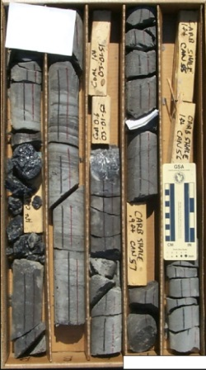
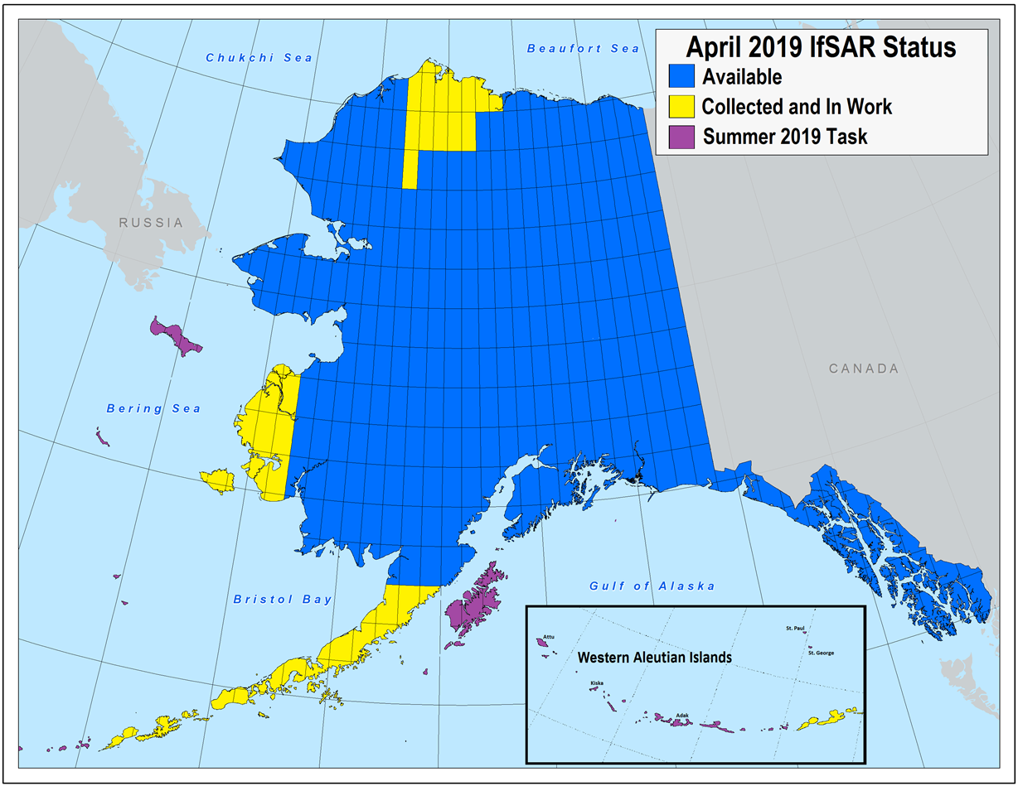
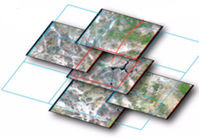
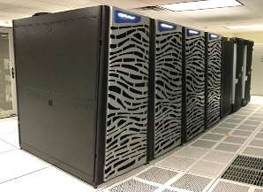
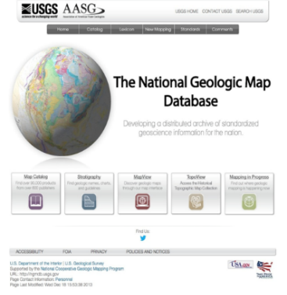
Core Science Systems – Mission Overview
National Cooperative Geologic Mapping Program
3-D Geologic Mapping
FEDMAP, STATEMAP, EDMAP
National Geologic Map Database (NGMDB)
Great Lakes Geologic Mapping Coalition
Earth MRI
National Geospatial Program
3D Elevation Program (3DEP)
Alaska Mapping and Map Modernization
National Hydrography Dataset Plus - High Resolution (NHDPlus HR)
US Topo
Federal Geographic Data Committee
Disaster Response
Earth Mapping Resources Initiative (Earth MRI)
National Land Imaging Program
Landsat Satellite Operations
Land Change Science, Research, and Technology Investigations
National Civil Applications Center
Land Change Monitoring, Assessment, and Projection (LCMAP)
National Land Cover Database (NLCD)
Uncrewed Aircraft Systems (UAS)
Science Synthesis, Analysis & Research Program
High Performance Computing
USGS Library
Biogeographic Mapping
Data Integration and Synthesis
National Geological & Geophysical Data Preservation
Core Research Center
John Wesley Powell Center for Analysis & Synthesis
Risk and Vulnerability Assessments

Slide 7
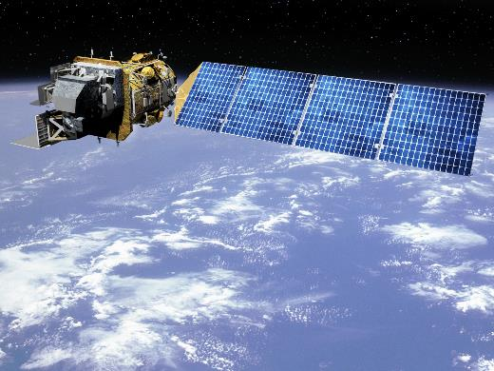
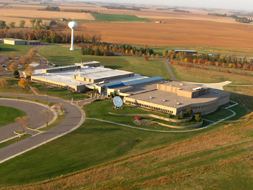
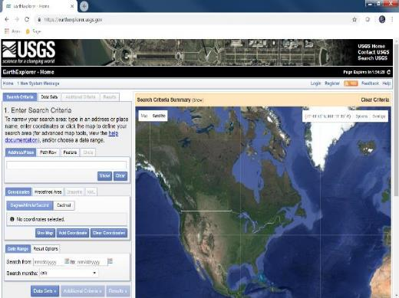
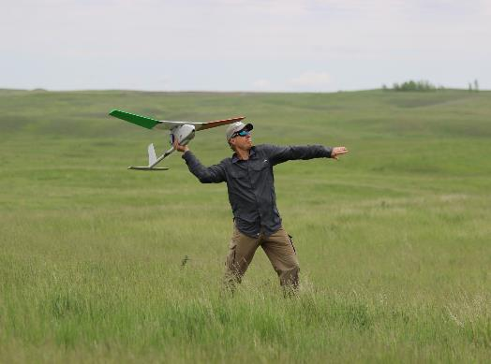
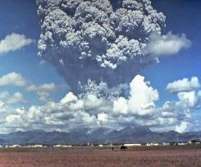
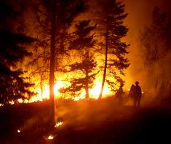
USGS National Land Imaging (NLI) Program – Mission Overview
Delivers a national and global capability to ensure broad public and scientific availability of observations of the Earth’s land surface
Coordinates and integrates civil Earth observations with other sources of data, including international, commercial and National Security space systems
EROS Center
Landsat 7, 8, 9, and Beyond
Supports government policy and decision makers
Guides National decisions to meet Government needs for land science and land observation
Earth Explorer –
https://earthexplorer.usgs.gov/
Hazards Data Distribution System -
https://hddsexplorer.usgs.gov/
Uncrewed Aircraft Systems (UAS)
National Civil Applications Center
7

Slide 8
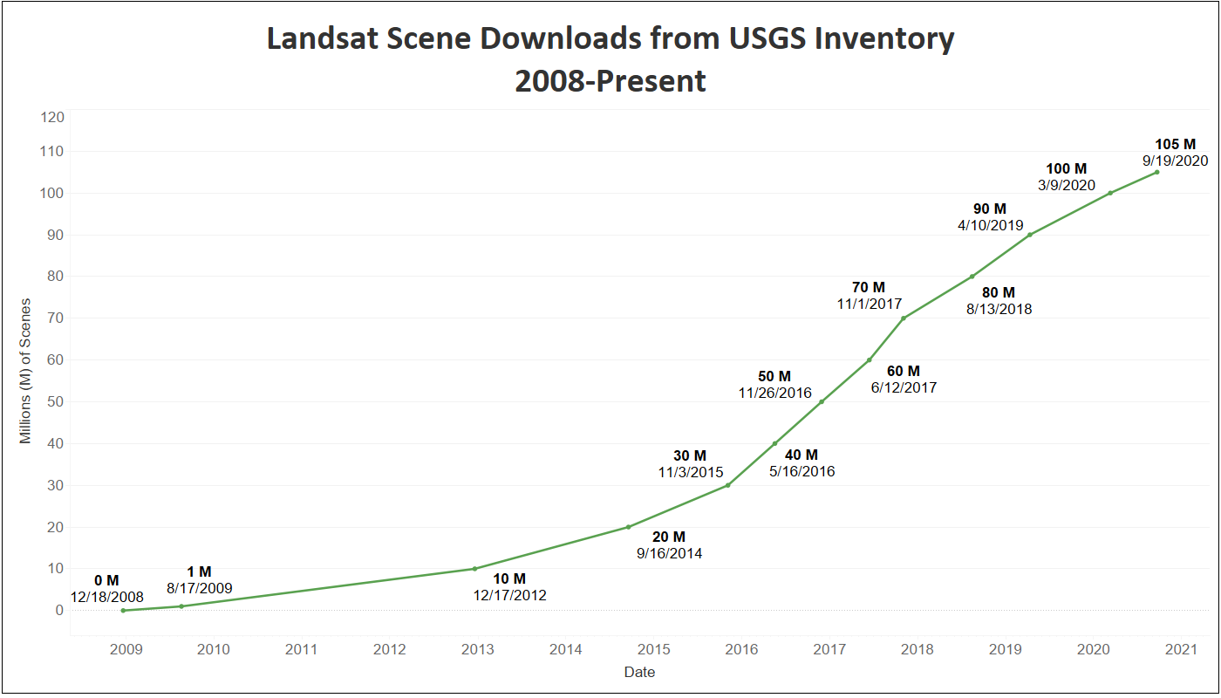
The Landsat Program
Landsat first launched in 1972, and has continuously provided Earth imagery ever since
There are now more than 9 million Landsat scenes available for download from USGS
More than 105 million scenes have been downloaded from USGS and cloud hosting sites since the archive became freely available in October 2008!
Millions more scenes have been and are being re-distributed by commercial cloud vendors
Landsat Scene Downloads from USGS Inventory
October 2008 - Present
105 Million
9/19/2020

Slide 9
Landsat Past, Present and Future
Sustainable Land Imaging (SLI)
is a partnership between DOI/USGS and NASA to maintain a sustainable program for spaceborne land imaging
FY2021 Launch
USGS documented user requirements across Federal agencies
NASA conducted technology investigations to reduce cost & risk in future missions
Currently Operating
Joint SLI Architecture Study Team (AST) completed its final report in 2019
AST delivered a set of viable architecture concepts for the next mission providing a basis for formulating future acquisition strategies
NASA and USGS Leadership working to develop details and options as part of their FY 2022 budget requests
The Landsat Program has amassed the longest and most comprehensive record of the Earth’s land surface in existence
NASA-USGS Interagency Partnership
- NASA: Space Segment and Launch
- USGS: Operations & Data Processing/Distribution

Slide 10
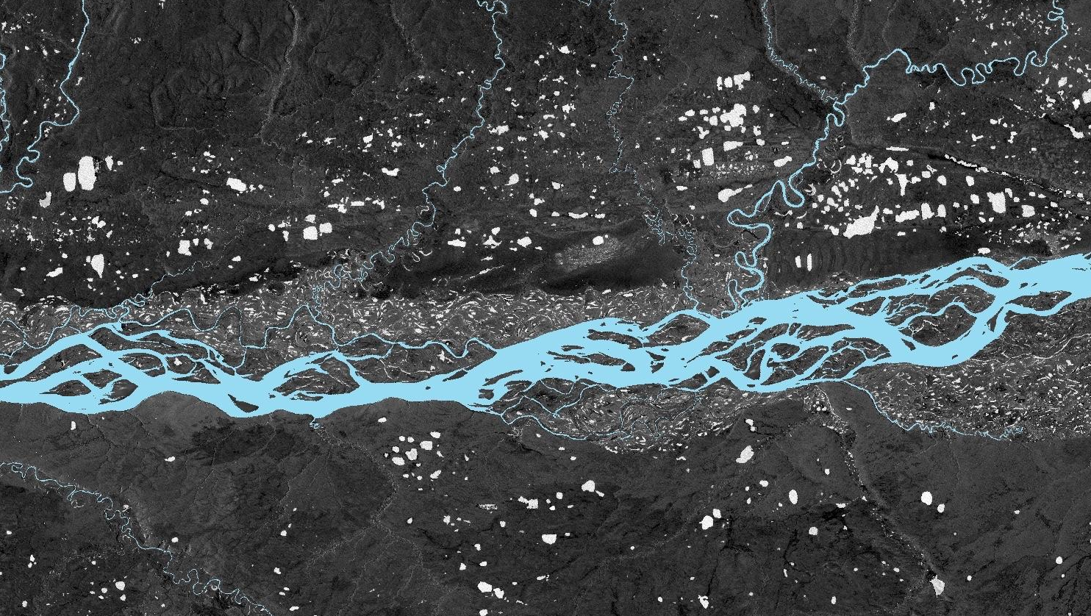
National Land Imaging Future Directions
Leveraging the Diversity of Earth Observations to Meet the Diverse Needs of Science & Operational Users
Improve Operational Capabilities
Enhance Research, Development and Innovation
Expand Product and Service Usability
Ensure Community Engagement
Landsat Next
Cross-Calibration of sensors
Hyperspectral Technology Investigations
Increasing User Satisfaction
International & Commercial Partnerships
Landsat 9
Sentinel/Landsat Ops & Data Harmonization
Investigate new science and technologies
National Security Space Data & Services
Land Change Monitoring Assessment and Projection / EarthMAP
Analysis Ready Data
Thoroughly understand user needs and capabilities available to meet them
Landsat 8 Flight & Ground Operations

Slide 11
Why Does NLI Engage Internationally?
To enhance USGS system capabilities, reduce overall costs, and increase
the quantity and quality of land-imaging data for Federal Civil Agencies
How Does USGS Engage?
Landsat International Cooperator Network and Landsat Ground Network
Bilateral Partnerships
European Commission/European Space Agency, Geoscience Australia/Australian Space Agency, German Aerospace Center, Indian Space Research Organization, Japanese Aerospace Exploration Agency, others
Multilateral Collaboration
Group on Earth Observations (GEO), Committee on Earth Observation Satellites (CEOS), International Charter for Space and Major Disasters, UN Committee on the Peaceful Uses of Outer Space, UN International Committee on Global Navigation Satellite Systems; Int’l Standards Organization Technical Committee 211 on Geographic Information and Geomatics, others
Support to U.S. National and International Earth Observation and S&T Policy
U.S. National Space Policy; U.S. National Plan for Civil EO; State Dept-led Civil Space Dialogues and international agreement reviews; EO support to USGS International Programs Office

Slide 12
USGS NLI Program Affiliations
US Group on Earth Observations (USGEO) and international Group on Earth Observations (GEO)
Co-Chair for 13-agency NSTC subcommittee; coordinate, plan, and assess Federal Earth observation activities; advance the global use of Earth observations for societal benefit
Civil Applications Committee (CAC)
Secretariat for 11-civil agency member committee facilitating appropriate civil use of overhead remote sensing technology and data collected by classified military and intelligence systems and commercial sources
Federal Geographic Data Committee (FGDC)
Co-lead (with US Department of Agriculture) on A16 Imagery Theme; promotes coordinated development, use, sharing, dissemination of geospatial data on a national basis; 32 members (DOI Chair/OMB Vice chair); formulate requirements across FGDC
National Digital Orthoimagery Program (NDOP)
Chair interagency body responsible for developing, promoting, executing a national strategy for the acquisition or development of ortho-imagery data for Federal agencies via partnerships with State, local, tribal, private orgs
National System for Geospatial Intelligence (NSG) Council, Committee (GEOCOM)
Participate as Principal and Associate members in governance bodies for NSG coordination and decision-making
National Geospatial Advisory Council (NGAC) Landsat Advisory Group
Provides advice to the Federal Government on the requirements, objectives and actions of the Landsat Program
DOI Remote Sensing Working Group
Team comprised of remote sensing experts from all DOI bureaus working together to share expertise
Landsat Science Team
Comprised of 21 scientists and engineers from the Federal government, academia, industry and international organizations
International Charter on Space and Major Disasters
Provides satellite data from national & private space agencies for those affected by natural or man-made disasters
AmericaView
A USGS-funded nationwide university consortium of scientists & educators who support remote sensing for 38 “StateViews”
Committee on Earth Observation Satellites (CEOS)
Promotes international coordination and data standardization of civil space-based Earth observation programs

Slide 13
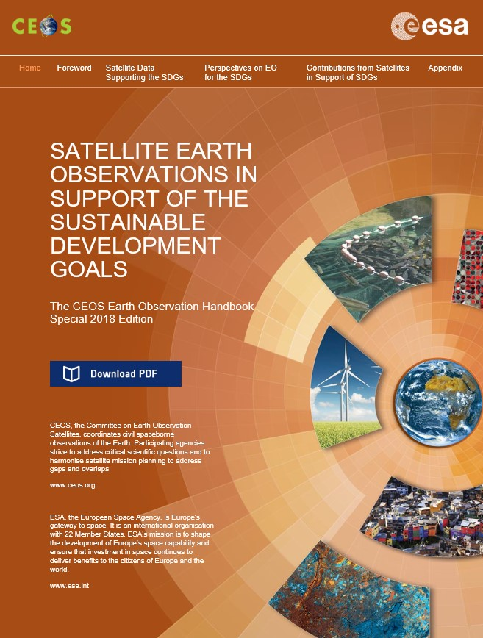
Multilateral Collaboration: Primary USGS CEOS Leadership Goals
www.ceos.org
Further the USGS goal for a global free/open data policy for vastly improved data availability and use
Bolster the USGS presence as a global leader in land remote sensing data and information
Enhance USGS's ability to address future mission requirements by better understanding needs and capabilities
Continue and expand upon advances in analysis ready data (ARD), interoperability, and other USGS collaboration efforts with Australia, Europe, India, and others

Slide 14
Available Earth Observation Data Products
(Funded by the USGS NLI and National Geospatial Programs, and by NASA for Provision through the USGS Earth Resources Observation and Science Center)
Satellite Imagery
Moderate Resolution (EO): Landsat, Copernicus Sentinel-2, EO-1, Terra ASTER, Resourcesat-1
High resolution (EO): Declassified USGS Imagery, Commercial Imagery
Low Resolution (EO): Terra MODIS, AVHRR, HCMM
Radar: SIR-C, IFSAR ORI Alaska
Other: Heat Capacity Mapping Mission
Image Collections: CalVal Reference Sites, GEOGLAM, Global Fiducials, GFOI, GLS, JECAM Sites, NLDC, NALC, TerraLook, Landsat Legacy, Landsat MRLC, LIMA Image Mosaic
Derived Products: WELD, ASTER, MODIS Derivatives, NASA SRTM
Aerial Imagery
Photography (airborne): NAIP, NAPP, NHAP, DOQ, High resolution Orthophotography, single frame records, Aerial Photo Mosaics, South Dakota NRCS, Antarctica Single Frame Records
Photo Index Maps: Antarctica Flight Lines Maps
Photography (space): Space Acquired Photography
UAS: Variety of sensors
Multi/Hyper-Spectral Images: Aircraft Scanners, ASAS
Radar and Radar-Derived: SLAR, AirMOSS
Light Detection and Ranging (LiDAR)
Elevation Products
United States: NED, LiDAR, IFSAR Alaska
Global: ASTER GDEM, GMTED2010, SRTM, GTOPO30, HYDRO1K

Slide 15
Join us at Pecora-22
The Nation’s biennial flagship conference on land imaging
science, technology, user needs, applications, and policy

