Slide 1
National Aeronautics and Space Administration (NASA)
Agency Report
WGISS – 51
Andrew Mitchell
Earth Science Data and Information System (ESDIS) Project
Goddard Space Flight Center
Greenbelt, MD
22nd of April 2021

Slide 2
NASA’s Earth Science Data Systems Program:
Major Components
Earth Observing System Data and Information System (EOSDIS) – Managed by the ESDIS Project
  Science Investigator-led Processing Systems (SIPS)
  Distributed Active Archive Centers (DAACs)
  Common Services/Tools
  Earth Science Data System Working Group (ESDSWG)
Data System Evolution
  ACCESS: Advancing Collaborative Connections for Earth System Science
  MEaSUREs: Making Earth System Data Records for Use in Research Environments
  Citizen Science for Earth System Science
  Science Portals/Machine Learning
  System Security Support and Small Sat. Data Buy
Standards and Interoperability
  CEOS (Committee on Earth Observation Satellites) Working Group on Information Systems and Services (WGISS)
  NASA-European Space Agency (ESA) Bilateral
  Partnership activities for Google and MSFT, etc…
Inter Agency ImPlementation and Advanced Concepts (IMPACT) Team
  Addresses satellite needs assessment working group (SNWG) requests for improved tools/services for federal agencies, dedicated user support and faster access/better management of data from airborne campaigns.
  Consolidates existing activities under a single project – Independent assessments, Data.gov, GCIS, USGEO, W3C, FGDC
Notes:
NASA’s Earth Science and Data Information System (ESDIS) Project develops and operates the science systems of the EOSDIS which is a coordinated series of long term global observations.
NASA's Earth Observing System Data and Information System (EOSDIS) is a key core capability in the Earth Science Data Systems (ESDS) Program. It provides end-to-end capabilities for managing NASA Earth science data from various sources—satellites, aircraft, field measurements, and various other programs.
NASA’s Earth Science Data Policy promotes usage of data by the community
No period of exclusive access
Data available at no cost to all users on a non-discriminatory basis, except where agreed upon with international partners

Slide 3
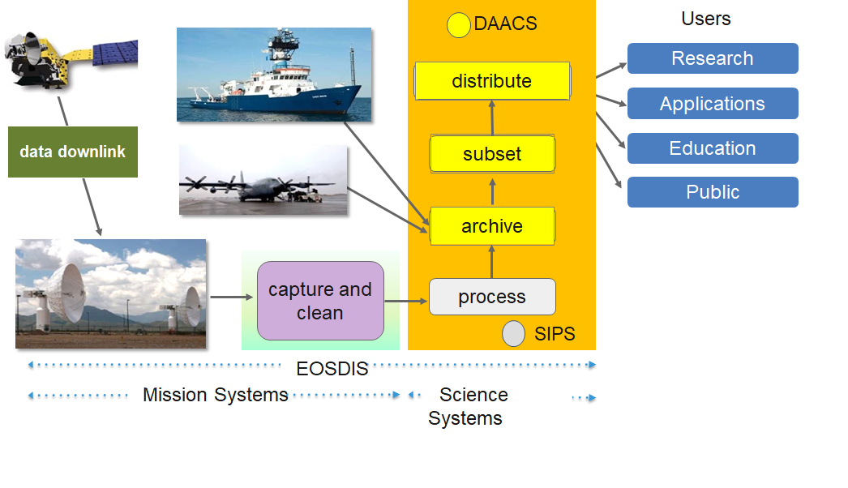
Earth Science Data and Information System (ESDIS)
The ESDIS Project manages the science systems of the Earth Observing System Data and Information System (EOSDIS). EOSDIS is a comprehensive distributed Earth science data and information system designed to support NASA's Earth science missions.
EOSDIS is designed to ingest, archive, distribute, and visualize, all types of Earth Science data which include satellite observations, field campaign measurements, airborne data, in situ data, model data, ancillary products used for processing and other related datasets.
The ESDIS Project provides and controls all aspects of the effort including but not limited to requirements, design, acquisition, development, operations, maintenance and decommission.
Operating since 1994, it has been evolving to keep pace with technology and users' requirements.

Slide 4
EOSDIS Distributed Active Archive Center (DAACs) and Science Investigator-led Processing Systems (SIPS)
Socioeconomic Data and Applications Center
Human Interactions,
Land Use, Environmental
Sustainability,
Geospatial Data
Suomi National Polar-orbiting Partnership (Suomi-NPP) Atmosphere
Goddard Earth Sciences Data and Information Services Center
Global Precipitation, Solar Irradiance,
Atmospheric Composition and Dynamics, Global Modeling
Land Processes
DAAC
Land Cover, Surface Reflectance,
Radiance, Temperature, Topography,
Vegetation Indices
◉
◉
◉
Crustal Dynamics Data Information System
Space Geodesy, Solid Earth
Level 1 and Atmosphere Archive and Distribution System (LAADS)
MODIS Level-1 and Atmosphere Data Products
◉
Measurements
of Pollution in the
Troposphere (MOPITT)
◉
◉
◉
◉
◉
◉
◉
◉
SIPS
Physical
Oceanography DAAC
Gravity, Sea Surface Temperature, Ocean Winds, Topography, Circulation & Currents
◉
Ocean Biology DAAC
Ocean Biology,
Sea Surface Temperature
◉
◉
Visible Infrared Imaging Radiometer Suite (VIIRS) Ocean
◉
Microwave Limb Sounder (MLS)
DAAC
Oak Ridge National Laboratory DAAC
Biogeochemical Dynamics, Ecological Data, Environmental Processes
◉
Ozone Mapping
Profiler Suite (OMPS) Ozone
•
Ozone Monitoring Instrument (OMI)
•
Ozone Mapping
Profiler Suite (OMPS) Ozone
•
Ocean Data Processing System (OCDPS)
•
MODIS Adaptive Processing System (MODAPS)
•
Visible Infrared Imaging
Radiometer Suite (VIIRS) Land
◉
Tropospheric Emission Spectrometer (TES)
National Snow and Ice Data Center DAAC
Frozen Ground, Glaciers,
Ice Sheets, Sea Ice,
Snow, Soil Moisture
LaRC Atmospheric
Science Data Center
Radiation Budget, Clouds, Aerosols, Tropospheric
Chemistry
◉
◉
◉
◉
◉
◉
Suomi National Polar-orbiting Partnership (Suomi-NPP) (ATMS) and (CrIS) Sounder
Global Hydrology
Resource Center DAAC
Hazardous Weather,
Lightning, Tropical Cyclones and
Storm-induced Hazards
Advanced Microwave
Scanning Radiometer for EOS 2 (AMSR-E/2)
Alaska Satellite
Facility DAAC
SAR Products, Sea Ice,
Polar Processes,
Geophysics
◉
f

Slide 5
ESDIS Goals
Provide scientific data stewardship for all data collections and insure data integrity
Provide a unified and simplified environment for a diverse and distributed community of Earth Science and Applications users to discover, obtain, and analyze data sources.
Evolve, grow and adapt to new sources of data and new data systems technologies
Expand the user community and engage with users to enhance and improve user access to data and other resources.
Partner with other organizations, US agencies, and Nations to share data and make it easier to integrate for science
Notes:
Image Source: https://unsplash.com/photos/jY9mXvA15W0

Slide 6
Earth Science Data System (ESDS)
Open Source Policy
NASA’s ESDS requires that all software developed through research and technology awards (i.e., ROSES or unsolicited proposals) or in-house government funded development is to be made available to the public as Open Source Software (OSS). This includes all software developed with ESDS funding used in the production of data products, as well as software developed to discover, access, analyze, visualize, and transform NASA data. This policy does not apply to commercial off-the-shelf (COTS) software.
https://earthdata.nasa.gov/earth-science-data-systems-program/policies/esds-open-source-policy
Notes:
Image Source: https://unsplash.com/photos/QckxruozjRg

Slide 7
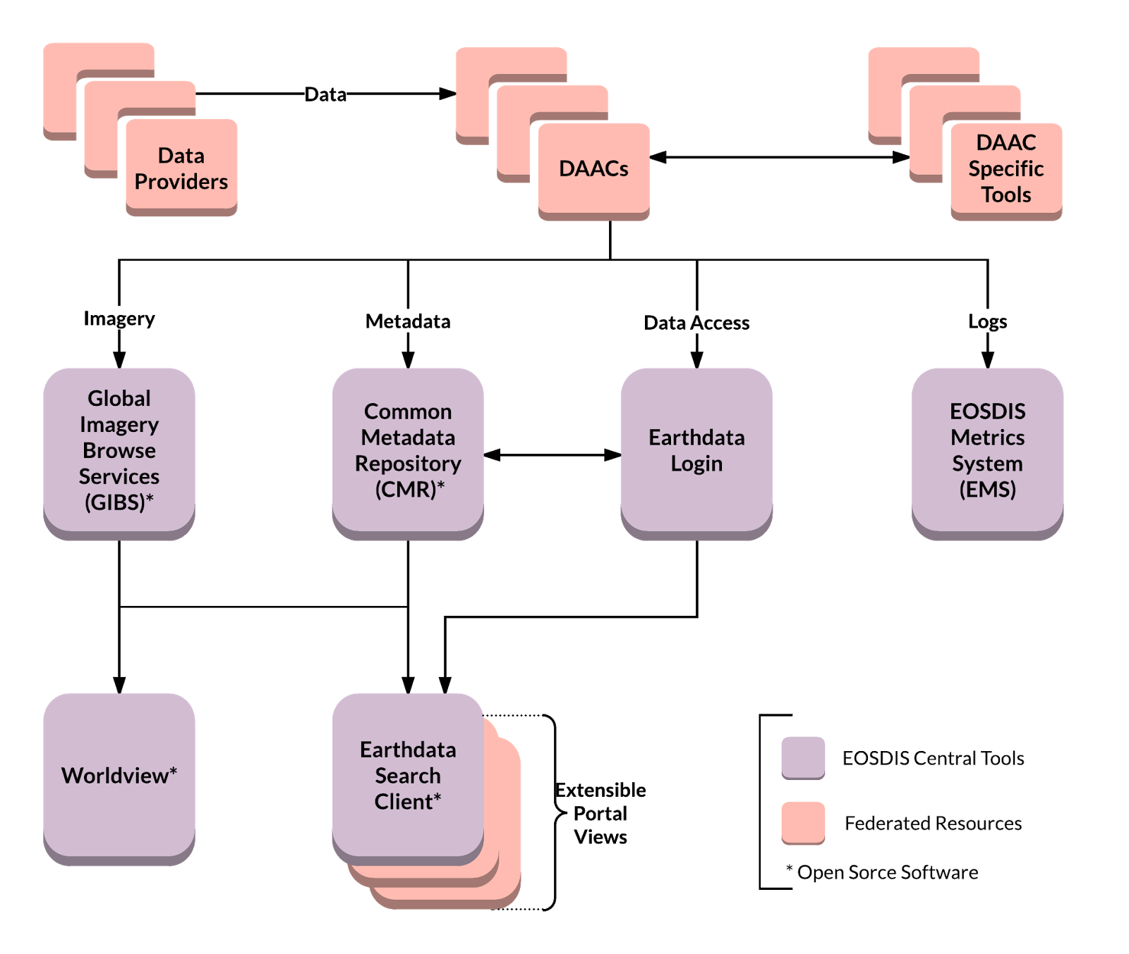
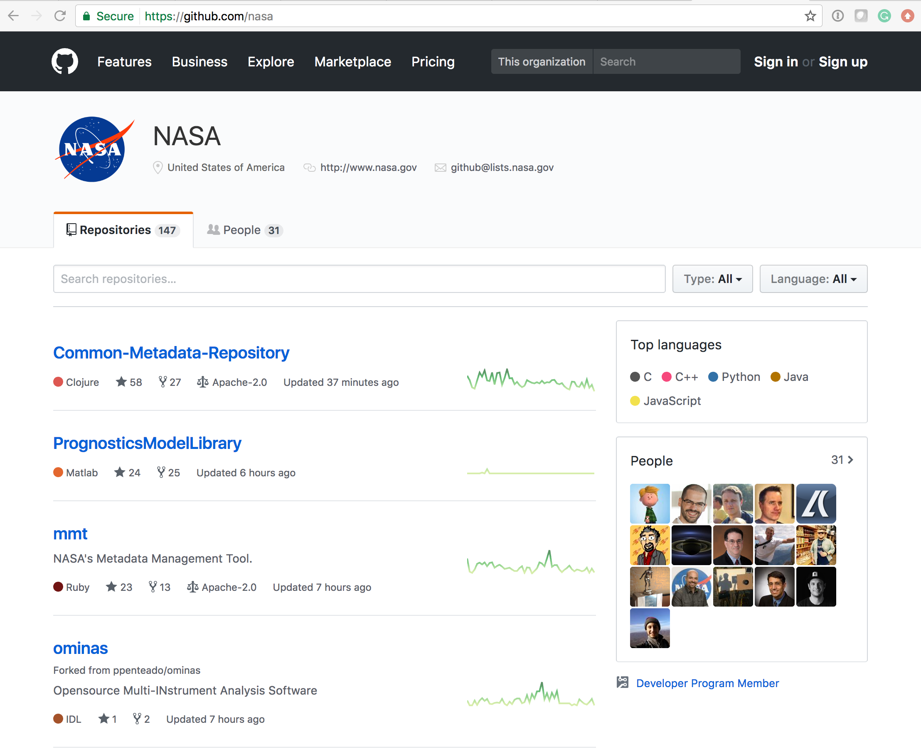
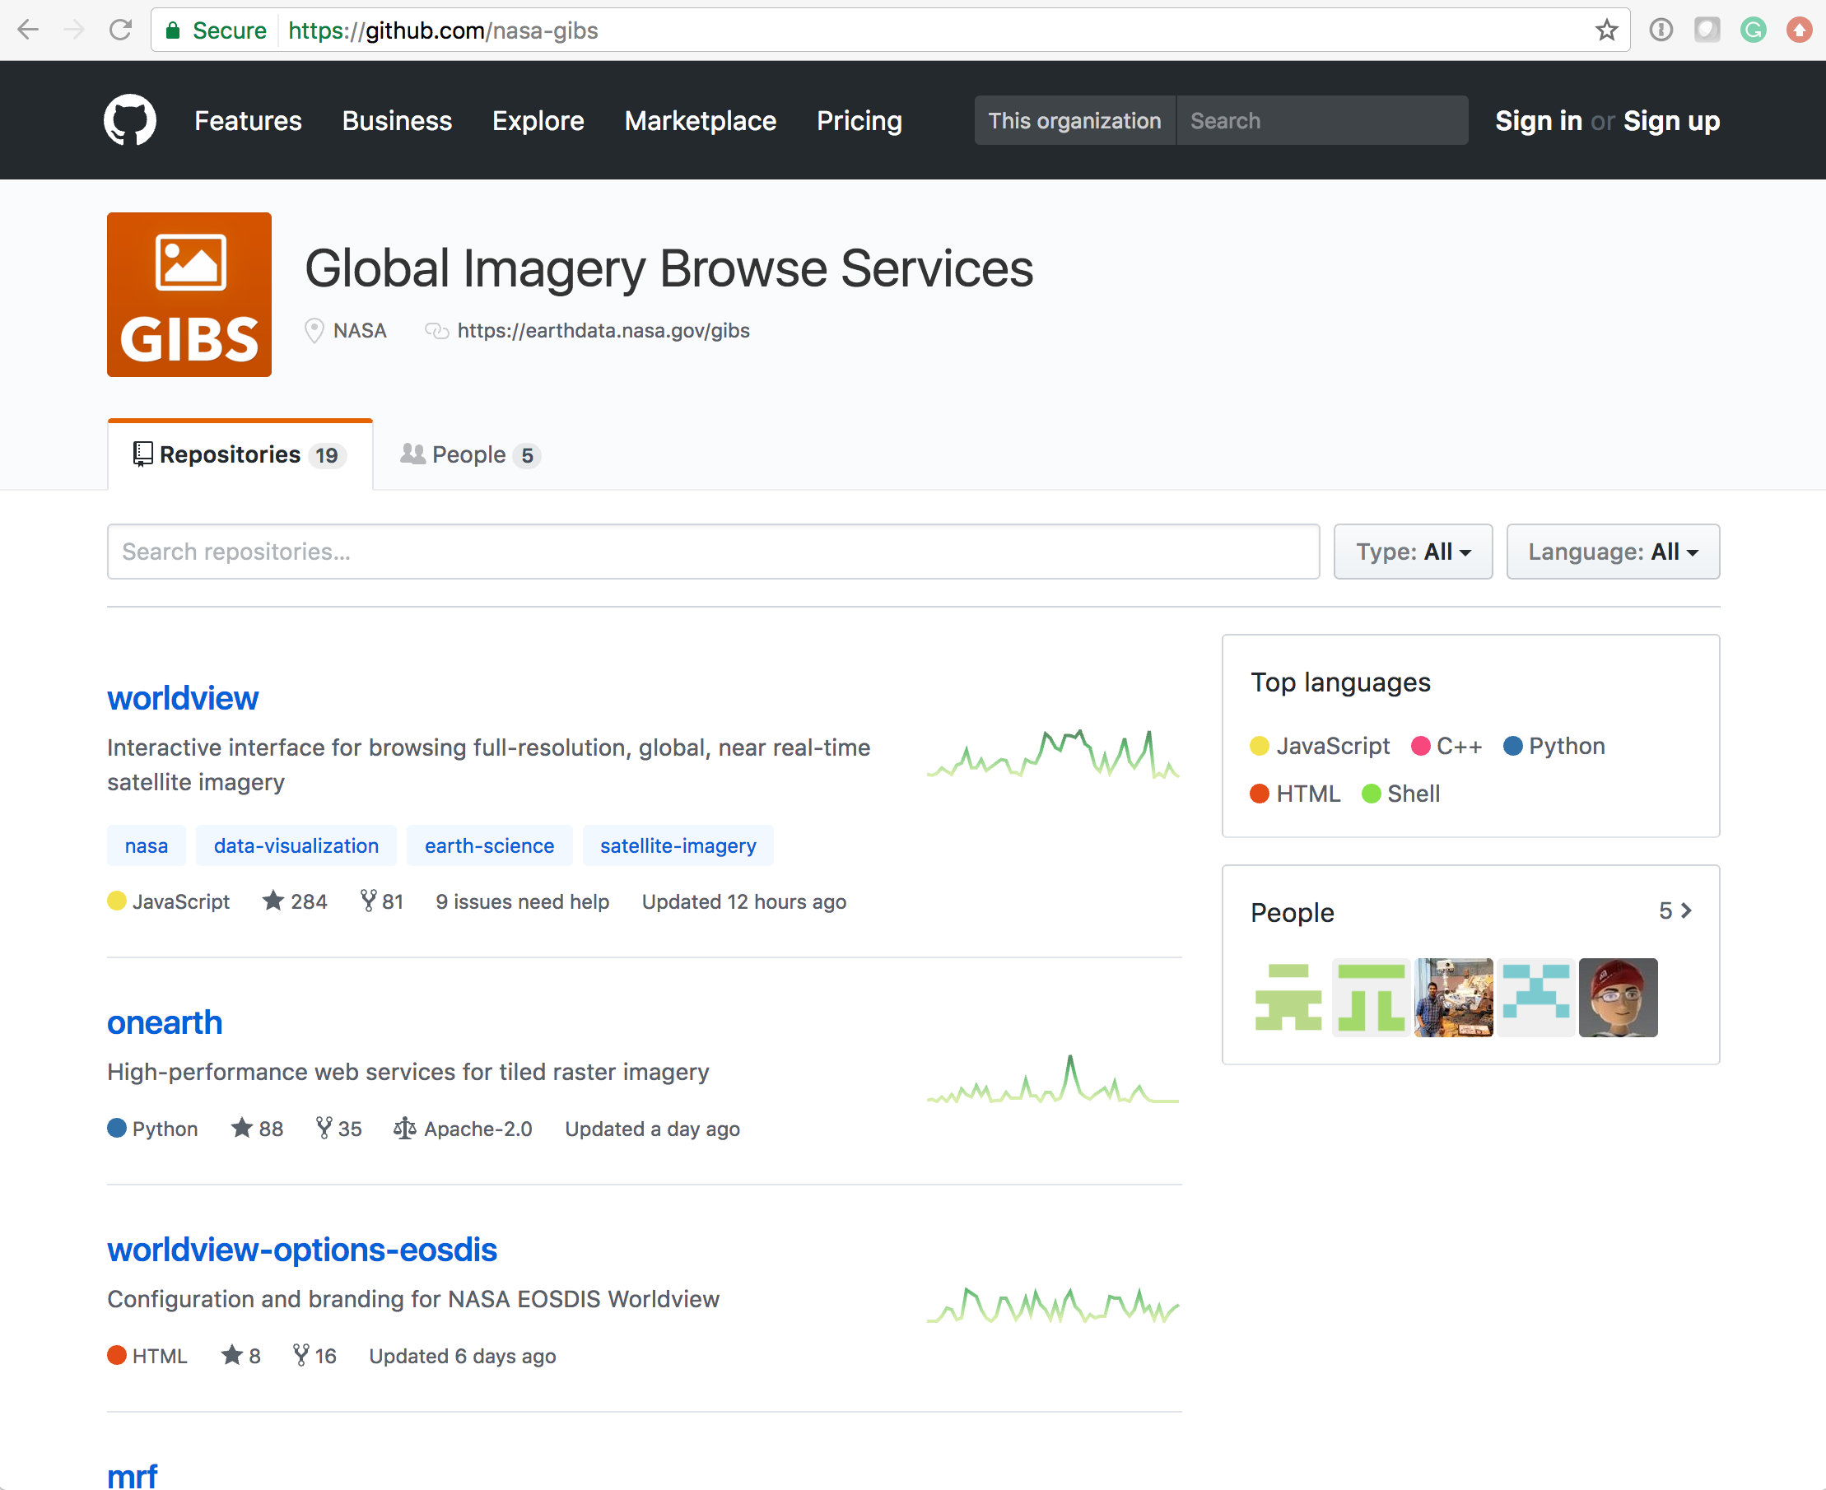
Open Data, Open Source, Open Services Cloud Architecture
Free data download
Open APIs
Open Source Clients
Notes:
Common discovery and visualization tools and services spanning all DAACs and SIPS to improve the discoverability, access and usability.
Open API architecture allows application developers maximum flexibility to “mix-and-match” services. Supports multiple clients
Interfaces with international organizations and U.S. government agencies to “federate” NASA metadata into their systems.
Checkout Github for NASA Open Source Software

Slide 8
Scaled Agile Framework (SAFe)
SAFe Community Teams
SDPS Infra.
SDPS Ingest
Giovanni in the Cloud
EMS
Other apps onboarding to EDC
SAFe is an agile software development methodology, emphasizing the value of iterating quickly and often to satisfy customers. ESDIS applies the SAFe methodology utilizing four development trains each containing multiple development tasks. A train is a team of developers who, along with other stakeholders, develops and delivers solutions incrementally using a series of fixed-length iterations within a Program Increment (PI).
Ingest & Archive
1. ASDC 2. ASF / TEA 3. CSDAP DMT 4. Cumulus OX | 5. Cumulus IX 6. GES DISC 7. GHRC | 8. LP DAAC 9. NSIDC 10. ORCA 11. ORNL | 12. PODAAC
Platform
1. NGAP 2. CICD | 3. EAA 4. EMCC | 5. ENS 6. EI | 7. Cloud Metrics 8. LZARDS
Search and Discovery
1. CMR 2. Earthdata / EDL | 3. Metadata Quality 4. Metadata Tools | 5. Search 6. UIUX | 7. Earthdata Pub 8. GITC
Transformation
1. ASF Data Services 2. Data Services | 3. Harmony | 4. OPeNDAP | 5. LP Data Services 6. PODAAC Data Transformation / Analysis

Slide 9
Incorporating User Feedback into Design
Earth Science Data Systems Working Group/
ACCESS Program
Science Researchers & Application users
Data Needs
Opportunities
IT and Security Directives
• Feedback through links on websites: https://earthdata.nasa.gov
• Specific discussions with users/developers through meetings
• Targeted improvement using Studies and Surveys; e.g. American Customer Satisfaction Index survey and study by commercial company: Blink
NASA HQ Earth Science Division
Guidance,
Technology,
Re-use
National Needs
Foundational
Decadal Survey
Vision & Direction
EOSDIS System Architecture
New Missions
Existing knowledge
Improvements,
Technology,
Re-use
Shared
Data
Opportunities
ESA
NOAA
Mission Operations
USGS
Collaborating Systems
Processing Centers
Data Centers
EOSDIS Elements
Notes:
Image Source: https://www.poynter.org/wp-content/uploads/2019/04/shutterstock_1348582508-1500x750.jpg

Slide 10

EOSDIS Key Metrics for FY2020
EOSDIS FY2020 Metrics
(Oct. 1, 2019 to Sept. 30, 2020)
Unique Datasets Distributed | 12,798
Total Archive Volume | 41.86 PB
Average Archive Growth | 32.8 TB/day
End User Distribution Products | 1,884.2 M
End User Distribution Volume | 44.04 PB
End User Average Distribution Volume | 123.6 TB/day
Distinct Users of EOSDIS Data and Services (Google Analytics) | 3.9 M
Web Site Visits (Google Analytics) | 2.96 M

Slide 11
EOSDIS Yearly Total Data Volume (PB) and Number of Products (Billions) Distributed to End Users
FY2020 Number of Products Distributed by Discipline
Products whose discipline was not available or not applicable including some of the ancillary data
Total Volume Distributed: 44.0 PB
Total # of Files Distributed: 1,884.2 Million

Slide 12
Volume Changes
Total EOSDIS Accumulated Data Archive Volume (Petabytes)
Trend: FY2000-FY2020
As data is acquired and reprocessed the collection both grows and shrinks
Multi-year datasets need to be summarized/ evaluated over long time series
Products range in size from kb to 1 GB
Important Events
FY2003 | Addition of ICESAT product
FY2008-FY2009 | Deletion of MODIS Collection 4 products
FY2013 | Addition of AQUARIUS and ICEBRIDGE products
FY2014 | Deletion of over 10 million files (2 PB) of data by ASF as part of their consolidation and transition of data to new media
FY2015-FY2019 | Reprocessing Collection 6 & 6.1 MODIS Terra and Aqua data products
FY2016 | Addition of GPM and ALOS PALSAR products
FY2017 | Addition of OB.DAAC
FY2018-2019 | Addition of SENTINEL 1A/1B and VIIRS products
Notes:
The trend data for earlier years are from EOSDIS Annual Metrics Reports.
Current fiscal year data will be updated by DAACS at the end of the fiscal year to report additional products or/and the deletion of the products that may not have been reported to EMS.

Slide 13
New Missions designated for EOSDIS
Launch, Processing & Archive
Missions | Daily Volume GB/day | Science Processing Element | DAAC(s) | Launch Date
Sentinel-6A | 794 | JPL POCC & GOC | PO.DAAC, GES DISC | Launched Nov 21, 2020
TROPICS Pathfinder | 75 | U of Wisc DPC | GES DISC | June 2021
TROPICS (EVI-3) | 75 | U of Wisc DPC | GES DISC | Jan 2022
EMIT | 923 | JPL SDS | LPDAAC | *Early 2022
SWOT | 21,762 | JPL SDS | PO.DAAC | *February 2022
JPSS-2 | 1,700 | SDS SIPS | GES DISC, OB.DAAC, LPDAAC, NSIDC, LAADS | NET Sept 2022
PREFIRE (2 cubesats) | 19 | U of Wisc SDPS | ASDC DAAC | *May 2, 2022,Aug 3,2022
MAIA (EVI-3) | 77 | JPL SDS | ASDC DAAC | *March 3,2022
NISAR | 73,390 | JPL SDS | ASF DAAC | Launch Jan 30,2023
TEMPO (EVI-1) | 1,700 | SAO SDPC | ASDC DAAC | *Aug 2022
PACE | 1,852 | GSFC PACE SDS | OB.DAAC | *Nov 2, 2022
CLARREO-PF on ISS | 385 | LASP CSDS & LaRC ICSDS | ASDC DAAC | *Nov 2022
TSIS-2 | .541 | LASP TSDS | GES DISC | *Feb 7, 2023
GeoCarb (EVM-2) | 636 | CSU GDOC | GES DISC | June, 2024
*These dates are under revision and subject to change.

Slide 14

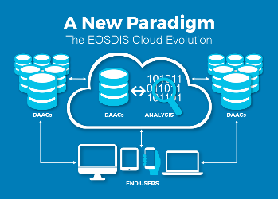


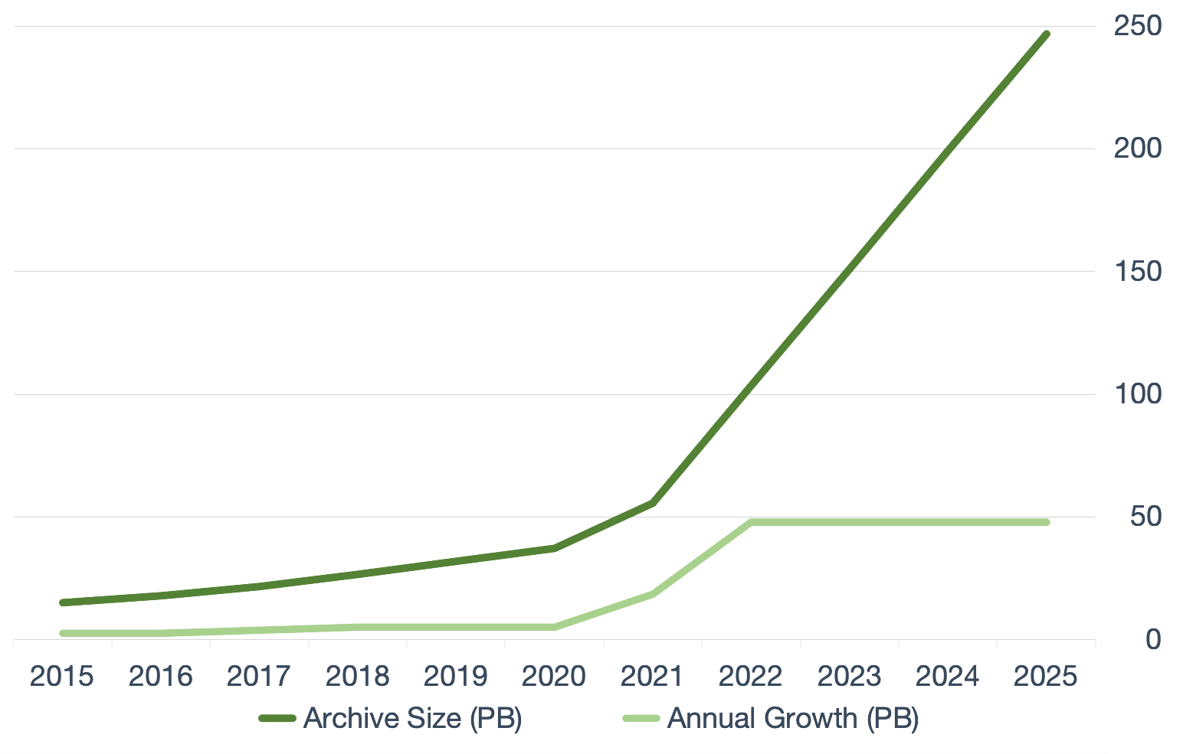
Earthdata Cloud
Data volumes for future missions will surpass in-house capacity/capability
Make data available to as many people as possible
Our users’ expectations and abilities are changing
Cloud Evolution: Our future
Scalable growth
Operational and analytical efficiency
Open science enables collaboration
Commercial cloud solutions
Agility and speed
Constant market-driven innovation by vendors (e.g., Amazon, Google)
Represent quickest path to enabling change
NISAR
SWOT
Today
Notes:
To efficiently handle storage and compute needs for the large SWOT and NISAR data volumes, new data management technologies and architectures are needed.
NASA’s Earth Observing System Data and Information System (EOSDIS) acquires, processes, preserves, and distributes observational data from various sources (satellites, aircraft, field measurements, and various other programs) to support Earth Science research focus areas. From its current size of approximately 30 petabytes (PB), the volume of data in the EOSDIS archive is expected to increase to approximately 250 PB by 2025.
Growth of Mission Data & Processing: Projected rapid archive growth and the need to effectively process significantly larger volumes of new mission data requires rethinking existing architectures. Estimating 132 TB daily ingest by 2022
Data Systems: More cost effective, flexible, and scalable data system ingest, archive, and distribution solutions are needed to keep pace with new mission advancement and capabilities
Science Users: Significantly larger data volumes requires additional ways to access and utilize these data, with “Data Close to Compute”
NASA’s Earth Science Data and Information System (ESDIS) Project has established the Earthdata Cloud Project aimed at operationalizing how EOSDIS (Earth Observing System Data and Information System) data collections can be archived collectively and disseminated in the cloud. As part of these efforts, EOSDIS successfully demonstrated that cloud environments offer performance and cost benefits.
Goals for EOSDIS cloud evolution:
Improve the efficiency of NASA’s data systems operations – continuing free and open data access to data
Prepare for new high-data-rate on-orbit missions
Increase opportunity for researchers and other users to access/process petabytes of data quickly without the need for complex data management capabilities
Allow for a transparent/extendable open source processing framework
Strategic Public and Private Partnerships
Demonstrate potential of cloud computing by bringing algorithms to the data to enable processing and analytics at scale.
Improve discovery of NASA data, services, and tools through commercial search engines.
Incorporate NASA Earth observation data into agency workflows.
Improve the ability to find and access Earth observation data and information.

Slide 15
Continuous Infrastructure & Process Improvements
Expanded use of agile and continuous integration techniques by each center/system
Common software requirements and development strategies
Uniform user experience based on design/development best practices
Open Source Policy
  Community software development to common code base
Common data services and APIs for uniform search, discovery and access
Centralized location for software and system development
  Continuous integration of new technology
Leverage commercial cloud computing to supplement current system functionality
    On demand resources for analysis and processing
    Enable sophisticated data access and service scenarios

Slide 16
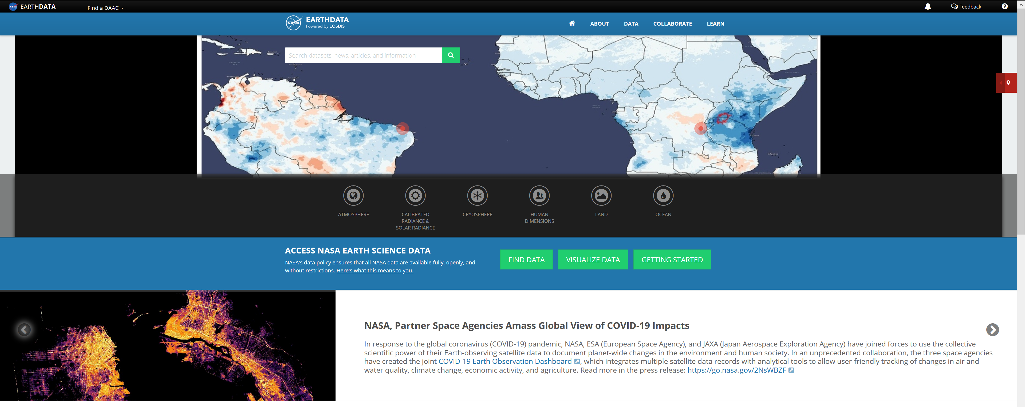
Additional information is available at:
  http://earthdata.nasa.gov/

Slide 17

NASA EARTH FLEET
NISAR 2020
TROPICS (6) 2020
LANDSAT-9 2020
SENTINEL-6A/B 2020, 2025
OPERATING & FUTURE THROUGH 2023
TSIS-2 2020
SWOT 2021
PREFIRE (2) 2022
MAIA 2022
GEOCARB 2022
PACE 2022
INVEST/CUBESATS
RAVAN 2016
RainCube 2018
CSIM 2018
CubeRRT 2018
TEMPEST-D 2018
CIRiS 2019
HARP 2019
CTIM*
HyTI*
SNoOPI*
NACHOS*
* Launch date TBD
GLIMR ~2026
TEMPO 2022
ICESAT-2 2021
GRACE-FO (2) 2023
CYGNSS (8) 2020
NISTAR, EPIC (DSCOVR/NOAA) 2020
ISS INSTRUMENTS
EMIT 2021
CLARREO-PF 2020
GEDI 2020
SAGE III 2020
OCO-3 2022
TSIS-1 2023
ECOSTRESS 2020
LIS 2020
SORCE 2020
CLOUDSAT 2021
TERRA >2021
AQUA >2022
AURA >2022
CALIPSO >2022
GPM >2022
LANDSAT 7 (USGS) ~2022
JPSS-2, 3 & 4 INSTRUMENTS
OMPS-Limb
LANDSAT 8 (USGS) >2022
OCO-2 >2022
(PRE) FORMULATION
IMPLEMENTATON
PRIMARY OPS
EXTENDED OPS
OSTM/JASON 2 (NOAA) >2022
SMAP >2022
09.10.19
SUOMI NPP (NOAA) >2022

Slide 18
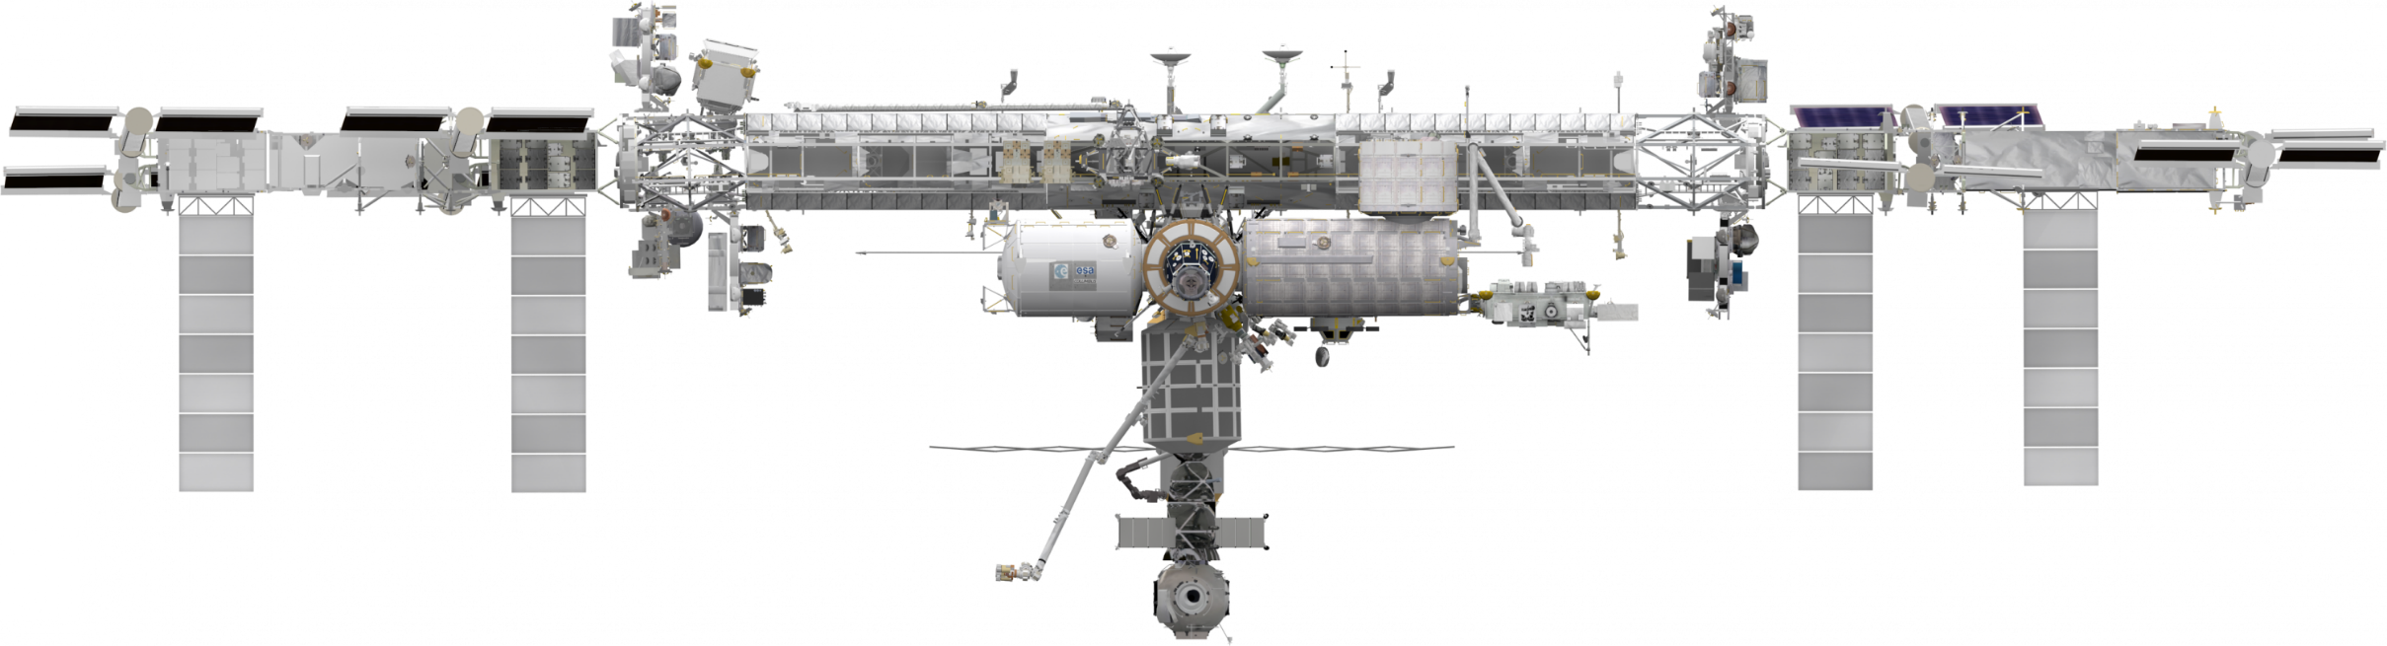
INTERNATIONAL SPACE STATION
EARTH SCIENCE OPERATING MISSIONS
EMIT (2021)
TSIS-1 (2023)
ELC-2
ELC-3
AMS
ESP-3
ELC-4
Columbus EF
JEMEF
ELC-1
SAGE III (2020)
OCO-3 (2022)
GEDI (2020)
ECOSTRESS (2020)
LIS (2020)
CLARREO-PF (2020)
External Logistics Carriers: ELC-1, ELC-2, ELC-3
External Stowage Platforms: ESP-3
Alpha Magnetic Spectrometer
Columbus External Payload Facility
Kibo External Payload Facility
(PRE) FORMULATION
IMPLEMENTATON
PRIMARY OPS
EXTENDED OPS
09.10.19
18

Slide 19










NASA EARTH FLEET
NISAR
SENTINEL 6 A/B
INTERNATIONAL COLLABORATIONS
GRACE-FO (2)
SWOT
OSTM/JASON 2 (NOAA)
(PRE) FORMULATION
IMPLEMENTATON
PRIMARY OPS
EXTENDED OPS
CALIPSO
CLOUDSAT
GPM
TERRA
AURA
AQUA
09.10.19

