Slide 1
EOSDIS Archive & Data Stewardship
Data Stewardship Interest Group session at
CEOS WGISS April 21, 2021
Andrew Mitchell & Diane Davies
ESDIS Project, NASA/Goddard Space Flight Center

Slide 2
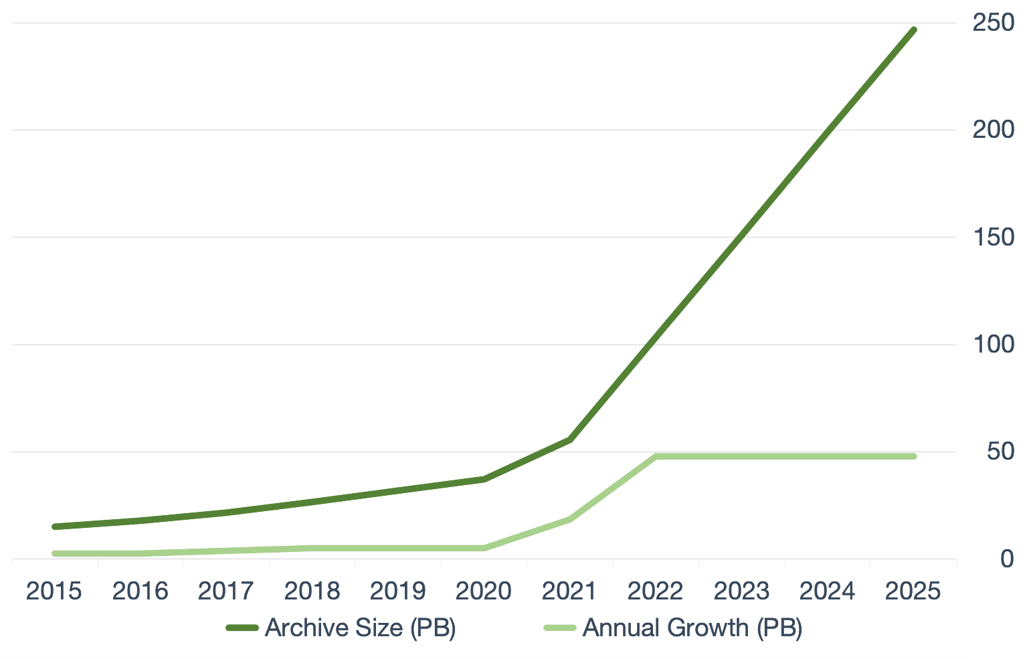
Current Archive Technology
EOSDIS Archives are managed using several technologies:
  Online disk on premise at several physical locations across the US.
  Nearline systems: typically LTO8 in Quantum Tape Library with Quantum QXS Arrays for staging using Xcellis appliances for managed file systems
  Earthdata Cloud
    New NASA missions are being ‘born in the Cloud’ and the size of the collection dictates the use of commercial cloud rather than on-premise resources. AWS is current commercial Cloud provider.
Cloud Evolution: Our future
Scalable growth
Operational and analytical efficiency
Open science enables collaboration
Commercial cloud solutions
Agility and speed
Constant market-driven innovation by vendors (e.g., Amazon, Google)
Represent quickest path to enabling change
Data volumes for future missions will surpass in-house capacity/capability

Slide 3
Composition of NASA Earth Science Archive
Data collection contains over 100 missions (starting in the 1970s)
Collection includes:
  On-orbit
  Airborne
  Campaigns including in field or at sea measurements
  Measurements from specific HQ calls
  Ancillary and supporting data
In TB from FY2020

Slide 4
Volume Changes
As data is acquired and reprocessed the collection both grows and shrinks
Multi-year datasets need to be summarized/evaluated over long time series
Products range in size from kb to 1 GB
Total EOSDIS Accumulated Data Archive Volume (Petabytes)
Trend: FY2000-FY2020
Important Events
FY2003 | Addition of ICESAT product
FY2008-FY2009 | Deletion of MODIS Collection 4 products
FY2013 | Addition of AQUARIUS and ICEBRIDGE products
FY2014 | Deletion of over 10 million files (2 PB) of data by ASF as part of their consolidation and transition of data to new media
FY2015-FY2019 | Reprocessing Collection 6 & 6.1 MODIS Terra and Aqua data products
FY2016 | Addition of GPM and ALOS PALSAR products
FY2017 | Addition of OB.DAAC
FY2018-2019 | Addition of SENTINEL 1A/1B and VIIRS products
Notes:
The trend data for earlier years are from EOSDIS Annual Metrics Reports.
Current fiscal year data will be updated by DAACS at the end of the fiscal year to report additional products or/and the deletion of the products that may not have been reported to EMS.

Slide 5
Product Lifecycle
Science Team
SIPS
Distributed Active Archives & Stewardship
HQ
Proposal
Concept
Proposal
I & T
Approval
DMP
Algorithm(s)
ATBD
Interface tests
Interface tests
ATBD
Approval
Operations tests
Operations tests
Prod. Gen. S/W
S/W
Archive
DOI
Landing Page
Publish
Distribute
Process
Reprocess
Std. Prod.
Cal/Val
QA
Std. Prod
Gather PCS Items
PCS Items
Improve Product
Prod. Gen. S/W
S/W
(Next Version)
PCS: Preservation Content Specification
Notes:
Spell out MOSS and PCS or offer a recognizable word

Slide 6
Sources of Content
All contribute to archive
Calibration Team
Mission logs
Science Data Product Documentation
Mission Data Calibration
Mission Operations
Product Generation Support Teams (SIPSs)
Instrument Teams / PI’s
Science Data Product Software
Science Data Software Tools
Science Data Products
Level 0 Data
Science Data Product Algorithm Input
Ancillary data sources (e.g., NOAA)
DAACs
Science Data Product Validation
Instrument Developer/ Manufacturer
Preflight/ Pre-Operations
Data gathering project (e.g., flight project)
Validation Team

Slide 7
Data Format/Packaging for LTA
Given the variety of data held in EOSDIS it is not practical to require that all data be in a single format
Several formats are acceptable as indicated by ESDIS Standards Office (https://earthdata.nasa.gov/esdis/eso/standards-and-references)
  Data Product Development Guide for Data Producers strongly recommends use of NetCDF and CF compliance
Preservation Content Specification (PCS) states:
  Documentation of the raw data formats and derived product formats is essential for a user to be able to use a data product. It is essential for sustainable long-term preservation that detailed knowledge of the file format be available, because even file formats that are currently well understood now may become incomprehensible over time.

Slide 8
Management and archiving of relevant associated information
ISO 19165-2:2020 was published in July 2020
  Geographic information — Preservation of digital data and metadata — Part 2: Content specifications for Earth observation data and derived digital products
  Based on prior work by NASA/ESA/CEOS WGISS
  Identifies all data and associated information content to be preserved
NASA’s PCS has been updated to broaden to include airborne and in situ data
  Includes mapping to and from ISO 19165-2:2020
  Covers “what” and “when”
Preservation Content Implementation Guidance (PCIG)
  Companion document to PCS
  Covers “how”
Updated PCS and PCIG are currently in review

Slide 9
Preservation Content Implementation Guidance
Recognizes diversity of size, funding, and requirements of NASA-funded projects
  Expected compliance is indicated as High, Medium or Low depending on project type (e.g., on-orbit missions, research and analysis investigations, data production investigation such as MEaSUREs)
  Each item called for in PCS is categorized as Required, Suggested, or Not applicable
  Detailed guidelines are provided in several sections
Common guidelines applicable to all types of projects
  Identifying preservation items
  Responsibility of organizations for identifying and gathering preservation items
  Provision of pointers to locations of items when not all of them are located at a given DAAC
  Use of persistent identifiers
  Ensuring future usability and need for on-going updates
  What to do when some artifacts are unavailable
  Organization and presentation of preservation checklists
  Presentation of preservation items on DAAC websites
  Preservation of information from project websites
  Long-term care and maintenance of preservation checklist and artifacts

Slide 10
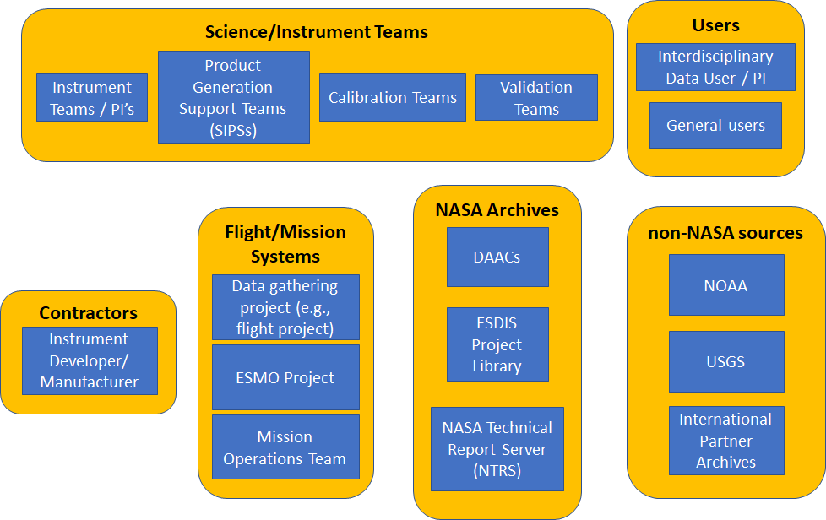
Preservation Content Implementation Guidance
On orbit/satellite missions
Figure shows organizations holding preservation contents during the life of a project. These contents must be gathered from these organizations for preservation
Guidance addresses each section of PCS and indicates how artifacts called for are to be gathered and organized for preservation

Slide 11
Preservation Content Implementation Guidance
Airborne and Field Investigations
  Guidance identifies types of documents that may apply to various PCS sections
  Tables show how items unique to airborne and field investigations map to PCS
  In presenting preservation materials, DAACs may choose whatever manner provides the best clarity for a given investigation. E.g.,
    By instrument (and resulting data products)
    By platform (and the instrument data and derived products associated with that platform
    By data product type (such as grouping the various aerosol data products, meteorological products, and support data products).
  Unique cases considered: Non-public Low-Level Data, Extremely Large Investigations, Data at Multiple DAACs, Facility Instruments contributing to multiple focus areas and investigations

Slide 12
Preservation Content Implementation Guidance
Data Producing Activities (e.g., Making Earth System Data Records for Use in Research Environments – MEaSUREs)
    Some activities create merged products using data from multiple instruments over time.
    Materials needing to be preserved extend beyond the specifics of merged product created, but also include details of every component included in the merged product.
    If components leading to merged product have been well documented and preserved elsewhere, preservation of content can consist of identifying and preserving pointers to any existing component documentation and data
    If component information is not preserved, best efforts should be made to provide sufficient information about components to ensure future users’ understanding of merged product.
    Guidance includes typical documents from such activities that meet specifications provided in PCS
Guidance includes comments about the Commercial Smallsat Data Acquisition Program and the Citizen Science for Earth Science Program

Slide 13
Challenges
Ongoing efforts to address integrity of Archive
  Considering checksums; e.g. use of sha256 instead of md5 and how this affects our collections and our users
  Ideas how to ‘watermark’ datasets to identify the origin of a dataset and ensure integrity
Vendor Lock-in on the Earthdata Cloud
  Want to ensure that we have ways to move the collection from one Cloud vendor to another
Usability and discoverability of data in Earthdata cloud
  Capabilities for analysis ready data relative to a long term archival format like HDF or netCDF
  Use of ZARR
Growth and changes to metadata
  How to support old datasets with new metadata and enable them to be used by tools

Slide 14
Further Information
https://earthdata.nasa.gov
Thanks to contributions from Dr. Rama Ramapriyan

Slide 15
Backup

Slide 16
EOSDIS Key Metrics for FY2020
EOSDIS FY2020 Metrics
(Oct. 1, 2019 to Sept. 30, 2020)
Unique Datasets Distributed | 12,798
Total Archive Volume | 41.86 PB
Average Archive Growth | 32.8 TB/day
End User Distribution Products | 1,884.2 M
End User Distribution Volume | 44.04 PB
End User Average Distribution Volume | 123.6 TB/day
Distinct Users of EOSDIS Data and Services (Google Analytics) | 3.9 M
Web Site Visits (Google Analytics) | 2.96 M

Slide 17
EOSDIS Yearly Total Data Volume (PB) and Number of Products (Billions) Distributed to End Users
FY2020 Number of Products Distributed by Discipline
Products whose discipline was not available or not applicable including some of the ancillary data
Total Volume Distributed: 44.0 PB
Total # of Files Distributed: 1,884.2 Million

