Slide 1
Notes:
To edit the background image, select ‘Format’ from the PowerPoint menu and ‘Slide Backgound’ from the drop-down menu. Within the new list of options that appears on the right of the screen, select the ‘File’ button under ‘Insert picture from’ and select your image from your file browser.

Slide 2
Key Points
Data Preservation and Stewardship Area | CEDA and JASMIN
Who are we ? | A datacenter and data analysis infrastructure serving the Atmospheric, Earth Observation and Climate Science communities in the UK.
Current archiving technology and infrastructure (e.g. Architecture, Robotics and Media type, Monitoring Tools) ? | Large datacenter with over 13 Petabytes of data collocated with data analysis infrastructure
Archive volume detailed per mission (e.g. coverage and timeframe, what product levels are preserved for long term)? | Volume range from Kbytes to Petabytes
Archiving operations concept, flows and processes? | On the EO side alone we support acquisition streams for over 80 3rd Party data products and 100’s of datasets. These are acquired and archived via number of processes and mechanisms
Data format/packaging for long term archive? | As an old archive we have a broad range of formats for historic reasons, we have a discrete number of supported formats and support some specializations.
Management and archiving of the relevant associated information (e.g. documentation, heritage SW, calibration data)? | We currently deal with a variety of associated data, grey materials, documentation, software and are looking to develop best practice in this area
Archive technology and media evolution and future trends? | Evolution to mix of storage types to make best use of capacity, including migration to object store.

Slide 3
CEDA: Data Preservation and Stewardship
Ruth Petrie, Victoria Bennett, Matt Pritchard, Sam Pepler, Esther Conway, Neil Massey, Ag Stephens and Richard Smith
CEOS WGISS – 51
22nd April 2021
Notes:
The abstract pattern can be removed or repositioned if required. Be careful to ‘Send to Back’ so that it does not obscure any important information.

Slide 4
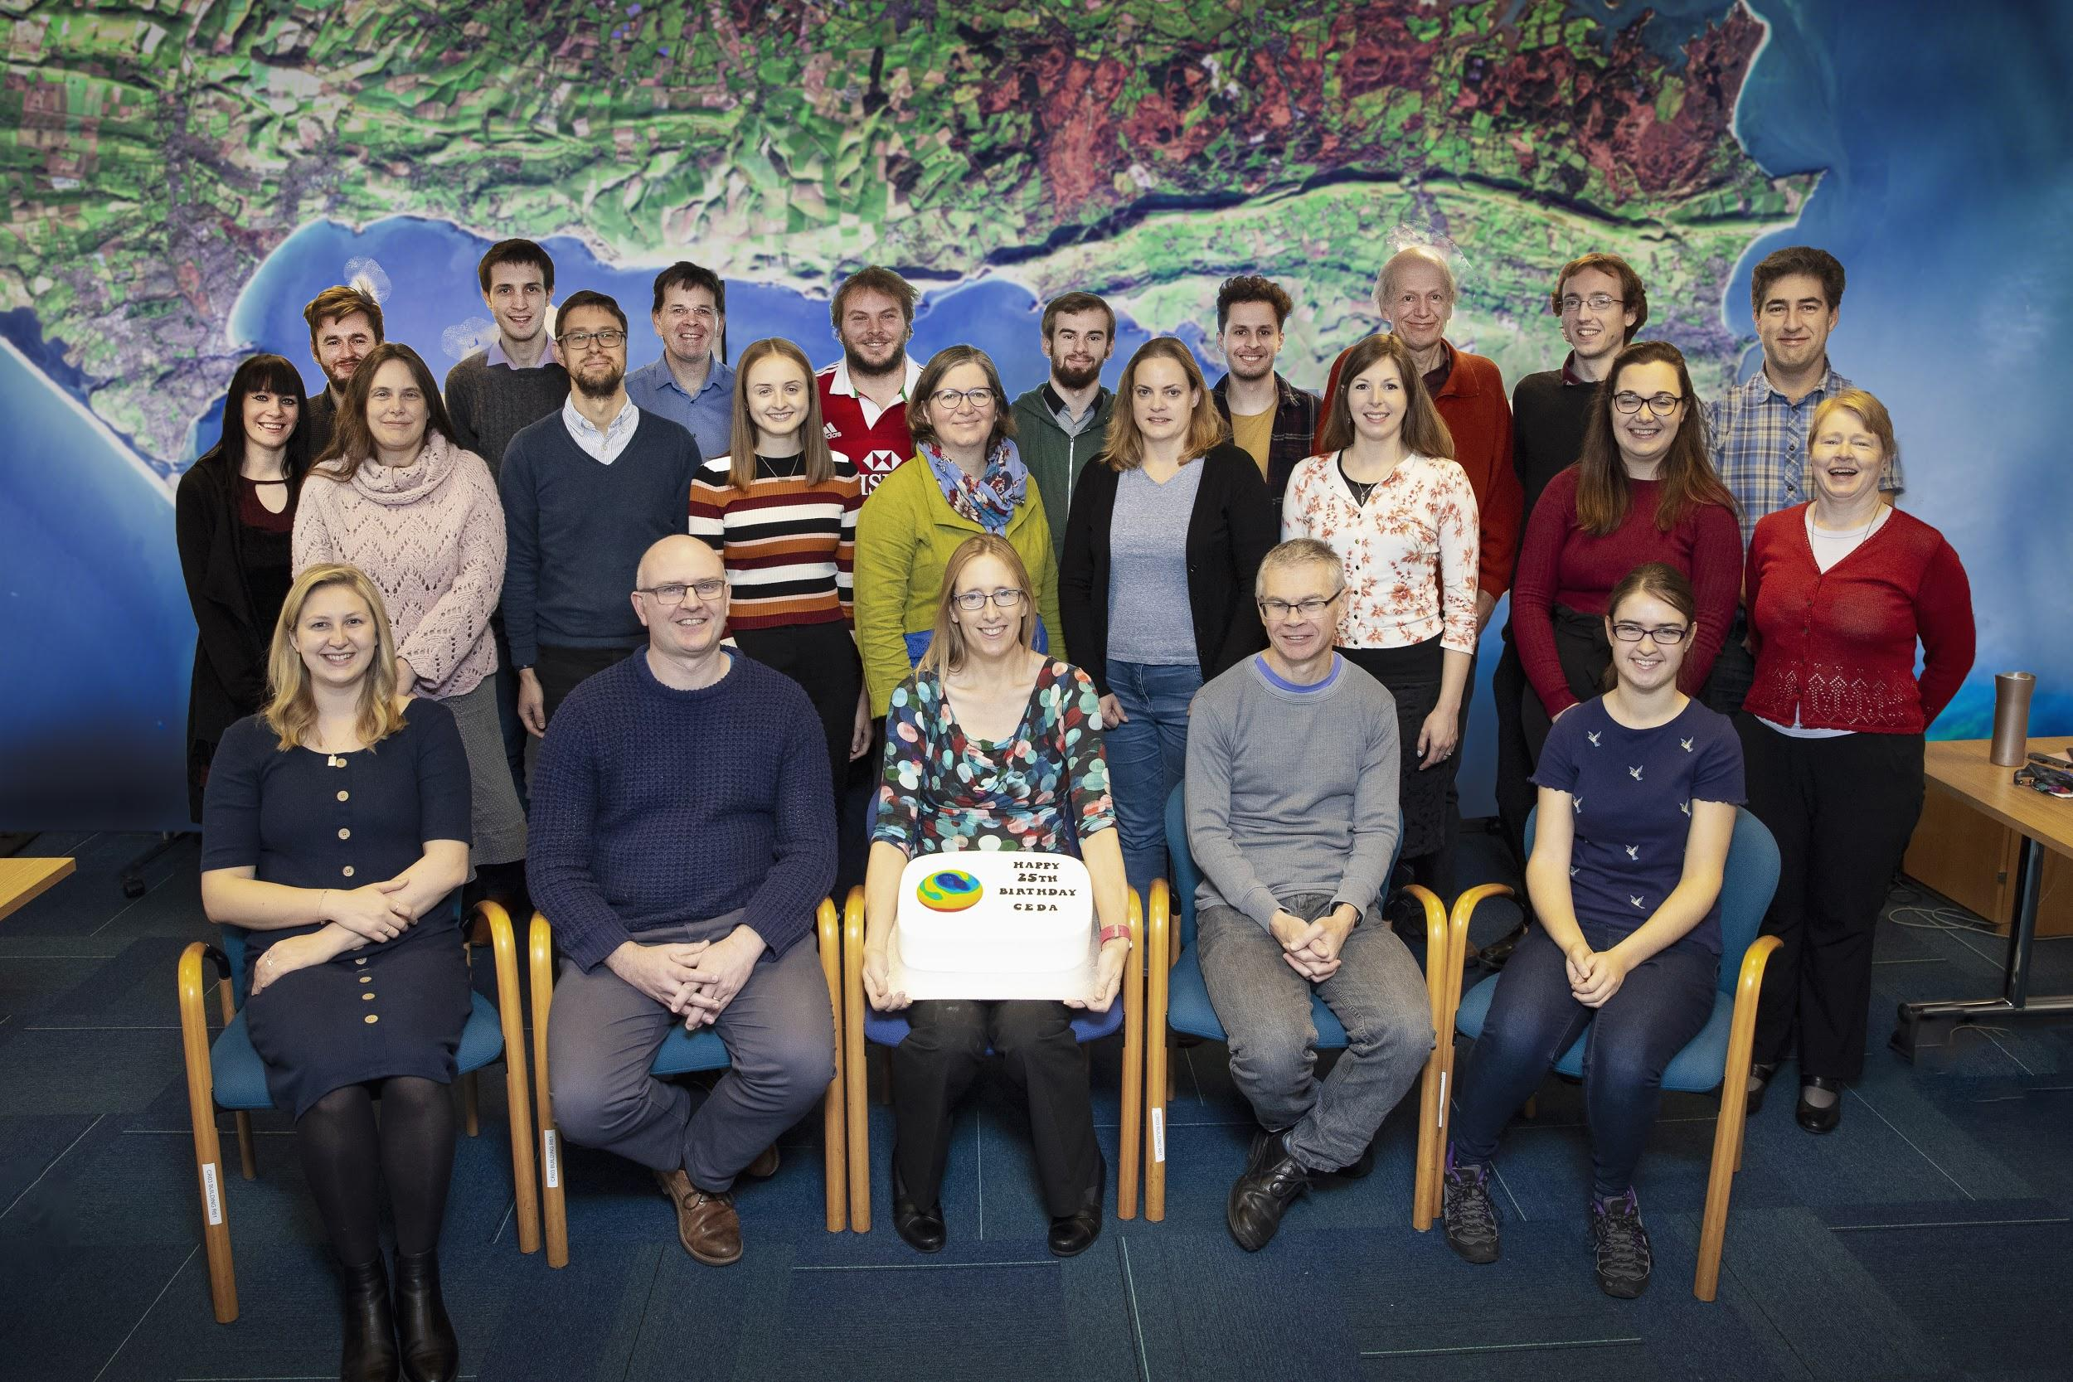
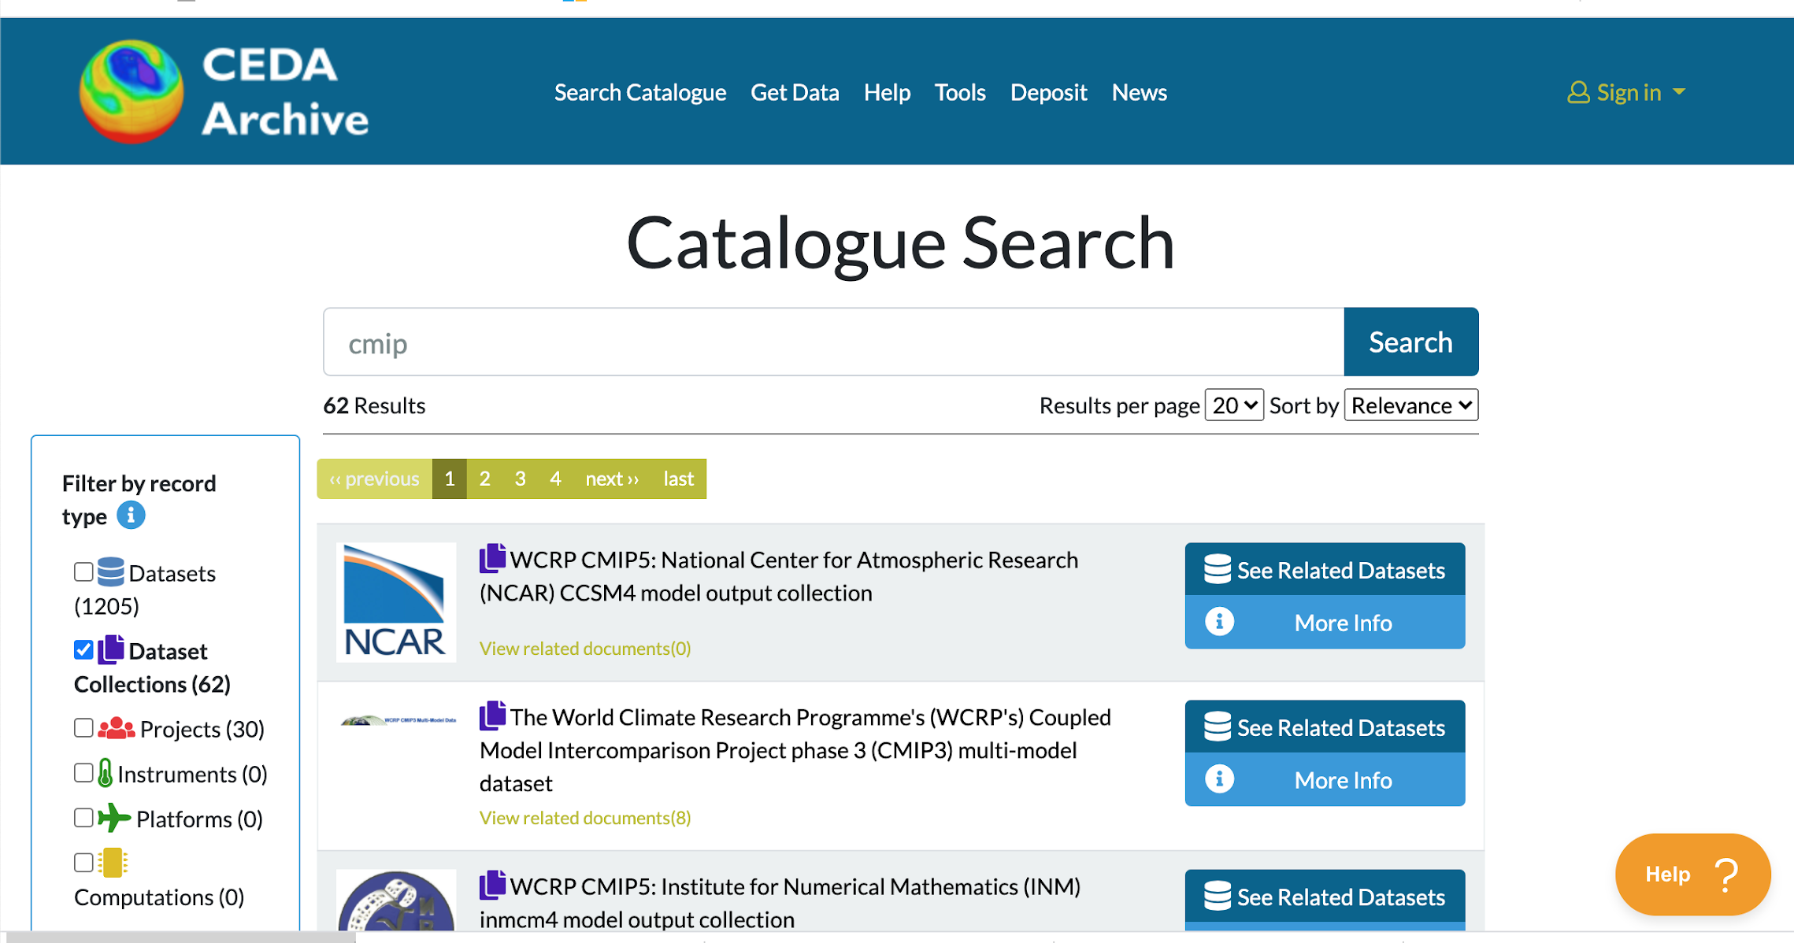
What is CEDA?
Centre for Environmental Data Analysis
Mission: To provide data and information services for environmental science
People
Data
JASMIN

Slide 5
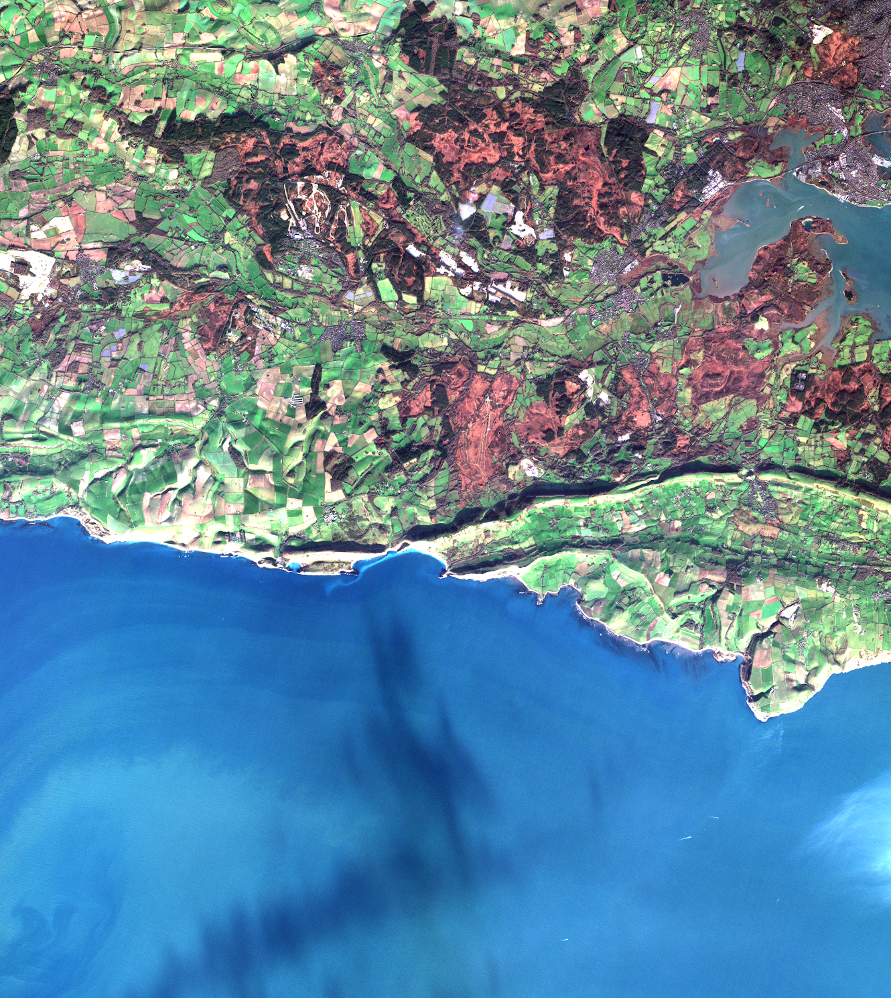
CEDA Archive
Holds over 13 Petabytes of atmospheric and earth observation data
Satellites
Weather stations, ground-based obs, aircraft campaigns
Climate models
Reanalyses
... amongst many more
Nearly 7,000 datasets, ~300 million files
~60,000 registered users
Most data open access, for download or use on JASMIN

Slide 6
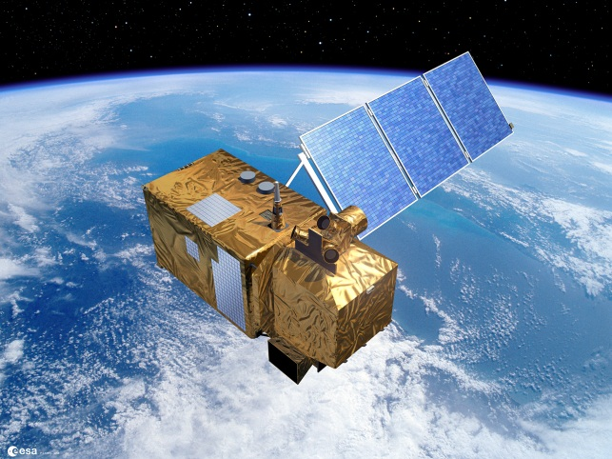
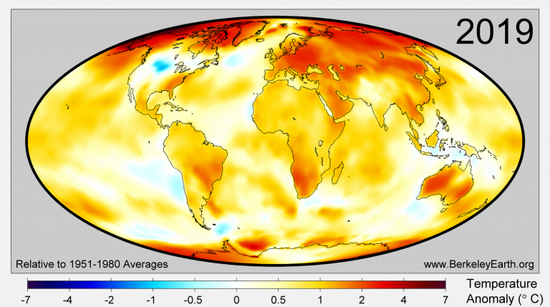
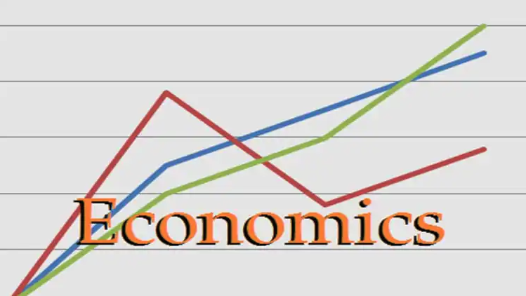
CEDA Users:
~67k registered users; ~20k are active users
Research communities
observational and modelling
Climate science
polar,
terrestrial,
marine
freshwater
Engineering
Biological Sciences
Economics
© ESA
© EUSTACE (EU Project)
© NSIDC

Slide 7
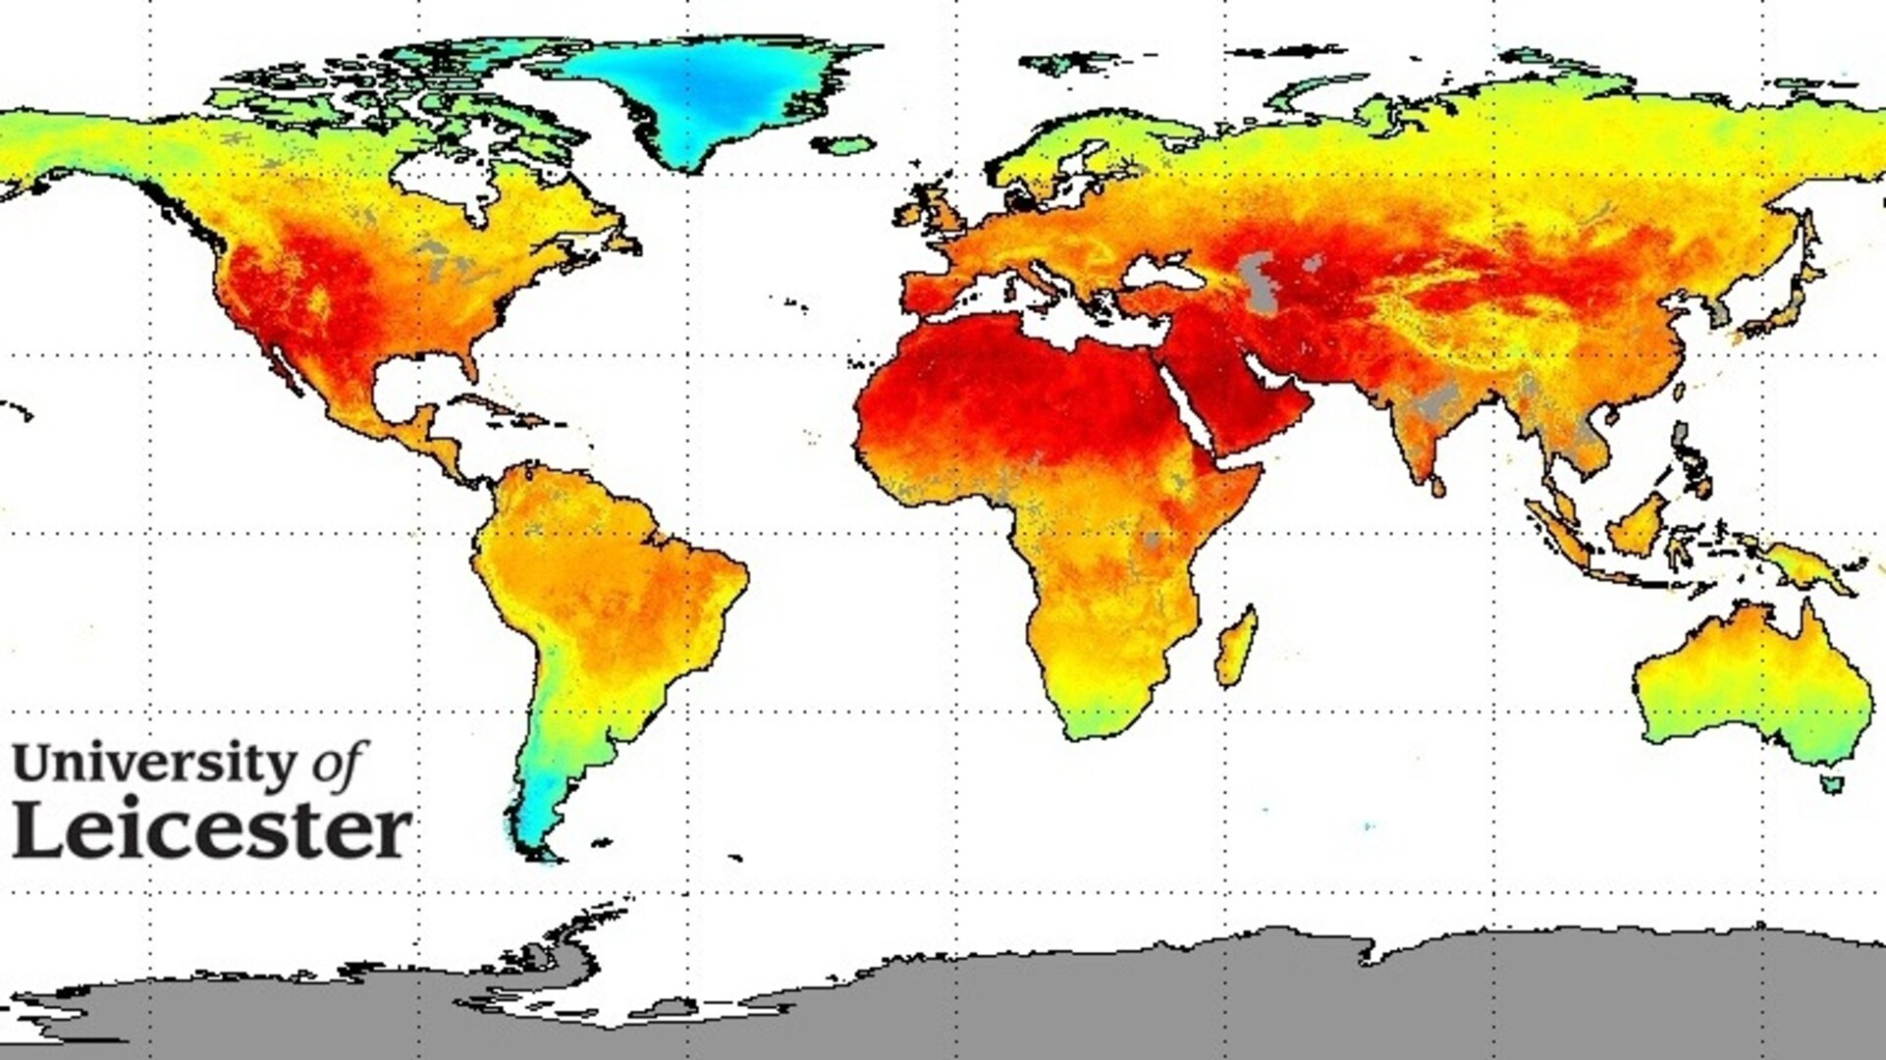
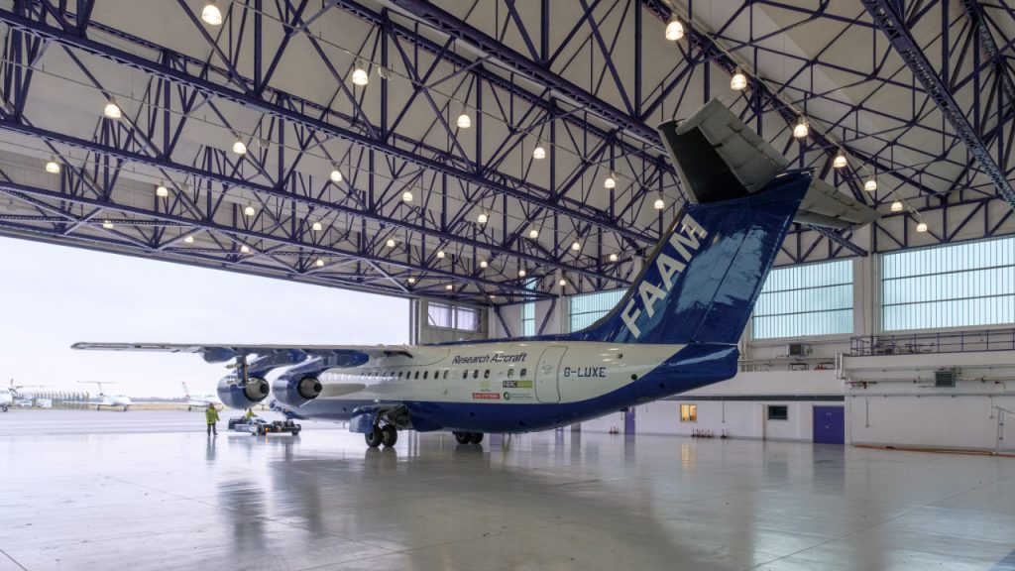
Data, observational examples:
ESA CCI archive
Full archive of global Essential Climate Variables
NCEO data:
Satellite data products, including surface temperature, atmospheric composition, cloud, aerosol, albedo, ..
NCAS data AMOF/ FAAM
Atmospheric Observatories, Radars, Aircraft obs
Met Office Observations : HadObs, MIDAS Station Data
Global data from Copernicus Sentinel Satellites (inc radar, surface imagery and radiometry, atmospheric composition)
.. and CEDA is part of the NERC Environmental Data Service with other NERC Data Centres (BODC, PDC, NGDC, EIDC)

Slide 8
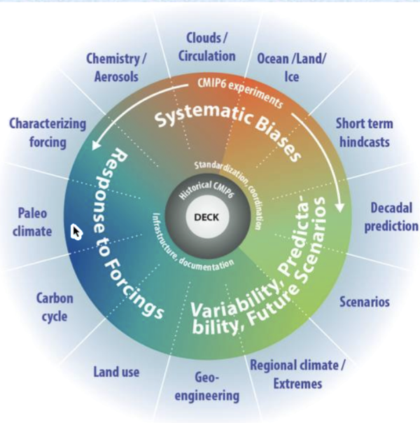
Data, modelling examples:
CMIP6: 6th Coupled Model Intercomparison Project
CEDA are preparing for 15-20 PB to be archived, 2.3 PB so far
Initial focus on IPCC WG1 priority data
..adding to ~1PB of CMIP5 data and 40TB of CMIP3 data.
CCMI (IGAC/SPARC Chemistry-Climate Model Initiative)
UKCP18: UK Climate Projections 2018
Various air quality models
Research project data

Slide 9
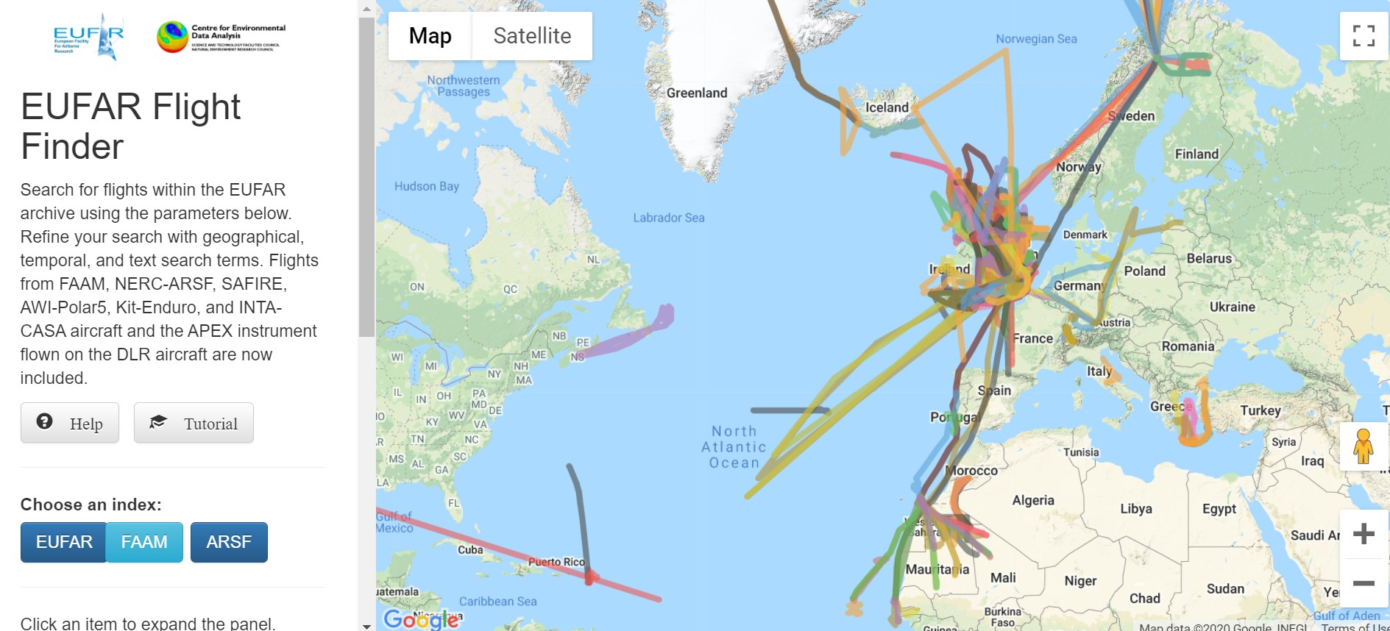
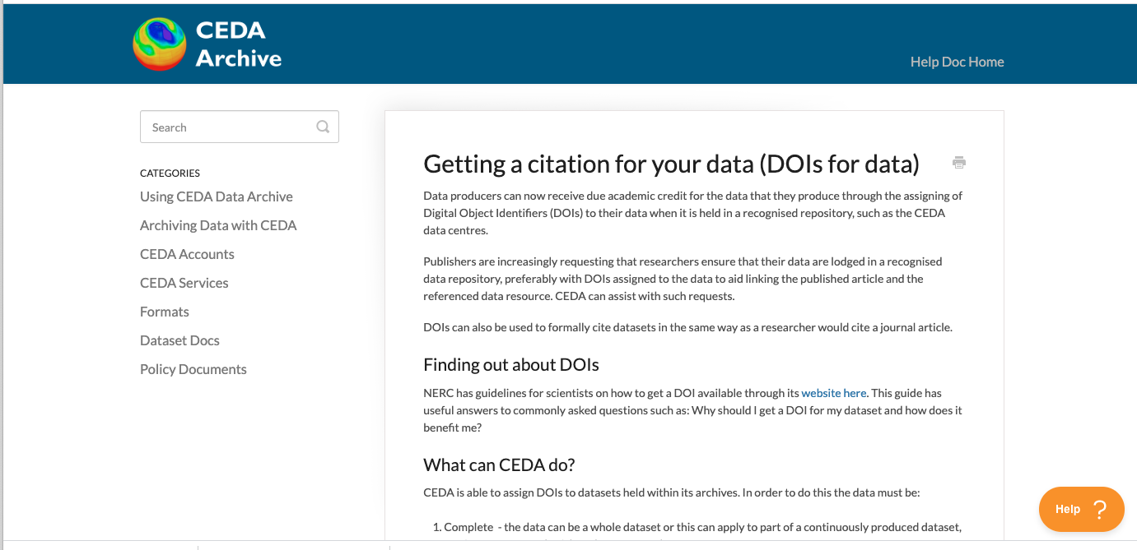
CEDA Archive Services
Catalogue search
Flight finder, Satellite finder
WPS: web processing service
subsetting and simple data manipulations, being developed for C3S … making it easier to interact with the data
Helpdesk & documentation
Data management planning
DOIs for deposited data
Helpful pictures

Slide 10
JASMIN
Facility operated by STFC on behalf of NERC
Joint endeavour between CEDA and STFC Scientific Computing Department
Large-scale, high-performance storage and compute
Centered around storage & data access
Flexible environment
Many component services
Huge range of workflows
~14,000 cores
~45 PB storage

Slide 11
JASMIN
Supports data analysis for NERC environmental science community
Large scale, data-intensive science
Compute co-located with the data
CEDA Archive data (curated)
Collaborative data (…not)
Cloud capabilities
Autonomy
Scalability

Slide 12
JASMIN: Users
Broadly the same scientific disciplines as CEDA users.
Over 2,000 active users
CEDA users are often JASMIN users
Many researchers only want access to the JASMIN compute & collaborative data and not CEDA archive.
240 group workspaces
~60 cloud tenancies

Slide 13
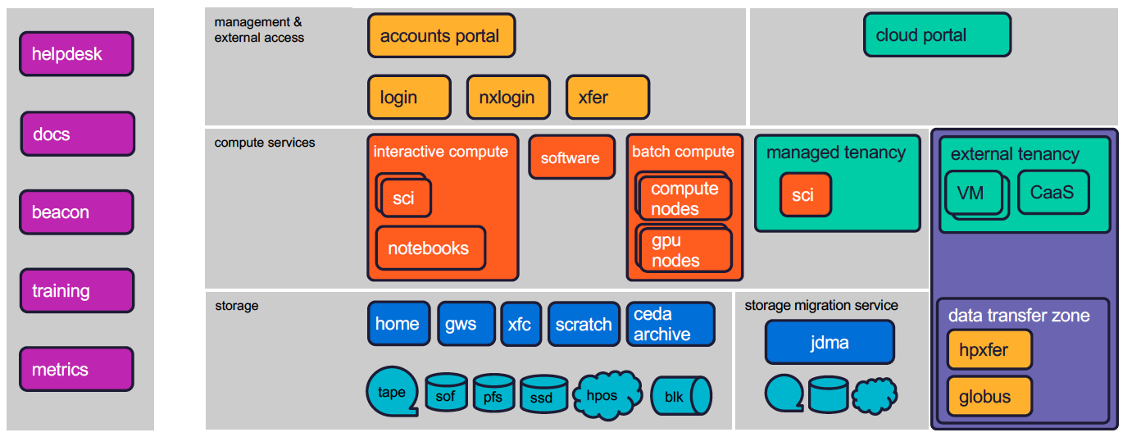
JASMIN:Services

Slide 14
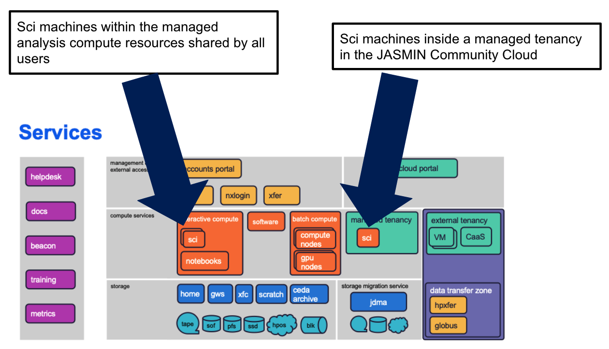
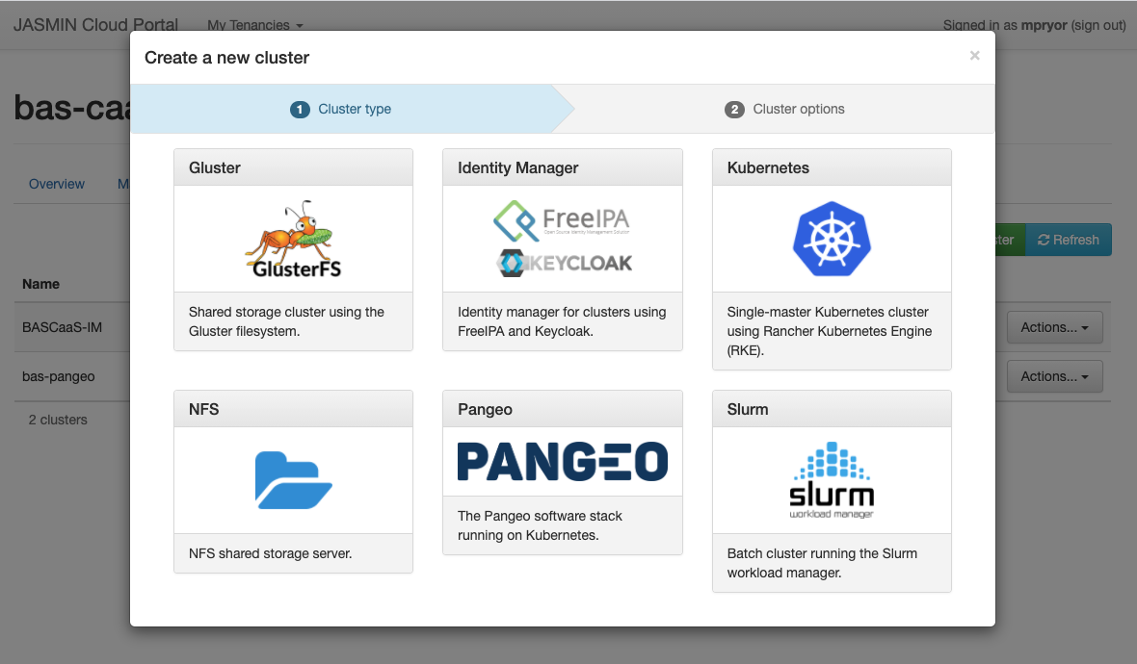
JASMIN: Recent developments
Storage
30 PB SOF now all allocated
1 PB PFS scratch area
Object storage interfaces
Compute
Major migrations: RHEL6 -> CentOS7
LSF -> SLURM
Cloud platform
“Tenancy sci” machines: further rollout
Cluster-as-a-Service
JASMIN Notebook service
Procurement for JASMIN Phase 7 underway

Slide 15
Archiving operations concept, flows and processes
FTP – Sentinel Hub
HTTP – MODIS Tool
CEDA Archive
EUMETSAT online archive IASI/GOME
WMO Data Feed
Processing
Restricted Access GWS
Ad Hoc data acquisitions
FTP , Globus, xfer
Arrivals
Project GWS
Web upload
Near Real Time EUMETCAST DISH
NCAS Instruments
Large Transfers - NAS Box and Tape

Slide 16
Data format/packaging for the long term archive
Details of recommended common formats used within the CEDA archive
File Formats Demystified
Metadata Basics
BADC-CSV Format for Data Exchange
NetCDF format
PP Binary Format
HDF
NASA Ames
GRIB
HITRAN
The CF Metadata Convention
CEDA: CF Conventions - examples of global attributes
Thousand of formats exist within the CEDA archive for historical reasons including EBCDIC !
We will accept specialist and proprietary formats when accompanied by adequate documentation
We support the development of product guides and format specializations for example the incorporation of uncertainty measurements

Slide 17
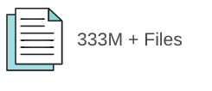
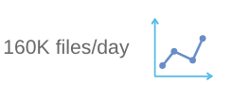
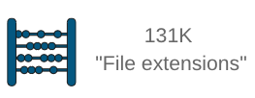
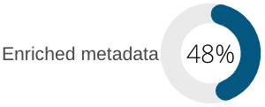
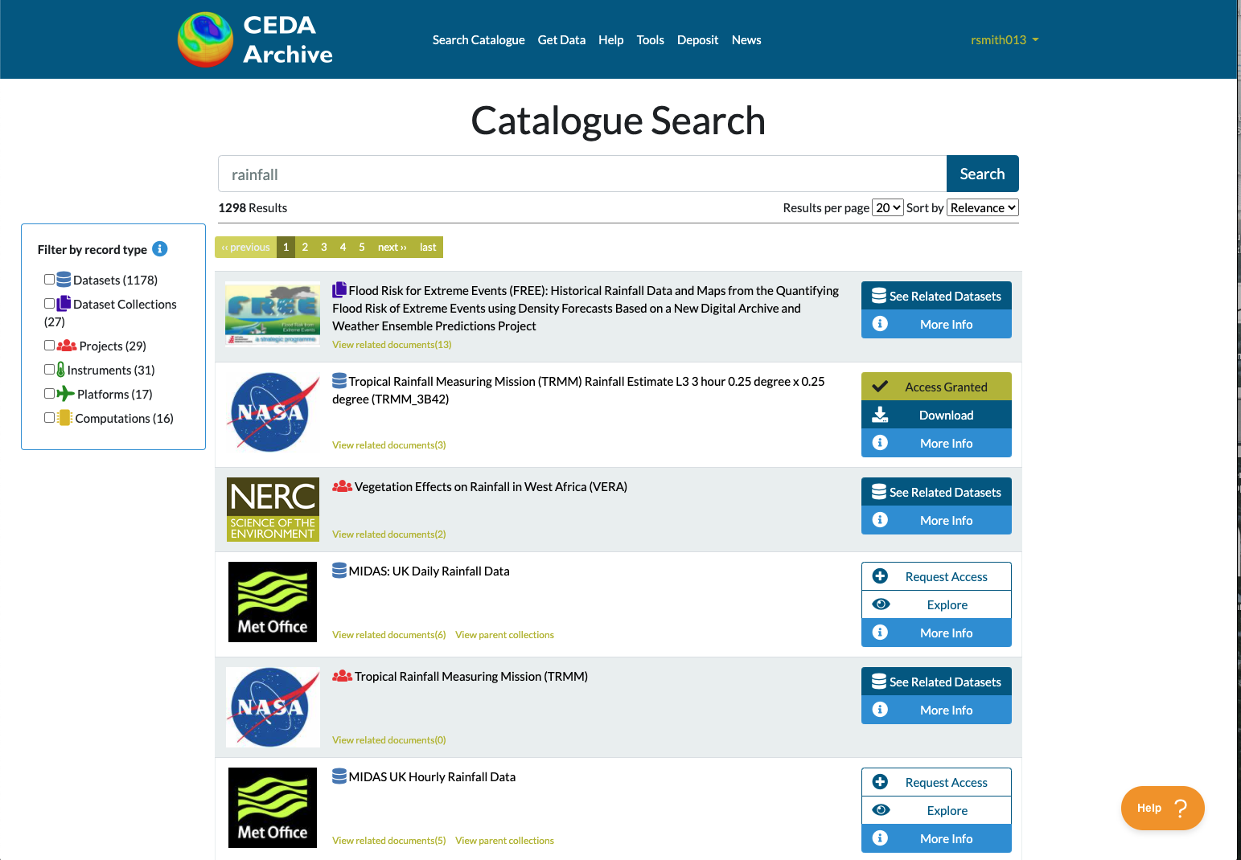
CEDA Search: Background
Notes:
One of the challenges is making our data discoverable. To give a few headline figures, which indicate the scale of the task.
The solution needs to be able to handle :
330 million files, growing at 160k/day
131k different file extensions. These are not all real extensions and some are an artefact of the file name e.g. .v20160812 but it just shows the level of heterogeneity in the archive.
We have 10 different file handlers to read netCDF and other datatypes and extract additional metadata e.g. bounding box, start/end time, variables contained. These can extract this information from around 48% of the CEDA archive.
The CEDA catalogue provides a top down approach to search, allowing hand written, curated content. We also wanted the ability to search the data files and compare similar data which you might not find from the catalogue

Slide 18
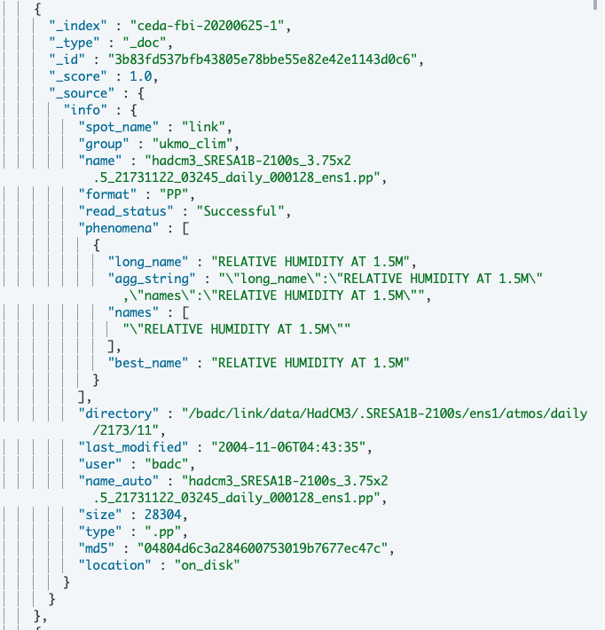
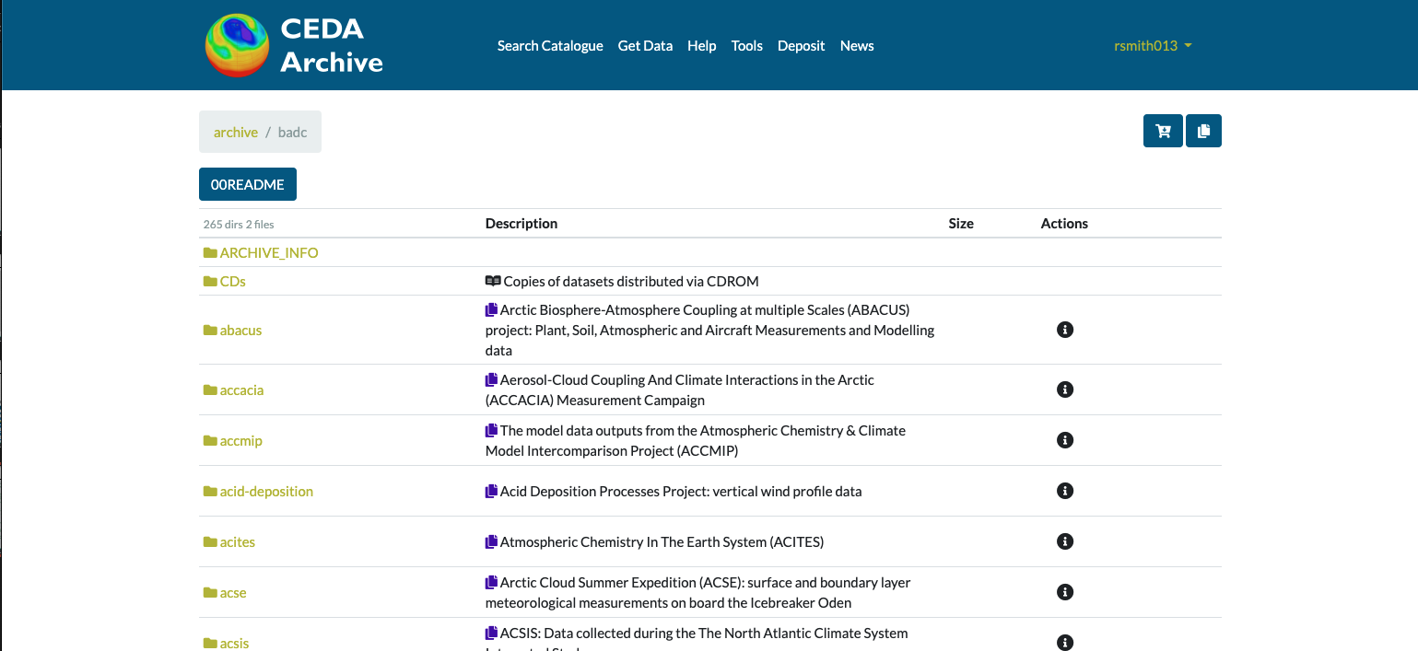
CEDA Search: Current
Elasticsearch holds a file based index
Notes:
We built an Elasticsearch index which holds file level metadata including information about where to find it in the CEDA archive, how large it is and (where possible) variable metadata.
This has allowed us to build tools such as data.ceda.ac.uk, which don’t rely on the file system and can be more responsive. It also allows us to improve internal processes. Information from this index feeds into the CEDA catalogue and we can more easily get statistics about the archive. ( the stats on the previous slide came from this index)

Slide 19
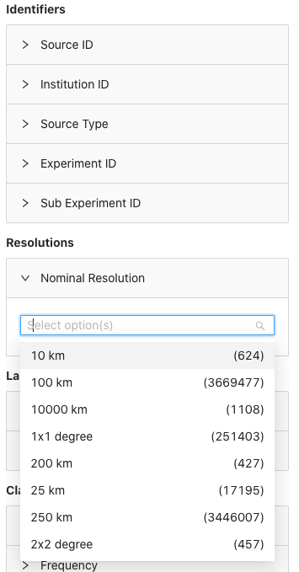
CEDA Search: The vision
What we want is faceted search:
Across multiple data types
Across multiple domains
With different and overlapping vocabularies
Beta ESGF Search
Notes:
But this doesn’t go far enough, we do not yet have a search solution which could allow users to find the data they want based in search parameters like:
- Space
Time
Domain specific key terms
And we want to do it in a difficult environment with the 130K different file extensions. Multiple domains with their own vocabularies, sometimes conflicting vocabs.
AND… We also want to be able to handle diverse storage media. Disk, Tape, Object Store

Slide 20
CEDA Search: Possible Solutions
OpenSearch:
P Faceted
P Free text search
P Established in EO community
O Relies on drill down
STAC:
P Faceted
P JSON API
P Item search
P Extensible
P Interest in EO community
O Not fully featured (yet)
Notes:
OpenSearch:
We are using OpenSearch as part of the CCI (Climate Change Initiative) Open Data Portal. It has a lot of what we are after, including features not included with STAC
STAC:
We like the look of STAC and it’s JSON API. In order for it scale to work for a heterogeneous archive, the core spec will need to be extended and there are some features on the roadmap which we would like to see:
facet discovery
free text search
collection search
Scaling both of these solutions require extensive connected systems and vocabulary mappings to take into account the different domains and research areas covered by the CEDA archive but would be a really nice way to interact and discover data and will allow different UIs to search data e.g. Map interfaces and faceted search.

Slide 21
Management and archiving of the relevant associated information (e.g. documentation, heritage SW, calibration data)
Other Data
Networks of calibration data
Description of calibration process in documentation, abstract or process information
Archived with main dataset
Cited data within CEDA or externally
Software and Documentation
MOLES records
Git hub
Zenodo (for software and grey material)
Institutional repository (CEDA Docs)
Trusted Repositories (e.g. University Repositories or Journals

Slide 22
Archive technology and media evolution and future trends
Hard Disk
Joint Data Migration Application (JDMA)
Hard Disk
s3netCDF
Object Store
Near-line archive (NLA)
Tape as Back up
For more information see Neil Massey blog:
https://www.jasmin.ac.uk/insights/workflows-across-heterogeneous-storage/
Tape

Slide 23
Future developments
JASMIN
Evolution to mix of storage types to make best use of capacity
Challenge: how to allocate resources fairly but remain flexible
GPU cluster for AI/ML workflows
Kubernetes cluster for scalable hosting of JASMIN/CEDA’s own services
CEDA
Integration with other NERC Environmental Data Centres
working with common tools on DataMad and Data management planning
Collaboration with the Digital Solutions programme

Slide 24
Thank you!
JASMIN: support@jasmin.ac.uk
CEDA: support@ceda.ac.uk
Twitter - @cedanews
Website - www.ceda.ac.uk
Notes:
The abstract pattern can be removed or repositioned if required. Be careful to ‘Send to Back’ so that it does not obscure any important information.

