Slide 1
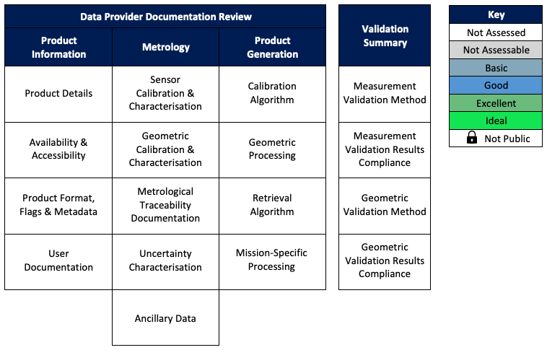
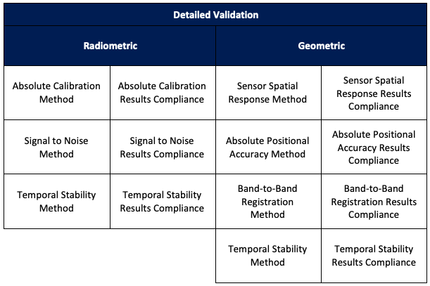
Cal/Val Maturity Matrix
Evolution since last reporting in WGISS. Easiest and More focus on CalVal aspects.
A coordinated, systematic framework for satellite mission quality assessment based on maturity matrix style reporting has been developed by ESA & NASA.
Comprehensive assessment includes review of mission quality as evidence by mission documentation and detailed independent validation.
Generic Assessment Framework implemented in detailed domain-specific guidelines. So far optical guideline drafted, work on SAR guideline recently initiated.
NASA & ESA are trialling this framework in their current and planned commercial satellite data assessment/procurement activity.
Such efforts have been on-going in recent years with commercial satellite vendors to understand and develop their quality information.

