Slide 1
CNES agency report
Richard Moreno – CNES
Data Terra RI Technical Director
Notes:
I will present the Geo Data Hub project
The aim of this project is to improve the use of CNES space data by users.
I will present how it fits in the French scientific ecosystem – eg through three French Research Infrastructures : Data Terra for Earth System data – PNDB for biodiversity and CLIMERI-France for climate modelling

Slide 2
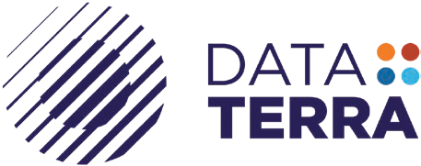
Gaia Data Project
Implement an integrated platform for distributed data and services
Initiative supported by the French Ministry of Innovation and Research
Above 3 Research Infrastructures :
Data Terra
organizes integrated access to observation data, products and services covering the various compartments of the Earth system (Ocean, Atmosphere, Land surface & Solid Earth) and their interactions
CLIMERI-France
The french climate modeling infrastructure, its mission is to produce international numerical simulations for the WRCP and to make their results available to various users in France and abroad.
PNDB
The french biodiversity data center, aims to federate existing data approaches within research infrastructures on "Living Earth".
Data Terra - Tutoriel réseaux sociaux © 2020
Notes:
GAIA Data project is supported by 3 …
It is about the same objective as Data Terra, but enlarged to 2 other French Research Infrastructure

Slide 3
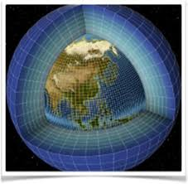
Explosion of data flows and diversity of the Earth system
Acquisition systems: space missions, in-situ sensors
Production systems (Cloud, HPC): overall simulations, improvement of resolutions, data re-analysis
Covers all the compartments of the Earth System
The development of new research is based on our ability to manage the entire data cycle:
Acquisition: continuous data processing, reduction and compression, primary data supply
Archiving and management of data and metadata: long-term archiving, preservation (metadata, provenance, distribution)
Dissemination via FAIR data services: multi-source virtual observatory services,
This new research includes:
Statistical data analysis: multi-source distributed data, Machine Learning
Ensemble simulations: multi-physical and multi-scale systems integrating multithematic forcing data
Inversion / assimilation: high-dimensional probabilistic inference methods based on very large learning sets.
Wide-area workflows (HPC/HDA) : Ability to deploy processing workflows in a multi-vendor infrastructure context by bringing processing closer to the data or by bringing together multiple sources of data on processing resources.
IAGO
Copernicus/Sentinel
Balloon
ARGO
Volcano observatories
Climate modeling
Data Terra - Tutoriel réseaux sociaux © 2020
Notes:
We face an explosion of data flows and a big diversity of data sources for the study of Earth System
These data come as much from space missions as from in-situ sensors, digital simulation or reanalyses combining modeling and observations.
They cover all the compartments of the Earth system.
The development of new research is based on our ability to manage the entire data cycle:
This new research includes statistical analysis of data, in particular through machine learning methods, multi-physical and multi-scale ensemble simulations integrating multi-thematic forcing data, inversion and assimilation methods. based on very large learning sets.
For the use of this data, it must be possible to deploy processing workflows in a multi-vendor infrastructure context by bringing the processing closer to the data or by bringing together the multiple sources of data on the processing resources.

Slide 4
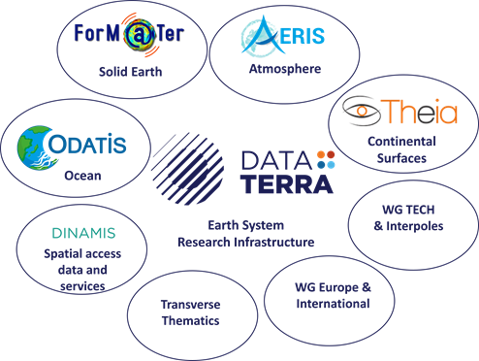
Data Terra Research Infrastructure
Structuration and Organisation in 2021
More than 20 years of continuous investments
    4 Data and Services Hubs
      AERIS - atmosphere
      Form@ter – solid Earth
      ODATIS - Ocean
      THEIA – Land surfaces
    Cross-cutting devices
      DINAMIS :Mutualised access to HR & VHR imagery
      Technical committee
      Science WG
      Europe & International WG
4
Notes:
Data Terra structuration and organisation is the following
It encompass 4 thematic data and services hubs
AERIS for the atmosphere
…
A 4 cross-cutting services

Slide 5
Data Terra in a few figures
26 organizations and universities (see bottom of the slide)
30 Data and Service Centers (CDS) and Spatial Data Infrastructures (SDI)
25 Consortium of Scientific Expertise
170 FTEs / 400 scientists, engineers and technicians
Over 500 products and services, over 15,000 users (scientists, data scientists, …)
50 000 TB (2018) ; 100 000 TB (2022/2023) ; 150 PB (2025)
More and more open to collaboration with industry & downstream
5
Notes:
Vérifier les chiffres

Slide 6
Gaia Data Services
Discovery, Access and Data Management Services
Catalog (metadata, vocabularies, ontologies), …
Transversal services => facilitate transdisciplinary work
Data grid, cloud, datacube, knowledge portal, IAM, user support & training
Services –Earth Analytics Lab
PANGEO / STAC / Intake ecosystem based on AI4GEO
On-demand data analysis services & Virtual Research Environnement
Interactive interface - Execution by users (Galaxy, WPS, VIP (France-Grilles )
VRE: definition and execution of domain-specific processing workflows
Regular production services
Optimization of data processing and formats (Zarr, CoG, Dask distributed computing, …)
Supported on a continuum of shared infrastructures
=> Data Scientist
Non-computer scientists
Data Terra - Tutoriel réseaux sociaux © 2020
Notes:
The services offered by the Gaia Data infrastructure include:

Slide 7
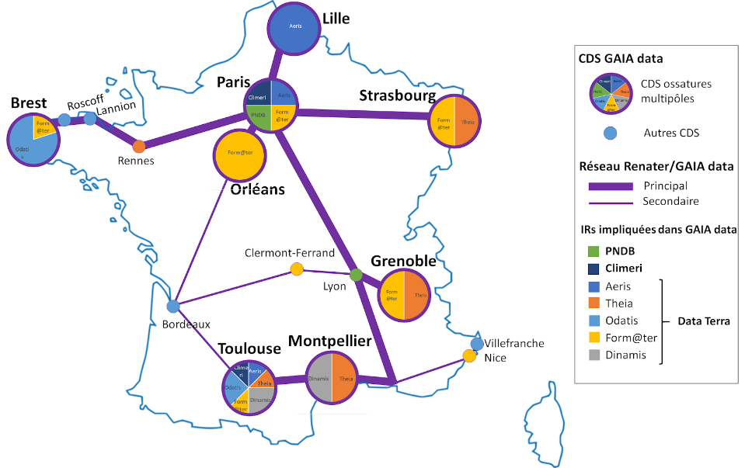

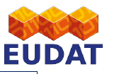

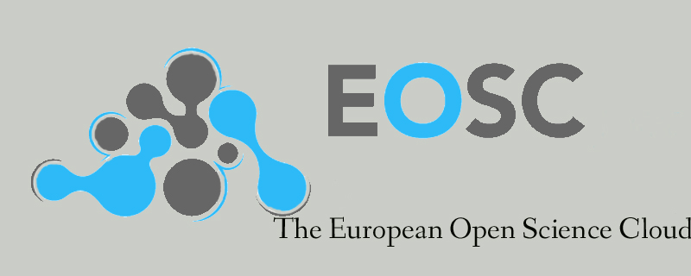
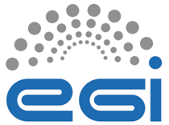

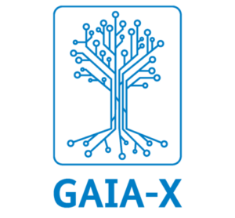
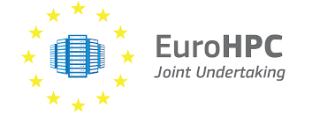

Gaia Data Infrastructure
Data and service grid by networking the 8 main centers
Establishment of a dedicated high-speed and secure network between the 8 main centers
Deployment of a data grid (iRODS system) across the 8 centers to enable remote data access and rapid and automatic transfer of large data sets from one center to another.
Interoperability of processing (Among the 8 centers, with HPC (GENCI/PRACE, COPERNICUS/DIAS, Public clouds (GAIA-X), …)
Interoperability (data services) with international organisations & initiatives (CEOS/WGISS, OGC, GEO, EOSC, DestinE, EuroHPC (exascale), …)
Connected to international initiatives
Destination Earth
Data Terra - Tutoriel réseaux sociaux © 2020
Notes:
The Gaia Data project infrastructure relies on the expertise of 30 data centers and services, 8 of which constitute Tier2 data and processing nodes. These 30 centers bring together nearly 400 scientists, data experts and thematicists and offer more than 500 products and services for more than 15,000 users.
One of the first objectives of the Gaia Data project is to build a data and services grid by networking the 8 main centers.
This grid will be based on the deployment of an iRods system across the 8 centers to enable remote data access and the rapid and automatic transfer of large data sets from one center to another.
To ensure interoperability of processing between Gaia Data centers, an EGI-type cloud management framework solution will also be deployed.
The processing workflows must also be able to use external means, such as Genci, EGI, DIAS or public clouds to meet high SLA needs or for “external” uses such as commercial applications.

