Slide 1
Archive Holdings and Technology Session
ESA Infrastructure and Experience
Daniele Iozzino
22/04/2021

Slide 2
Outline
Current archiving technology and infrastructure;
Archive volume detailed per mission;
Archiving operations concept, flows and processes;
Data format/packaging for long term archive;
Management and archiving of the relevant associated information;
Archive technology and media evolution and future trends;
Challenges and Needs;
AoB.

Slide 3
EO Data Preservation System
The main components of the Earth Observation (EO) Data Preservation System involved in the preservation process are the Management System for Data and Associated Knowledge (KMS), Data Information System (DIS), Master Archive (DAS), Cold Back-up Archive (CBA).

Slide 4
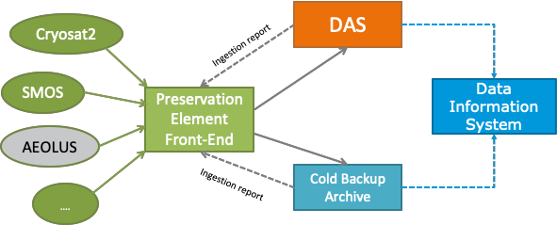
Preservation Element Front End
ESA and Third-Party active mission data are circulated by the Preservation Element Front-End (PE- FE). Once the data has been ingested and validated, confirmation reports are sent to the Mission Payload Data Ground Segment via standard network transfer protocol. Bulk dissemination of data coming from reprocessing campaigns is circulated on storage devices.
metadata
metadata

Slide 5
What products are preserved
«Archiving Policy for ESA Earth Explorers, Heritage Missions and Third Party Missions Earth Observation Space Data» gives preservation best practices for the following data:
Payload Instruments Data (Raw Data) for missions
Payload Instruments Data (Level-0), Spacecraft telemetry data, auxiliary and ancillary data
for missions in Phase E (Operations)/F1(Post-Operations)/F2(Heritage)
Higher-level data (e.g. Level-1/Level-2 bulk reprocessed datasets or reprocessing campaigns)
in Phase E (Operations)/F1 (Post-Operations)/F2 (Heritage)
LIVE missions
Preservation Front-end
Reprocessing Campaigns
Higher-level
Dissemination Facilities
Space Data Preservation Archive
Payload Instrument Data
Higher-level

Slide 6
Master Archive
The ESA Master Archive is implemented through a dedicated service (DAS) awarded to industry through an open ITT in 2016. ESA has outsourced EO data archiving activities to a single provider with the goal to benefit from economy of scales and standardization of data archival & delivery processes and interfaces.
These archiving activities shall cover:
Historic ESA flagship mission data (ERS-1/2, Envisat)
Future, active and historic ESA Earth Explorer mission data
Future, active and historic ESA Third Party Mission data
Campaign data acquired in the context of ESA EO airborn campaigns
Input and Output data of services managing EO data (e.g. DSI)

Slide 7
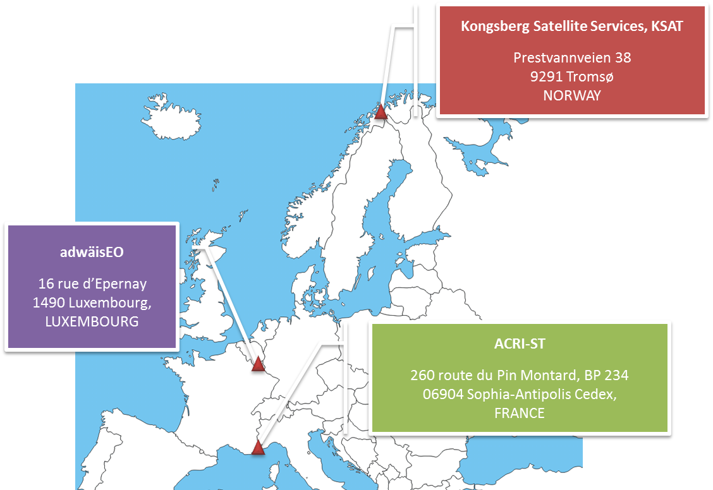
DAS Consortium
The industrial consortium is made of ACRI-ST (FR), adwäisEO (LU) and KSAT (NO), with the following distribution of roles:
In order to guarantee the data safety, the archive is distributed between two locations sited > 200km apart; a master archive in Luxembourg and an archive back up in Sophia Antipolis (France).
ACRI-ST: Data Archiving (and delivery) Service provider – Prime contractor
adwäisEO: data archiving (and delivery) operation provider with its leading edge IT and connected secured infrastructure in Luxembourg
KSAT: data knowledge provider and overall ingestion validation

Slide 8
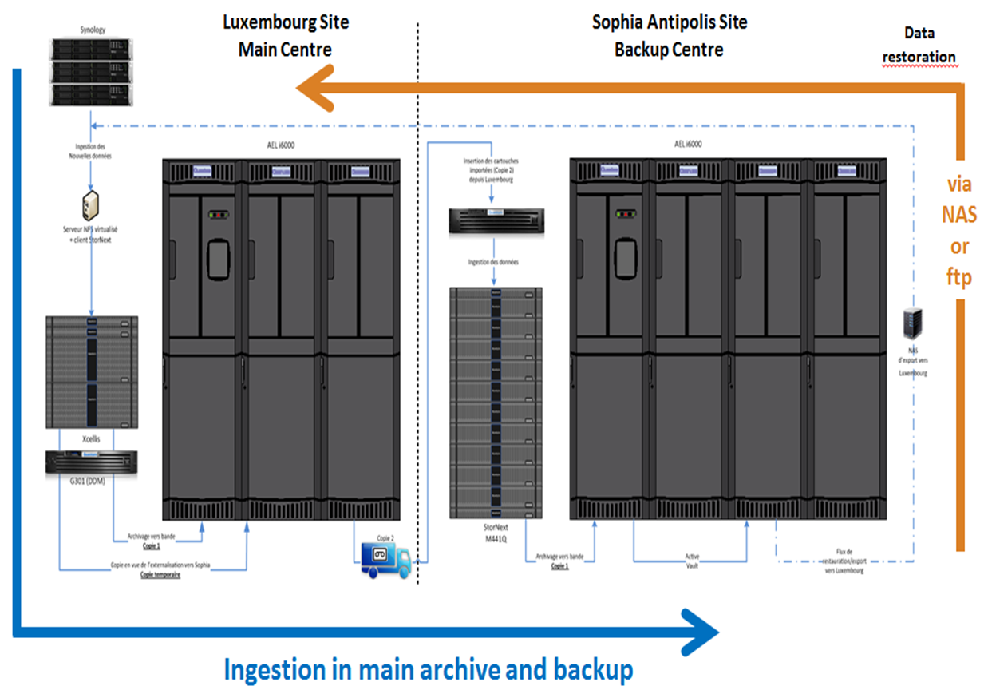
DAS Infrastructure

Slide 9
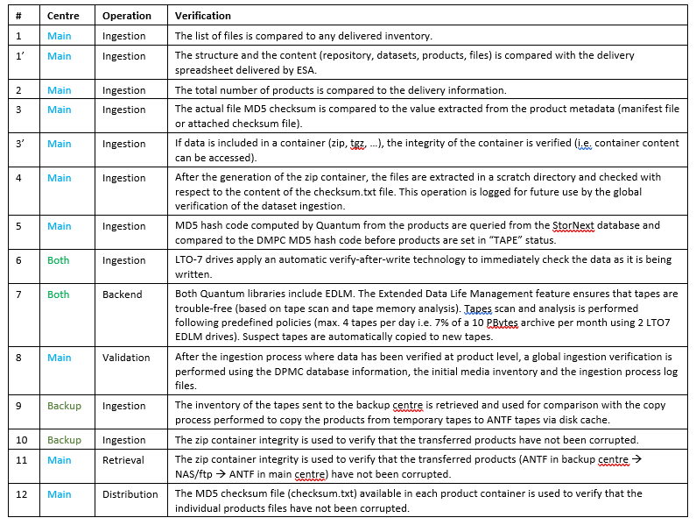
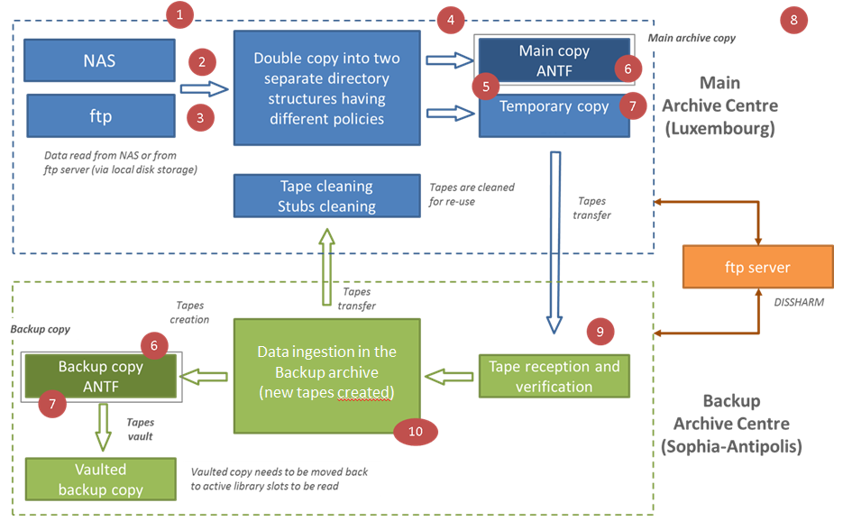
DAS Data Workflow

Slide 10
DAS Data Verification
One of the most important activities performed by the Master Archive service is the data quality check, which is performed not in terms of scientific content but in terms of reliability of the process during data transfer. This verification includes the points summarized in the following questions:
are all input data archived?
are we sure that the archived data has not been corrupted during the transcription?
are we compliant with the requirements related to the minimum distance between the two archive copies?
are we sure that the stored data is still retrievable and usable?
are we sure that the retrieved data has not been corrupted?

Slide 11
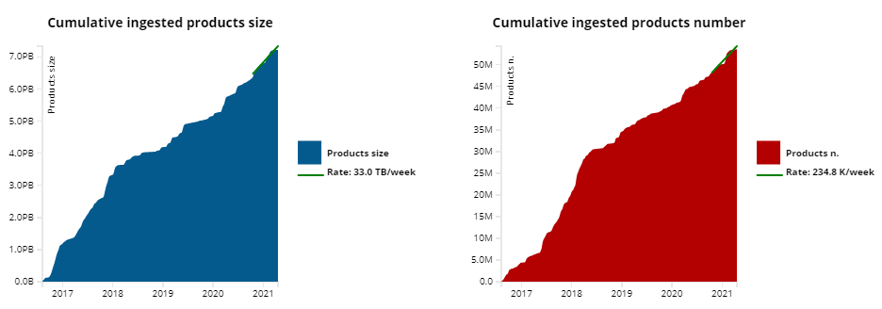
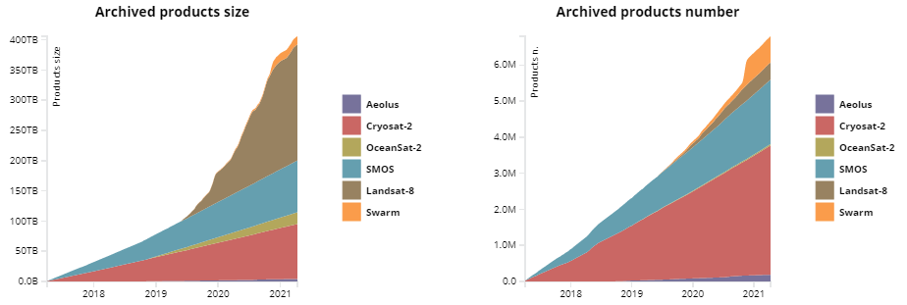
DAS Archive Content - Ingestion
Ingestion – Historical data
52 Millions of products
6.3 PB as volume
856 datasets
Live Missions
(via PEFE)
0.7 Millions of products
0.4 PB as volume
6 Missions
ESA UNCLASSIFIED – For Internal Use

Slide 12
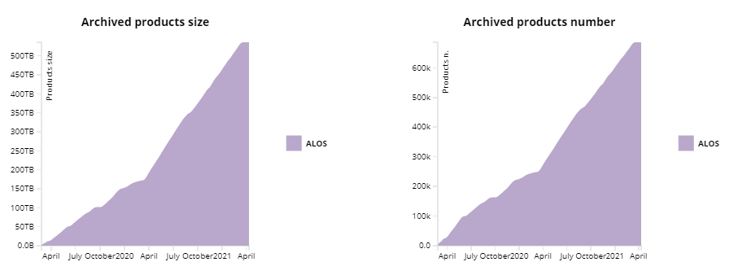
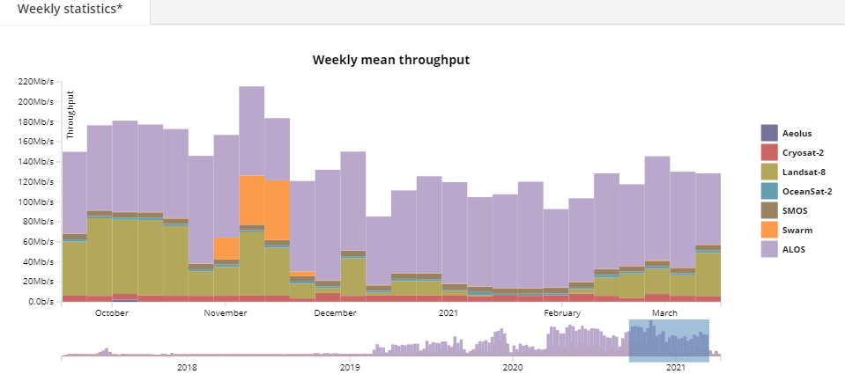
DAS Archive Content – Live missions
Online Missions (via PEFE)
0.7 M products
0.5 PB as volume
3 productTypes
Avg weekly throughput
from PEFE for Live & Online missions
ESA UNCLASSIFIED – For Internal Use

Slide 13
Cold Back-up Archive
The Cold Back-up archive has been implemented in 2014 on ESA premises. It servers as the second copy of the ESA EO Master Archive for both historical and Live mission data.
The Archive serves as the front-end Archive for Inter-Directorates Activities.
Live data is received trough the Preservation Element Front End, but the Archive is capable of interfacing directly with missions PDGS for missions outside the PEFE scope.
The archive keeps an historical copy of any dataset, even if declared obsolete. Duplication of dataset are managed with metadata. Moreover, the archive keeps a copy of ESA EO Payload Instruments Data (Raw Data).
Two copies of the data are held at ESA premises in Frascati with the Main Tape Library capable of storing 36 Petabytes of online data.

Slide 14
Cold Back-up Archive Overview
Archive based on Tape Libraries
16gb/s fibre connection
ORACLE HSM driven
Disaster Recovery on different building
Master Library :
ORACLE SL8500
3000 licensed slot
T10000D and LTO-8 drives
6 robotic arms
SSD cache
Disaster Recovery Library:
Spectralogic T950V
500 slots
LTO-7 drives
SSD cache
36 PB of Online Capacity
Data Volume (April 2021) 12 Petabyte | Number of Files (April 2021) 160,000,000

Slide 15
Cold Back-up Archive Overview (2)
Both Libraries used to rely on T10000 drives. When the end of life of the T10000 family was declared, a migration towards LTO-8 has been performed due to price and availability
SSD cache for incoming data, a mirror of two SSD disks is dedicated to the file-system metadata to boost performances
A specific tool is used to monitor the quality of the tapes, in case of I/O errors, alarm triggers specific procedures to migrate all the data of the tape. An average of 7 tapes per year are migrated due to I/O errors

Slide 16
Cold Back-up Archive Content
Mission | Uncons. | Cons. | Native | EO-SIP | LIVE
ERS-1/2 | X | X | X | X
Envisat | X | X | X | X
Cryosat-2 | X | X | X | X | X
SMOS | X | X | X |  | X
SWARM | X |  | X |  | X
AEOLUS |  |  |  | X | X
Goce | X | X | X | X
Oceansat | X |  | X | X | X
Adeos | X |  | X
ALOS | X | X | X | X | X
GOSAT | X |  | X |  | X
Ikonos-2 | X |  | X | X
IRS-P3 | X | X | X | X
JERS-1 | X | X | X | X
Kompsat-1 | X |  | X
Landsat-1,8 | X | X | X | X | X
MOS-1,1b | X | X | X
Nimbus | X |  | X
NOAA-7,19 | X | X | X | X
ODIN | X |  | X |  | X
PROBA-1 | X |  | X |  | X
QuickSCAT | X |  | X
Rapideye | X |  | X
Scisat | X |  | X |  | X
Seasat | X | X | X | X
SeaStar | X |  | X
SPOT1-2 | X | X | X | X
TerraSAR | X |  | X
WorldView-1,3 | X |  | X | X
Windsat | X |  | X
Inter-directorates disaster recovery archive
Second copy of the ESA EO Master Archive
Unique RAW data and Unconsolidated data
Live mission support
Consolidated Packages and Native Format archiver
Data validation
Direct Connection to Missions Ground Segment
Average data ingested /day: 13TB
Peak data read/day: 20TB
Type | Mission | GB
Astronomy archives | ISO | 165
Astronomy archives | EXOSAT | 80.2
Planetary archives | GIOTTO | 0.5
Planetary archives | CASSINI-H | 7.8
Planetary archives | EARTH | 73.6
Planetary archives | HST | 0.15
Planetary archives | SMART-1 | 319
Planetary archives | VEX | 178
Heliopyhics archives | ULYSSES | 208

Slide 17
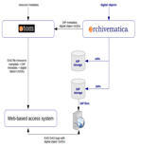
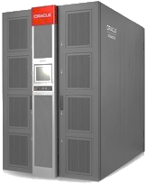
Archiving operations concept, flows and processes
Space Data Technical Information Preservation Archive
Preserved Data Set Content
Space Data Preservation Archive
Metadata
Metadata
Space Data Technical Information
Metadata
Metadata (at collection level)
Space Data
Space Data Associated Information
Space Data Software and Tools
Preservation
Platform
EO Space Data Information System (DIS)
Space Data Collections
Technical Documents
Scientific Publications
DAS
SDPA OADS DSI
Live Missions
Reprocessing Campaign
Inter-Directorates Data

Slide 18
Data format/packaging for long term archive
Data is ideally consolidated and preserved in the form of EO-SIP packages
Metadata is extracted with specific software to validate the package and
metadata contained
Bulk Ingestion from local or remote locations
Automated Ingestion from inbox baskets
EO-SIP and SAFE Validation
Metadata extraction
Reporting
Ingestion Confirmation Reports
Data Information System population
Advanced queries with any of the metadata field

Slide 19
Management and archiving of the relevant associated information
Data Curator
MERCURY Circulator
Workflows + Additional Metadata
EOP & Internal Repository
Papers and Technical Documents Backlog
ATOM
Data Librarian
Ingest Docs + Metadata SIP
AIP
Physical DIP
Repository
New Technical Documents
New Scientific Publications
Pre-Ingest
Archivematica
Other Repositories
EAD 2002 XML
No Physical DIP
Repository

Slide 20
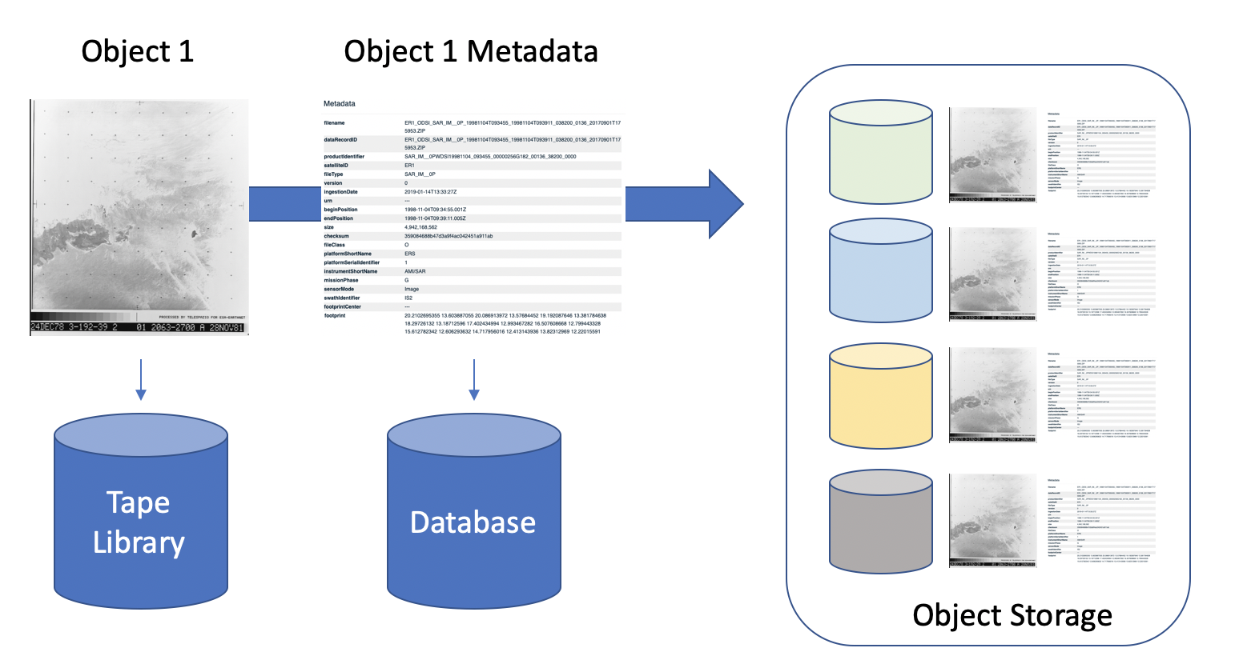
Archive technology and media evolution and future trends
Object Storage is being studied as a possible replacement for the disaster recovery Library
Data is already unstructured and metadata driven
Limitations of OS are similar to those of the Robotic Libraries
ORACLE HSM end of life is being assessed
Two solutions identified, Q-STAR and Versity
Versity can import HSM inodes, no need to read tapes but licensing models are expensive
Q-STAR needs to import data by reading it from tapes but off-line tapes are not taken into account for its licensing

Slide 21
Challenges and Needs
Recovery of faulty tapes takes time. When a tape has I/O error, it has to be read from sequentially to re-archive all data contained
Tape prices are not predictable. T10K tapes prices doubled when ORACLE declared the end of life of the tape family. LTO-8 tape shortage in mid 2019 due to patent infringement battle meant LTO-8 tapes where unavailable for a long time
With the end of life of Storagetek T10K tape family and ORACLE HSM archive manager, it is feared that the main vendors are moving away from tape archive solutions. At the moment the only Enterprise solution is limited to IBM

