Slide 1
CEOS Webinar Toolkit
Dr. Kenton Ross, NASA (WGCapD)

Slide 2
Background & Purpose
WGCapD Recommendation @ 2020 CEOS Plenary:
CEOS should create a “Webinar Toolkit” that includes guidelines and good practice for creating and branding CEOS webinars. The toolkit would include how-to guidance, templates, and branding design assets. WGCapD also proposed a framework for CEOS working teams to gain WGCapD support during the webinar creation process and amplification of promotional efforts.
Objectives:
Increase awareness of CEOS, its activities, and resources available
Harness the work done by SIT Chair on branding the CEOS thematic observation strategies (TOS)
Increase recognition of CEOS-sponsored activities and resources through standardization/branding
Bring WGCapD lessons learned on webinar good practices to CEOS working teams
Benefits:
Easy to follow webinar creation process
Curated archive of useful documentation & resources
Strengthened & more effective CEOS webinars
Increased recognition of CEOS contributions
Enhanced community awareness, access, and ability to use satellite data and supporting technologies
Increased number of people benefiting from the CEOS working team efforts

Slide 3




Toolkit Structure
Primary Resource:
Webinar Creation Guide
Templates:
Storyboard Template
Trainee Spreadsheet
Post-Training Questionnaire Template
Report Template
Supporting Guidance:
Design Elements:
Promotional Flyer Template (PPT)
Draft Thematic Observation Icons
Presentation Templates (to be completed after icons)
Logo & Icon Bank
Needs Assessment Guide
Learning Objectives Guide
Promotion Guide
Tech Guide
(orange = in progress)
Notes:
The webinar toolkit is organized such that the Webinar Creation Guide is the primary support document that outlines three phases (pre, during, and post) of webinar creation, along with the steps and best practices within each phase. It also addresses the topics of branding, evaluation, tips for success, and useful resources. There are four additional guides that go into specifics about 1. Conducting a needs assessment, 2. Drafting effective learning objectives, 3. How-to for webinar promotions, and 4. A technology guide with resources and recommendations. The toolkit also has multiple templates available: for creating a storyboard, a spreadsheet for collecting trainee information, post-training assessment for trainees, and a training report template. There are also design elements including a promotional flyer, icons and logos, and presentation templates. The items in orange are still in progress gaining appropriate approvals from within CEOS but will be shared soon.

Slide 4
Toolkit Guides
Webinar Creation Guide
Serves as a starting point for those creating a webinar
Provides guidance on:
  Full process and phases of webinar development
  General good practices for each step
  Insights into branding and webinar evaluation
  Tips for effective webinars
  Resource list
Many of the good practices and tips come from the WGCapD Training Best Practices document
Needs Assessment Guide
Discusses general steps for conducting a needs assessment, the different approaches available, general considerations, and resources
Learning Objectives Guide
Provides an overview of the importance of good learning objectives, how to write them effectively, and considerations and resources available
Webinar Promotion Guide
Identifies suggested promotional activities and steps, characteristics of good promotional emails, general tips and considerations, and resources
Tech Guide
Provides recommendations for platform options, audio & visual, lightning, low bandwidth considerations, etc.

Slide 5
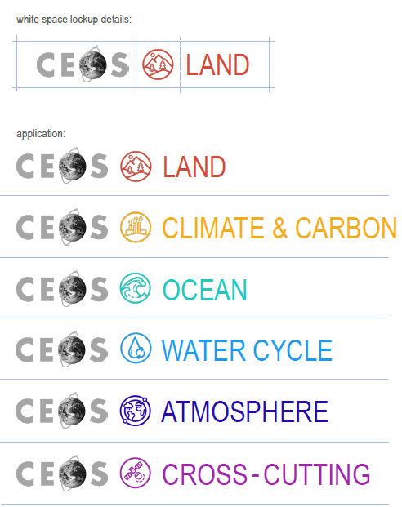


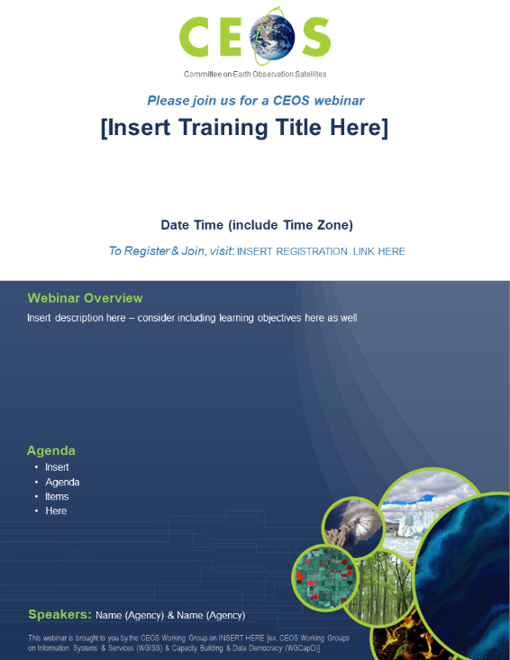
Templates & Design Assets
Currently Available
Storyboard Template
Trainee Spreadsheet
Post-Training Questionnaire Template
Report Template
Draft Thematic Observation Icons
Draft Promotional Flyer Template
Coming Soon
Presentation Templates
Logo & Icon Bank
Tech Guide
Notes:
As mentioned earlier, there are a suite of design assets available to support webinar creation. Icons are being reviewed by the CEOS Secretariat. Following their approval, a set of presentation templates, a bank of icons and logos, and the technology guide will be shared (likely shared publicly in the June timeframe but passed to the WGISS Jupyter Notebooks Webinar team ahead of that).

Slide 6
WGCapD Review Support
Conduct Needs Assessment
Identify Target Audience & Trainers
Define Webinar Learning Objectives
Develop Webinar Materials
Promote Webinar to Potential Attendees
Pre-Webinar: 60-90 days before
Share Rubric
Trouble-shoot Technical Difficulties
Publicize Ongoing Event
Offer Interactive Participation for Attendees
Use Exercises to Convey Material Presented
Webinar Good Practice
During Webinar:
WGCapD can review
Conduct Post-Training Survey
Prepare Lessons Learned Document
Complete a Training Report
Post Report on CEOS Website
Include Participants in CEOS Training Distribution List
WGCapD actions
Post-Webinar: 5-45 days after
Notes:
Here you can see the different phases of webinar creation. In yellow you can see the steps where WGCapD can help review your activities, and in green are the actions WGCapD can provide in support of the webinar. While requesting WGCapD’s support is optional, the group is happy to help and is working out its internal processes for supporting review. The Jupyter Notebooks Webinar is currently moving through the pre-webinar steps and WGCapD is happy to review learning objectives and review webinar materials as they are developed. WGCapD is also happy to help send email blasts to potential attendees to raise awareness.

