Slide 1
Technical readiness for CARD4L (CEOS Analysis-Ready Data for Land) WGISS#51 – 21 April 2021
P. Goryl, C. Albinet, S. Pinori, G. Brizzi

Slide 2
Analysis Ready Data – Summary
ARD represents a growing trend but definition varies greatly across user groups and data providers.
The CEOS Land Surface Imaging Virtual Constellation (LSI-VC) was tasked in 2015 to “Define intercomparable ARD products within the context of land surface imaging” → CARD4L
CEOS ARD focuses on interoperability, common data formats, inter-calibration, validation and inter-comparison strategies
CARD4L are base for CEOS Data Cube (CDC) architecture:
time-series multi-dimensional stack of spatially aligned pixels
improves computation time vs typical scene-based approaches
ARD is associated with fitness for purpose → ARD for what ?
ARD evolution ARD beyond Land – Atmospheric subgroup, Aquatic, Nightlight Radiance, Lidar Terrain and Canopy Height, SAR Geocoded Single-Look Complex (SLC), Interferometric Radar
CARD4L at ESA:
CARD4L-SR
CARD4L-ST
CARD4L-NRB
Sentinel-2 compliant (with recent GRI)
Proba-V – in progress
MERIS – in progress
Sentinel-3/OLCI/SYN
(A)ATSR almost compliant
Sentinel-3/SLSTR
cloud shadow is missing.
In progress
Normalised Radar Backscatter (ortho-rectification)
Sentinel-1/(A)SAR – work in progress using new Copernicus DEM

Slide 3
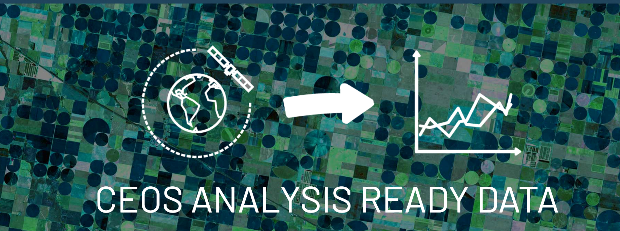
Analysis Ready Data
ARD represents a growing trend but definition varies greatly across user groups and data providers.
The CEOS Land Surface Imaging Virtual Constellation (LSI-VC) was tasked in 2015 to “Define intercomparable ARD products within the context of land surface imaging”
CEOS ARD focuses on interoperability, common data formats, inter-calibration, validation and inter-comparison strategies
http://ceos.org/ard/

Slide 4
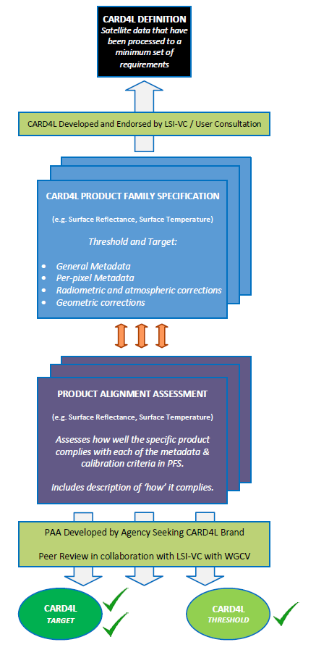
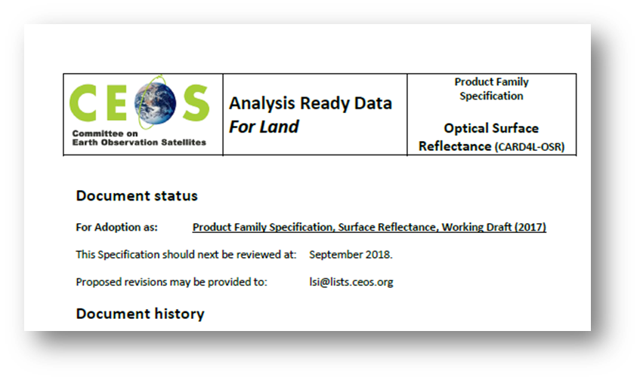
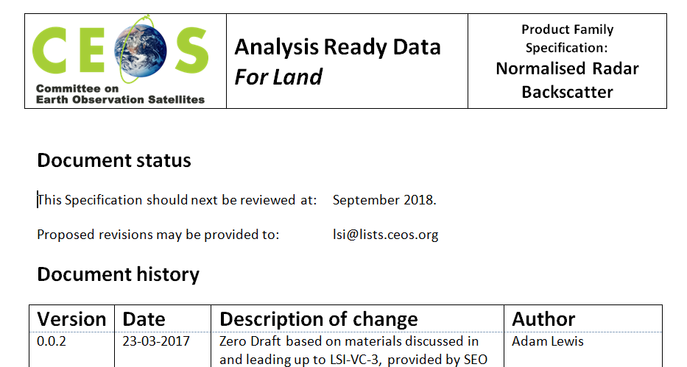
CARD Strategy
Definition
Satellite data processed to a minimum set of requirements and organized into a form that allows immediate analysis with a minimum of additional user effort and interoperability both through time and with other datasets.
Product Family
Specifications (PFS)
Threshold and Target requirements
Product Alignment Assessment

Slide 5
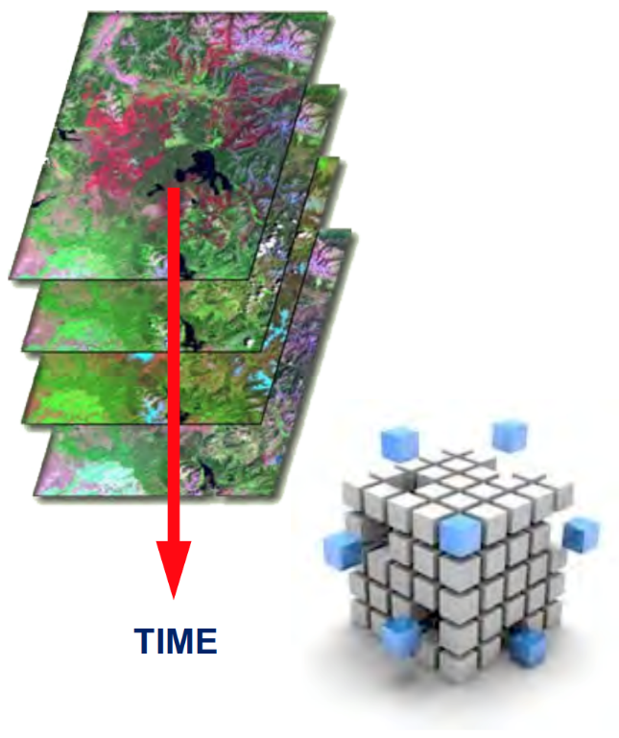
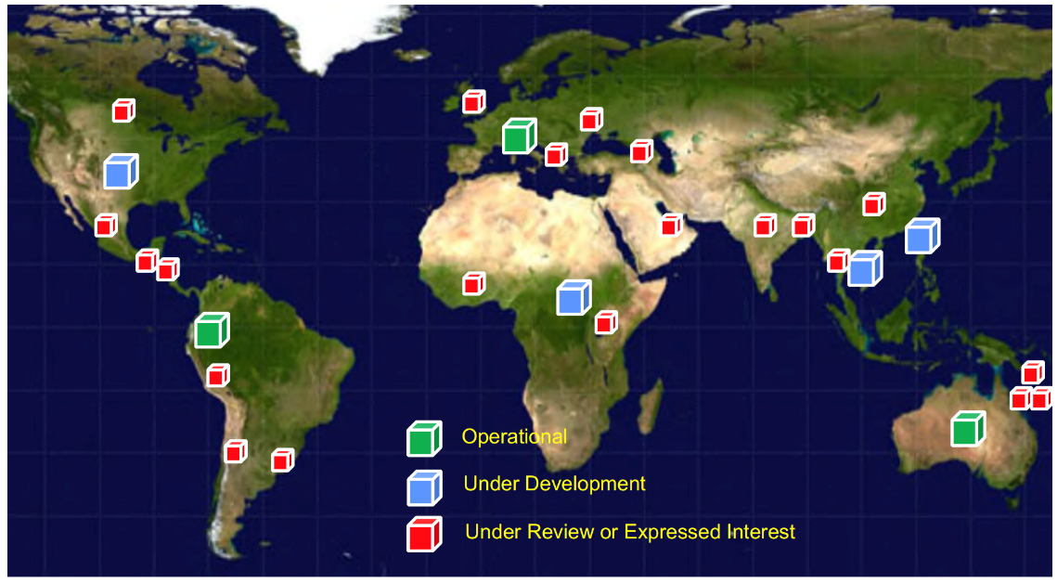
Why CARD ?
Benefits for different stakeholders
Ease access to data
Reduce processing burden
Save Time and Effort
Minimize Costs
Increase Uptake
Increase Impact
Increase Relevance
Increase Efficiency
Enable Interoperability
Value-add appeal to customers
Improve efficiency and effectiveness in data use
CARD are base for CEOS Data Cube (CDC) architecture:
time-series multi-dimensional stack of spatially aligned pixels
improves computation time vs typical scene-based approaches
Objective of 20 National-scale Data Cubes by 2022

Slide 6
CARD4L – Product Families
Projects for specific geo parameters
CARD4L-OSR
CARD4L-ST
CARD4L-NRB
Data collected with multispectral sensors operating in the VIS/NIR/SWIR wavelengths with ground sample resolution 10-100m.
Data collected with multispectral sensors operating in the thermal infra-red (TIR) wavelengths with ground sample resolution 10-100m.
Data collected by Synthetic Aperture Radar (SAR) sensors.

Slide 7
CARD4L - ESA contributions
CARD4L-SR
CARD4L-ST
CARD4L-NRB
Sentinel-2
Sentinel-3/OLCI/SYN
Proba-V
MERIS
Sentinel-3/SLSTR
(A)ATSR
Sentinel-1
(A)SAR

Slide 8
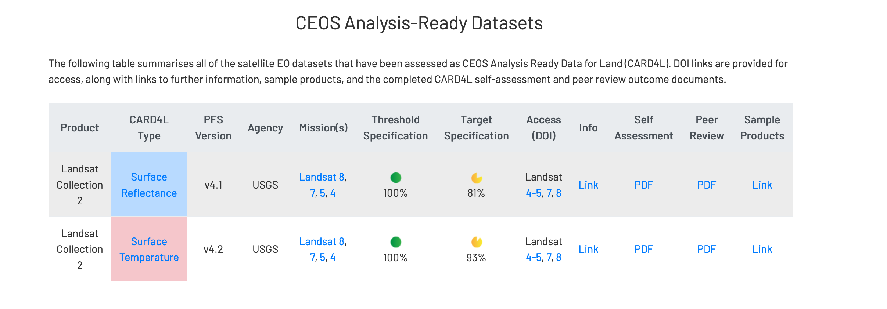
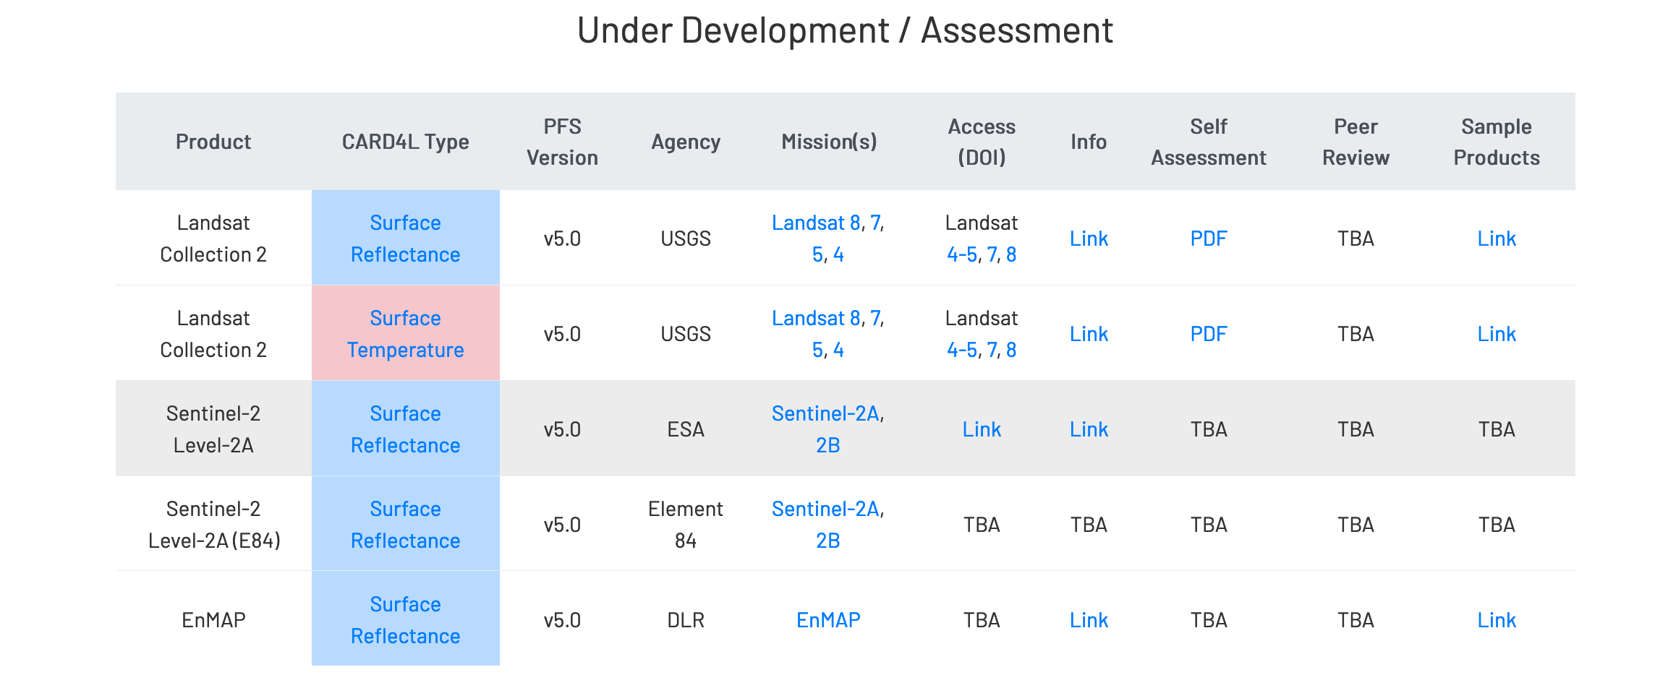

Slide 9
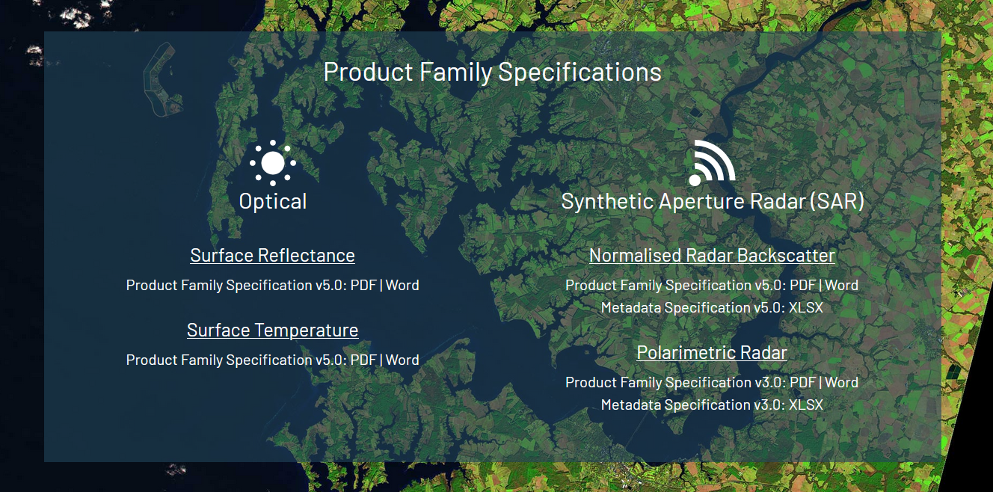
CARD4L Family Specifications

Slide 10
CARD4L Optical - Surface Reflectance
Requirements:
Main technical specification = surface reflectance, ortho-rectified, cloud masking (including cloud shadow)
Current CARD4L specification 5.0 (08.06.2020)
ESA/GMQ is analysing the best approach between two algorithms:
CAWA-2 (Clouds, Aerosol and WAter vapour products) advanced algorithm “Joint cloud/aerosol retrieval” (project ongoing)
ICOR (developed for S3-OLCI instrument)
CAWA-2 vs. ICOR
Integration + testing
Reprocessing
Draft plan
Adaptation to CARD4L + testing
April 2021
June 2021 March 2022
April 2022
Q3 2022

Slide 11
CARD4L Optical – Land Surface Temperature
Requirements:
Main technical specification = Land Surface Temperature, ortho-rectified, cloud masking (including cloud shadow)
Current CARD4L specification 5.0 (08.06.2020)
ESA/GMQ is evaluating the improvement of this product considering as well the LST-CCI interest
Development of Cloud masking shadow in EO/GMQ
Adaptation of algorithm to LST CCI (in ESA/ESRIN only L1B data are generated, (A)ATSR CARD4L “effort” in CCI)
Cloud shadow
Adaptation CCI
Integration + testing
Reprocessing
Draft plan
February 2022
May 2022
Oct 2022
Q4 2022

Slide 12
CARD4L SAR – Normalized Radar Backscatter
Requirements:
Main technical specification = Normalised Radar Backscatter (ortho-rectification)
Current CARD4L specification 5.0 (12.05.2020)
ESA/GMQ is working to implement some ERS/Envisat processor changes to produce CARD4L compliance products
Activity on going for Sentinel-1 including new DEM (Copernicus) → specification
Pre-requisite modification of SAR ERS/ENVISAT processor
Coordination between SAR ERS/ENVISAT and SAR S-1-Working Group
Development of ERS/ENVISAT CARD4L software based on S-1 specification (starting from SAR ERS/ENVISAT processor)
S1 Specification
Integration + testing
SAR ERS processor
Development and testing
Draft plan
Q1 2021
Q2 2021
Q3 2021
Q1 2022

Slide 13
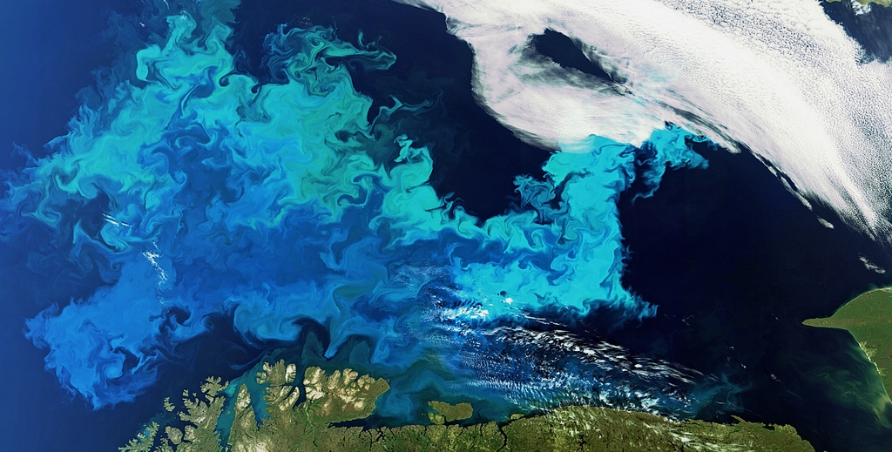
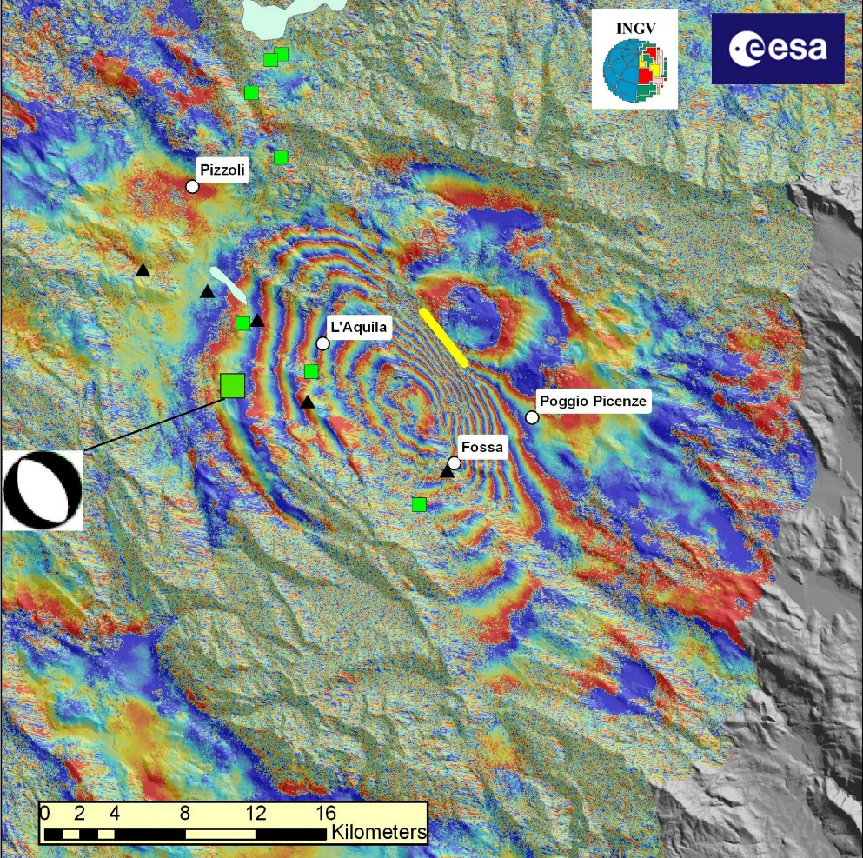
Future CARD4L specifications
OPTICAL PRODUCT FAMILY
Aquatic Reflectance (inland bodies and coastal)
To be completed by mid-2021
Nightlight Radiance
Lidar Terrain and Canopy Height
SAR PRODUCT FAMILY
Geocoded Single-Look Complex (SLC)
To be completed by mid-2021
Interferometric Radar
To be completed by end 2021
Ocean color image in the Barents Sea, captured by the MERIS imager onboard Envisat (https://meom-group.github.io/unravel/)
L'Aquila earthquake: Envisat interferogram
https://www.esa.int/ESA_Multimedia/Images/2009/04/L_Aquila_earthquake_Envisat_interferogram

