Slide 1
Jupyter Notebooks Developing a Best Practice
WGISS - 51 Virtual Meeting
Wednesday 20th April 2021
Esther Conway (NCEO/CEDA), Ag Stephens (NCEO/UKSA), Richard Smith (NCEO/UKSA), Kenton Ross (NASA), Lauren Childs-Gleason (NASA), Yousuke Ikehata (JAXA), Makoto Natsuisaka (JAXA), Matt Paget (CSIRO), Brian Killough (SEO), Rizvi Syed (SEO), Damiano Guerruci (ESA) and Giuseppe Troina (ESA)

Slide 2
Key Points and Progress!
Topic list and discussion points for have been drawn up in the presentation
Some topics are more mature, others will require more discussion – How can we facilitate this?
A pragmatic approach is needed – consider publishing core topics first then extending – We don’t need to do everything at once
Need to link the development to support of webinars and existing CEOS work

Slide 3
32
Pixalytics Ltd | Satellite Applications Catapult | US Naval Research Laboratory
UK Hydrographic Office | CEDA - NCEO | NASA/JPL/PODAAC
JAXA | German Aerospace Center | NASA/JPL
Telespazio VEGA UK | CNES | NASA
NCEO University of Sheffield | Farallon Institute | NASA
Jet Propulsion Laboratory | RSAC c/o European Space Agency | Assimila
Comisión Nacional de Actividades Espaciales (Argentine Space Agency) | ORNL DAAC | NASA
NASA/ASDC | National Snow and Ice Data Center | NASA/Ocean Biology Distributed Active Archive Center (OB.DAAC)
CSIRO | Friedrich-Schiller University Jena | Gabonese Agency for Studies and Space Observations (AGEOS)
Total Responses as of Friday, 16th April , 2021
Survey Still Open !

Slide 4
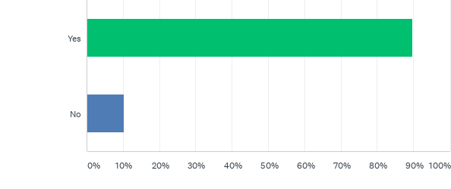
Q4: Do you or the institutions you support currently use Jupyter Notebooks.

Slide 5
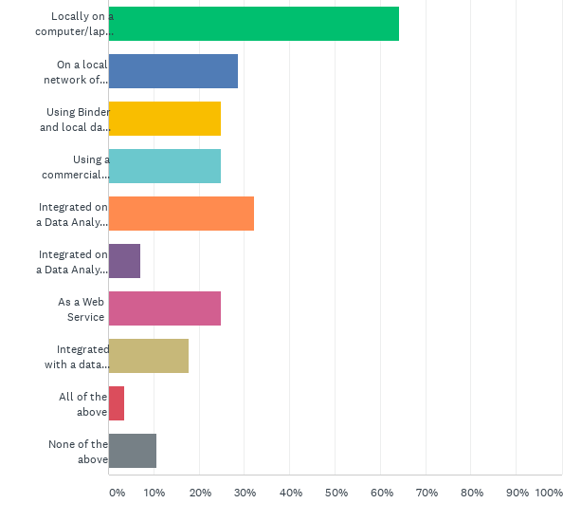
Q5: How do you currently run Jupyter Notebooks?

Slide 6
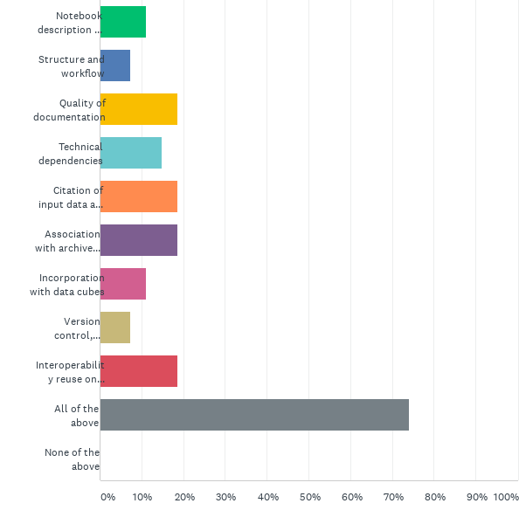
Q11: Do you you think the CEOS community would benefit from best practice advice on any of the following area?

Slide 7
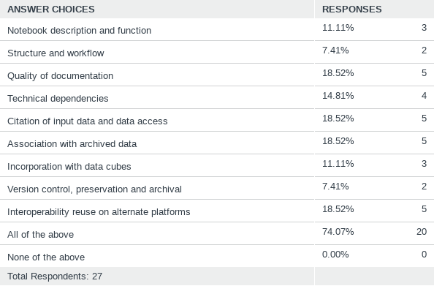
Q11: Do you you think the CEOS community would benefit from best practice advice on any of the following area?

Slide 8
Actions !
CaoD , GEO ?, CODATA ?, WGISS
Data Discovery and Access
Collaboration and developing a Community of Interest
Training Capabilities (online access to Jupyter Notebooks and Data)
Data Interoperability and Use
Best Practice Document
Tech Expo
Introduction to Jupyter Notebooks
Data Preservation and Stewardship
CaoD/WGISS
Preservation and CEOS repository
Domain Specific /CapD Webinars
Tech Expo Webinars
Tech Expo

Slide 9
Who and why would we create a best practice document
Who will benefit form a Best Practice
Data Producers
Authors of Jupyter Notebooks
Providers of EO data training
Users of EO data
EO data archives
Providers of Data Analysis Infrastructure
JUPYTER NOTEBOOK BEST PRACTICE CONTENT
4.1 General Recommendations
4.2 Notebook description and function
4.3 Structure, workflow and documentation
4.4 Technical dependencies and Virtual Environments
4.6 Citation of input data and data access
4.7 Association with archived data
4.8 Incorporation with data cubes
4.9 Version control, preservation and archival
4.10 Open source software licensing
4.12 Publishing software and getting a DOI
4.12 Interoperability and reuse on alternate platforms
4.13 Creating a binder deployment

Slide 10
Notebook description and function
Clear understanding the purpose of a notebooks and deciding if it a reusable asset. Successfully conveying how and why a notebook should be used by its intended community
This is an important first step where we nned to differentiate between notebooks that are to for personal and those that should be treated as reusable assets. We need a discussion of the range of notebooks that agencies/institions may wish to actively manage

Slide 11
Structure, workflow and documentation
Encourage the development of good workflow and structure within notebooks along with quality documentation. Supporting their reuse and adaptation by new users
Good software engineering principles
Use of Functions
Use of Modules
Size of Notebook
Capturing Output
There is material good out there covering this area, this good be reviewed against SEO python activities and webinar and training examples.

Slide 12
Technical dependencies and Virtual Environments
Language and versions
Libraries
Other Code
Virtual Machines on Data Analysis Platforms
Installing libraries from within notebook, recommending conda etc.
Setting up virtual environments
Testing
This ties into software preservation discussion in DSIG and require a technical discussion regarding how new libraries and environments are set up on Data Analysis platforms and other Jupyter hub services.

Slide 13
Citation of input data and data access
Currently there is no guidance on how a Jupyter notebook should
Cite input data
Explain access requirements i.e. is it open or do need to apply for access
Location and structure of data
Citable as: Disney, M.; Chernetskiy, M.; Gomez-Dans, J.; Lewis, P.; Urban, M.; Schmullius, C. (2020): BACI: System State Vector (SSV) land surface time series dataset for the European regional site, 2000-2015, v1.0. Centre for Environmental Data Analysis, 30 January 2020. doi:10.5285/af13038e9caf499482a9bbb0b8fca2b8. http://dx.doi.org/10.5285/af13038e9caf499482a9bbb0b8fca2b8
X
This again ties into DSIG work on citation of data but also navigating the structure and locating input data and code
X
X
X

Slide 14
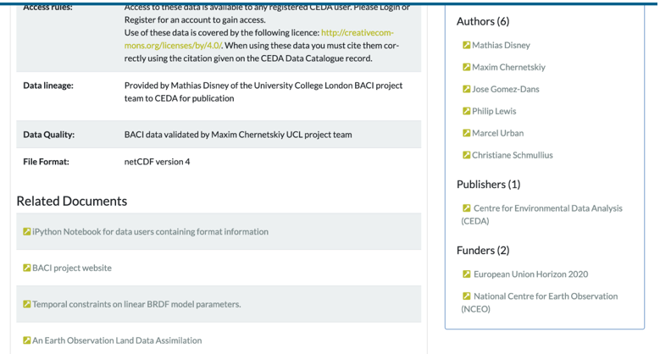
Association with archived data
There are many issue around how software should be linked to archived data and how permanent. This should be ? Areas for discussion include:
Research Objects
AIP’s
Part of the catalogue record
Deprecation and update
There have been a lot of CEOS discussion on the preservation of information and software connected with data. We need to consider how medium term resources should be associated and withdrawn

Slide 15
Incorporation with data cubes
Establishing Connections with Data Cubes
Defining what data gets loaded
Working with xarray
Porting Notebook from hierarchical file system to a data cube
A rich area for Tech Expo discussion would be using Jupyter notebooks with data cubes.

Slide 16
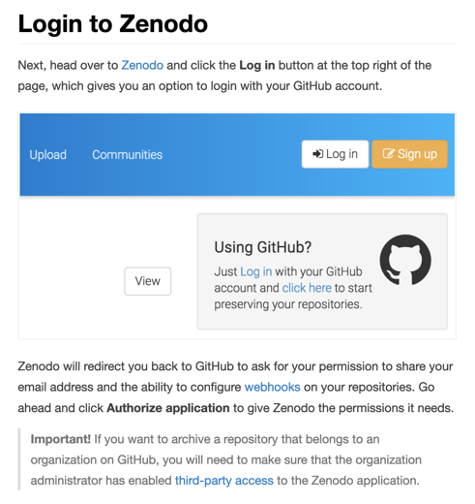
Version control, preservation and archival, publishing software, getting a DOI and licence
GitHub
Institutional/National Repositories
Structure of Repositories
Zenodo
Issuing a DOI
Versions
Creative Commons Licensing
A lot of different solutions are presenting themselves for the preservation of software. With the Jupyter notebooks there is also the potential for extension and specialization.

Slide 17
Interoperability and reuse on alternate platforms
As we accumulate notebooks and data for webinars and training. I would propose transferring examples between agency data analysis platforms, to examine issues.

Slide 18
Creating a binder deployment
What is a Binder?
A Binder (also called a Binder-ready repository) is a code repository that contains at least two things:
Code or content that you’d like people to run. This might be a Jupyter Notebook that explains an idea, or an R script that makes a visualization.
Configuration files for your environment. These files are used by Binder to build the environment needed to run your code. Configuration files may be placed in the root of your repository or in a binder/ folder in the repository’s root (i.e. myproject/binder/).
A Binder repository can be built by a BinderHub, which will generate a link that you can share with others, allowing them to interact with the content in your repository.
Another aspect of CapD is supporting the development of systems and services. This may be something that binder could help with.

Slide 19
Any other comments?
Contact Us !
esther.conway@stfc.ac.uk

