Slide 1





ESA Digital Twin Earth Climate Explorer Project on JASMIN
WGISS-51, Session on Data INTEROPERABILITY and USE
21 April 2021
Ag Stephens, Philip Kershaw

Slide 2
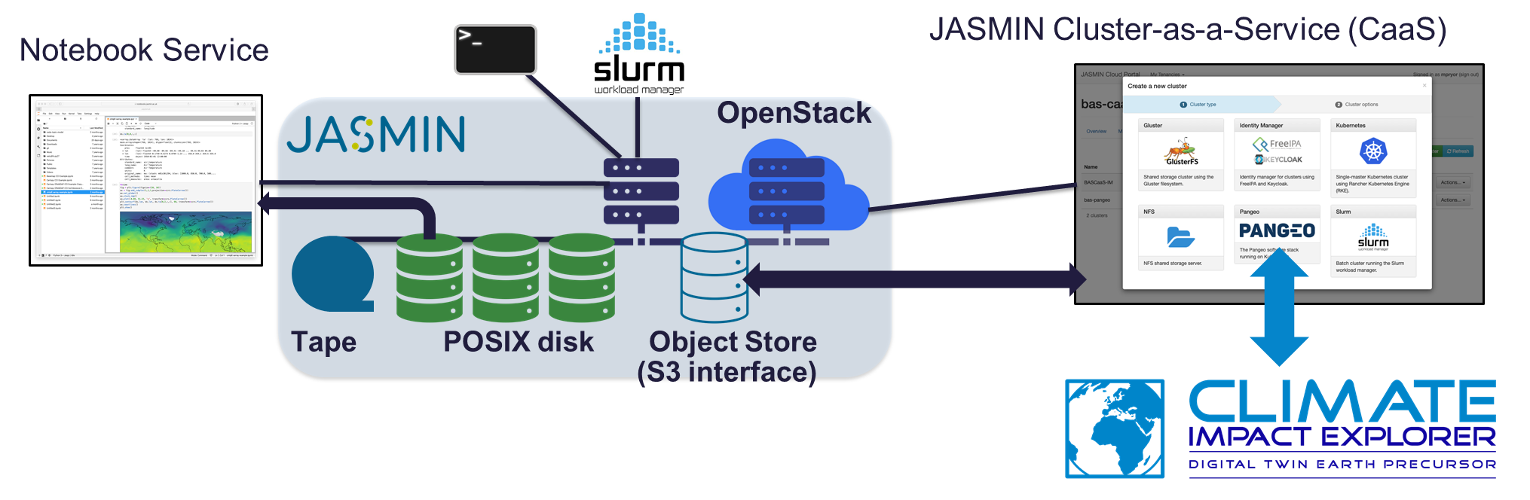
ESA Digital Twin Earth Climate Explorer Project on JASMIN
DTEP Climate Explorer: JULES Land-Surface model - assimilation of EO data with ML emulation – enable real-time use by decision-makers.
JASMIN platform:
Data-intensive computing
+ community cloud hybrid
Develop a Strategy for CMIP
data in Object Store for JASMIN
Investigating functionality/performance of object store formats:
  NetCDF – using "range-gets" // Zarr // S3-netCDF
Other projects using JASMIN Object Store with Zarr: ESA CCI Knowledge Exchange
Object Store issues: CMIP6/PANGEO/Zarr, Data Preservation, Search and cataloguing (Intake/STAC etc), Heterogeneous storage (tape/POSIX/object store)

Slide 3






Climate Impact Explorer
Build on existing advanced Earth System Models (JULES Land-Surface model)
Assimilate state-of-the-art Earth Observation data to produce to optimise model simulations
Build a Machine Learning emulation to the end user
Goal to enable decision-makers without expert technical knowledge to generate and visualise, in real-time, decision relevant information relating to regionalised impacts of climate change.

Slide 4


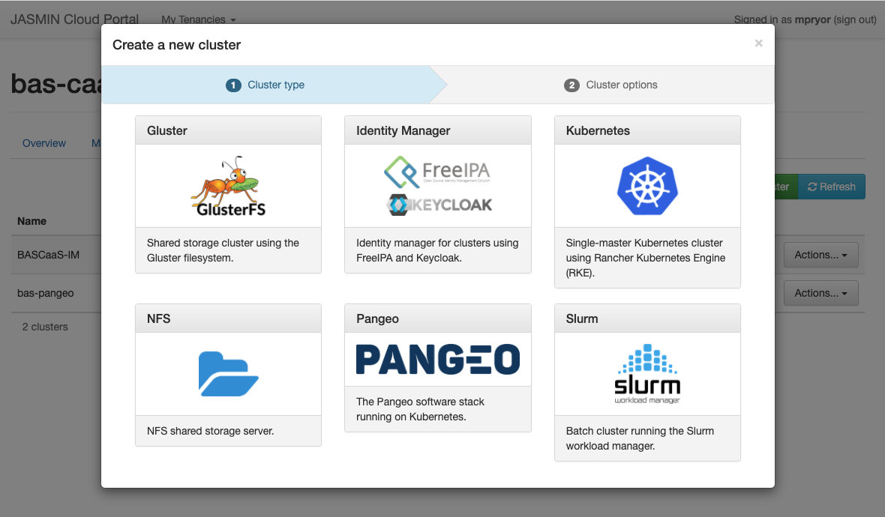
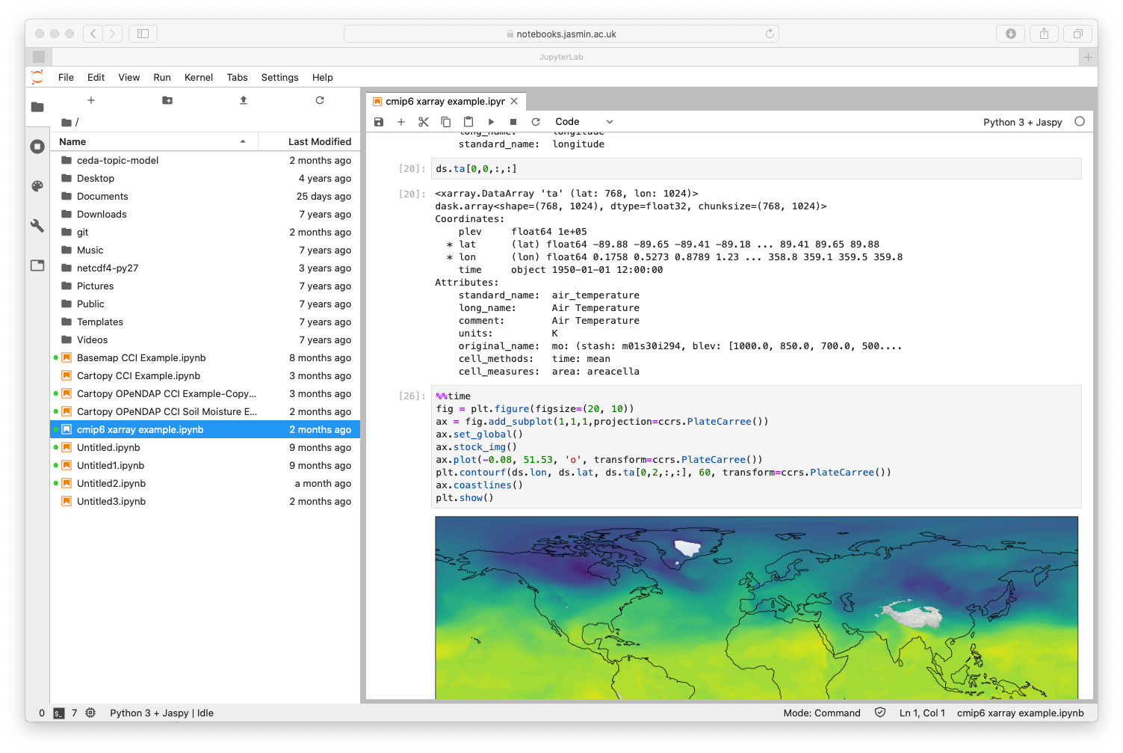






JASMIN: Data-intensive computing + community cloud hybrid
JASMIN Cluster-as-a-Service (CaaS)
Notebook Service
OpenStack
Tape POSIX disk Object Store
(S3 interface)
Notes:
CaaS has provided a lift-up with DTE project: the ability to immediately provision a canned Pangeo instance – Jupyter Notebook env, Dask and also Identity Service with Keycloak for Single sign-on
This has saved a lot of prep work so the project can hit the ground running

Slide 5




Cloud-compatible s/w stack to maximise portability between public cloud and on-premise
Public (commercial) cloud
On-premise: private/community cloud
technical agility for migration
Object Store
National Facility for the research community
Kubernetes
DevOps, Infrastructure-as-Code approach
Notes:
- Hybrid capability

Slide 6
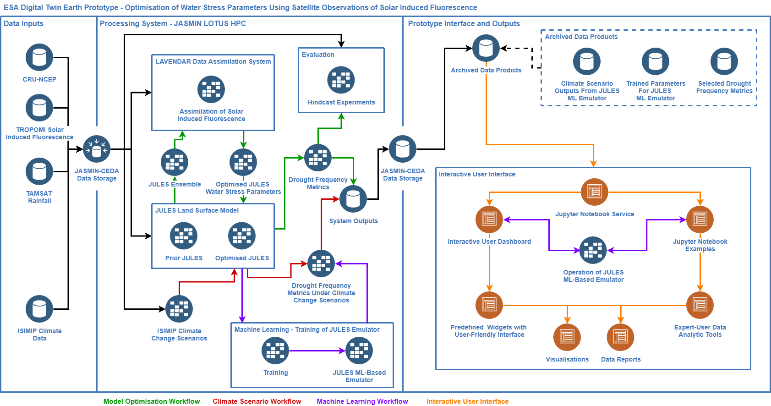
JASMIN:
High Performance / Data Intensive Computing Environment
JASMIN:
Object Store
JASMIN:
Community Cloud
Notes:
HPC provides primary data production environment (JULES model needs MPI), also for ML training
Cloud provides interactive analysis environment for target users
Object Store is the joining glue: we make a workflow to transfer netCDF outputs from HPC env to object store so it is in analysis-ready form for notebook env running on cloud

Slide 7
Prior Work: Develop a Strategy for CMIP Data with Object Store for JASMIN
Performance-based: evaluate different technologies
  S3netcdf4: https://github.com/cedadev/S3-netcdf-python
  NetCDF4-python with HTTP range GET extension
  Xarray / Zarr
Functional and user-directed: populate a subset of CMIP Data using xarray / zarr
Notes:
We report on testing of two different systems for storage and access: Xarray and Zarr and an in-house developed application S3-netcdf-python. We also consider functional aspects such as the challenge of balancing new models to orient data into a form optimised for user analysis against considerations such as versioning and data integrity critical for the purposes of long-term preservation and archiving.

Slide 8
Object Store performance test design
Use JASMIN Caringo object store (S3 compliant interface)
Use serial client queries – x/y and time series slicing
Used BCC test dataset, relative humidity
Object / chunking ( 🡪 ~250MB objects)
Serialisation | Time steps | Height | latitude | longitude
S3netcdf4 | 60 | 19 | 160 | 320
NetCDF4-python | 7200 | 19 | 160 | 320
xarray/zarr | 68 | 19 | 160 | 320

Slide 9
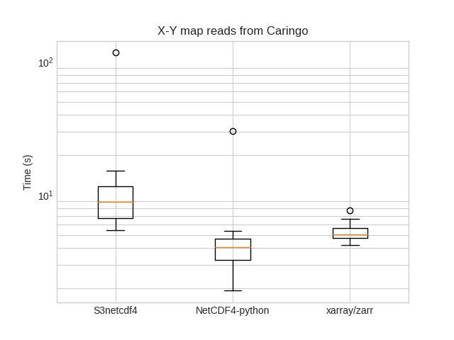
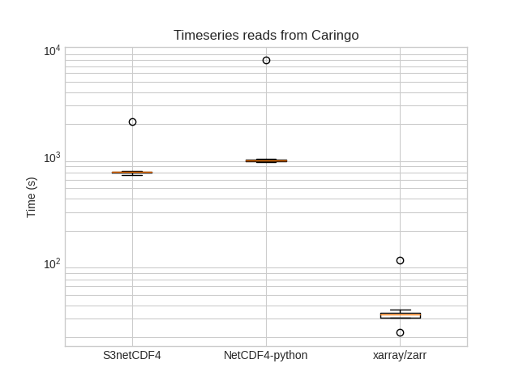
Object testing results reflect the chunking strategies; more analysis needed
Complete slices in lat/lon allow for efficient retrieval
xarray/zarr performed well on time series queries

Slide 10
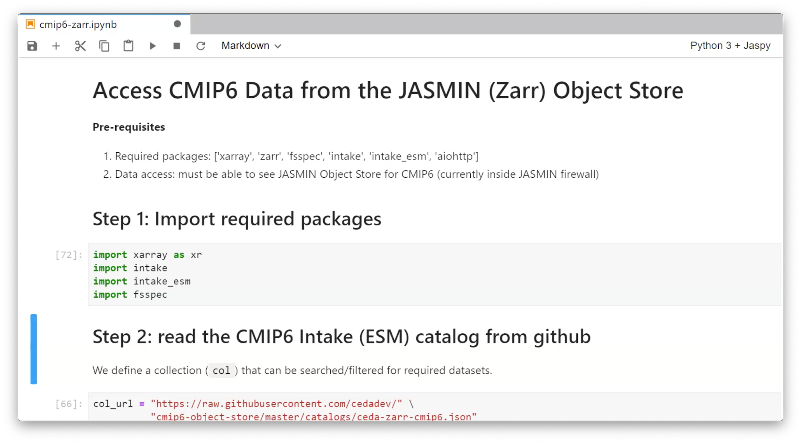
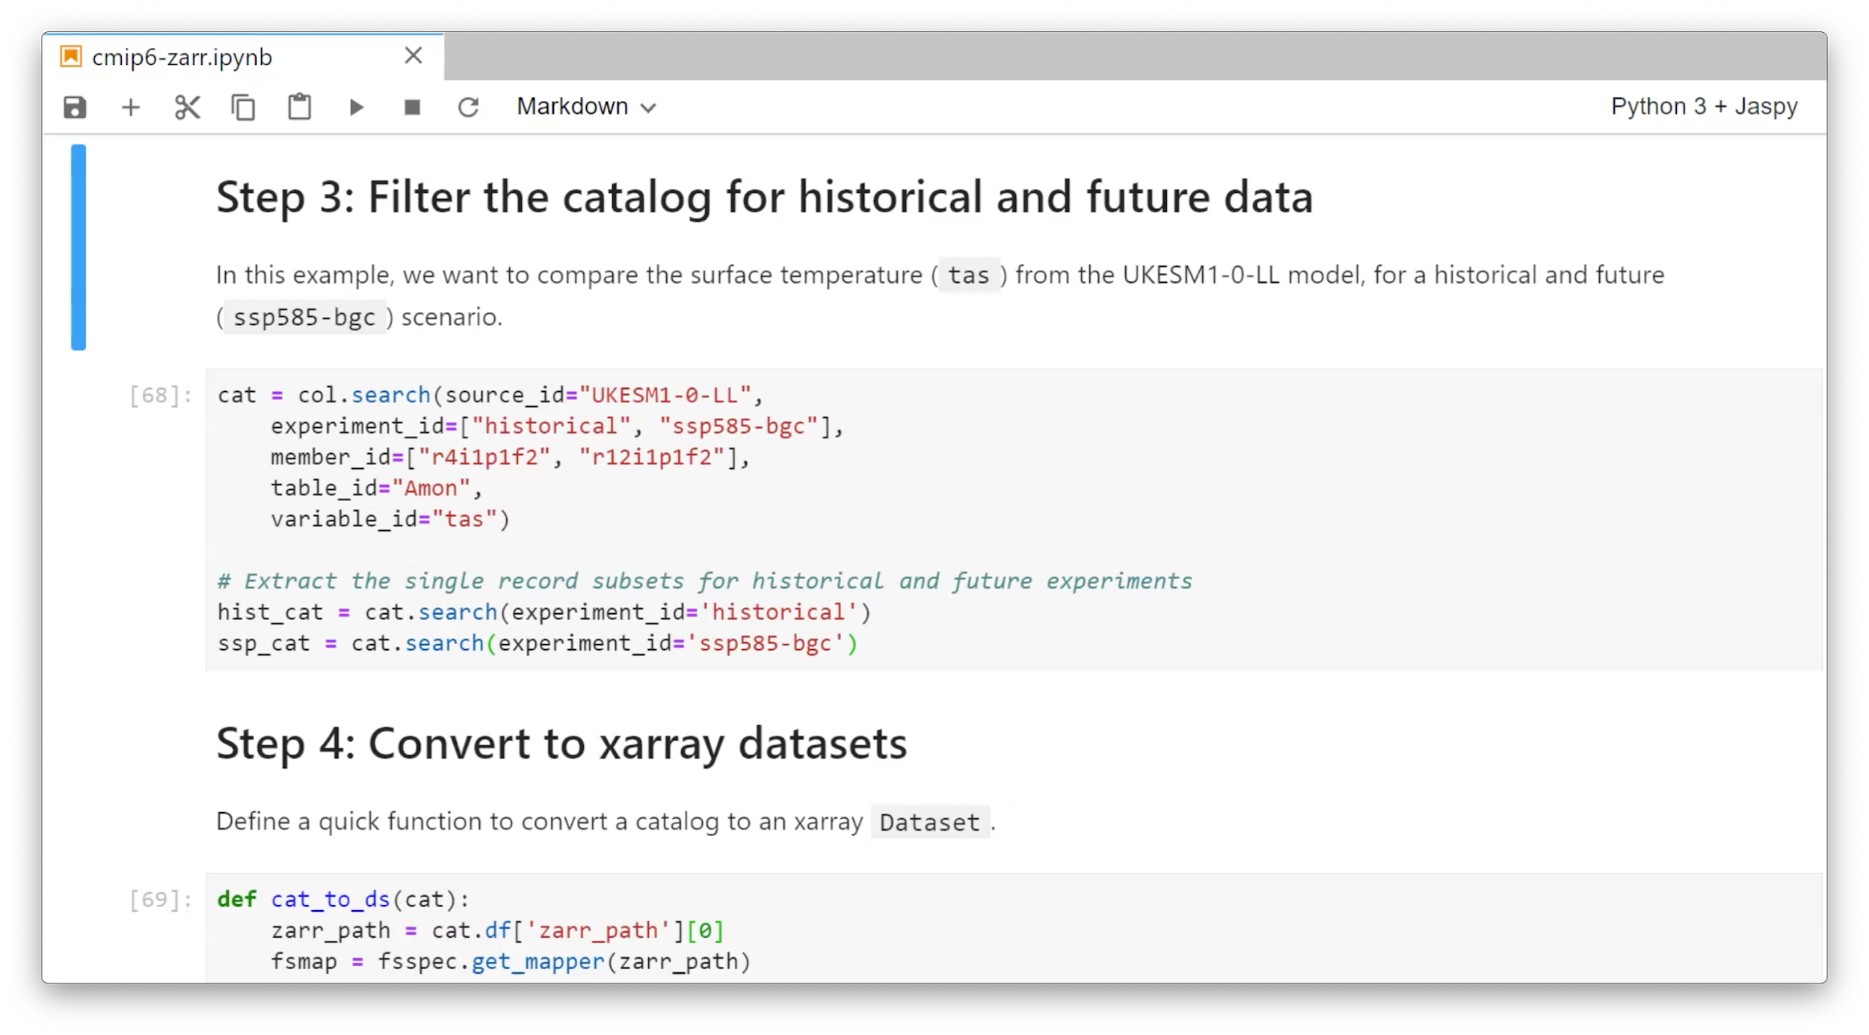
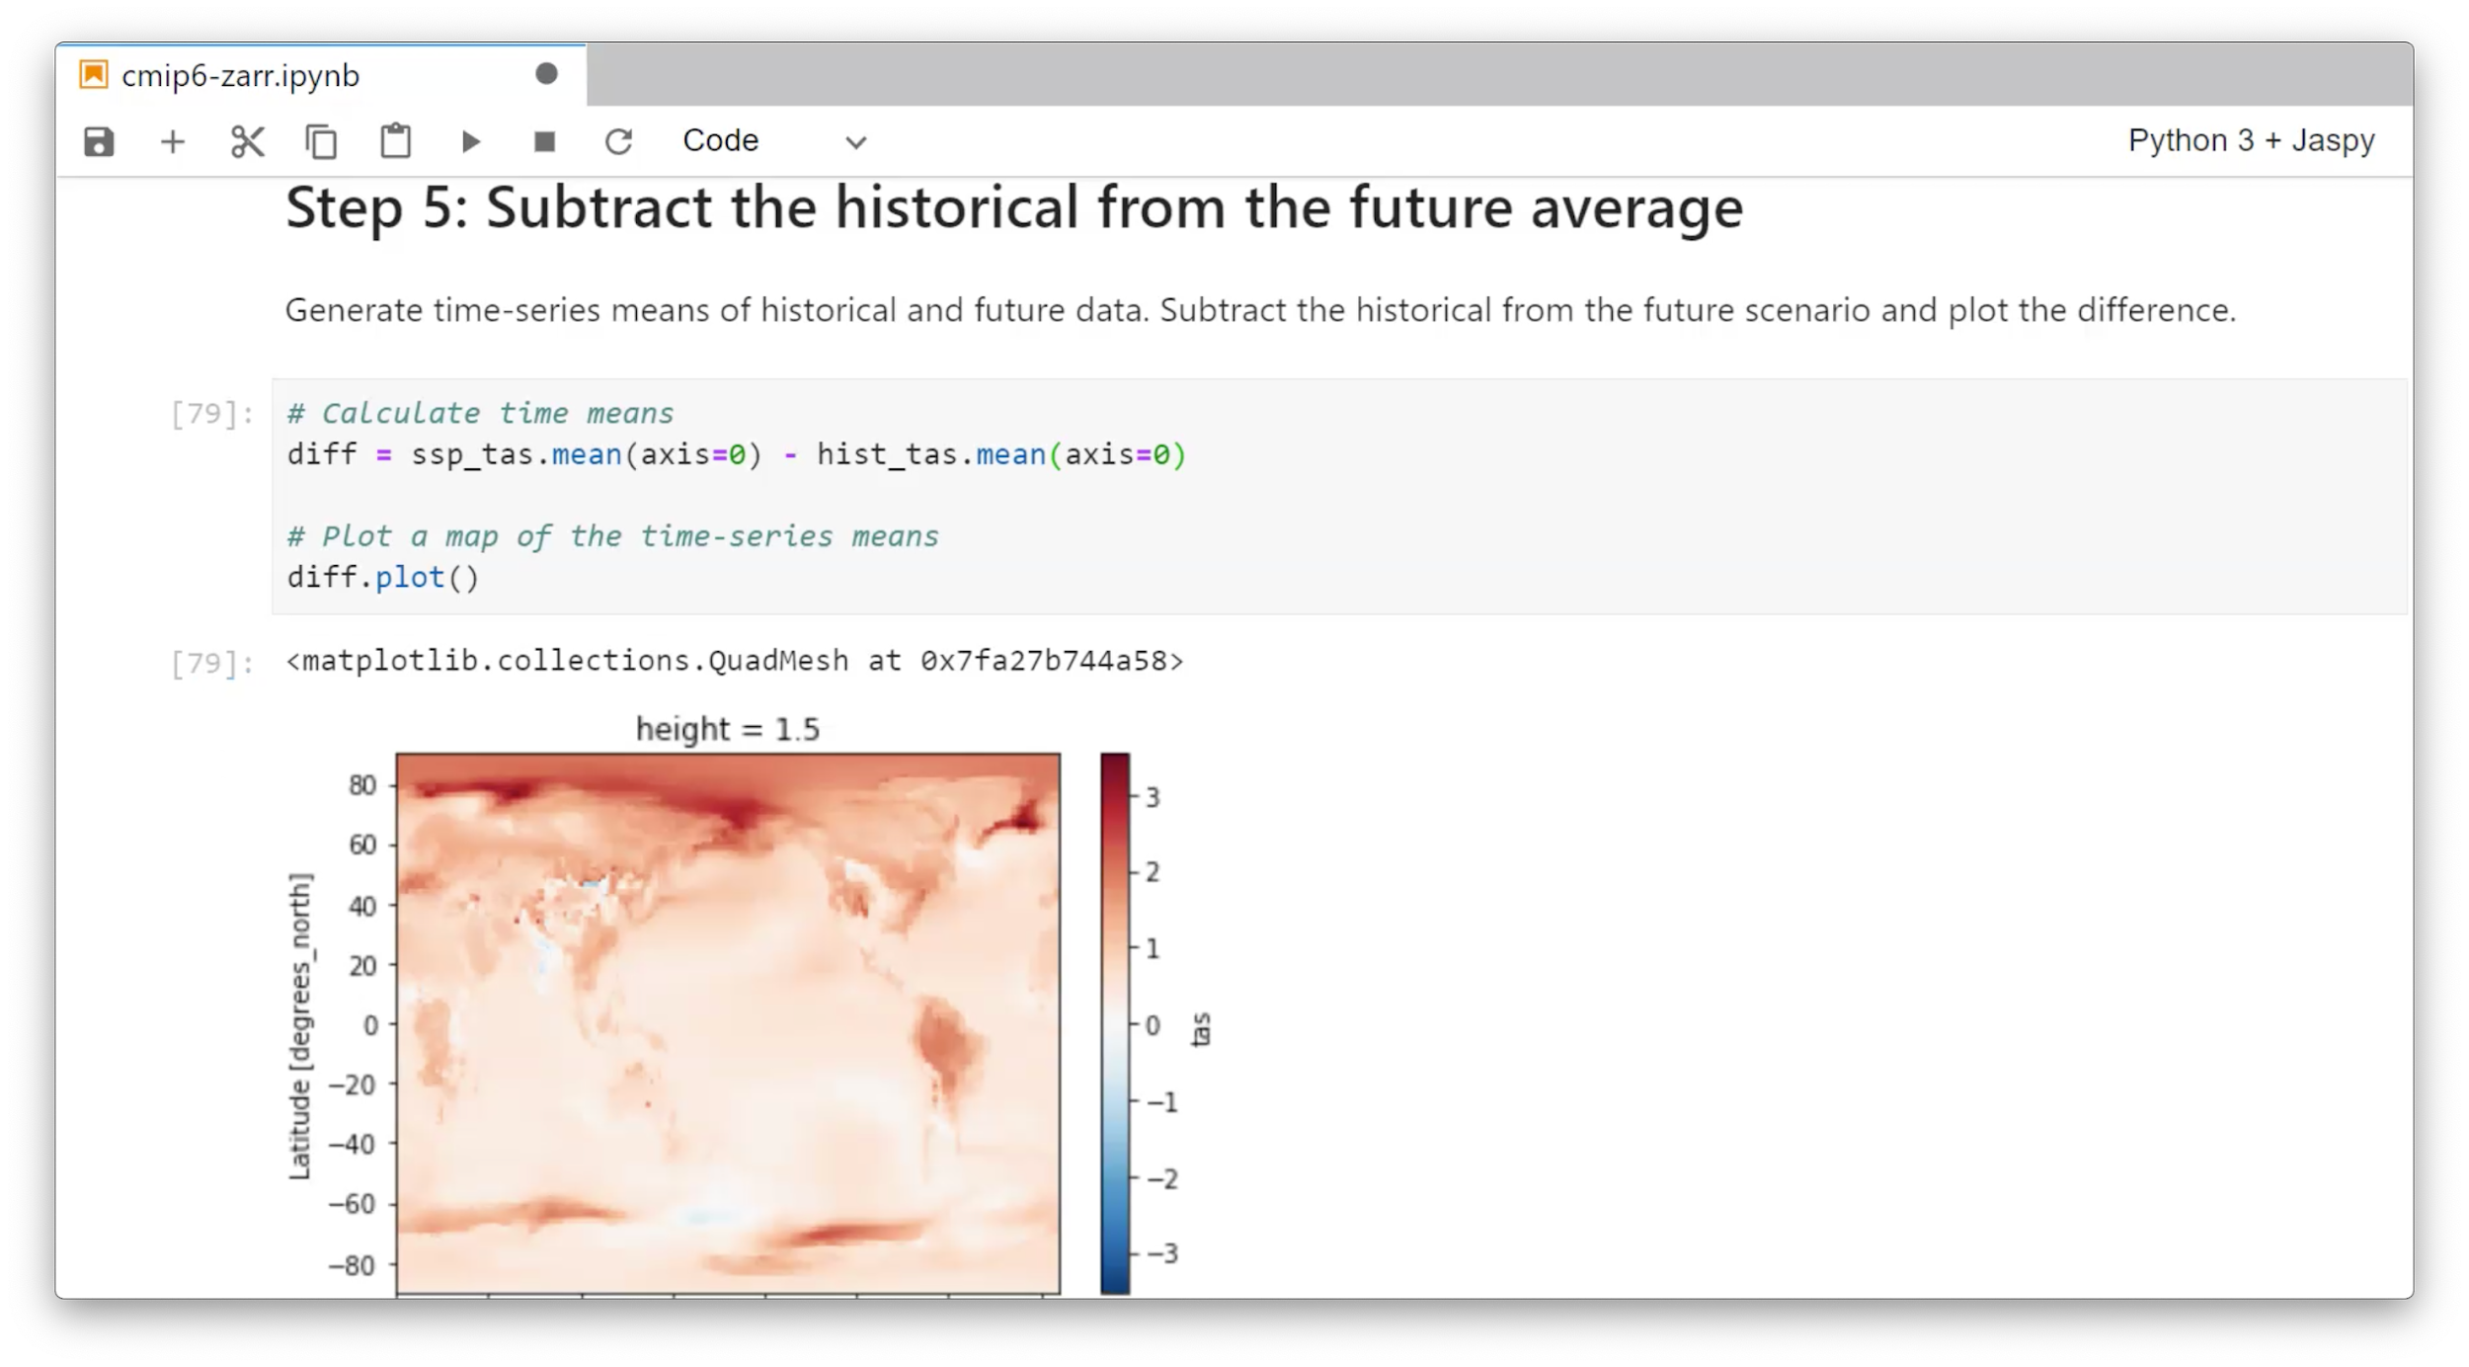
CMIP6 Subset on Object Store: functional evaluation

Slide 11
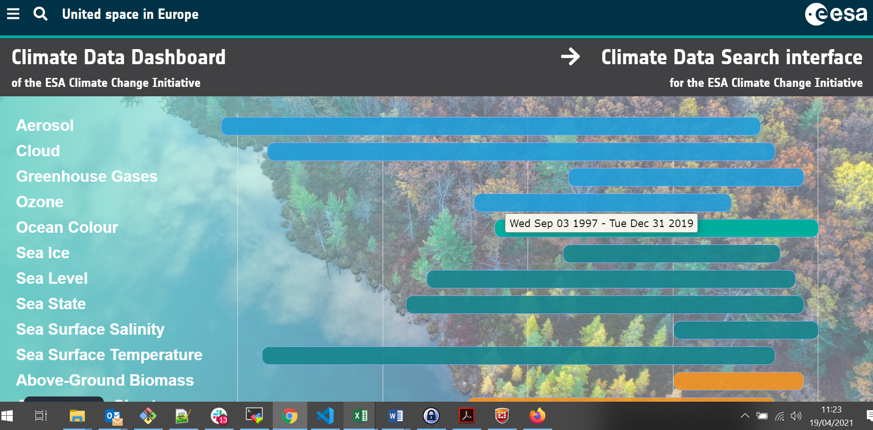
Approach for Digital Twin Earth Climate Explorer
Establish object store tenancy on JASMIN
Training and support using Zarr to store netCDF data
Draw on CEDA experience with CMIP6 pilot
Other projects also using
JASMIN Object Store with Zarr:
ESA CCI Knowledge
Exchange Project

Slide 12




Ongoing work and next steps
Collaboration on CMIP data on object store: Pangeo community, AWS ESGF node, DKRZ, …
Search:
- object store and traditional HTTP file serving
- Develop ESM profile for STAC
Long-term preservation and archiving – to address:
- Checksums
- Versioning
- Reconstruction from data corruption
Interface for multiple storage media
- S3 as interface for tape and object store
Notes:
Hybrid cloud and federation model way forward: under development for ESGF
Cloud-compatible strategy to follow for agility between on-premise and cloud hosting;
- s/w, devops
- private/community cloud (cloud on-premise at research centres)
Object store has attractive properties for storage and analysis of CMIP data, evaluation and pilots are underway
- but there are some challenges to tackle but fundamental changes are already here and will continue to be played out

Slide 13
Contacts
Ag Stephens: ag.stephens@stfc.ac.uk
Phil Kershaw: philip.kershaw@stfc.ac.uk
Support: support@ceda.ac.uk
Notes:
Hybrid cloud and federation model way forward: under development for ESGF
Cloud-compatible strategy to follow for agility between on-premise and cloud hosting;
- s/w, devops
- private/community cloud (cloud on-premise at research centres)
Object store has attractive properties for storage and analysis of CMIP data, evaluation and pilots are underway
- but there are some challenges to tackle but fundamental changes are already here and will continue to be played out

