Slide 1
Executive Summary
Earth Analytics Interoperability Lab
Engagement Status:
15 registered users across 4 CEOS projects
Disasters, COAST, DEMIX Asia-RiCE
OEA community forum for EAIL
Interoperability Status:
US East sample region data:
USGS Collection 2 – used-in-place on AWS
Element 84 Sentinel 2 COGS – used-in-place on AWS
Sinergise S1 ARD Service – ordered-and-stored, fee for service
All confirmed or under assessment for CARD4L
EASI Training notebooks EAIL tailored
Dask Gateway for scalable computing
Larger nodes, GPU – customisable
Strategy and next steps
Some progress since WGISS 50
Proposed interop BP development:
Cloud access/use for CEOS – metadata and services
Cloud formats BP
Cloud data lifecycle BP
EAIL and Jupyter Notebook BP

Slide 2
CEOS Earth Analytics Interoperability Lab Update
Committee on Earth Observation Satellites
Dr. Robert Woodcock, CSIRO, WGISS Chair
Dr. Brian Killough, NASA, CEOS Systems Engineering Office
Mr. Jonathan Hodge, CSIRO Chile, Program Director
WGISS 51 Virtual Meeting
20-22 April 2021
Notes:
The CEOS Earth Analytics Interoperability Lab (EAIL or “The Lab” for short) is a new initiative, an experiment mainly responding to demand from CEOS Projects related to the CEOS Future Data Architectures and Analysis Ready Data strategy

Slide 3
Why do we need an Interoperability Lab?
Validating interoperability between multiple CEOS organizations and working groups is complex
ARD and FDA are here and there are WGISS technologies and Best Practices that need to change
The CEOS EAIL is intended to help CEOS WG & VCs explore these challenges together
EAIL is jointed operated by WGISS, CEOS SEO, CSIRO (Aus) and CSIRO Chile
Notes:
Interoperability work is relevant to all of CEOS and connected to LSI-VC, WGISS, WGCapD and the SEO. Plus specific projects (CEOS-COAST), and collaborators (GEO GLAM, GEO Aquawatch).
A significant number of these projects have contacted WGISS and SEO for assistance and advice in two main areas:
Integrated EO data analytics platform technology
Analysis Ready Data – formats, discovery, use
All involve multiple CEOS agencies, hence there is a strong need to interoperability. Most are also seeking a place to conduct experiments with newer technologies that aren’t always available from a CEOS agency (at least not yet).

Slide 4
Current Status
Engagement
15 registered users – more to come
Large numbers is not the goal
CEOS engagement:
WG Disasters Flood Pilot
CEOS COAST
DEMIX
Asia-RiCE
In all cases EAIL is working with the groups on preparing data and regions of interest and assisting new users
Open Earth Alliance community forum for EAIL
https://forum.symbios.space/c/ceos-eail/8
Very empty now but ready to use

Slide 5
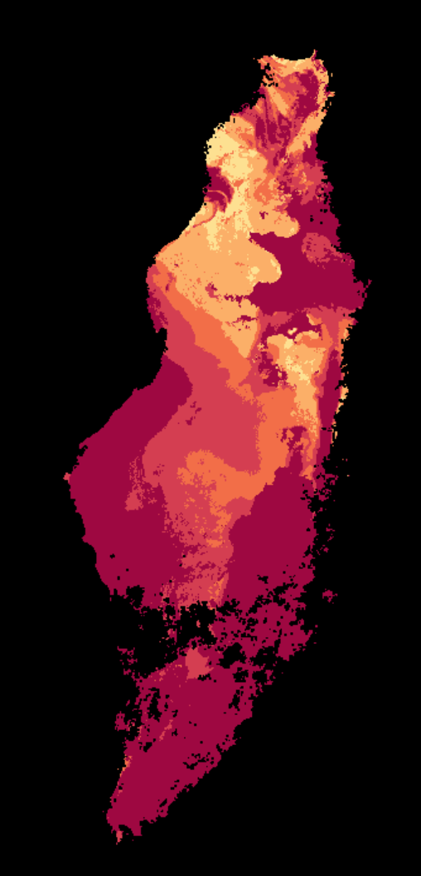
Current Status
Interoperability
Fully deployed and operational
For training purposes US Southeast states and coastline have been indexed (https://explorer.eail.easi-eo.solutions):
USGS Collection 2 – full landsat archive, used-in-place, requester pays
Element 84 Sentinel 2 COGS, used-in-place, public
Sinergise S1 ARD service – ordered-and-stored, fee for service (but quick)
All of these are ARD (confirmed or under assessment for CARD4L)
CSIRO EASI Training notebooks: customised for direct use in EAIL
Dask Gateway:
The EAIL supports scalable computing
Customised based on project demand with larger nodes, GPU for ML, etc.
Notes:
The EAIL differs to the OEA Google Colab ODC environment in user count, data sharing and computational capacity – different purpose, though similar technology stack.

Slide 6
Tech Expo: CSIRO Jupyter Notebook Experience with Matt Paget
Dask distributed computing
Visualization
Notes:
More EAIL demonstration in the Tech Expo Session with Matt PAget.

Slide 7
WGISS 50 – Strategy brainstorm
Progress…but now the work begins
Asia-RiCE
CEOS COAST
WG Dis Flood Pilot
Projects plus SEO on EAIL
Early Engagement
Earth Analytics Interoperability Labs (participants)
CEOS EAIL, OEA ODC Colab operational
(?AI4GEO, Brazil DataCube, ISRO,…?)
CEOS
Sentinel 1 Data Pipelines?
Cloud Native Discovery?
Jupyter Notebooks
(BP in progress)
Interoperability
Best Practices
Demonstration Notebooks
Working Group:
SAR2CUBE
CSIRO Data Pipelines…
Working Group:
Data Discovery and Access
Working Group:
Tech Expo
AI4GEO
SEO
ESA…
Notes:
Jupyter notebooks best practice is underway.

Slide 8
CEOS Data in Cloud – Developing Best Practices
Discovery issues:
Provenance
Location
Provider
Region
Cost to use
Hidden costs
USGS Collection 2
Element 84 S2 COGS
NASA Coming soon?
Notes:
Using the Cloud distributed collections from USGS et al
Several issues:
Staying in sync
Notification services
data management plans
errors (at scale things fail) – corrupted files, quality issues positioning errors over time – these issues are to be expected. The question is with this much use can we automate support notification client side? Will CEOS accept notifications from a Bot (not a person)?
STAC standard - differences stac vs stac
Scale – S3 manifests with daily update could be very helpful
Regional replicas?

Slide 9
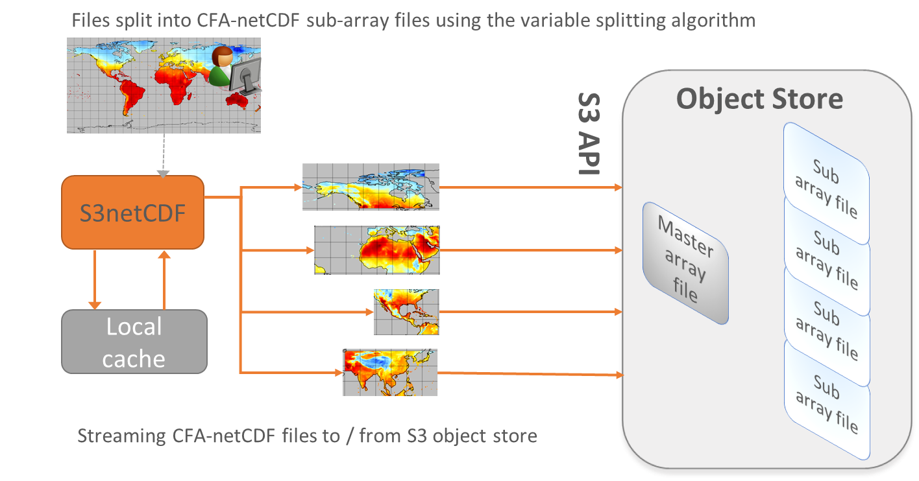
Cloud data formats – Best Practices
Direct data access
COGS –
Cloud optimised GeoTIFFs (ready for Sentinel and Landsat)
NetCDF in the Cloud
Zarr – Cloud native array storage
Notes:
In addition to the apps, storage and compute infrastructure the EAIL also supports experiments in Cloud data formats.
COGS is readily available and supported via the Open Data Cube and associated python libraries (e.g. rasterio)
Zarr support is being developed by CSIRO in the Open Data Cube and available as an experimental environment for those interested (you can also do this via standard xarray zarr support).
There are several efforts underway in this area. What is WGISS role in communicating this across CEOS? Do we need to or just rely on others (note that LSI-VC ARD has had questions about this repeatedly in their ARD PFS discussions).

Slide 10
EAIL – Where to from here?
Roadmap:
WGISS+SEO deploy the lab
Establish support and operations mechanism with SEO
CEOS COAST et al:
User registrations
inventory of data, analytics, etc
Getting started notebooks and data
Joint interop experiments for capabilities needed by these projects
Jupyter Notebook BP
Propose IG activities in:
Cloud metadata CEOS BP
Data in the Cloud BP – Formats, error handling, notification, manifests,…
Cloud data lifecycle BP
Notes:
Metadata variants (STAC vs STAC, and MTL, and valid data polygons, and common band names, cloud masks?vocabs?)
Make ARD certification obvious?
Make CEOS agency connection obvious – since folks are creating copies.

