Slide 1
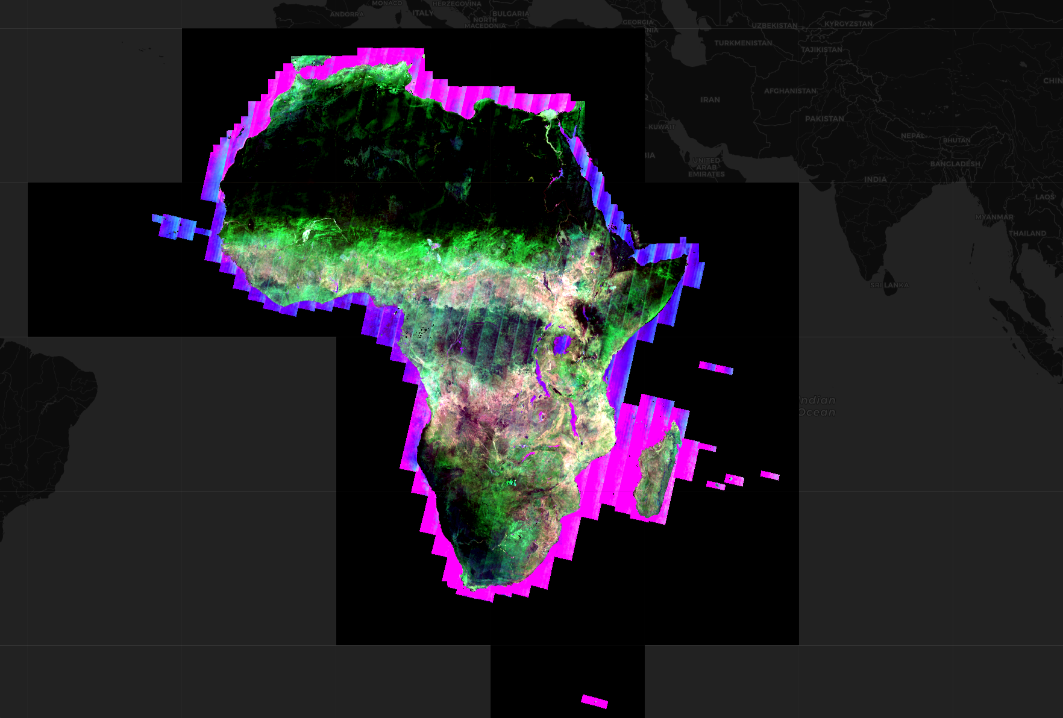
Key Points
Cloud Optimised GeoTIFFs remove the need to pre-tile data for analysis
Spatio-Temporal Asset Catalog metadata provides a standard to index from
Indexing STAC into the ODC means that on-demand global data cubes are easy
Broad area analyses are accessible to more people when data is on the cloud.

Slide 3
Alex Leith
Background in GIS
Spatial technology and DevOps in my past
Assistant Director of DEA Technologies in Geoscience Australia
One of the technical leads in Digital Earth Africa
Treasurer for OSGeo Oceania
Chair of the Open Data Cube Steering Council

Slide 4
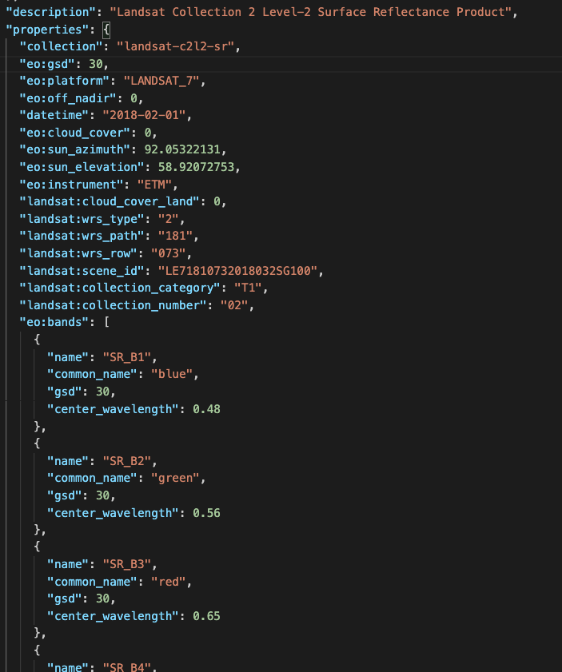
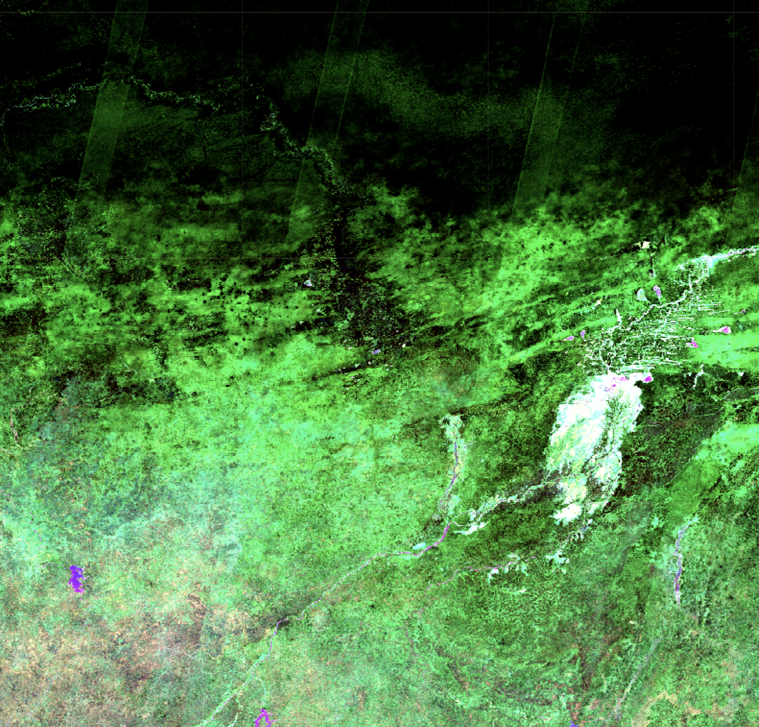
The Plan
Intro to DE Australia and DE Africa
Intro to Earth observation data
Intro to the Open Data Cube
What’s a COG
What’s STAC

Slide 5
What is Digital Earth Australia
Digital Earth Australia organizes Earth observation data for Australia
Priority has been for government and now includes industry
The Open Data Cube software project enables DEA
Team of 60 within Geoscience Australia

Slide 6
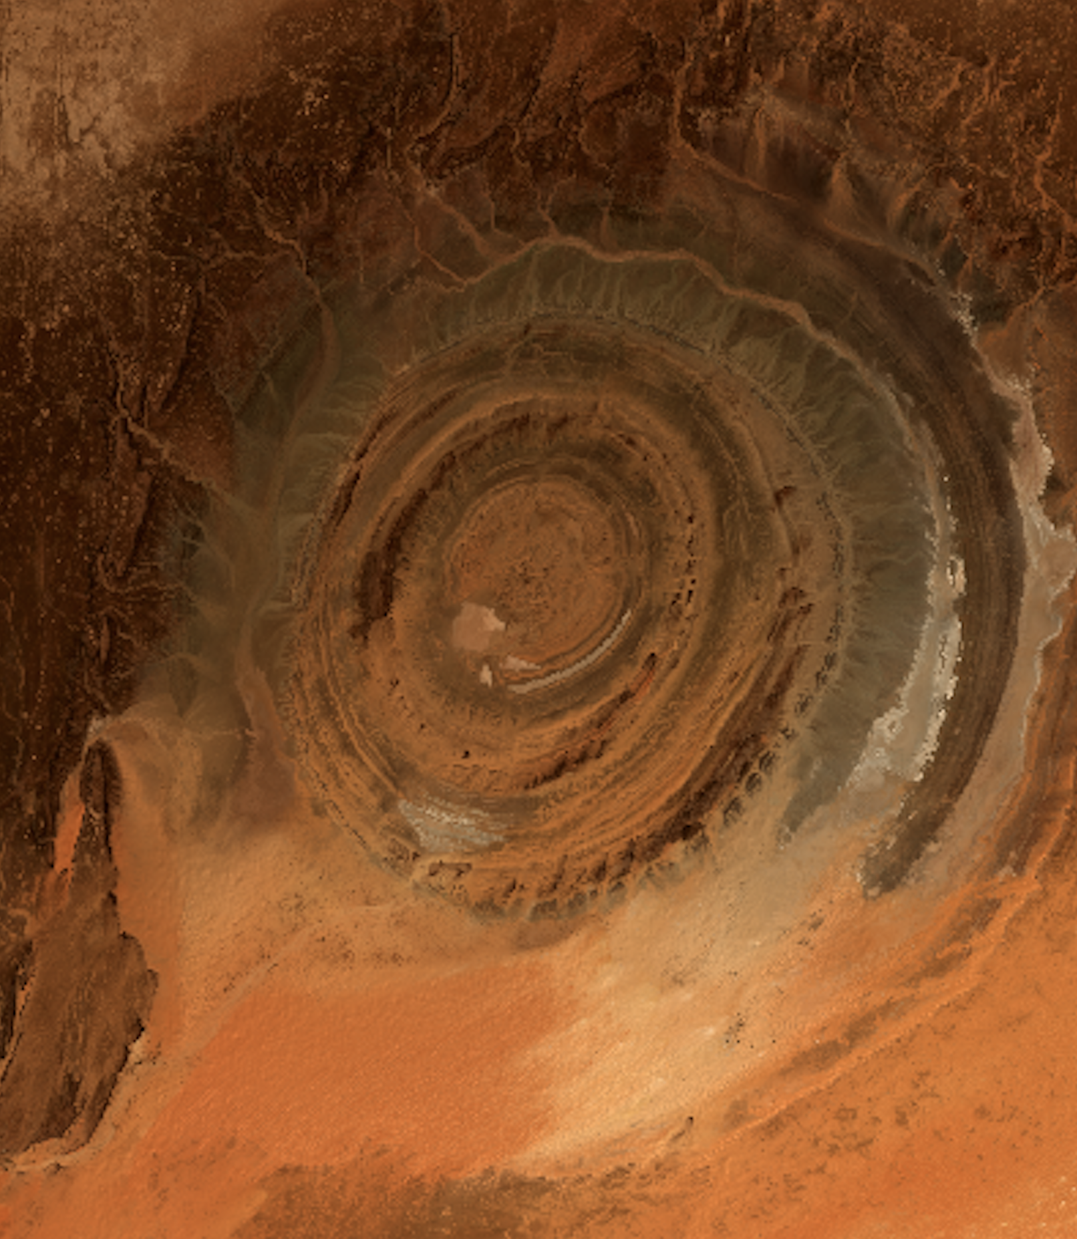
What is Digital Earth Africa
Make EO data more easily accessible
Develop in-country capacity
Broad applications including:
  Mining
  Land cover
  Surface water
  Agriculture
  COVID-19
Currently 20 staff across the world including in Geoscience Australia

Slide 7
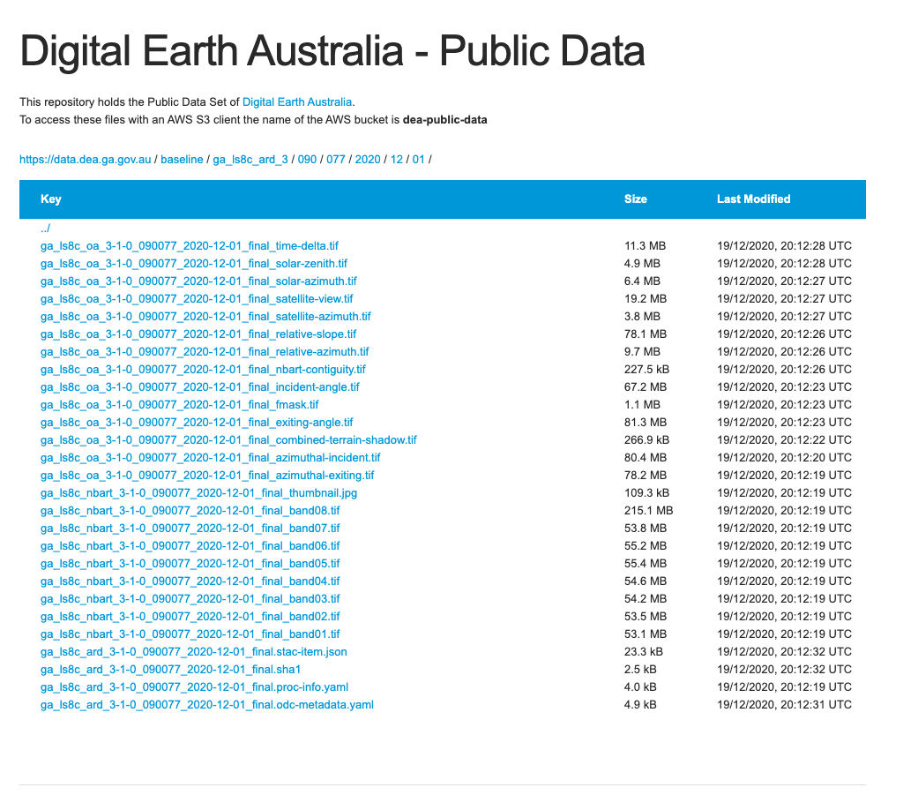
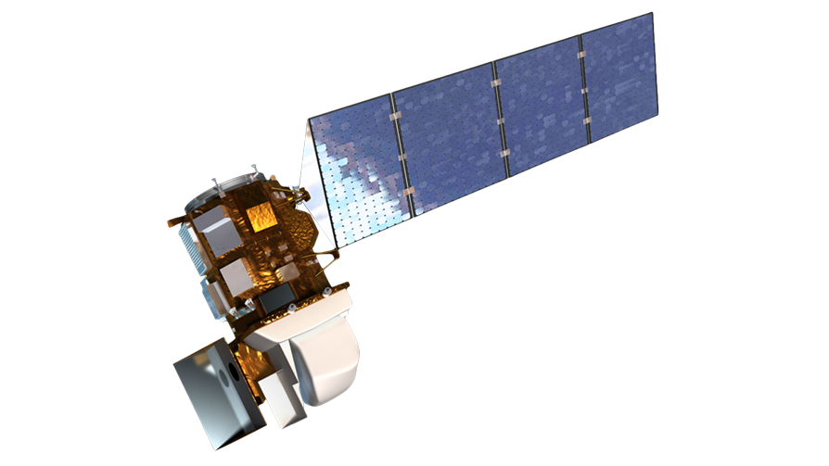
Optical Earth Observation Data
6 common bands
Blue
Green
Red
Near - Infrared
2 Shortwave Infrared
Landsat 5, 7 and 8: 1986 to date: 30m resolution, 16 day revisit
Sentinel 2a and 2b: 2017 to date: 10m, 5 day revisit
370,000 Landsat scenes over Australia over 30 years
1,800,000 Sentinel-2 scenes over Africa over 4 years
Landsat 8

Slide 8
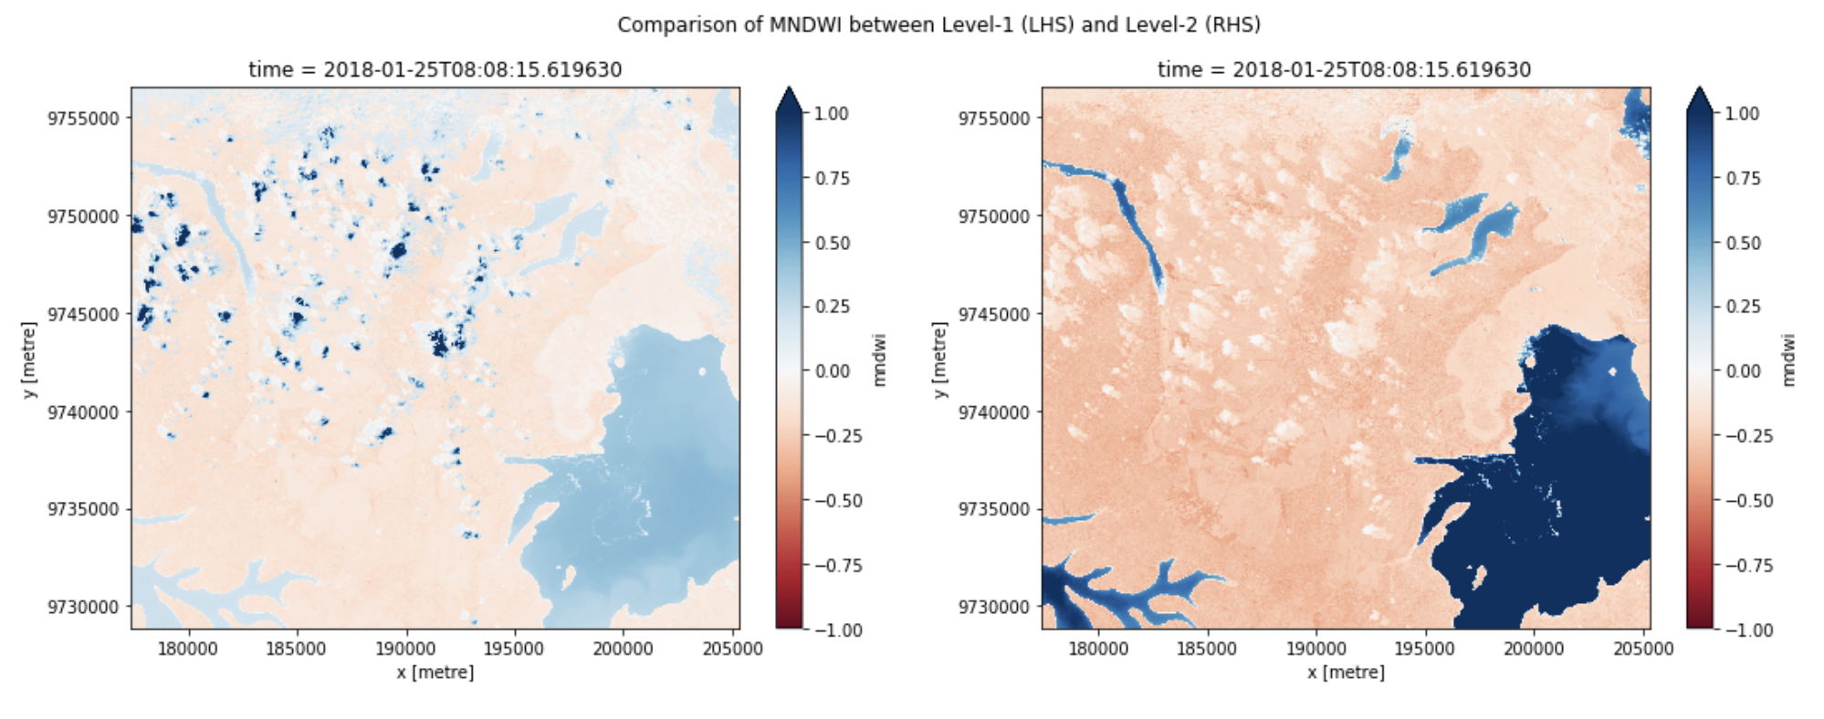
Analysis Ready Data

Slide 9
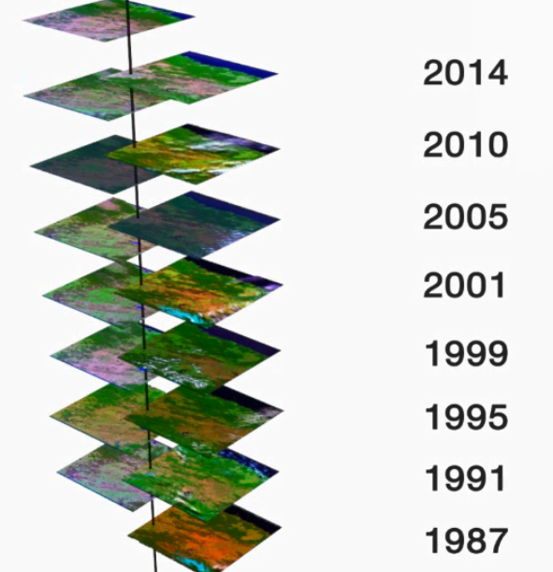
Old ARD: some of the data in my local environment
Make satellite data Analysis Ready:
Orthorectification
Calibrate
Regrid and stack into NetCDFs

Slide 10
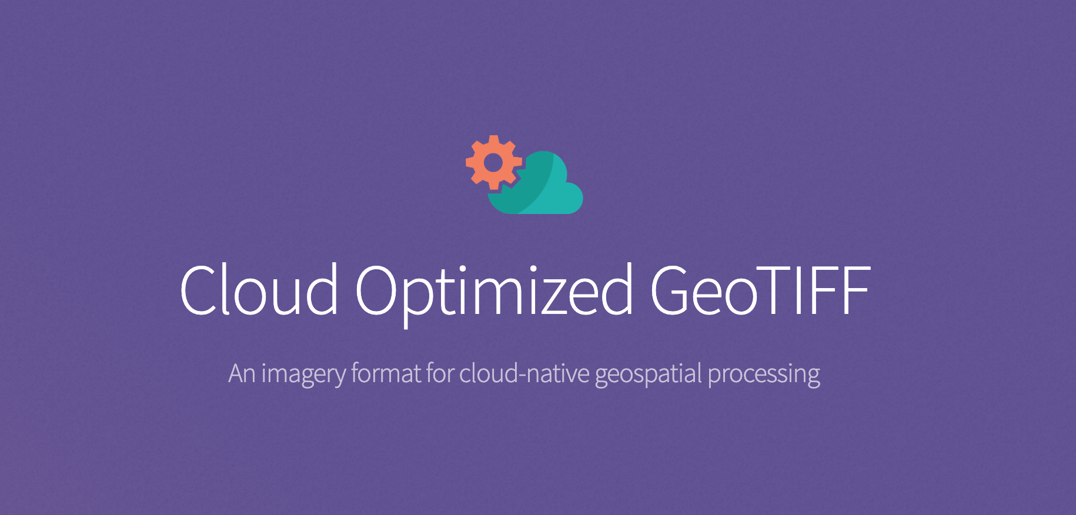
What is a COG
“A Cloud Optimized GeoTIFF (COG) is a regular GeoTIFF file, aimed at being hosted on a HTTP file server, with an internal organization that enables more efficient workflows on the cloud.
It does this by leveraging the ability of clients issuing ​HTTP GET range requests to ask for just the parts of a file they need.”

Slide 11
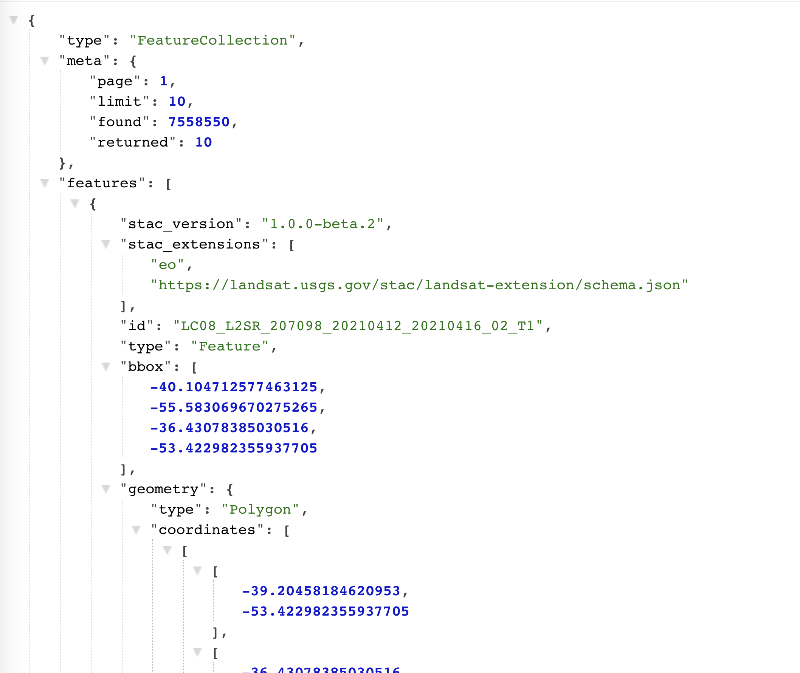
New ARD: all the data all the time
https://landsatlook.usgs.gov/sat-api/collections/landsat-c2l2-sr/items

Slide 12
What is the Open Data Cube

Slide 13
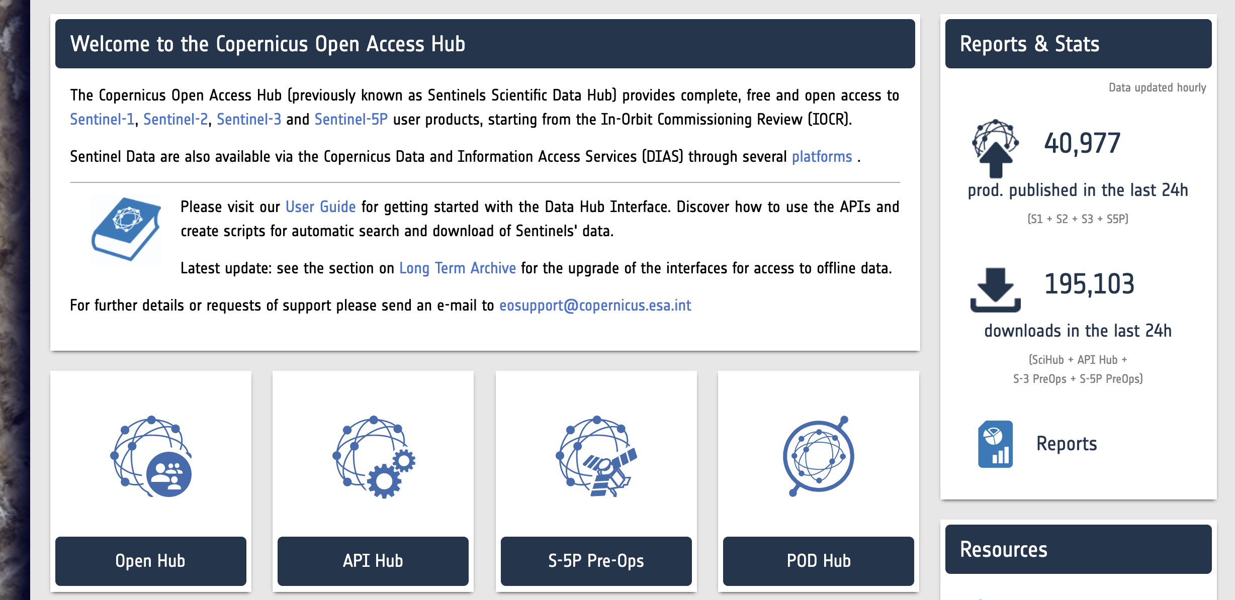
Metadata
There’s no easy way to access big data, because it’s big
S3 command line: very powerful, high learning curve
  aws s3 ls s3://deafrica-sentinel-2/
Dynamic STAC API: OGC API for Features, built for robots
  https://explorer.digitalearth.africa/stac/search?collection=s2_l2a
Web interface: Easy to use, limited functionality

Slide 14
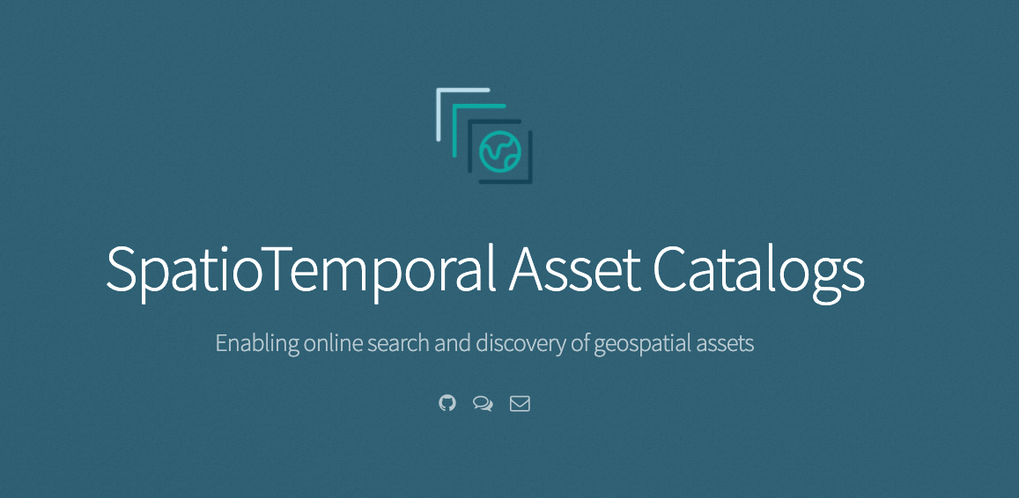
What is STAC
The SpatioTemporal Asset Catalog (STAC) specification provides a common language to describe a range of geospatial information, so it can more easily be indexed and discovered. A 'spatiotemporal asset' is any file that represents information about the earth captured in a certain space and time.
The goal is for all providers of spatiotemporal assets (Imagery, SAR, Point Clouds, Data Cubes, Full Motion Video, etc) to expose their data as SpatioTemporal Asset Catalogs (STAC), so that new code doesn't need to be written whenever a new data set or API is released.

Slide 15
SNS and SQS + STAC
AWS’s Simple Notification Service (SNS) allows you to publish a notification that we can use and is open to others too
AWS’s Simple Queue Service (SQS) allows you to put chunks of information, usually JSON, on a queue, and to get them off again
https://medium.com/awesome-cloud/aws-difference-between-sqs-and-sns-61a397bf76c5

Slide 16
DE Australia: Worked example
Landsat scene is pushed to AWS -> SNS
SQS -> Index into the ODC
SQS -> Process with WO algorithm -> SNS
SQS -> Process with the FC algorithm -> SNS
SQS -> Index into the ODC
SQS -> Index into the ODC

Slide 17
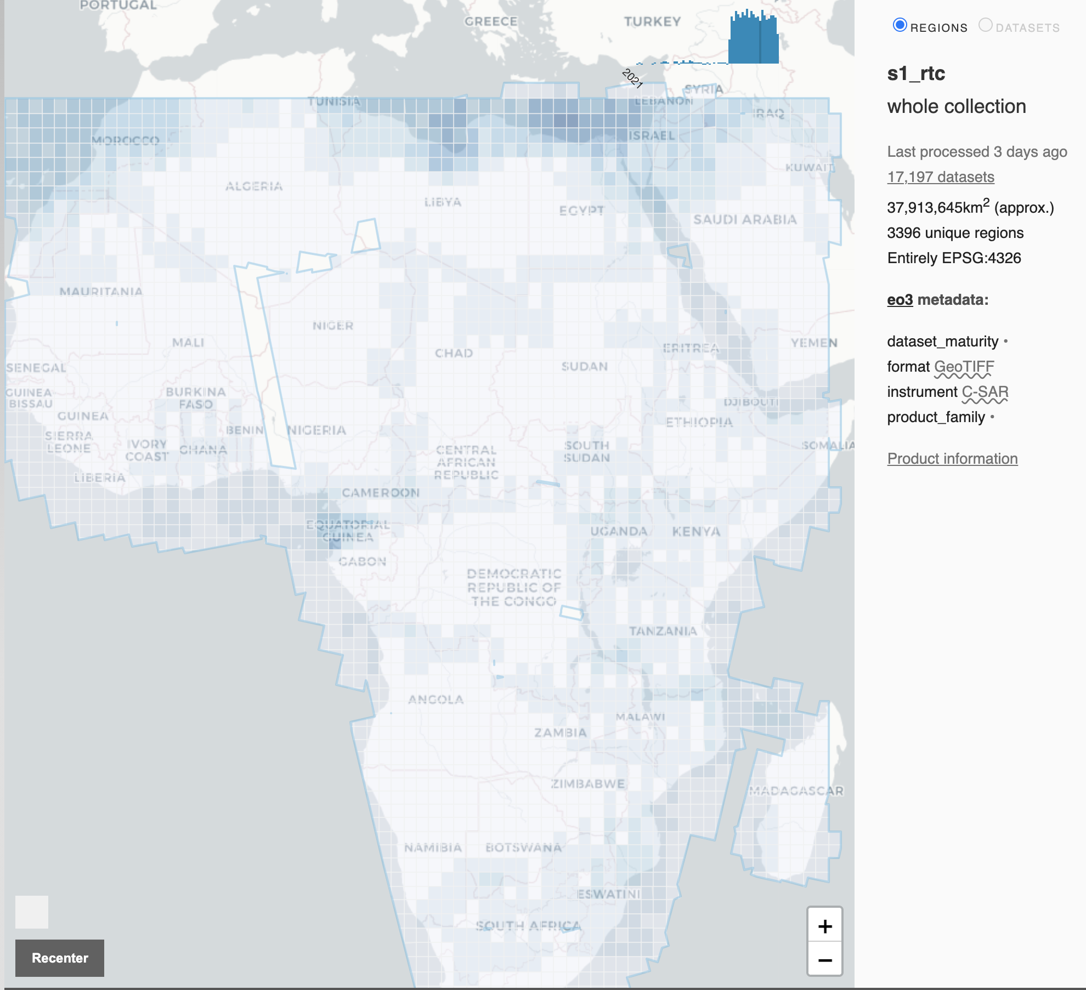
Notes on DE Africa’s use of STAC
Worked with Element84 to ensure STAC 1.0.0 is ODC Compatible
STAC is used globally for Sentinel-2 data on AWS
STAC is used in Sinergise’s new Sentinel-1 STAC is used in USGS Landsat, which is not easy.

Slide 18
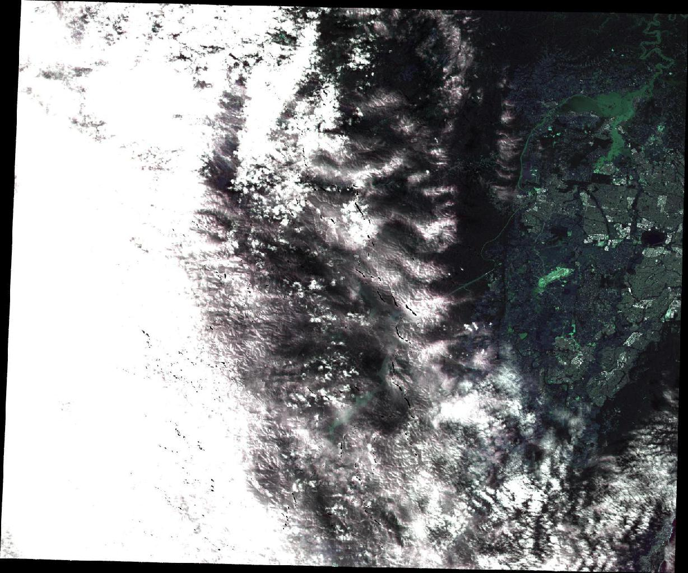
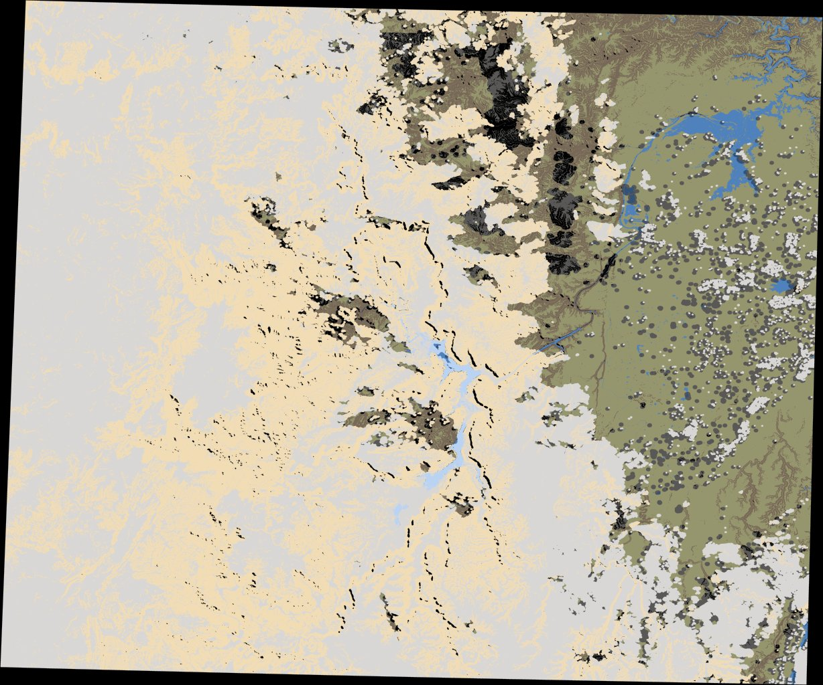

Slide 19
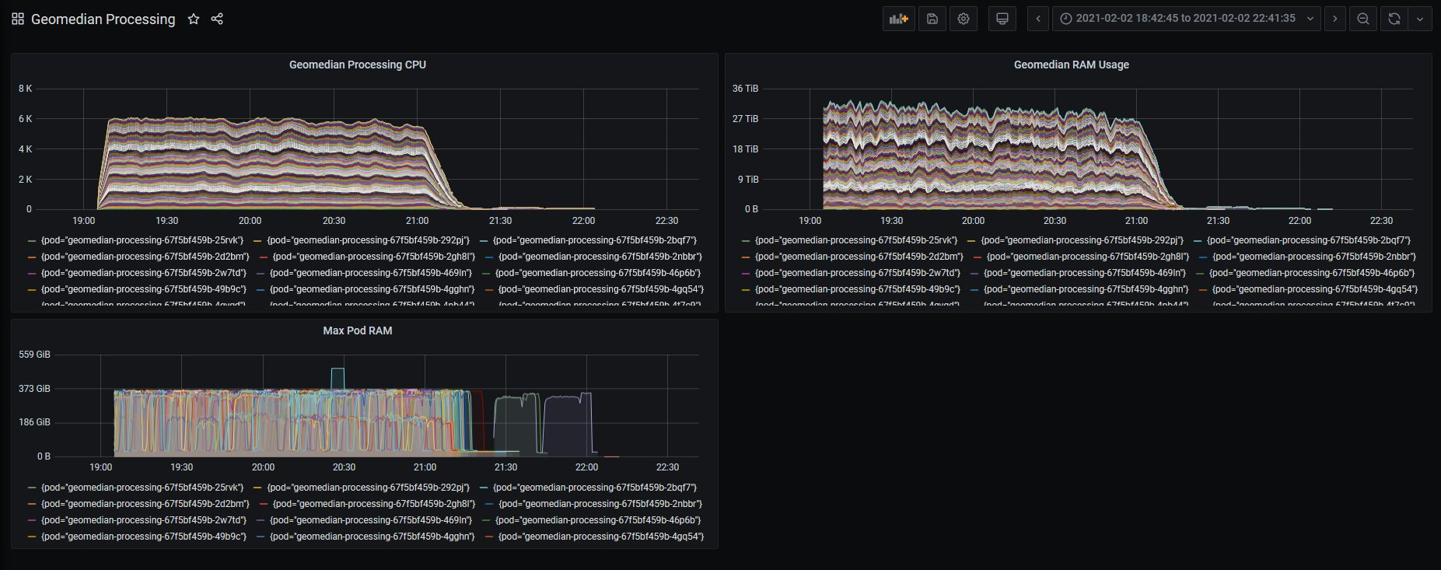
Example: 500 TB data, 30 TB of RAM, 6,000 CPUs

Slide 20
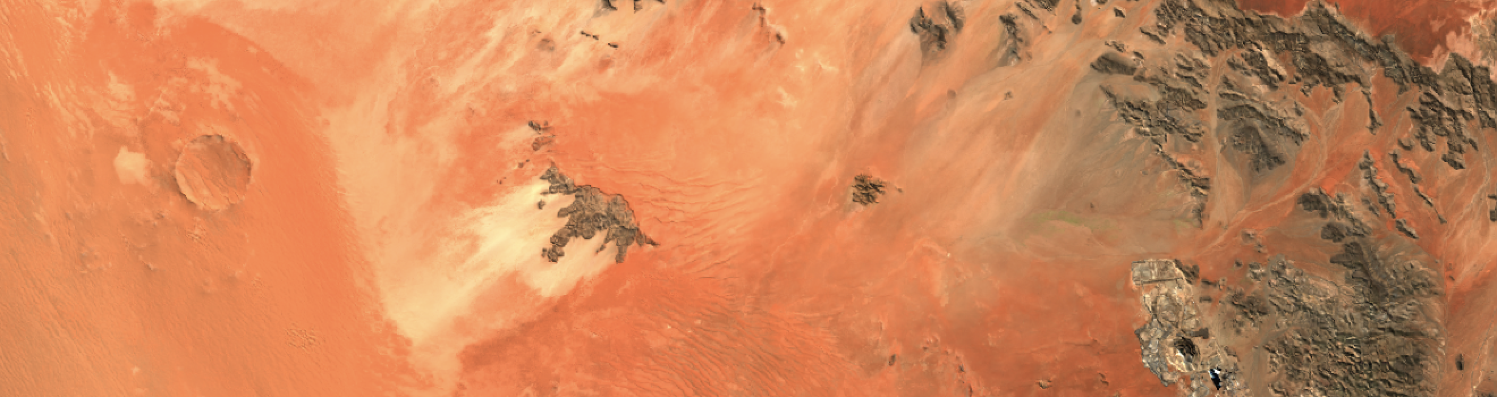
COGs & STAC Keep it Simple
Cloud Optimised GeoTIFFs enable new types of workload
STAC enables global EO community interoperability
The Open Data Cube is compatible, flexible and powerful
Sentinel-2 from 3/9/2020 indexed from STAC record:
https://sentinel-cogs.s3.us-west-2.amazonaws.com/sentinel-s2-l2a-cogs/33/J/XK/2020/9/S2B_33JXK_20200903_0_L2A/S2B_33JXK_20200903_0_L2A.json

Slide 21
Get in touch
Digital Earth Africa
deafrica@ga.gov.au
training.digitalearthafrica.org
Open Data Cube
http://slack.opendatacube.org
Alex Leith
@alexgleith
alex.leith@ga.gov.au

