Slide 1
SEO Perspective on CEOS Satellite Data in the Cloud Brian Killough, CEOS SEO
There are many TRENDS in cloud-based satellite data ... growing data volumes in the cloud, ARD formats, Jupyter notebooks, many vendor options (Amazon-AWS, Google-GCP, Microsoft-Azure), increase use of radar data, open science.
STAC and COG formats are becoming more common ... STAC is great for ODC data indexing and COG formats are great for loading subsets of large data files.
Suggestions for the future ...
Discourage downloading data and use data in the cloud
Encourage the use of the cloud computing through CEOS prototypes (e.g., EAIL, ODC-Sandbox)
Promote the production and use of ARD with STAC and COG formats
Participate in Python notebook training events and focus on “simplicity”
Demonstrate the value of radar data by working on ARD processing, data access, and training.

Slide 2
An SEO Perspective on CEOS Satellite Data in the Cloud
Brian Killough
NASA Langley Research Center
CEOS Systems Engineering Office (SEO)
WGISS-51 Meeting (virtual) April 21, 2021

Slide 3
The Trends
Growing amounts of free/open satellite data are available in the cloud .. no need to download large volumes of data.
Satellite data are being pre-processed into analysis-ready formats by data providers and users. CEOS is expanding its CARD4L datasets (Aquatic Reflectance, Nightlights, Interferometric Radar, LIDAR).
Cloud resources for analyses are becoming popular ... AWS, Google Cloud, MS-Azure. The recent WGISS EAIL project has high demand.
Jupyter notebook programming environments using Python are becoming popular and some are even free (Google-Colab). Check out the CEOS SEO sandbox in the coming month!
International collaboration is increasing ... SDG focus and a realization that satellite data can be used without significant effort
Increasing use of radar data due to the release of Sentinel-1. The only issue is availability of global ARD. The CEOS SEO has a prototype solution, but the European Commission is discussing long-term solutions.
Open Science is becoming a common theme and desire (GEO, NASA CEOS Chair). Open Source tools are becoming more popular (Earth Engine, Open Data Cube).

Slide 4
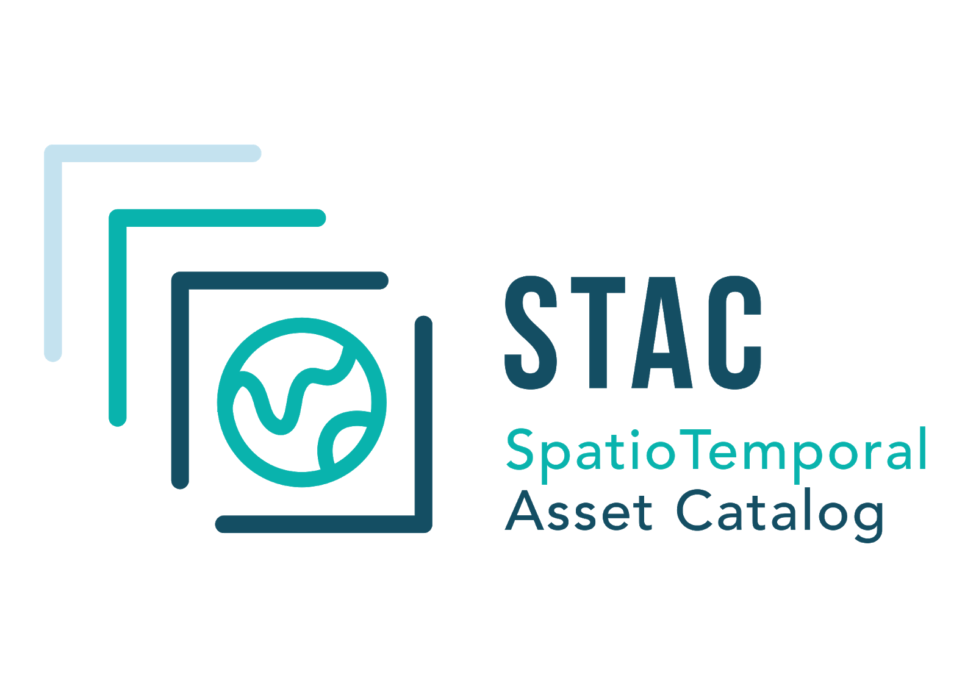
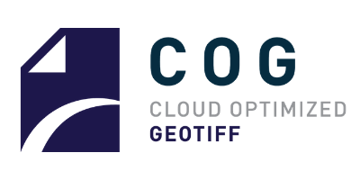
Benefits of STAC and COG
Spatio-Temporal Asset Catalog (STAC) metadata formats are great for the Open Data Cube (ODC) as it simplifies the ODC "indexing" process. There is no effect on ODC "data loading".
Cloud-Optimized GeoTIFF (COG) formats are becoming quite common for satellite data storage in the cloud. ODC data loading is more efficient as subsets of tiles can be loaded for analyses thereby requiring less network transfer compared to normal TIFFs.

Slide 5
Suggested Ideas
Discourage downloads and promote the use of satellite data in the cloud. Demonstrate the advantages through prototypes (e.g. EAIL, ODC-Google Sandbox) and avoid single vendor solutions.
Promote the production and use of ARD and associated formats (e.g., COG, STAC).
Participate in the development and conduct of Python notebook training events (e.g. WGCapD). Keep things “simple” to encourage more users from smaller and developing countries.
Demonstrate the value of radar data by working on ARD processing, data access, and training.

