Slide 1

Executive Summary
Chair Report
Call for Nominations for Vice Chair
Activity Highlights
  OpenSearch Best Practices (update)
  CEOS Earth Analytics Interoperability Lab (update)
  CEOS Interoperability Terminology (endorsed)
  Persistent Identifier (PID) Best Practice
  Maturity matrix – self-assessment tool, cal/val
CEOS ARD Strategy update
  Beyond Land
  WGISS: Cloud Formats and Discovery
Next actions:
  Jupyter Notebooks for EO Best Practice
  Cloud formats Best Practice
    Includes metadata for discovery and use
  Linking WGISS systems with Cloud

Slide 2

Welcome to WGISS 51
Chair Report
Committee on Earth Observation Satellites
Dr. Robert Woodcock, CSIRO, WGISS Chair
WGISS 51 Virtual Meeting
20-22 April 2021

Slide 3

Working Group on Information Systems and Services
What we do:
  promote collaboration in the development of systems and services that manage and supply CEOS earth observation data
  create and demonstrate prototypes supporting CEOS and Group on Earth Observation (GEO) requirements
  addresses the internal management of EO data, the creation of information systems and the delivery of interoperable services
Interest Groups:
  Data Preservation and Stewardship
  Discovery and Access
    WGISS Connected Data Assets System Level Team
  Interoperability and Use Interest Group
  Technology Exploration Group
  https://ceos.org/ourwork/workinggroups/wgiss/

Slide 4

Join WGISS
Call for Nominations for Vice Chair
  Vice Chair November 2021-November 2023, transitions to
  Chair from November 2023 - 2025
Get involved in an Interest Group (CEOS members)
  Technology Exploration and Interoperability and Use Interest Groups
This Photo by Unknown Author is licensed under CC BY

Slide 5
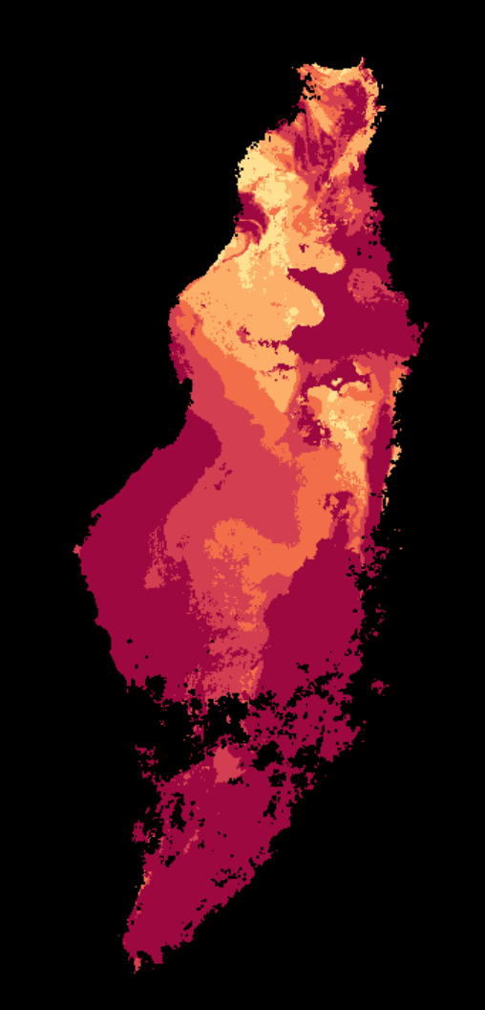
Activity Highlights
Discovery and Access
  OpenSearch Best Practices (update)
  STAC
  Cloud data access
Data Interoperability and Use
  Cloud formats and data use
  CEOS Earth Analytics Interoperability Lab (update)
  CEOS Interoperability Terminology (endorsed)
Technology Exploration
  Jupyter Notebooks for EO Webinars and Best Practice
Data Preservation and Stewardship
  Persistent Identifier (PID) Best Practice
  Maturity matrix – self-assessment tool, cal/val
Notes:
Coming up in WGISS 51

Slide 6

CEOS Strategic Initiatives
CEOS Future Data Architecture (FDA)
  “Now” Data Architectures
    USGS Collection 2 on AWS, and others
  WGISS will be updating action, augmenting best practices:
    Discovery systems
    Cloud data formats: COGS, Zarr
CEOS Analysis Ready Data (ARD)
Status of CARD4L PFS: Current
Surface Reflectance (v5.0)
Surface Temperature (v5.0)
Normalised Radar Backscatter (v5.0)
Polarimetric Radar (v3.0)
Status of CARD4L PFS: In-Development
Aquatic Reflectance
Nighttime Light Surface Radiance (NLSR)
Geocoded SLC (SAR)
Interferometric Radar
LIDAR
See http://ceos.org/ard for further details
Notes:
Release of USGS LS Collection 2, Element 84 S2, on AWS, NASA LHS coming soon
ARD beyond land with SST-VC/LSI-VC

Slide 7
ARD/FDA Strategy Update
Ideas for discussion (from SIT36)
Strategy update underway and to be presented at CEOS Plenary 2021
Update the Strategy to reflect progress and developments in the space
  Formalisation of a comprehensive framework for CEOS ARD in general (i.e., beyond land)
  Continued promotion to users, data providers, data distributors
    webinars, key meetings
    SDG applicability
  Advisory Notes to provide guidance on key topics as complements to the non-prescriptive PFS
  Continued pilot activities (incl. EAIL)
  Increased linkage between WGISS systems and CEOS ARD and the cloud – discovery of and access to CEOS Agency ARD
    MIM Database links to CEOS ARD products
In general: topics related to accessibility and utilisation of CEOS ARD – increasing impact of CEOS data, including via an increased scope of the CEOS ARD concept

