Slide 1
USGS Landsat Migration to the Cloud
20 April 2021
Kristi Kline
USGS

Slide 2
Landsat Cloud Project Scope
Modernize Processing, Access, and Distribution of Landsat Data
  Change from a primary business model of downloads to enabling access to the full archive
  Enable users to interact with the data in an integrated environment
  Ensure provenance and data stewardship
Key Project Objectives:
  Establish an enterprise cloud environment for Landsat
  Enable access to Collection 1 Level-1 and Level-2 in the cloud
    Replicate Collection 1 Level-1 and establish operational data management procedures
    Demonstrate global scale production of Landsat data in the cloud through production of Level-2 products using a cloud framework
    Process Landsat archive in 1-2 months rather than 9-12 months
  Establish modern access and visualization tools to access data
  Establish an Environment and System to Produce and Enable Landsat Collection 2 in the cloud
  Demonstrate key science use cases exploiting Landsat data

Slide 3
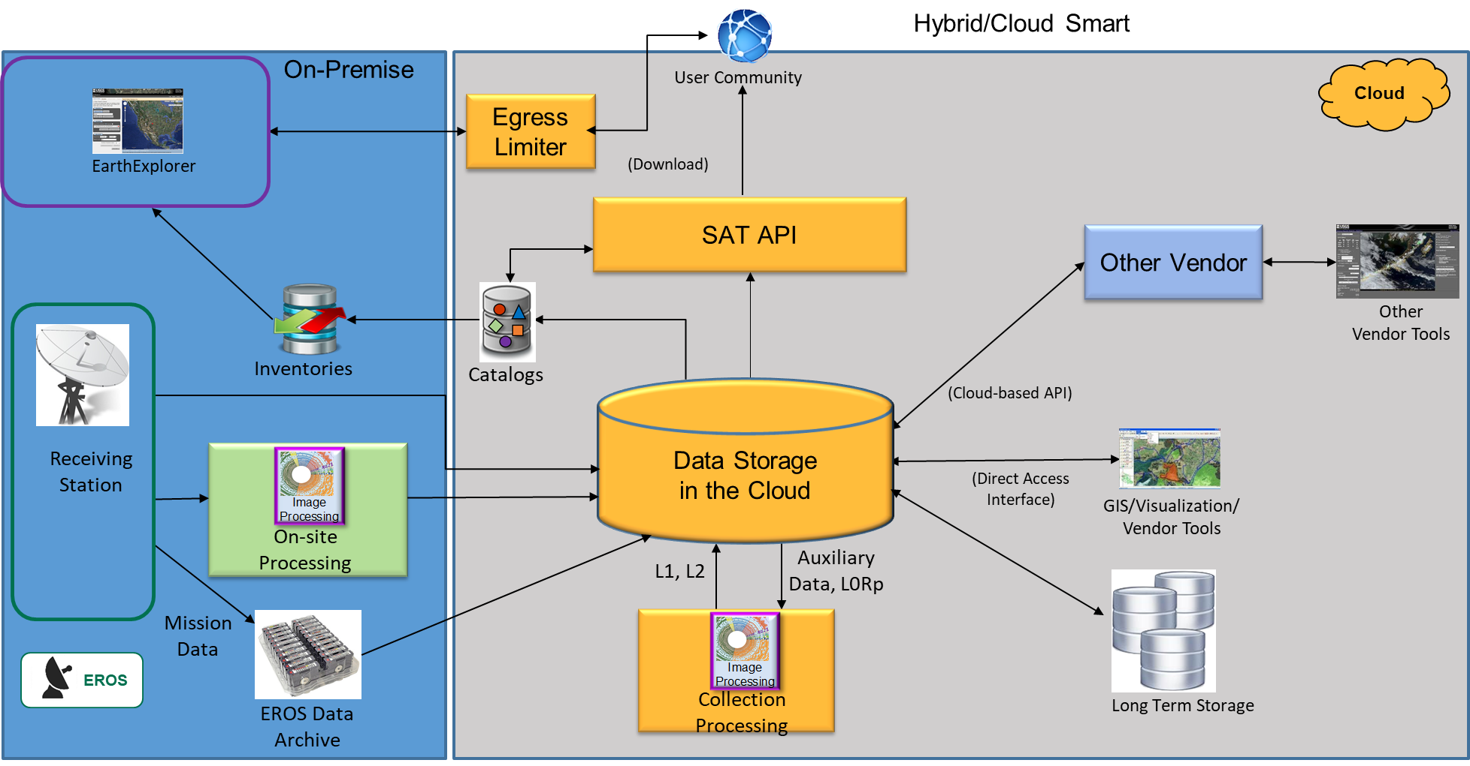
Landsat Cloud Operational Concept View

Slide 4
Web Enabled to Cloud Enabled
Cloud Enabled
  Next evolution of Landsat - transitioning to a Smart Cloud implementation
  Continuation of free and open data policy
  Enables opportunity for users to access data directly allowing:
    Execution of algorithms directly on only the data needed
    Selective data usage (specify bands etc. for use)
    Reduced need for IT infrastructure
Notes:
Temporal depth

Slide 5
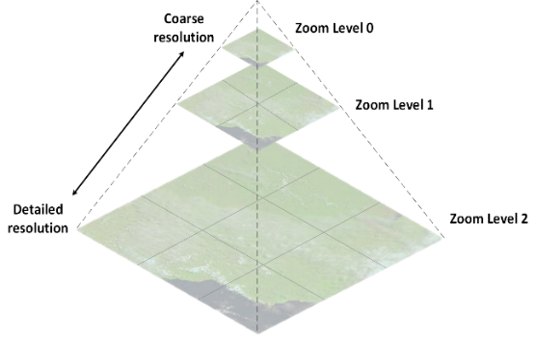
Cloud Optimized GeoTIFF Format
An enhanced GeoTIFF with tiling and overviews
  Uses internal tiling instead of lines to speed access and support better remote reading
  Downsampled overviews are generated when lower resolution data is acceptable
  No changes to the underlying pixels
  Stored in an unbundled format
  Data is internally compressed
  Enables HTTP Get Range requests

Slide 6
SpatioTemporal Asset Catalog (STAC)
New collaborative standard for managing access metadata
  Open-source, headed by Planet Labs, freely available on GitHub, with Landsat extension
  Flexibility to support many types of geospatial data (satellite, drone, radar, etc.)
  Allows for interoperability between satellite metadata
Exposes data in a common, machine-readable JSON format for both end users and internal processes
Includes direct links to S3 objects or HTTP links
Can be exploited through Jupyter Notebooks by end users to read data directly from the cloud without downloading
Gaining wide adoption by the remote sensing community
  i.e., Government, International, Commercial, Academic
STAC 1.0.0 specification (including Landsat extension) release expected on 26 April, 2021

Slide 7
Collection 2 Processing Architecture

Slide 8
Processing Metrics
Collection 2 processing took one month to complete (8/19/2020 – 9/19/2020)
  8.8 million scenes to Level 1 and Level 2
  Average per day: 293,000/day
  Began with small batches and increased to over 400,000 scenes process per day to Level 1 and Level 2
  Collection 1 processing at EROS in 2017 averages 25-35,000 scenes processed per day for only Level 1 products
Previous Collection 1 processing took over 18 months (with some downtime between individual missions while code changes were completed)
Docker images used to run the Image Processing containers
AWS Spot EC2 types:
  General purpose w/SSD (m5d) 4xlarge to 24xlarge
  Memory Optimized w/SSD (r5d) 4xlarge to 24xlarge
AWS Batch and Step functions used for scheduling the jobs
  Overall, worked ok, but we did run into limits that in the environment
  Spot terminations caused some issues in the processing runs

Slide 9
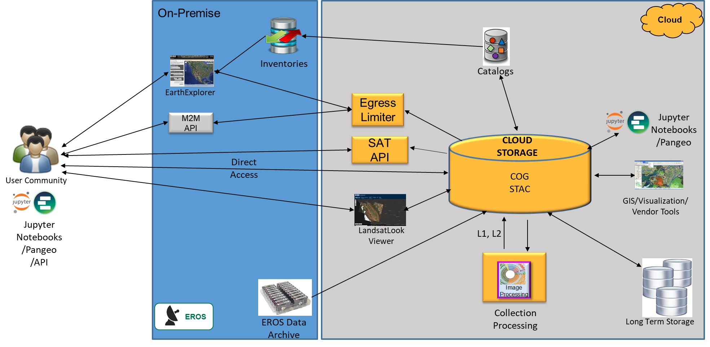
Collection 2 Access Architecture

Slide 10
Collection 2 Egress Limiter
Implemented egress limiter to ensure control of costs
Provide access to the data, but also implement controls on egress to defined limits
Egress limiter will not allow total throughput to exceed the pre-defined limit

Slide 11
Distribution Metrics
Processing U.S. Analysis Ready Data in Cloud
Changes to Web Application Firewall to increase throughput
Notes:
Temporal depth

Slide 12
Collection 2 Schedule and Upcoming Activities
ORR #1 – Data Processing Readiness – July 2020 (complete)
ORR #2 – Public Data Availability – November 2020 (complete)
  Collection 2 scenes released to the public on 1 December 2020
ORR #3 – Enhanced Data Access – April 2021
  STAC 1.0.0
  SatAPI
  Direct Access Metrics
  EROS Managed AWS WAF
  Public SNS Topic
  Cloud Inventory Report

Slide 13
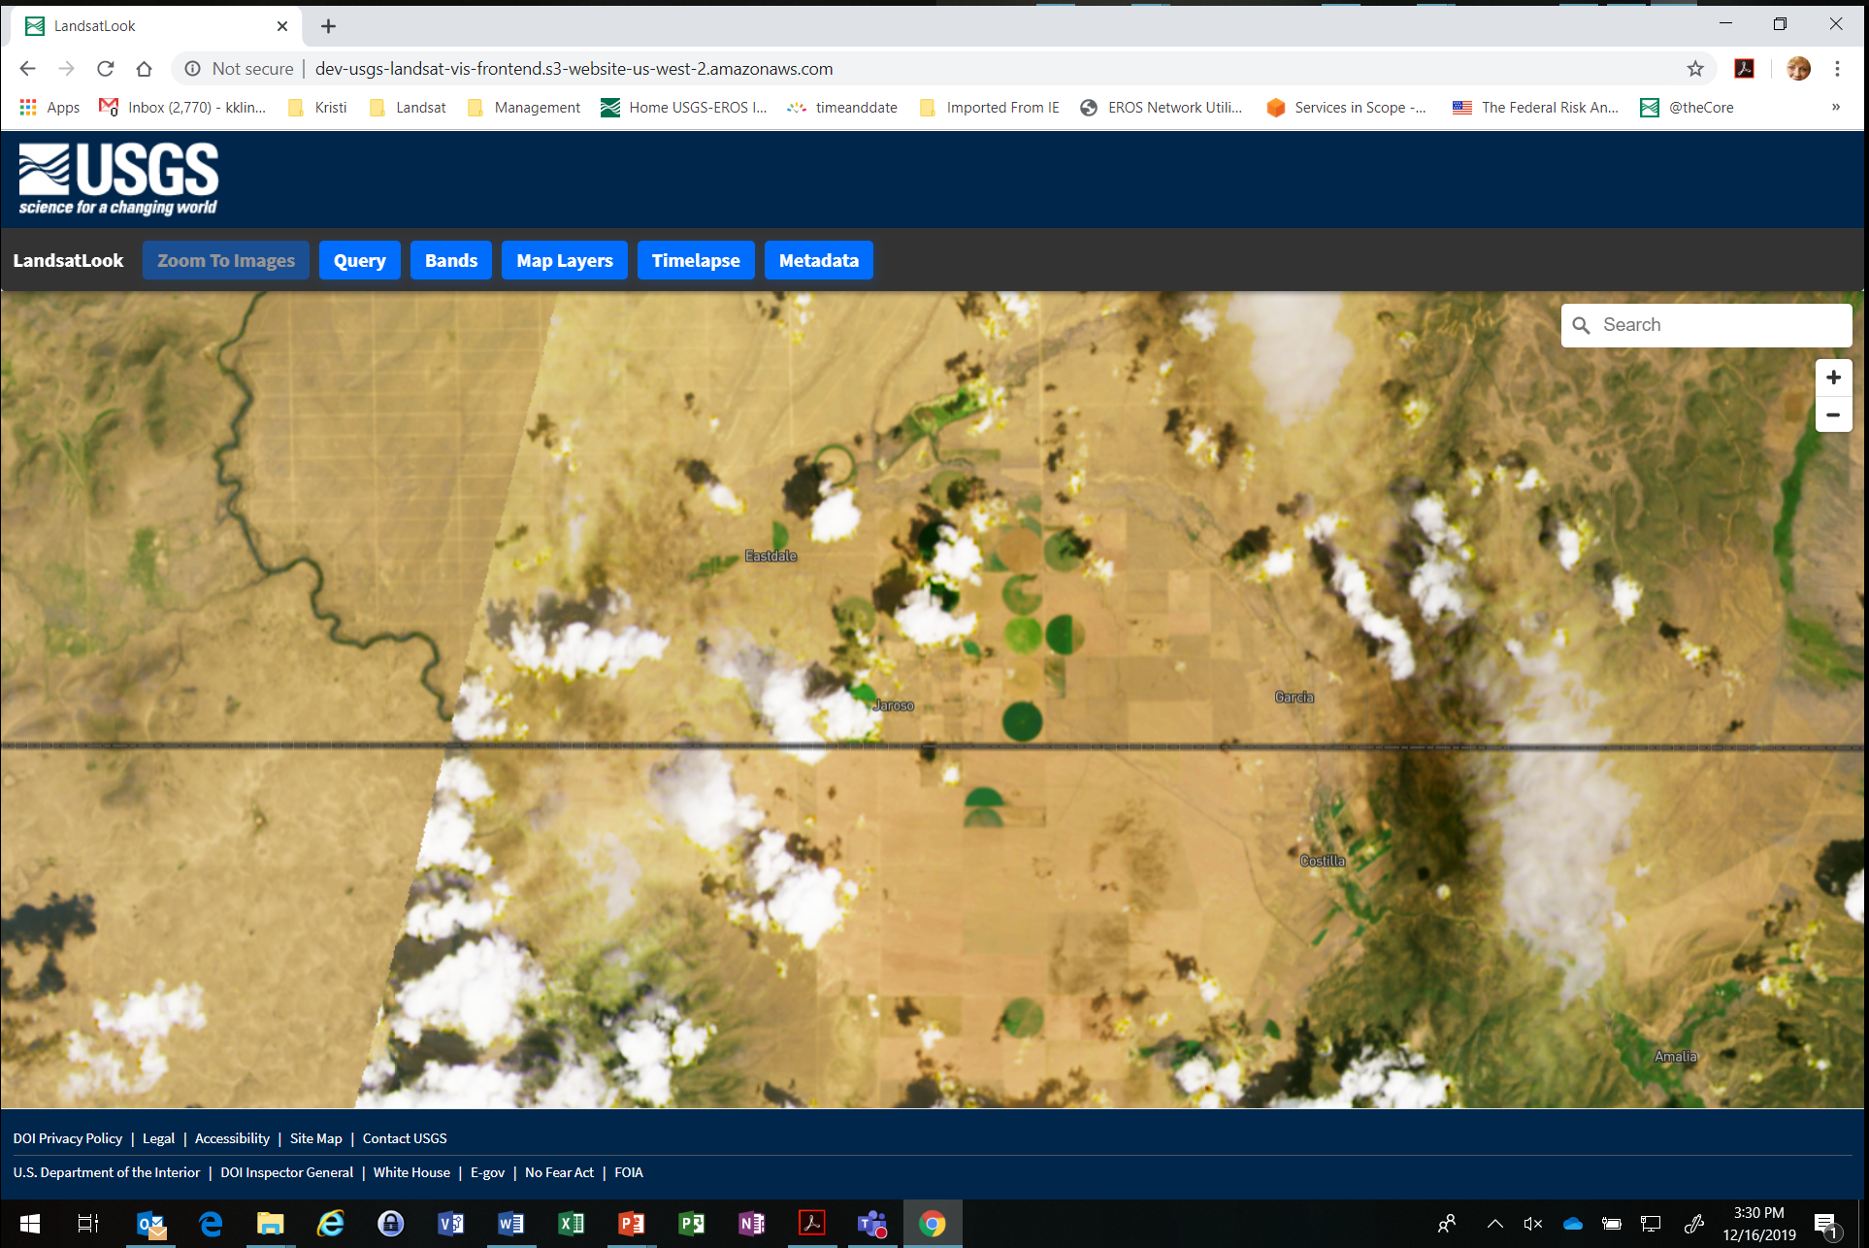
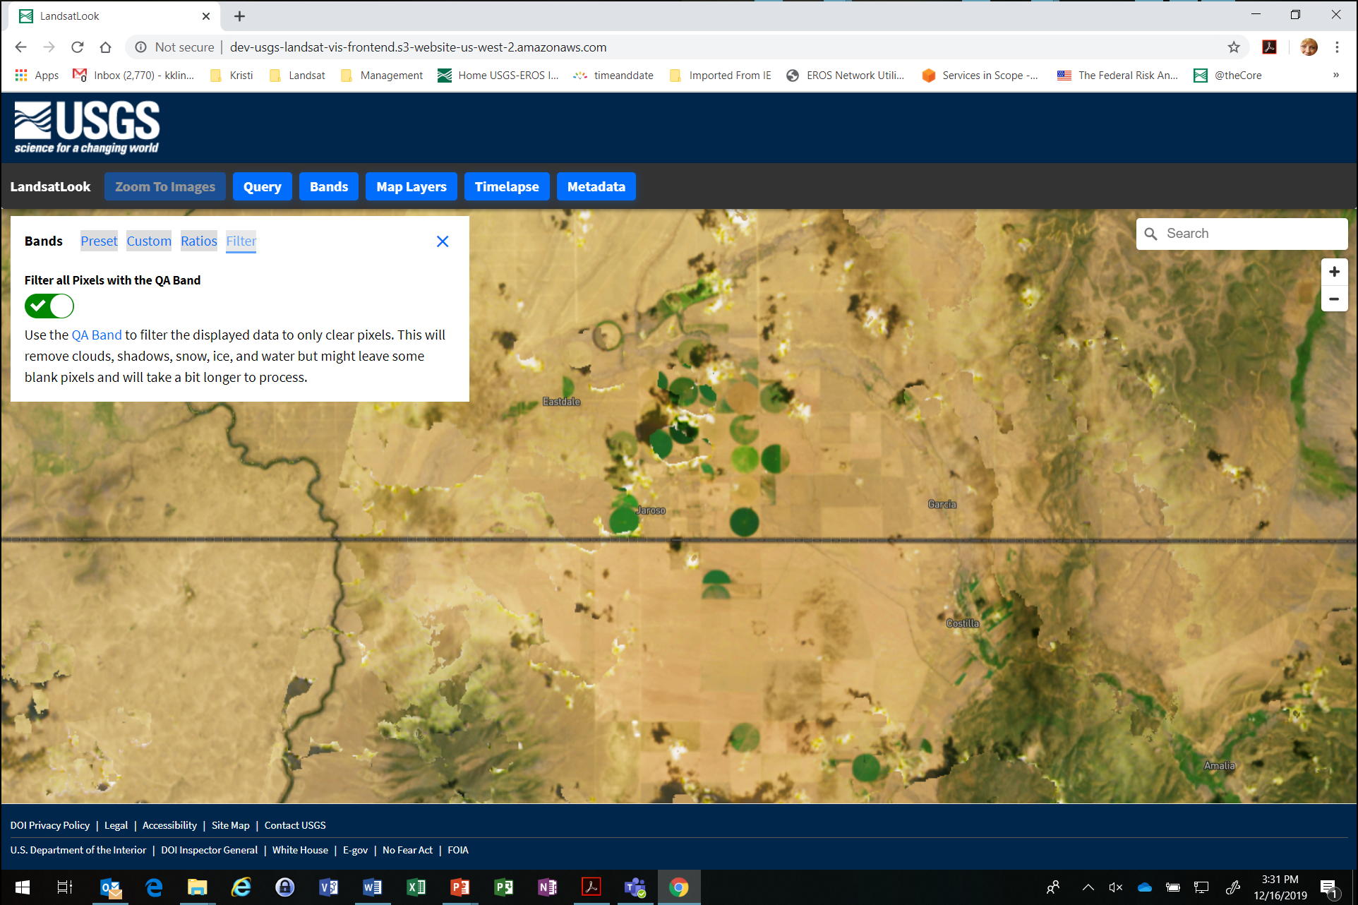
New LandsatLook Tool

